Slide 1
Dataset Cartography: Mapping and
Diagnosing Datasets with Training Dynamics
Reproduction of Swayamdipta et al., EMNLP 2020
Julia Mazine
RoBERTa-large · SNLI · NLI Diagnostics
github.com/JuliaMazine/dataset-cartography-reproduction
1 / 20
Notes:
This talk explains the Dataset Cartography paper first, then a focused reproduction of its SNLI data-selection result. The question running through the talk is whether the path a model takes while learning an example can reveal useful structure in the dataset. I will spend roughly the first half on the paper and the second half on what we reproduced. The structure is motivation, method, original evidence, reproduction protocol, results, and interpretation. Appendix slides hold configuration details so the main argument stays readable.

Slide 2
PAPER
Aggregate metrics hide example-level structure
10,000 training examples
→
Accuracy
Loss
92.0%
0.21
These summaries say little about which examples were learned immediately, learned unreliably, or never learned.
Can we diagnose a dataset by watching how the model learns each example?
2
Notes:
We normally describe a training run with aggregate loss and evaluation accuracy. Those are necessary, but they collapse thousands of different example histories into one number. Some examples may become correct almost immediately, some may fluctuate, and some may resist the provided label. Dataset Cartography starts from the idea that this variation is useful information about the dataset itself. Two runs with identical final accuracy can contain very different datasets: one may have many consistently easy cases, while another may depend on unstable borderline cases. Aggregate evaluation therefore cannot tell us which examples drive learning, which are redundant, or which deserve annotation review.

Slide 3
PAPER
SNLI is a three-way natural-language inference task
PREMISE
“Cafe Express” sign covered in graffiti.
ENTAILMENT
A sign covered in graffiti.
must be true
NEUTRAL
The sign is hard to read.
may be true
CONTRADICTION
The sign is brand new and clean.
cannot be true
The model receives a premise–hypothesis pair and predicts their logical relation.
SNLI: Bowman et al. (2015). Examples shown are real SNLI training pairs.
3
Notes:
SNLI is central to our reproduction. Each example contains a premise and a hypothesis, and the task is to decide whether the hypothesis follows from the premise, could be true without following, or conflicts with it. These three hypotheses share one real SNLI premise. In-distribution evaluation uses held-out SNLI examples; later we will distinguish that from the hand-built NLI Diagnostics set. Entailment means the hypothesis must follow from the premise, contradiction means it cannot be true given the premise, and neutral covers cases where neither conclusion follows. The task is simple to state but exposes lexical, logical, and commonsense reasoning failures.

Slide 4
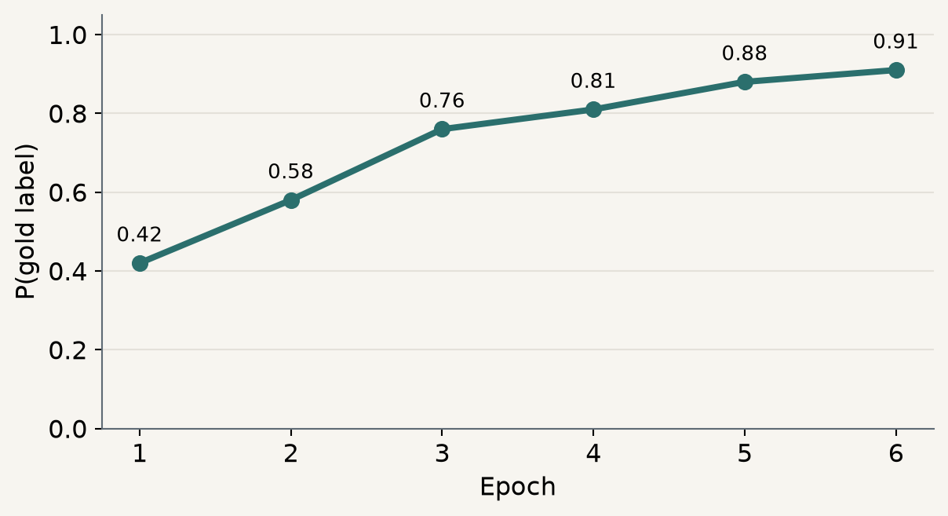
PAPER
Training dynamics record the path, not only the endpoint
Ordinary analysis
Dataset Cartography
What did the final model predict?
Epoch 6
→
GOLD LABEL
0.91
one decision
a trajectory across training
Swayamdipta et al. (2020), §2.1.
4
Notes:
The conceptual shift is simple. Instead of keeping only the final prediction, record the probability assigned to the gold label at the end of every epoch. The sequence of probabilities is an example’s training trajectory. The illustrated example rises smoothly from 0.42 to 0.91. Dataset Cartography summarizes each such trajectory and plots every training example. Recording once per epoch is computationally cheap because the model already performs these forward passes during training. The original work used all epochs, including the first, and reports that early approximations can still correlate well with converged maps.

Slide 5
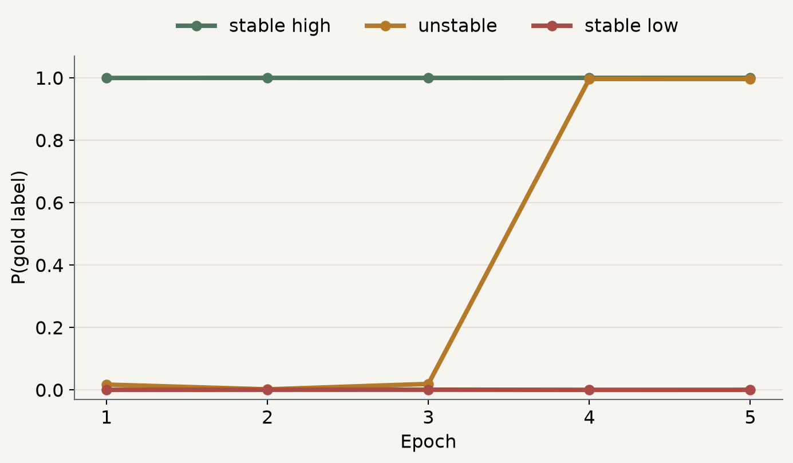
OUR REPRODUCTION
Three examples produce three distinct trajectories
Stable high
Beach children → men in a jungle
CONTRADICTION
Unstable
Woman playing tennis → woman practices tennis
CONTRADICTION
Stable low
Girl photographed → boy photographed
ENTAILMENT
How can these trajectories be summarized with a few comparable numbers?
Actual epoch-level probabilities from our full SNLI run; five logged epochs.
5
Notes:
These are not stylized curves; they come from our recorded SNLI training dynamics. One example is assigned essentially full gold probability in every epoch. The tennis pair switches abruptly from near zero to near one, showing high instability. The girl-versus-boy example stays near zero because its provided entailment label conflicts with the sentences. These trajectories motivate confidence, variability, and correctness. The unstable example also shows why a final prediction alone is insufficient: at the last epoch it looks confidently correct, but its earlier epochs tell us the model crossed a sharp decision boundary. Confidence and variability retain that history.

Slide 6

PAPER
Confidence summarizes how strongly an example is learned
WHERE
E number of epochs
yᵢ gold label
Average probability assigned to the gold label throughout training.
pθₑ model probability at epoch e
HIGH CONFIDENCE
LOW CONFIDENCE
The model generally supports the provided label.
The model repeatedly struggles with that label.
Confidence is relative to the gold label and to this model and training procedure.
Swayamdipta et al. (2020), Eq. 1 and §2.1.
6
Notes:
Confidence is the mean gold-label probability over epochs. High confidence means the learner usually assigns strong probability to the annotation; low confidence means it repeatedly does not. This is not the model’s maximum class probability and it is not an objective property of the sentence pair. It depends on the gold label, the model family, and training procedure. A high mean can coexist with one unusual epoch, and a low mean can arise from a bad annotation, a genuinely difficult case, or a model limitation. Confidence is therefore a diagnostic coordinate, not a verdict about data quality.

Slide 7
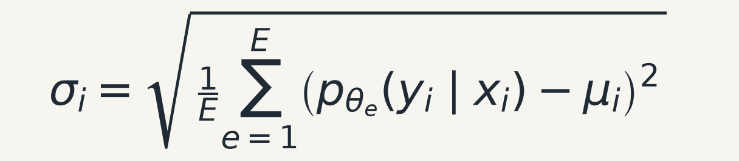
PAPER
Variability captures instability; correctness counts decisions
CORRECTNESS
Fraction of epochs in which the predicted class equals the gold label.
Standard deviation of gold-label confidence across epochs.
stable high confidence
low variability
Variability can be low when the model is consistently right or consistently wrong.
unstable confidence
high variability
stable low confidence
low variability
Correctness helps distinguish those cases.
Swayamdipta et al. (2020), §2.1.
7
Notes:
Variability is the standard deviation of those probabilities. An example can have low variability for two opposite reasons: it is confidently correct every epoch, or confidently inconsistent with its annotation every epoch. Correctness provides a coarser count of how often the predicted class matches the label. Together the measures distinguish stable-high, unstable, and stable-low behavior. The paper uses population standard deviation across epochs. Correctness takes only E plus one possible values, so it loses probability information, but it makes the distinction between stable correct and stable incorrect examples especially intuitive.

Slide 8
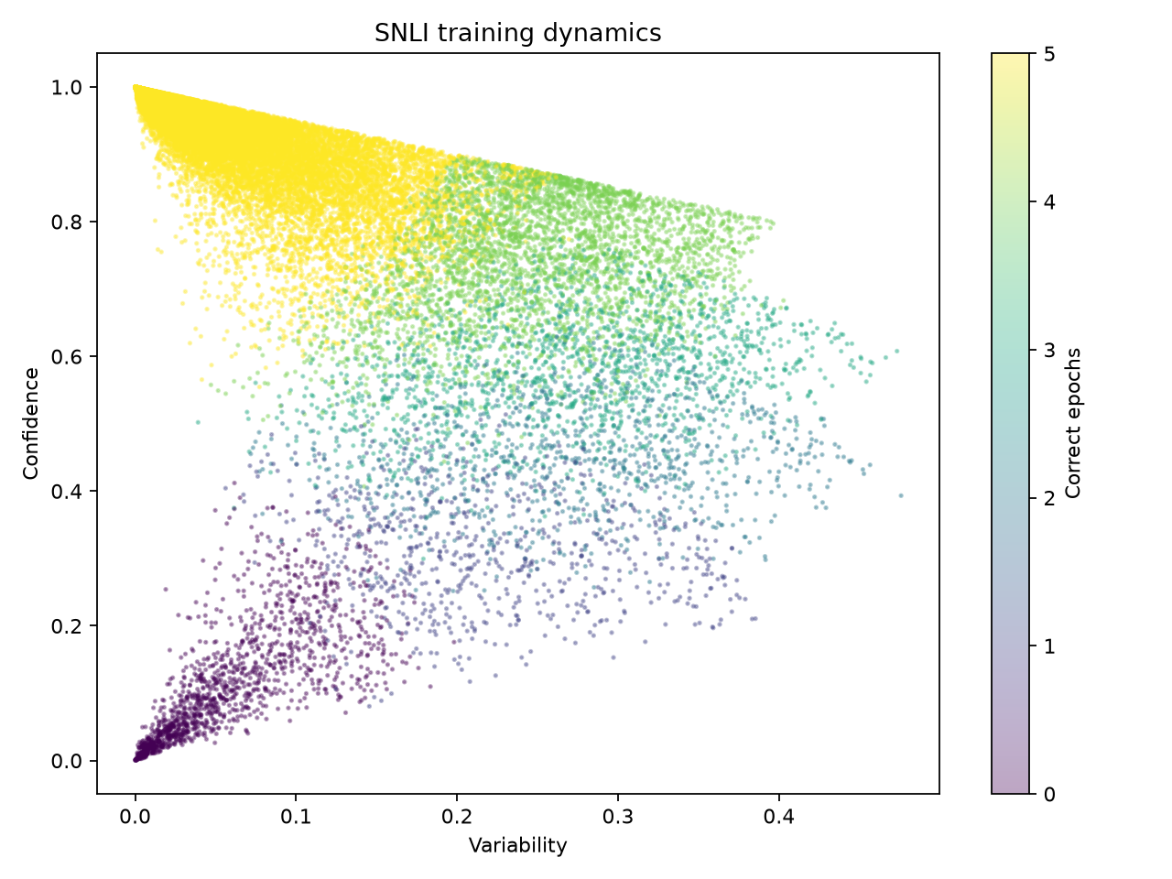
PAPER
A data map places every example by confidence and variability
EASY-TO-LEARN
high confidence
low variability
AMBIGUOUS
high variability
confidence may vary
HARD-TO-LEARN
low confidence
often low correctness
Every point is one training example.
Method: Swayamdipta et al. (2020), §2.2. Plot shown: our reproduced SNLI map.
8
Notes:
The data map uses variability on the horizontal axis and confidence on the vertical axis. Each point is one training example, and color shows the number of epochs predicted correctly. The bell shape gives three characteristic regions. The labels are descriptive and model-relative; they are not fixed semantic categories or permanent properties of an example. The authors observed broadly similar bell-shaped geometry across SNLI, MultiNLI, WinoGrande, and QNLI with RoBERTa-large. They also stress that changing the encoder can move individual coordinates even when the overall structure remains recognizable.

Slide 9
OUR REPRODUCTION
Map regions become interpretable through real examples
EASY-TO-LEARN
AMBIGUOUS
HARD-TO-LEARN
PREMISE
PREMISE
PREMISE
Two children are on the beach and play in wet sand.
A woman in red and white clothing is playing tennis.
Photographers photograph a girl sitting in a street.
HYPOTHESIS
HYPOTHESIS
HYPOTHESIS
Two men are walking through a jungle.
Dressed all in white, the woman practices tennis.
The photographer is taking a picture of a boy.
CONTRADICTION
CONTRADICTION
ENTAILMENT
confidence 1.000 · variability < .001
confidence .406 · variability .482
confidence < .001 · variability < .001
Ambiguous ≠ mislabeled. Hard-to-learn ≠ automatically wrong.
Examples and coordinates from our reproduced SNLI map; five logged epochs.
9
Notes:
These examples make the geometry concrete. The beach-versus-jungle contradiction is consistently easy. The tennis pair is arguably compatible rather than contradictory, and the model switches sharply during training. The hard example’s entailment label says a girl entails a boy, so its near-zero confidence is unsurprising. These examples illustrate tendencies, not equivalences: ambiguity does not mean annotation error, and hard-to-learn does not guarantee one. The middle example also warns against reading the gold label as unquestionable truth: practicing tennis is compatible with playing tennis, so contradiction is debatable. The map helps prioritize such cases for human inspection without asserting the correction automatically.

Slide 10
PAPER
The paper tested whether map regions predict useful behavior
SNLI
MultiNLI
WinoGrande
QNLI
natural-language inference
multi-genre inference
commonsense reasoning
question answering reformulated as NLI
DATA USEFULNESS
Which regions support ID and OOD generalization?
OPTIMIZATION
Can a model learn from only ambiguous examples?
ANNOTATION QUALITY
Are low-confidence regions enriched for problems?
UNCERTAINTY
How do dynamics relate to human agreement?
The maps were hypotheses about dataset structure; these experiments tested their meaning.
Swayamdipta et al. (2020), §§3–6.
10
Notes:
The paper did more than visualize four datasets. It treated the regions as empirical hypotheses. The authors trained new models on selected regions, tested in-distribution and independently collected out-of-distribution sets, varied subset size to study optimization, injected label noise, and compared dynamics with human agreement. This validation program is why the method is interesting. The subset experiments retrain from scratch after ranking examples, controlling the amount of training data. OOD sets were collected independently or designed adversarially, so they ask whether a selection learns something broader than the original dataset distribution.

Slide 11
PAPER
Ambiguous subsets often supported stronger generalization
WinoGrande — 33% subsets
SNLI — 33% ambiguous
Training data | ID | OOD
Full 100% | 79.7 | 86.0
Random | 73.3 | 85.6
Hard-to-learn | 77.9 | 87.2
Ambiguous | 78.7 | 87.6
IN-DISTRIBUTION
92.2%
within 0.2 pp of full data
NLI DIAGNOSTICS
63.5%
Across these experiments, challenging and variable examples could preserve ID accuracy while improving independently collected OOD performance.
A recurring empirical pattern — not a universal law about every dataset or model.
Published values: Swayamdipta et al. (2020), Tables 2 and 3; best of 3 seeds for SNLI.
11
Notes:
On WinoGrande, the most ambiguous third produced the strongest reported OOD score, 87.6, while retaining much more ID performance than a random third. In SNLI, the ambiguous third was within 0.2 percentage points of full-data ID performance and exceeded full-data Diagnostics accuracy. The paper found related patterns across datasets, but we should state this as empirical evidence for these settings, not a universal rule. On WinoGrande, easy selections underperformed the random subset, while ambiguous and hard selections were competitive or better. For SNLI, the paper reports improvements across the Diagnostics categories, although the aggregate numbers shown here are the comparison we reproduce.

Slide 12
PAPER
Easy examples can be necessary for optimization
WinoGrande: only the most ambiguous data
Different regions can serve different roles
25–50%
learns
AMBIGUOUS
informative decision boundaries
≤17%
chance-level
EASY
stable optimization signal
TOO MUCH EASY
weaker OOD performance
With 17% ambiguous data, replacing only one tenth with easy examples restored learning and beat the random baseline on ID accuracy.
“Ambiguous good, easy bad” would misstate the paper.
Swayamdipta et al. (2020), §4 and Figure 3.
12
Notes:
The optimization experiment adds an important qualification. WinoGrande models trained on 25 percent or more of the most ambiguous data learned successfully, but at 17 percent or less they collapsed to chance despite restarts. Replacing just one tenth of that 17 percent subset with easy examples restored learning and beat the random ID baseline. Easy examples therefore are not useless; they can provide stable optimization signal. This result suggests a curriculum-like balance: difficult variable examples may define useful distinctions, while some stable examples help the optimizer find a workable solution. The paper leaves the optimal mixture as an open question rather than prescribing one fixed ratio.

Slide 13
PAPER
Hard-to-learn regions are enriched for annotation problems
1
Flip labels for 1% of easy WinoGrande examples
→
2
Retrain and recompute training dynamics
→
3
Flipped examples move toward lower confidence
Human reannotation of predicted groups
Responsible interpretation
Dataset | Predicted noisy | Predicted clean
WinoGrande | 67% | 13%
SNLI | 76% | 4%
● Low confidence is a useful review signal.
● The region also contains legitimate difficult cases.
● Hard-to-learn does not mean mislabeled.
Data maps prioritize inspection; they do not replace annotation review.
Swayamdipta et al. (2020), §5 and Figure 4.
13
Notes:
The authors injected controlled noise by flipping labels for one percent of easy WinoGrande examples. After retraining, the corrupted examples shifted toward lower confidence. A simple confidence-based classifier then identified candidate issues. In human review, 67 percent versus 13 percent of WinoGrande’s predicted noisy and clean groups were mislabeled or ambiguous; on SNLI the contrast was 76 versus 4 percent. This shows enrichment, not perfect diagnosis. The simple noise classifier used confidence as its single feature and achieved a sanity-check score of 100 percent F1 on similarly constructed artificial data. Real-data human review was weaker, which is expected because naturally difficult and mislabeled examples are not the same population.

Slide 14
PAPER
The selected SNLI experiment tests data efficiency and generalization
IN-DISTRIBUTION (ID)
OUT-OF-DISTRIBUTION (OOD)
SNLI test set
NLI Diagnostics
Same collection process and task distribution as training.
1,104 hand-crafted examples probing lexical semantics, logic, predicate–argument structure, and knowledge.
Training data | Examples used | SNLI test | Diagnostics
Full | 100% | 92.0 | 61.8
Random | 33% | 91.3 | 60.4
Hard-to-learn | 33% | 91.8 | 62.0
Ambiguous | 33% | 92.2 | 63.5
Question: can one third of SNLI retain ID performance and improve diagnostic generalization?
Published values: Swayamdipta et al. (2020), Table 3; best of 3 random seeds.
14
Notes:
This is the concrete experiment we chose. ID means the ordinary SNLI test distribution. OOD means the NLI Diagnostics set, a small hand-crafted challenge set targeting multiple reasoning categories. The paper’s ambiguous third slightly exceeded the full-data ID score and improved Diagnostics by 1.7 points. The numerical ID difference is small; the interesting claim is data efficiency plus OOD behavior. Diagnostics contains categories for lexical semantics, predicate–argument structure, logic, and knowledge. We report one aggregate accuracy because that is what our evaluator produces. This keeps ID and OOD claims distinct and avoids implying that a higher SNLI score guarantees broader reasoning.

Slide 15
OUR REPRODUCTION
Reproduction protocol follows the published SNLI selection
SNLI 1.0
Paper coordinates
Four conditions
RoBERTa-large
Two evaluations
→
→
→
→
549,367 valid train pairs
confidence + variability
full · random · ambiguous · hard
one seed per condition
SNLI test · Diagnostics
Selection definitions
Training settings
● Random: published 33% sampling procedure
● Ambiguous: highest variability
● Hard-to-learn: lowest confidence
● learning rate 1.07086 × 10⁻⁵
● effective batch 96 · maximum length 128
● up to 6 epochs · best validation checkpoint
Published coordinates isolate the data-selection claim from map reconstruction differences.
15
Notes:
We retained every official SNLI example with a valid label and joined all 549,367 training IDs to the authors’ released coordinates. The random subset follows their published sampling seed and procedure. Ambiguous selects highest variability and hard-to-learn selects lowest confidence. Every model is RoBERTa-large with the recovered learning rate, effective batch 96, and best validation checkpoint. Using released coordinates matters: it reproduces the paper's selection directly before asking whether our locally reconstructed map agrees. Otherwise a difference in final accuracy could combine selection error with training error and would be harder to interpret.

Slide 16
OUR REPRODUCTION
Hardware constraints changed implementation details
Aspect | Original paper | Our reproduction
GPU | Quadro RTX 8000 | RTX 4070 Ti SUPER · 16 GB
Batch | physical batch 96 | 32 × 3 gradient accumulation = 96
Precision | 2020 training stack | BF16 · modern PyTorch/Transformers
Padding | length 128 | dynamic padding · max length 128
Reporting | best of 3 seeds | one available seed: 93078
Epochs | paper says 6; config early stopping | best checkpoints; 4–6 epochs
These facts make exact equality unlikely while leaving the subset comparison scientifically interpretable.
Exact settings and evidence are documented in docs/original_experiment.md and results/run_metrics/.
16
Notes:
The original physical batch of 96 does not fit a 16 GB card, so we used 32 examples with three accumulation steps, preserving the effective batch. BF16 and dynamic padding reduce memory. The software stack is modern. Most importantly, the paper reports the best of three seeds, while the released configuration exposes one seed. Our comparisons therefore test whether the reported pattern appears, not whether every decimal is identical. Gradient accumulation preserves optimizer batch frequency but not every floating-point operation, and BF16 changes numerical rounding. Dynamic padding preserves attention masks and the 128-token truncation limit while reducing wasted computation. These are practical, documented deviations.

Slide 17
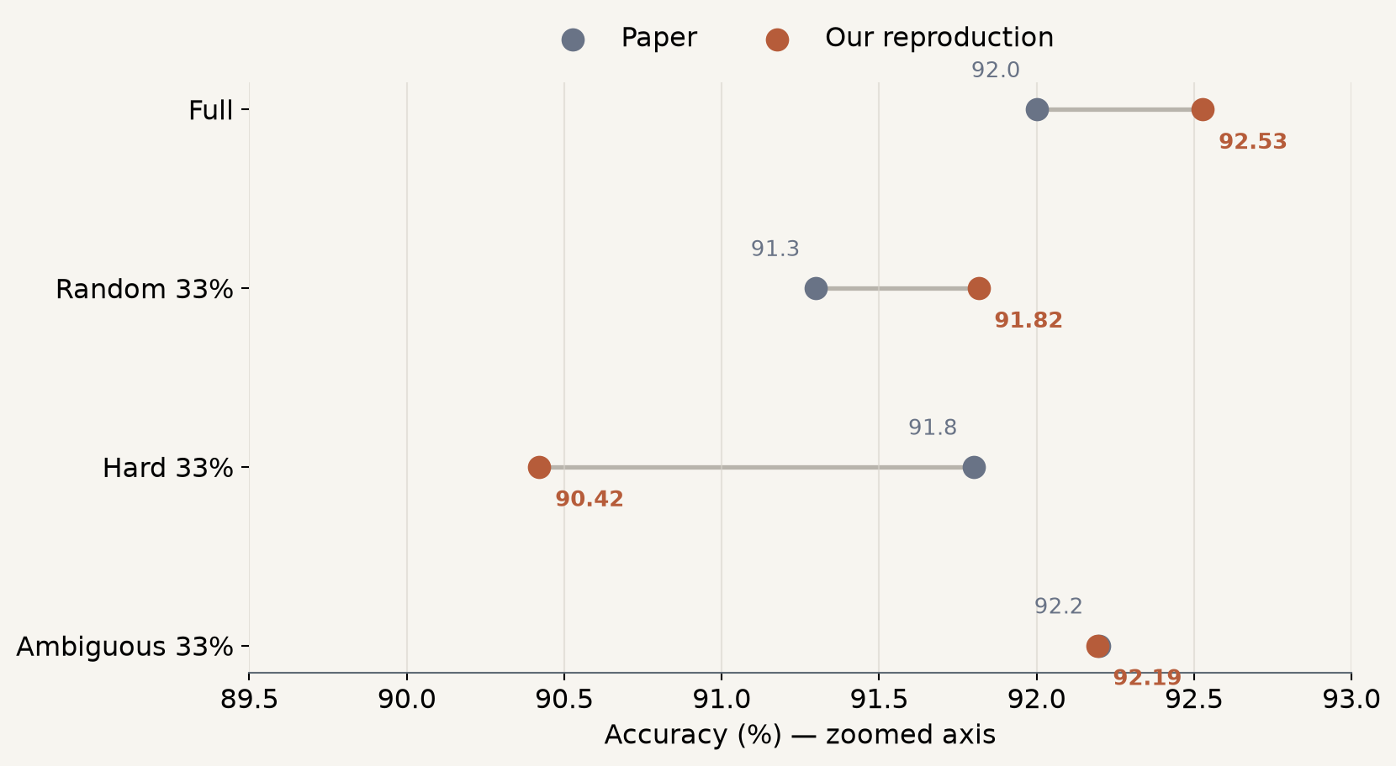
OUR REPRODUCTION
In-distribution accuracy closely matches the paper
Subset | Paper | Ours | Δ
Full | 92.0 | 92.53 | +0.53
Random | 91.3 | 91.82 | +0.52
Hard | 91.8 | 90.42 | -1.38
Ambiguous | 92.2 | 92.19 | -0.01
Central reproduction result
Ambiguous: 92.19 vs 92.2
Axis is deliberately labeled as zoomed; direct values and differences are shown.
17
Notes:
On SNLI test, full and random are about half a point above the paper. The ambiguous subset is essentially exact: 92.19 versus 92.2. It also beats our random third by 0.38 points and comes within 0.34 of our full-data run. Hard-to-learn is the largest ID disagreement, 1.38 points below the paper. The plotted axis is zoomed and explicitly labeled; the table keeps the size of each difference visible. The ordering is not identical because our full run exceeds ambiguous by 0.34 points, whereas the published ambiguous value exceeds full by 0.2. Given best-of-three versus one seed, the defensible conclusion is near-equivalent performance with one third of the data, not that ambiguous selection always wins ID.

Slide 18
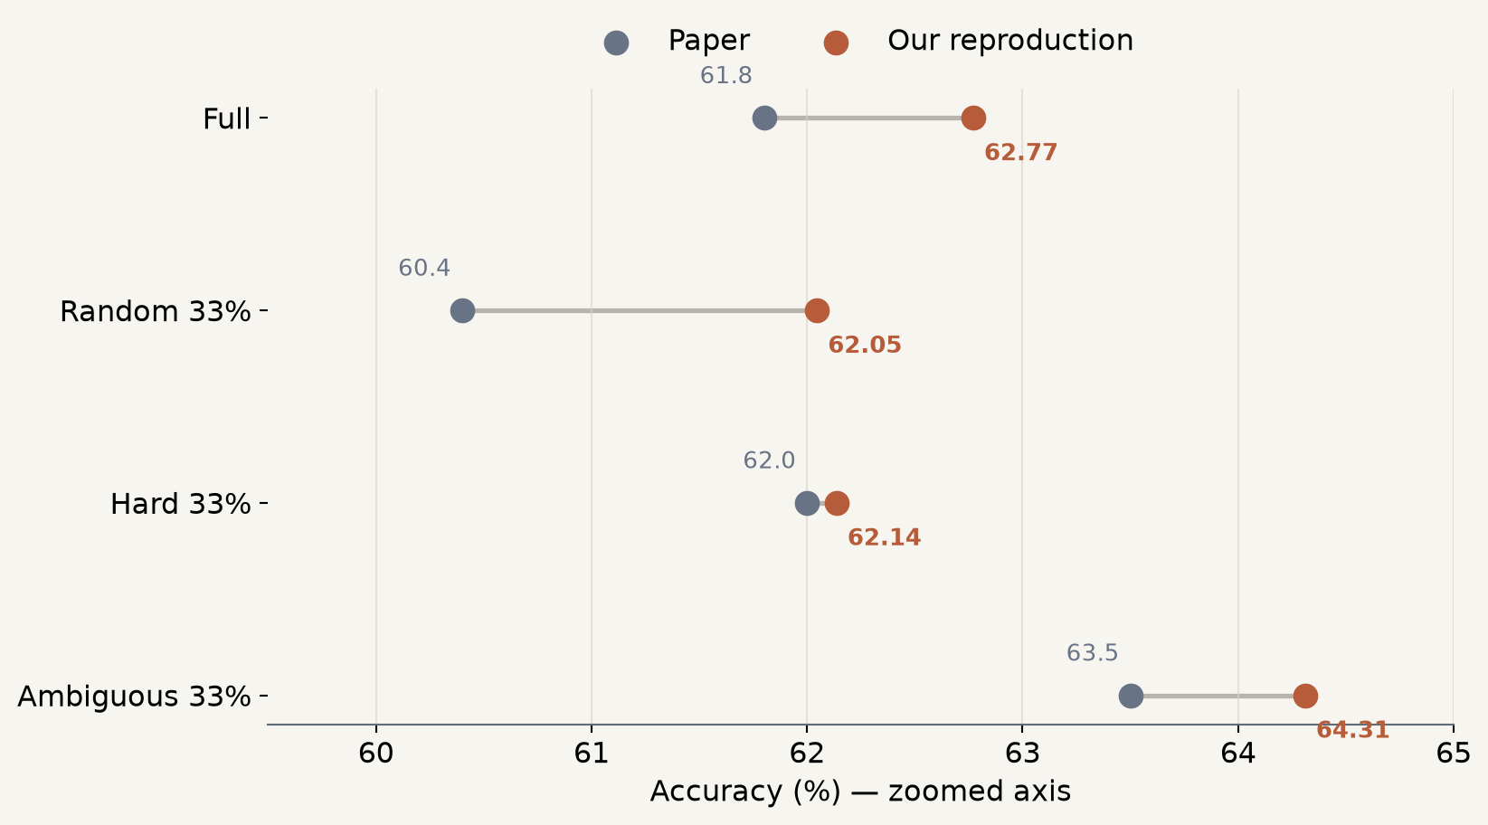
OUR REPRODUCTION
The ambiguous subset also leads on NLI Diagnostics
Subset | Paper | Ours | Δ
Full | 61.8 | 62.77 | +0.97
Random | 60.4 | 62.05 | +1.65
Hard | 62.0 | 62.14 | +0.14
Ambiguous | 63.5 | 64.31 | +0.81
Our Diagnostics ranking
Ambiguous > Full
> Hard > Random
NLI Diagnostics contains 1,104 labeled examples; one seed can move several examples.
18
Notes:
On Diagnostics, every reproduction score is within 1.65 points of the published value. Ambiguous remains best at 64.31, 1.54 points above our full run and 2.26 above our random third. The ranking supports the paper’s main OOD pattern. The random run is our largest positive difference. Diagnostics is only 1,104 examples, so a small number of predictions and seed differences can move the percentage. Here the qualitative ordering is especially informative: ambiguous is best in both paper and reproduction, and random is lowest. Hard-to-learn roughly matches the paper's OOD result even though its ID result is lower, reinforcing that ID and OOD answer different questions.

Slide 19
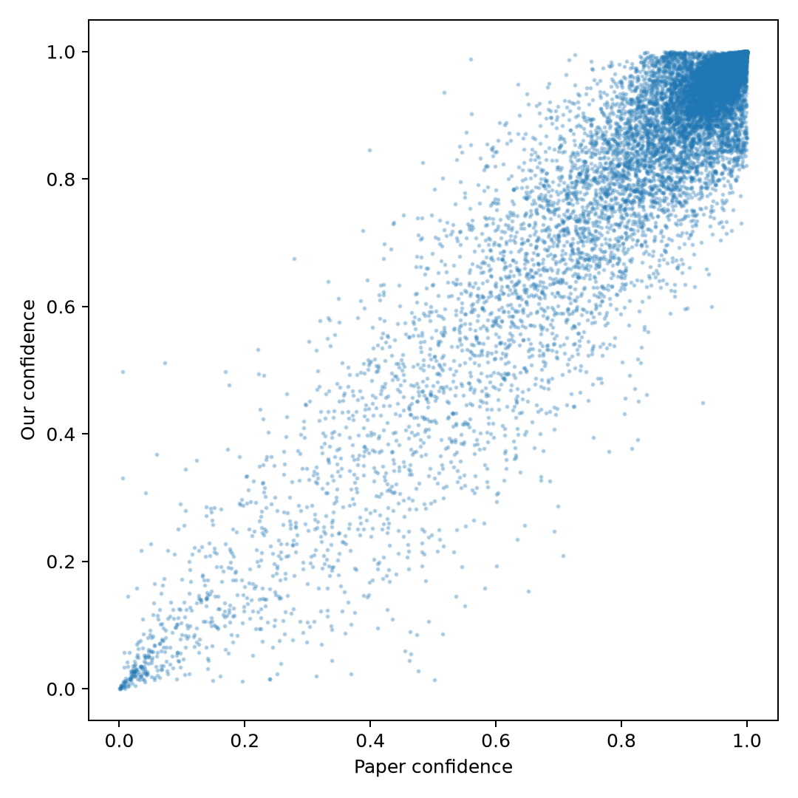
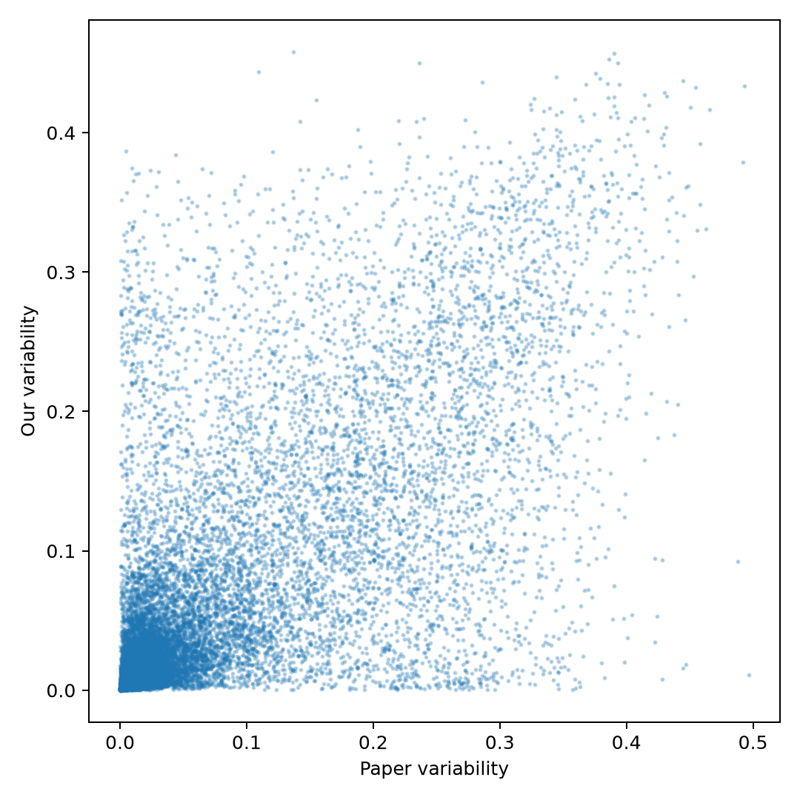
OUR REPRODUCTION
Reproduced maps agree more on confidence than variability
Map coverage
Confidence Pearson / Spearman
Variability Pearson / Spearman
Ambiguous-set overlap
99.91%
0.944 / 0.888
0.708 / 0.772
75.2%
Individual agreement: the paper’s “girl → boy” hard example is also among our lowest-confidence examples.
Coverage excludes 498 examples lacking exactly one observation in every logged epoch; no values were imputed.
19
Notes:
We also reconstructed the map from our own training dynamics. Coverage is 99.91 percent because 498 examples lacked exactly one observation in every logged epoch and were excluded rather than imputed. Confidence correlates strongly with the released map: Pearson 0.944. Variability is less stable but still substantial at 0.708. Seventy-five percent of ambiguous selections overlap. Qualitatively, the exact girl-versus-boy example highlighted as hard in the paper also appears among our lowest-confidence examples. Set overlap is a stricter criterion than correlation because ranking changes near the one-third cutoff can swap membership. A 75.2 percent ambiguous overlap therefore coexists naturally with a Spearman variability correlation of 0.772. The excluded 0.09 percent is transparently reported.

Slide 20
SYNTHESIS
The selection result reproduces; map details remain sensitive
SUPPORTED BY OUR EVIDENCE
LESS STABLE OR DIFFERENT
● Ambiguous 33% matches paper ID accuracy: 92.19 vs 92.2.
● Ambiguous remains best on Diagnostics: 64.31.
● Confidence structure transfers strongly between maps.
● One third of the data approaches full-data performance.
● Hard-subset ID is 1.38 points below the paper.
● Variability agrees less strongly than confidence.
● The paper reports best of 3 seeds; we have one.
● Hardware, precision, and software stacks differ.
Training histories expose structure that final accuracy alone cannot show.
In this SNLI reproduction, selecting high-variability examples preserved accuracy and strengthened diagnostic generalization, while exact map coordinates remained sensitive to training details.
Questions
github.com/JuliaMazine/dataset-cartography-reproduction
20
Notes:
The evidence supports the paper’s central SNLI selection result: the ambiguous third nearly matches full-data ID accuracy and leads on Diagnostics. The map’s confidence structure is robust, while variability and the hard-subset score are more sensitive. The broader lesson is that per-example training histories can diagnose usefulness, uncertainty, and possible annotation issues, but all region names remain conditional on the model and training process. That is the conclusion I would defend from this reproduction. Practical uses include dataset auditing, selecting compact training sets, and studying uncertainty, but computing the initial map still requires training on the full dataset. Our evidence is one dataset, one model family, and one seed, so broader deployment should validate the map again under the intended setup.

Slide 21
APPENDIX
Exact reproduction hyperparameters
Setting | Value
Model | roberta-large
Seed | 93078
Learning rate | 1.0708609960508476 × 10⁻⁵
Optimizer | AdamW; ε=1e-8; weight decay 0; max grad norm 1
Schedule | linear decay; zero warmup
Maximum length | 128 tokens
Batch | 32 physical × 3 accumulation = 96 effective
Precision | BF16
Checkpoint | highest SNLI validation accuracy
Epoch cap | 6; patience 3
A1
Notes:
Backup slide with the full settings that materially affect comparison. The recovered settings are documented in the repository and the raw run metrics.

Slide 22
APPENDIX
Individual run metrics
Run | Train N | Epochs | Runtime | Validation | SNLI test | Diagnostics
Full | 549,367 | 5.00 | 120.0 min | 93.23 | 92.53 | 62.77
Random 33% | 181,291 | 5.00 | 40.6 min | 92.40 | 91.82 | 62.05
Hard 33% | 182,335 | 4.00 | 33.9 min | 91.21 | 90.42 | 62.14
Ambiguous 33% | 182,335 | 6.00 | 50.5 min | 93.05 | 92.19 | 64.31
All runs use one seed. Epoch counts differ because early stopping selected the best validation checkpoint.
Raw JSON files: results/run_metrics/
A2
Notes:
Backup slide containing every individual measured run rather than rounded headline values. There is no hidden aggregation across seeds.

Slide 23
APPENDIX
Subset construction
RANDOM 33%
181,291 examples
Pandas sample with the recovered subset seed 725862.
AMBIGUOUS 33%
182,335 examples
Sort released coordinates by highest variability.
HARD-TO-LEARN 33%
182,335 examples
Sort released coordinates by lowest confidence.
FULL
549,367 examples
Every official SNLI training example with a valid label.
All coordinate joins are one-to-one and cover every valid training ID before selection.
A3
Notes:
Backup slide describing exact subset construction. The slight count difference between random and coordinate-based subsets follows the separate procedures in the original code.

Slide 24
APPENDIX
Complete paper-versus-reproduction table
Subset | Paper ID | Our ID | Δ ID | Paper OOD | Our OOD | Δ OOD
Full | 92.0 | 92.53 | +0.53 | 61.8 | 62.77 | +0.97
Random 33% | 91.3 | 91.82 | +0.52 | 60.4 | 62.05 | +1.65
Hard 33% | 91.8 | 90.42 | -1.38 | 62.0 | 62.14 | +0.14
Ambiguous 33% | 92.2 | 92.19 | -0.01 | 63.5 | 64.31 | +0.81
Paper values are best-of-three; reproduction values are one run with seed 93078.
A4
Notes:
Backup slide containing the full numerical comparison and signed differences in percentage points.

Slide 25
APPENDIX
Reproduction environment and artifact locations
Environment
Repository artifacts
● NVIDIA RTX 4070 Ti SUPER · 16 GB
● Python 3.12 · PyTorch 2.3
● Transformers 4.44–4.49 range
● CUDA · BF16 · dynamic padding
● results/reproduction_metrics.csv
● results/run_metrics/*.json
● results/map_comparison.json
● presentation/generate_presentation.py
● presentation/speaker_notes.md
The deck can be regenerated without model checkpoints from the committed compact results and assets.
Paper: Swayamdipta et al., Dataset Cartography, EMNLP 2020 · ACL Anthology 2020.emnlp-main.746
A5
Notes:
Backup slide for reproducibility questions and artifact navigation.

