Slide 1

Fake vs. Real: Classifying News Headlines
· NLP Study · 34k+ Headlines · Ironhack DS/ML Bootcamp
Julia Parnis
17.01.2026

Slide 2
Detecting deception
REAL
FAKE
Label in dataset
Label in dataset
New York mayor to back $2.5 billion light rail in key speech
Top official: we find illegal aliens – and here’s why we won’t deport them
Why it matters (Europe)
85%
37%
15%
56%
say fake news is a problem in their country
encounter fake news daily or almost daily
feel very confident
they can identify fake news
somewhat confident
Germany 84% · Spain 88%
Germany 24% · Spain 53%
Germany: 14% very confident · Spain 13% very confident
Source: European Commission — Flash Eurobarometer 464 (Fake News and Disinformation Online), Feb 2018.
Why Machine Learning helps?
· Scalability: Process millions of headlines instantly · Objectivity: No bias, no fatigue, reproducible · Speed: Real-time detection before it spreads

Slide 3







Dataset and approach
EDA & Data quality checks
Text Preprocessing
Vectorization
Modeling: 3 phases
Phase 1: Basic comparison
Phase 2: With features
Phase 3: Hyperparameter tuning
Model Evaluation
Summary
Dataset at a glance:
34,152 headlines
2 columns after split: label + headline
Label distribution:
17,572 fake (label 0) vs 16,580 real (label 1)
0 null values
1,946 duplicated headlines

Slide 4
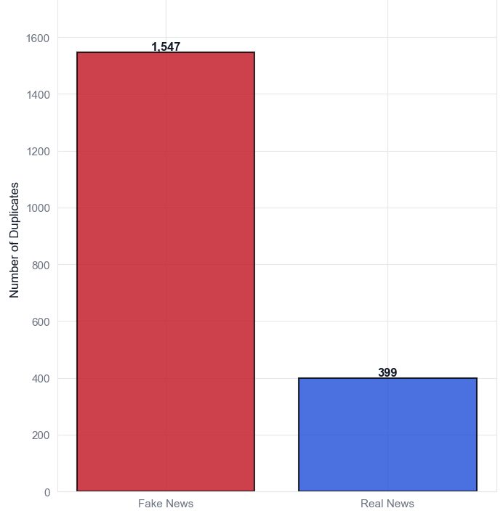
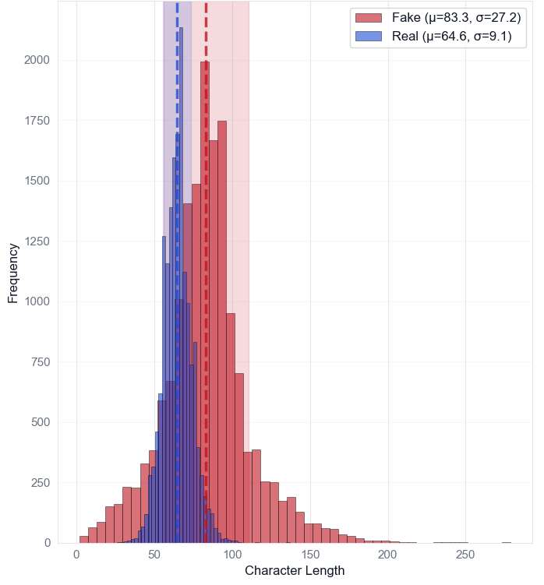
EDA signals: duplicates & headline length
Duplicates
Headline length (characters)
1,547
Fake: 83.3 ± 27.2
Real: 64.6 ± 9.1
Difference in variability: p<0.0001 (Levene’s test)
399
Fake News
Real News
5.7% duplicated overall (1,946 / 34,152)
79.5% of duplicates are fake
Fake news are longer + more variable
characters (length) and words (count)
→ Engineered features used: ꞏ duplication_count, ꞏ headline_length, ꞏ word_count

Slide 5
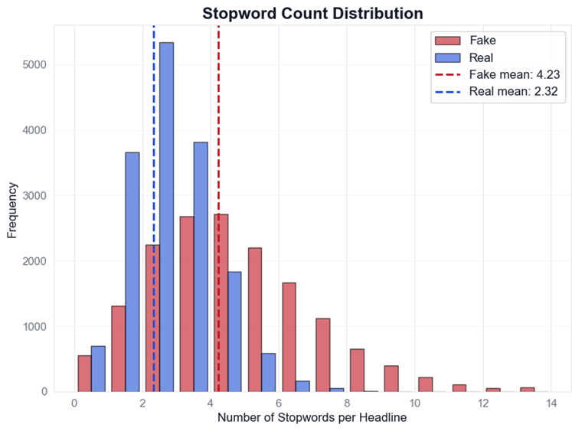
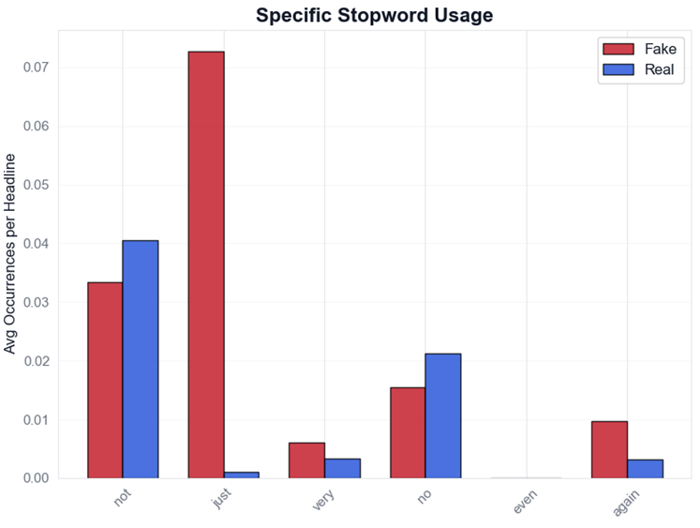
Stopwords as signal: count + key words
Takeaway: Fake headlines contain ~1.8x more stopwords (mean 4.23 vs 2.32)
➔ we keep high signal stopwords + engineer stopword_count
not
just
very
no
even
again
p<0.0001 (t-test)
Fake: 4.23 ± 2.47
Real: 2.32 ± 1.26
Engineered feature: stopword_count
Keep: just, very, again, not, no, never, only, even

Slide 6
Text Preprocessing: hybrid approach
Goal: reduce noise without removing high-signal stopwords
Pipeline (5 steps):
1
Lowercase + strip URLs/ email
BEFORE ➔ AFTER (example)
Original:
“Better policies are needed for better results”
Processed:
“good policy be need for good result”
2
Replace punctuation➔ spaces
3
Tokenize (split into words)
4
Remove stopwords
(keep 8 signal words)
5
Remove short tokens (<3)
+ POS lemmatization
Kept stopwords (signal): ▪ not ▪no ▪never ▪only ▪just ▪very ▪again ▪ even
Output: BOW/TF-IDF + engineered stopword_count

Slide 7
Vectorization: BoW vs TF-IDF
Baseline: Logistic Regression ▪5k features ▪(1,2)-grams ▪min_df=2 ▪max_df=0.95 ▪ 80/20 stratified split
BAG OF WORDS (CountVectorizer)
TF-IDF(TfidfVectorizer)
Test accuracy: 92.46%
Test accuracy: 92.15%
Simple and fast
Works very well with linear models on sparse text
Counts word/ n-gram occurrences
Weights words by importance (down-weights very common terms)
Works very well on sparse text
Can over-emphasize rare/ noisy terms
Decision: BoW performed slightly better (+0.31 pp) ➔ used in Phase 1
TOP PREDICTIVE TERMS (LogReg coefficients)
Fake (top negative weights)
Real (top positive weights)
video
gop
hilary
just
dem
factbox
urge
tillerson
spokesman
trade

Slide 8
Model development: 3 phases
Metric focus: F1-score (balances precision & recall)
PHASE 1 – Baselines (BoW only)
PHASE 2 –BoW + engineered features
PHASE 3 – Hyperparameter tuning
Models: LR • Linear SVM • NB • RF • XGBoost
Best: Logistic Regression
F1: 0.9260 (Acc: 0.9246)
Added: duplication_count • stopword_count • headline_length • word_count
Best overall: Logistic Regression
F1: 0.9330 (Acc: 0.9319)
Δ vs Phase 1: +0.0070
Grid search (C, solver, class_weight…)
Result: ~no change
F1: 0.9325
Winner: tuned XGBoost
Reached F1=0.9420
Engineered features: duplication_count • stopword_count • headline_length • word_count

Slide 9
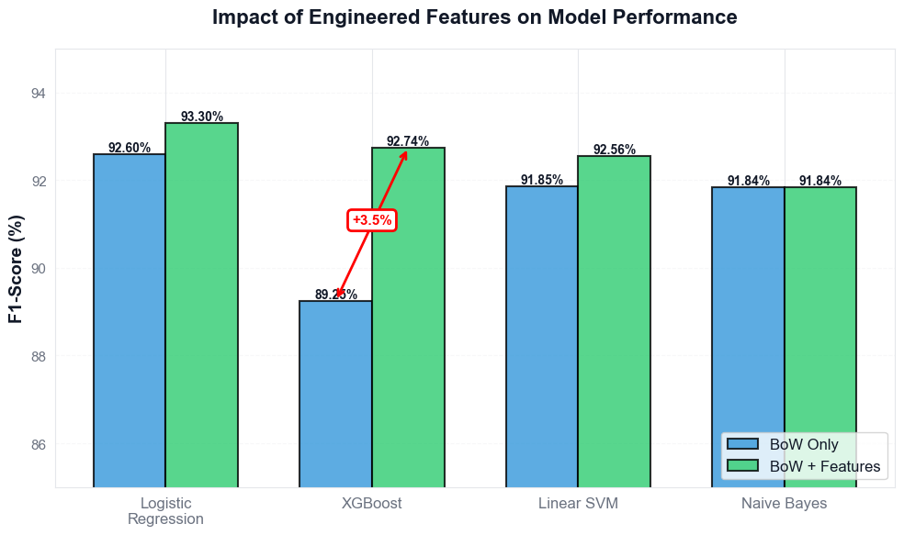
Model development: Phase 2
Engineered features: duplication_count • stopword_count • headline_length • word_count

Slide 10
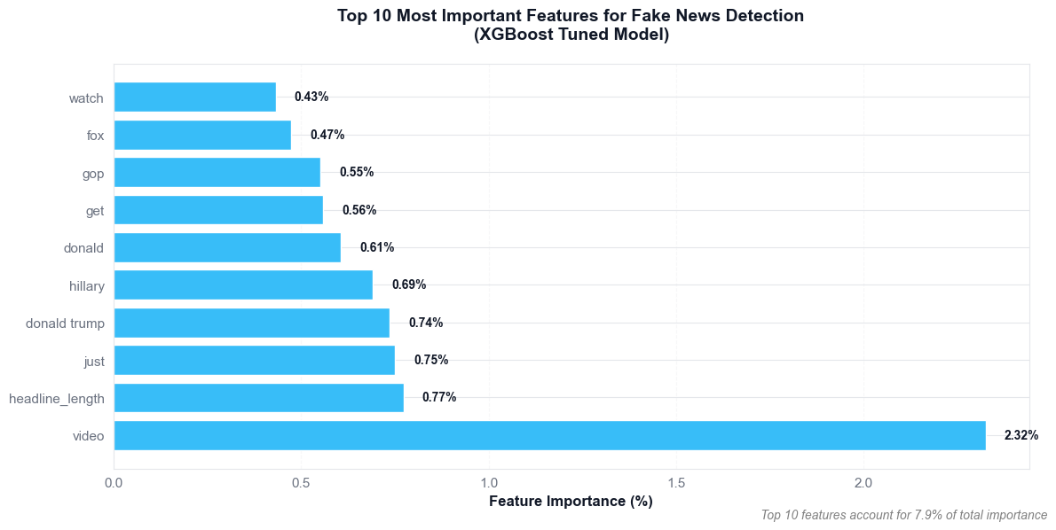
Model development: Hyperparameter Tuning
Logistic Regression Model
Winner: XGBoost Model
Grid search (C, solver, class_weight, penalty)
F1-Score: 93.25%
Grid search (n_estimators, max_depth, LR…)
F1-Score: 94.20%
Engineered Features Contribution:
headline_length: 0.77%
word_count: 0.27%
stopword_count: 0.22%
duplication_count: 0.20%

Slide 11
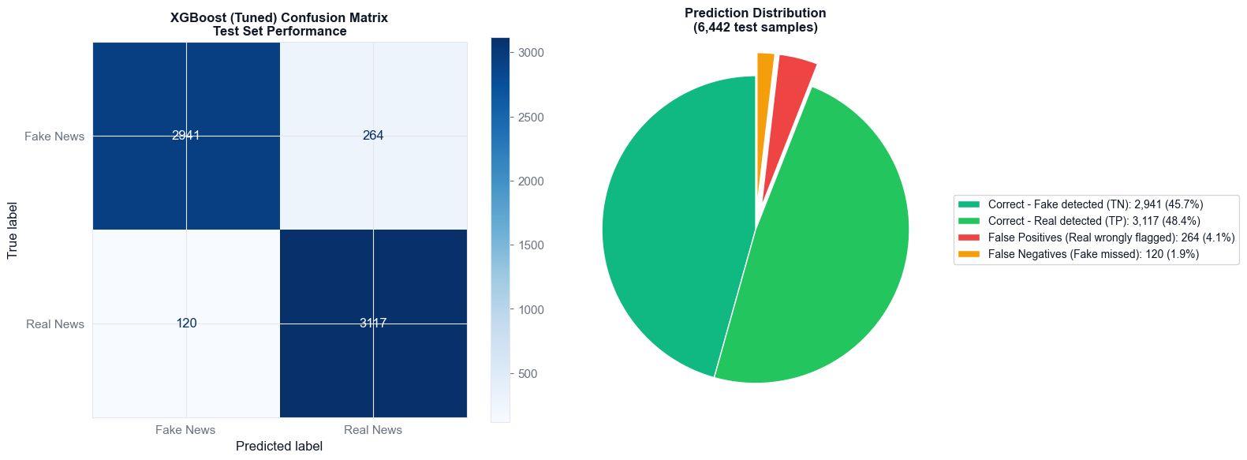
XGBoost: the winner
FP
FN
4.1%
1.9%
45.7%
Correct (TN)
48.4%
Correct (TP)

Slide 12
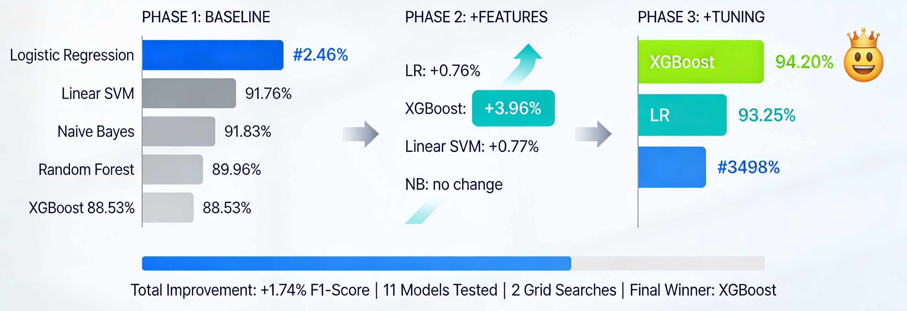
Summary
92.46%
93.25%
Limitations/ Next Steps
Test on fresh/real-world sources
Try a transformer baseline + calibration

