Slide 1

Evolutionary Dynamics and Molecular Epidemiology of Viruses
Instructors: Julia A. Palacios and Nicola Mueller

Slide 2
Logistics
Slides and tutorials.
Coffee Break 3:00-3:30pm, 2nd floor lobby
Enrolled: 26 graduate students, postdocs, professors and researchers.
Your participation is encouraged!
https://juliapalacios.github.io/SISMID_EvolutionaryDynamics/

Slide 3
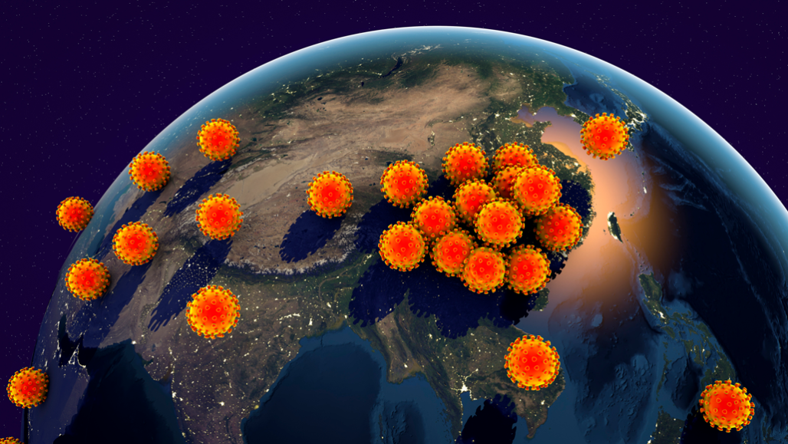
Molecular Surveillance of Infectious Diseases
Instrumental in tracking the spread and evolution of the virus during a pandemic
Provides insights into the origin of the virus, its evolutionary rate, the timing of introductions, the patterns of transmission and the rise of novel variants.
Figure credit: https://www.sciencenewsforstudents.org/article/who-calls-covid-19-a-global-pandemic
Notes:
I probably do not need to convince you that Genomic surveillance of infectious diseases is instrumental in tracking the spread and evolution of the virus during the pandemic. It has provided insights into the origin of the virus, its evolutionary rate, the timing of introductions, the patterns of transmission and the rise of novel variants that have spread through populations.

Slide 4
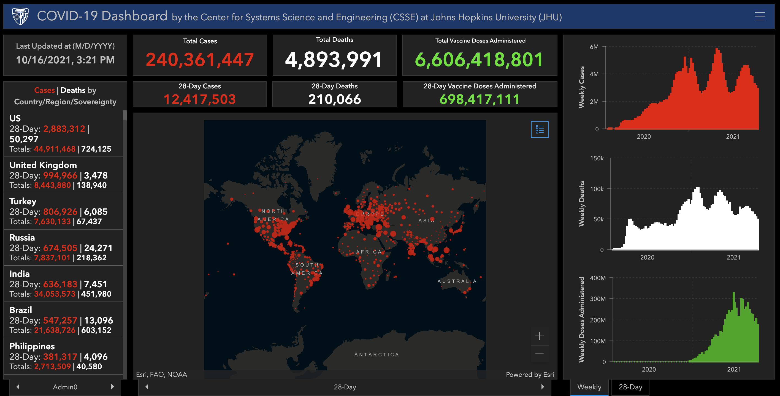
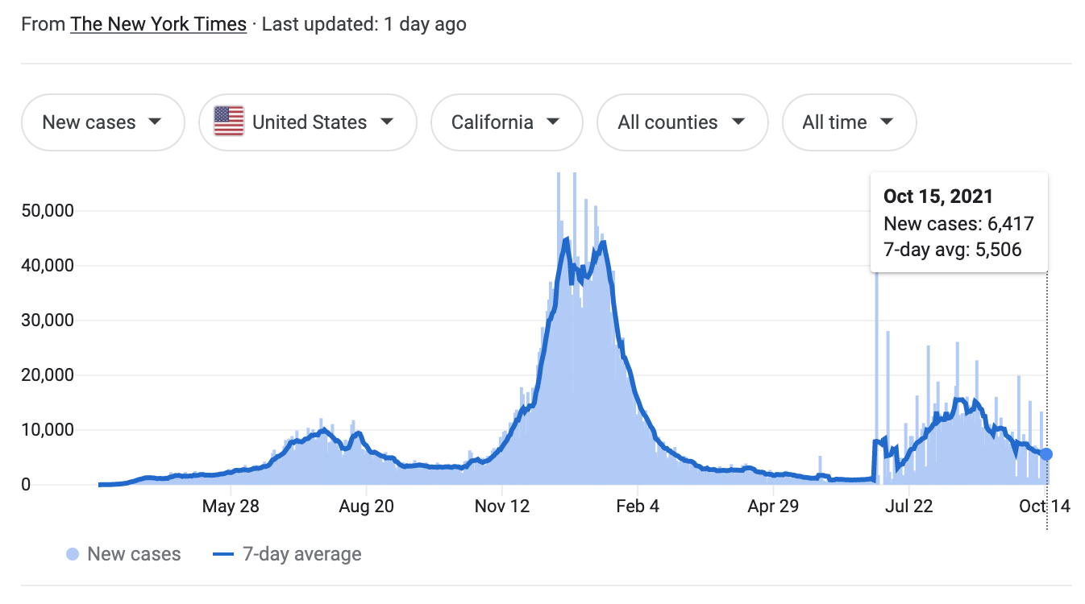
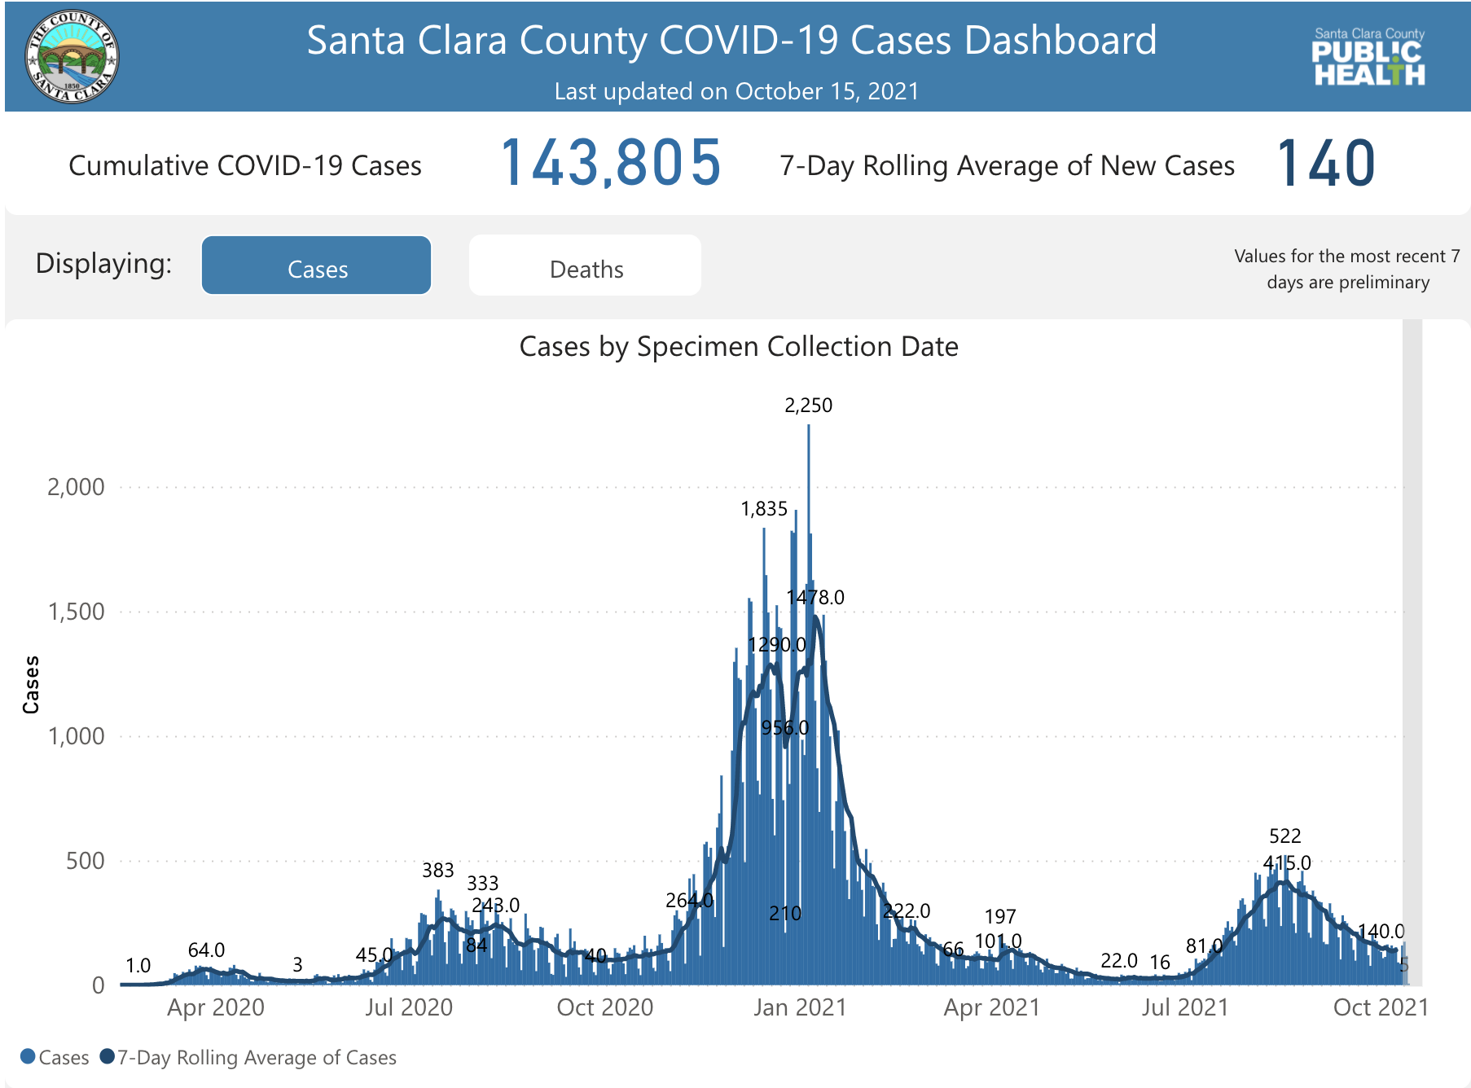
Surveillance of Infectious Diseases
Molecular data complements more general surveillance systems
Case count time series
Can be biased due to delays and reporting errors
Can be incomplete due to under-reporting and asymptomatic cases
Notes:
But of course, molecular surveillance only complements more general surveillance systems that include contact tracing and case count data,
Complementing this is needed because case count time series can be biased due to delays and reporting errors and it can also be incomplete due to under-reporting and asymptomatic cases

Slide 5
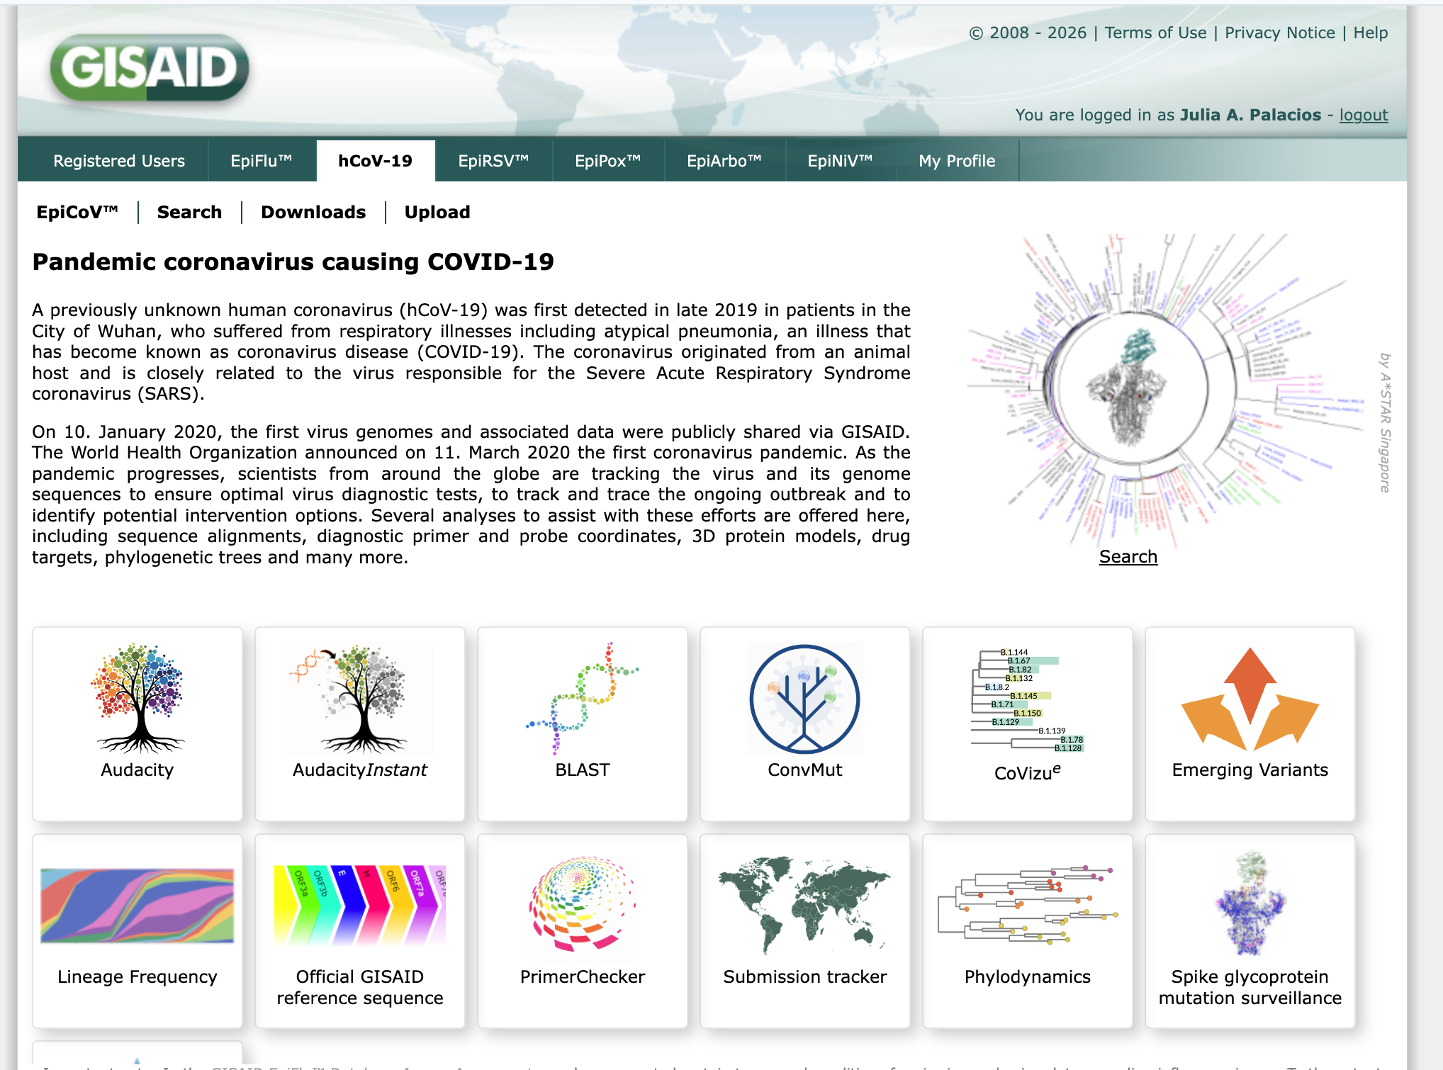
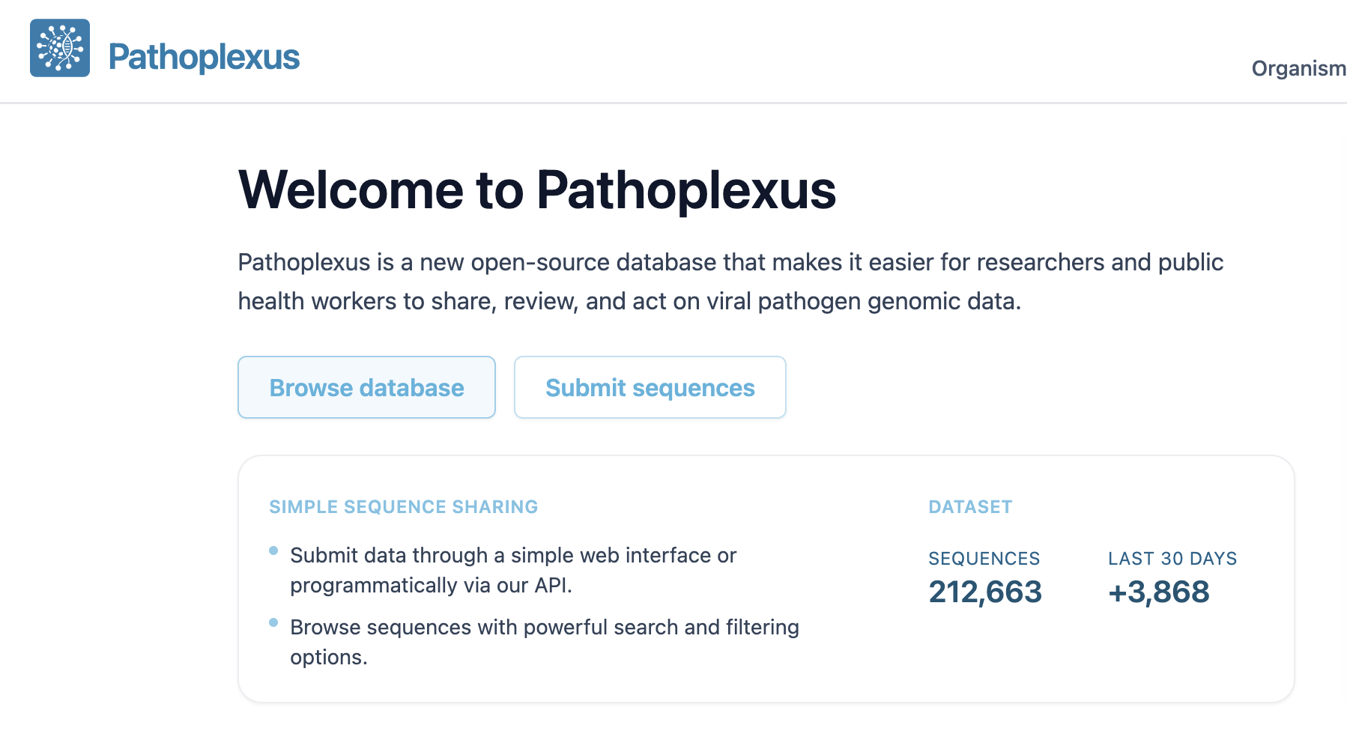
Surveillance of Infectious Diseases
Notes:
Molecular surveillance has been possible thanks to the enormous efforts of laboratories, researchers and governments around the word that deposit their sequences in GISAID and make them publicly available.

Slide 6
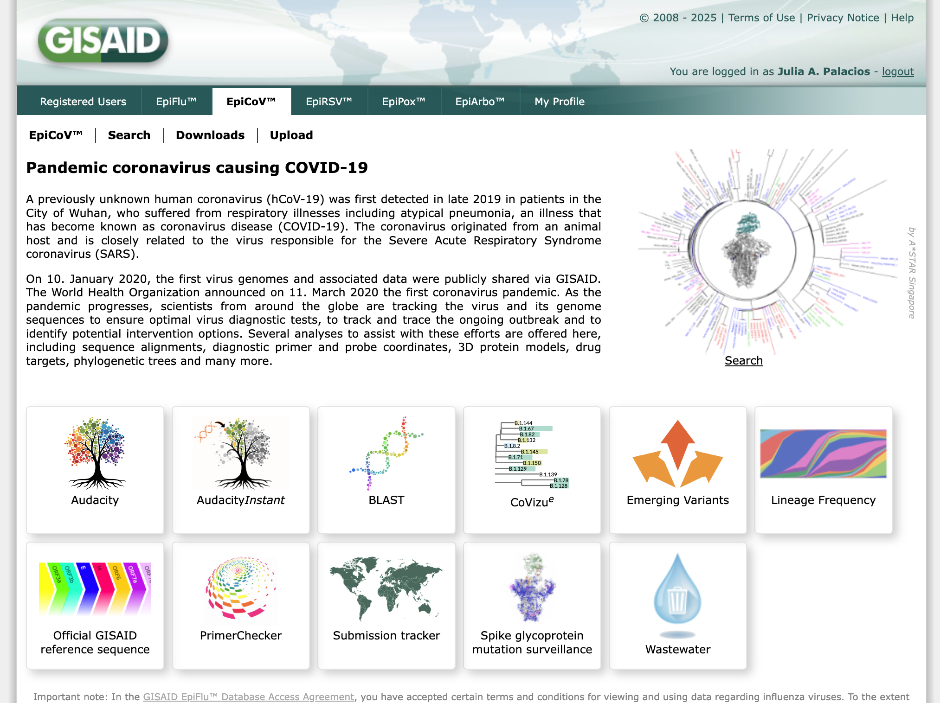
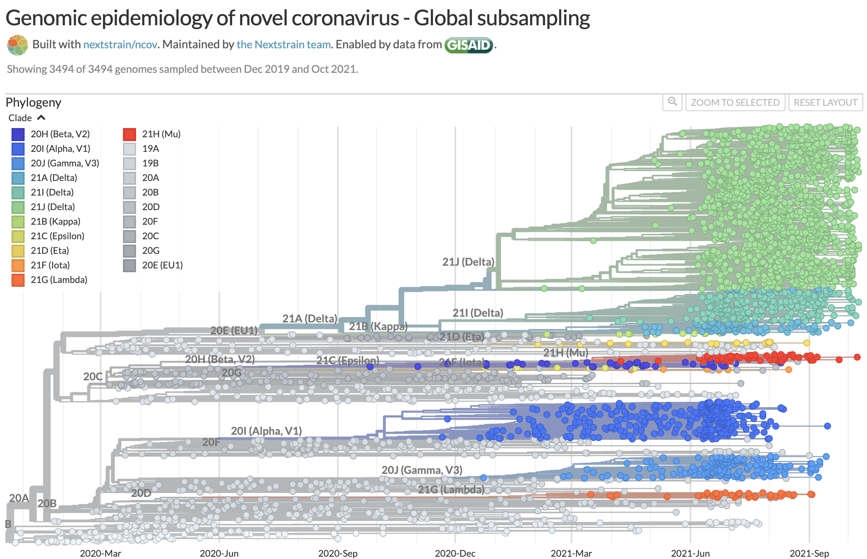
Surveillance of Infectious Diseases
Notes:
Researchers have also popularized visualizations (such as nextstrain) that allows us to keep track of introductions around the world and the tracking of variants making molecular analyses useful to public health officials and the general public.

Slide 7
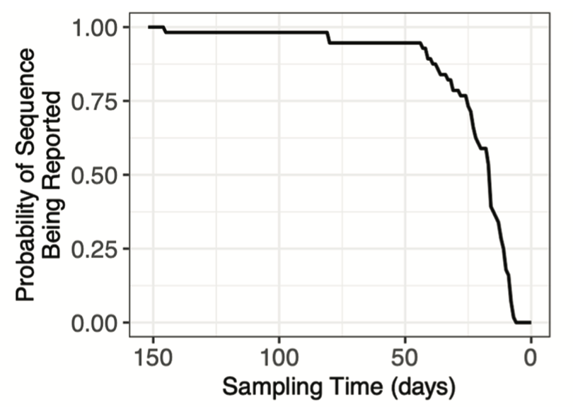
Reporting delay of molecular sequences
Molecular surveillance
It is usually delayed by at least 2-3 weeks.
Sequencing and reporting errors.
Medina et al., PLOS Comp. Biology, 2025
Notes:
However, sequences are usually deposited in Gisaid at least 3 weeks after collection in the best case and sequences are also subject to sequencing and reporting errors, for example with the date of collection.

Slide 8
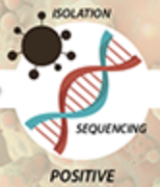
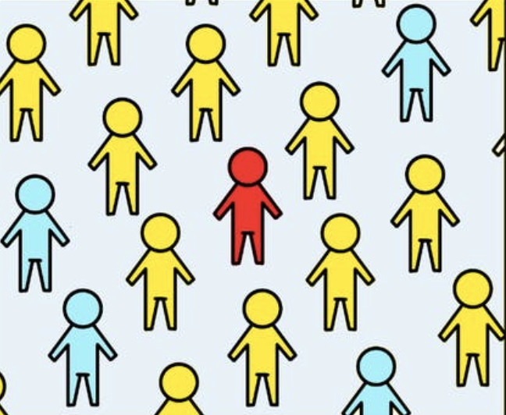
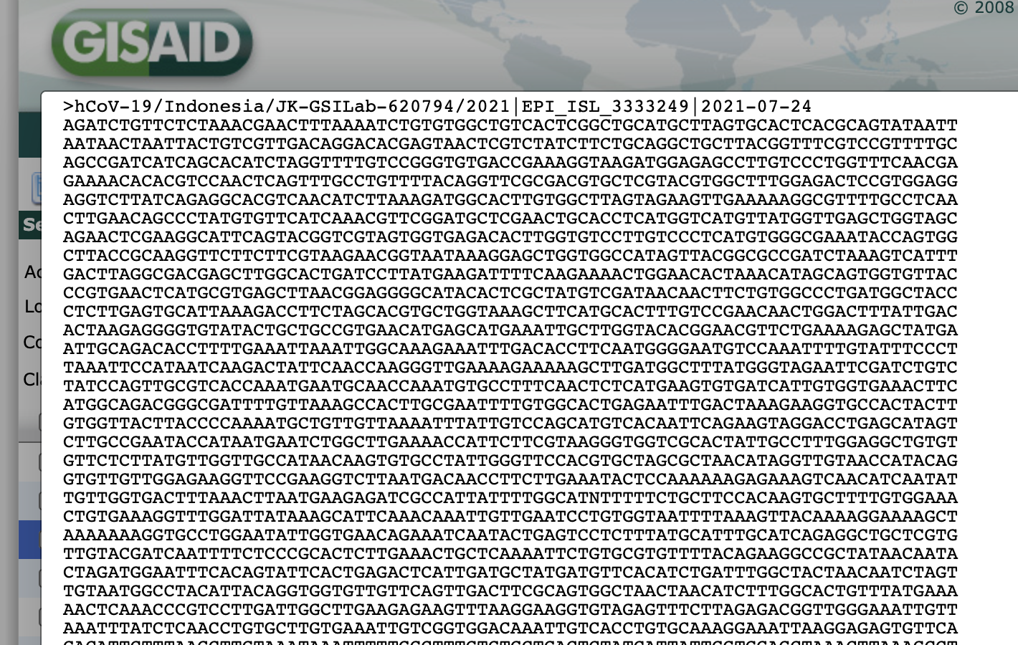

Data: Viral molecular sequences from infected individuals
Today there are millions of sequences available in GISAID
Notes:
In this talk our data consist of SARS-CoV-2 viral molecular sequences isolated from infected individuals, together with biological sample collection date .
As of two weeks ago, there were more than 3 million sequences available in GISAID.
Despite the enormous efforts of laboratories, governments and researchers to collect and sequence molecular, many challenges remain in analyzing and interpreting the data collected.

Slide 9
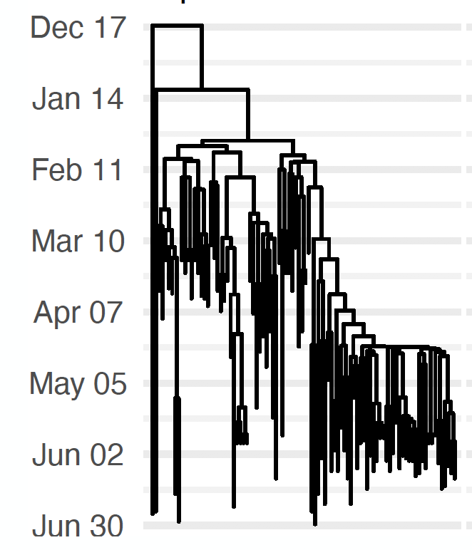
Phylodynamics of infectious diseases
SARS-CoV-2 in Washington State in 2020
Aims to understand disease dynamics by joint modeling of evolutionary, epidemiological and immunological processes
Notes:
A typical summary of such sequences is the phylogeny or genealogy. This tree is typically reconstructed using distance—based methods or Maximum likelihood methods. However, the study does not end there and we are interested in understanding the processes that generates the tree.
Here we focus on phylodynamics of infectious diseases. Phylodynamics or molecular epidemiology aims to understand disease dynamics by joint modeling of evolutionary, epidemiological and immunological processes. – We will mainly focus on epidemiological.
The goal is basically to understand the underlying processes that generate the sample phylogeny of the molecular sequences.
These methods offer powerful tools to help us understand and monitor the pandemic however there are few challenging applications in which the state-of-the-art methods are not sufficient.
On the left I am showing you the estimated phylogeny of SARS-CoV-2 in Washington State in 2020 of one of the variants with all sequences available up to Jun of last year.

Slide 10
Evolutionary dynamics and molecular epidemiology of viruses
The goal is to:
Understand patterns of transmission and spread (effective population size)
Estimate the rate of evolution / mutation rate
Compare evolution across pathogens
Understand the sources of molecular variation (mutation, selection, recombination)
Surveillance

Slide 11
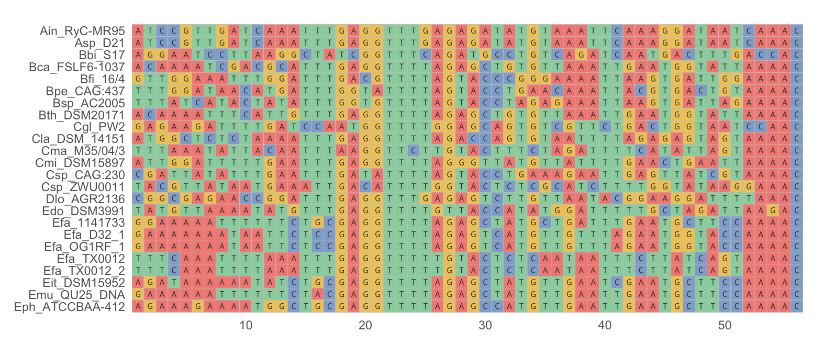
Observed data
https://michitobler.github.io/primer-of-evolution/evolution-of-dna-sequences.html

Slide 12
Observed data
Biological sequences (DNA, RNA, protein) contain information about their underlying evolutionary processes.
Molecular sequences from different organisms are not independent because they share evolutionary history.
The central concept is a genealogy: a bifurcating tree that depicts the ancestral relationships of the samples.

Slide 13
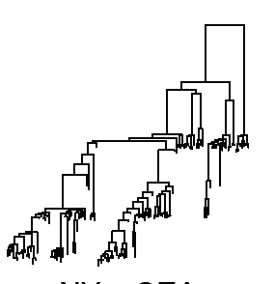
What is a genealogy?
Genealogy
Time
Tips correspond to individuals (one species)
Internal nodes are ranked
Branch lengths are in the same scale
Samples are time stamped (tips)

Slide 14
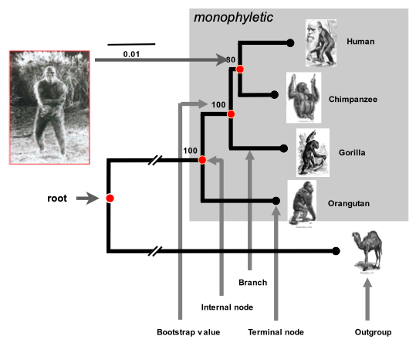
What is a genealogy?
Genealogy
Phylogeny
Time
Tips correspond to individuals (one species)
Internal nodes are ranked
Branch lengths are in the same scale
Samples are time stamped (tips)
Tips correspond to species
Usually internal nodes are not ranked
Branch lengths are in different scales
Unrooted trees are commonly analyzed

Slide 15
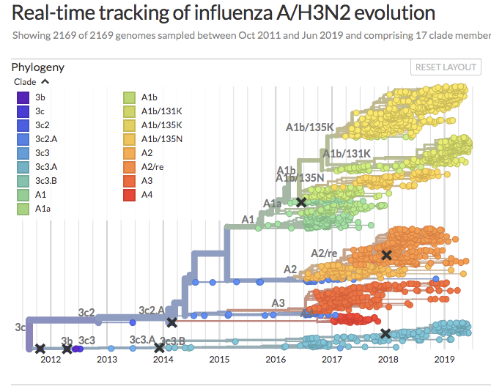
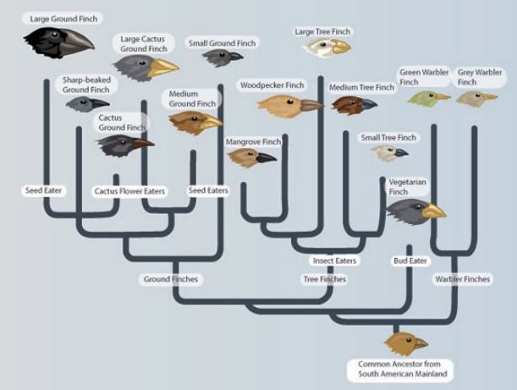
Phylogenetics, phylodynamics and population genetics
Phylodynamics
Attempts to enhance understanding of infectious disease dynamics using pathogen phylogenies
Phylogenetics is the study of the evolutionary history of species. It seeks to determine the “family tree”.
Understanding selection
Evidence for coevolution
Pathways of trait evolution

Slide 16
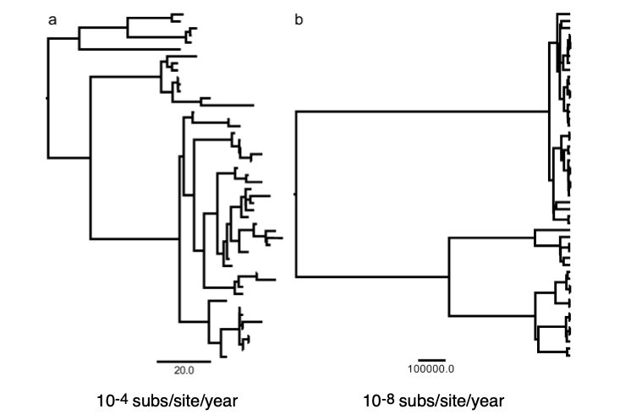
Phylodynamics and population genetics
For rapidly evolving organisms
For slowly evolving organisms

Slide 17
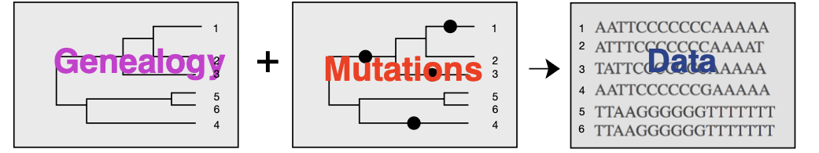
Statistical phylogenetics seeks to infer the phylogeny from molecular data
Genealogies inform about past evolutionary history.
Ancestry
Signatures of selection
Population structure
Population history

Slide 18
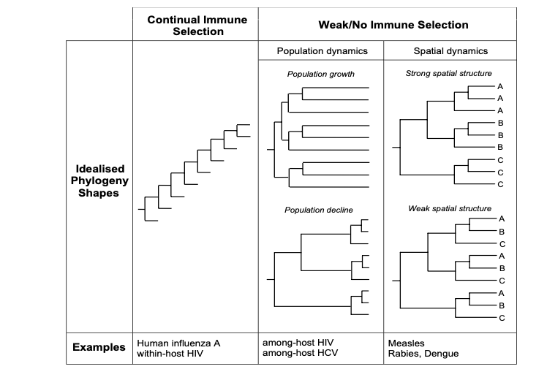
Phylodynamic patterns inform about selection and population structure

Slide 19
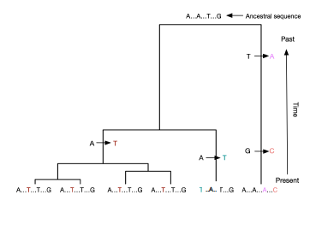
A process of substitutions superimposed on the genealogy generates observed sequences at the tips of the genealogy

Slide 20
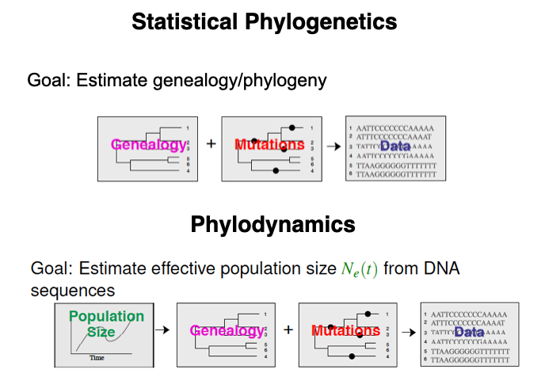
Coalescent Process

Slide 21
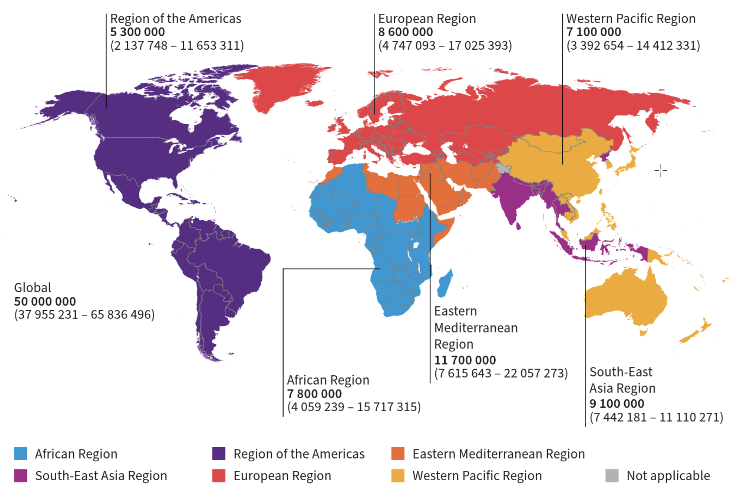
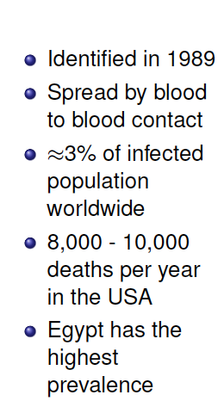
Example 1: Hepatitis C in Egypt

Slide 22
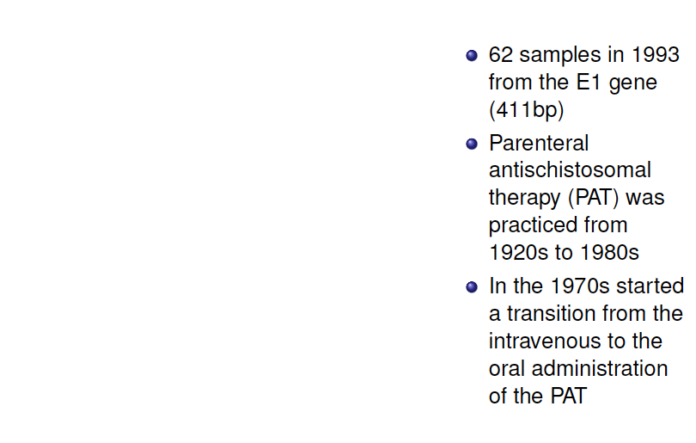
Example 1: Hepatitis C in Egypt

Slide 23
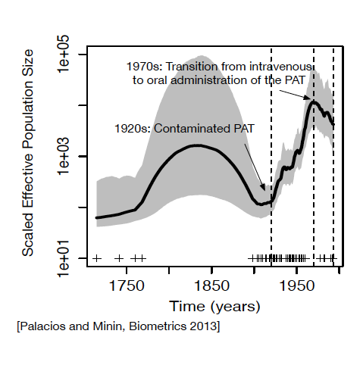
Example 1: Hepatitis C in Egypt

Slide 24
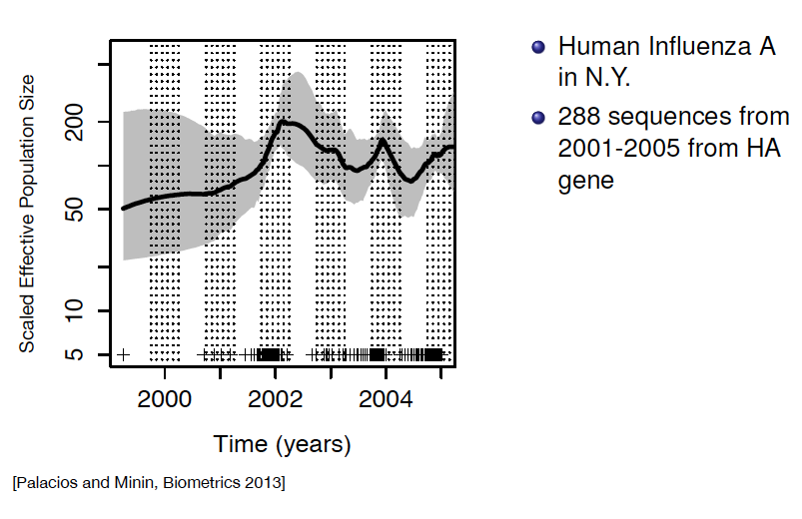
Example 2: Influenza in NY

Slide 25
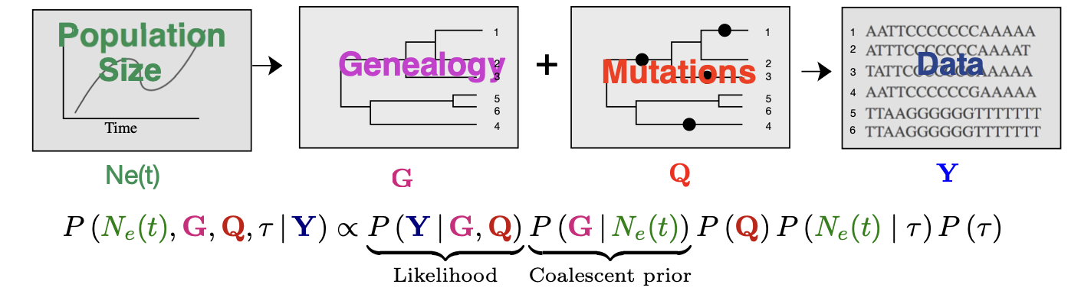
Bayesian Evolutionary Analysis by Sampling Trees (BEAST)

Slide 26
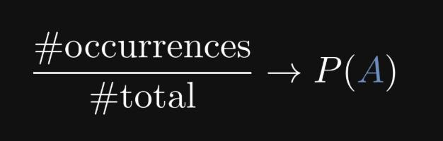
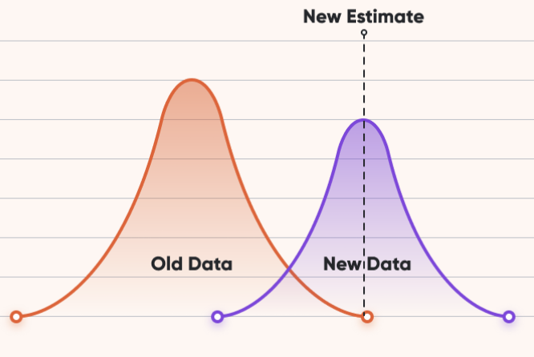
Frequentist vs Bayesian Inference
Frequentist
Probability is interpreted as long run frequency.
The goal is to create procedures with long run guarantees.
Procedures are random while parameters are fixed and unknown
Larry Wasserman –All of Statistics
Figure credit: https://www.optimonk.com/mastering-bayesian-a-b-testing/

Slide 27
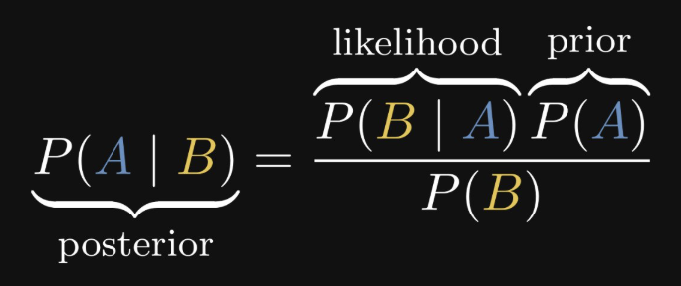
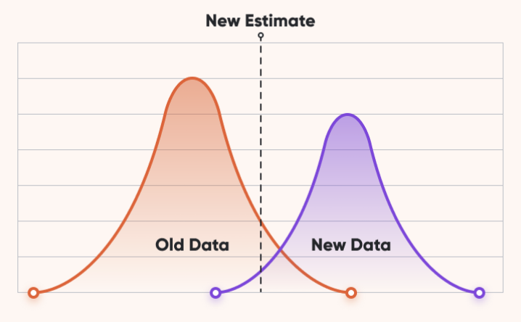
Frequentist vs Bayesian Inference
Bayesian
Probability is interpreted as a measure of subjective degree of belief
Everything is regarded as random
Goal is to quantify and analyze degrees of belief
Larry Wasserman –All of Statistics

Slide 28
Frequentist vs Bayesian Inference
Frequentist
Probability is interpreted as long run frequency.
The goal is to create procedures with long run guarantees.
Procedures are random while parameters are fixed and unknown
Bayesian
Probability is interpreted as a measure of subjective degree of belief
Everything is regarded as random
Goal is to quantify and analyze degrees of belief
Larry Wasserman –All of Statistics

Slide 29
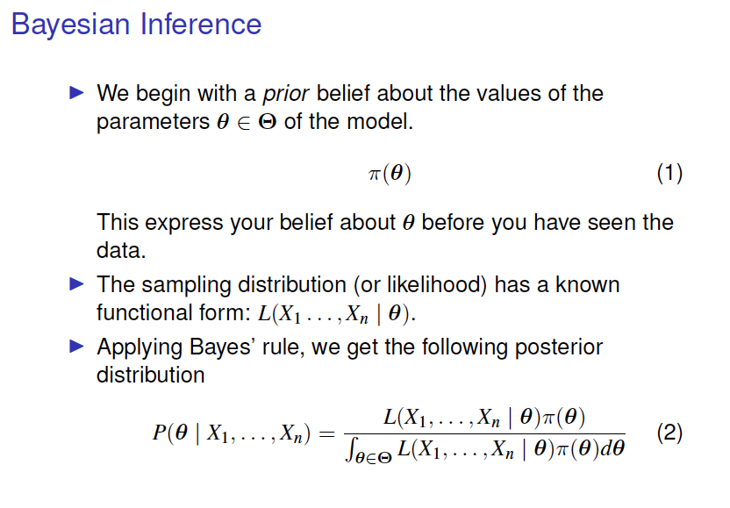

Slide 30
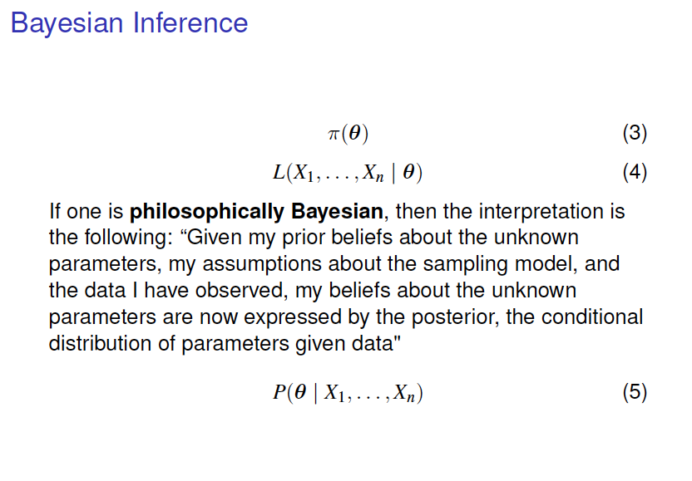

Slide 31
Example: Poisson-Gamma
Suppose your observations are a realization from a Poisson distribution with parameter λ =1
You don’t know that λ =1
You have a prior belief that λ may behave as a Gamma(.1,1)

Slide 32
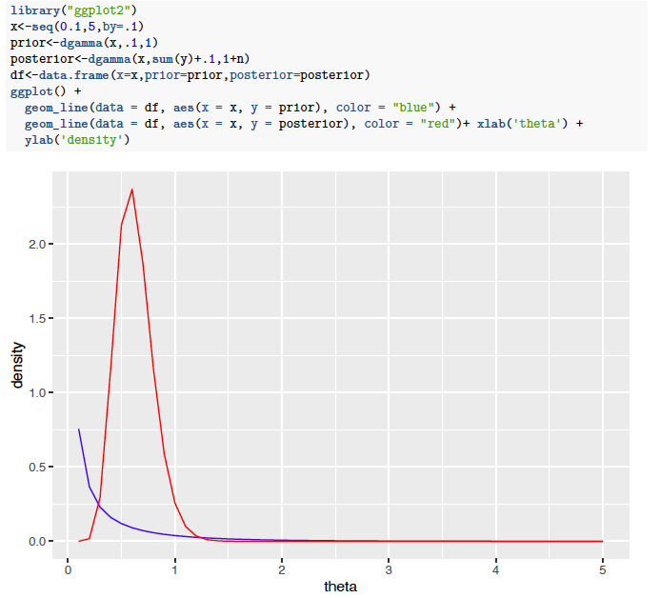
Example: Poisson-Gamma

Slide 33
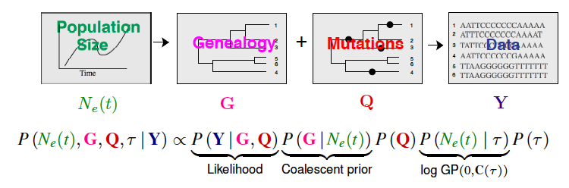
Bayesian Evolutionary Analysis by Sampling Trees
Posterior
Birth-death prior
Piece-wise constant (deterministic)
Parametric prior

Slide 34
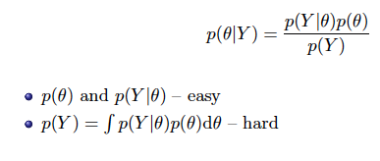
Bayesian Evolutionary Analysis by Sampling Trees
Posterior
Birth-death prior
Piece-wise constant (deterministic)
Parametric prior
Target of interest:

Slide 35
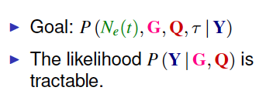
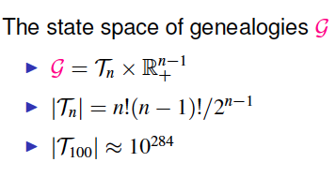

Bayesian Evolutionary Analysis by Sampling Trees

Slide 36
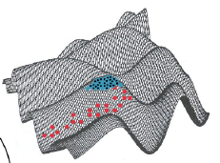
Markov Chain Monte Carlo
Algorithm generates a Markov chain that visits parameter values( e.g. a specific tree) with frequency equal to their posterior density/probability.
A Markov chain: a random walk where the next step only depends on the current parameter state
Marc Suchard – Past SISMID

Slide 37
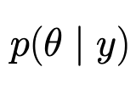
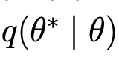

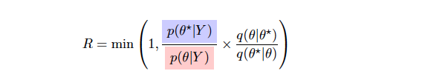
Metropolis-Hastings Algorithm
Key idea: Find a reversible transition matrix P whose stationary distribution is your target distribution.
Assume your target distribution is
At each step we sample a new state from an arbitrary proposal distribution
The transition i is accepted with probability:
Otherwise stay in the current state

Slide 38

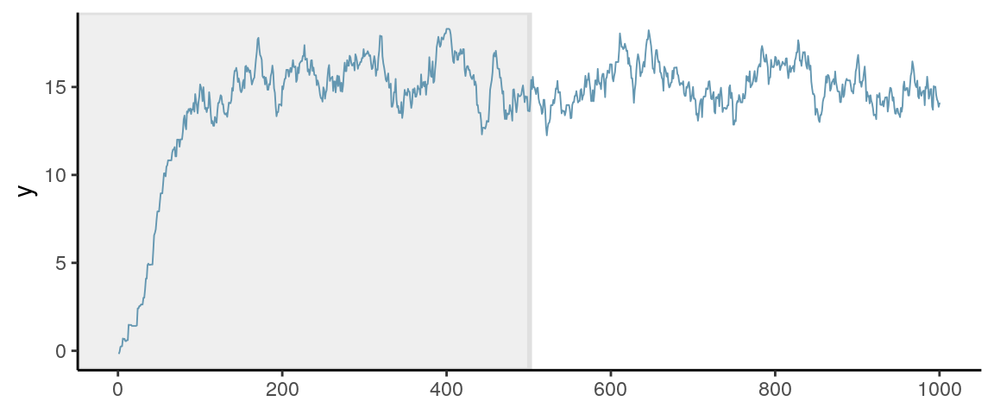
Metropolis-Hastings Algorithm
We repeat the process of proposing a new state, evaluating acceptance probability and either accept or reject a move millions of times.
Although correlated, the Markov chain samples are valid draws from the posterior; however …
Initial sampling (burn-in) is often discarded due to correlation with initial state

Slide 39
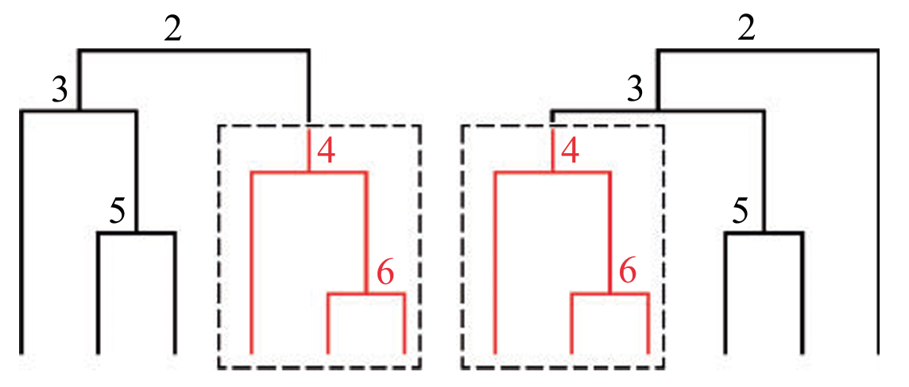
Example of transition kernels

Slide 40
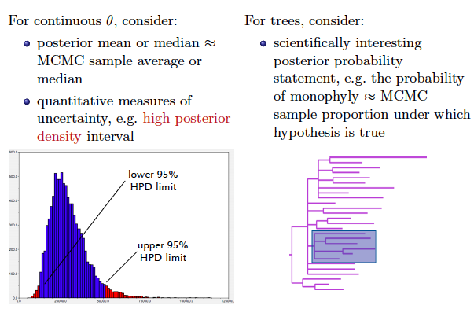
Posterior summaries

Slide 41
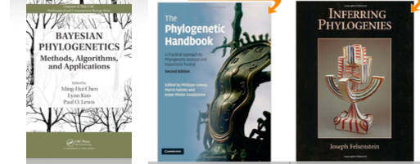
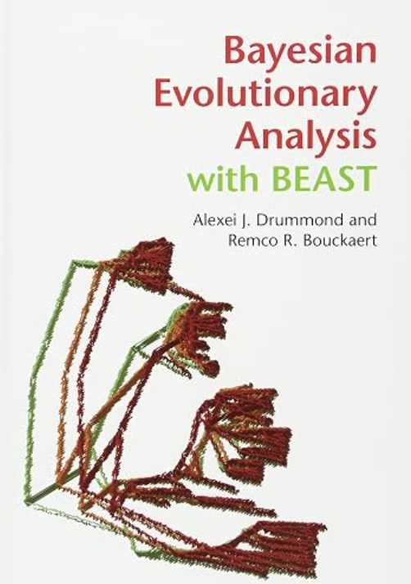
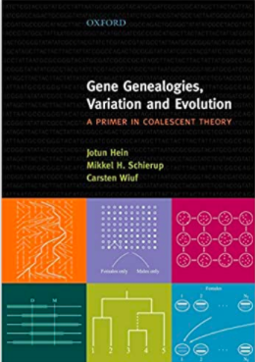



Book references

Slide 42


Recent review papers

Slide 43

Examples…

Slide 44
Questions?

Slide 45

Questions?

