Slide 1
Tracking the evolution of pathogens over time
Site and clock models in phylogenetics

Slide 2
The spread of pathogens between hosts over time can be described using a phylogenetic tree.

Slide 3
When pathogens are replicated, random errors occur, some of which will rise to fixation.

Slide 4
We can access some of this information by sequencing pathogens at the “tips” of phylogenetic trees.

Slide 5
This results in the data we typically have, i.e. a sequence alignment and the information when a sequence was isolated from a patient.

Slide 6
Evolutionary models allow us to get from sequence alignments and sampling times to phylogenetic trees.

Slide 8
Site models describe the relative change across nucleotides and positions in the alignment and consist of several parts.
Substitution models describe how fast/slow the change from one to another nucleotide happens compared to others
Gamma rate heterogeneity models describe how fast/slow some sites in an alignment change bases compared to others
Codon positions models allow for some codon positions to evolve faster/slower than others

Slide 9
Substitution models allow to account for differences in nucleotide substitution rates.
Rate Matrix
Base Frequencies
b
A
G
f
π_{A} + π_{C} + π_{G} + π_{T} = 1
d
c
C
T
e
JC
a=b=c=d=e=f
π_{A}=π_{C}=π_{G}=π_{T}
No I or G
0 free parameters
HKY
a=c=d=f, b=e
π_{A}, π_{C}, π_{G}, π_{T}
No I or G
4 free parameters
GTR
a, b, c, d, e, f
π_{A}, π_{C}, π_{G}, π_{T}
No I or G
8 free parameters
(slide from Sebastian Duchene)

Slide 10
Some site in the alignment might be more flexible and therefore evolve less quickly.
CTAT--GGCACCCAGCCCATGCAT-GGT
CTAA--GGCAACCAGCCCATACAT-GCT
CTATGTGGCAACCAGCCCATGCAT-GCT
ATATGTGGCAGCCAG-----GCATAGGT
ATATGTGGCAGCCAGCCCATGCATAGGT
Medium
Slow
Fast
(slide from Sebastian Duchene)

Slide 11
Proportion of invariable sites account for sites that do not change (e.g., HKY+I).
1
Proportion of sites
1-P_{inv}
P_{inv}
0
Rate
(slide from Sebastian Duchene)

Slide 12
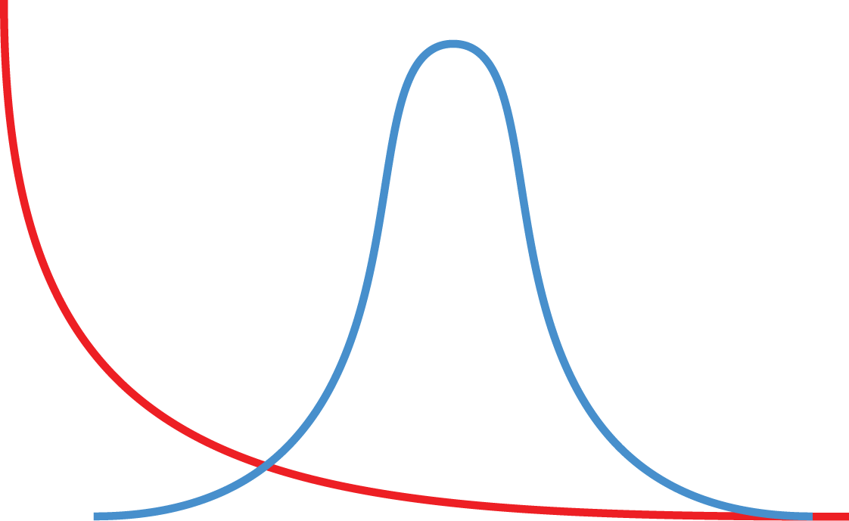
Gamma rate heterogeneity models account for rate differences across sites (e.g. HKY+G₄).
alpha=0.5
alpha=100
Proportion of sites
0
(slide from Sebastian Duchene)

Slide 13
Changes in the third codon position are far more likely to not affect the amino acid
Splitting up the alignment into different codon positions and allow each having its own site model allows accounting for these differences
https://www.genomenon.com/codon-chart/

Slide 14
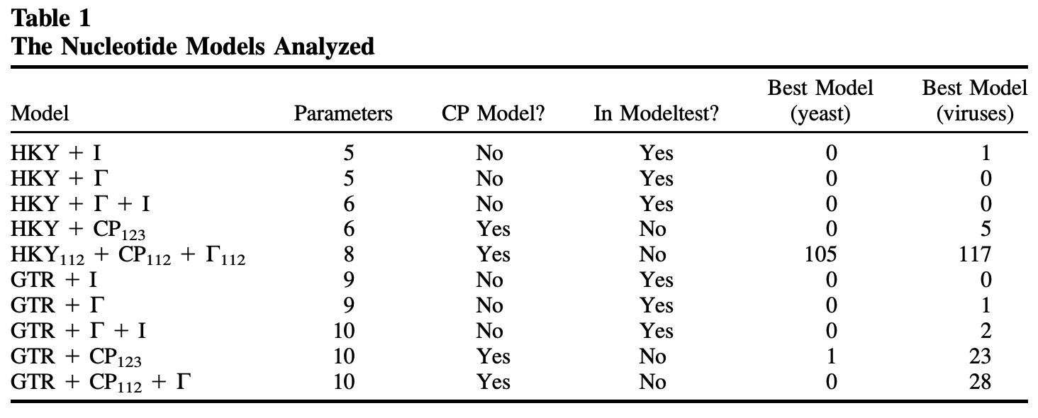
Accounting for rate variation between codon positions is almost always better
Shapiro et al., 2006, MBE

Slide 15
Practical considerations
Everything affects everything in Bayesian phylogenetics. Wrong evolutionary models lead to wrong trees lead to wrong population parameters.
Overparameterization is better than under-parameterization. In doubt, use the more complex site model, such as a GTR+ model (Abadi et al., 2019, Nat. comm.)
Never forget to account for rate heterogeneity (experience). Also, the JC69 model is hardly ever appropriate.

Slide 16
QUESTIONS?

Slide 17
The molecular clock

Slide 18
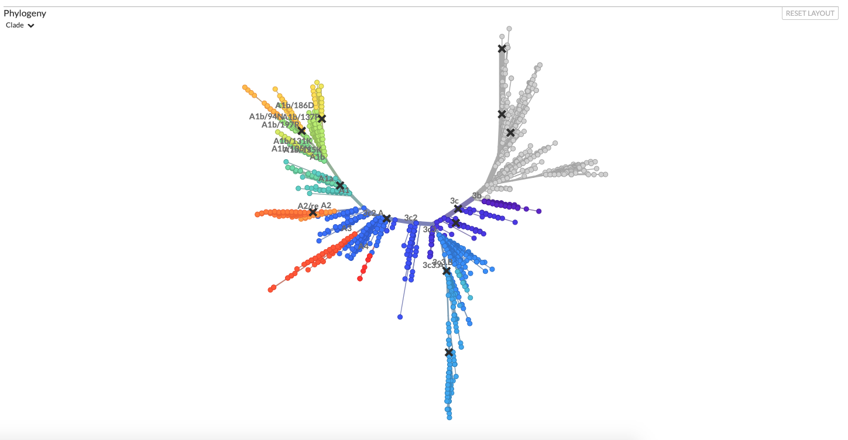
Using site models, we can get from alignments to divergence trees
nextstrain.com

Slide 19
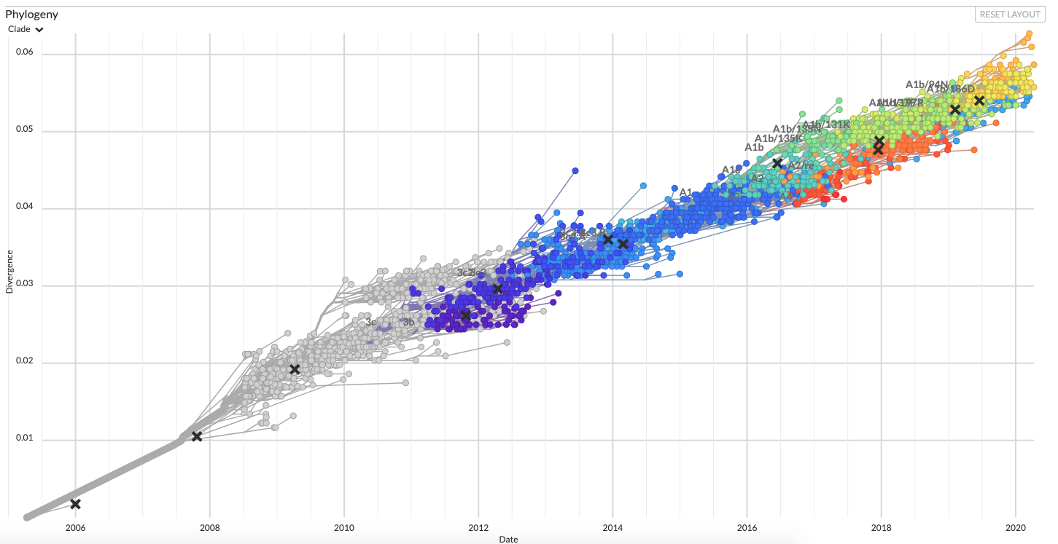
Sequences that are further apart in time are more diverged
nextstrain.com

Slide 20
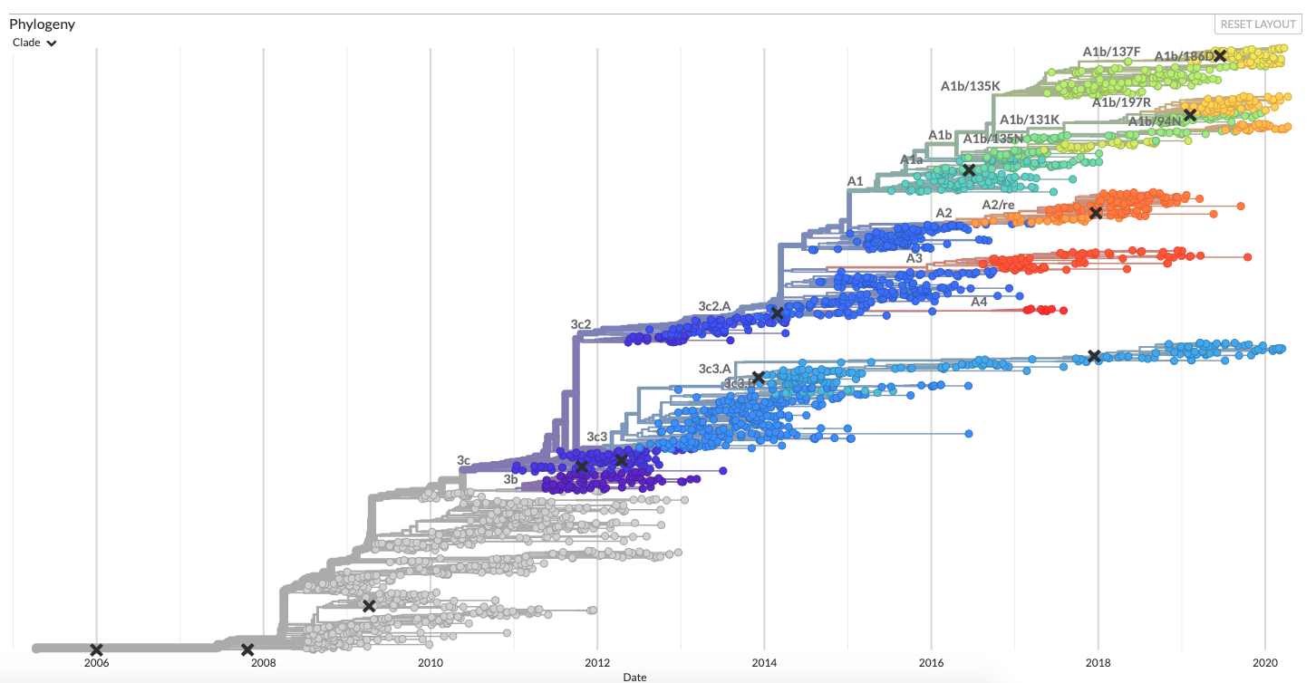
Molecular clocks bring us from divergence trees to time trees
nextstrain.com

Slide 21
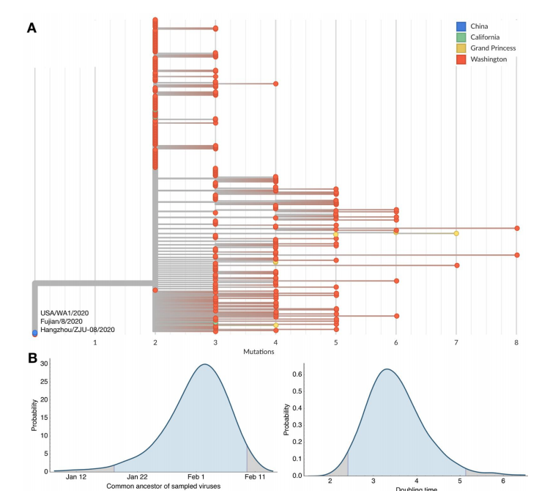
Evolutionary models can be used to estimate common ancestor times
Bedford et al., 2020, BioRxiv

Slide 22
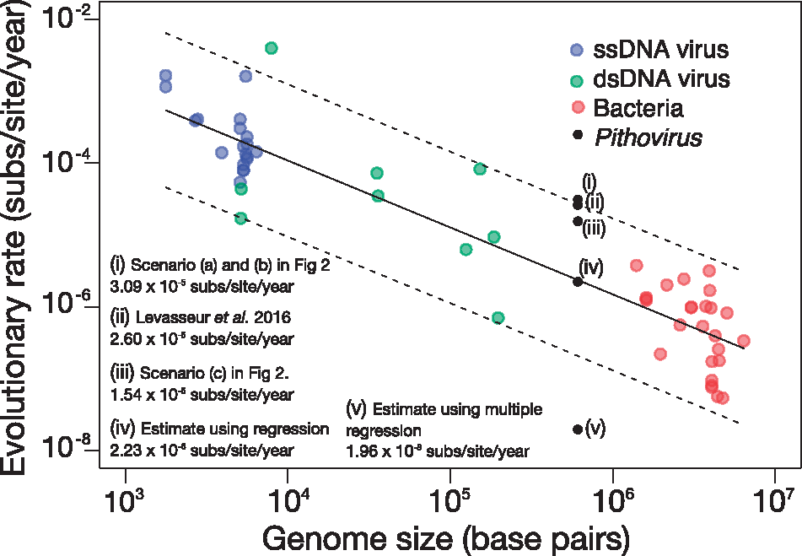
Different organisms have vastly different rates of evolution
Duchene et al., 2018, Vir. Evol.

Slide 23
Mathematically clock models are functions that have divergence as input and time as output
Strict clock models assume that evolution happens equally fast on each branch of a tree. Strict clocks are mostly used to study pathogens over rather short times (a few years)
Random clock models allow different branches of a phylogenetic tree to have different rates (speed) of evolution. These are more prevalent when analyzing datasets that were sampled over longer time periods

Slide 24



Mathematically clock models are functions that have divergence as input and time as output
Strict Clock:
All Branches evolve equally fast.
Local Clock:
Speed of evolution can change at estimated points in time.
Uncorrelated Clock:
Each branch evolves at a speed that is a random draw from a distribution.

Slide 25
What is my clock rate? (from Holmes et al. 2016
Mutation rate (short term, faster): Error rate in replication.
Substitution rate (long term, slower): Long term rate of evolution.
Evolutionary rate (=clock rate): Measured rate of change. Result of mutation rate and population processes, such as selection. Typically sits between the mutation and substitution rate (The notation in BEAST is confusing with regards to what is what).

Slide 26
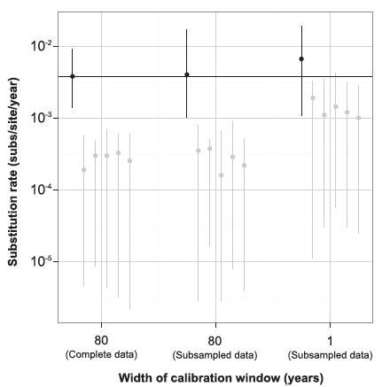
Is there enough signal to estimate evolutionary rates? Tip Randomization
Duchene et al., 2015a, MBE

Slide 27
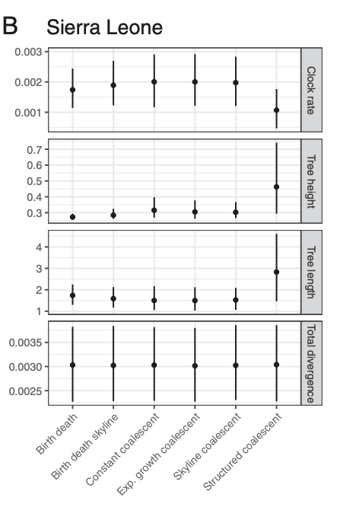
Model choices not directly related to clock models can impact rate estimates
Möller et al., 2018, PNAS

Slide 28
Some reading material
Accounting for codon positions: https://doi.org/10.1093/molbev/msj021
Overfitting site models is ok: https://www.nature.com/articles/s41467-019-08822-w
Posterior predictive simulations to evaluate clock signal: https://academic.oup.com/mbe/article/32/11/2986/981260
Time randomization to evaluate clock signal: https://academic.oup.com/mbe/article/32/7/1895/1016979
Rates of evolution in EBOV: https://www.nature.com/articles/nature19790

