Slide 1

Tree Priors
Instructor: Julia A. Palacios

Slide 2
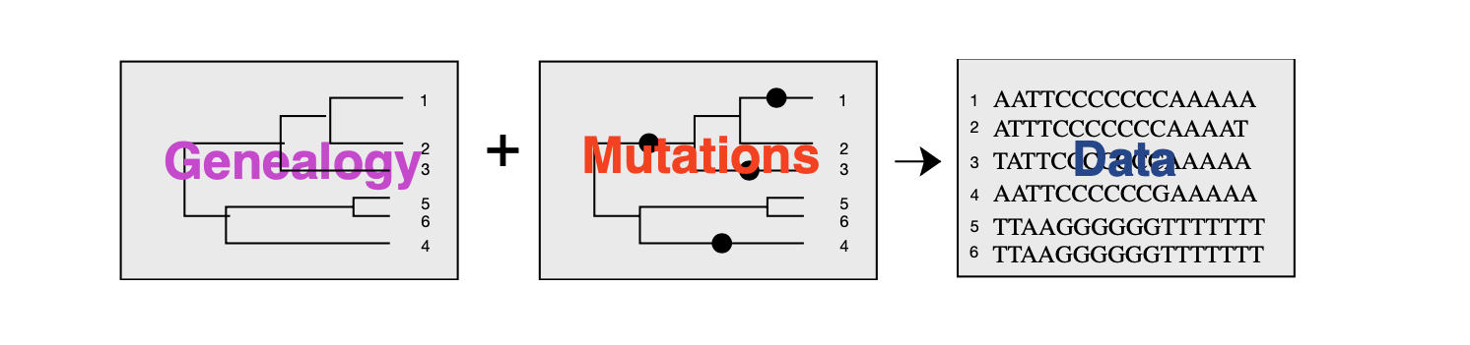
Phylodynamic model:
Phylodynamic
Parameters
Notes:
In what follows, I will focus on this part of the model

Slide 3
The aim is to infer phylodynamic parameters
Phylodynamic
Parameters
Phylodynamic parameters:
Effective population size and epidemiological parameters
Notes:
In what follows, I will focus on this part of the model

Slide 4
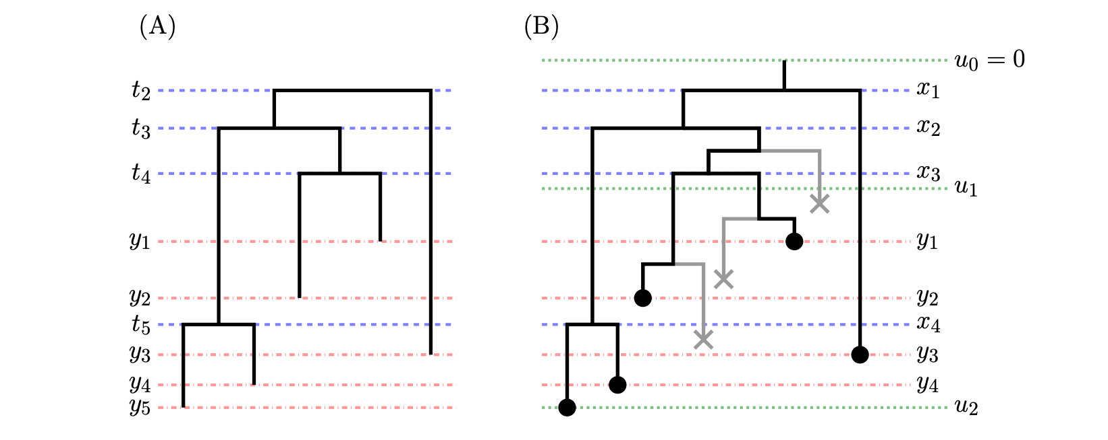
Phylodynamic models
Coalescent process (CP)
Birth-death-sampling process (BDSP)
Kingman, 1982
Rodrigo and Felsenstein, 1999
Stadler and Bonhoeffer, 2013
Notes:
There are two modeling frameworks commonly used in phylodynamics.

Slide 5
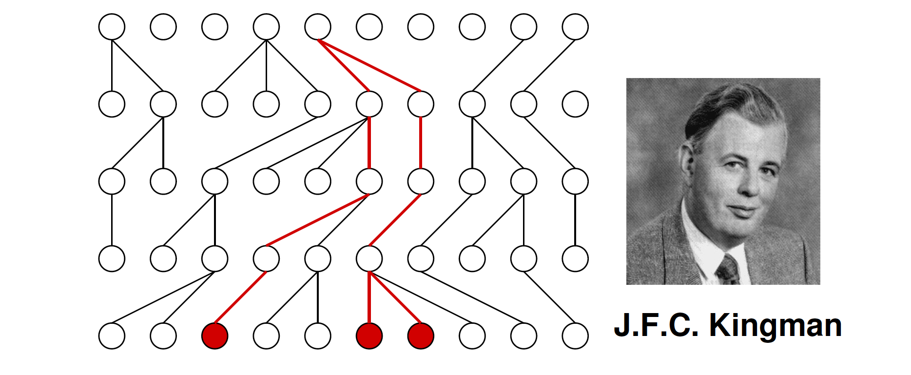
Kingman’s discrete-time coalescent

Slide 6
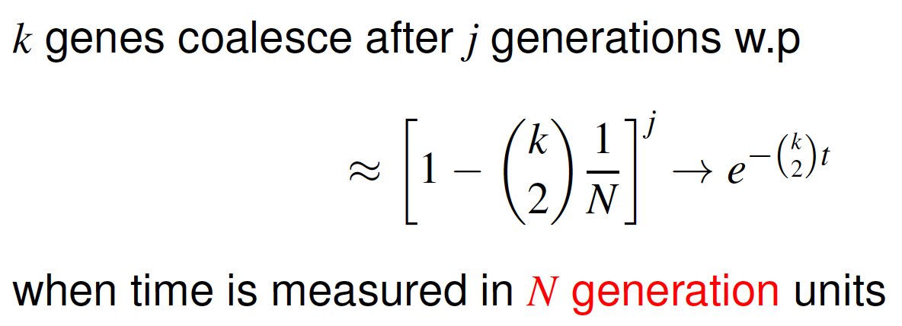
Kingman’s discrete-time coalescent

Slide 7
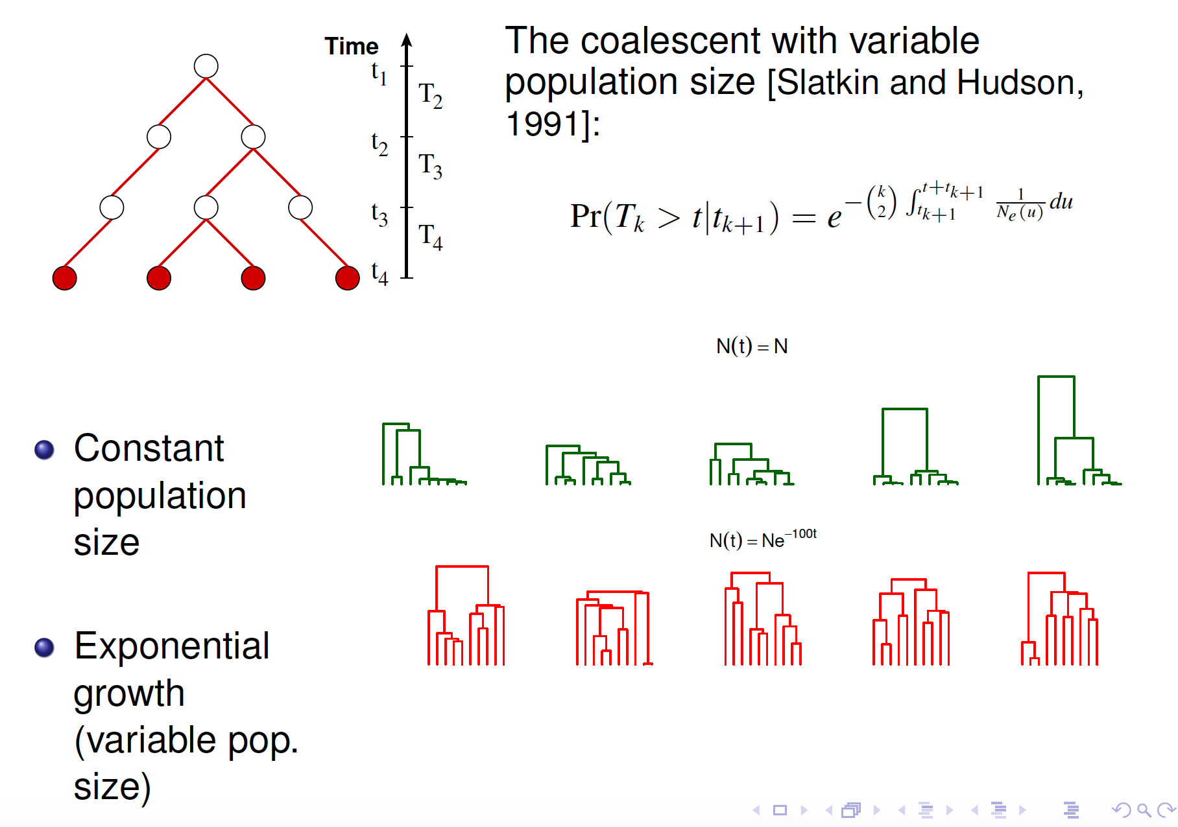
Coalescent with variable population size

Slide 8
Coalescent with variable population size

Slide 9
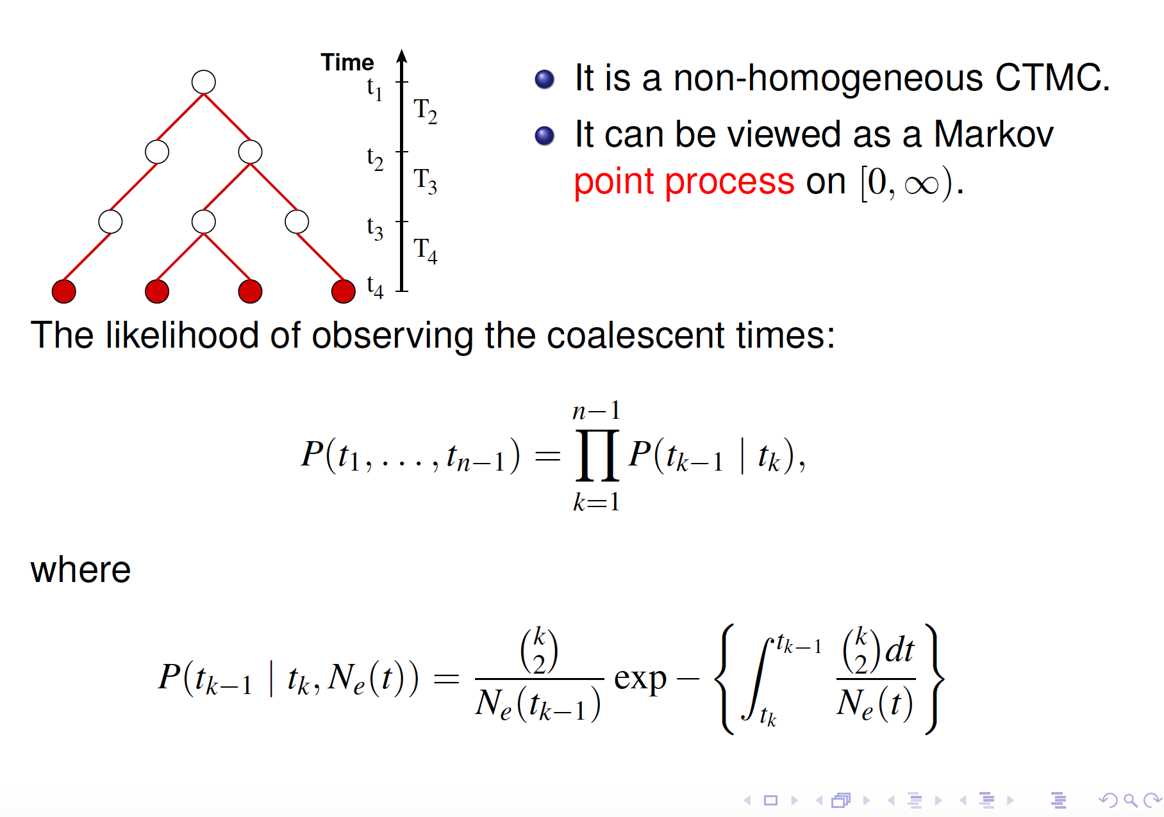
Coalescent with variable population size

Slide 10
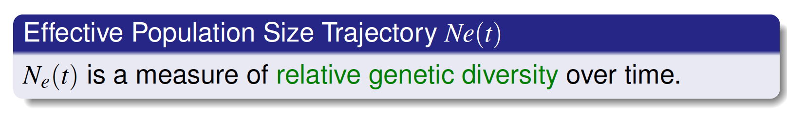
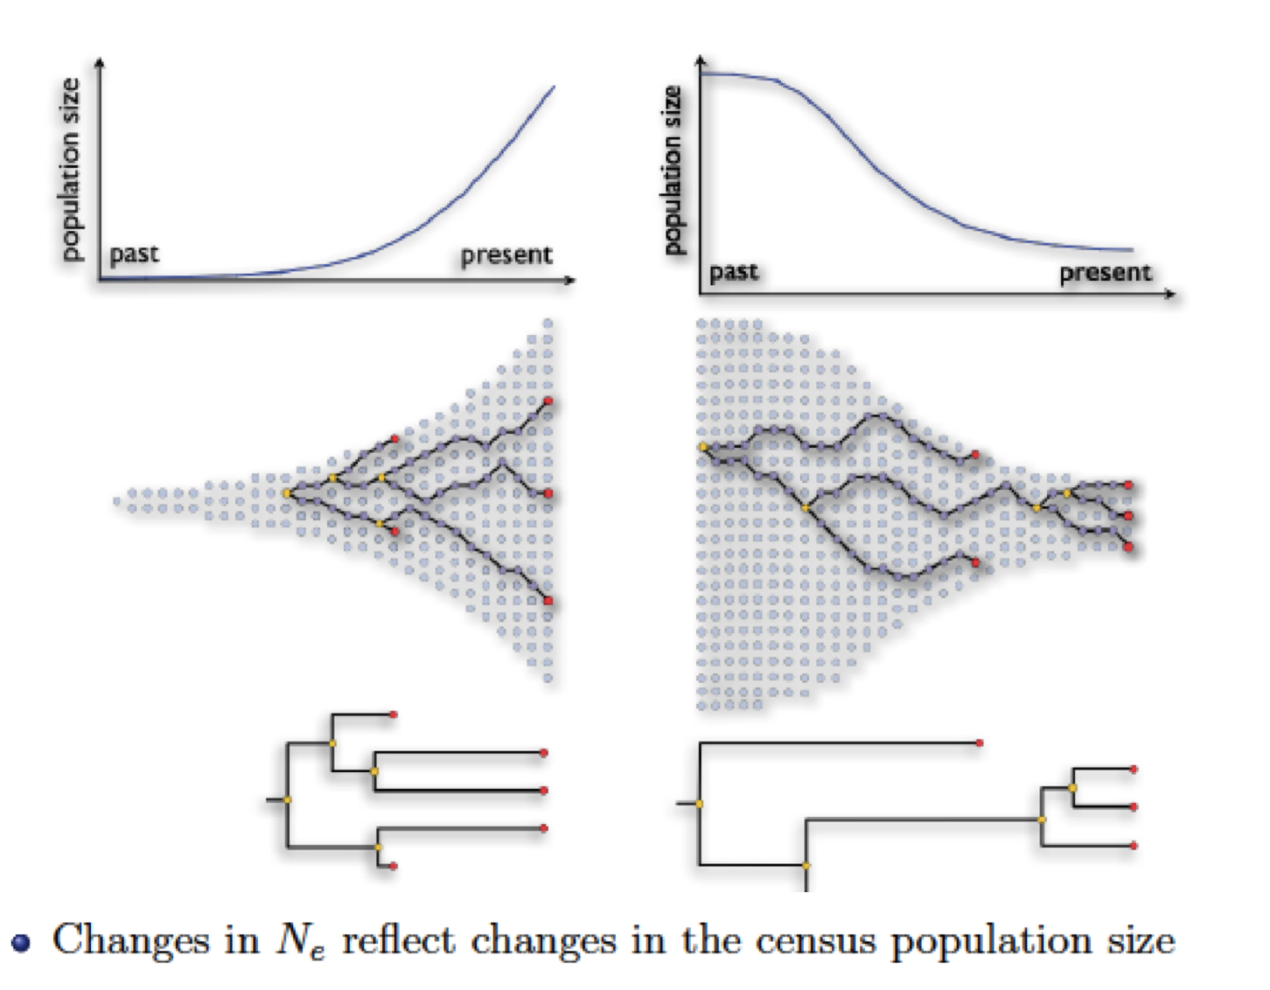
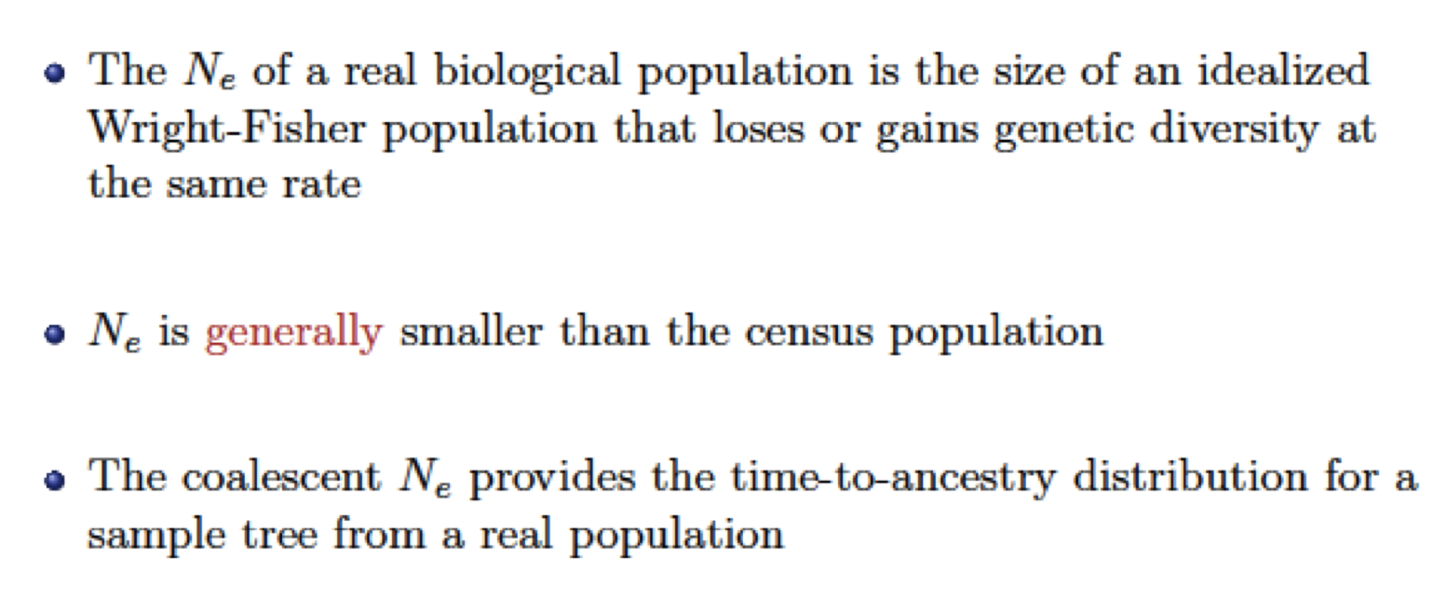
Coalescent models
The shape of the phylogeny depends on the effective population size Ne(t).

Slide 11
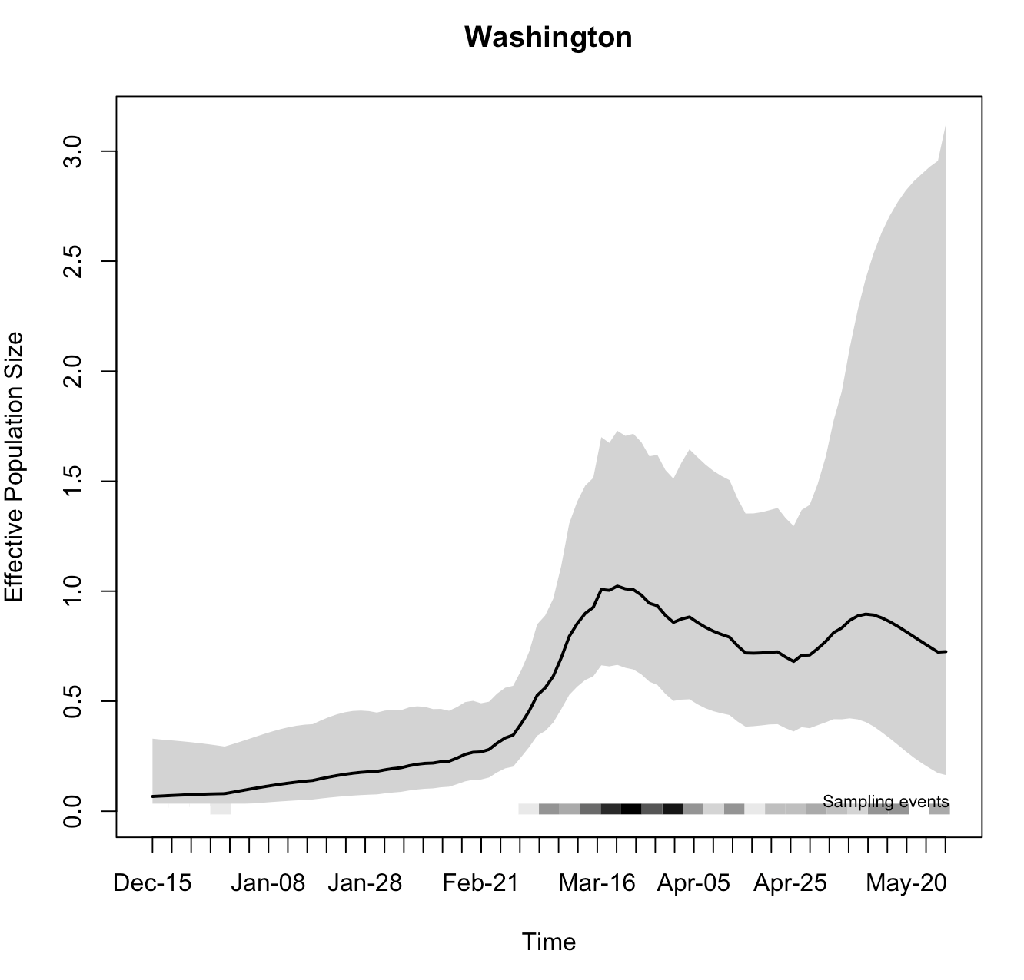
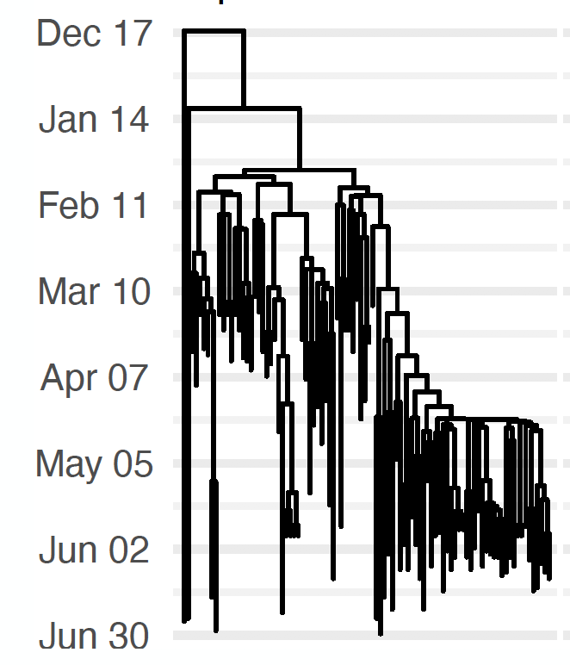
Coalescent model applied to SARS-CoV-2
SARS-CoV-2 in Washington State in 2020
Effective Population Size
Notes:
The heatmaps show the intensity of. the sampling times
But what is the interpretation of the effective population size?

Slide 12
Tree priors
Phylodynamic
Parameters
Coalescent prior
Priors on Ne(t)
Notes:
In what follows, I will focus on this part of the model

Slide 13
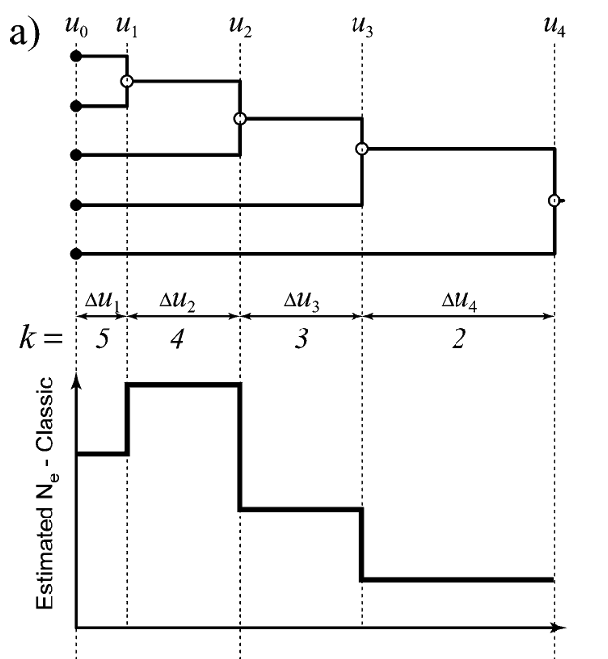

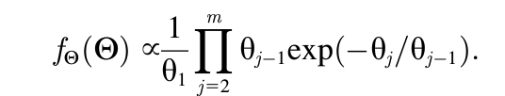
Bayesian skyline plot (BEAST, BEAST 2)
Equivalent to estimating exponential mean from
one observation.
Notes:
In what follows, I will focus on this part of the model

Slide 14
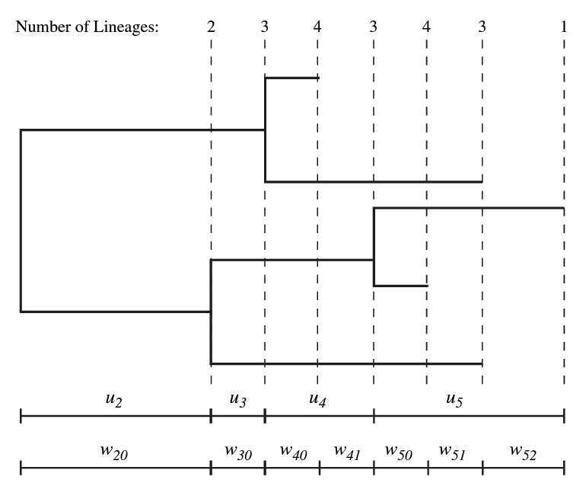

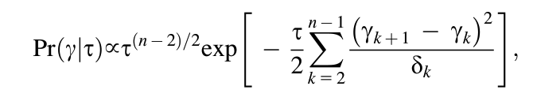
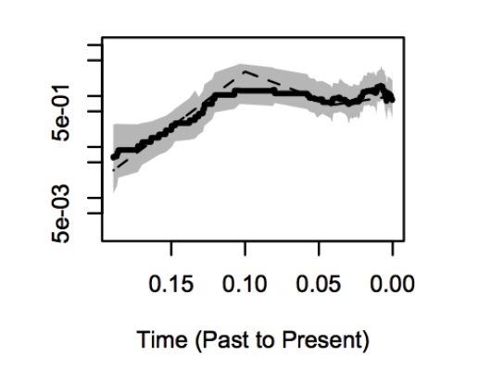
Bayesian skyride and Bayesian skygrid (BEAST)
Places a log- GMRF prior with precision τ.
Fast implementation for fixed genealogy using INLA is available in the R package:
https://github.com/Juliapalacios/phylodyn
Notes:
In what follows, I will focus on this part of the model

Slide 15
Preferential sampling (BEAST)
Sequences available in Gisaid
2020

Slide 16
Preferential sampling
Poisson process with rate proportional to Ne(t)
x
x
x
x
x

Slide 17
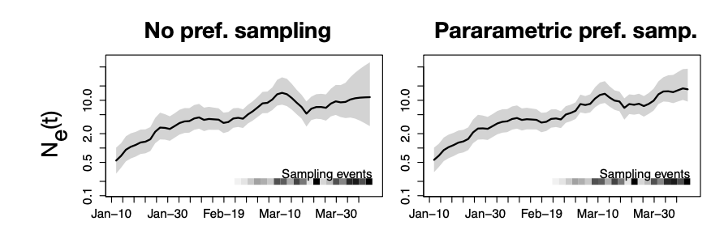
Covid In Santa Clara county. Accounting for PS decreases uncertainty
Cappello and Palacios, JCGS 2021

Slide 18
Tree priors
Phylodynamic
Parameters
Coalescent prior
Extension with SIR
Birth-Death models
Notes:
In what follows, I will focus on this part of the model

Slide 19
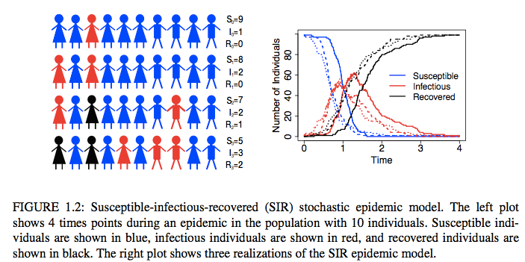
Interpretation of effective population size
Volz et al, 2009
Notes:
We will start by assuming the following population dynamics – We divde the population into compartments into susceptible, infected and recovered. Infections occurs at rate beta(t) per individual and recovers at rate gamma(t). We then pick a sample at random from the infected population at time 0 and trace back their ancestry

Slide 20
Interpretation of effective population size
Volz et al, 2009

Slide 21
Interpretation of effective population size
Volz et al, 2009
Notes:
Then the probability that at time t a transmission corresponds to a transition ancestral to the sample is

Slide 22
Interpretation of effective population size
Volz et al, 2009

Slide 23
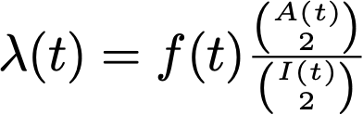
Interpretation of effective population size
Volz et al, 2009

Slide 24
Interpretation of effective population size
Volz et al, 2009

Slide 25

Interpretation of effective population size
Volz et al, 2009

Slide 26

Interpretation of effective population size
Volz et al, 2009

Slide 27

Interpretation of effective population size
Volz et al, 2009

Slide 28
Interpretation of effective population size
Volz et al, 2009

Slide 29

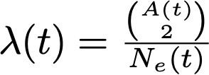

Interpretation of effective population size
In standard coalescent model:
Volz et al, 2009

Slide 30
Tree priors
Phylodynamic
Parameters
Coalescent prior
Extension with SIR
Birth-Death models
Notes:
In what follows, I will focus on this part of the model

