Slide 1
Dataset preparation and other approaches
Nicola F. Müller
e-mail: nicola.mueller@ucsf.edu

Slide 2
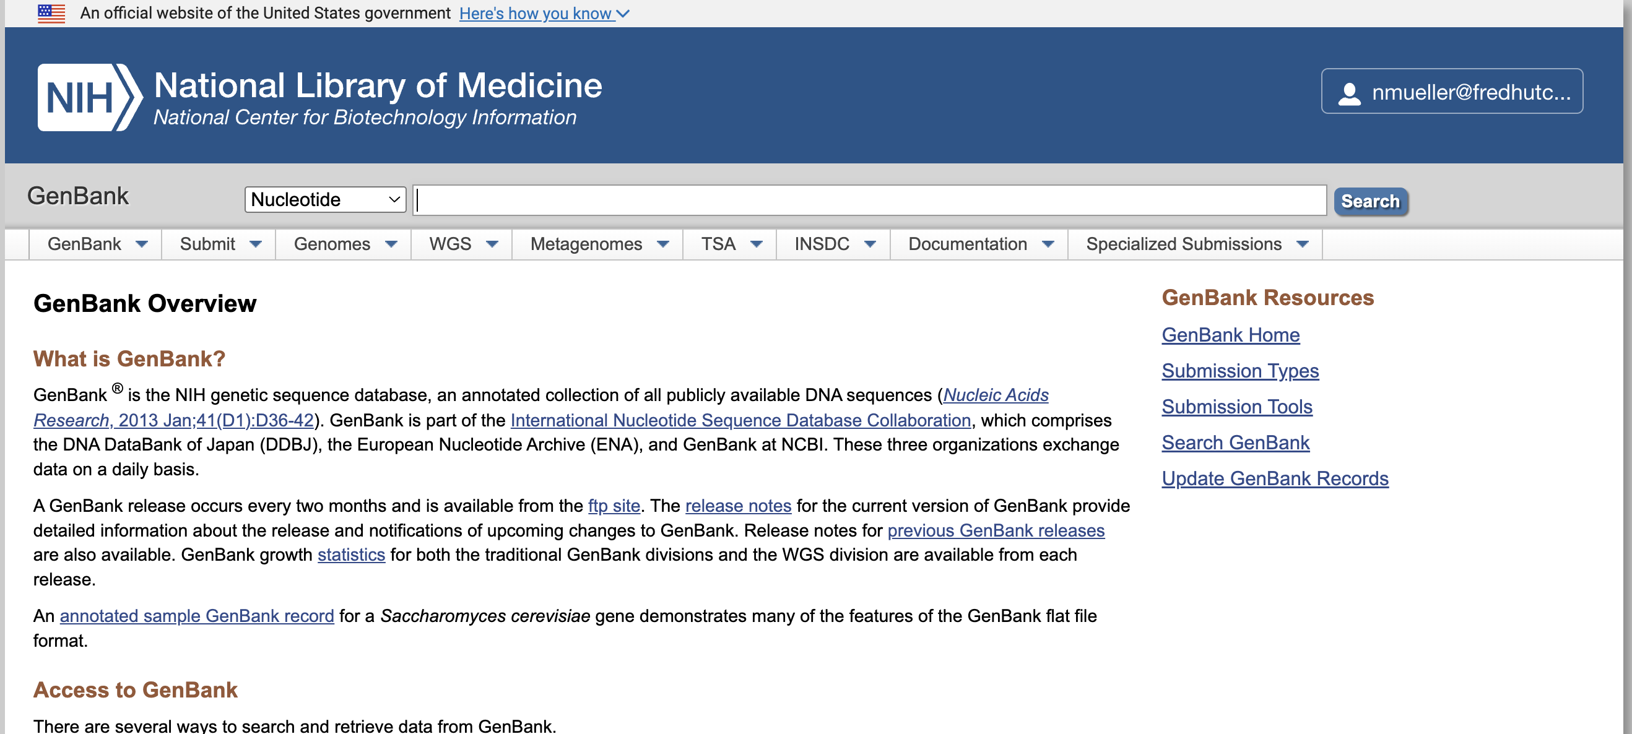
Genbank

Slide 3
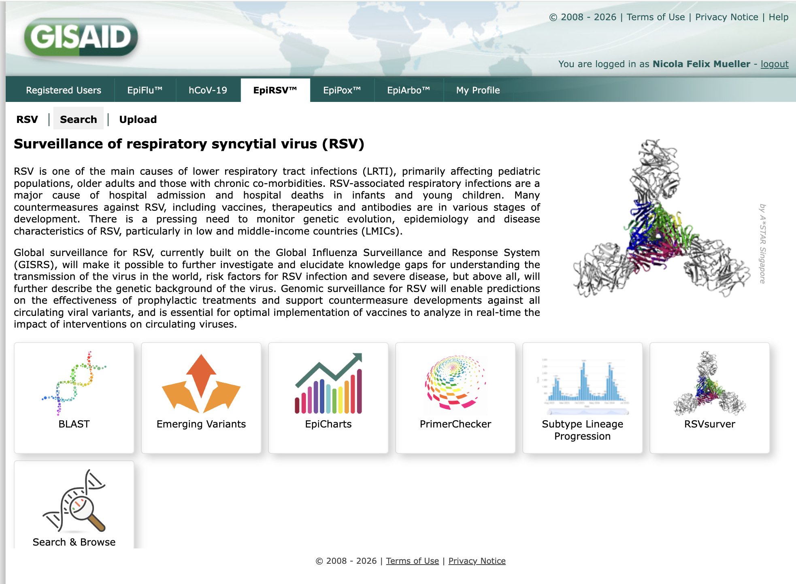
Gisaid

Slide 4
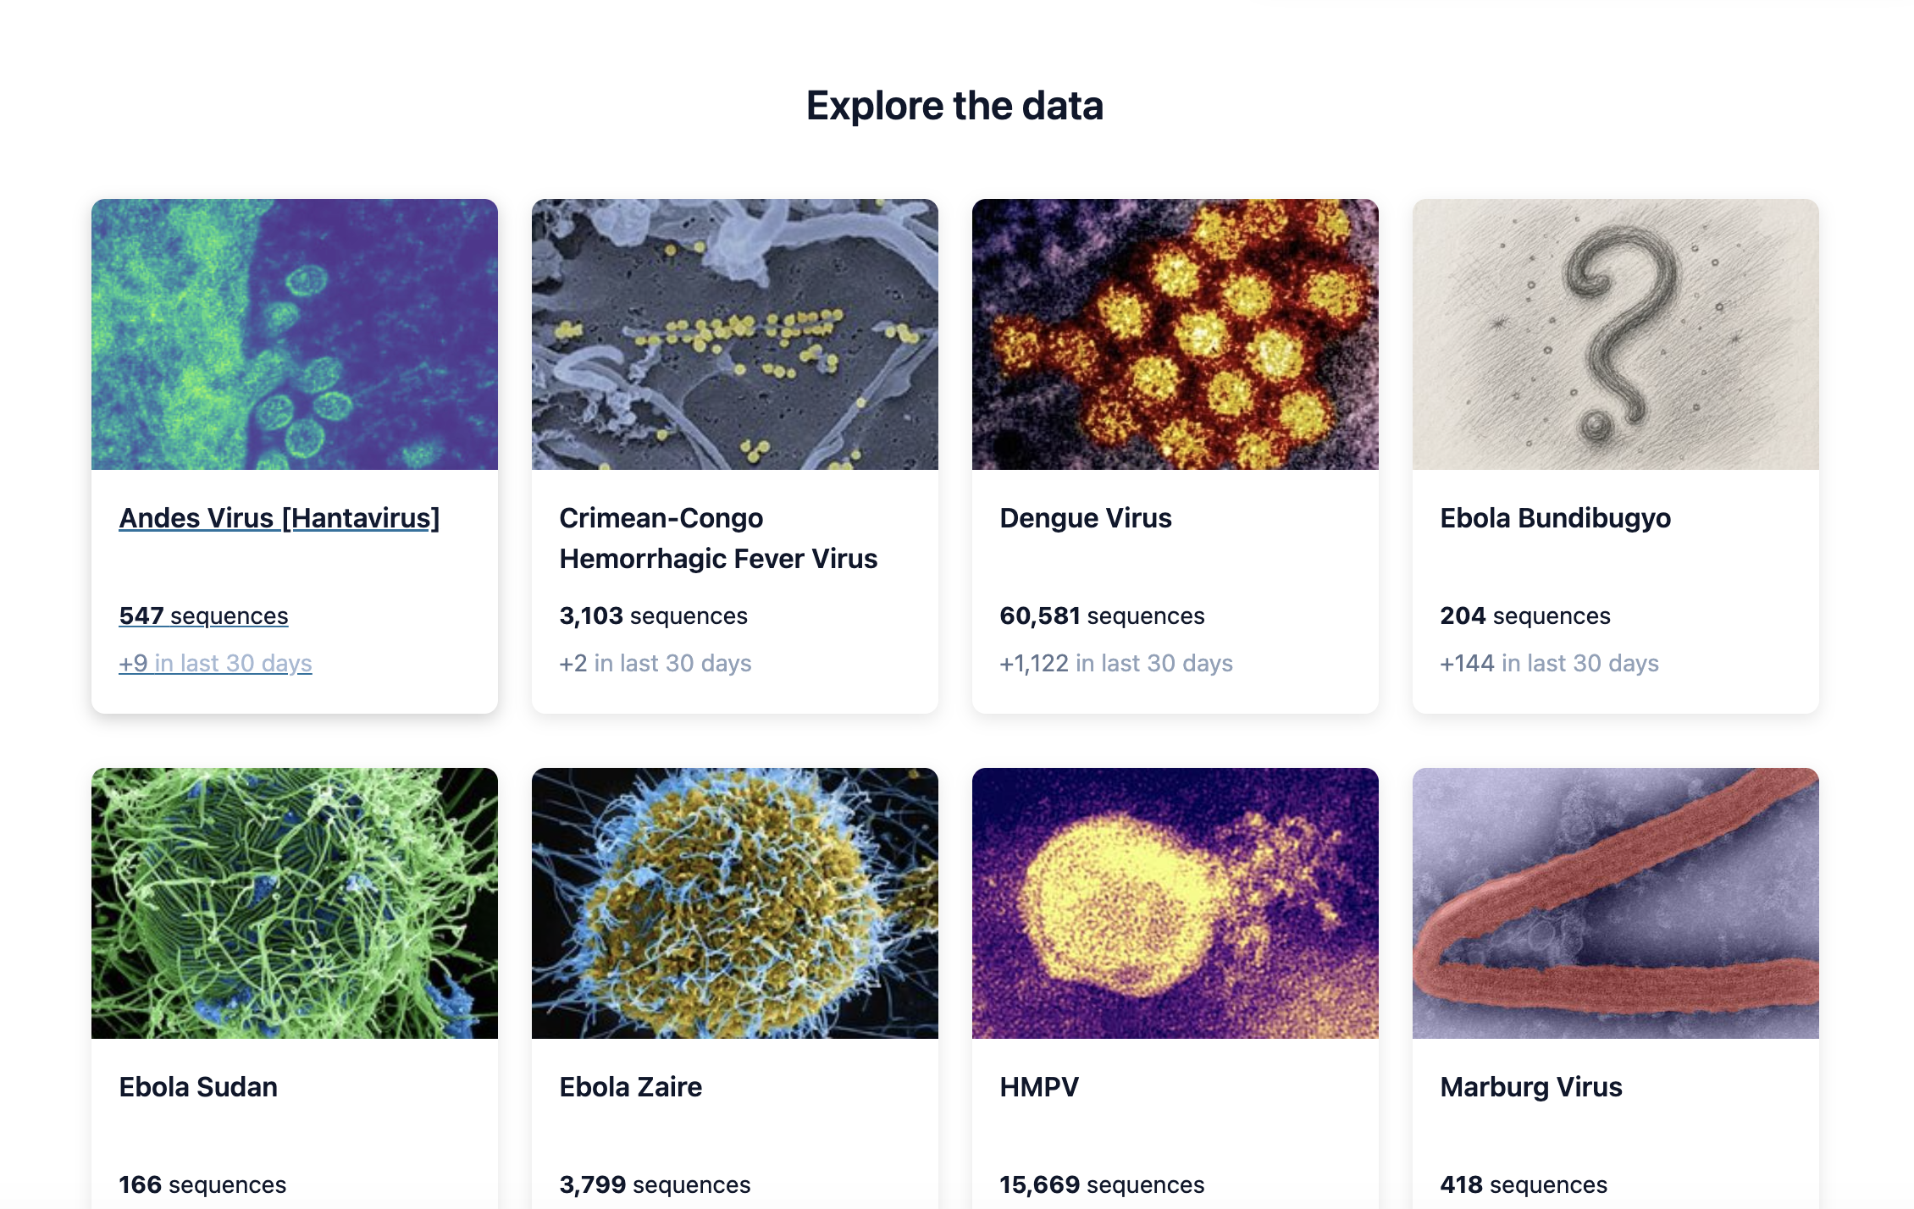
Pathoplexus

Slide 5
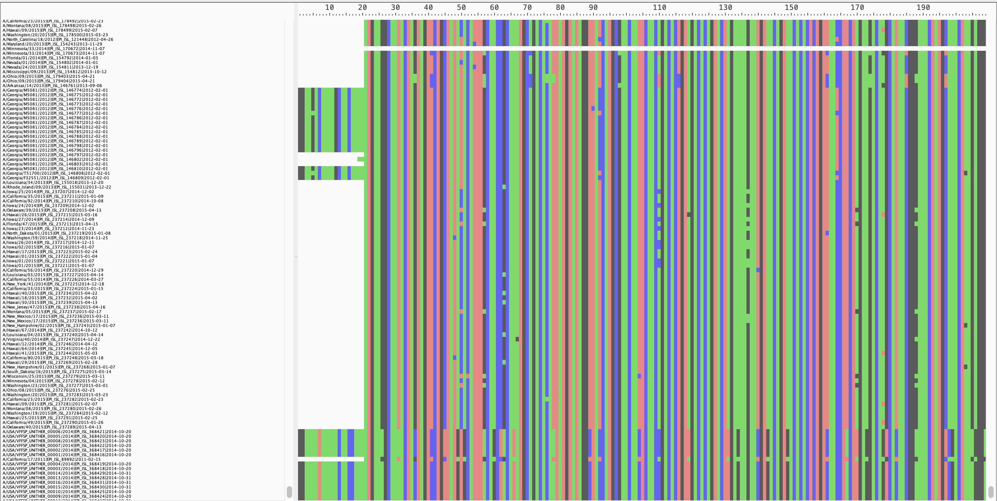
Alignment for viruses is often simple, but requires checking them nonetheless

Slide 6
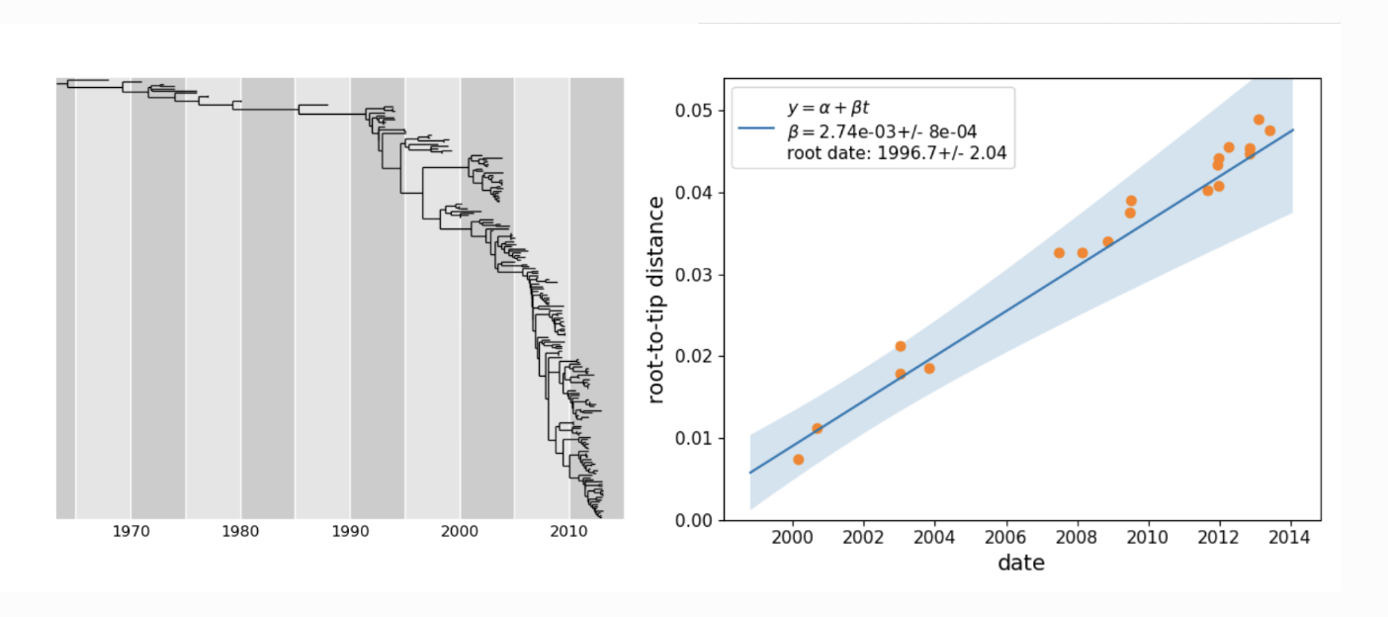
TreeTime for outlier detection

Slide 7
Subsampling approaches are driven by the question you seek to answer and computational limitations
If you want to use birth death models, they assume constant sampling rate -> proportional sampling
If you want to use coalescent models, you may want equal information over time -> equal sampling over time
Structured models benefit from good representation over time

Slide 8
Even subsampling across time and space
Group isolates into locations, select an even number of samples per location
Within each location, to get even sampling, group isolates into months
Randomly select a year and month
Choose one sample within that year and month
Repeat until you have your desired dataset size

Slide 9
Alternative Approaches
Parsimony
Maximum Likelihood
Bayesian phylodynamics with mutation annotated trees

Slide 10
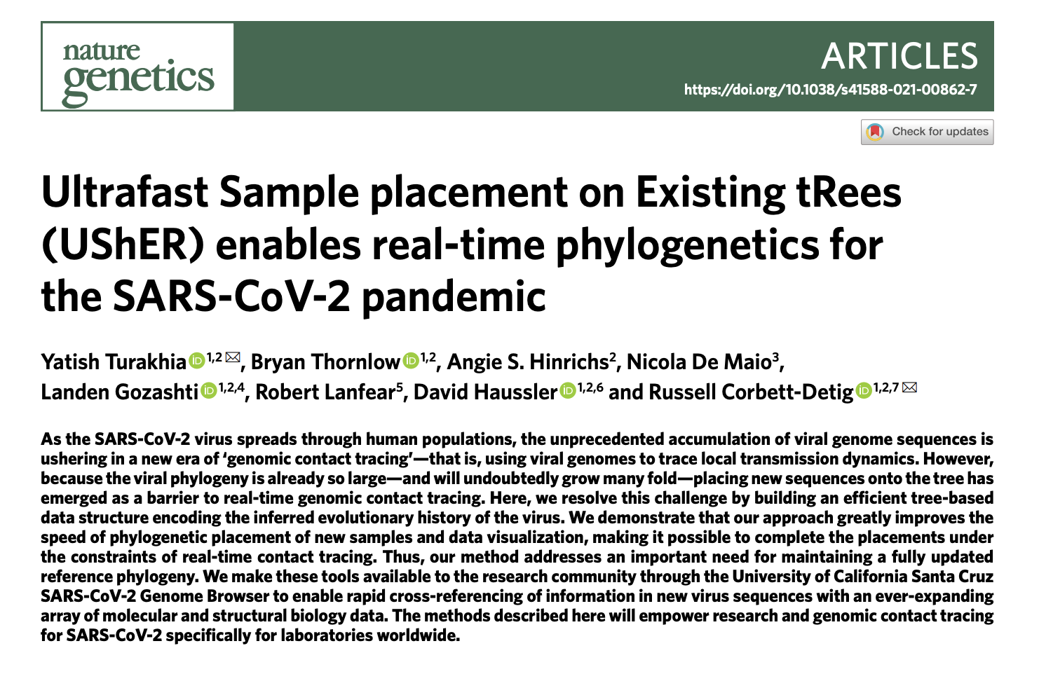
Parsimony

Slide 11
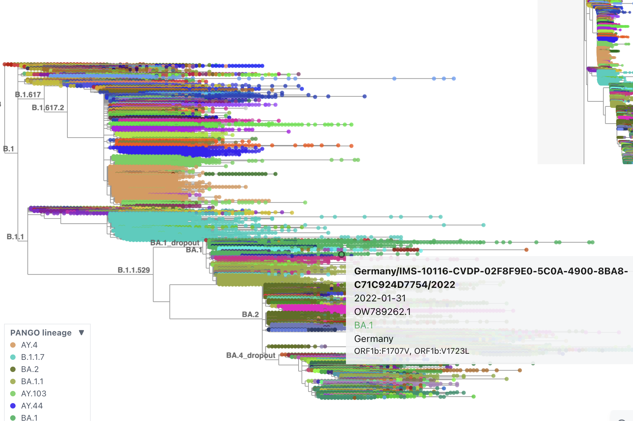
https://taxonium.org/

Slide 12
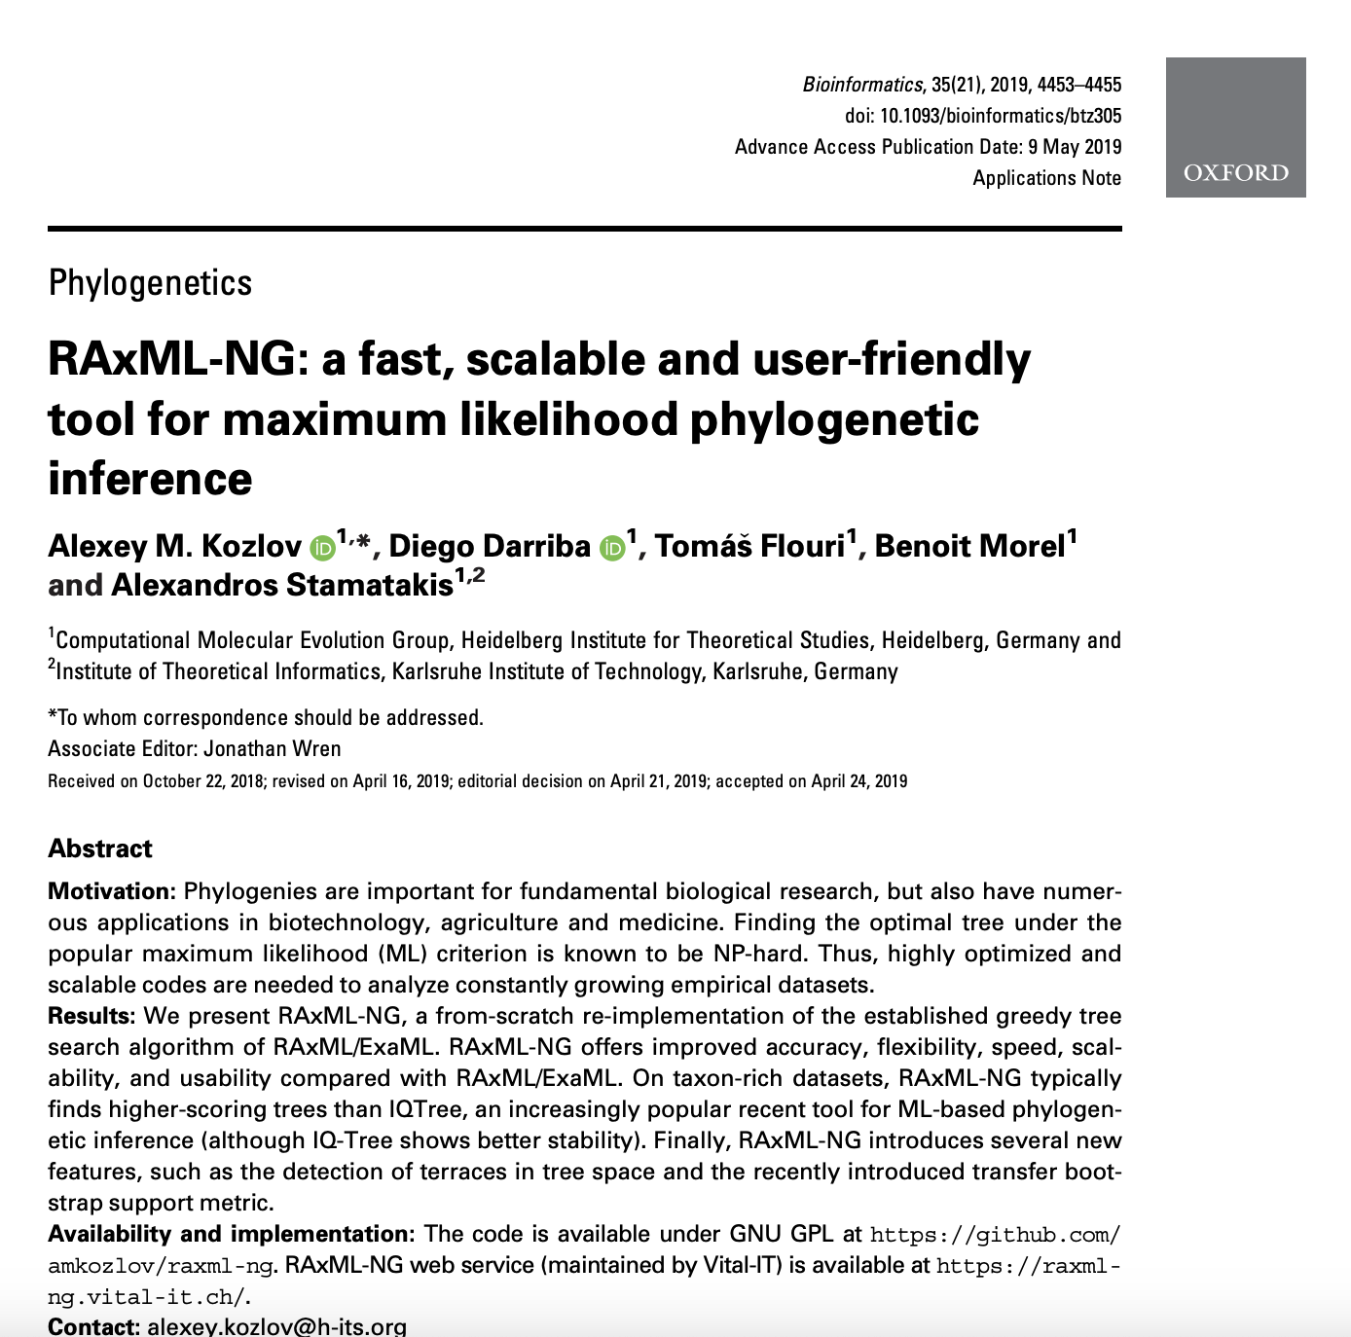
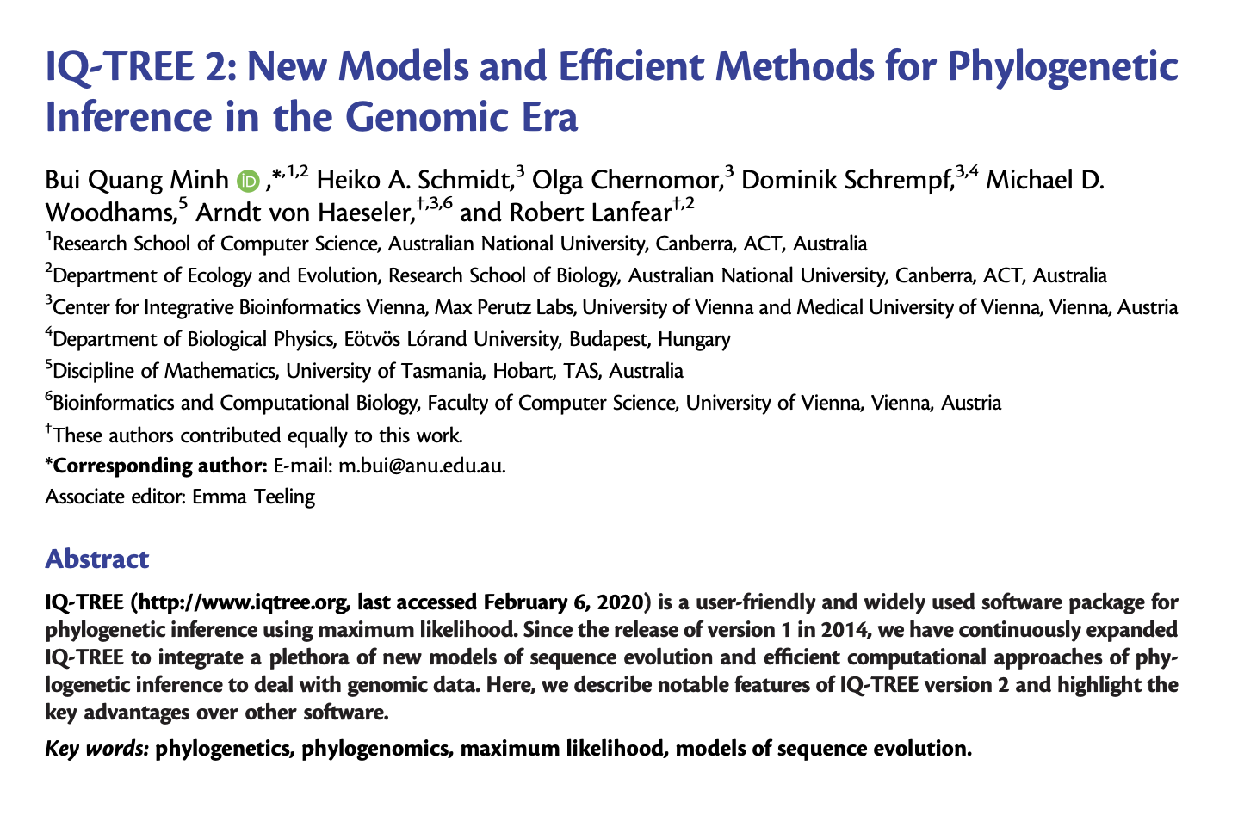
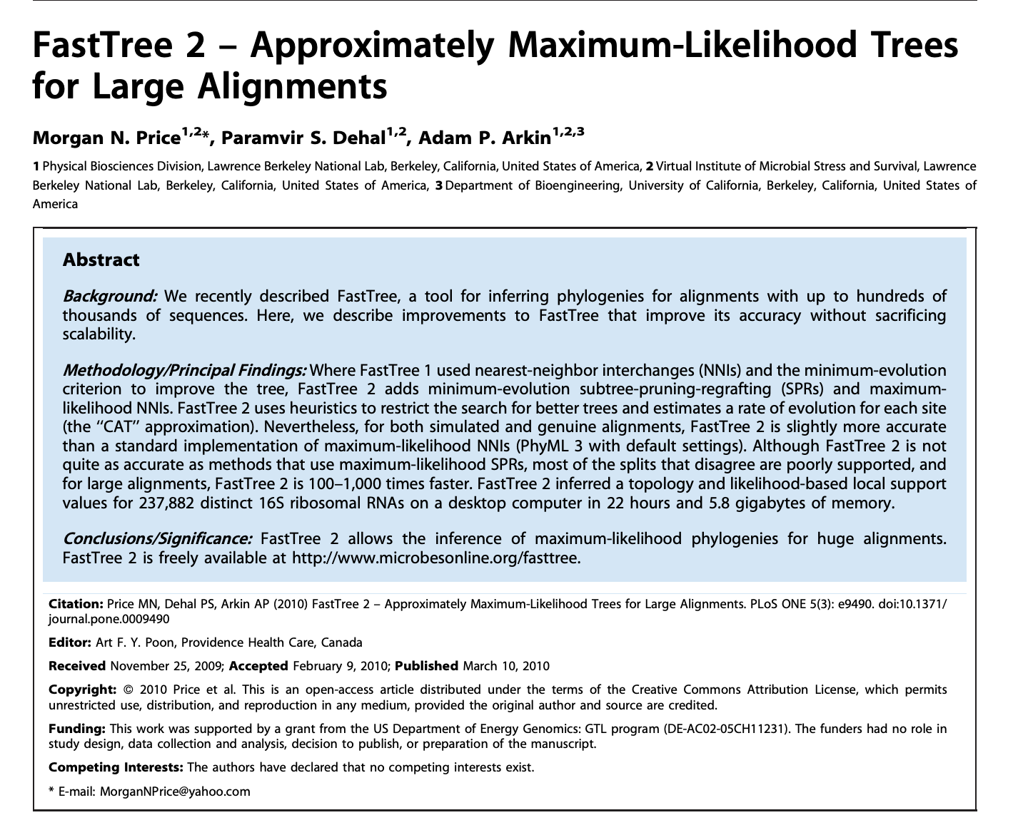
Maximum Likelihood
MLE tree is inferred using e.g. raxml, Iqtree, fasttree

Slide 13
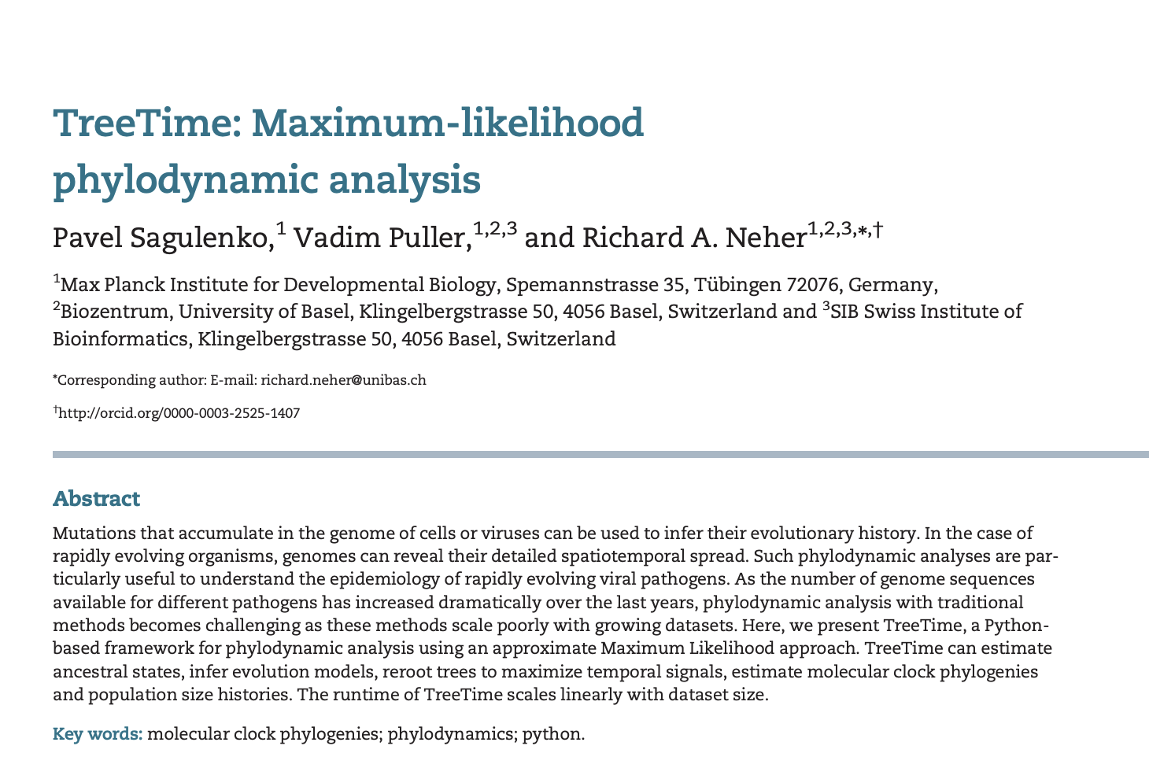
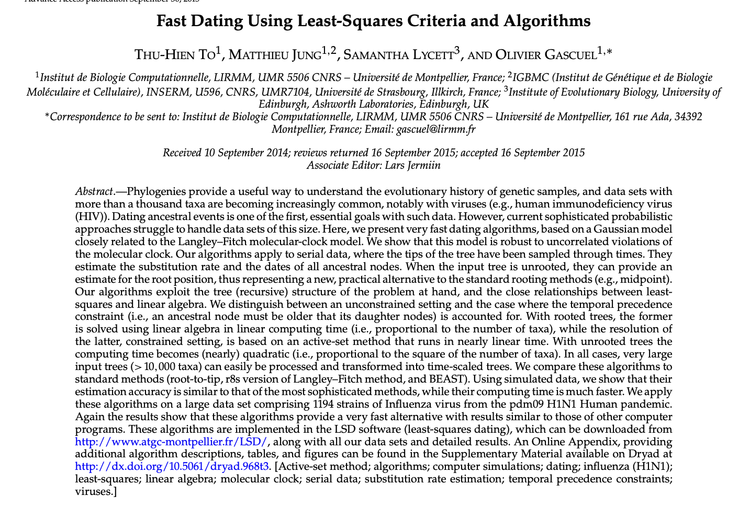
Maximum Likelihood
Timed phylogenetic tree is inferred from the MLE tree and sampling times

Slide 14
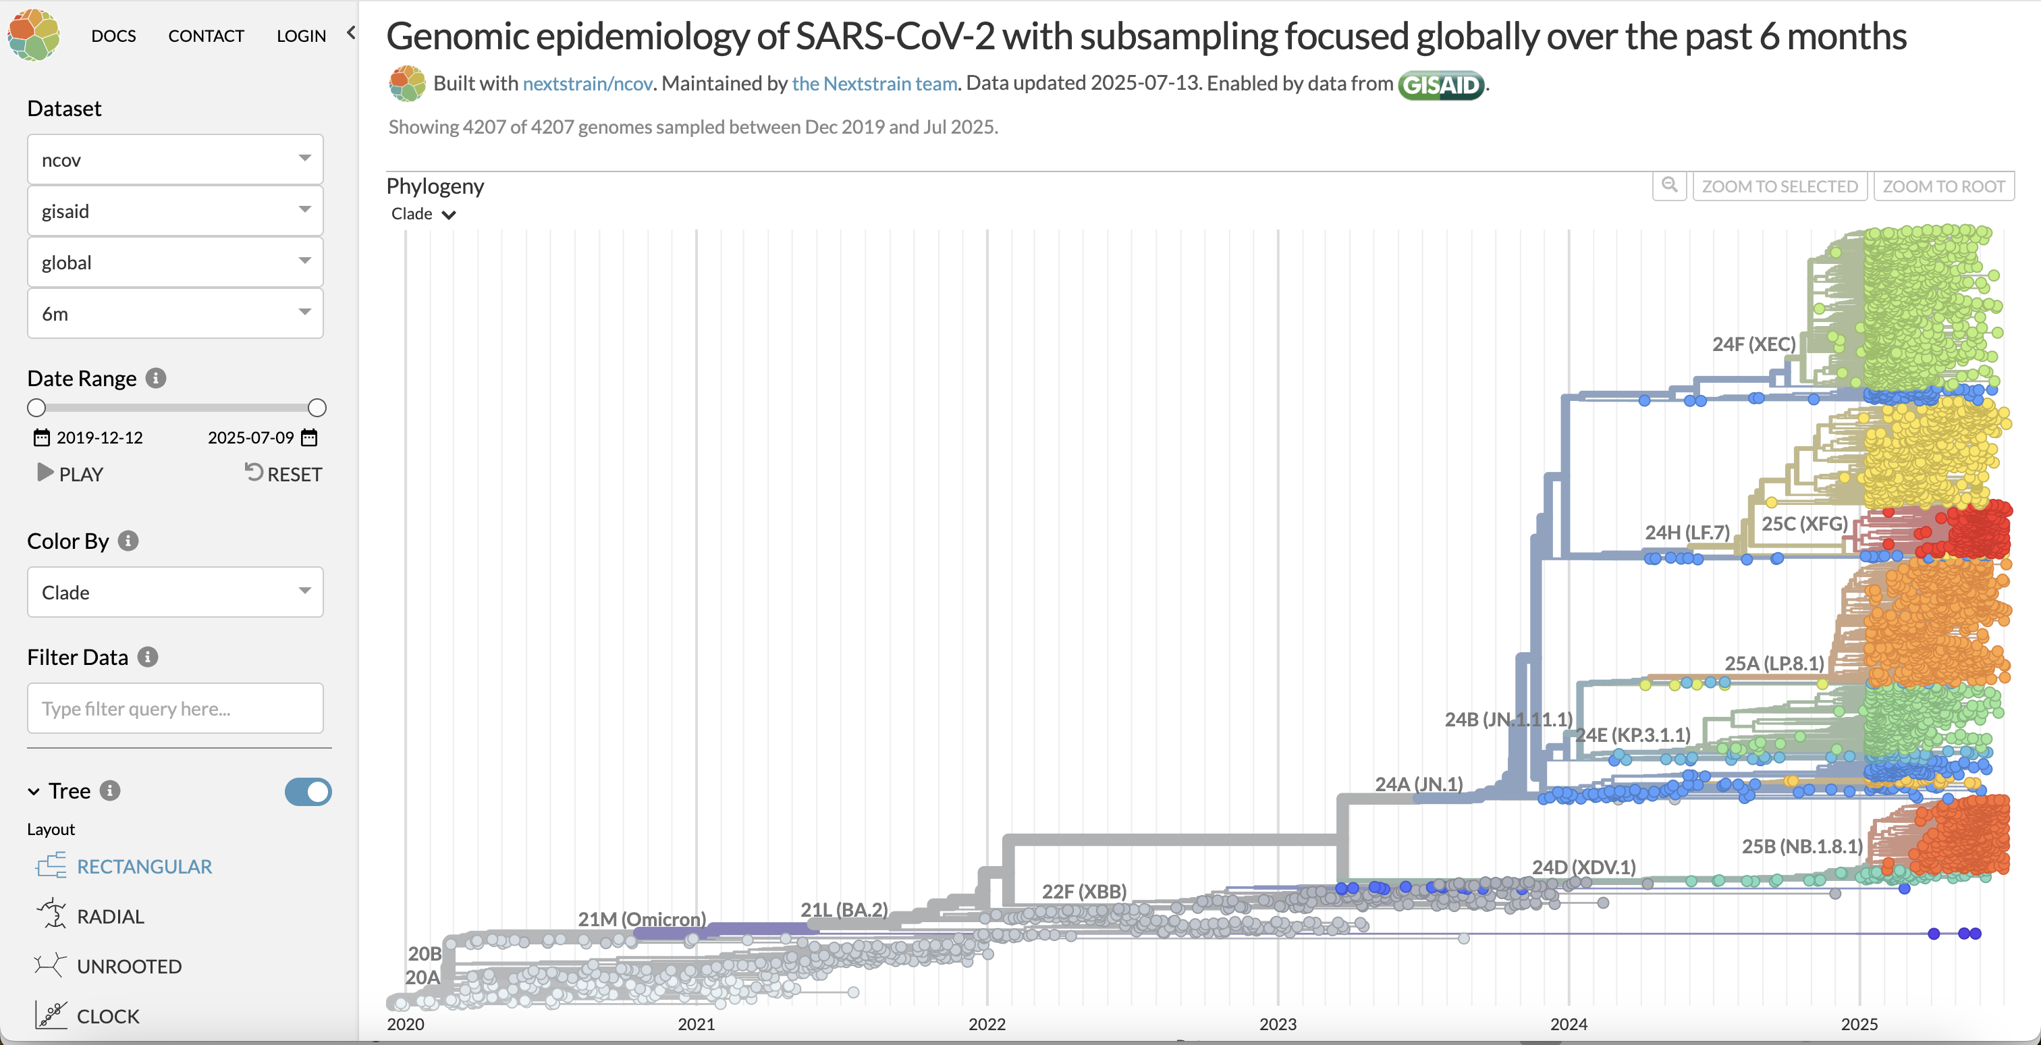

Slide 15
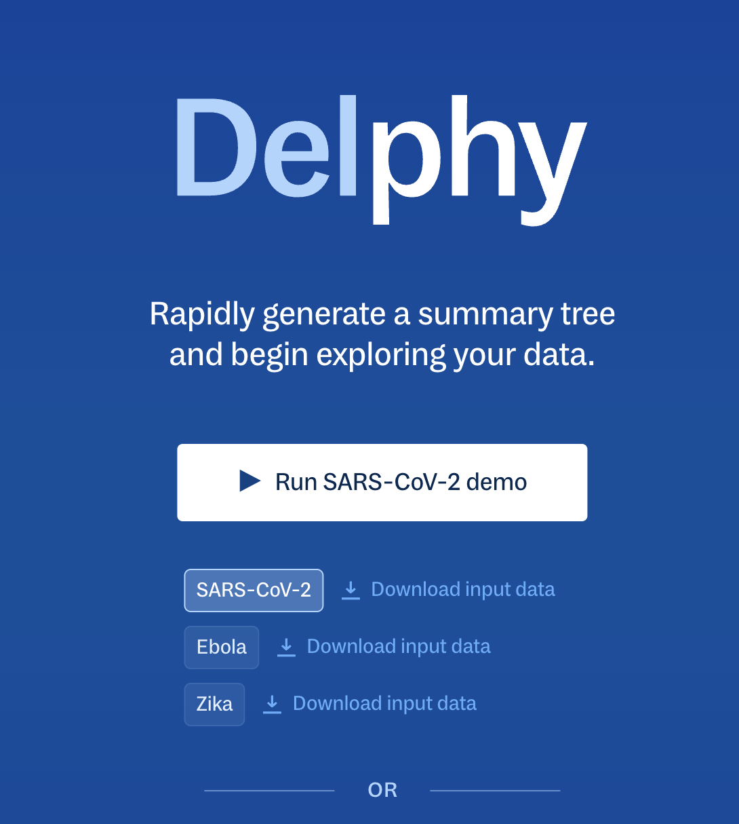
Bayesian phylodynamics with mutation annotated trees -> https://delphy.fathom.info/

Slide 16
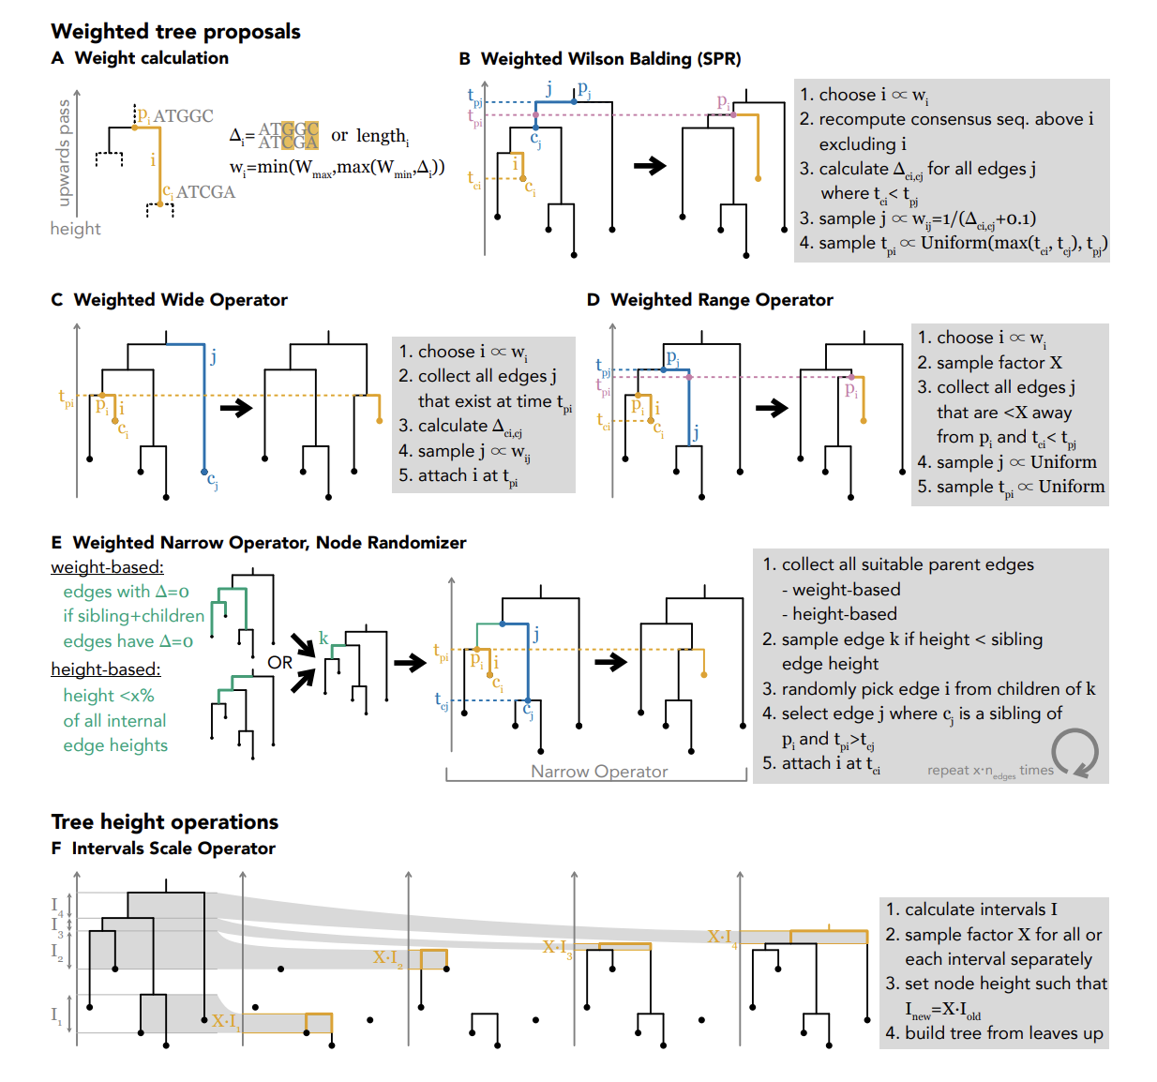
Bouckaert et al. 2025, BioRxiv

Slide 17
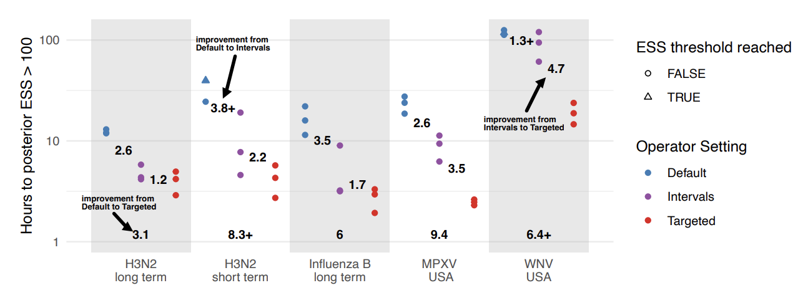
Faster BEAST using the TargetedBEAST package
Bouckaert et al. 2025, BioRxiv

Slide 18
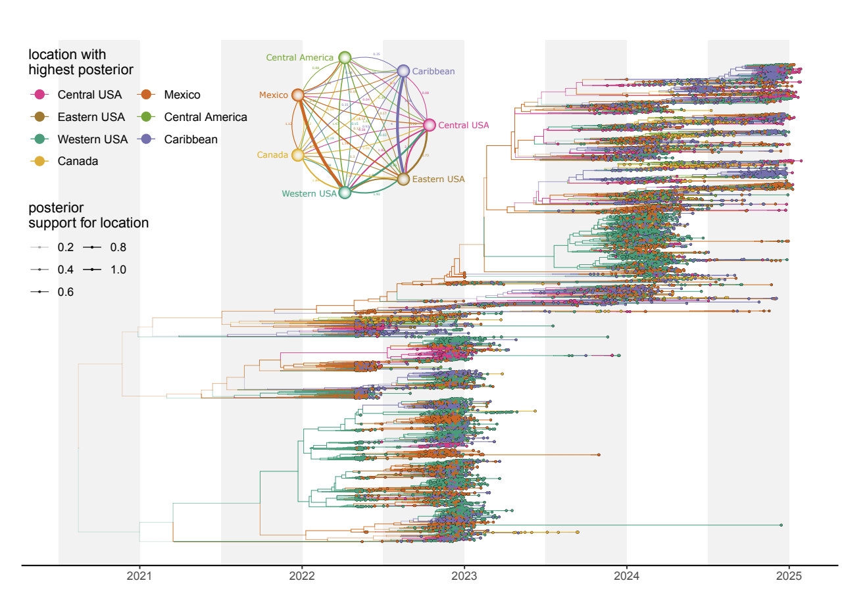
Bouckaert et al. 2025, BioRxiv

Slide 19
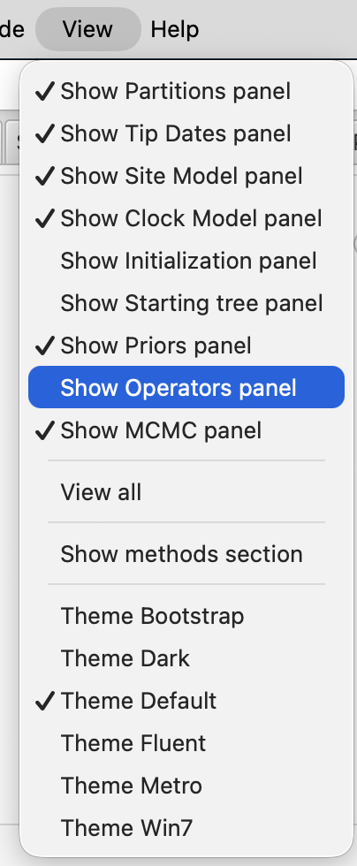
Bouckaert et al. 2025, BioRxiv

Slide 20
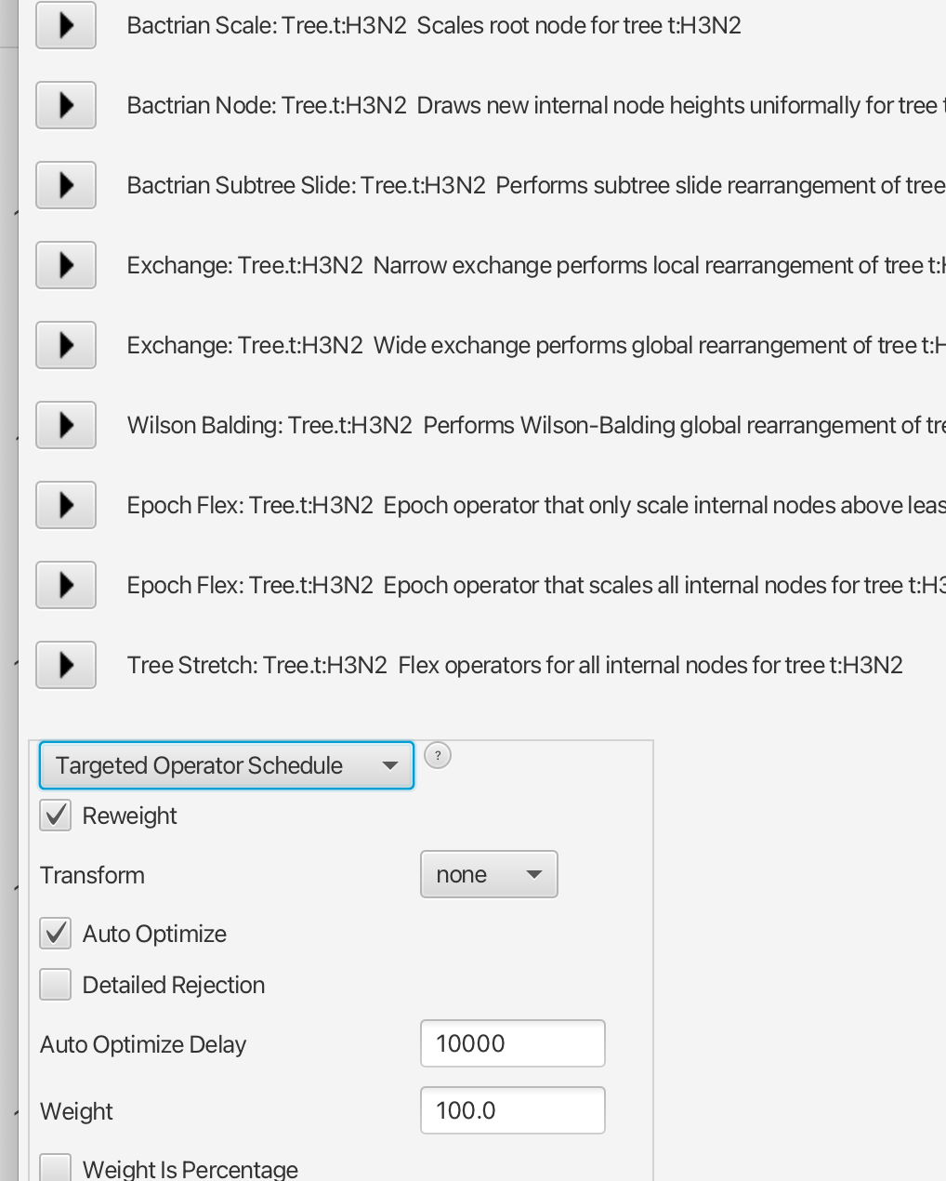
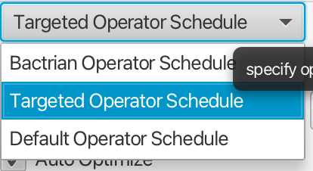
Bouckaert et al. 2025, BioRxiv

Slide 21
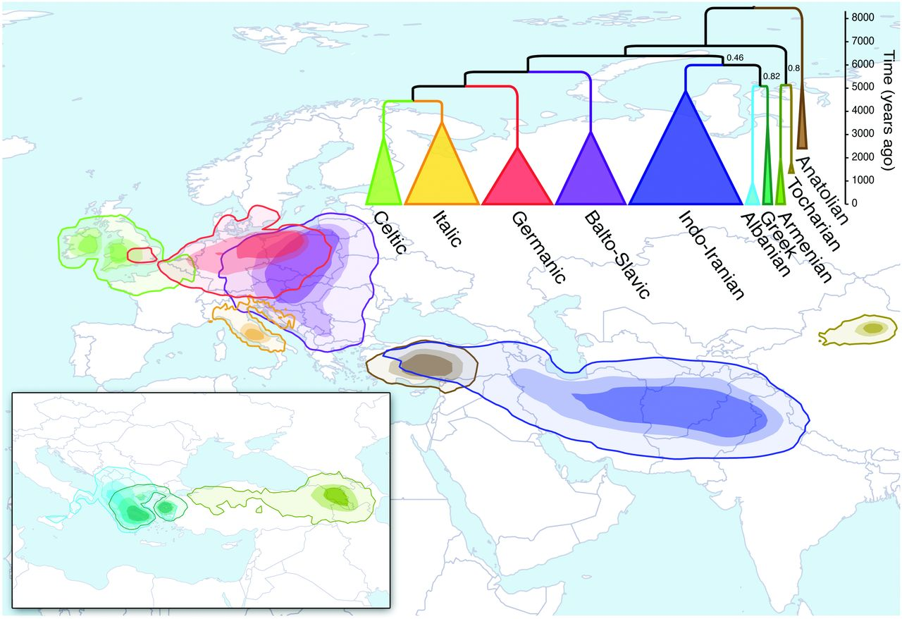
Unsampled dynamics: Languages
Bourckaert, 2012, Science

Slide 22
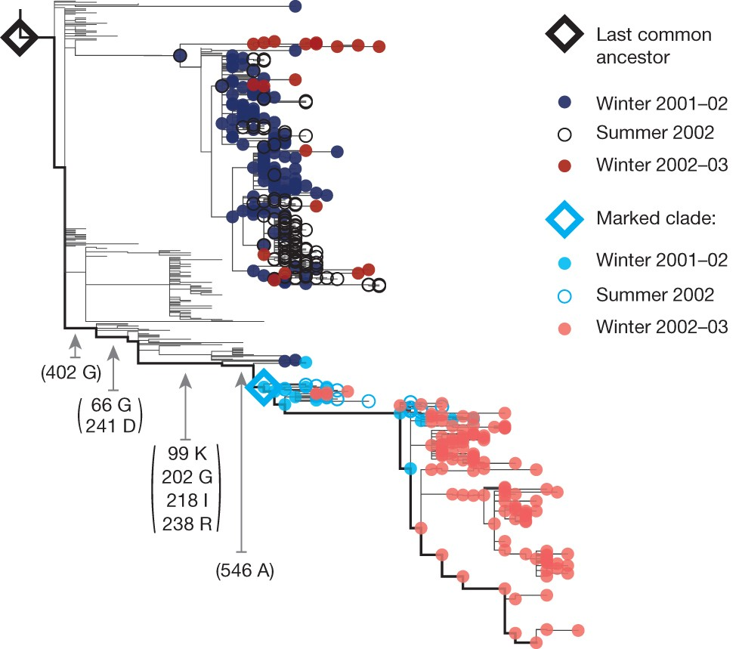
Fitness
Lukzsa et al. 2014, Nature

