Slide 1
Tracking the evolution of pathogens over time
Nicola F. Müller
e-mail: nicola.mueller@ucsf.edu

Slide 14
Our data: We know who was infected with which pathogen and sequence and when they were sampled

Slide 15
Phylogenetics allows us to infer the shared ancestral history of the different pathogens

Slide 16
Bayesian phylogenetics allows us to jointly infer the phylogenetic trees, evolutionary and Demographics models
L. Du Plessis, T. Stadler “Getting to the root of epidemic spread with phylodynamic analysis of genomic data” Trends in Microbiology, 2015
Notes:
One way to do so, is what’s called Bayesian phylogenetics.
In Bayesian phylogenetics, we try to infer the phylogenetic tree, how genomes evolve over time, which is this second bit here and how the tree was created.
The tree generating process is some model that describes how the tree came to be.
The three terms in the back are priors that allow us to input our prior belief in parameters, for example what is a priori by expectation of the rate of evolution of a pathogen.
Back to tree priors

Slide 17
Bayesian phylogenetics allows us to jointly infer the phylogenetic trees, evolutionary and Demographics models
Tree generating models
Model of sequence evolution
L. Du Plessis, T. Stadler “Getting to the root of epidemic spread with phylodynamic analysis of genomic data” Trends in Microbiology, 2015
Notes:
One way to do so, is what’s called Bayesian phylogenetics.
In Bayesian phylogenetics, we try to infer the phylogenetic tree, how genomes evolve over time, which is this second bit here and how the tree was created.
The tree generating process is some model that describes how the tree came to be.
The three terms in the back are priors that allow us to input our prior belief in parameters, for example what is a priori by expectation of the rate of evolution of a pathogen.
Back to tree priors

Slide 18
Bayesian phylogenetics allows us to jointly infer the phylogenetic trees, evolutionary and Demographics models
Tree generating models
Model of sequence evolution
L. Du Plessis, T. Stadler “Getting to the root of epidemic spread with phylodynamic analysis of genomic data” Trends in Microbiology, 2015
Notes:
One way to do so, is what’s called Bayesian phylogenetics.
In Bayesian phylogenetics, we try to infer the phylogenetic tree, how genomes evolve over time, which is this second bit here and how the tree was created.
The tree generating process is some model that describes how the tree came to be.
The three terms in the back are priors that allow us to input our prior belief in parameters, for example what is a priori by expectation of the rate of evolution of a pathogen.
Back to tree priors

Slide 19
Notes:
To get from a multiple sequence alignment to a timed phylogenetic trees, we use evolutionary models that are often split into two parts.
The Site model tells us how we can get from a multiple sequence alignment (without using sampling times) to a divergence tree.
This divergence tree has a branch length genetic distance.
To get from a divergence tree to a tree where the branch lengths and node heights are in actual time, we use clock models.
Clock models are essentially mathematical functions to map genetic distance into time.
The simplest form of these molecular clock models are strict clocks, which essentially assume that evolution happens at the same speed everywhere on the tree.
Also, as a side comment, insertions and deletions are typically ignored in phylogenetic reconstructions.

Slide 20
Notes:
To get from a multiple sequence alignment to a timed phylogenetic trees, we use evolutionary models that are often split into two parts.
The Site model tells us how we can get from a multiple sequence alignment (without using sampling times) to a divergence tree.
This divergence tree has a branch length genetic distance.
To get from a divergence tree to a tree where the branch lengths and node heights are in actual time, we use clock models.
Clock models are essentially mathematical functions to map genetic distance into time.
The simplest form of these molecular clock models are strict clocks, which essentially assume that evolution happens at the same speed everywhere on the tree.
Also, as a side comment, insertions and deletions are typically ignored in phylogenetic reconstructions.

Slide 21
Notes:
To get from a multiple sequence alignment to a timed phylogenetic trees, we use evolutionary models that are often split into two parts.
The Site model tells us how we can get from a multiple sequence alignment (without using sampling times) to a divergence tree.
This divergence tree has a branch length genetic distance.
To get from a divergence tree to a tree where the branch lengths and node heights are in actual time, we use clock models.
Clock models are essentially mathematical functions to map genetic distance into time.
The simplest form of these molecular clock models are strict clocks, which essentially assume that evolution happens at the same speed everywhere on the tree.
Also, as a side comment, insertions and deletions are typically ignored in phylogenetic reconstructions.

Slide 22
Site models describe the relative change across nucleotides and positions in the alignment and consist of several parts.
Substitution models describe how fast/slow the change from one to another nucleotide happens compared to others
Gamma rate heterogeneity + invariant site models describe how fast/slow some sites in an alignment change bases compared to others
Codon positions models allow for some codon positions to evolve faster/slower than others
Notes:
Site models model how transitions between different nucleotides or at different positions in the genome evolve relative to one another
There is not an aspect of time in the site model
In the BEAST notation, the site model consists of the substitution model, which is something like a Jukes Cantor model for example.
The substitution model models how rapidly changes from, for example, A to G happens relative to G to T.
The gamma rate heterogeneity models how positions on the genome may evolve at different speeds. This can include a rate category of 0, which means that a site is invariant.
Codon position models model how different codon positions evolve at different speeds

Slide 23
Substitution models describe how fast/slow the change from one to another nucleotide happens compared to others
Notes:
Site models model how transitions between different nucleotides or at different positions in the genome evolve relative to one another
There is not an aspect of time in the site model
In the BEAST notation, the site model consists of the substitution model, which is something like a Jukes Cantor model for example.
The substitution model models how rapidly changes from, for example, A to G happens relative to G to T.
The gamma rate heterogeneity models how positions on the genome may evolve at different speeds. This can include a rate category of 0, which means that a site is invariant.
Codon position models model how different codon positions evolve at different speeds

Slide 24
Gamma rate heterogeneity + invariant site models describe how fast/slow some sites in an alignment change bases compared to others
Notes:
Site models model how transitions between different nucleotides or at different positions in the genome evolve relative to one another
There is not an aspect of time in the site model
In the BEAST notation, the site model consists of the substitution model, which is something like a Jukes Cantor model for example.
The substitution model models how rapidly changes from, for example, A to G happens relative to G to T.
The gamma rate heterogeneity models how positions on the genome may evolve at different speeds. This can include a rate category of 0, which means that a site is invariant.
Codon position models model how different codon positions evolve at different speeds

Slide 25
Substitution models allow to account for differences in nucleotide substitution rates.
Rate Matrix
Equilibrium Base Frequencies
b
A
G
d
c
f
π_{A} + π_{C} + π_{G} + π_{T} = 1
C
T
e
(slide from Sebastian Duchene)

Slide 26
Substitution models allow to account for differences in nucleotide substitution rates.
Rate Matrix
Equilibrium Base Frequencies
b
A
G
d
c
f
π_{A} + π_{C} + π_{G} + π_{T} = 1
C
T
e
JC
a=b=c=d=e=f
π_{A}=π_{C}=π_{G}=π_{T}
No I or G
0 free parameters
HKY
a=c=d=f, b=e
π_{A}, π_{C}, π_{G}, π_{T}
No I or G
4 free parameters
GTR
a, b, c, d, e, f
π_{A}, π_{C}, π_{G}, π_{T}
No I or G
8 free parameters
(slide from Sebastian Duchene)

Slide 27
Some site in the alignment might be more flexible and therefore evolve less quickly.
CTAT--GGCACCCAGCCCATGCAT-GGT
CTAA--GGCAACCAGCCCATACAT-GCT
CTATGTGGCAACCAGCCCATGCAT-GCT
ATATGTGGCAGCCAG-----GCATAGGT
ATATGTGGCAGCCAGCCCATGCATAGGT
Medium
Slow
Fast
(slide from Sebastian Duchene)

Slide 28
Proportion of invariable sites account for sites that do not change (e.g., HKY+I).
1
Proportion of sites
1-P_{inv}
P_{inv}
0
Rate
(slide from Sebastian Duchene)

Slide 29
Gamma rate heterogeneity + invariant site models describe how fast/slow some sites in an alignment change bases compared to others
Notes:
Site models model how transitions between different nucleotides or at different positions in the genome evolve relative to one another
There is not an aspect of time in the site model
In the BEAST notation, the site model consists of the substitution model, which is something like a Jukes Cantor model for example.
The substitution model models how rapidly changes from, for example, A to G happens relative to G to T.
The gamma rate heterogeneity models how positions on the genome may evolve at different speeds. This can include a rate category of 0, which means that a site is invariant.
Codon position models model how different codon positions evolve at different speeds

Slide 30
Gamma rate heterogeneity models account for rate differences across sites (e.g. HKY+G₄).
alpha=0.5
alpha=100
Proportion of sites
0
(slide from Sebastian Duchene)

Slide 31
Gamma rate heterogeneity + invariant site models describe how fast/slow some sites in an alignment change bases compared to others
Notes:
Site models model how transitions between different nucleotides or at different positions in the genome evolve relative to one another
There is not an aspect of time in the site model
In the BEAST notation, the site model consists of the substitution model, which is something like a Jukes Cantor model for example.
The substitution model models how rapidly changes from, for example, A to G happens relative to G to T.
The gamma rate heterogeneity models how positions on the genome may evolve at different speeds. This can include a rate category of 0, which means that a site is invariant.
Codon position models model how different codon positions evolve at different speeds

Slide 32
Changes in the third codon position are far more likely to not affect the amino acid
Splitting up the alignment into different codon positions and allow each having its own site model allows accounting for these differences
https://www.genomenon.com/codon-chart/

Slide 33
CTA (Leucine)
First position:
ATA (Isoleucine)
GTA (Valine)
TTA (Leucine)
Second position:
CCA (Proline)
CAA (Glutamine)
CGA (Arginine)
Third position:
CTC (Leucine)
CTG (Leucine)
CTT (Leucine)
https://www.genomenon.com/codon-chart/

Slide 34
Codon positions models allow for some codon positions to evolve faster/slower than others
Notes:
Site models model how transitions between different nucleotides or at different positions in the genome evolve relative to one another
There is not an aspect of time in the site model
In the BEAST notation, the site model consists of the substitution model, which is something like a Jukes Cantor model for example.
The substitution model models how rapidly changes from, for example, A to G happens relative to G to T.
The gamma rate heterogeneity models how positions on the genome may evolve at different speeds. This can include a rate category of 0, which means that a site is invariant.
Codon position models model how different codon positions evolve at different speeds

Slide 35
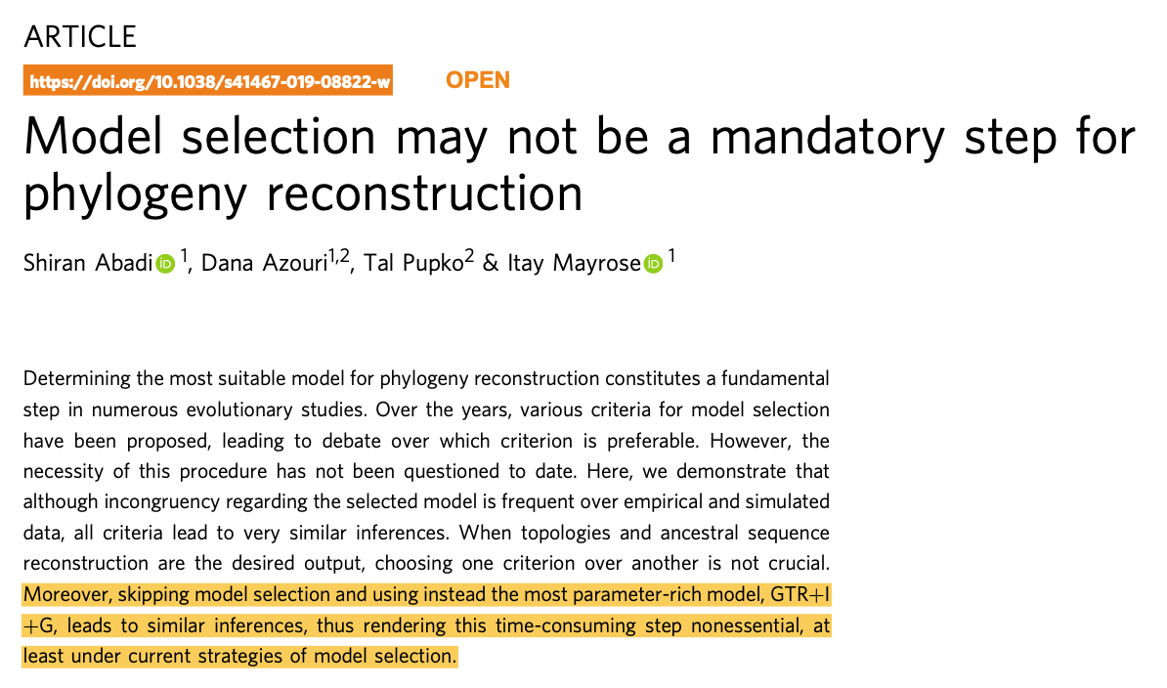

Slide 36
Practical considerations
Everything affects everything in Bayesian phylogenetics. Wrong evolutionary models lead to wrong trees, which leads to wrong population parameters.
Overparameterization is better than under-parameterization. In doubt, use the more complex site model, such as a GTR+ model (Abadi et al., 2019, Nat. comm.)
Never forget to account for rate heterogeneity (experience). Also, the JC69 model is hardly ever appropriate.

Slide 37
The molecular clock

Slide 38
Using site models, we can get from alignments to divergence trees
nextstrain.com

Slide 39
Sequences that are further apart in time are more diverged
nextstrain.com

Slide 40
Molecular clocks bring us from divergence trees to time trees
nextstrain.com

Slide 41
Evolutionary models can be used to estimate common ancestor times
Bedford et al., 2020, Science

Slide 42
Different organisms have vastly different rates of evolution
Duchene et al., 2018, Vir. Evol.

Slide 43
The time resolution is dependent on the size of the genome and the rate of evolution
Dudas et al., 2019, BMC Eco. Evo.

Slide 44
What is my clock rate? (from Holmes et al. 2016
Mutation rate (short term, faster): Error rate in replication.
Substitution rate (long term, slower): Long term rate of evolution.
Evolutionary rate (=clock rate): Measured rate of change. Result of mutation rate and population processes, such as selection. Typically sits between the mutation and substitution rate (The notation in BEAST is confusing with regards to what is what).

Slide 45
Rates of evolution can vary due to different hosts
Worobey et al. (2014), Nature
Notes:
This strict clock model assumption is, however, often broken.
In this example, by Worobey et. al, they looked at if the rates of evolution varied in influenza for different host species and found that they indeed where higher in pigs and birds, compared to times when humans or horses where the host species.

Slide 46
Rates of evolution can vary in the short term and long term
Duchene et al. (2014), Proceedings B
Notes:
Rates of evolution can also depend on the time frame one considers.
In short, when using shorter time windows, evolutionary rates tend to be higher than when considering longer time windows.
The way I think about this is that there are different forces at play in the short and long term.
In the short term, selection plays less of a role and the rate of evolution is more driven by the how many errors accumulated
In the long term, selection plays a bigger role and will impact the rate of evolution much more.
There is a few more processes that can impact the likely rate of evolution, such as host switches

Slide 47
Mathematically clock models are functions that have divergence as input and time as output
Strict clock models assume that evolution happens equally fast on each branch of a tree. Strict clocks are mostly used to study pathogens over rather short times (a few years)
Random clock models allow different branches of a phylogenetic tree to have different rates (speed) of evolution. These are more prevalent when analyzing datasets that were sampled over longer time periods

Slide 48
Random clock models can be separated into two classes
Local random clock models. Clock rates change on a few branches in the tree only. Once they change, all the descendent branches will inherit the same rate
Uncorrelated clock models. Clock rates can vary on each branch (completely uncorrelated). Each branch has a clock rate that is considered a random draw from some distribution (typically Exponential or lognormal).

Slide 49
Molecular clock models map genetic divergence into time
Clock models can account for variation in the speed of evolution across an evolutionary history.
Ho et al. (2014), Molecular Ecology
Notes:
These processes are often not explicitly incorporated into our molecular clock models.
Instead, we often just allow rates to vary across different branches in a random fashion.
Local clocks assume that there are discrete point in the phylogeny where evolutionary rates change.
Random clocks assume that the rate of evolution on each branch is a random draw from some underlying distribution.
These models can accommodate some of the variations in the speed of evolution between different parts of evolutionary histories.
However, they can introduce a lot of uncertainty and can increase the computational complexity of phylogenetic analyses by quite a bit.
So, in effect, a lot, I would say most, phylogenetic analysis assume strict clock models.
This is a, sometimes necessary, assumption for analyses, that nonetheless has to be kept in mind when taking about things, such as common ancestor times or branch lengths.
It is particularly important to keep in mind that uncertainty about these times might be over or underestimated and that these estimate can also be biased.

Slide 50
Where does the time information come from to inform the molecular clock?
Calibrations -> Knowing something about when two lineages shared a common ancestor.
Sampling through time of “measurably evolving pathogens”.
Just “knowing” the rate, that is from the prior.
Notes:
In order for clock rates to be estimated, some information about how things evolve over time must exist.
There is two main ways to get this information.
In the first, some ancestral event, or several events are known.
In paleontology, for example, this could be a fossil.
What is more common in viruses, is that there are samples isolated over some time.
In this case, the sampling times

Slide 51
The time information should be in the same order of magnitude as the evolutionary history
Bedford et al. (2015), Nature
Boni et al. (2020), Nat. Mic.
Notes:
If we look at this influenza A/H3N2 phylogeny, we see that the branching process happens very much on the same time scale as the sampling, which in turn gives us a lot of information about the speed of evolution.
If we contrast this to a SARS-like phylogeny, sampling happened over a few years, while the evolutionary history connecting the individual samples happened in the order of centuries or millennias.
In these situations, one is pretty much stuck with just assuming some rate of evolution

Slide 52
Is there enough signal to estimate evolutionary rates? Tip Randomization
Duchene et al., 2015a, MBE

Slide 53
In the posterior probability, modelling the evolution of sequences feeds into the tree likelihood.
DuPlessis, L. et al. (2015),
Trends in Microbiology
Notes:
In the posterior probability, modelling the evolution of sequences feeds into the tree likelihood.
This doesn’t mean other parts of the posterior distribution don’t affect the estimates of the sequence evolution.

Slide 54
Model choices not directly related to clock models can impact rate estimates
Möller et al., 2018, PNAS
Notes:
The less information there is about the rates of evolution, the more important the priors become.
This explicitly includes the tree prior.
Models that put more weight on shorter trees will also, as a consequence, put more weight on higher rates of evolution.

Slide 55
Some reading material
Accounting for codon positions: https://doi.org/10.1093/molbev/msj021
Overfitting site models is ok: https://www.nature.com/articles/s41467-019-08822-w
Posterior predictive simulations to evaluate clock signal: https://academic.oup.com/mbe/article/32/11/2986/981260
Time randomization to evaluate clock signal: https://academic.oup.com/mbe/article/32/7/1895/1016979
Rates of evolution in EBOV: https://www.nature.com/articles/nature19790

