Slide 1
How to read xmls
Nicola F. Müller
e-mail: Nicola.mueller@ucsf.edu

Slide 2
Why learn about BEAST xmls?
It is easier to change small parts of an analysis in the xml directly (change chain length or a prior)
Some of the more complex analyses are only possible in the xml directly (e.g. linking parameters in different models).
You can check someone else's analysis (i.e. see what was actually done)

Slide 3
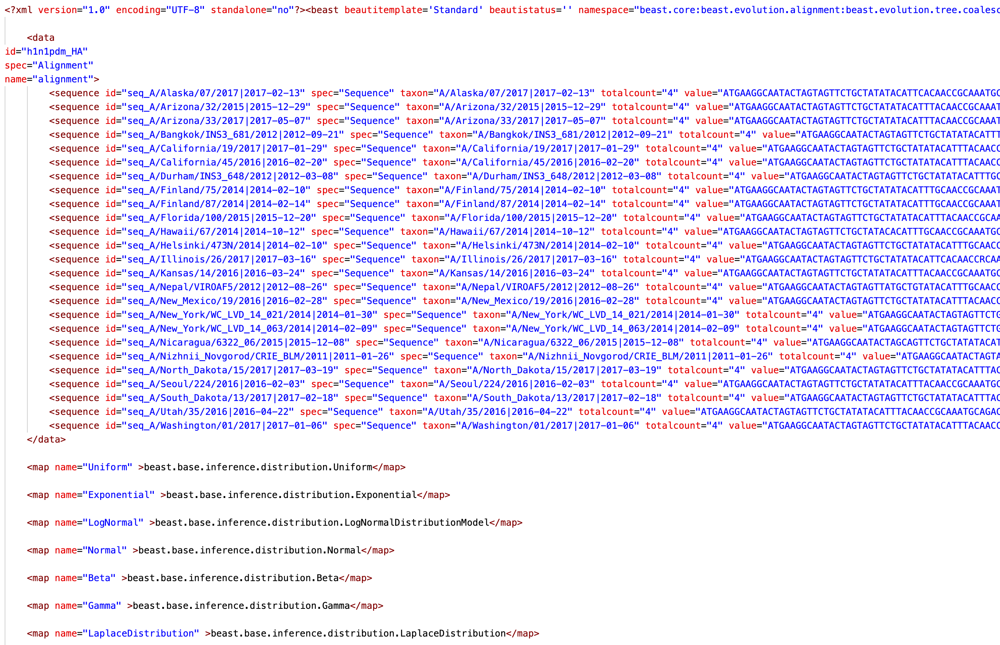
The xml contains all the data

Slide 4
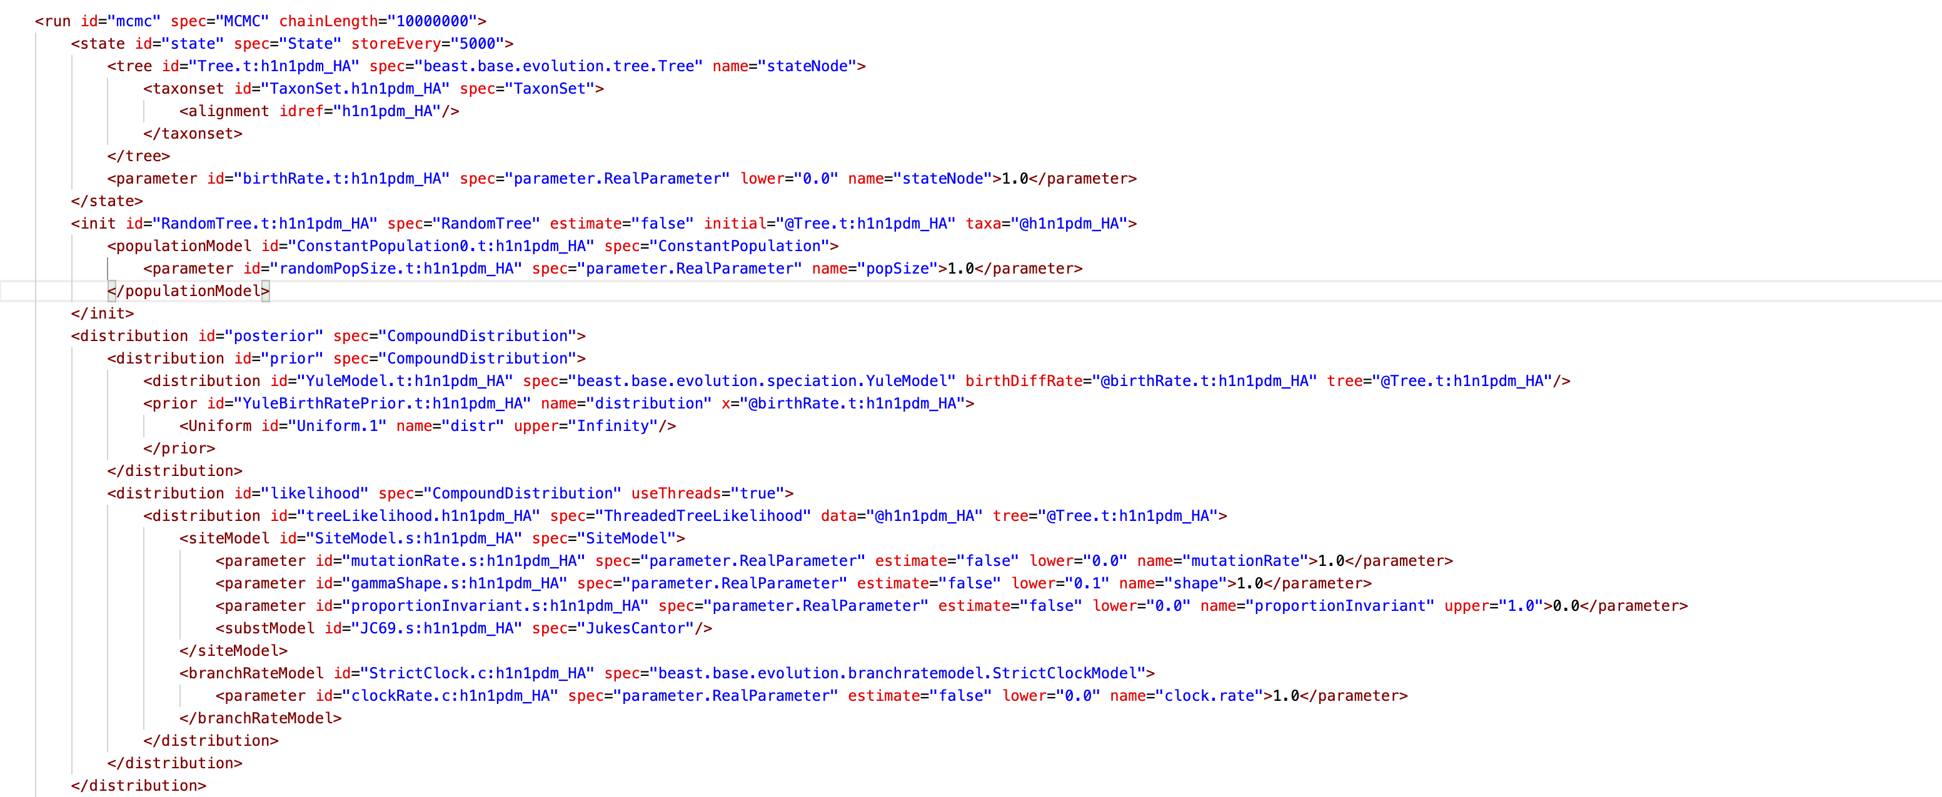
The settings and specifications of the MCMC

Slide 5
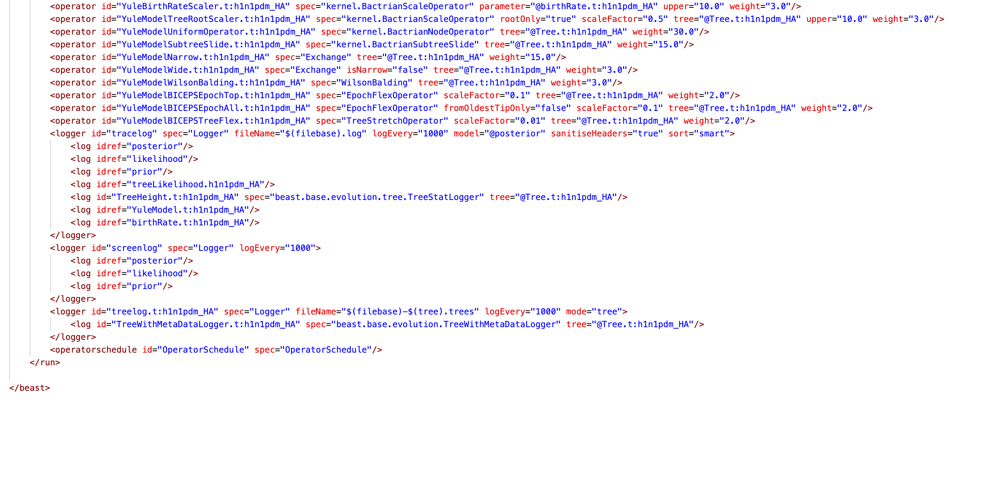
And what is logged

Slide 6
Organization
Data -> Alignments
Run -> MCMC
State -> Initial states + definitions of what can change
Initialization -> Tree initialization
Posterior -> Everything that goes into the posterior
Prior
Tree Prior
Parameter Priors
Likelihood
Operators
Loggers

Slide 7
Xml is a hierarchical structure
<distribution id="CoalescentConstant.t:h1n1pdm_HA" spec="Coalescent">
<populationModel id="ConstantPopulation.t:h1n1pdm_HA" spec="ConstantPopulation" popSize="@popSize.t:h1n1pdm_HA"/>
<treeIntervals id="TreeIntervals.t:h1n1pdm_HA" spec="beast.base.evolution.tree.TreeIntervals" tree="@Tree.t:h1n1pdm_HA"/>
</distribution>

