Slide 1

Phylogenetic mapping
Julia A. Palacios

Slide 2
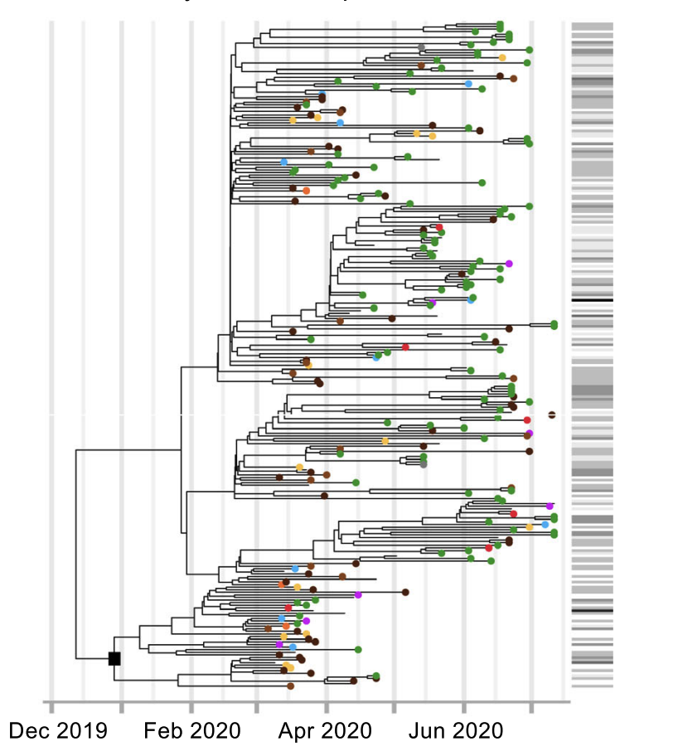
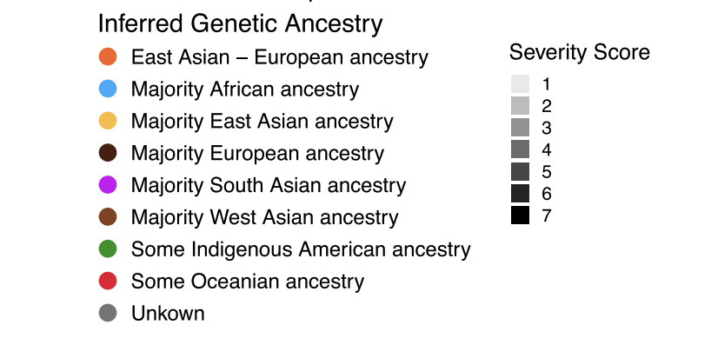
SARS-CoV-2 Study early 2020 at Stanford Hospital
The phylogenetic tree is estimated from SARS-CoV-2 viral sequences.
Ancestry of infected patients is estimated from their genomes.
Parikh et al., Nature Communications 2022

Slide 3
SARS-CoV-2 Study early 2020 at Stanford Hospital
Is the virus being transmitted
within ancestries?
Parikh et al., Nature Communications 2022

Slide 4
SARS-CoV-2 Study early 2020 at Stanford Hospital
A severity score is calculated for each infected patient according to observed disease response.
Parikh et al., Nature Communications 2022

Slide 5
SARS-CoV-2 Study early 2020 at Stanford Hospital
A severity score is calculated for each infected patient according to observed disease response.
Are patients infected with similar strains presenting similar disease symptoms?
Parikh et al., Nature Communications 2022

Slide 6
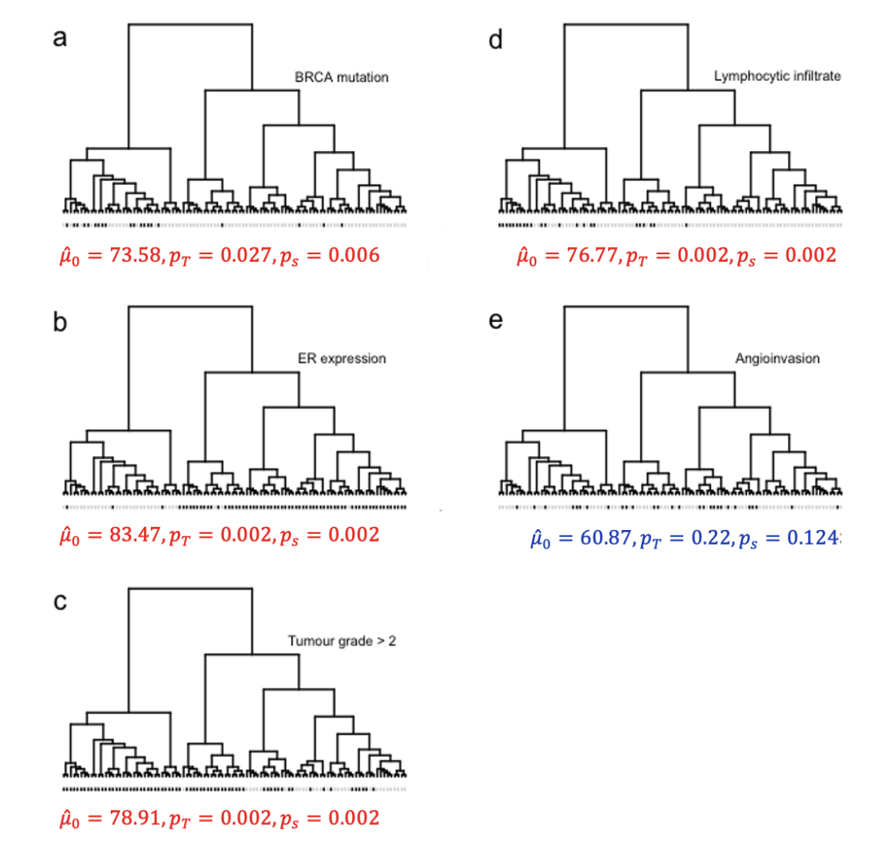
Breast cancer gene expression data on 98 patients
The hierarchical tree is constructed from correlation of gene expression data used as “distance”.
Traits tested:
BRCA mutation
Estrogen receptor expression
Histological grade
Lymphocytic infiltration
Angioinvasion
Behr et al, 2020; van’t Veer et al., 2002

Slide 7
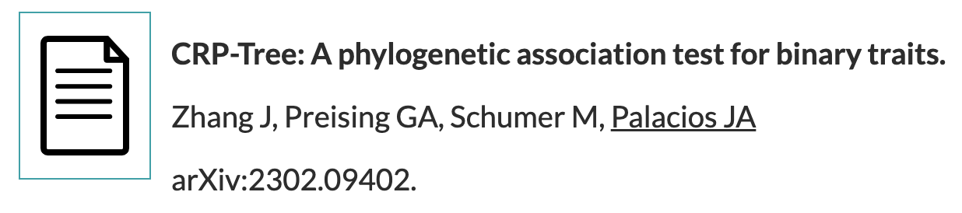
Goal: Statistical test for phylogenetic/tree association
Phylogenetic Association:
The tendency of related organisms to share some trait characteristics more than organisms drawn at random from the same tree.

Slide 8
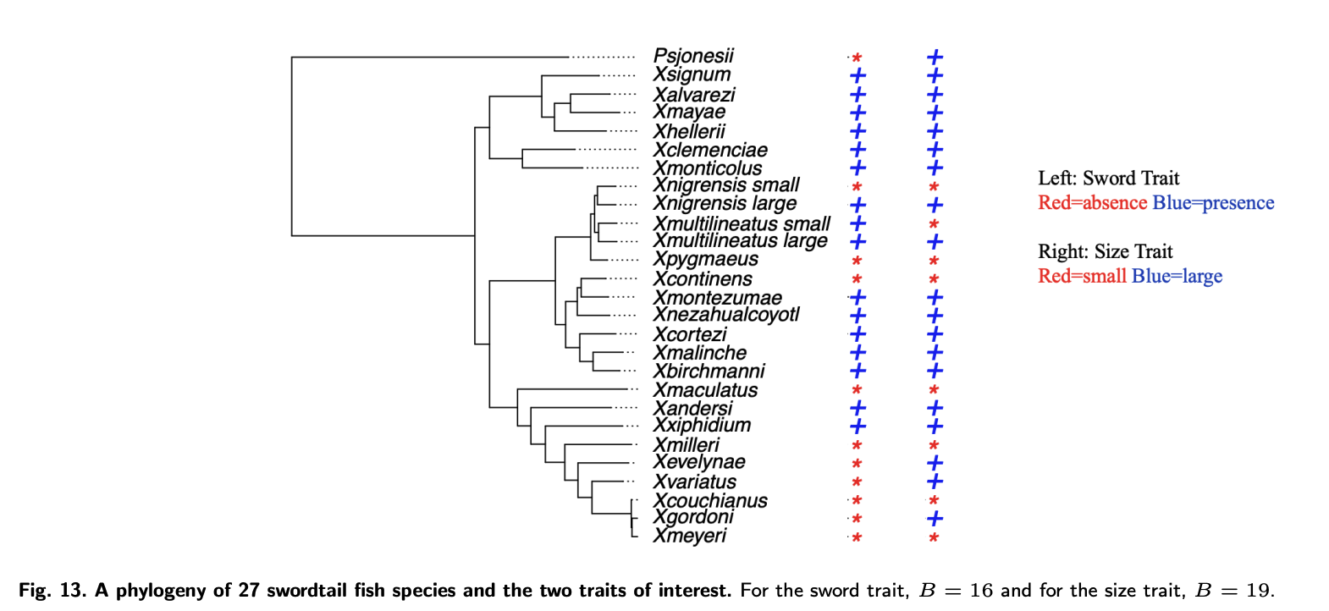
Swordtail fish species, an example in Phylogenetics
Sword
Body
Size
Swordtail fish is a classic model for studying sexual selection.
It is believed that females prefer large male body size and “sword” ornament.
Is there a phylogenetic association with body size and sword ornament?
Preising et al., bioRxiv. doi: https://doi.org/10.1101/2022.12.24.521833

Slide 9
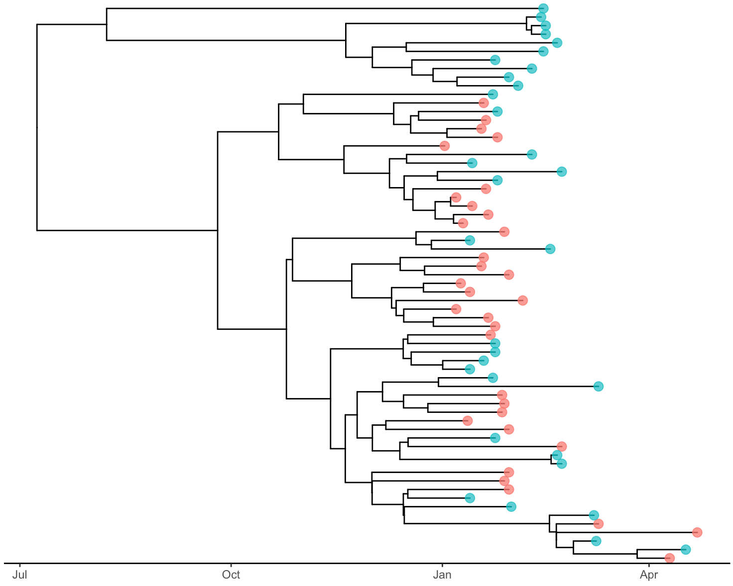
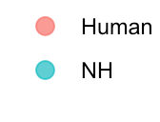
Yellow fever virus in Brazil in 2017
YFV is the most severe mosquito borne infection in South America, where non-human primates and humans are infected by different mosquito species.
Faria et al. (2018) collected complete viral genomes from 33 humans and 32 non-human primates.
Is the virus spreading between human and nonhuman primates?

Slide 10
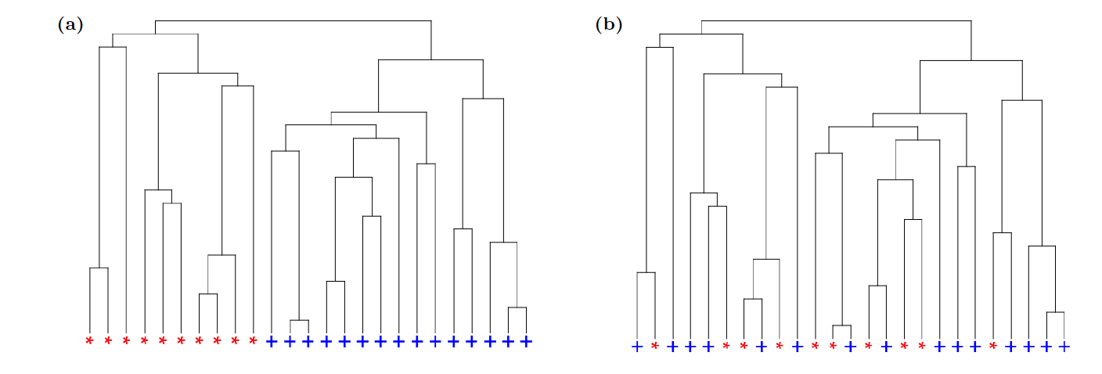
Goal: Statistical test for phylogenetic association
Assumptions:
We are given a partially labeled ranked tree shape:
We assume R red and B blue tips.
We ignore branch lengths.

Slide 11
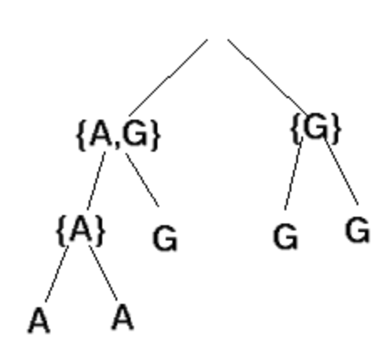
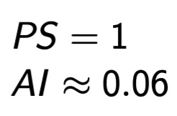
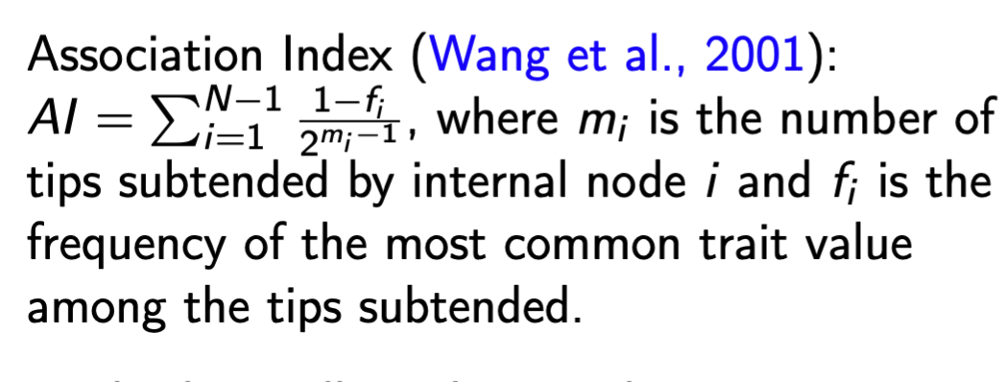
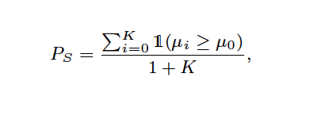
Other tests for phylogenetic association
Parsimony Score (Fitch, 1971).
Statistic: the minimum number of state changes in the phylogeny in order to reconstruct the states at the parent nodes based on characters at the tips.
Association Index (Wang, 2001).
Statistic:
#tips subtended by node i
freq. most common train subtending i
Significance can be assessed via permutation
Notes:
Based on heuristics

Slide 12
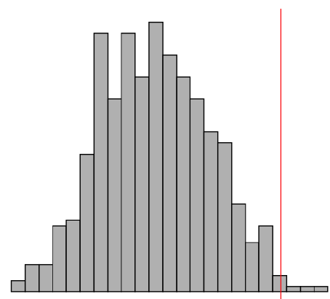
Goal: Statistical test for phylogenetic association
N= Number of tips
B= Number of blue tips
Observed

Slide 13
A null coalescent model (unlabeled tips)

Slide 14
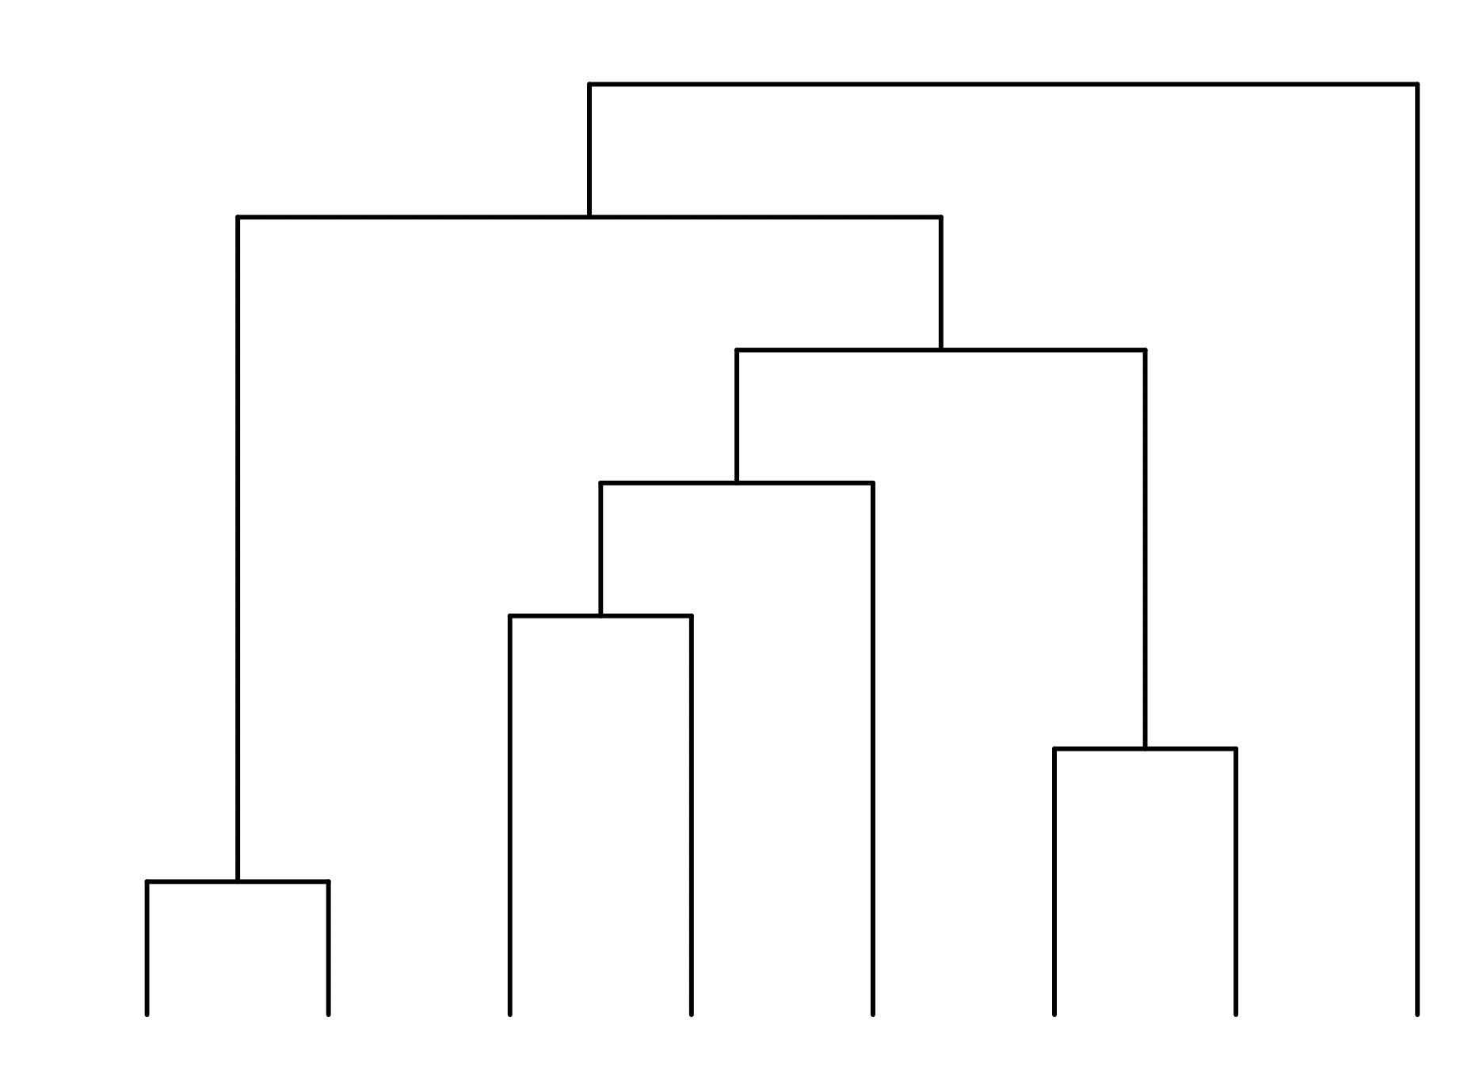
A null coalescent model
1

Slide 15
A null coalescent model
2
1

Slide 16
A null coalescent model
3
2
1

Slide 17
A null coalescent model
4
3
2
1

Slide 18
A null coalescent model
7
6
5
4
3
2
1

Slide 19
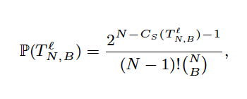
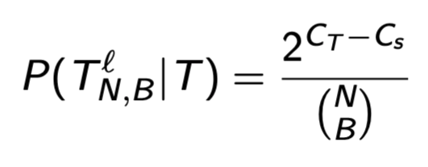
A null coalescent model with colors
R=5, B=3
7
6
5
4
3
2
1

Slide 20
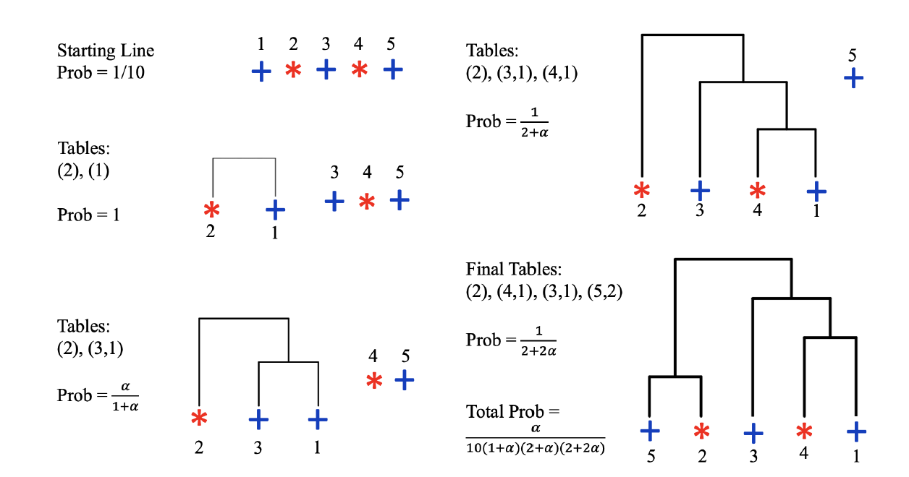
An alternative model: The CRP-Tree

Slide 21
An alternative model: The CRP-Tree

Slide 22
An alternative model: The CRP-Tree
Note: We are branching (forward)
Note: We attach to the left

Slide 23
An alternative model: The CRP-Tree

Slide 24
An alternative model: The CRP-Tree
The parameter in our tree-generating model controls how likely are lineages to descend from a node of the same type.

Slide 25
An alternative model: The CRP-Tree
The initial ordering and always attaching to the left are key.

Slide 26
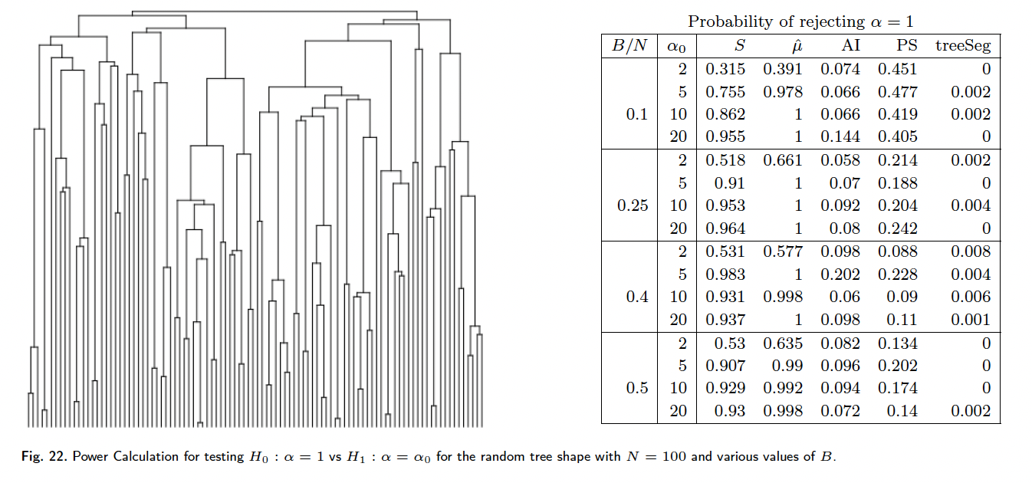
Results on Simulations

Slide 27
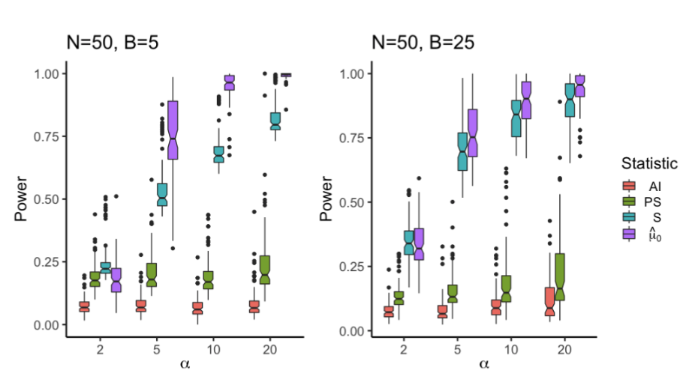
Results on Simulations

Slide 28
Breast cancer gene expression data on 98 patients
Traits: BRCA mutation, estrogen receptor expression, histological grade, lymphocytic infiltration, angioinvasion
van’t Veer et al., 2002

Slide 29
Swordtail fish species
Classic model for studying sexual selection. Females prefer large male body size and “sword” ornament
Preising et al., bioRxiv. doi: https://doi.org/10.1101/2022.12.24.521833

Slide 30
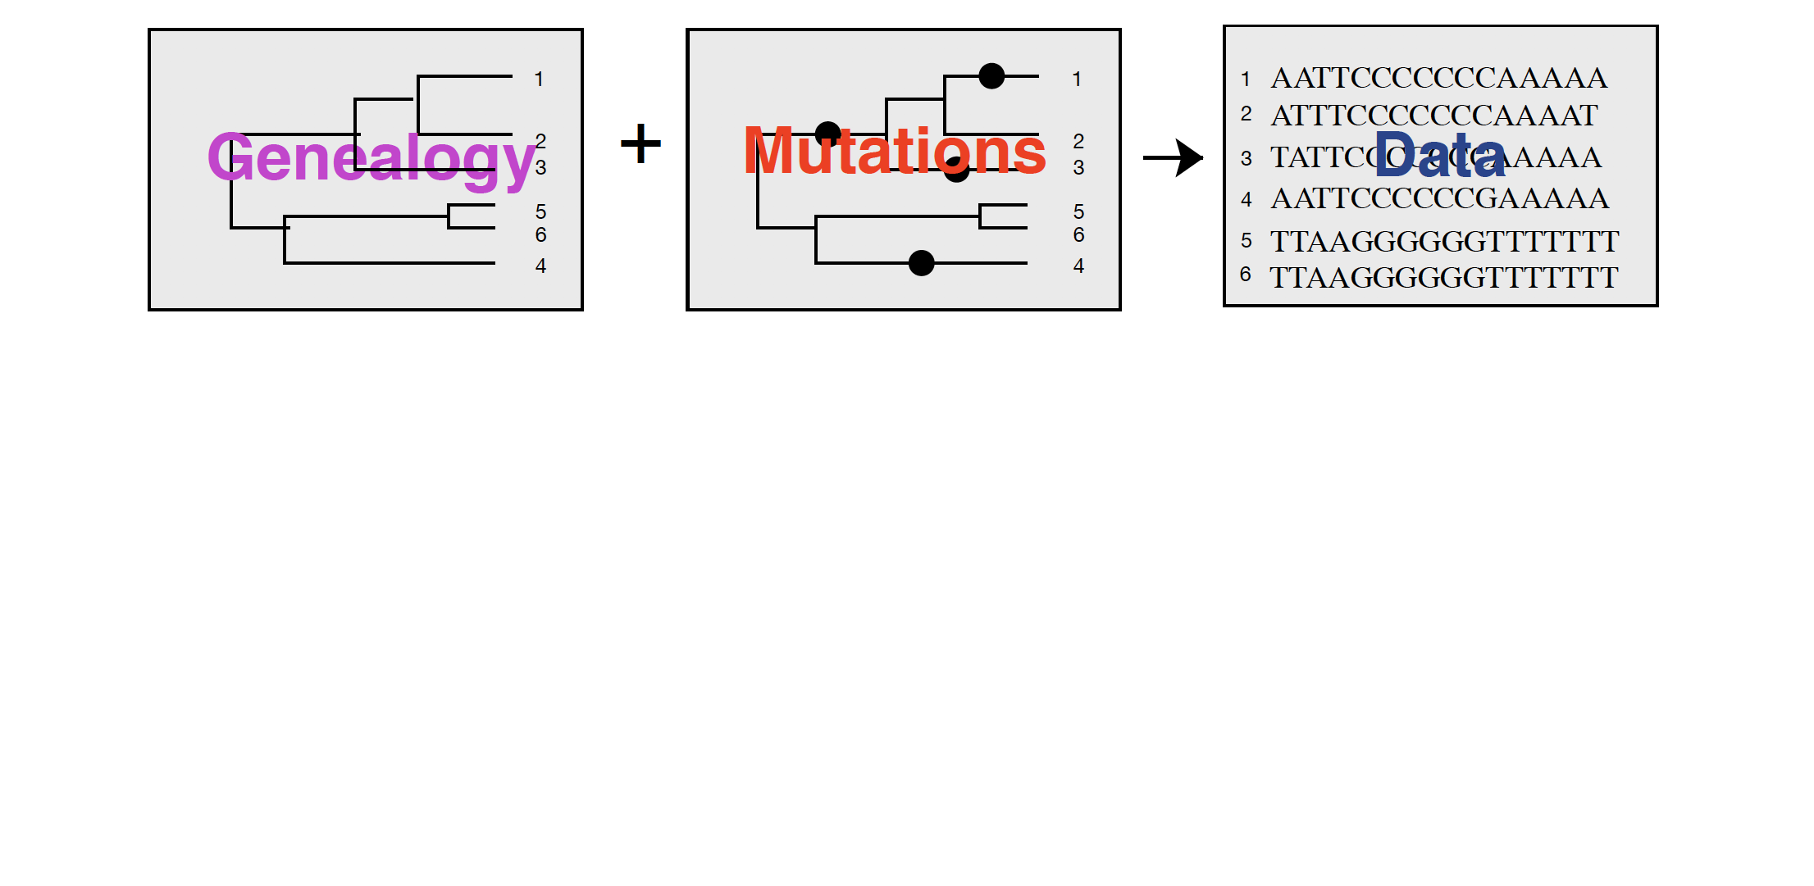
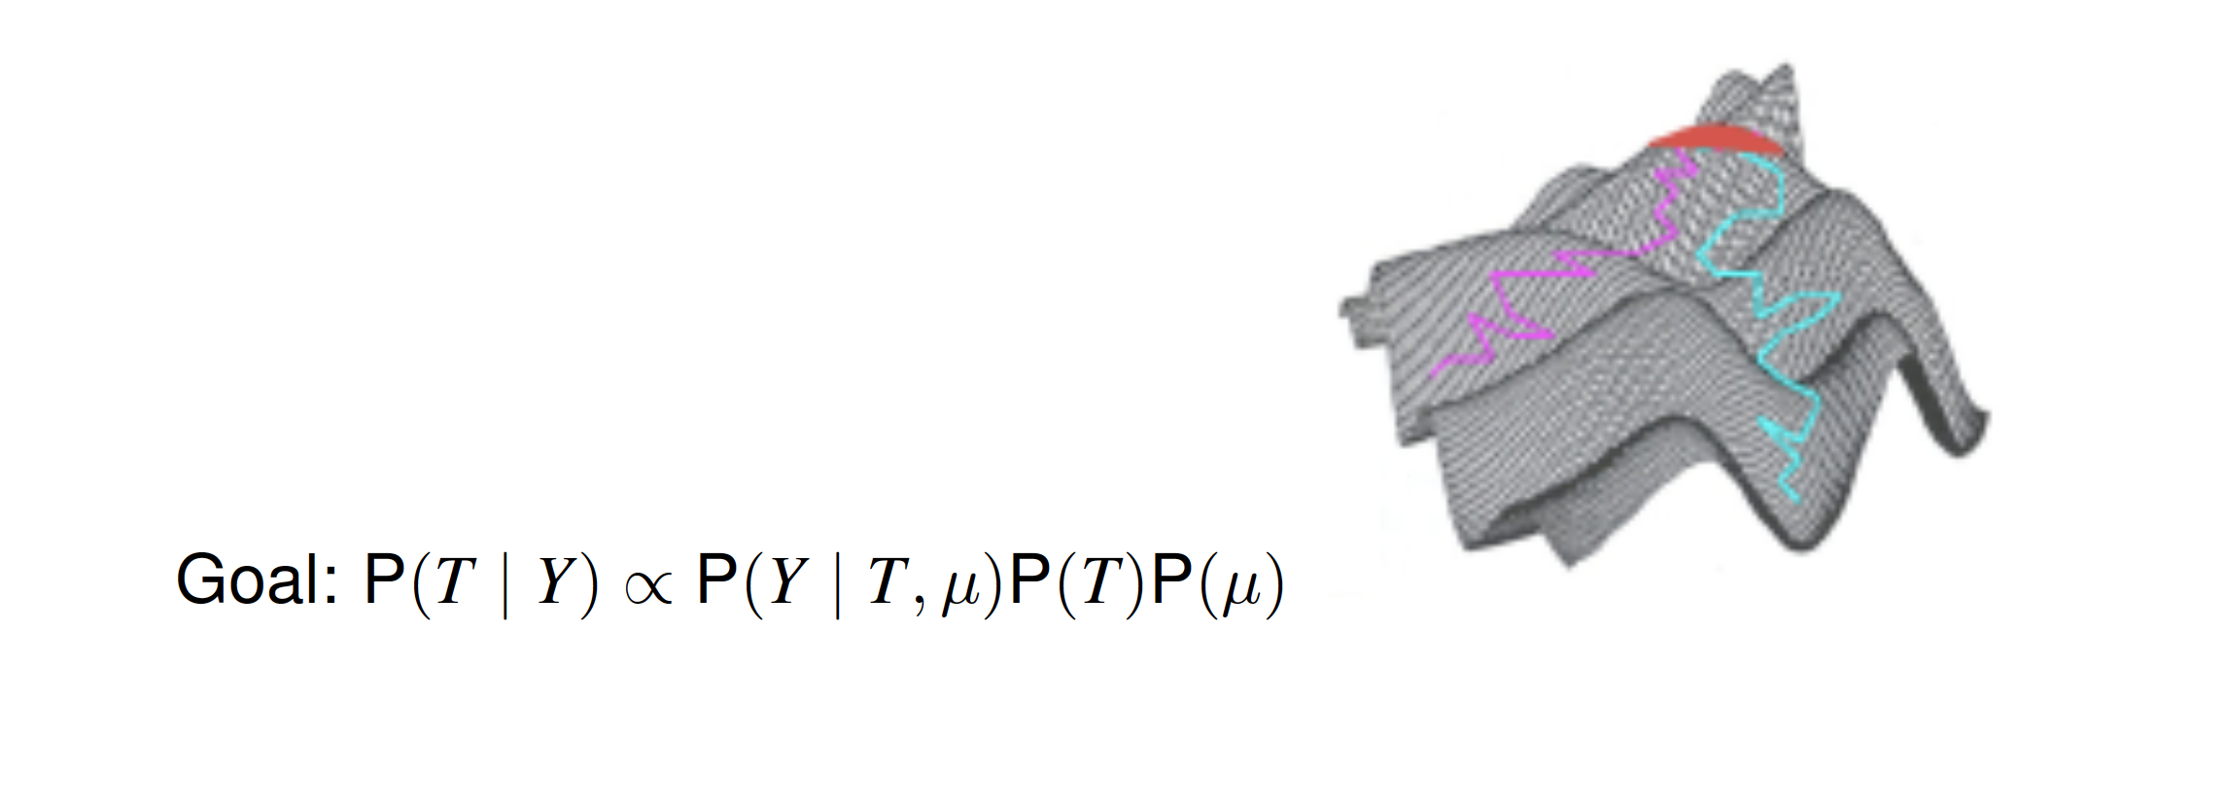
Trees are usually not directly observed
Notes:
Phylogenies or genealogies are usually not directly observed, instead we observe genetic data such as molecular DNA or RNA sequences and having a mutation model and a tree model in place we can then estimate the posterior distributions of the trees. This is usually done via MCMC methods.

Slide 31
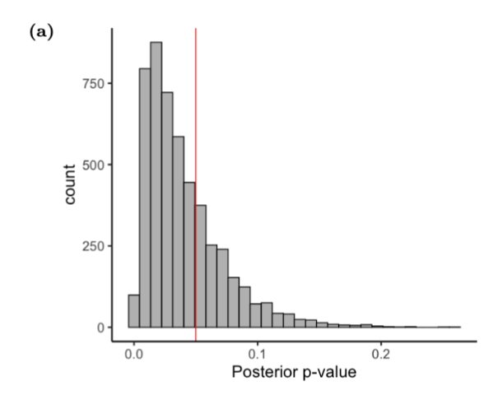
Yellow fever virus in Brazil in 2017

Slide 32
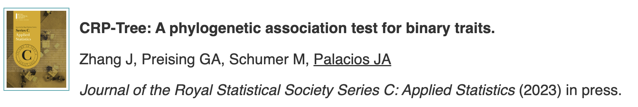
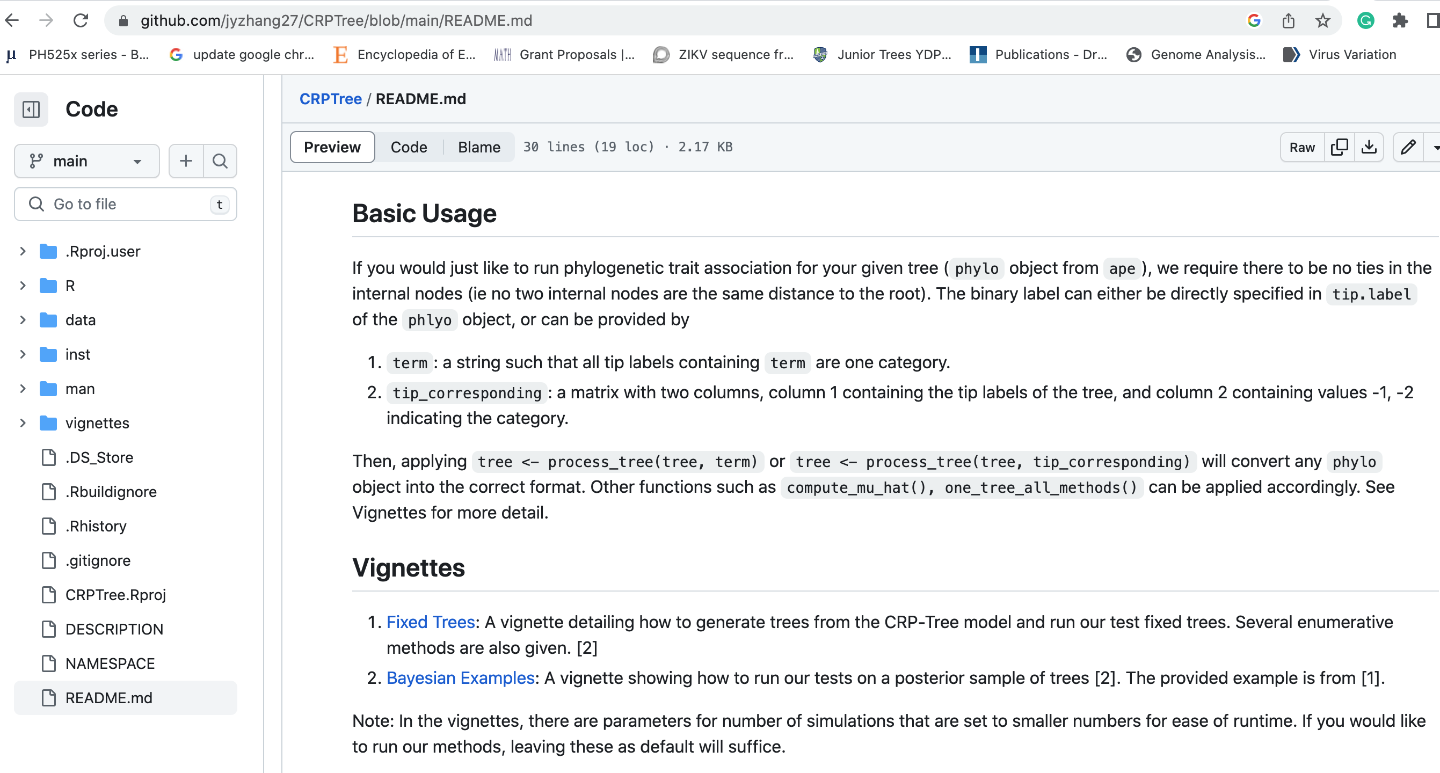

Reference and R-package CRP-Tree
Preprint:
Github R-package:

