Slide 1
Modelling population structure
Nicola F. Müller
e-mail: nicola.mueller@ucsf.edu

Slide 2
Phylogenetic trees are formed by population processes and contain information about them

Slide 3
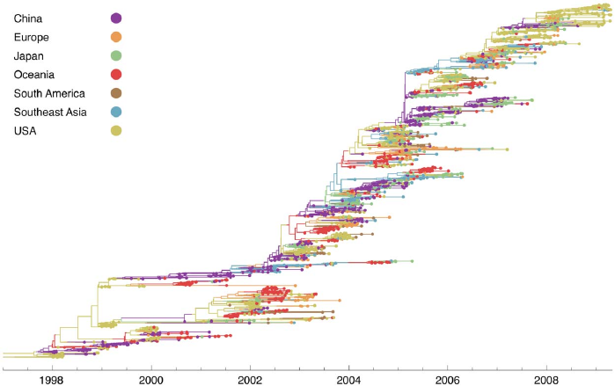
H3N2 sequences show spatial clustering
Bedford et al., 2010, PLoS Path.

Slide 4
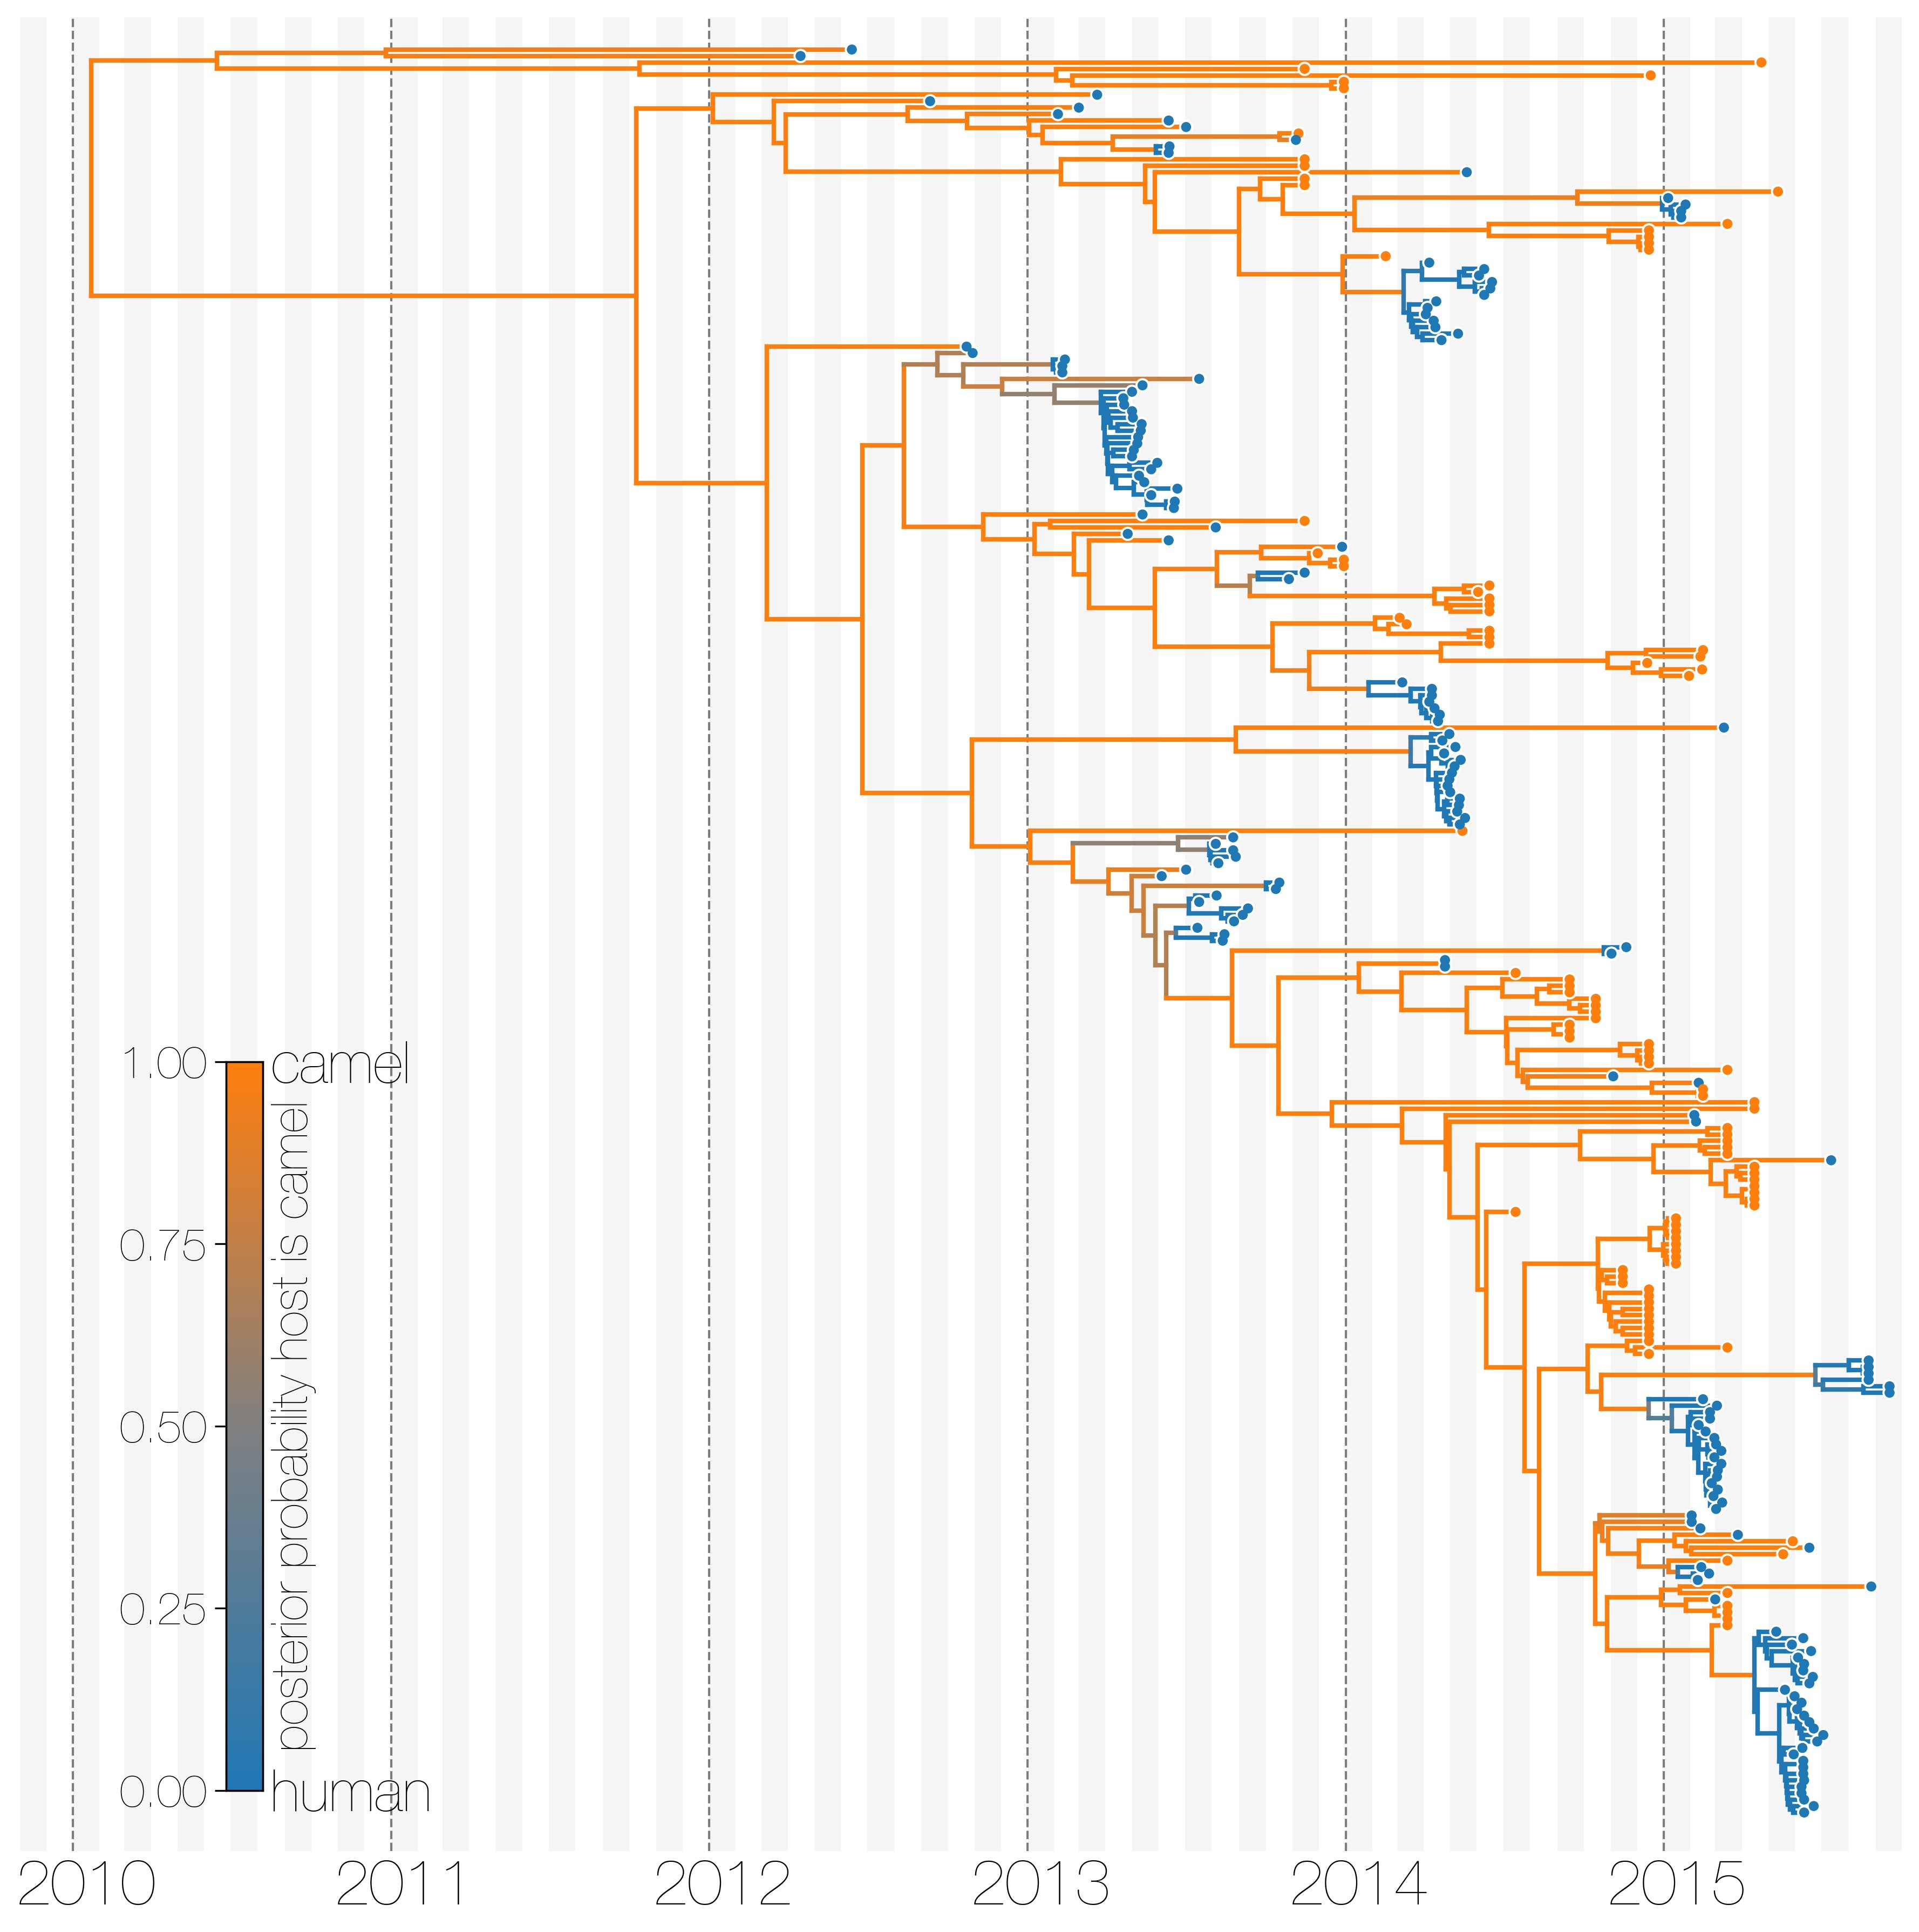
MERS sequences cluster by host of isolation
Dudas et al., 2018, eLife

Slide 5
In the posterior probability, modelling the population dynamics happens in the tree prior.
DuPlessis, L. et al. (2015),
Trends in Microbiology

Slide 6
Models to account for population structure:
DTA: Assumes structure to be a neutral trait evolving “on top” of a phylogenetic tree (Lemey 2009).
Structured Coalescent: Models how lineages coalesce within and migrate between discrete locations.
Multi-type Birth-death models: Models how lineages give birth to other lineage in the same and migrate between them.

Slide 7
Tree was generated by a different process (e.g. a coalescent process).
Slide from Timothy Vaughan

Slide 8
Root of the tree is in some location (here red)
Slide from Timothy Vaughan

Slide 9
Then models the migration process on top of this tree from the root to the tips
Slide from Timothy Vaughan

Slide 10
Sampling locations are considered Data.
Slide from Timothy Vaughan

Slide 11
Discrete trait analyses treat geography the same way as substitutions are treated
Some number of states instead of the 4 nucleotides are considered, but only one position. The number of states corresponds to discrete locations.
Some transition model between states (can be asymmetric) which are the migration rates.
Is not a tree prior, as such, a separate tree prior is needed.

Slide 12
Migration rates can be informed using outside data in a GLM approach

Slide 13
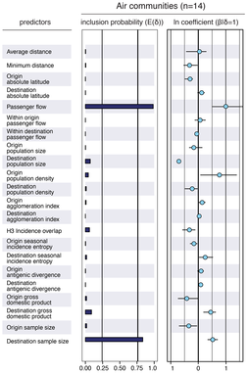
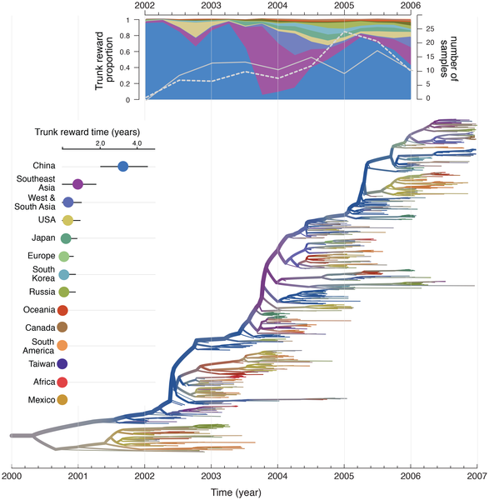
Migration rates in the DTA model can be informed by transportation Data
Lemey et al., 2014, PLoS Path.

Slide 14
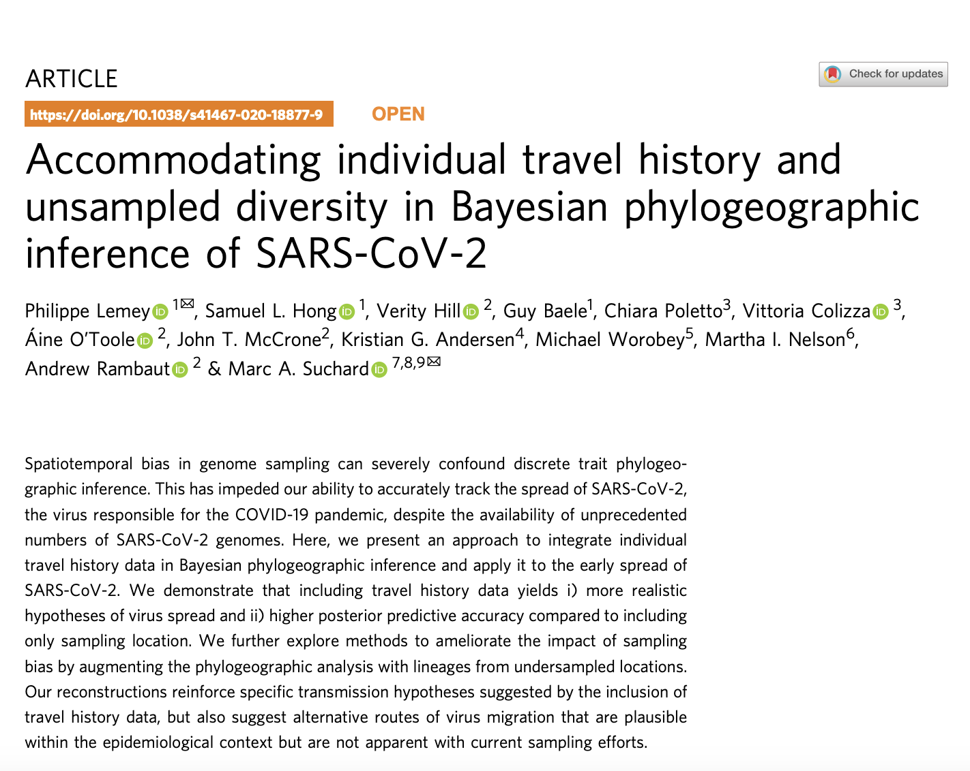
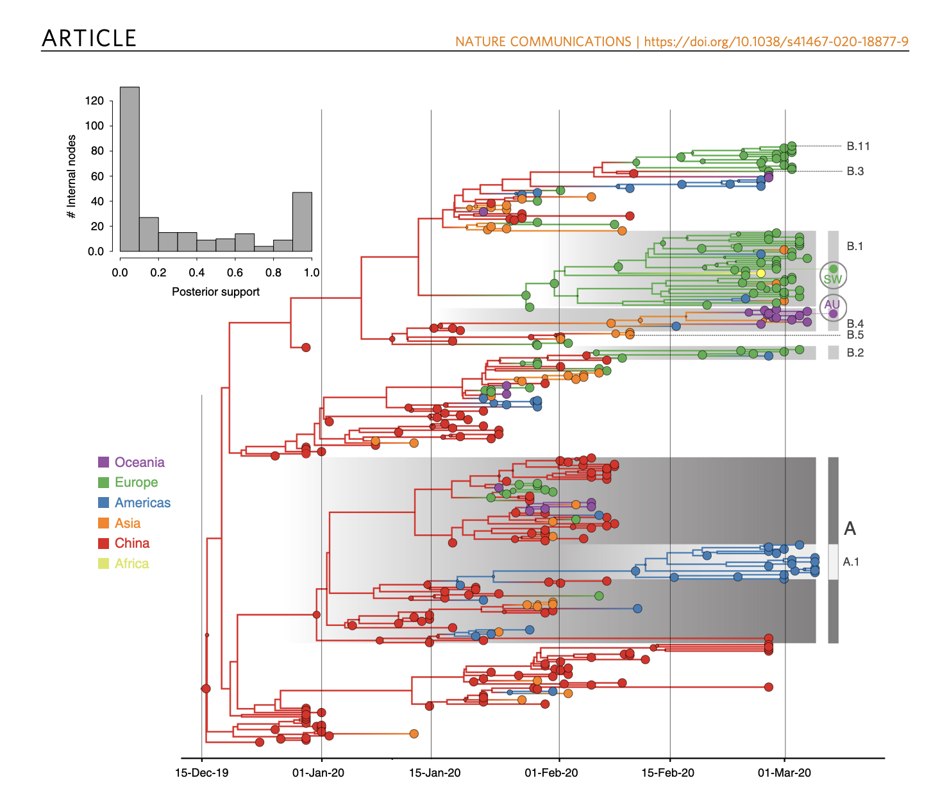
Lemey et al., 2020, Nat. Comm.

Slide 15
We track the ancestry of 4 viruses isolated from 4 people in 3 locations from present to past

Slide 16
Lineages can have originated from a different location at a rate given by the migration rate.

Slide 17
Two lineages can share a common ancestor at a rate inverse proportional to the Ne of location blue

Slide 18
Two lineages can share a common ancestor at a rate inverse proportional to the Ne of location yellow

Slide 19
Lineages can have originated from a different location at a rate given by the migration rate.

Slide 20
And then coalesce again in location blue, reaching the root of the tree

Slide 21
The structured coalescent models how lineages coalesce within and migrate between locations

Slide 22
This allows us to estimate how migration rates between locations differ

Slide 23
Or how the number of infected individuals differs between location

Slide 24
MERS sequences cluster by host of isolation
Dudas et al., 2018, eLife

Slide 25
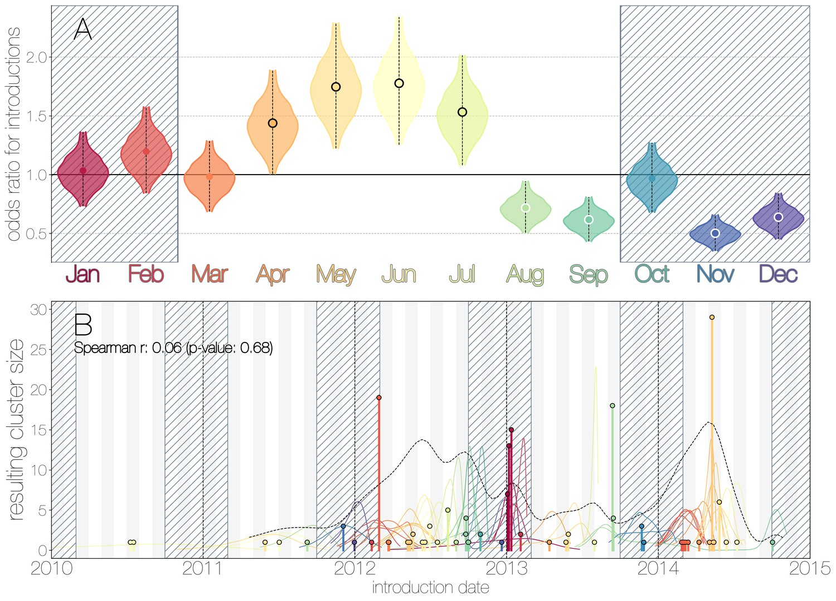
Seasonal trends in camel to human transmissions
Dudas et al., 2018, eLife

Slide 26
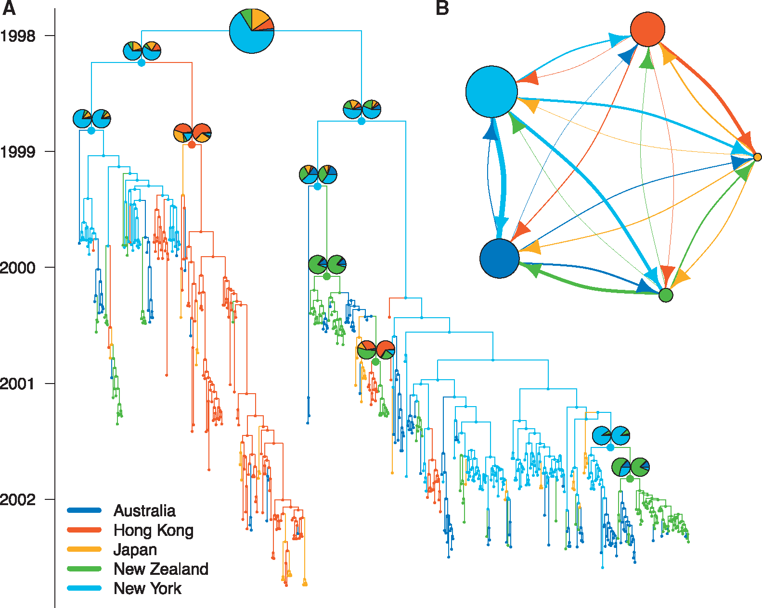
MASCOT approximates the structured coalescent to dramatically improve efficiency
Müller et al., 2018, Bioinf.

Slide 27
Migration rates and effective population sizes can be informed using outside data in a GLM approach

Slide 28
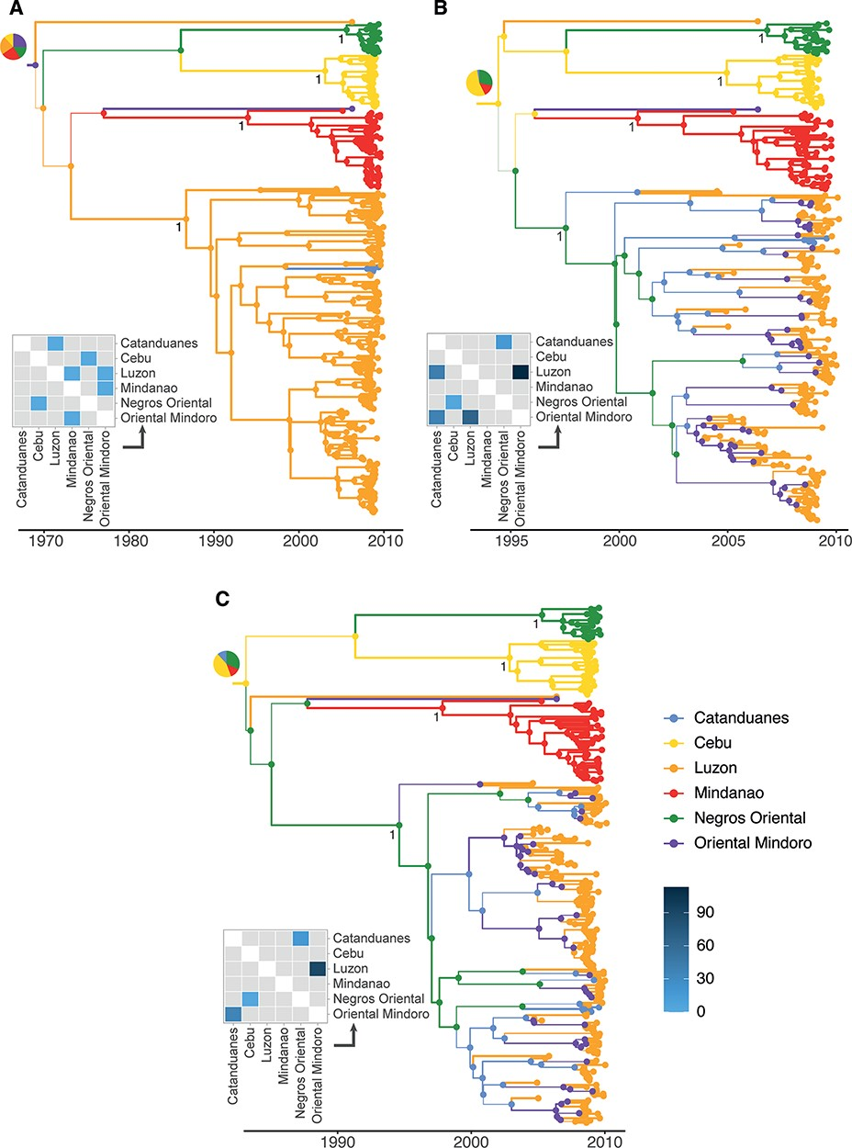
DTA typically returns a parsimonious ancestral state reconstruction
Layan et al. Virus Evolution, 2023

Slide 29
Effective population size dynamics can be modelled using MASCOT-Skyline
Müller et al. PLoS Comp Biol, 2025

Slide 30
Accounting for population dynamics in structured coalescent can impact ancestral state reconstruction
Müller et al. PLoS Comp Biol, 2025

Slide 31
Structured phylodynamic methods can be biased by unaccounted for populations structure
Müller et al. PLoS Comp Biol, 2025

Slide 32
Different methods can interpret very similar observations differently
Müller et al. PLoS Comp Biol, 2025

Slide 33
Different methods can interpret very similar observations (number of events) as different migration rates
Müller et al. PLoS Comp Biol, 2025

Slide 34
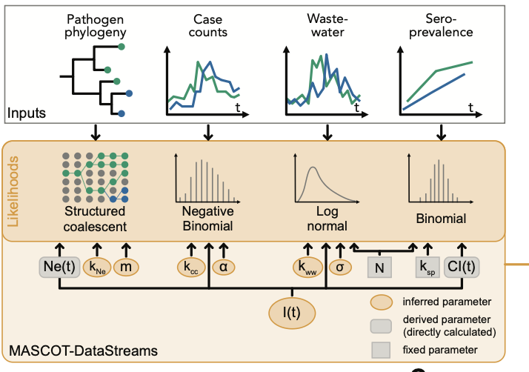
Joint inference of dynamics from genomics, case counts and seroprevalence
Weidemüller et al. in preparation

Slide 35
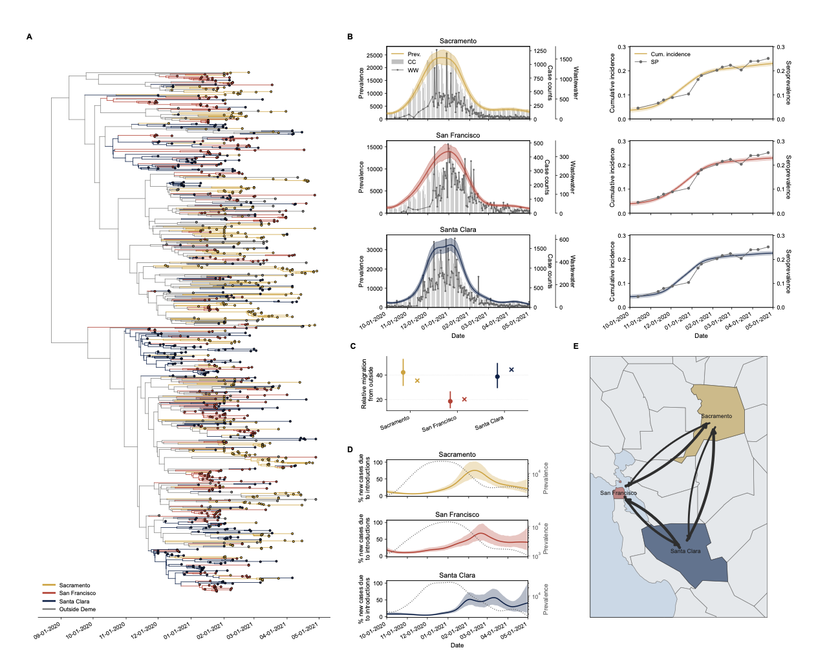
Joint inference of dynamics from genomics, case counts and seroprevalence
Weidemüller et al. in preparation

Slide 36
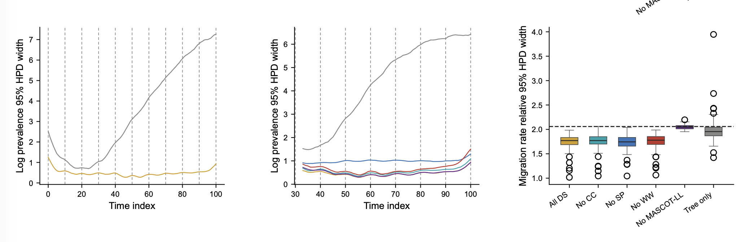
Genomics by itself is often worse at recovering population dynamics that case counts
Weidemüller et al. in preparation

Slide 37
MultiTypeTree: exact structured coalescent
Mascot: somewhat approximate
BASTA: rather approximate

Slide 38
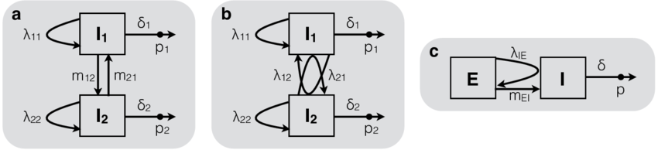
Multitype birth death processes model forward in time birth death sampling and migration
Kühnert et al., 2016, MBE

Slide 39
3 different implementations:
BDMM: original implementation in BEAST2
BDMM-Prime: reformulates the model setup, includes additional abilities, such as simulation trajectories
BDMM-Flow: speeds up computations of BDMM-prime, leading to much improved scaling

Slide 40
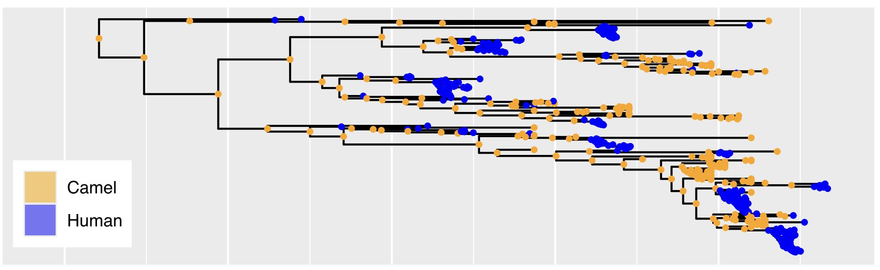
BDMM-prime enables reconstructing ancestral locations under the multi-type birth death model
Vaughan and Stadler, 2025, MBE

Slide 41
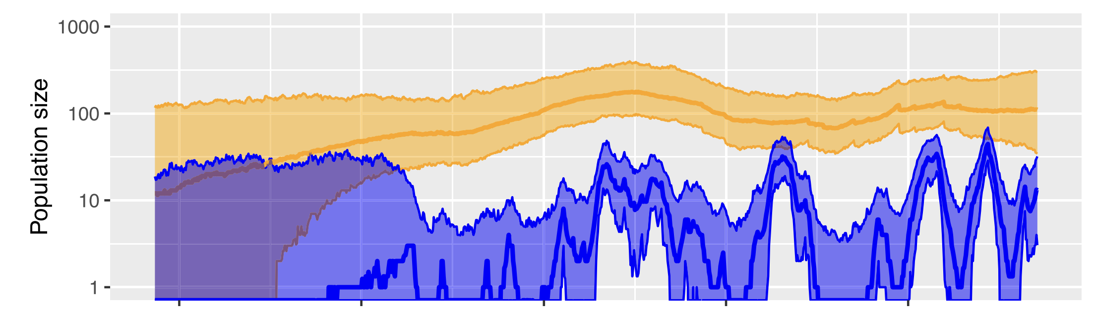
And, can sample population size trajectories under the multi-type birth death model as well
Vaughan and Stadler, 2025, MBE

Slide 42
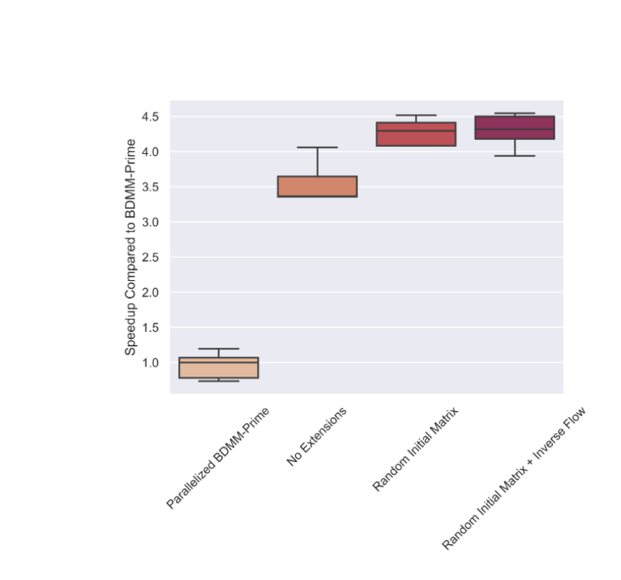
BDMM-Flow improves scalability of bdmm-prime, while being largely equivalent in accuracy
https://github.com/tochsner/BDMM-Flow

Slide 43
Pros / Cons
Pro: parameter estimates map to biologically meaningful quantities (R₀, length of infectious period, etc)
Con: computational cost (BDMM) or approximations (MSBD)
Con: sensitive to unmodelled sampling discrepancies

Slide 44
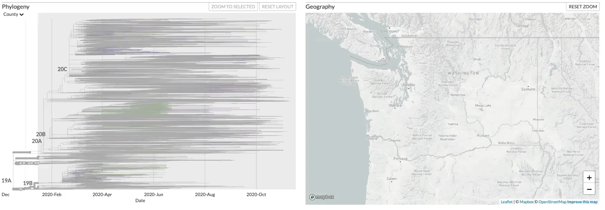
Phylogenetic tree of SARS-CoV-2 sequences isolated in Washington State reveal multiple introductions.
https://nextstrain.org/groups/blab/ncov/wa-phylodynamics?c=county
Notes:
Here, I show phylogenetic tree reconstructed from SARS-CoV-2 sequences isolated in Washington State and around to world, where samples from Washington State are colored based on the county they were isolated in.
After an initial introduction, SARS-CoV-2 spread mostly around Seattle, but more widespread around the state soon thereafter.
Viruses introduced early differed from those later, most notably by a amino acid substitution in the spike protein.
These two variants are referred to as 614D and 614G.

Slide 45
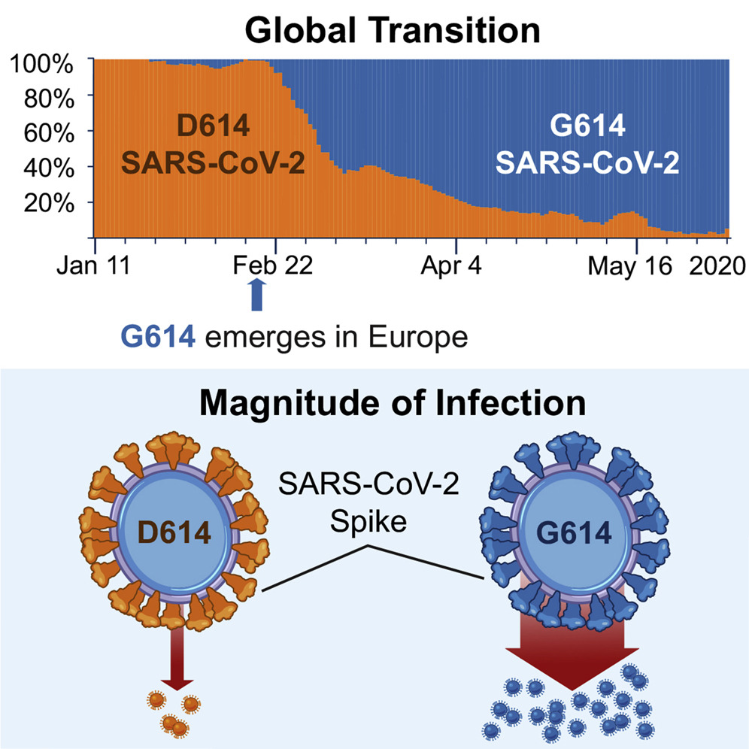
The two spike variants 614D and 614G were shown to differ in viral load and presumably transmission rate.
Korber et al. (2020), Cell
Notes:
The two spike variants 614D and 614G were shown to differ in viral load and presumably transmission rate.
614G emerged in Europe and soon became the dominant spike variant around the world.
The same pattern could be observed in Washington State, leading us to investigate why it took over here.

Slide 46
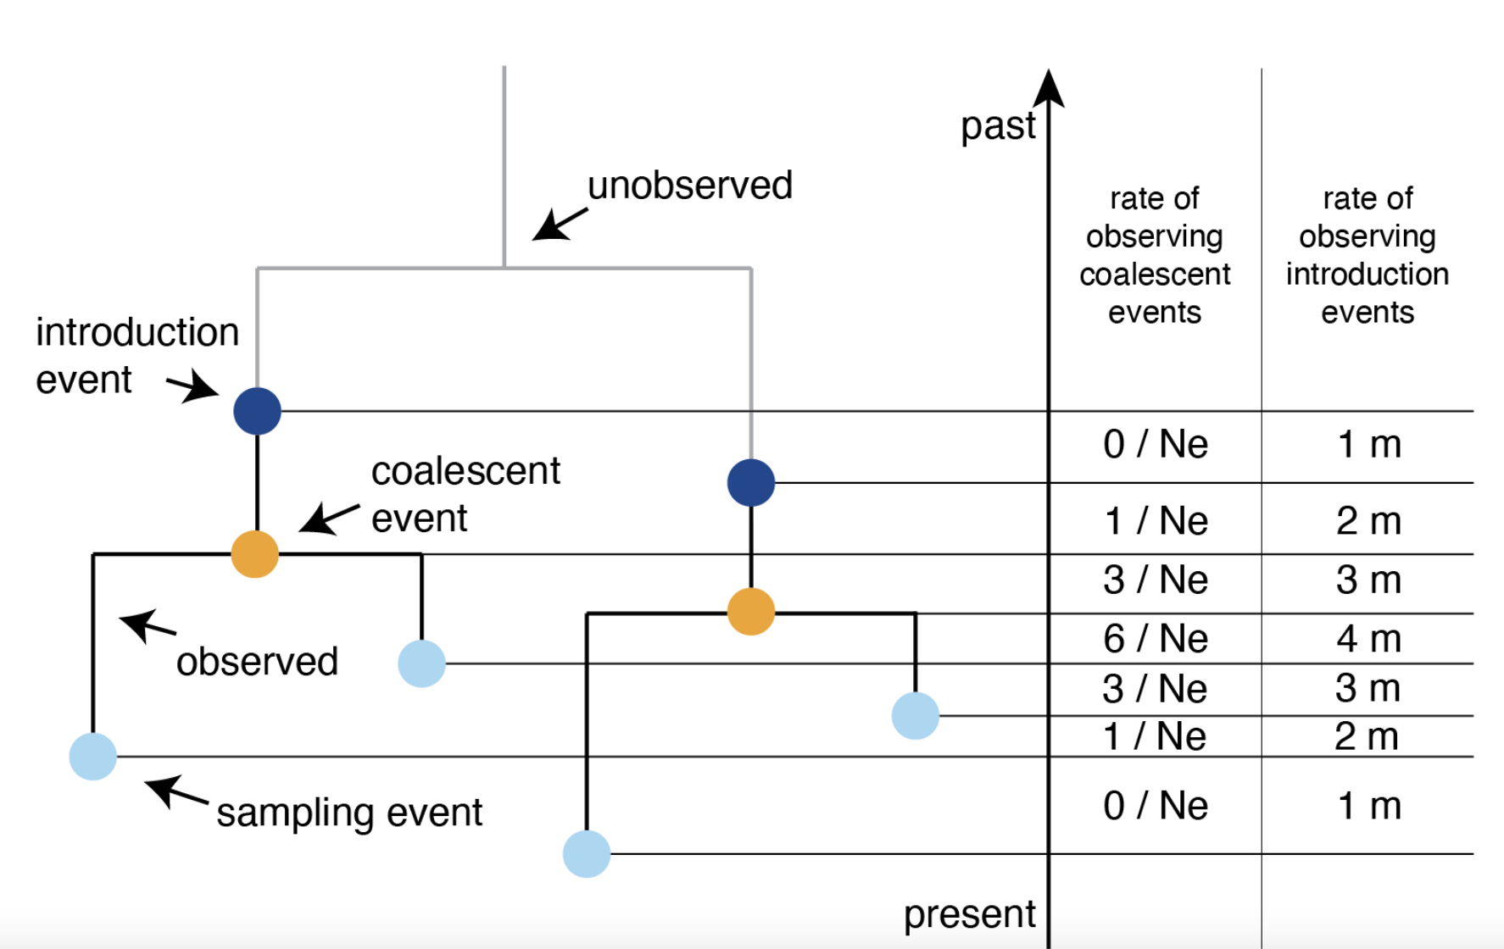
Migration histories can be conditioned on instead of estimated
Müller, Wagner, Frazar and Roychoudhury et al. (2021), BioRxiv

Slide 47
Reconstructing the effective population size of the spike variants reveals different temporal patterns
Müller, Wagner, Frazar and Roychoudhury et al. (2021), Sci. Trans. Med.
Notes:
We used phylodynamic approaches to study how the case load of the two different variants changed over time.
Reconstructing the effective population size, as measure proportional to the number of infected over time, of the spike variants reveals different temporal patterns.
614D dominated early, but soon declined, while 614G cases peaked much later.

Slide 48
Changes in the reproduction rate of different spike variants reflect different mobility trends in the state
Müller, Wagner, Frazar and Roychoudhury et al. (2021), Sci. Trans. Med.
Notes:
We can also reconstruct how the reproduction number, that is the number of secondary infections per infected individual changed over time using phylodynamics.
This revealed that the transmission dynamics of 614D cases change with mobility patterns in King County while 614G cases are more consistent with mobility patterns outside of King County.

Slide 49
Introductions played different roles in the spread of different SARS-CoV-2 spike variants
Müller, Wagner, Frazar and Roychoudhury et al. (2021), Sci. Trans. Med.
Notes:
We can also use these phylodynamic methods to get an idea of how important introductions are in driving cases.
What we find is that introductions from outside the state played only a minor role (after the initial introduction) in driving cases of 614D, but played a major role in driving 614G cases, the dominant variant at that time in Europe and the North East of the US.
This suggest that the changes in local frequencies of the two different spike variants very driven by different timings of when local measure were introduced and by a large number of introductions of 614G viruses from outside the state.

Slide 50
QUESTIONS?

Slide 51
Some reading material
Paper on DTA: https://doi.org/10.1371/journal.pcbi.1000520
How do different structured coalescent methods compare: https://academic.oup.com/mbe/article-abstract/34/11/2970/3896419
Birth-death models with migration: https://doi.org/10.1093/molbev/msw064
GLM for DTA: https://doi.org/10.1371/journal.ppat.1003932
GLM for MASCOT: https://doi.org/10.1093/ve/vez030

