Slide 1
Introduction

Slide 2
Introduction to Statistics

Slide 3
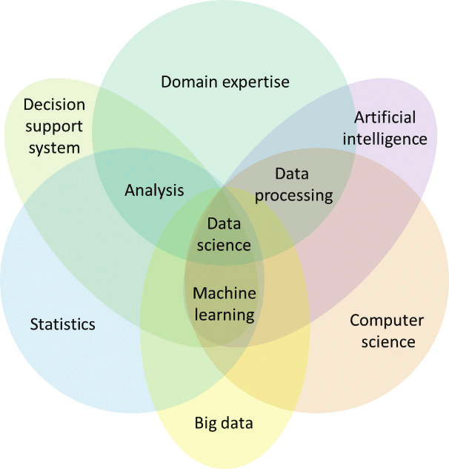
Statistics
Example
Example: Cats in New York
An article presented results on the number of injuries of cats that had plummeted from buildings in New York City, according to the number of floors they had fallen. The damage caused by such falls was dubbed feline high-rise syndrome (FHRS).
Researchers in the life sciences analyze data that exhibit some variability. For example, patients given the same treatment may respond differently; PCR (Polymerase Chain Reaction) prepared identically may have different results due to contamination, thermal damage, etc. The challenge to the life scientist is to discern the signal from the noise.
Statistics
Statistics is the science of understanding data (collection, analysis and presentation) and of making decisions in the face of variability and uncertainty. Statistics is a core component of data science.
Data Science, credit: Lee et al. 2018

Slide 4

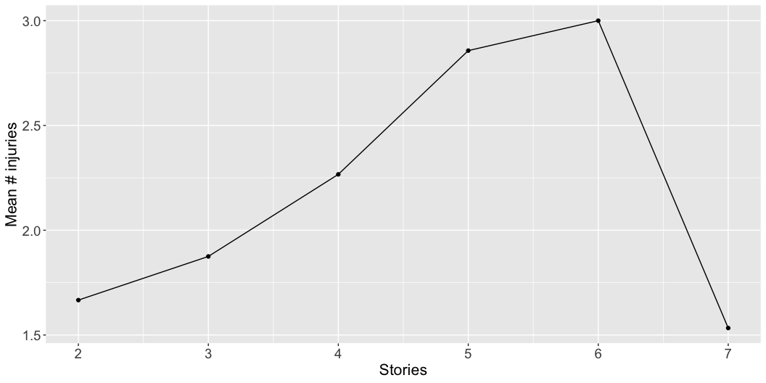
Raining cats

