Slide 1
Julia Usage Trends at NERSC
SC 2022
Nov 15, 2022
Johannes Blaschke
Data Science Engagement Group, NERSC

Slide 2
NERSC TL;DR
Our Users come to NERSC with varying amounts of HPC experience and with a very broad range of science problems
Our hardware is heterogeneous
Future engagements will increasingly involve cross-facility workflows (e.g. live data processing from experiments)
Need #1: High-Productivity High-Performance Glue Code
Need #2: Portable (whole) Workflow Performance

Slide 3
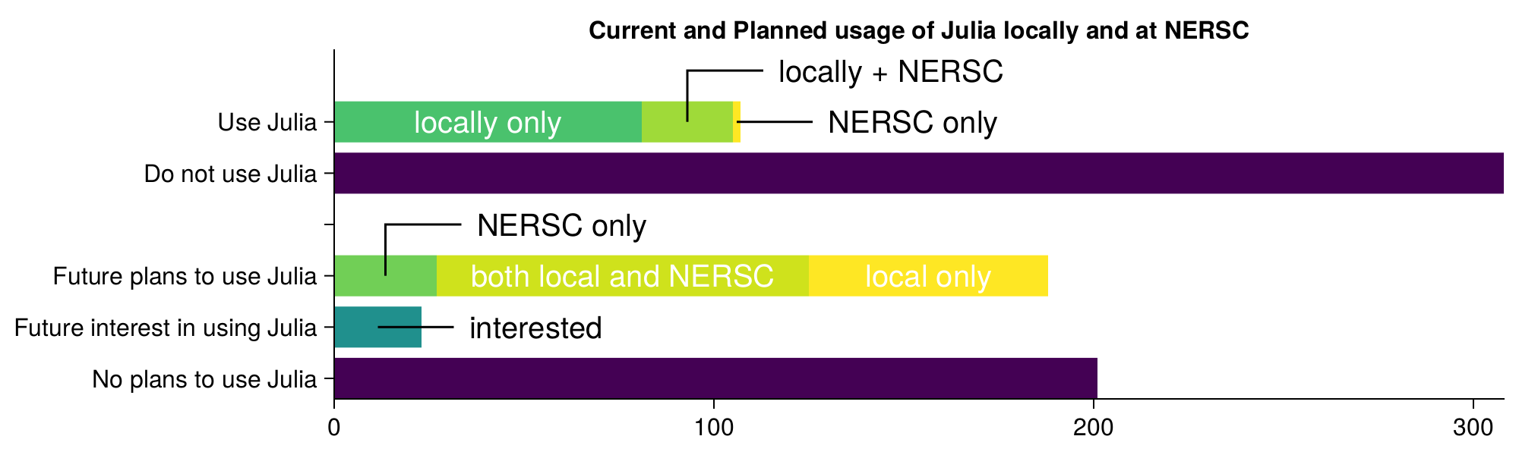
2021 NERSC Users Survey

Slide 4
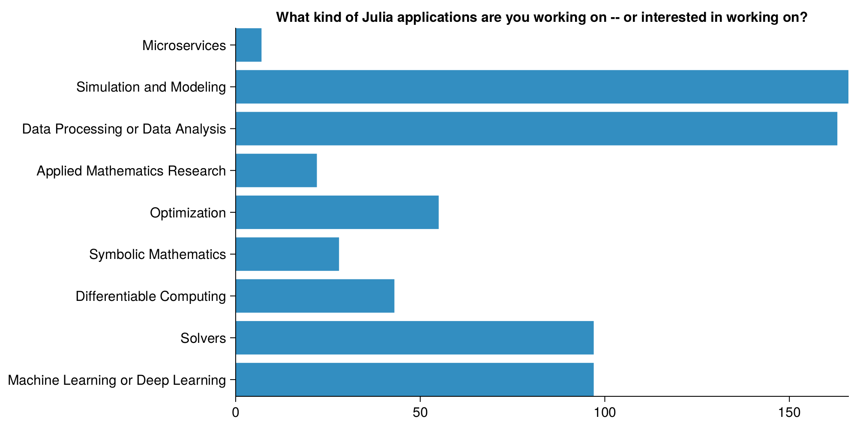

Slide 5
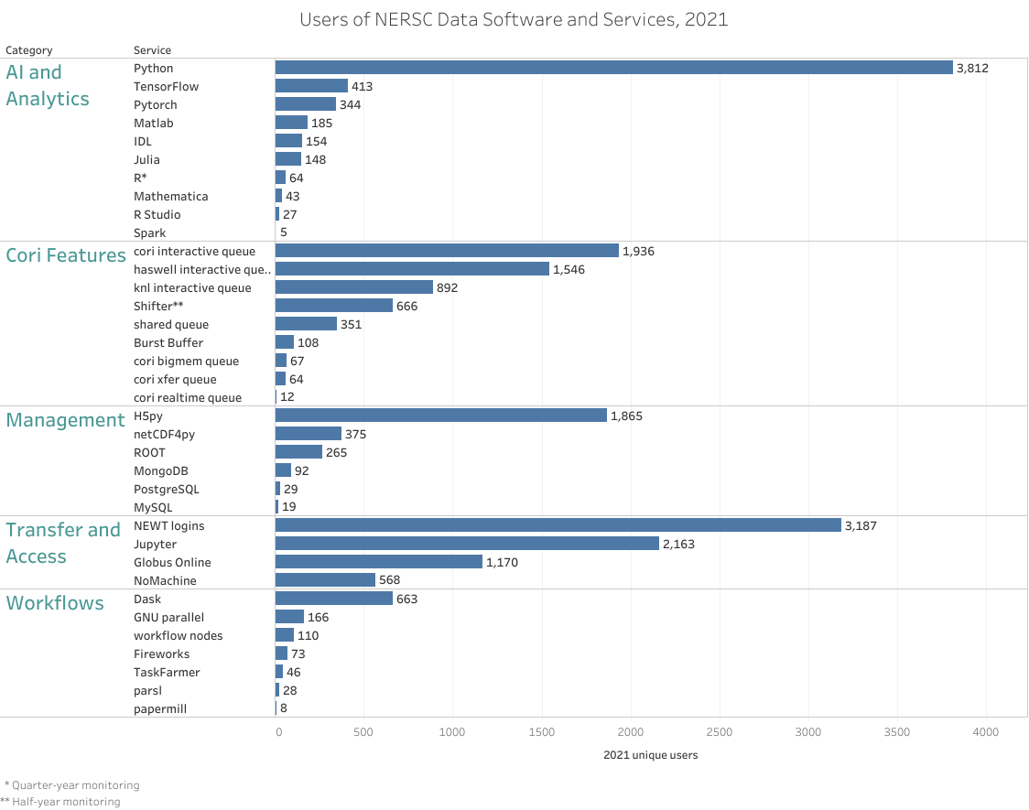
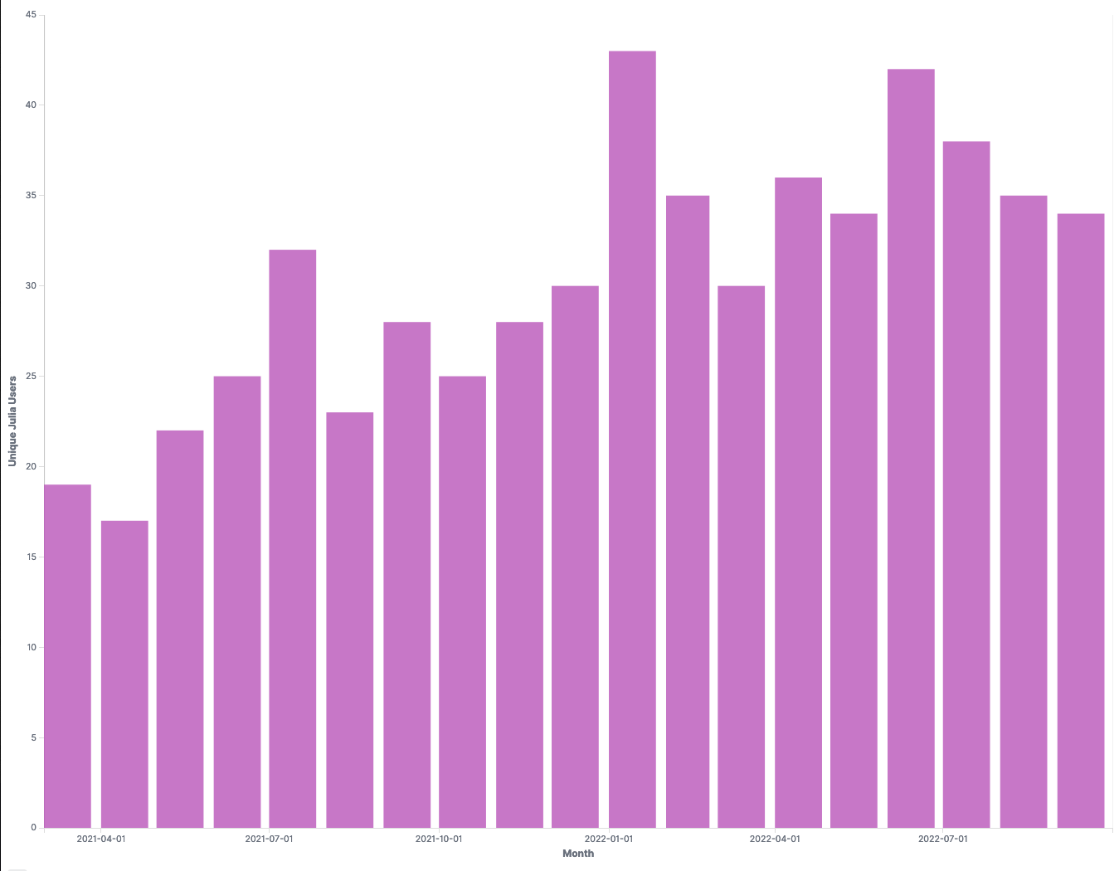
Julia Usage Trends at NERSC
Growing use of Julia modules at NERSC
229 module users (04/21-07/22)
40
Monthly Unique Julia
20
0

Slide 6
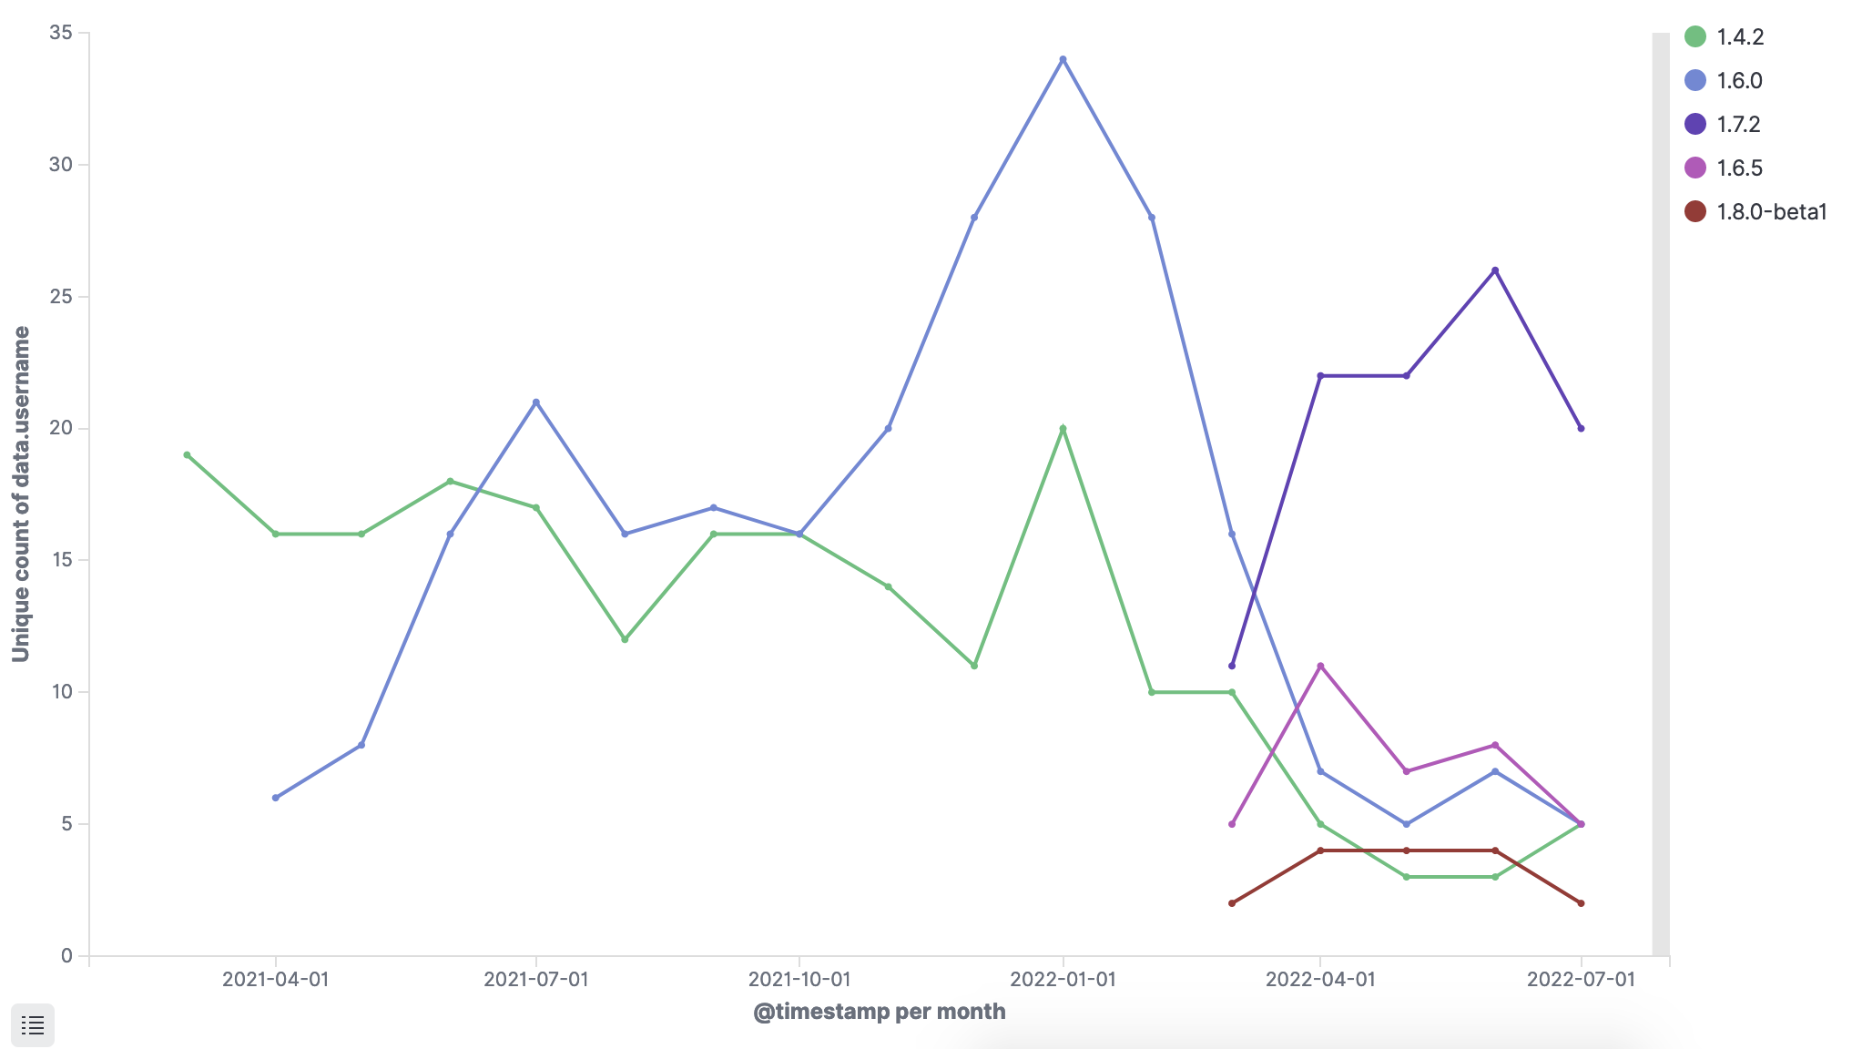
Julia Usage Trends at NERSC
Julia Users like new versions
Difficult for center software release cycle to keep up with latest Julia version
Use CI/CD to keep up to date
Enable users to be productive with their own Julia versions

