Slide 1







Performance in Julia (Matrix-Matrix Multiplication)
Pedro Valero-Lara and William Godoy
Computer Scientist at Computer Science and Mathematics Division, Programming Systems Group
valerolarap@ornl.gov

Slide 2
Motivation
What is the position of Julia in HPC?
We use a very simple 3 for-loop nested matrix-matrix multiplication https://github.com/williamfgc/simple-gemm
Kokkos, OpenMP, Julia, Python+Numba
Exascale architectures (Crusher/Frontier)
CPU -> 64-core AMD EPYC 7A53
GPU -> AMD MI250X

Slide 3
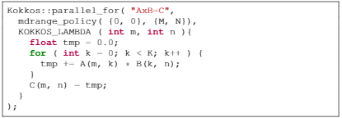
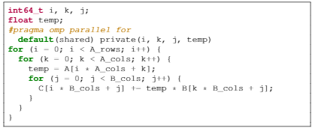
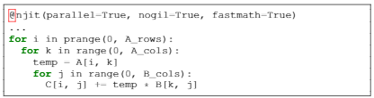
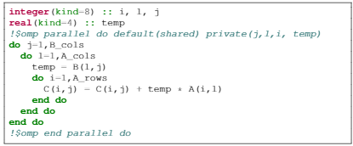
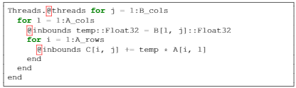
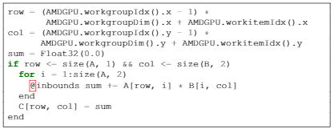
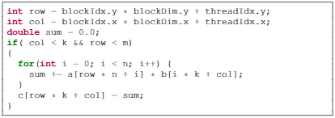
Which programming language/model is each one?
4
1
5
2
6
3
7

Slide 4
Performance Numbers on 1x AMD CPU EPYC 7A53 64-Core (Frontier)
OpenMP:
OMP_NUM_THREADS=64, OMP_PROC_BIND=spread, OMP_PLACES=threads
Modules loaded: rocm/5.2.0 or PrgEnv-gnu/8.3.3
C:
Compilers: AMD clang version 14.0.0 (amdclang), -march=znver3 -mtune=znver3 -fopenmp=libomp –O3 (GCC) 11.2.0 20210728 (Cray Inc.) (gcc), -fopenmp -O3
Fortran:
Compilers: AMD flang-new version 14.0.0 (amdflang), -march=znver3 -mtune=znver3 –fopenmp –O3 GNU Fortran (SUSE Linux) 7.5.0 (gfortran), -fopenmp -O3
Similar performance using AMD clang/flang and GNU GCC/Fortran
Kokkos (OpenMP):
Kokkos 3.5.0, KOKKOS_DEVICES=OpenMP, (AMD clang) KOKKOS_ARCH = "Zen3“, (GCC) KOKKOS_ARCH=“BSD”
OMP_NUM_THREADS=64, OMP_PROC_BIND=spread, OMP_PLACES=threads
Modules loaded: rocm/5.2.0 or PrgEnv-gnu/8.3.3
Compilers: AMD clang version 14.0.0 (amdclang++), -std=c++14 -march=znver3 -mtune=znver3 -fopenmp=libomp –O3 (GCC) 11.2.0 20210728 (Cray Inc.) (g++), -std=c++14 -fopenmp -O3
Similar performance using AMD clang and GNU GCC
Python+NUMBA:
Python 3.9.12 and NUMBA 0.55.2 EXECUTABLE=../../python/GemmDenseThreads.py python3 -64 --project=$GemmDenseDIR $EXECUTABLE $M $M $M
Julia:
julia 1.8.0-rc1: https://julialang.org/downloads/#upcoming_release PROJDIR=../../julia/GemmDenseThreads EXECUTABLE=$PROJDIR/gemm-dense-threads.jl srun -n 1 --ntasks-per-node=1 -c julia -O3 -64 --project=$PROJDIR $EXECUTABLE $M $M $M
https://github.com/williamfgc/simple-gemm

Slide 5
Performance Numbers on 1x AMD GPU MI250x (Frontier)
HIP:
Modules loaded: rocm/5.2.0
Compiler: HIP version: 5.2.21151-afdc89f8 AMD clang version 14.0.0
Kokkos (HIP):
Kokkos 3.5.0 (installed in Crusher) hipcc -std=c++14 -I/sw/crusher/spack-envs/base/opt/cray-sles15-zen3/cce-14.0.0/kokkos-3.5.00-wnl6ceqkrlte4qbopksgwnyfwk4arjyo/include -L/sw/crusher/spack-envs/base/opt/cray-sles15-zen3/cce-14.0.0/kokkos-3.5.00-wnl6ceqkrlte4qbopksgwnyfwk4arjyo/lib64 -lkokkoscore test.cpp –o run export LD_LIBRARY_PATH= $LD_LIBRARY_PATH:/sw/crusher/spack-envs/base/opt/cray-sles15-zen3/cce-14.0.0/kokkos-3.5.00-wnl6ceqkrlte4qbopksgwnyfwk4arjyo/lib64
Julia:
julia 1.8.0-rc1: https://julialang.org/downloads/#upcoming_release
Run on Crusher: export JULIA-AMDGPU_DISABLE_ARTIFACTS=1 https://github.com/williamfgc/simple-gemm/blob/main/scripts/julia/run_amdgpu_crusher.sh
Python+Numba:
Note that the support of NUMBA for AMD GPUs is “unmaintained”: https://numba.readthedocs.io/en/stable/release-notes.html?highlight=ROCm#version-0-54-0-19-august-2021
https://github.com/williamfgc/simple-gemm

Slide 6
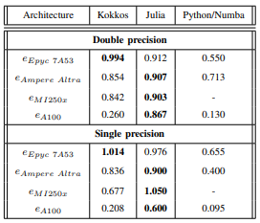
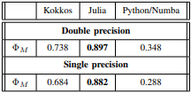


Performance Portability (Julia vs Python+Numba vs Kokkos)
Performance Portability (ΦM) [1]
e_i (a) -> efficiency of one portable code (i) on an application (matrix-matrix multiplication)
T -> number of platforms
Efficiency
Time consumed by the portable model divided by the time consumed by the no-portable and specific model
Architectures tested
2 CPUs architectures
ARM Ampere Altra Ampere 80 core, 1 NUMA
AMD Epyc 7A53 x 64-core, 4-NUMA
2 GPUs
NVIDIA A100
AMD MI250X
https://github.com/williamfgc/simple-gemm
[1] A. Marowka, “On the performance portability of openacc, openmp, kokkos and RAJA,” in HPC Asia 2022: International Conference on High Performance Computing in Asia-Pacific
Region, Virtual Event, Japan, January 12 - 14, 2022. ACM, 2022, pp. 103–114. [Online]. Available: https://doi.org/10.1145/3492805.3492806

Slide 7
Thanks! Questions??
Pedro Valero-Lara and William Godoy
Computer Scientist at Computer Science and Mathematics Division, Programming Systems Group
valerolarap@ornl.gov

