Slide 1
Auto-Tuning GPU Kernels in Julia
Julia for HPC Tutorial
Floris-Jan Willemsen & Evelyne Ringoot

Slide 2



Overview
Program
Introduction
Autotuning basics
Using optimization algorithms and restrictions
Energy-efficient autotuning
Practical matters
Either run the notebooks locally or use the provided AMD GPUs
Materials can be downloaded at:
https://fjwillemsen.com/s/JuliaSC26
Floris-Jan Willemsen, Leiden University
Evelyne Ringoot, MIT, USA
Notes:
About us
Program
We will have three sessions in which we start with introducing some new concepts followed by a hands-on session.
Practical stuff

Slide 3
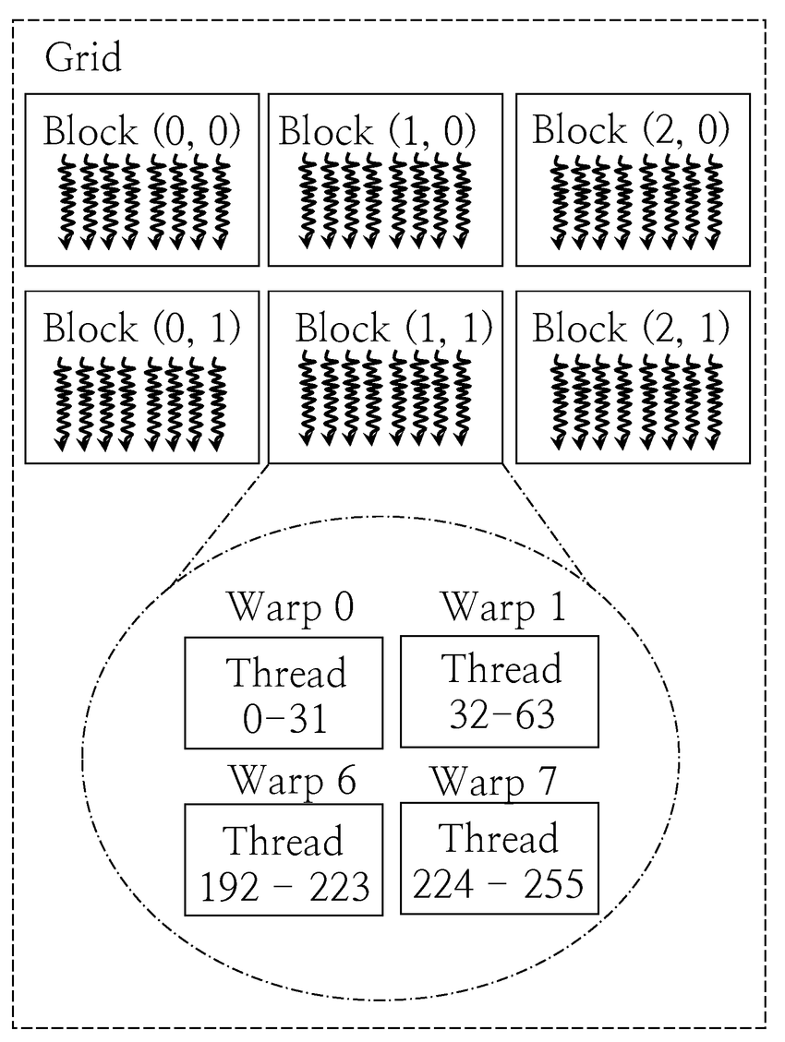




The portability challenge in HPC
Develop and optimize code for CUDA
Translate code to HIP, SYCL, …
Maybe: optimize code for each hardware
Cry…
Driven by different launch models, memory semantics, and compiler intrinsics resulting in different optimal hyperparameter values
Complexity scales as: libraries × vendors × hardware generations
University buys AMD GPUs
Surprise: bad code performance
Try to run on MacBook, GPU or heterogeneous cluster
Example: linear algebra libraries
Very small data size (<256)
CPU, e.g., LAPACK
rcoSOLVER
Larger data
Faster on GPU
Data fits in GPU
cuSOLVER
oneMKL
Data larger than GPU
limited
Multiple CPU cores
PLASMA
Multicore GPUs
MAGMA
Using GPU
vendor software
Mixed GPU-CPUs
SLATE
Porting and re-optimizing code is not sustainable [1]
Maintaining spaghetti-code is not sustainable
Notes:
Everyone in HPC today faces the same nightmare. You’ve got NVIDIA GPUs in one cluster, AMD in another, maybe some Intel GPUs, and Apple Silicon locally. So what do we do? We write CUDA kernels. Then we rewrite them in HIP. Then SYCL. Then find out none of that runs on your laptop anymore.
Each demands its own kernel launch syntax, its own memory model quirks, its own compiler intrinsics. It’s not just kernels, it means maintaining entire parallel code paths with divergent optimization logic. And these optimizations don’t transfer. The tile size that’s optimal on an H100 might tank performance on an MI300X. The warp-level primitives you hand-tuned for NVIDIA don’t map cleanly to AMD’s wavefronts. So you end up with a combinatorial explosion: N libraries × M vendors × K hardware generations. This isn’t sustainable, neither in time nor software complexity. It locks scientific software to specific hardware procurement cycles, and makes reproducibility across centers nearly impossible.
This problem is exemplified in Evelyn’s specialty: linear algebra libraries, where for every type of hardware a different library has been developed.
Each vendor-specific implementation is a maintenance burden that grows exponentially with every new architecture. The numbers are staggering: for example in the Exascale Computing Project [1], it took 250 staff member 6 years to port 70 libraries for performance portability; clearly not the kind of time budget the average scientist has available, or wants to spend on translating the same mathematical intent into three, four, five different vendor dialects. And when the next generation lands? You do it all over again. This is the performance-portability dilemma: we need vendor-level efficiency, but we can’t sustain vendor-locked codebases.
Something has to give.
Now imagine a world where…

Slide 4

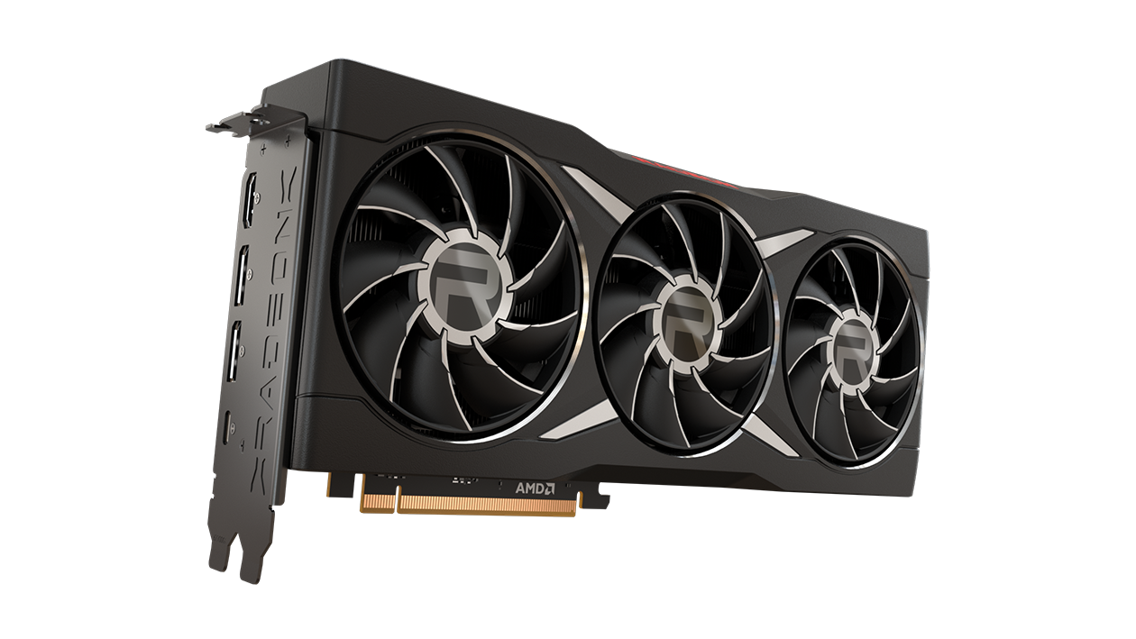
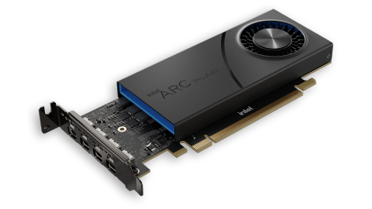
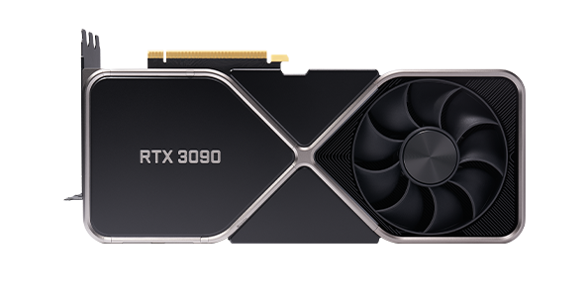

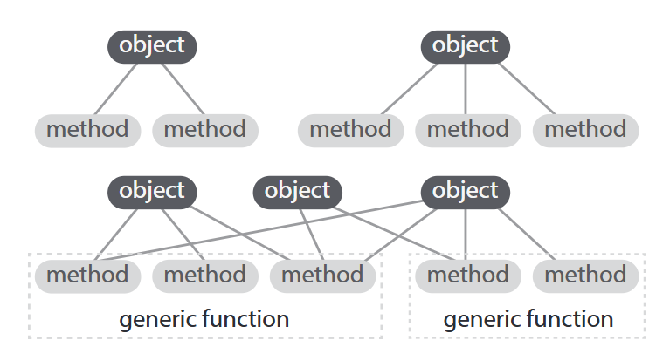
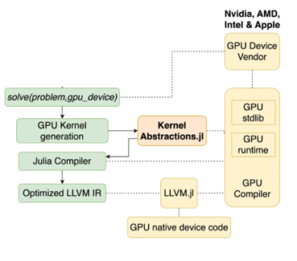

The Dream: performant, extensible, sustainable
Julia: performance through compiler JIT optimization
Seamless support for
Multiple-dispatch provides composability
Kernel abstractions: portable code across GPU vendors
Wide range of hardware
Novel data precision
or mixed precision
HPC code development
scalability
exp
mantissa
Kernels compiled to native code through LLVM
FP64
+
FP32
TF32
BF16
FP16
(Bezanson, e.a., 2019 [2])
High-level abstractions allow plugging in low-level building blocks and extending to new building blocks seamlessly
(Utkarsh, e.a., 2023 [3],
library: Churavy, e.a., 2023 [4])
Notes:
Here’s the idea: you write your kernel once in Julia, using high-level abstractions without vendor-specific code, just algorithmic intent. At JIT-compile time, KernelAbstractions lowers that single kernel to vendor-specific Intermediate Representations: PTX for NVIDIA, GCN/RDNA assembly for AMD, SPIR-V for Intel and SYCL targets, Metal IR for Apple. You’ve got the same source code, the same Julia process, and yet native performance on each backend. NextLA.jl builds on this for linear algebra. It gives you BLAS/LAPACK-style operations that just work across NVIDIA, AMD, Intel, and Apple hardware. One codebase serving four vendor backends, without any vendor-specific kernel code. This is the promise: express intent once, run efficiently everywhere.

Slide 5
The Dream: performant, extensible, sustainable
Julia: performance through compiler JIT optimization
Seamless support for
Multiple-dispatch provides composability
Kernel abstractions: portable code across GPU vendors
Wide range of hardware
Novel data precision
or mixed precision
HPC code development
scalability
Is compiler optimization sufficient?
exp
mantissa
Kernels compiled to native code through LLVM
FP64
+
FP32
TF32
BF16
FP16
(Bezanson, e.a., 2019 [2])
High-level abstractions allow plugging in low-level building blocks and extending to new building blocks seamlessly
(Utkarsh, e.a., 2023 [3],
library: Churavy, e.a., 2023 [4])
Notes:
No, we need hyperparameters for GPU code

Slide 6
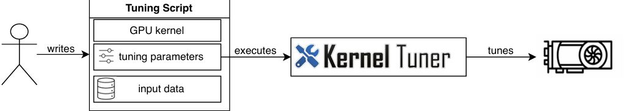
Autotuning optimizes parameters by hardware
Autotuning loop
Generate configurations
Mature search and optimization infrastructure
Compile and run each candidate
Measure performance
Search for the best configuration
Caches results per hardware target
Supports:
  CUDA, HIP, OpenCL, C++, Fortran, OpenACC
  20+ search optimization algorithms and multi-objective Optimization
  Energy measurement of GPU kernels
  Mixed-precision & accuracy tuning
Notes:
Auto-tuning is simple in principle: you define a parameterized kernel and a search space of valid configurations. The auto-tuner then:
Generates candidate configurations from the search space
Compiles & executes each candidate on the target hardware
Measures actual runtime (or energy, accuracy, memory footprint etc.)
Searches, ideally intelligently, to find the global minimum
Caches results so re-tuning is instant on known hardware
This goes on in a loop, replacing the guesswork of ”I think 256 threads works well” that quickly becomes infeasible with complex kernels on a multitude of hardware platforms with empirical measurements and intelligent optimization to efficiently get close to the optimal configuration.
This auto-tuning is a common approach, and various auto-tuners exist for a variety of programming languages and GPU programming models. One of which is Kernel Tuner, a mature, open-source auto-tuning framework we build on. Born in the Python ecosystem, Kernel Tuner has been developed since 2016, and is used in production at labs and research projects, offering a wide array of features. Such as:
CUDA, OpenCL, C++, HIP, etc kernels
Bayesian optimization, genetic algorithms, Multi-objective etc
Energy measurements and accuracy tuning

Slide 7
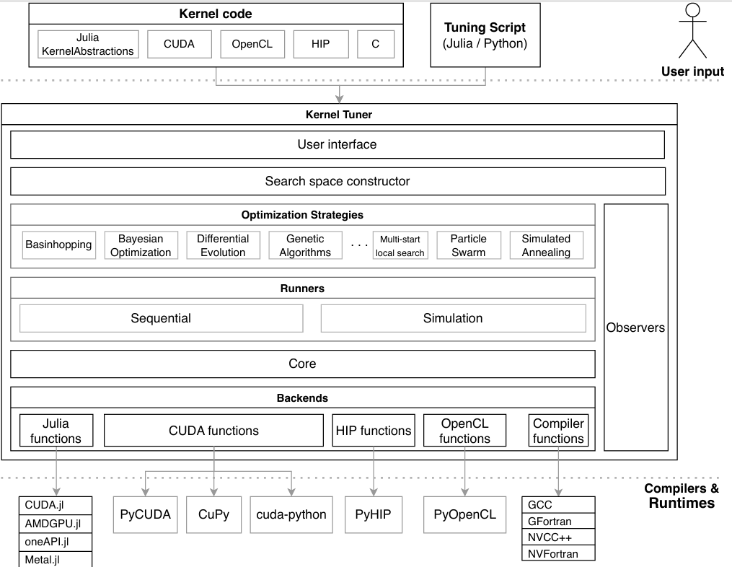
KernelTuner meets KernelAbstractions.jl
Kernel Tuner manages:
  Search space
  Search strategy
  Error handling
  Persistent cache
Julia compiles and launches GPU kernels
PythonCall.jl / JuliaCall provide in-process interoperability
Combines Julia portability with Kernel Tuner’s mature ecosystem
Notes:
However, this often vendor-specific auto-tuning had not yet made its way to the high-level style of KernelAbstractions. This is where the auto-tuning and Julia superpowers meet: high level of abstraction and portability while also achieving high performance. In Julia, you can pass values as type parameters, and the compiler specializes the entire kernel for those constants at compile time, without branching or runtime overhead. The compiler sees exact values and generates optimal machine code. This aligns perfectly with auto-tuning: the tuner searches the space of tunable parameters, and for each candidate, it passes constants into the kernel. The JIT compiler does the rest: specializing, inlining, unrolling, vectorizing, etc.. So we replace manual expert guesses with automated design-space search. The expert defines the search space; the auto-tuner finds the optimum for each target platform, while the kernel source code never changes. Only the constants passed at launch time.
How do we make this practical? We built KernelTuner.jl: a bridge between the Kernel Tuner auto-tuning ecosystem and Julia’s native GPU runtime.
Here’s the architecture: The Python side (Kernel Tuner) handles the search space construction, error handling, search strategy, etc. The Julia side compiles and executes kernels. This design means there is no code duplication. The kernel lives in Julia, the auto-tuning logic lives in Python, communicating via PythonCall and JuliaCall. This allows both to develop at their own pace, while benefiting from each other’s developments, meaning we get Kernel Tuner’s rich (and increasingly richer) feature set for free, usable on Julia kernels across all GPU backends. Time to see that in action, what have you got for us?

Slide 8
Auto-Tuning GPU Kernels in Julia
Go to:
fjwillemsen.com/s/JuliaSC26

Slide 9

Go to:
fjwillemsen.com/s/JuliaSC26form
We care about
your experience.
Please take a minute to provide some feedback.
Notes:
https://whispermeter.com/feedback/BNT8SOOXK3

Slide 10

Stay Tuned,
Or Contribute.
f.q.willemsen@liacs.leidenuniv.nl
eringoot@mit.edu
Star / Open an issue on: https://github.com/KernelTuner/KernelTuner.jl

Slide 11
References
[1]: Scalable Delivery of Scalable Libraries and Tools: How ECP Delivered a Software Ecosystem for Exascale and Beyond, Michael A. Heroux
[2] Effective extensible programming: unleashing Julia on GPUs,Besard et al, 2018
[3] Automated translation and accelerated solving of differential equations on multiple GPU platforms, Utkarsh et al, 2023
[4] JuliaGPU/KernelAbstractions.jl , Churavy et al, 2023

Slide 12
Questions?
Feedback?
f.q.willemsen@liacs.leidenuniv.nl
eringoot@mit.edu
Star / Open an issue on: https://github.com/KernelTuner/
KernelTuner.jl

