Slide 1
Predictive Analysis in Julia
Philip Thomas
SQuInT Breakout Session
21 February 2015

Slide 2
Brief overview of predictive analysis in Julia using the JuMP package for optimization, with a focus on Physics applications

Slide 3
Agenda
Introduction
Optimization and Operations Research
Julia and JuMP
Applications

Slide 4
Introduction

Slide 5
Resources for this talk
Github.com/StaffJoy/jump-examples
Vagrant is the easiest way to run the examples
Follow-up at Blog.StaffJoy.com
Shoot us a tweet: @StaffJoy

Slide 6
About Me
WUSTL 2013 - BS in Systems Engineering, Physics
Data telemetry and analysis for network security
StaffJoy application makes teams more efficient by automating shift scheduling and management.
We use JuMP extensively (10-50 models per workforce)

Slide 7
Optimization and Operations Research

Slide 8
Optimization
Minimize or maximize an objective function subject to constraints by varying decision variables.
Decision variables are typically:
Binary
Integral
Unconstrained

Slide 9
Example - Carrying Change
What is the lightest way to carry 99 cents in US coins?
Min 2.5p + 5n + 2.268d + 5.670*q
s.t. p + 5n + 10d + 25q ≥ 99
p, n, d, q ≥ 0
p, n, d, q ∈ Z

Slide 10
Problem Classification
Type | Example objective function | Example Algorithm
Linear Programming | x + y ∀ x, y ∈ R | Simplex
Integer Programming | x + y ∀ x, y ∈ Z | Branch and bound
Convex Programming | √(x + y) ∀ x, y ∈ R | Interior point method
General Nonlinear Programming | x*y ∀ x, y ∈ R | Evolutionary algorithm

Slide 11
Classic OR Optimization Applications
Knapsack problem
Routing problems
Traveling salesman problem
Scheduling

Slide 12
Physics Applications
Variational calculus (Power series)
Lagrangian mechanics
Ground energy states, e.g. repellant particles
Power flow

Slide 13
Julia and JuMP

Slide 14

Julia
Open source scientific computing language
JIT compiler with dynamic Dispatch
Package Manager
Parallel and Distributed
learnxinyminutes.com/docs/julia/

Slide 15
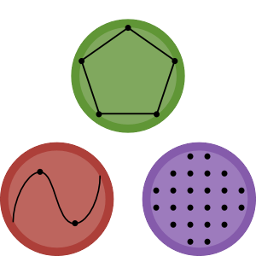
JuMP - Optimization in Julia
Julia for Mathematical Programming
JuliaOpt.org
Wrapper for low-level solvers
Provides an extensible optimization metalanguage
Currently supports LP, IP, NLP and more

Slide 16
Why JuMP
“Rosetta stone” for optimization
High-level
Extensible
Supports a variety of low-level solvers, including commercial and open-source

Slide 17
Brief Intro to JuMP
Import using JuMP
Model m = Model(solver=CbcSolver())
Variables @defVar(m, x <= 0, Int)
@defVar(m, y >= -4, Int)
Constraints @addConstraint(m, x - 2y == -2)
Objective @setObjective(m, Min, x-y)
Solve solve(m)

Slide 18
Applications

Slide 19
Example - Carrying Change
What is the lightest way to carry 99 cents in US coins?
Min 2.5p + 5n + 2.268d + 5.670*q
s.t. p + 5n + 10d + 25q ≥ 99
p, n, d, q ≥ 0
p, n, d, q ∈ Z

Slide 20
macklemore.jl
using JuMP, Cbc m = Model(solver=CbcSolver()) @defVar(m, pennies >= 0, Int) @defVar(m, nickels >= 0, Int) @defVar(m, dimes >= 0, Int) @defVar(m, quarters >= 0, Int) @addConstraint(m, 1 * pennies + 5 * nickels + 10 * dimes + 25 * quarters >= 99) @setObjective(m, Min,
2.5 * pennies + 5 * nickels + 2.268 * dimes + 5.670 * quarters) solve(m)

Slide 21
macklemore.jl
Minimum mass: 22.68 grams
using:
0 pennies
0 nickels
10 dimes
0 quarters

Slide 22
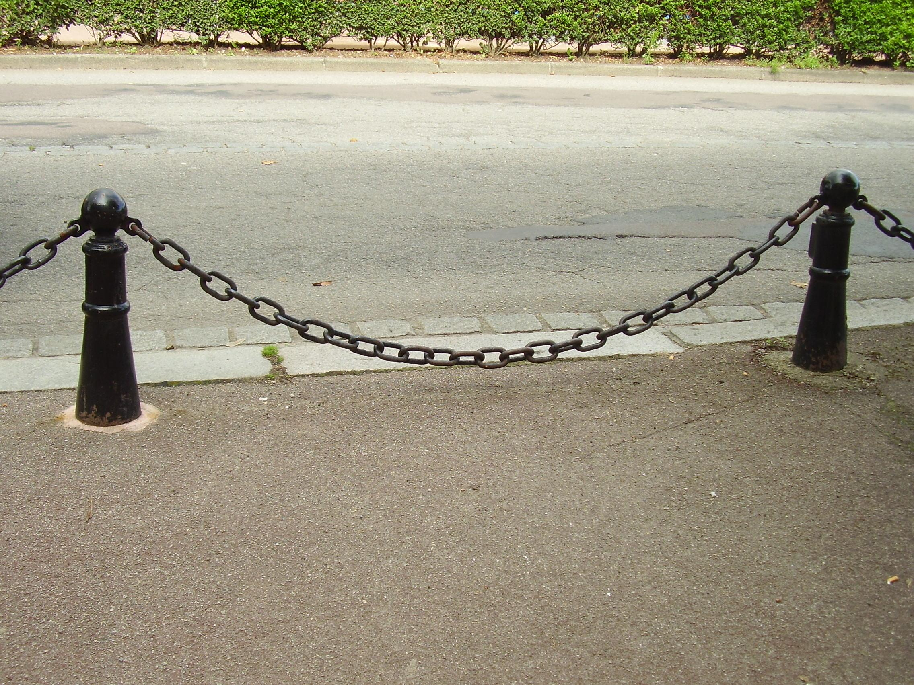
Catenary

Slide 23
catenary.jl
Code on Github

Slide 24
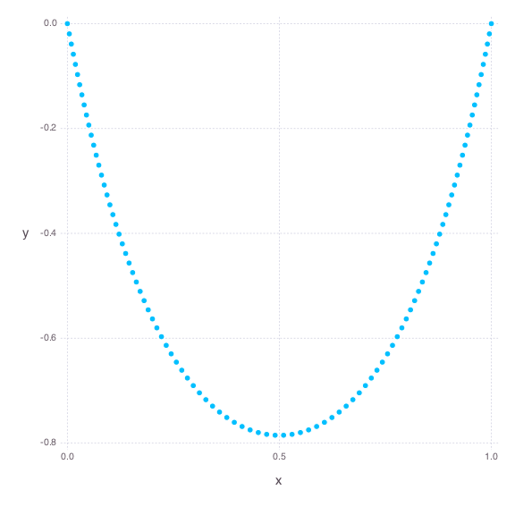
catenary.jl

Slide 25
Agenda
Introduction
Optimization and Operations Research
Julia and JuMP
Applications

Slide 26
Philip Thomas
Philip@StaffJoy.com

