Slide 1
ZOHO CRM · ADMISSIONS EVALUATION
Connected admissions across
four brands and every campus
Ekya Schools · Ekya Nava · CMR NPS · CMR NPUC
Demo presentation · 20 minutes · Follow with live CRM · Cooper and Co org60040760589
Notes:
Open this deck in Zoho Show. Keep CRM in a second window.
Say: This is one CRM for the group. We will walk four brands, from first enquiry to founder accept.
Then: I will cue each scene here, then we click the live record.

Slide 2
PRESENTING ORDER
Nine scenes. Same order as the live CRM demo.
Time
Scene
On this slide
Then open in CRM
00:00
0
Four brands, one CRM
Accounts → Ekya | CMR Group
01:30
1
Same phone, two campuses
Leads → 9876543210
04:00
2
Sibling and intercampus
Reddy, then Iyer
06:00
3
Phone, database, abandoned form
Joseph → Banerjee → Nair
09:00
4
Campus visit booked and missed
Menon, then Das
12:00
5
Submit → HOS → waitlist or accept
Khan → Rao → Patel → Mehta
16:00
6
PU is a different journey
Gowda + Deals
17:30
7
What is already automated
Setup → Ekya workflows
19:00
8
Close and go-live
Questions
Ekya / CMR admissions · Agenda
Notes:
Say: We stay in this order. I show a cue slide, then we click CRM. Use Ekya Lead Stage, not Admission Stage. We will not edit the showcase records.

Slide 3
BEFORE WE CLICK
How to watch this demo
Look at
Ignore
Ekya Lead Stage, Brand, Campus, App Type, Form Status, Visit Status, Founder Decision.
Admission Stage. That picklist belongs to an older process in this org.
Do not edit
Parking lot
Sharma, Menon, Das, Rao, Patel, or Mehta while the customer is watching.
Parent portal, live WhatsApp, VOIP/IVR, payments, Bookings, Campaigns, Forms OTP.
Ekya / CMR admissions · Ground rules
Notes:
Say this once. Then hide Setup until Scene 7. CRM tabs already open: Leads, Accounts, Deals, Workflows.

Slide 4
SCENE 0 · 0:00–1:30
Four brands. One CRM.
The group account holds Ekya Schools, Ekya Nava, CMR NPS, CMR NPUC, and Ekya Vana Early Years.
Campuses sit under the brand. Early Years and future campuses add as accounts, not new modules.
K-12 and PU are different admissions processes. Brand, Campus, Grade, and App Type split the journey.
Campus accounts are locations. They are not finance legal entities.
OPEN IN CRM
Accounts → Ekya | CMR Group
Expand brand and campus children.
ID 902823000002022001
Ekya / CMR admissions · Scene 0
CRM · Accounts
Notes:
SAY: This is one CRM for the group. Ekya Schools, Nava, CMR NPS, and CMR PU College are brands. Campuses sit under the brand. Early Years and future campuses can be added here without a new module.
K-12 and PU are not the same admissions process. Every enquiry carries Brand, Campus, Grade, and App Type so the journey, the owner, and the dashboard can split.
DO NOT open finance / Books.

Slide 5
SCENE 0 · STILL ON ACCOUNTS
Brands and campuses in this org
Brand
Campuses
App type
Ekya Schools
JP Nagar, BTM Layout, ITPL, Byrathi, NICE Road
K-12
CMR National Public School
HRBR Layout
K-12
Ekya Nava
Panathur
K-12
CMR National PU College
HRBR, BTM, ITPL, Byrathi, NICE Road
PU
Ekya Vana Early Years
Campus X, Y, Z (placeholders)
K-12
Ekya / CMR admissions · Scene 0
CRM · stay on Accounts
Notes:
Point at brand accounts and a couple of campuses. Mention Maya and Indravadhan as campus owners. Do not invent Books legal-entity names.

Slide 6
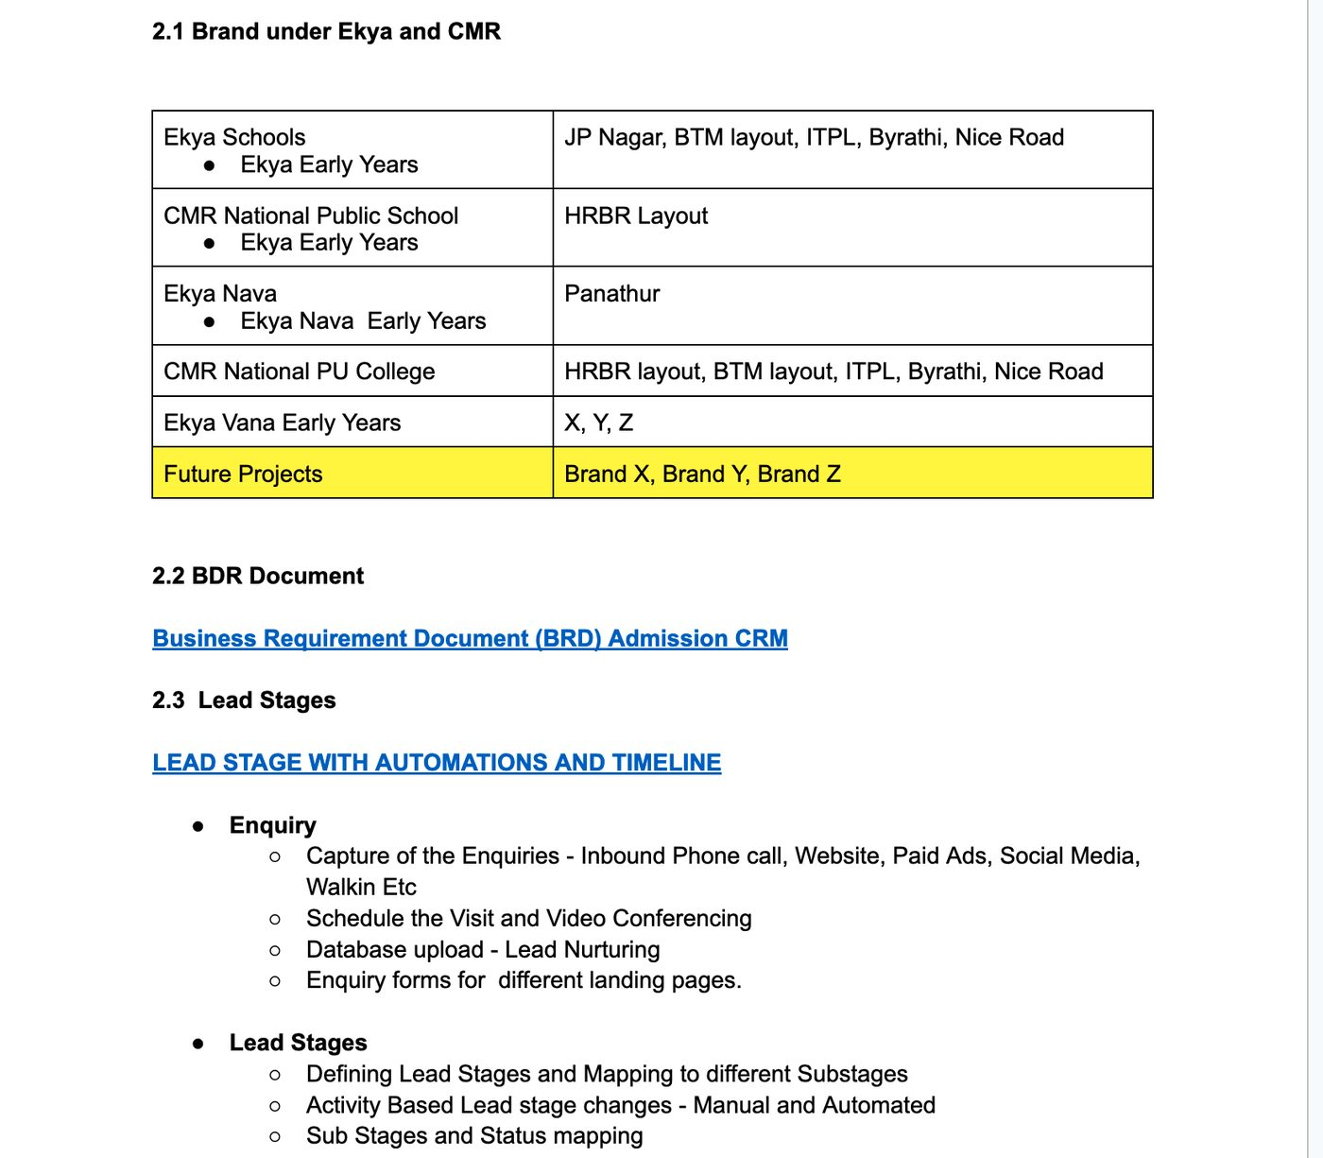
SCENE 0 · SCREENSHOT FROM THE SOP
Brands, campuses, and lead stages
Ekya / CMR admissions · SOP screenshot
CRM · stay on Accounts
Notes:
Leave this up for 10 seconds while Accounts is still open. This is their document, not a mock.

Slide 7
THE PATH WE WILL WALK
Ekya Lead Stage — not Admission Stage
Enquiry
App
Initiated
Visit
Scheduled
Visit
Missed
App
Submitted
HOS
Review
Founder
Review
Accepted
/ Waitlist
›
›
›
›
›
›
›
Review and Readiness Session also exist on the picklist. We will not linger there today.
Disqualified and Junk are outcomes, same as Accept and Waitlist.
Each live record you open is already sitting on one of these stages.
Ekya / CMR admissions · Journey
Notes:
Say: Everything we open next is a parent on this path. Keep your eye on Ekya Lead Stage.

Slide 8
SCENE 1 · 1:30–4:00
One mobile number. Two campuses.
Lead 1
Lead 2
Parent / student
Anita Sharma / Aarav Sharma
Parent / student
Anita Sharma / Diya Sharma
Campus
Ekya JP Nagar
Campus
Ekya BTM Layout
Stage
Enquiry
Stage
App Initiated
Form
Not started
Form
Started
Search
9876543210
Search
same number
If you unique-lock mobile, this family breaks. Each campus keeps its own nurture path.
Ekya / CMR admissions · Scene 1
CRM · Leads · 9876543210
Notes:
SAY: Anita used one mobile number for two campuses. We did not treat that as a duplicate. JP Nagar is still an enquiry for Aarav. BTM has already started Diya’s application. Each campus nurtures its own record.
If asked whether they can apply twice from the same number: Yes. That was an explicit requirement.
POINT AT: Brand, Campus, Grade, Student Name, How Heard, OTP Verified, Ekya Lead Stage, Phone.

Slide 9
SCENE 2 · 4:00–6:00
Sibling and intercampus are flags, not duplicates.
SIBLING
INTERCAMPUS
Kavya Reddy / Vihaan Reddy
CMRNPS HRBR · LKG · Enquiry
Sibling Enquiry = true
Search: Reddy
Meera Iyer / Ananya Iyer
Nava Panathur · Grade 5 · Enquiry
Intercampus Enq = true
Previous school: Ekya JP Nagar
Search: Iyer
Ekya / CMR admissions · Scene 2
CRM · Leads · Reddy then Iyer
Notes:
SAY: Sibling and intercampus are flags on the lead, not a second product. Counsellors see why a second file exists instead of merging the family by accident.
Meera is moving a child from JP Nagar to Nava Panathur. The previous school is on the record.

Slide 10
SCENE 3 · 6:00–9:00
Three ways an enquiry lands.
3.a Inbound phone
3.b Database upload
3.c Abandoned form
Maria Joseph / Leo Joseph
Amit Banerjee / Riya Banerjee
Suresh Nair / Nila Nair
How Heard = Inbound Phone
Hotline 080-46809096
Call Count 1 · BTM · Enquiry
Search: Joseph
How Heard = Database Upload
Stage Enquiry · form empty
No current-year workflow until the parent acts
Search: Banerjee
App Initiated · Form Abandoned
Meta Ads · UKG
Task: 24h incomplete application
Search: Nair
Ekya / CMR admissions · Scene 3
CRM · Joseph → Banerjee → Nair
Notes:
Stay tight: one sentence per record, land on Nair.
PHONE: Four published hotlines. After VOIP, IVR maps campus. Activity belongs on this lead.
DATABASE: Last year’s list can live in CRM for nurture. It should not fire this year’s incoming-lead workflow until the parent acts.
NAIR: She started the form from a paid campaign and did not submit. 24-hour task. Honest limit: Zoho Forms does not natively push abandoned as a CRM stage.
Open the 24h incomplete application reminder task on Nair.

Slide 11
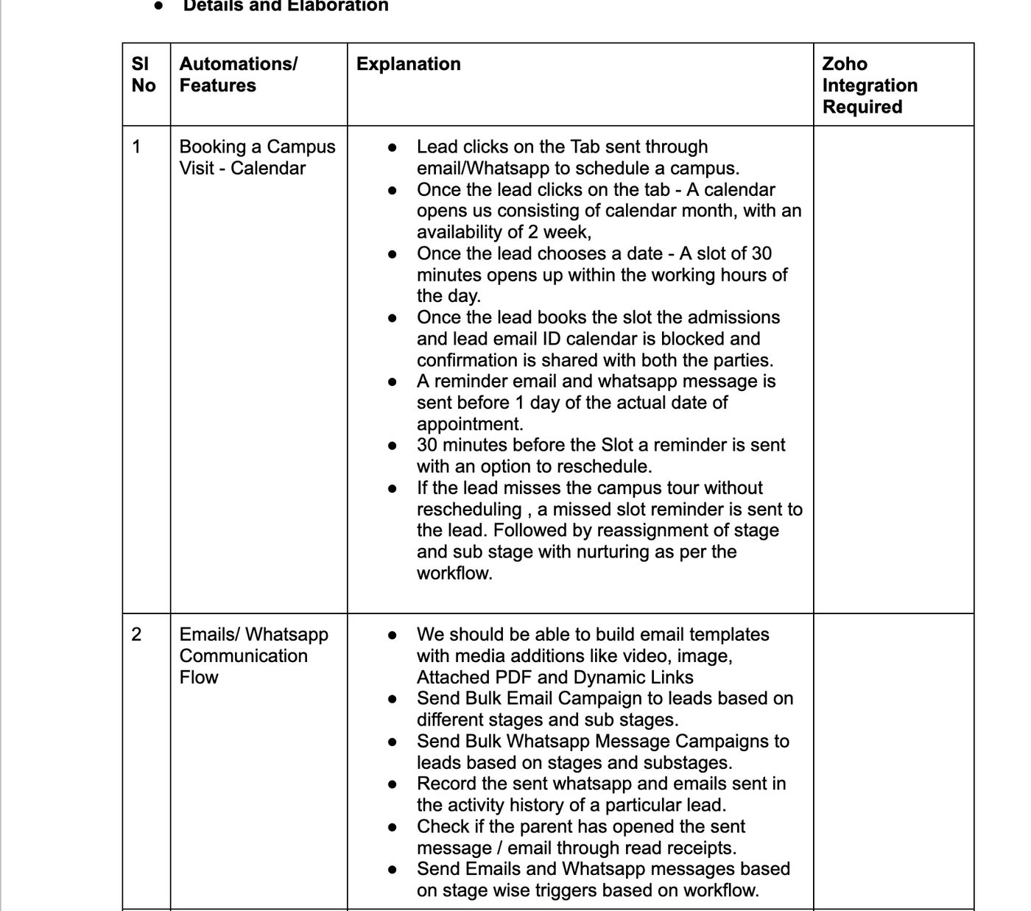
SCENE 3 · SCREENSHOT FROM THE SOP
Enquiry forms and inbound phone
Ekya / CMR admissions · SOP screenshot
CRM · return to Nair
Notes:
Point at enquiry fields and the four hotlines. Then go back to Nair in CRM.

Slide 12
SCENE 4 · 9:00–12:00
Book the visit. Recover the miss.
BOOKED
MISSED
Priya Menon / Arjun Menon · Byrathi
Stage Visit Scheduled · Status Booked
18 Sep 2026 10:00–10:30 IST
Event on the lead
Tasks: day-before, and 30-min with reschedule
Search: Menon
Rohit Das / Ishaan Das · NICE Road
Stage Visit Missed · Status Missed
Visit date 10 Sep 2026
Missed-visit event + nurture task
Setting Visit Status to Missed fires the workflow
Search: Das
Ekya / CMR admissions · Scene 4
CRM · Menon then Das
Notes:
SAY BOOKED: Parent gets a link, sees about two weeks of availability, picks a 30-minute slot. Confirmation to admissions and the parent. Day before, workflow marks Reminder Sent. Thirty minutes before, reminder with reschedule. Bookings can sit on top later.
SAY MISSED: If they miss without rescheduling, stage moves to Visit Missed and nurture starts. You do not rely on someone dragging a Kanban card.

Slide 13
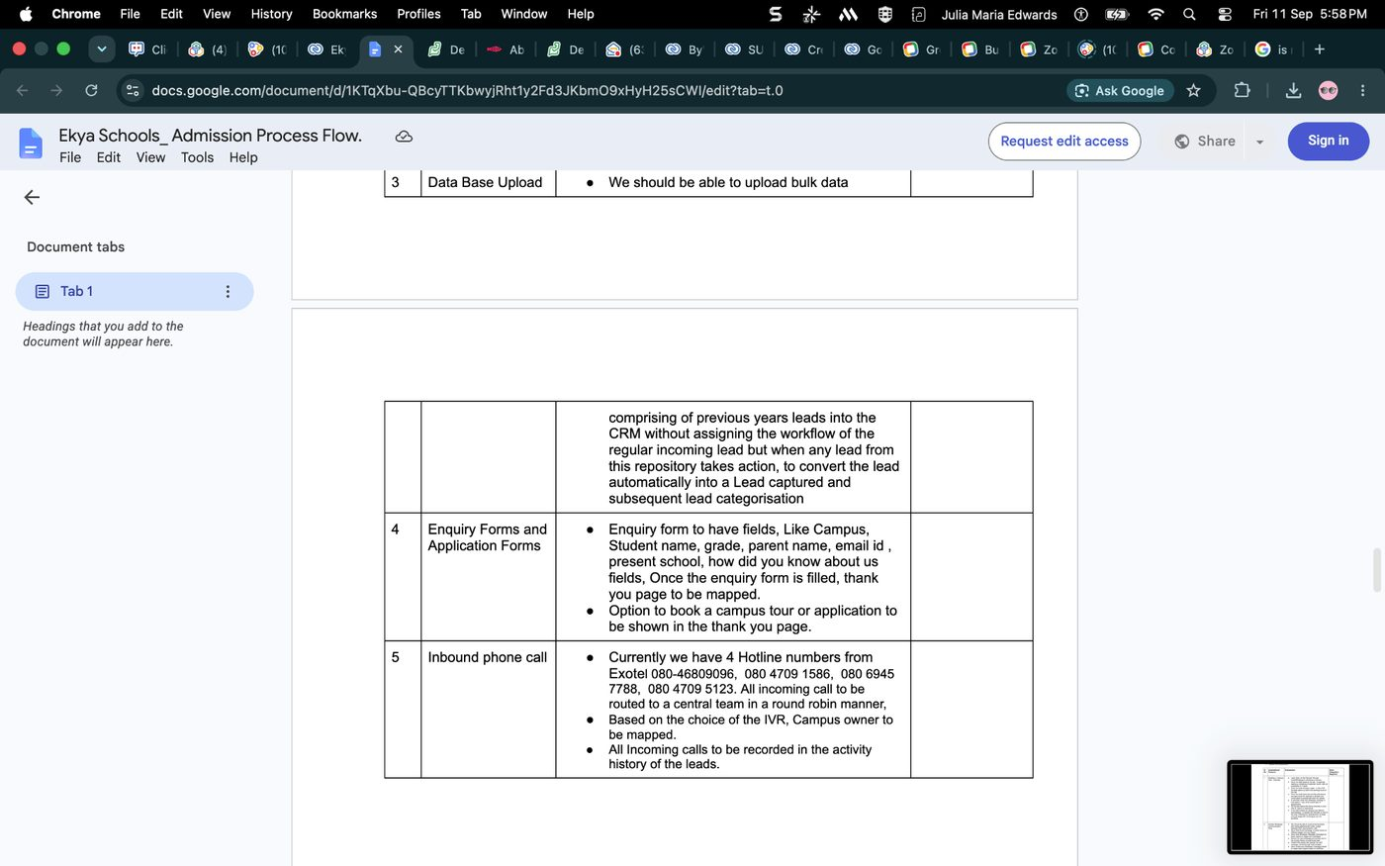
SCENE 4 · SCREENSHOT FROM THE SOP
Campus visit and email / WhatsApp flow
Ekya / CMR admissions · SOP screenshot
CRM · Menon then Das
Notes:
This is the booking and reminder sequence they asked for. Menon and Das are the live proof.

Slide 14
SCENE 5 · 12:00–16:00
Submit. HOS comments. Waitlist or accept.
1
Farah Khan / Zara Khan
App Submitted
Khan
CMRNPS HRBR · form submitted, visit attended
2
Lakshmi Rao / Aditi Rao
HOS Review
Rao
Founder Decision Pending · HOS comments on the record
3
Neha Patel / Kabir Patel
Waitlist
Patel
Founder Decision Waitlist · Grade 1 capacity at JP Nagar
4
Sanjay Mehta / Aanya Mehta
Accepted
Mehta
Founder Decision Accept · workflow moved the stage
Ekya / CMR admissions · Scene 5
CRM · Khan → Rao → Patel → Mehta
Notes:
Tell this as one file moving forward. Do not linger.
KHAN: Application is in. Visit happened. Optional: open deal K-12 Application - Zara Khan.
RAO: Head of School writes on the same record. Founder sees the comment. No side email thread.
PATEL: Accept and Waitlist are first-class outcomes. Capacity is a founder decision, not a lost lead.
MEHTA: When the founder sets Accept, a workflow moves Ekya Lead Stage to Accepted.
DO NOT change Founder Decision on Rao or Patel during the demo.

Slide 15
SCENE 6 · 16:00–17:30
PU is not the Grade 1 pipeline.
K-12 DEAL
PU DEAL
Zara Khan · CMRNPS HRBR
App Type K-12 · Grade 6
Deal: K-12 Application - Zara Khan
Standard Deal Stage stays Qualification
Admissions status lives on Ekya stages
Ramesh Gowda / Kiran Gowda
Brand CMRNPUC · NPUC HRBR
App Type PU · PUC 1 · App Initiated
Deal: PU Application - Kiran Gowda
Search: Gowda
Ekya / CMR admissions · Scene 6
CRM · Gowda + Deals
Notes:
SAY: Same CRM, different journey. PU and K-12 dashboards can be two views on App Type. You do not run PUC 1 through the Grade 1 school pipeline.

Slide 16
SCENE 7 · 17:30–19:00
Six Ekya workflows. The spine of what you just saw.
01
Ekya Set Stage Enquiry
New branded lead starts at Enquiry
02
Ekya Form Started Stage
Nair / Diya Sharma → App Initiated
03
Ekya Form Submitted Stage
Khan / Mehta → App Submitted
04
Ekya Visit Day Before
Menon reminder the day before 18 Sep
05
Ekya Visit Missed Stage
Das when Visit Status = Missed
06
Ekya Founder Accept Stage
Mehta when Founder Decision = Accept
Ekya / CMR admissions · Scene 7
CRM · Setup → Workflow Rules → Ekya
Notes:
SAY: These six rules are the spine. Email, WhatsApp, Bookings, and telephony plug into the same fields. We did not overwrite the existing EdNova process in this org.
DO NOT open or edit EdNova follow -up update.

Slide 17
SCENE 8 · 19:00–20:00
In this org today. Go-live next.
YOU JUST CLICKED
TO GO LIVE
Brand, campus, grade, channel on every lead
Same phone, two campus journeys
Sibling and intercampus flags
Visit booked and missed nurture
HOS comments and founder accept / waitlist
K-12 and PU as parallel pipelines
Forms with OTP
Parent portal for documents and edit
Bookings or Google Calendar
Campaigns and WhatsApp by grade
Marketplace telephony on four hotlines
Payment with campus-specific bank details
Books: one org under Zoho One; other legal entities standalone
Ekya / CMR admissions · Scene 8
Notes:
SAY: You asked for one place that knows the brand, the campus, the grade, the channel, the visit, and the founder decision. That is what you just clicked through.
To go live: Forms with OTP, parent portal, Bookings or Google Calendar, Campaigns and WhatsApp by grade, marketplace telephony, payment with campus-specific bank details. One Books org can sit under Zoho One; other legal entities need their own Books. We did not invent entity names because those packs were empty.
Questions I can answer from this org: two applications on one phone, sibling vs intercampus, K-12 vs PU, missed-visit nurture, HOS to founder.
STOP. Take questions.

Slide 18
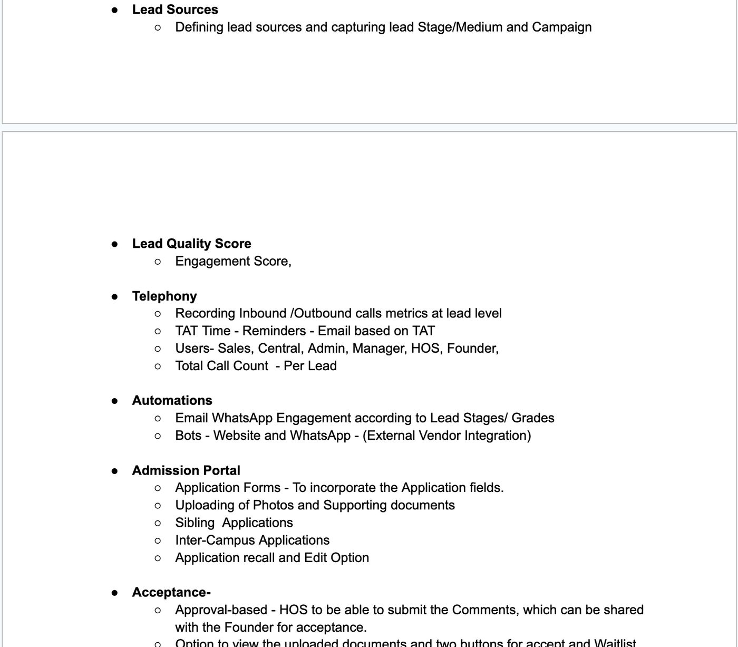
SCENE 8 · SCREENSHOT FROM THE SOP
Portal, telephony, and acceptance
Ekya / CMR admissions · SOP screenshot
Notes:
Go-live items live here: portal, telephony, HOS/founder. Do not claim they are live in this org.

Slide 19
Questions from this org
Two applications on one phone · Sibling vs intercampus
K-12 vs PU · Missed-visit nurture · HOS to founder
Notes:
Leave this up. Do not improvise edits on showcase leads.

Slide 20
PRESENTER APPENDIX
Search cheat sheet
Two campuses, same phone
9876543210
HOS → founder
Rao
Sibling
Reddy
Waitlist
Patel
Intercampus
Iyer
Accepted
Mehta
Abandoned form
Nair
PU vs K-12
Gowda
Visit booked
Menon
Database upload
Banerjee
Visit missed
Das
Inbound hotline
Joseph
App submitted
Khan
Ekya / CMR admissions · Appendix
Leads search
Notes:
Keep this slide in presenter view or printed. Not for the customer unless they ask.

Slide 21
PRESENTER APPENDIX
12-minute cut — skip Scene 2 and Scene 6
00:00
Accounts tree
Scene 0
01:00
9876543210 two campuses
Scene 1
03:00
Nair abandoned form + 24h task
Scene 3c only
05:00
Menon booked, Das missed
Scene 4
08:00
Khan → Rao → Patel → Mehta
Scene 5
11:00
Workflow list + close
Scenes 7–8
Ekya / CMR admissions · Appendix
Notes:
If time is short: drop sibling/intercampus and PU. In Scene 3 show only Nair.

Slide 22
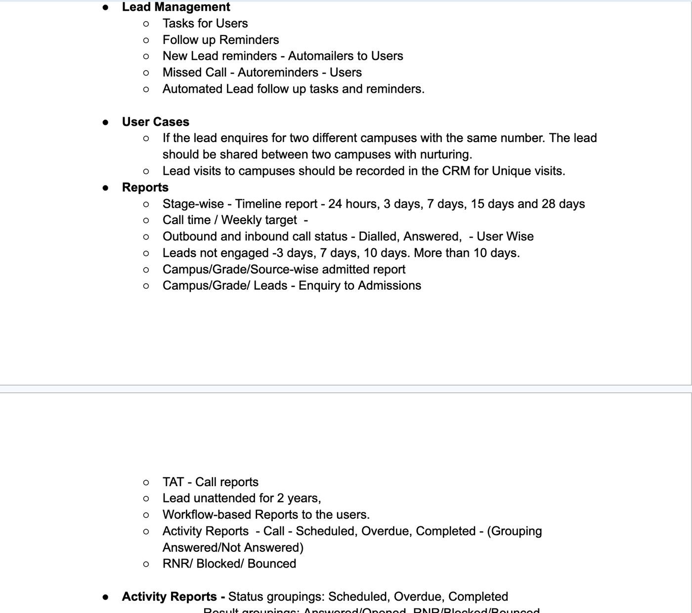
APPENDIX · SOP
Reports they asked for
Ekya / CMR admissions · SOP screenshot · presenter only
Notes:
Only if they ask about reports. Do not walk every bullet.

