Slide 1




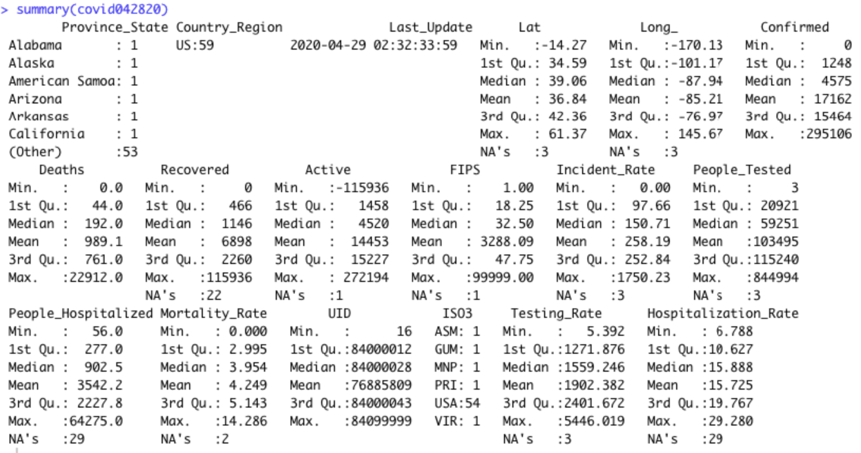
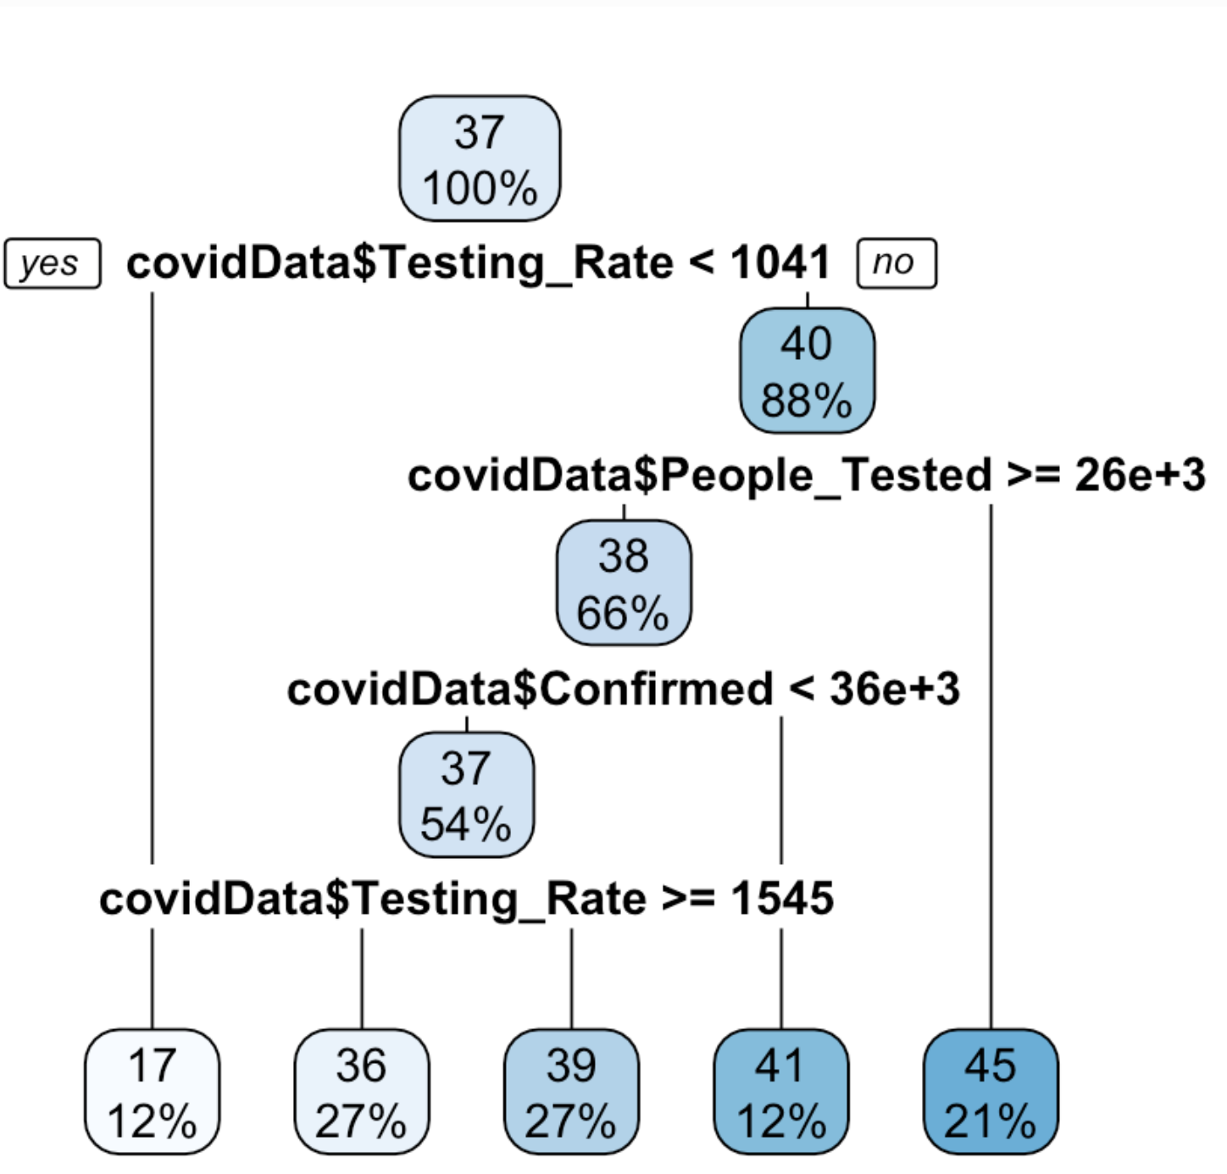
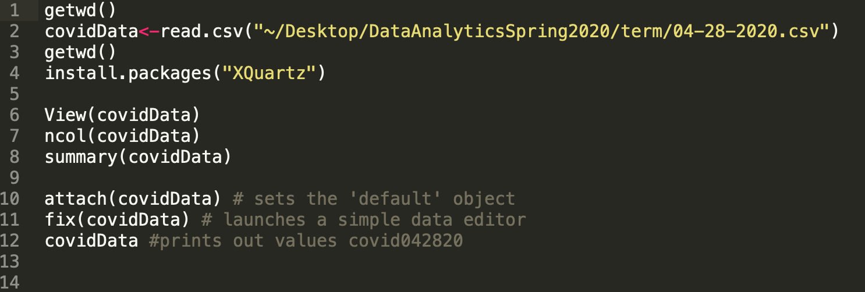
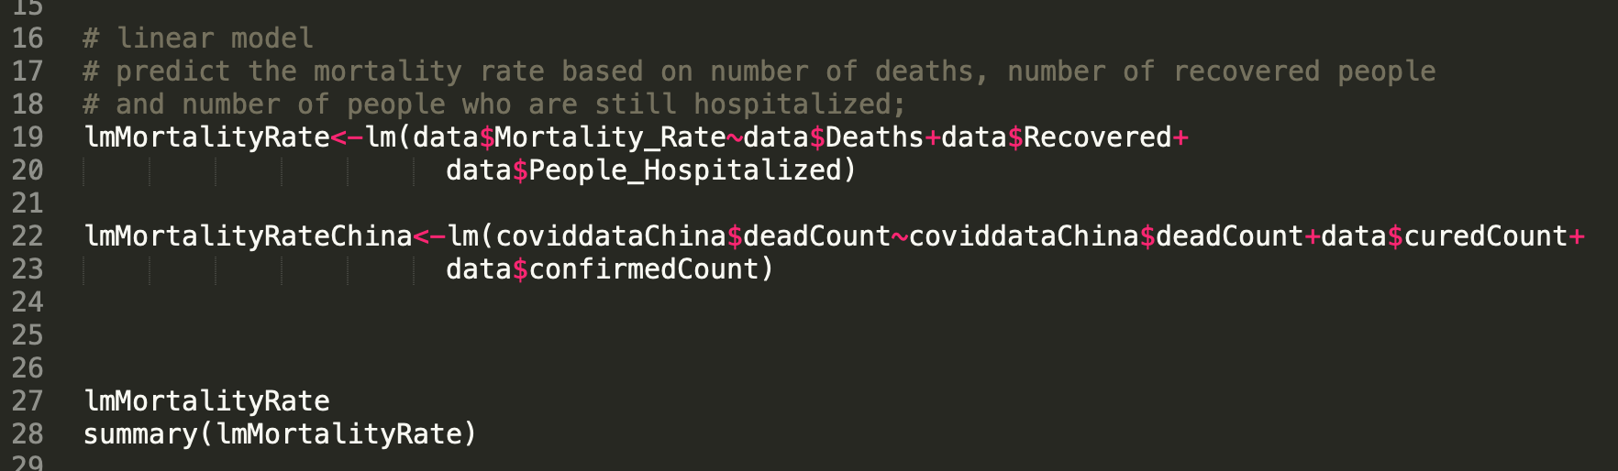
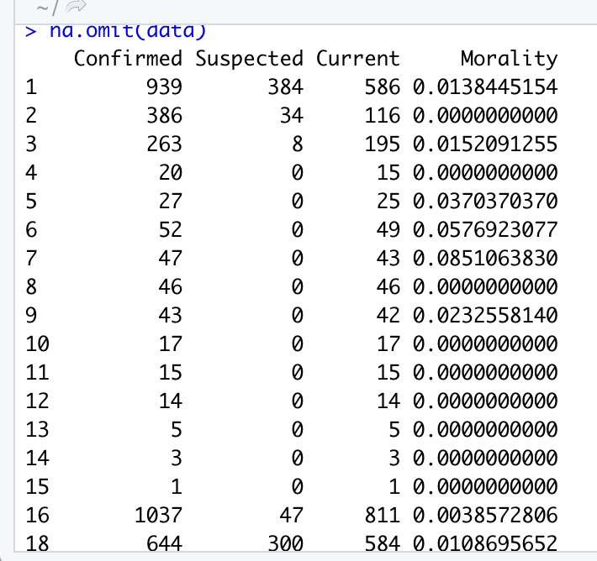
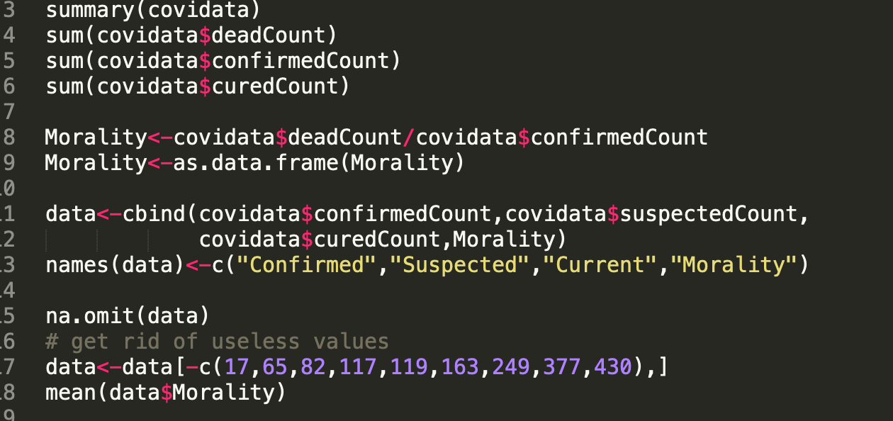
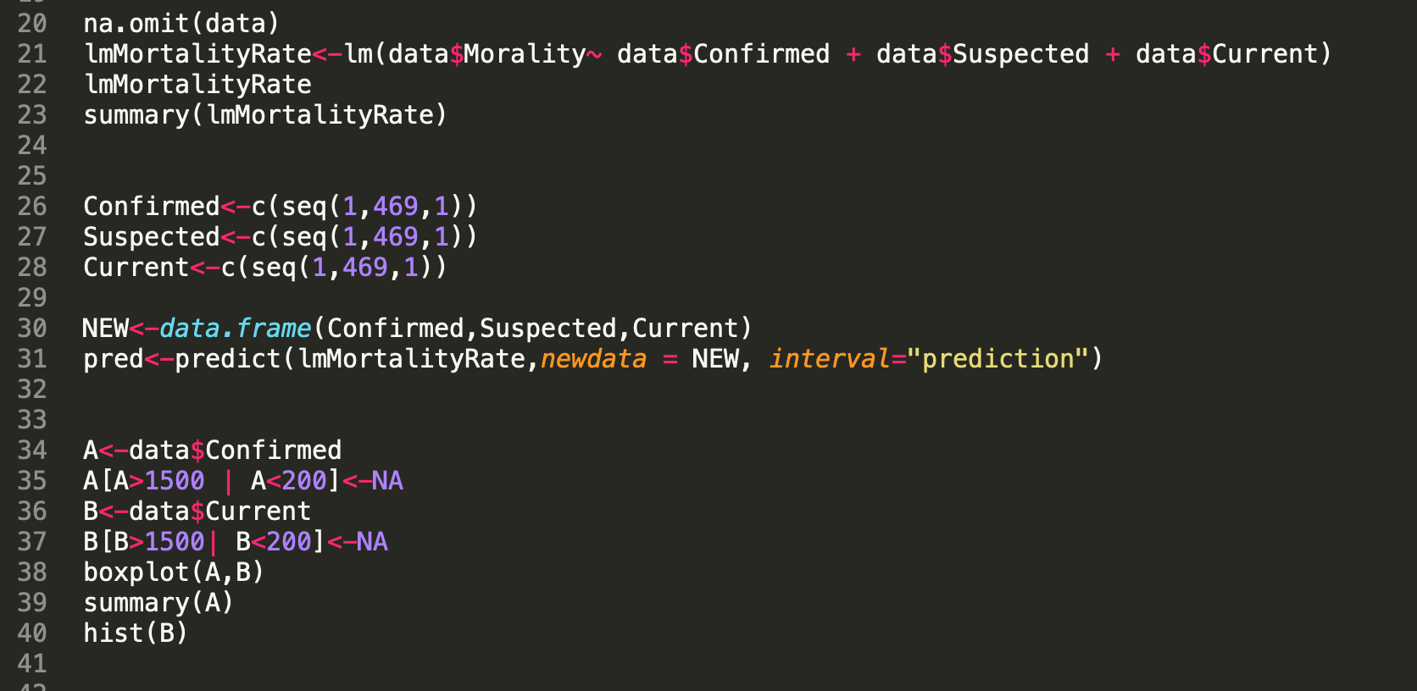

The Analysis Of COVID-19 Data
Shiwei Huang: huangs8@rpi.edu
¹Rensselaer Polytechnic Institute, Tetherless World Constellation, Troy, NY, United States,
Abstract
Tidying Messy Datasets
The main goal of my final project is to compare two sets of data: COVID19 up-to-date data within the United States and COVID19 up-to-date data in China. In the following part of my data analysis, I will use the mortality rate, confirmed case number, suspected case number to understand why the COVID19 mortality rate is different from different countries.
I will use my data model and the scholar paper abstraction to get a conclusion. The second goal of my analyses is to understand whether the testing rate has anything to do with America’s geographic location. That being said, I want to understand whether the higher latitude has the higher testing rate, or vice versa.
For the first part of my analysis, since mid-march, COVID-19 has hit America hard. I wanted to use the latest COVID-19 data as an excel file and perform various analyses on the COVID data. Mainly, my main interest is to analyze the COVID-19 data points within the United States across different states. In my data analyses, I will perform basic reports such as the historical number of max death in the states and number of minimum deaths within each state; number of confirmed cases maximum; mean and minimum within each state; number of maximum; and minimum and average recovered people within each state.
Common workflow for data processing
U.S data summary (up to April 28)
Import
From spreadsheet files
From Johns Hopkins Data (CSSEGISandData)
Inspect
Explore the dataset to get descriptive results
Find out data features and outliers
Process
Deal with the problems in datasets
Read from the data output
Clean data
ii. Tree graph
1. Import data:
R language (R)
A. Read from Spreadsheet files
2. Inspect data:
Several methods are used to inspect the dataset.
Linear regression
3. Analyse the data:
Conclusion
My two different datasets showed me that the mortality rate is different in between the United States and China. I consulted different sources for clear clarification. For example, Johns Hopkins analysis. The analysis showed that there are different ways to measure the COVID-19 mortality rate. Different countries throughout the world have reported very different mortality ratios are likely due to a variety of reasons.
My data told me two important things with COVID-19 in between the United States and China. First, the mortality rate of COVID-19 in China is 50% lower than the mortality rate within the United States. Second, within the United States, places with a higher latitude have a higher percentage to get tested.
With regards to the mortality rate differences in between the United States and China, there are a number of different reasons. Such reasons include the health care system, differences in terms of the COVID-19 measurements and differences in counting the COVID-19 data.
With regards to the mortality rate in relation with the latitude, there are also a number of different reasons to be considered. People need to count on the number of population density states and different health care facilities across different states . These factors are extremely important in terms of analyzing the mortality in our future analysis.
iii. Analyzing the mortality rate
The analysis showed that there are different ways to measure the COVID-19 mortality rate. Different countries throughout the world have reported very different mortality ratios are likely due to a variety of reasons. Such reasons are different in the number of people tested, so for example, with more testing numbers, we could get a clearer picture on the population who are identified as COVID-19 carriers. With more testing, it also enables doctors to get more accurate data. Second reason is the demographic reason. Mortality rate is also related to the population of citizens who are elderly.
Sponsors:
Glossary:
Python – A programming language, capable of processing data/statistical analysis
R – A program to process data and perform statistical analysis
Package (P) or Library (R): software package to be loaded to perform extra tasks
Pandas – An useful data manipulation package in python
Df, dataframe – Data manipulation structure in R & python pandas
Levels in R dataframe – for factor data, the possible number of choices are levels
Resources:
China data source: https://github.com/midas-network/COVID-19/blob/master/data/cases/china/cumulative_cases_DXY/table_getAreaStat_en_2020-04-28.csv
US data source: https://github.com/CSSEGISandData/COVID-19/tree/master/csse_covid_19_data/csse_covid_19_daily_reports_us

