Slide 1



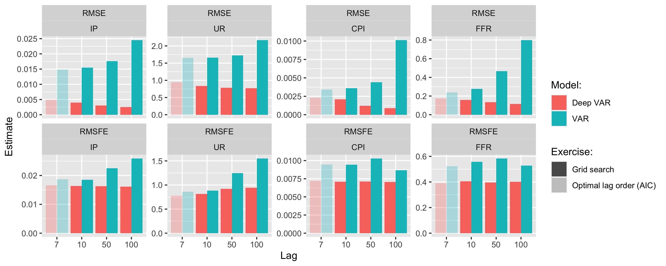
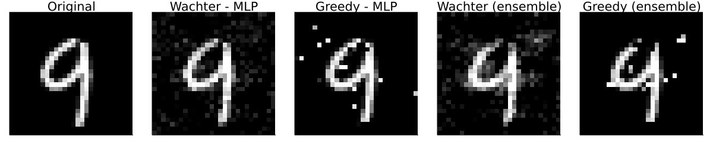
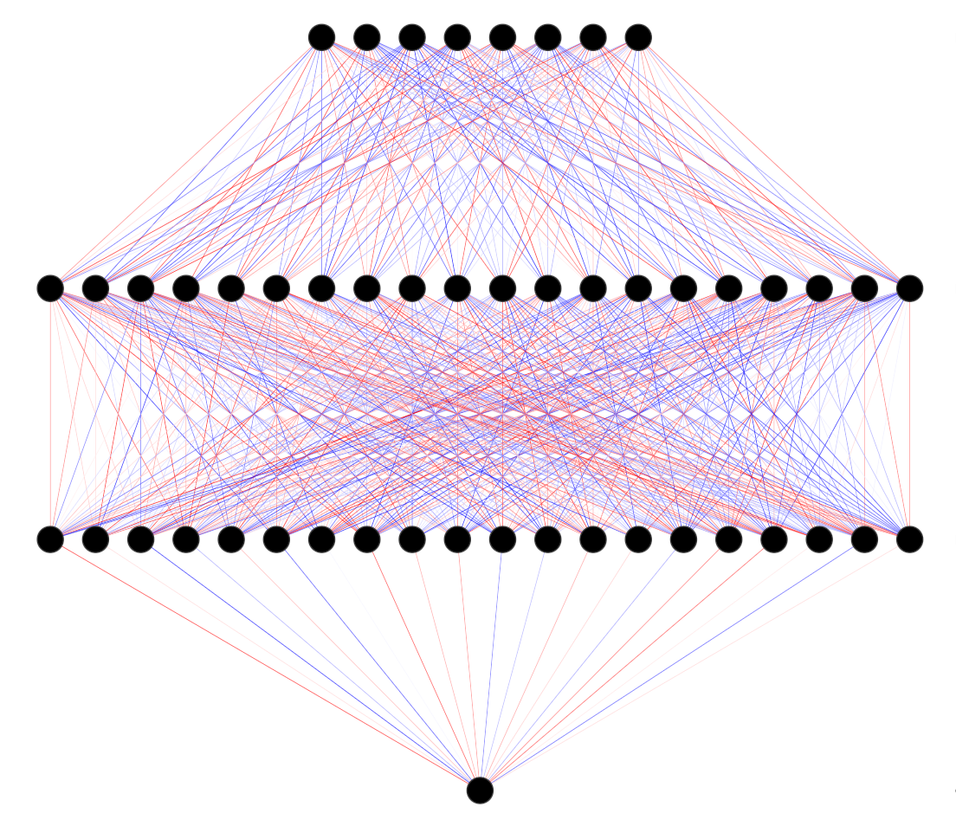

Counterfactual Explanations
and Algorithmic Recourse
Patrick Altmeyer (student)
Dr. Cynthia Liem (supervisor)
Explaining black box models through counterfactuals
… to realistic recourse for Bayesian models.
Endogenous shifts in algorithmic recourse
Empirical evidence
Hyperparameter tuning
Human operators in charge of the black-box decision-making systems do not understand how they works and essentially often they still choose to rely on it blindly. Unfortunately, those individuals who are subject to the decisions produced by such systems typically have no way of challenging them. Counterfactual Explanations (CE) can help the former group to make sense of their system: they explain how inputs into the system would have to change for it to yield a different decision. CEs that involve realistic and actionable changes can be used for the purpose of Algorithmic Recourse (AR): recourse offers individuals in the latter group a way to turn a negative decision into positive one.
To evaluate our proposed methodology empirically we use the FRED-MD data base to collect a sample of monthly US data on output (IP), unemployment (UR), inflation (CPI) and interest rates (FFR). Our sample spans the period from January 1959 through March 2021.
Our findings show a consistent and significant improvement in predictive performance: the Deep VAR incurs much lower loss than the conventional benchmark. It also outperforms other popular approaches that address non-linearity (Threshold VAR and Random Forest).
For a our baseline comparison we keep things simple: for example, we let the conventional VAR guide our search for optimal lag length. A short exercise in hyperparameter tuning demonstrates that the Deep VAR is less prone to overfitting with respect to the number of lags among other things.
My work so far:
Built a scalable library for CE and AR in Julia: CEAR.jl.
Ran experiments investigating the dynamics of AR.
Proposed a related research project to bachelor’s students.
Figure 3: Pseudo out-of-sample RMSE and RMSFE for VAR and Deep VAR across different lag choices.
From basic principles …
Where to go from here
A simple methodology
Recent work
We developed our idea under the following premise: maximise performance of an existing and trusted framework under minimal intervention. VAR has become a standard tool for practitioners to construct economic forecasts, but the assumption of linearity through time and variables is restrictive. We relax that assumption through one simple step: estimate each system equation through a recurrent neural network.
We have added Threshold VAR for comparison (Figure 2).
Progress on uncertainty quantification through Bayesian deep learning – MC dropout (Gal and Ghahramani 2016). Recent work by Daxberger et al. (2021) shows that Laplace Approximation is a promising way forward.
Open questions
Figure 2: Comparison of cumulative loss over the entire sample period for Deep VAR and benchmarks.
What other benchmark models should we consider?
Structural identification – how to proceed? Verstyuk (2020) works with Cholesky decomposition as in conventional VAR.
Can the existing toolbox (IRFs, variance decomposition, policy counterfactuals, …) be derived for Deep VAR?
Deep VAR as a tool for detecting non-linearities?
But wait a minute …
Beyond the static setting
To evaluate our proposed methodology empirically we use the FRED-MD data base to collect a sample of monthly US data on output (IP), unemployment (UR), inflation (CPI) and interest rates (FFR). Our sample spans the period from January 1959 through March 2021.
Our findings show a consistent and significant improvement in predictive performance: the Deep VAR incurs much lower loss than the conventional benchmark. It also outperforms other popular approaches that address non-linearity (Threshold VAR and Random Forest).
References
Daxberger et al. (2021). “Laplace Redux-Effortless Bayesian Deep Learning.”. In: Advances in Neural Information Processing Systems 34
Gal and Ghaharamani (2016). “Dropout as a Bayesian Approximation: Representing Model Uncertainty in Deep Learning.”. In: International Conference on Machine Learning, 1050–59. PMLR.
Kilian and Luetkepohl (2017). “Structural Vector Autoregressive Analysis.”. In: Cambridge University Press.
Verstyuk (2020). “Modeling Multivariate Time Series in Economics: From Auto-Regressions to Recurrent Neural Networks.”. In: Available at SSRN 3589337.
Figure 1: Neural Network Architecture. Inputs are lags of all variables. Output is variable of interest in time t.

