Slide 1




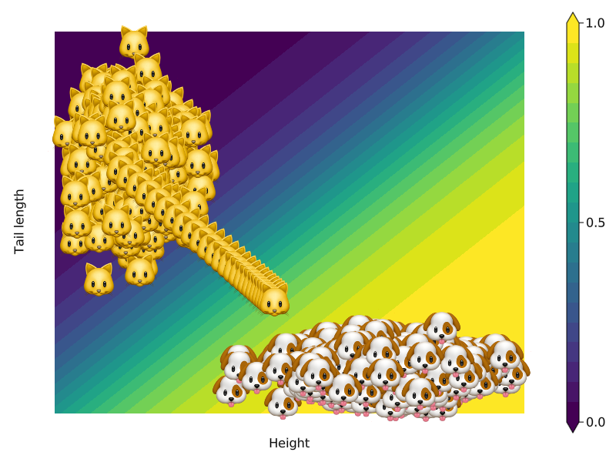
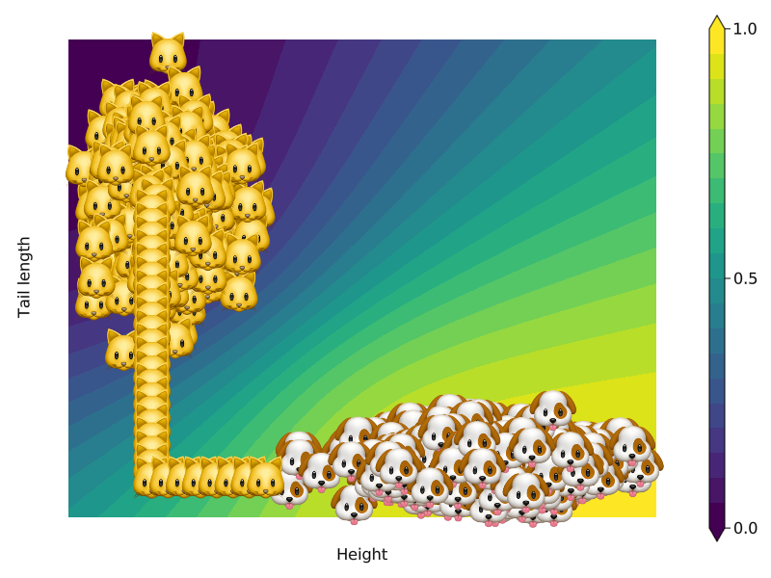
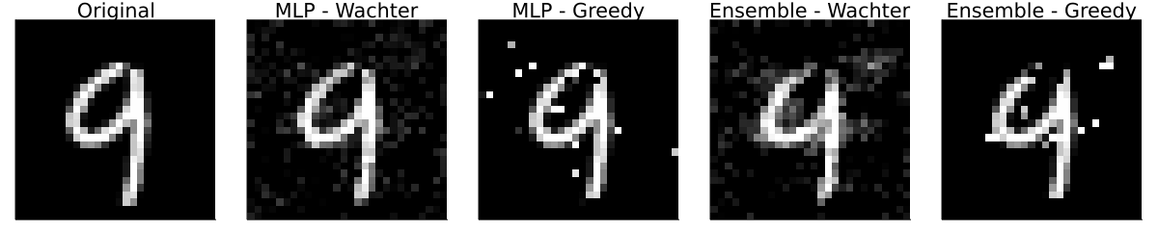
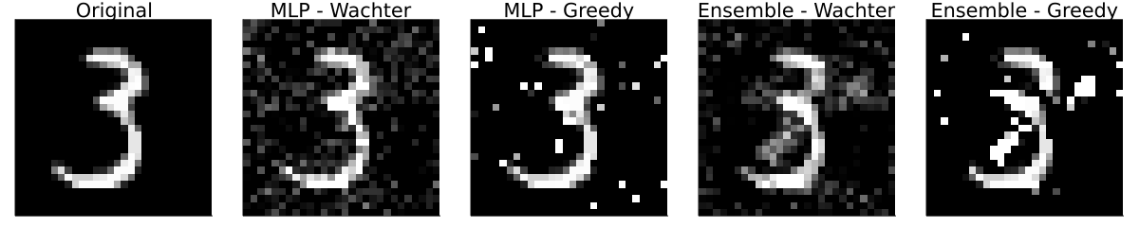
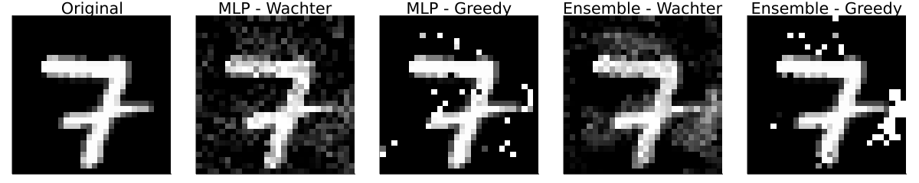
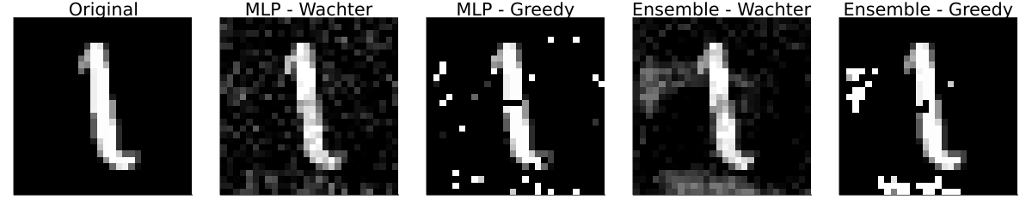
Counterfactual Explanations
and Algorithmic Recourse
Patrick Altmeyer (p.altmeyer@tudelft.nl)
Dr. Cynthia Liem
Explaining black box models through counterfactuals
Our work so far:
Where to go from here
Built a scalable library in Julia: CounterfactualExplanations.jl (to be submitted to upcoming JuliaCon 2022).
Have run experiments investigating the dynamics of AR: individuals who received recourse form a distinct cluster in target class leaving them potentially vulnerable to discrimination through the system.
Proposed a related research project to bachelor’s students and aim to submit work-in-progress to AIES ’22 student track.
Open questions (your thoughts are more than welcome!)
All too often human operators rely blindly on decisions made by black-box algorithms. Counterfactual Explanations (CE) can help programmers make sense of the systems they build: they explain how inputs into a system need to change for it to produce a different output. CEs that involve realistic and actionable changes can be used for the purpose of individual recourse: Algorithmic Recourse (AR) offers individuals subject to algorithms a way to turn a negative decision into positive one.
How much of an issue is this really? Can we think of real-world examples where scope for discrimination may lead to undesirable outcomes?
How does the magnitude of domain and model shifts vary across different approaches to generating AR? (student project)
Can we assess what factors mitigate endogenous shifts when generating recourse?
From basic principles …
A light-hearted motivating example
Suppose we have fitted some black box classifier to divide cats and dogs based on two features: height and tail length. One individual cat – let’s call her Kitty 🐱 – is friends with a lot of cool dogs and wants to remain part of that group. The counterfactual path in Figure 1 shows how 🐱 needs to change her appearance in order to be allocated to the group of dogs by the system.
Figure 1: Generating recourse for 🐱 following Wachter et al. (2018)^{[1]}. Contour shows the predictions of a simple MLP.
… to realistic recourse.
CE by implicitly minimizing predictive uncertainty
As 🐱 crosses the decision boundary in Figure 1 she fools the system, but we can still clearly distinguish her from the rest of her dog friends. Her counterfactual self is ambiguous and unrealistic. Consider instead the counterfactual path generated in Figure 2 which uses a Bayesian approach: for the same confidence threshold 🐱 ends up in a much denser area.
Applied to MNIST data the Bayesian approach arguably generates the most realistic counterfactuals, albeit with mixed success (Figures 3-6).
Figure 2: Generating recourse for 🐱 following Schut et al. (2021)^{[2]}. Contour shows the predictions of a deep ensemble.
Figure 3: Counterfactual explanations for MNIST data – turning a 9 into a 4.
Figure 4: Counterfactual explanations for MNIST data – turning a 3 into an 8.
Figure 5: Counterfactual explanations for MNIST data – turning a 7 into a 2.
Figure 6: Counterfactual explanations for MNIST data – turning a 1 into a 7.
But wait a minute …
Beyond the static setting
In practice decision-making systems are regularly updated. Recent work has investigated the robustness of AR^{[3]}: can we be sure that 🐱 can stay with her dog friends after model updates? In our work we go a step further and ask ourselves:
Does 🐱 herself trigger model shifts through her move across the decision boundary?
Does that have consequences for other cats or dogs that want to implement recourse?
More generally, what are the dynamics of algorithmic recourse?
Preliminary experiments show:
Individuals like 🐱 form a distinct cluster in the target class leaving them potentially vulnerable to further discrimination through the system (Figure 7).
Figure 7: Algorithmic recourse leads to domain and model shifts.
References
[1] Wachter et al. (2018). “Counterfactual explanations without opening the black box: automated decisions and the GDPR.”. In: Harvard Journal of Law & Technology (31)
[2] Schut et al. (2021). “Generating interpretable counterfactual explanations by implicit minimisation of epistemic and aleoteric uncertainty.”. In: Proceedings of Machine Learning Research (130)
[3]. Upadhyay et al. (2021). “Towards Robust and Reliable Algorithmic Recourse.”. In: Proceedings of the 35th Conference on Neural Information Processing Systems (NeurIPS 2021).

