Slide 1
RESUME (04/10/2024)
Simple PINN
Inferring parameters
Inferring function
Inferring function + parameter
Noise

Slide 2
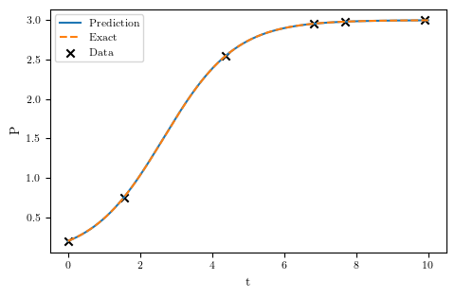
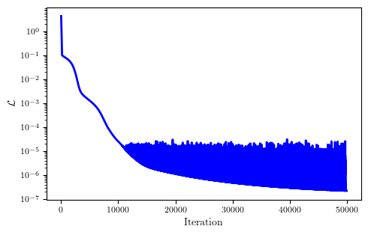

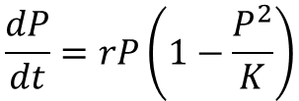
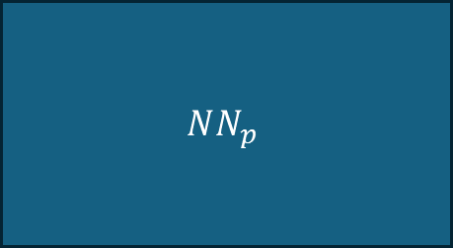
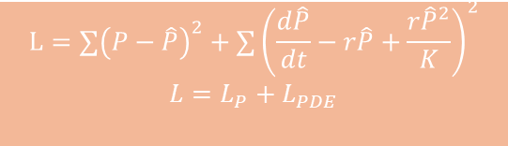
Simple PINN
$$NN_{p}$$
t
$$\hat{P}$$
$$L=∑{\left(P−\hat{P}\right)}^{2}+∑{\left(\frac{d\hat{P}}{dt}−r\hat{P}+\frac{r{\hat{P}}^{2}}{K}\right)}^{2}$$
$$L=L_{P}+L_{PDE}$$
$$\frac{dP}{dt}=rP\left(1−\frac{P^{2}}{K}\right)$$

Slide 3
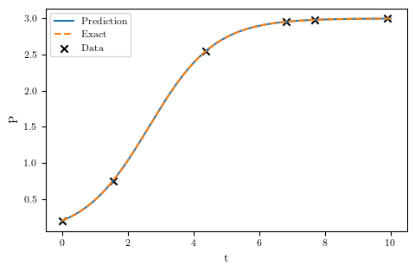
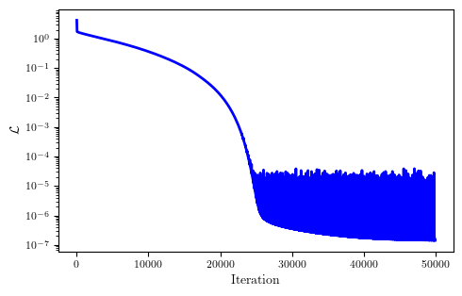


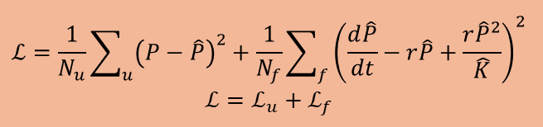

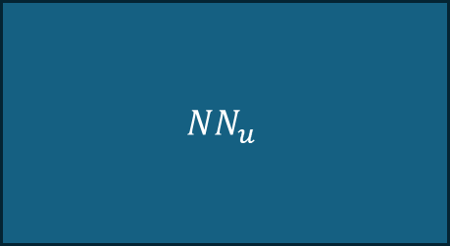
Inferring parameters
$${NN}_{u}$$
t
$$\hat{P}$$
$$\hat{K}$$
$$ℒ=\frac{1}{N_{u}}\sum_{u}{{\left(P−\hat{P}\right)}^{2}}+\frac{1}{N_{f}}\sum_{f}{{\left(\frac{d\hat{P}}{dt}−r\hat{P}+\frac{r{\hat{P}}^{2}}{\hat{K}}\right)}^{2}}$$
$$ℒ=ℒ_{u}+ℒ_{f}$$
$K$=3 $\hat{K}$=3.0003374

Slide 4
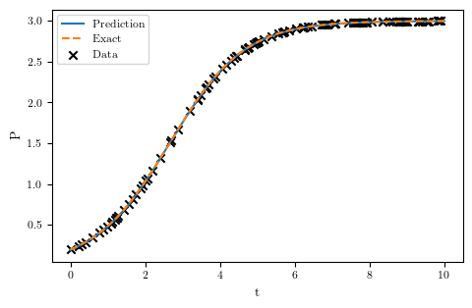
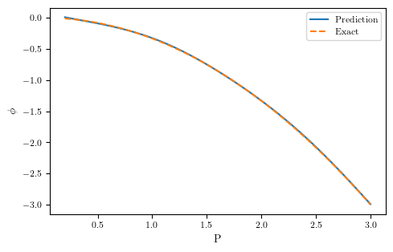
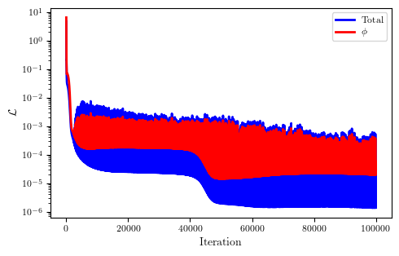

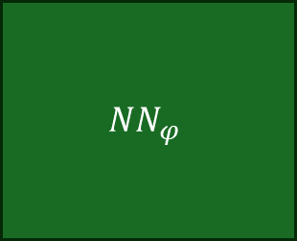


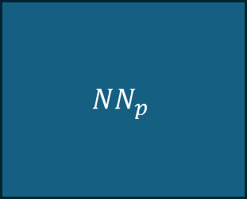
Inferring function
$$NN_{p}$$
$$NN_{φ}$$
t
$$\hat{P}$$
$$\hat{φ}$$
$$L=∑{\left(P−\hat{P}\right)}^{2}+∑{\left(\frac{d\hat{P}}{dt}−r\hat{P}−\hat{φ}\left(P\right)\right)}^{2}$$
$$L=L_{P}+L_{PDE}$$

Slide 5
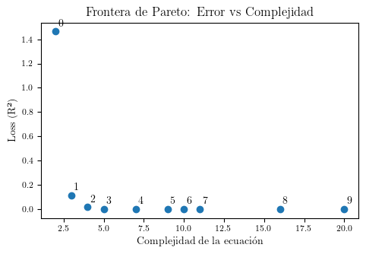
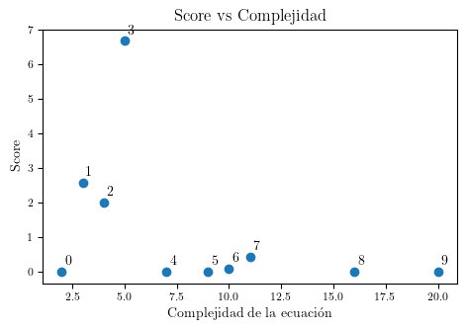
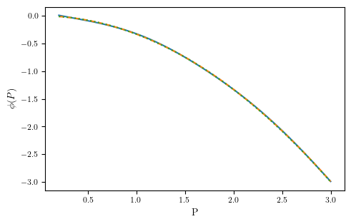
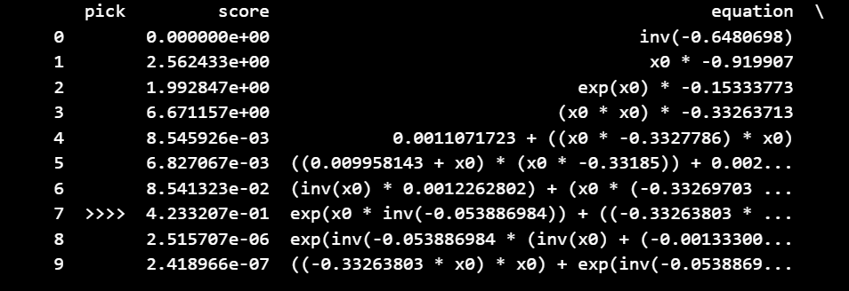
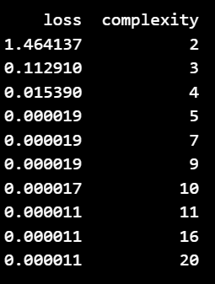
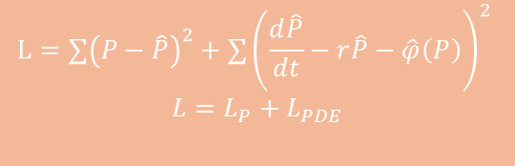
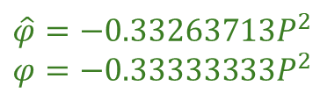
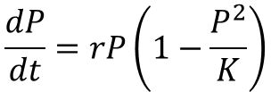
Inferring function
$$NN_{p}$$
$$NN_{φ}$$
t
$$\hat{P}$$
$$\hat{φ}$$
$$L=∑{\left(P−\hat{P}\right)}^{2}+∑{\left(\frac{d\hat{P}}{dt}−r\hat{P}−\hat{φ}\left(P\right)\right)}^{2}$$
$$L=L_{P}+L_{PDE}$$
$$\frac{dP}{dt}=rP\left(1−\frac{P^{2}}{K}\right)$$
$$\hat{φ}=−0.33263713P^{2}$$
$$φ=−0.33333333P^{2}$$

Slide 6
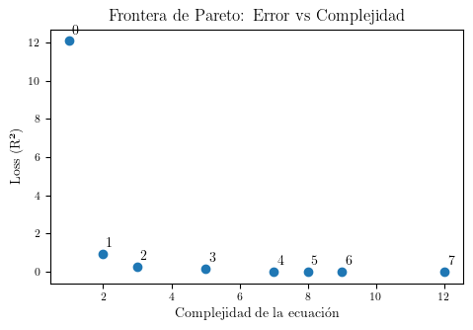
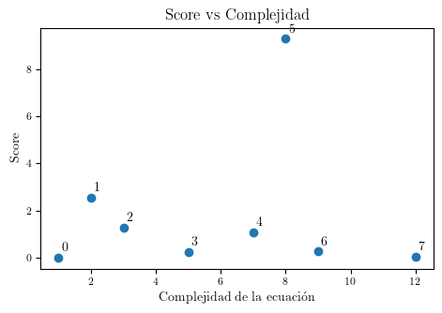
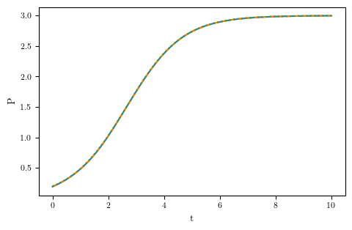
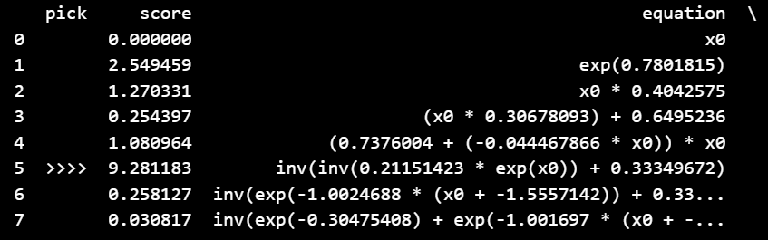
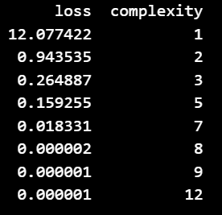
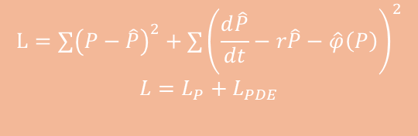
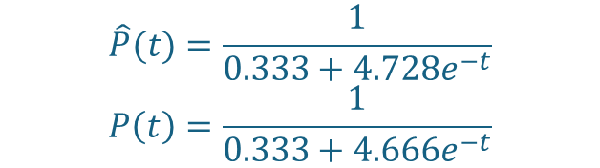
Inferring function
$$NN_{p}$$
$$NN_{φ}$$
t
$$\hat{P}$$
$$\hat{φ}$$
$$L=∑{\left(P−\hat{P}\right)}^{2}+∑{\left(\frac{d\hat{P}}{dt}−r\hat{P}−\hat{φ}\left(P\right)\right)}^{2}$$
$$L=L_{P}+L_{PDE}$$
$$\hat{P}(t)=\frac{1}{0.333+4.728e^{−t}}$$
$$P\left(t\right)=\frac{1}{0.333+4.666e^{−t}}$$

Slide 7

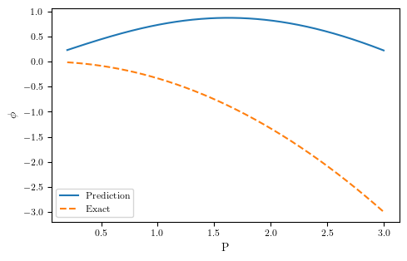
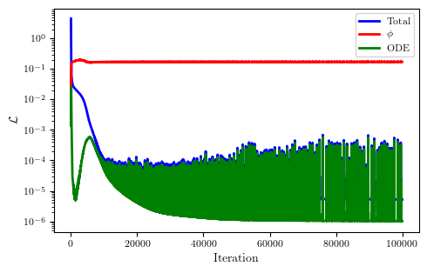
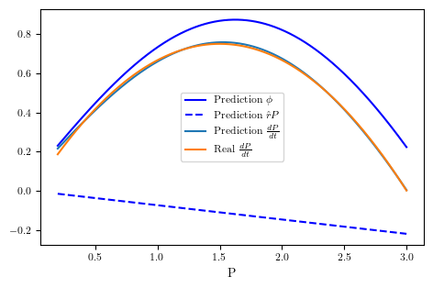

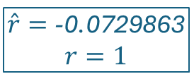
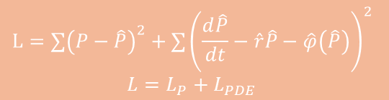
Inferring function+ parameter
$$NN_{p}$$
$$NN_{φ}$$
t
$$\hat{P}$$
$$\hat{φ}$$
!
$$\hat{r}$$
$$L=∑{\left(P−\hat{P}\right)}^{2}+∑{\left(\frac{d\hat{P}}{dt}−\hat{r}\hat{P}−\hat{φ}\left(\hat{P}\right)\right)}^{2}$$
$$L=L_{P}+L_{PDE}$$
$$\hat{r}=\text{−0.0729863}$$
$$r=1$$

Slide 8



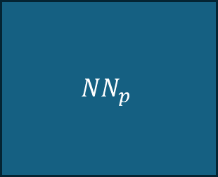



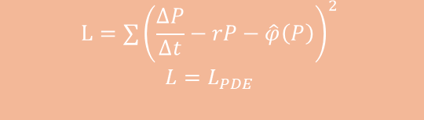
Noise
$$NN_{p}$$
$$NN_{φ}$$
t
$$\hat{P}$$
$$\hat{φ}$$
$$L=∑{\left(P−\hat{P}\right)}^{2}+∑{\left(\frac{d\hat{P}}{dt}−r\hat{P}−\hat{φ}\left(P\right)\right)}^{2}$$
$$L=L_{P}+L_{PDE}$$
$$NN_{d}$$
P
$$\hat{φ}$$
$$L=∑{\left(\frac{∆P}{∆t}−rP−\hat{φ}\left(P\right)\right)}^{2}$$
$$L=L_{PDE}$$

Slide 9






Noise
$$NN_{p}$$
$$NN_{φ}$$
t
$$\hat{P}$$
$$\hat{φ}$$
$$L=∑{\left(P−\hat{P}\right)}^{2}+∑{\left(\frac{d\hat{P}}{dt}−r\hat{P}−\hat{φ}\left(P\right)\right)}^{2}$$
$$L=L_{P}+L_{PDE}$$

Slide 10
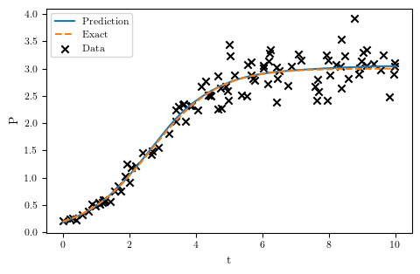
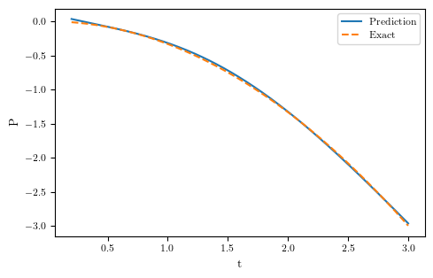
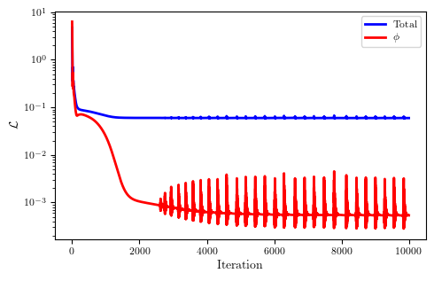
Noise
$$NN_{p}$$
$$NN_{φ}$$
t
$$\hat{P}$$
$$\hat{φ}$$
$$L=∑{\left(P−\hat{P}\right)}^{2}+∑{\left(\frac{d\hat{P}}{dt}−r\hat{P}−\hat{φ}\left(P\right)\right)}^{2}$$
$$L=L_{P}+L_{PDE}$$

Slide 11
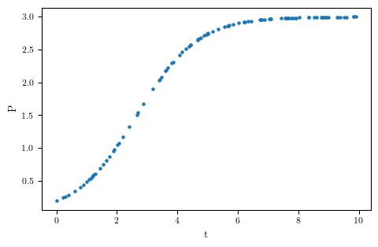

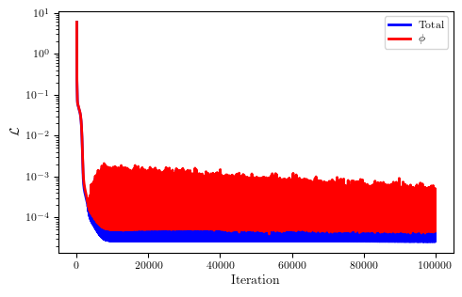
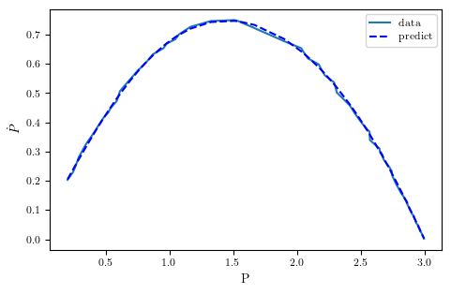


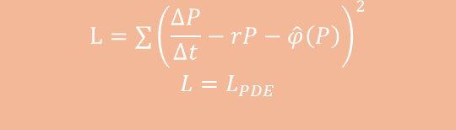
Noise
$$NN_{d}$$
P
$$\hat{φ}$$
$$L=∑{\left(\frac{∆P}{∆t}−rP−\hat{φ}\left(P\right)\right)}^{2}$$
$$L=L_{PDE}$$

Slide 12
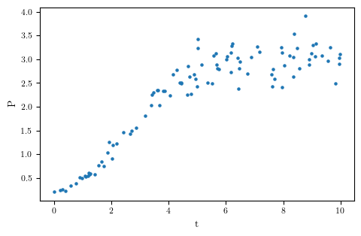
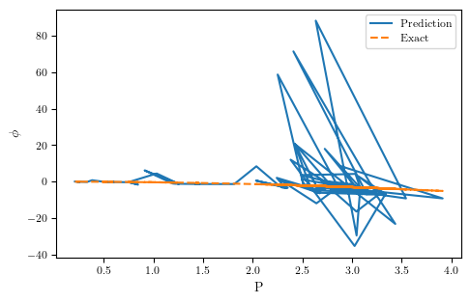
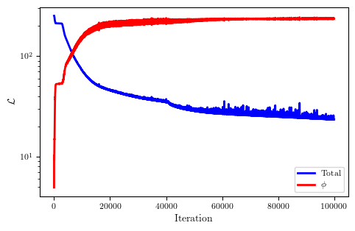
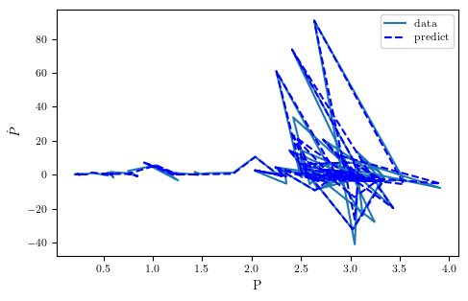



Noise
$$NN_{d}$$
P
$$\hat{φ}$$
$$L=∑{\left(\frac{∆P}{∆t}−rP−\hat{φ}\left(P\right)\right)}^{2}$$
$$L=L_{PDE}$$

Slide 13
RESUME (14/10/2024)
Inferring dPdt
Inferring ED in LB φ(p)
Inferring EDK
Inferring EDLB introducing P and S
Inferring ED in LB φ(p,t)

Slide 14








Inferring dPdt
$$\frac{dP}{dt}=rP\left(1−\frac{P}{K}\right)$$
$$NN_{u}$$
$$NN_{φ}$$
t
$$\hat{P}$$
$$\hat{φ}$$
$$ℒ=\frac{1}{N_{u}}\sum_{u}{λ_{u}{\left(P−\hat{P}\right)}^{2}}+\frac{1}{N_{f}}\sum_{f}{λ_{f}{\left(\frac{d\hat{P}}{dt}−\hat{φ}(\hat{P})\right)}^{2}}$$
$$ℒ=ℒ_{u}+ℒ_{f}$$
$$\hat{P}(t)=\frac{1}{{0.333+4.638e}^{−t}}$$
$$P\left(t\right)=\frac{1}{0.333+4.666e^{−t}}$$
$$\hat{φ}=−0.333P^{2}+0,999P$$
$$φ=−0.333P^{2}+P$$

Slide 15










Inferring ED in LB
$$NN_{p}$$
$$NN_{φ}$$
t
$$\hat{P}$$
$$\hat{φ}$$
$$L=∑{\left(P−\hat{P}\right)}^{2}+∑{\left(\frac{d\hat{P}}{dt}−\hat{φ}\left(P\right)\right)}^{2}$$
$$L=L_{P}+L_{ODE}$$
!

Slide 16






Inferring EDLB introducing with phi(P, t)
$$NN_{p}$$
$$NN_{φ}$$
t
$$\hat{P}$$
$$\hat{φ}$$
$$L=∑{\left(P−\hat{P}\right)}^{2}+∑{\left(\frac{d\hat{P}}{dt}−\hat{φ}\left(P, t\right)\right)}^{2}$$
$$L=L_{P}+L_{ODE}$$

Slide 17







Inferring EDLB introducing with phi(P, t)
Propuesta. No dejar términos exponeneciales, log, etc. Buscamos el modelo más sencillo que explique el comportamineto que observamos
$$rP−rP^{2}(a+bt)$$
$$k\left(t\right)=1/(k_{0}+mt)$$
$$\frac{dP}{dt}=rP\left(1−\frac{P^{2}}{K}\right)$$

Slide 18








Inferring EDLB introducing with phi(P, t)
$$\frac{dP}{dt}=aP+bP^{2}+cP^{2}t$$
K=k(t)
$$\frac{dP}{dt}= aP+bP^{2}+cPt$$

Slide 19



















Inferring EDK introducing with phi(P, t)
Las predicciones de las PINNs parecen coherentes para cada nivel de antibiotic. Se podría ver si son capaces de interpolar a otro nivel de antibiótico
La regression simbolica empieza a ser demasiado compleja, y dejar que ponga la dependencia explicita con t, al final provoca de nuevo una falta de interpretabilidad
$$\frac{dP}{dt}=−3.6P^{2}t−27.47P^{2}+30.54P$$
$$\frac{dP}{dt}=−154.42Pt−54.367t^{2}+152.48t$$

Slide 20

















Inferring EDLB with P and S
$$\frac{dP}{dt}=f\left(P,S\right)$$
$$\frac{dS}{dt}=−aP$$
$$NN_{u}$$
$$NN_{φ}$$
$$\hat{ln⁡(P)}$$
$$\hat{P}$$
t
$${\hat{φ}}_{P}$$
$$\hat{ln⁡(S)}$$
$$\hat{S}$$
$$\hat{m}$$
$L=∑{\left(P−\hat{P}\right)}^{2}+∑{\left(\frac{d\hat{P}}{dt}−{\hat{φ}}_{P}\left(P,S\right)\right)}^{2}$ $+∑{\left(\frac{d\hat{S}}{dt}+\hat{m}\hat{P}\right)}^{2}$
Ninguna de las dos te da la curvature decreciente, aunque en otros datos no es tan pronunciada
Si haces dependiente dS/dt=aPS también tienes cosas coherentes.
fisicamente tiene más sentido, ya que creas un atractor en S=0 (??) Tampoco tiene sentido que a menos alimento, baje se reduzca menos. P+S->P
$$\frac{dP}{dt}=−36.73P^{2}+29.19PS+14.58P$$
$$\frac{dS}{dt}=−0. 516P$$
!
$$\frac{dP}{dt}=−72.12P^{2}+40.80P^{2}S+39.94P$$
$$\frac{dS}{dt}=−0. 455P$$

Slide 21









Inferring EDLB with P and S
$$P+P→P$$
$$P+S→P+P$$
$$P→P+P$$
$$NN_{u}$$
$$NN_{φ}$$
$$\hat{ln⁡(P)}$$
$$\hat{P}$$
t
$${\hat{φ}}_{P}$$
$$\hat{ln⁡(S)}$$
$$\hat{S}$$
Una reproducción más rapida cuando las bacterias estan alimentadas y teien suficiente sustrato, y otra más lenta
$$\hat{m}$$
$L=∑{\left(P−\hat{P}\right)}^{2}+∑{\left(\frac{d\hat{P}}{dt}−{\hat{φ}}_{P}\left(P,S\right)\right)}^{2}$ $+∑{\left(\frac{d\hat{S}}{dt}+\hat{m}\hat{P}\hat{S}\right)}^{2}$
$$\frac{dP}{dt}=−26.49P^{2}+35.84PS$$
$$\frac{dS}{dt}=−0. 644PS$$
$$\frac{dP}{dt}=−35.60P^{2}+24.83PS+16.93P$$
$$\frac{dS}{dt}=−0.904PS$$

Slide 22


Líneas futuras
Modelo PS y ver como varían los coeficientes según A, asumiendo A=cte y no A=A(t)
Cuesta de entrenar y luego no hay una expression lineal bonita -------------→
Modelo PSA
$\frac{dP}{dt}=f_{1}\left(P,S,A\right)$
$\frac{dS}{dt}=−m(A=0)PS$
$\frac{dA}{dt}=¿f_{2}\left(P,S,A\right)→f_{2}\left(P,A\right)?$
Limitar a terminos de segundo grado

Slide 23










$$NN_{u}$$
$$\hat{ln⁡(P)}$$
$$\hat{P}$$
$$NN_{φ}$$
t
$$\hat{ln⁡(S)}$$
$$\hat{S}$$
$${\hat{φ}}_{P}$$
$$\hat{ln⁡(A)}$$
$$\hat{A}$$
$$\hat{l}$$
$L=∑{\left(P−\hat{P}\right)}^{2}+∑{\left(\frac{d\hat{P}}{dt}−{\hat{φ}}_{P}\left(P,S,A\right)\right)}^{2}+∑{\left(\frac{d\hat{S}}{dt}+m\hat{P}\hat{S}\right)}^{2}$ $+∑{\left(\frac{d\hat{A}}{dt}+l\hat{P}\hat{A}\right)}^{2}$
$$\frac{dP}{dt}=f_{1}\left(P,S,A, I?\right)$$
$$\frac{dS}{dt}=−m(A=0)PS$$
$$\frac{dA}{dt}=−lPA$$
$$\frac{dI}{dt}=+lPA−Pj$$
$$P+P→P$$
$$P→P+P$$
$$P+S→P$$
$$P+A→I$$
$$I→P$$

Slide 24
RESUME (24/10/2024)
Inferring dPdt
Inferring ED in LB φ(p)
Inferring EDK
Inferring EDLB introducing P and S
Inferring ED in LB φ(p,t)

Slide 25





Data approximation
Kinetic approximation
APPROACH

Slide 26













r(t)P
$$NN_{u}$$
$$\hat{ln⁡(P)}$$
$$\hat{P}$$
t
$$\hat{ln⁡(r)}$$
$$\hat{r}$$
$$L=∑{\left(P−\hat{P}\right)}^{2}+∑{\left(\frac{d\hat{P}}{dt}−\hat{r}\left(t\right)P\right)}^{2}$$

Slide 27
rP-k(t)P**2

Slide 28
r(t)P sin periodo de latencia

