Slide 1

Final Project Classification of Musical Instruments by Sound
Zozulia, Yuliia
CSCI E-89 Deep Learning
Harvard University Extension School
Prof. Zoran B. Djordjević

Slide 2
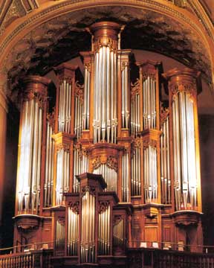
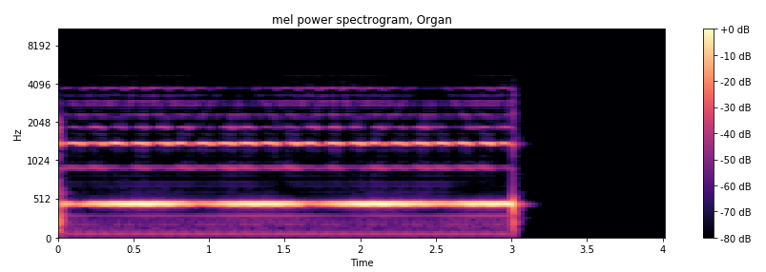
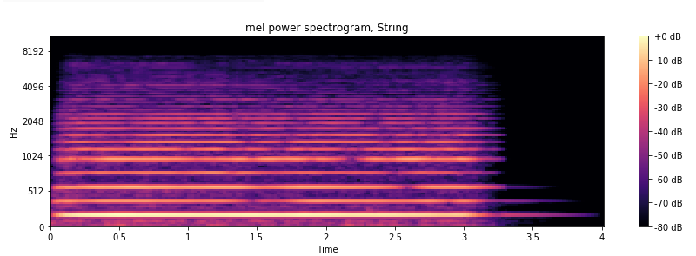
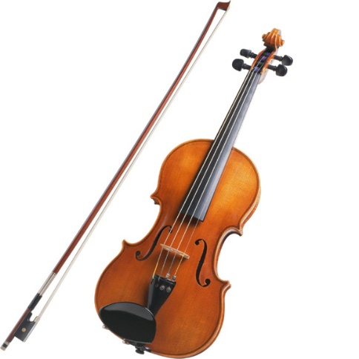
Problem Statement
The goal is to develop the model which will allow us to recognize music instrument from the sound of it. I used convolutional neural network, implementing it using Keras - high-level neural networks API, running on top of TensorFlow. As dataset, I used The NSynth Dataset, which contains sounds of musical notes from different instrument families.

Slide 3
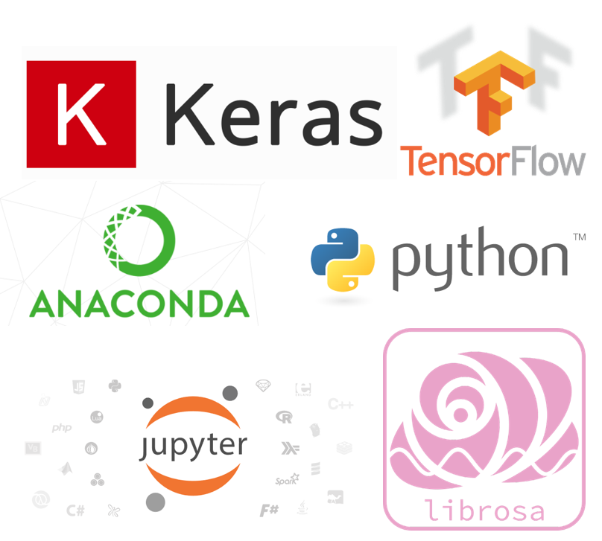
Technologies Used:

Slide 4
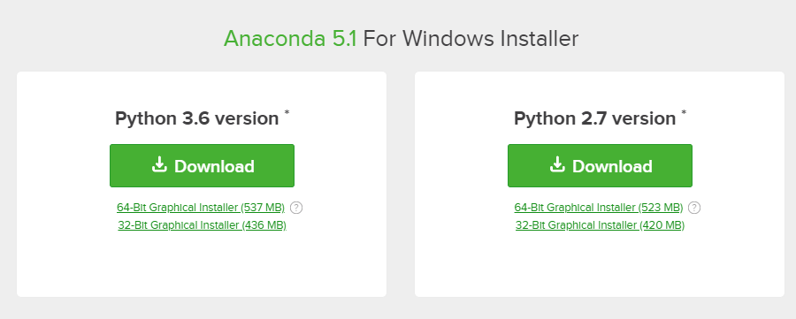
Overview of Install/Config/Set up
To set up Anaconda, go to:
https://www.anaconda.com/download
Pick OS (Windows 64-Bit in my case) and Python version (Python 3.6), click “Download” and follow steps of Graphical Installer.
Once done, you have installed Anaconda, Python and Jupiter Notebook.
Packages used in the project:
TensorFlow, Numpy, Keras, Matplotlib, Librosa, shutil, IPython.

Slide 5
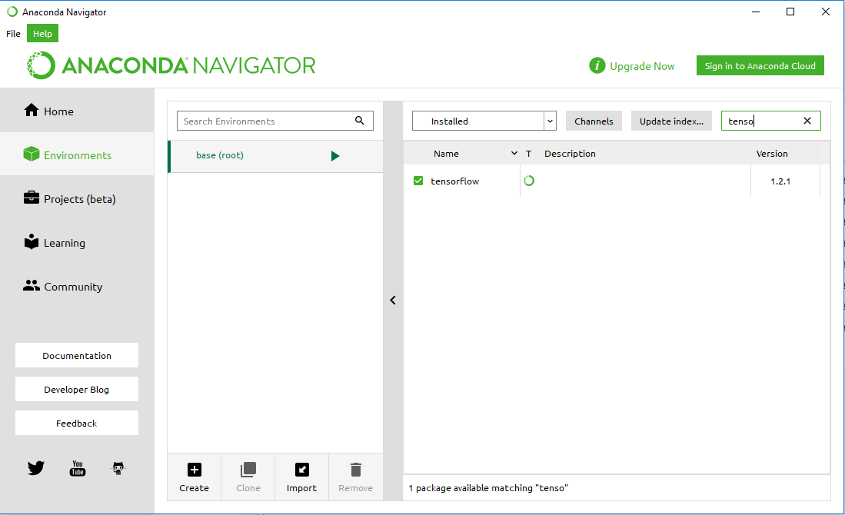
Overview of Install/Config/Set up
To install packages, open Anaconda Navigator, go to Environment, pick appropriate Environment (base(root)) in my case, then in “Search Packages” type package name, for example, “Tensotflow”. If not installed already, select checkbox near “Tensorflow” and press “Apply”.
Librosa can be installed from the conda-forge channel:
conda install -c conda-forge librosa

Slide 6

Description of Data
To perform classification of Musical Instruments by sound, we need to find large dataset with records of sound with information about performer.
I used The NSynth Dataset from Magenta
https://magenta.tensorflow.org/datasets/nsynth
NSynth is an audio dataset containing 305,979 musical notes, each with a unique pitch, timbre, and envelope. For 1,006 instruments from commercial sample libraries, authors generated four second, monophonic 16kHz audio snippets, referred to as notes.

Slide 7
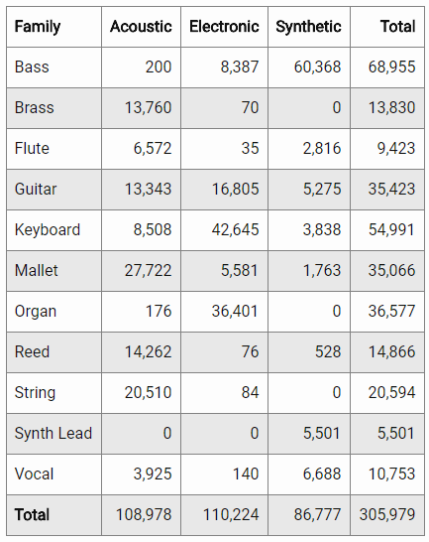
Description of Data
Frequency counts for instrument classes
with Sources as columns an Families as rows
(Original Data)
I would like to proceed only with acoustic and electronic, so let’s delete synthetic.
Also, dataset contains records of vocal, with is not instrument, so let’s delete them too.
After cleaning, we have 9 classes of instrument families.
The whole dataset (305,979 samples) is huge (23.5 Gb)
I used subset of 9,459 samples (1.13 Gb) in training set and 3,039 (371 Mb) in test set.

Slide 8
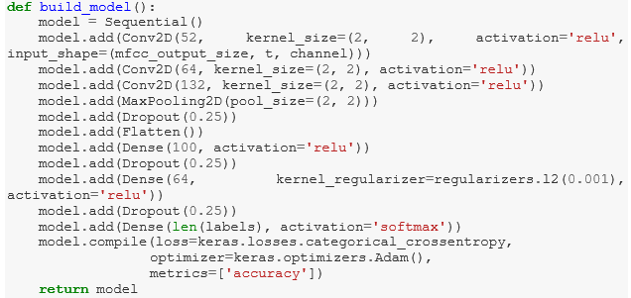
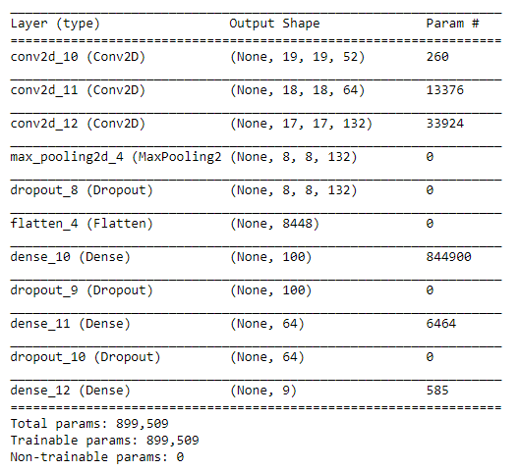
Fitting the model
Convolutional Neural Network was used.
Testing accuracy after 10 epochs is 98.4%.
Each epoch took about 1 minute, so the whole training process was completed in 10 minutes (running on CPU (AMD FX-8320E Eight-Core Processor 3.5 GHz).

Slide 9
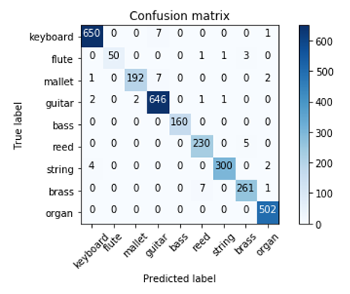
Results
Testing accuracy is 98.4%.
Confusion matrix looks very good! Number of miss-predicted instruments is very small.
Among miss-predicted values is keyboard predicted as guitar (7 times) and reed predicted as brass (5 times).

Slide 10
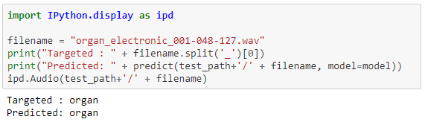

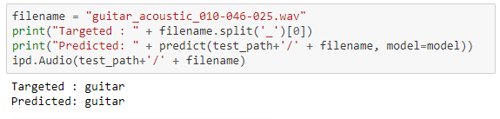
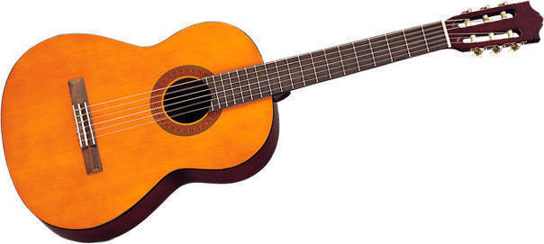
Let’s make predictions!

Slide 11
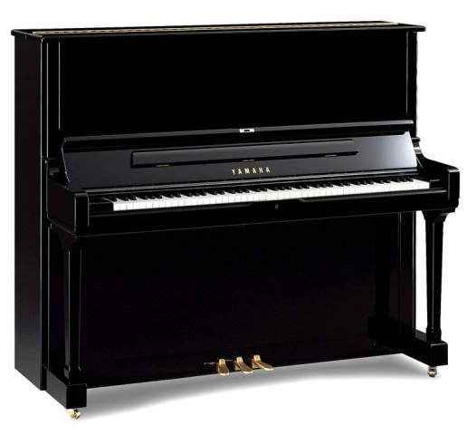
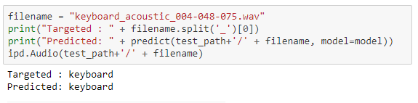
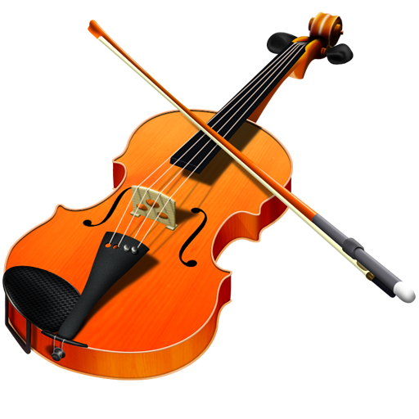
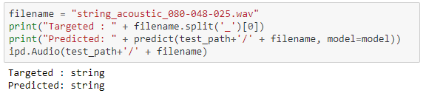
Let’s make predictions!

Slide 12
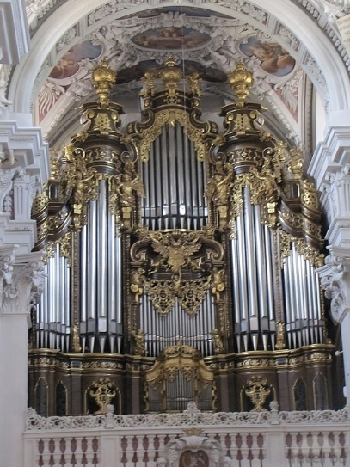
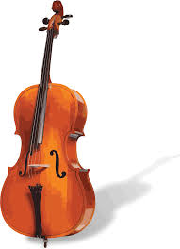
Spectrograms
Let’s take a look at mel power spectrogram for several different instruments

Slide 13
Summary
I used Convolutional Neural Network to create a model for classification music instruments by sound.
Keras provides very user-friendly user interface and consistent & simple APIs for NN development. It’s really pleasure to work with it.
Using NSynth, which contains audio record of the solitary note, as dataset, developed model, implemented thought Keras, trains very fast and produce very good results (98% test accuracy).
It would be nice to expand the model to learn how to recognize instrument not from the single note, but from actual piece of music with a single predominant instrument. Model, similar to the one I successfully used for NSynth Dataset, when trained on IRMAS dataset (with modification to accommodate more complex data), gives me only 47.5% testing accuracy (number of classes – 9).
Also, it would be interesting to use other sound features, which can be extracted from sound file using Librosa library, like spectral centroid, roll-off frequency, tonal centroid features, zero-crossing rate, etc.

Slide 14
References
Code and technical info:
https://keras.io/
https://anaconda.org/anaconda/anaconda-navigator
https://www.python.org/
http://jupyter.org/
https://github.com/librosa/librosa
https://blog.manash.me/building-a-dead-simple-word-recognition-engine-using-convnet-in-keras-25e72c19c12b
http://scikit-learn.org/stable/auto_examples/model_selection/plot_confusion_matrix.html#sphx-glr-auto-examples-model-selection-plot-confusion-matrix-py
http://nbviewer.jupyter.org/github/librosa/librosa/blob/master/examples/LibROSA%20demo.ipynb
Data source:
https://magenta.tensorflow.org/datasets/nsynth

Slide 15
YouTube URLs
Two minute (short): https://youtu.be/koA5rjbmMZk
15 minutes (long): https://youtu.be/wFLID1VJqik

