Slide 1
Mortality in Myocardial Infarction Care (MIMIC): Comparison of MI mortality prediction among MIMIC-IV and TMU dataset
Group 10- 簡辰穎、 蘇芊卉、姜光謙、蔡孟翰、陳亮穎

Slide 2

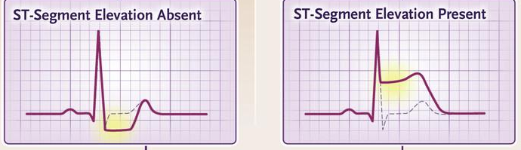
Myocardial Infarction (MI)
Introduction
Methods
Results
Discussion
N Engl J Med. 2017 May 25;376(21):2053-2064.
Cardiac enzyme
Decreased blood flow
Troponin-T
Troponin-I
CK-MB
Heart muscle necrosis
EKG changes
Type I | coronary atherothrombosis
Type II | supply–demand mismatch
Type III | sudden death w/o EKG/Lab
Type IV | PCI-induced
NSTEMI
STEMI
Notes:
Myocardial infarction (MI) is the death of heart muscle caused by prolonged and inadequate blood flow.
Based on the mechanism of ischemia, MI could be categorized into 4 types. The most common etiology is type I, which is related to coronary atherothrombosis.
Anderson JL, Morrow DA. Acute Myocardial Infarction. N Engl J Med. 2017 May 25;376(21):2053-2064. doi: 10.1056/NEJMra1606915IF: 96.2 Q1 . PMID: 28538121.

Slide 3
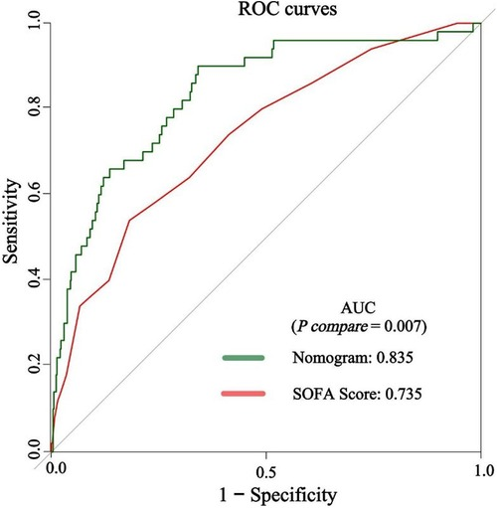


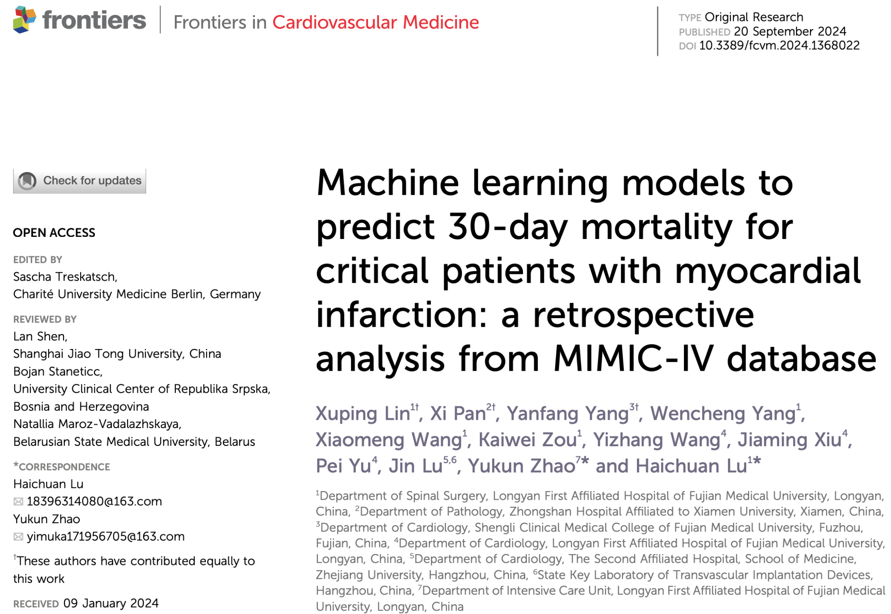
Myocardial Infarction (MI)
Introduction
Methods
Results
Discussion
https://doi.org/10.3389/fcvm.2024.1368022
Mortality & Morbidity
Aims
Develop machine learning model for prediction of MI mortality
Compare difference of model performance in MIMIC-IV and TMU dataset
Nomogram
No external validation
Notes:
Anderson JL, Morrow DA. Acute Myocardial Infarction. N Engl J Med. 2017 May 25;376(21):2053-2064. doi: 10.1056/NEJMra1606915IF: 96.2 Q1 . PMID: 28538121.

Slide 4
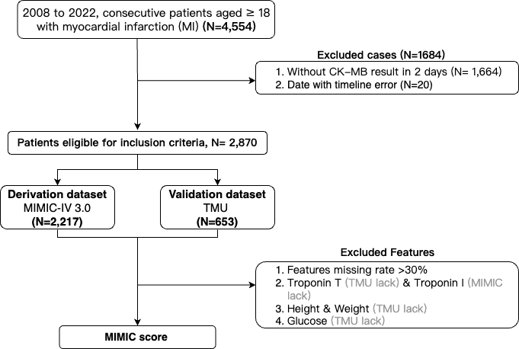

Patient Population
Introduction
Methods
Results
Discussion
Inclusion
Dual Center, N=4554
TMU
Age ≥18
MI at admission
MIMIC-IV
Exclusion
NO CK-MB data
Timeline error
N=2870
Derivation
MIMIC-IV
N=2217
N=653
Validation
TMU
Accuracy
Sensitivity
XGBoost
Random Forest
Height, Weight, Troponin-T, Glucose
Missing <30%
Specificity
Precision

Slide 5
Baseline characteristics-Patient demographics
Introduction
Methods
Results
Discussion
MIMIC-IV | Survivors | Non-survivors | P
Age, year | 71.3 (13.3) | 68±16 | 0.86
Male | 970 (58.3%) | 124(27) | 1.00
Race |  |  | 0.066
Asian | 44 (2.6%) | 11 (2.0%)
White | 1114 (67.0%) | 365 (65.9%)
Black | 153 (9.2%) | 36 (6.5%)
Hispanic | 44 (2.6%) | 14 (2.5%)
Other | 308 (18.5%) | 128 (23.1%)
Death after admitted at ICU, hours | - | 218.9 (189.9)

Slide 6
Baseline characteristics-Vital signs
Introduction
Methods
Results
Discussion
MIMIC-IV | Survivors | Non-survivors | P
Systolic Blood Pressure (SBP), mmHg | 125.7 (23.3) | 116.7 (21.1) | <0.001
Diastolic Blood Pressure (DBP), mmHg | 68.0 (16.7) | 64.0 (16.8) | 0.033
Mean Blood Pressure (MBP), mmHg | 83.1 (19.7) | 77.9 (16.6) | 0.008
Heart rate (HR), beats/minute | 87.3 (19.0) | 90.4 (19.2) | 0.043
Body temperature,°C | 36.8 (0.6) | 36.6 (1.0) | 0.131
SPO2 (Oxygen Saturation),% | 96.1 (3.7) | 95.9 (3.9) | 0.583
Glucose, mg/dL | 200.2 (124.2) | 176.5 (86.6) | 0.048

Slide 7
Baseline characteristics
Introduction
Methods
Results
Discussion
Laboratory data-1
MIMIC-IV | Survivors | Non-survivors | P
Hematocrit, % | 33.4 (6.4) | 32.7 (6.2) | 0.042
Hemoglobin, g/dL | 10.9 (2.3) | 10.4 (2.2) | <0.001
Red Blood (RBC) Cell count, 10⁶/µL | 3.7 (0.8) | 3.5 (0.8) | <0.001
White Blood Cell (WBC) count, 10³/µL | 12.3 (10.1) | 14.8 (10.0) | <0.001
Platelet, 10³/µL | 215.0 (93.5) | 211.1 (108.5) | 0.452
MCH, pg | 30.0 (2.5) | 29.9 (2.9) | 0.31
MCHC,% | 33.0 (1.6) | 32.2 (1.7) | <0.001
RDW,% | 14.9 (2.1) | 15.7 (2.2) | <0.001
Neutrophils,% | 78.6 (13.0) | 79.5 (14.3) | 0.295
Lymphocytes,% | 12.5 (10.4) | 10.4 (10.6) | 0.001
Sodium, mmol/L | 138.2 (4.9) | 139.1 (6.7) | 0.008
Potassium, mmol/L | 4.3 (0.8) | 4.5 (0.9) | 0.001
Calcium, mg/dL | 8.4 (0.8) | 8.2 (1.0) | <0.001

Slide 8
Baseline characteristics
Introduction
Methods
Results
Discussion
Laboratory data-2
MIMIC-IV | Survivors | Non-survivors | P
Bicarbonate, mmol/L | 23.8 (5.4) | 23.9 (6.2) | 0.967
Chloride, mmol/L | 103.5 (6.2) | 104.1 (8.0) | 0.092
Anion gap, mmol/L | 16.2 (4.5) | 18.3 (5.4) | <0.001
Troponin T, ng/dL | 1.0 (2.0) | 1.3 (2.3) | 0.048
Troponin I, ng/dL | - | - | -
Creatine kinase (CK), U/L | 225 (108-575) | 226 (91-675) | 0.241
Creatine kinase-myocardial band (CKMB), IU/L | 12.0 (5.0-29.5) | 12.0 (5.0-36.0) | 0.071
NT-proBNP, pg/mL | 12770.2 (1977-20500) | 16127.9 (4721.5-25904.5) | 0.081
Creatinine, mg/dL | 1.9 (2.1) | 2.2 (1.8) | <0.001
eGFR, mL/min | 65.3 (42.9) | 50.5 (39.1) | <0.001
AST/GOT, U/L | 48 (29-102) | 72 (34-19) | 0.009
ALT/GPT, U/L | 28 (18-56) | 36 (20-111) | 0.001

Slide 9
Baseline characteristics-Patient demographics
Introduction
Methods
Results
Discussion
TMU | Survivors | Non-survivors | P
Age, year | 71.3 (13.3) | 68±16 | 0.86
Male | 533 (74.0%) | 49 (65.3%) | 0.139
Glucose, mg/dL | 141.9 (53.0) | 163.2 (76.4) | 0.146

Slide 10
Baseline characteristics
Introduction
Methods
Results
Discussion
Laboratory data-1
TMU | Survivors | Non-survivors | P
Red Blood (RBC) Cell count, 10⁶/µL | 4.1 (2.6) | 11.6 (59.0) | 0.299
White Blood Cell (WBC) count, 10³/µL | 89.2 (680.7) | 13.2 (5.7) | 0.020
Platelet, 10³/µL | 213.6 (77.3) | 187.9 (79.6) | 0.014
MCH, pg | 30.2 (2.9) | 30.1 (3.1) | 0.916
MCHC,% | 34.1 (1.2) | 33.7 (1.1) | 0.008
Sodium, mmol/L | 137.7 (4.3) | 137.6 (5.6) | 0.795
Potassium, mmol/L | 3.8 (0.5) | 4.0 (1.0) | 0.049
Calcium, mg/dL | 8.5 (0.8) | 8.3 (0.9) | 0.187

Slide 11
Baseline characteristics
Introduction
Methods
Results
Discussion
Laboratory data-2
TMU | Survivors | Non-survivors | P
Bicarbonate, mmol/L | 22.1 (4.7) | 19.1 (6.5) | 0.001
Chloride, mmol/L | 104.1 (7.4) | 102.7 (12.2) | 0.574
eGFR, mL/min | 58.6 (38.7) | 36.2 (36.1) | <0.001
NT-proBNP, pg/mL | 6607.6 (9432.4) | 9041.6 (10316.0) | 0.381
AST/GOT, U/L | 97.0 (262.5) | 401.1 (936.7) | 0.034
ALT/GPT, U/L | 68.6 (213.4) | 291.6 (788.3) | 0.044

Slide 12
Model Performance- Stratification by race
Introduction
Methods
Results
Discussion
 | Accuracy
Random forest
Internal testing | 0.7928
External validation
XGBoost
Internal testing | 0.8000
External validation
Random forest | Accuracy
Asian (N=55) | 0.64
White (N=1479) | 0.78
Black (N=189) | 0.84
Hispanic (N=58) | 0.67
Other (N=436) | 0.85
XGBoost | Accuracy
Asian (N=55) | 0.91
White (N=1479) | 0.79
Black (N=189) | 0.87
Hispanic (N=58) | 0.83
Other (N=436) | 0.78
Random forest | Accuracy
Male (N=1304) | 0.79
Female (N=913) | 0.79
XGBoost | Accuracy
Male (N=1304) | 0.75
Female (N=913) | 0.80

Slide 13
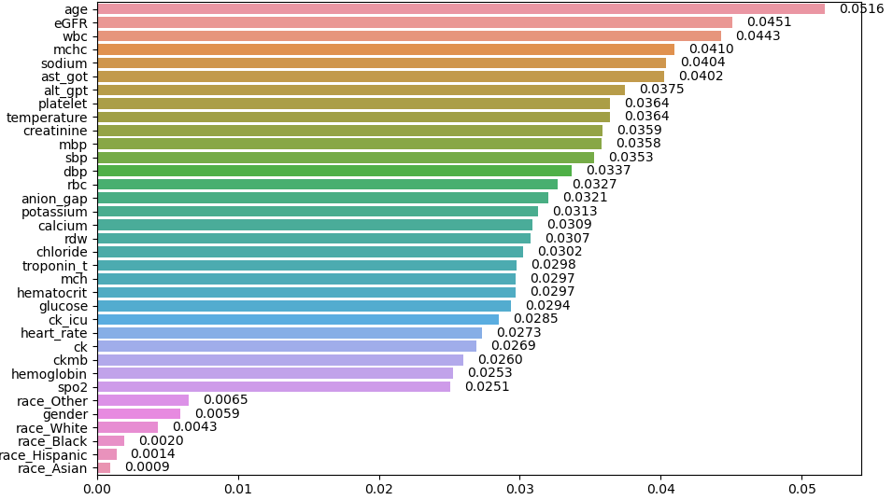
Feature Importance- Random foreset
Introduction
Methods
Results
Discussion

Slide 14
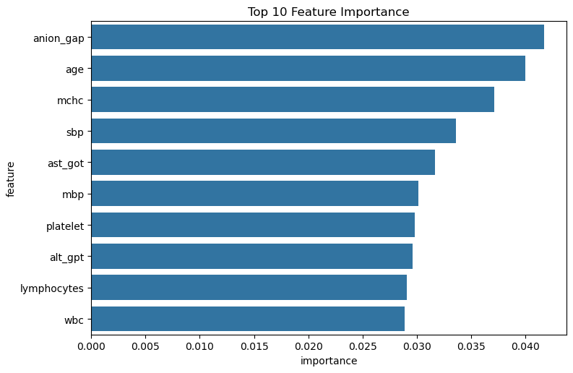
SHAP- XGBoost
Introduction
Methods
Results
Discussion

Slide 15
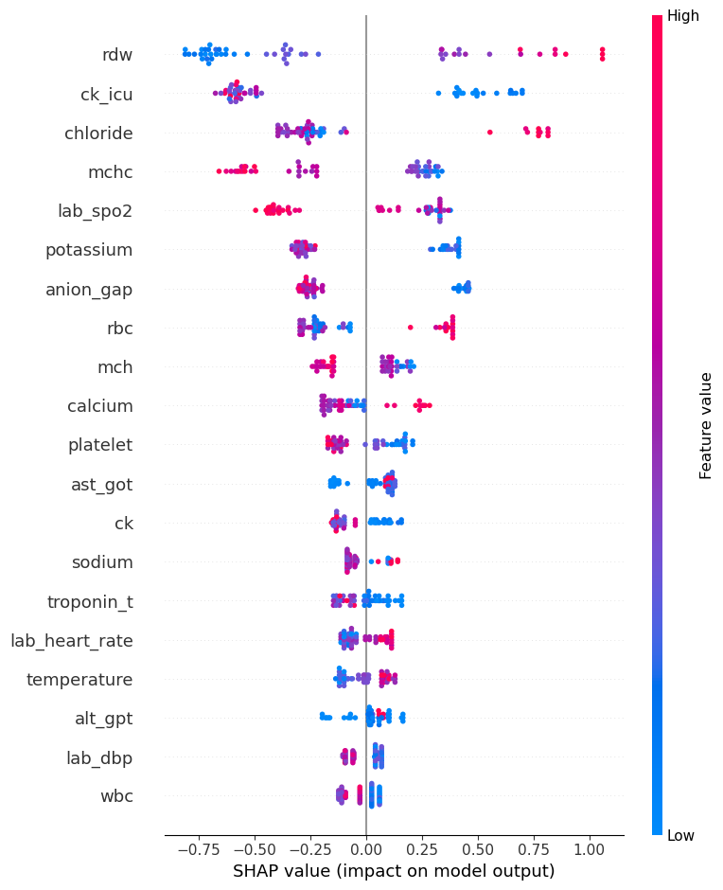
SHAP- XGBoost
Introduction
Methods
Results
Discussion

Slide 16
Discussion
Introduction
Methods
Results
Discussion
All objective features can reach the accuracy of
No past history
TIMI: need past history and symptoms
XGBoost revealed less bias regarding human race in MIMIC IV dataset. More time to test more model.
SHAPley value and Feature importance revealed different results. It’s important to analyze both of them and thinking about the rationale behind the feature selected

Slide 17
Limitations
Introduction
Methods
Results
Discussion
Retrospective study
Inclusion of MI by ICD-10 coding system
Bias in model training: MI patients admitted to ICU → more severe
Difference in derivative and validation dataset: Mimic → ICU; TMU → general
STEMI: underwent PCI and go to CCU
NSTEMI: CCU for follow-up
Different testing kits: CK-MB and other blood tests

Slide 18
Conclusions
Introduction
Methods
Results
Discussion
XGBoost revealed less bias regarding human race in MIMIC IV dataset
SHAPley value and Feature importance revealed different results

