Slide 1
Functions
Julia Users Group – 4 Sept 2021

Slide 2
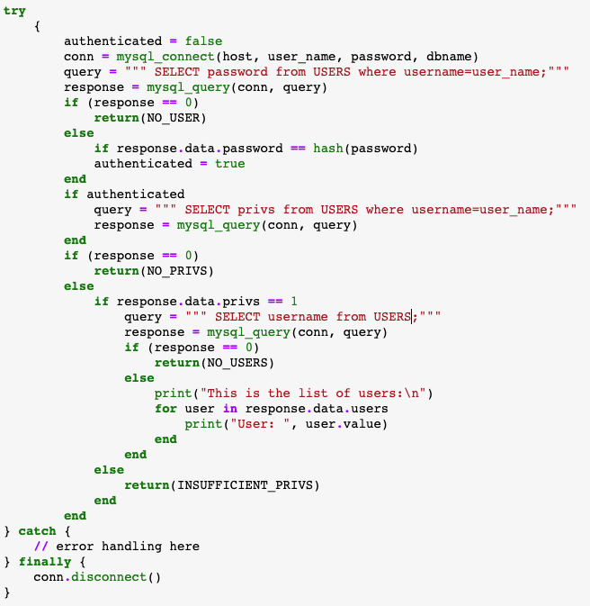
Some code…

Slide 3
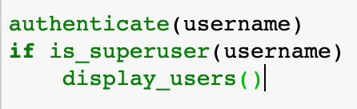
Some code…

Slide 4
Why do we use functions?

Slide 5
Why do we use functions?
Readability

Slide 6
Why do we use functions?
Readability
Abstraction

Slide 7
Why do we use functions?
Readability
Abstraction
Reusability

Slide 8
Why do we use functions?
Readability
Abstraction
Reusability
Extensibility

Slide 9
Why do we use functions?
Readability
Abstraction
Reusability
Extensibility
Testability

Slide 10
Writing Good Functions
(Credit: Jeff Knupp -> https://hackernoon.com/write-better-python-functions-c3a9a36382a6)
Functions should:

Slide 11
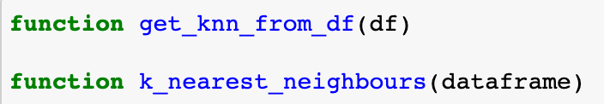
Writing Good Functions
(Credit: Jeff Knupp -> https://hackernoon.com/write-better-python-functions-c3a9a36382a6)
Functions should:
Be sensibly named

Slide 12
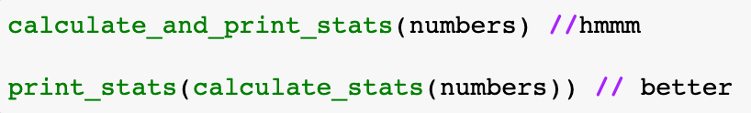
Writing Good Functions
(Credit: Jeff Knupp -> https://hackernoon.com/write-better-python-functions-c3a9a36382a6)
Functions should:
Be sensibly named
Have a single responsibility

Slide 13
Writing Good Functions
(Credit: Jeff Knupp -> https://hackernoon.com/write-better-python-functions-c3a9a36382a6)
Functions should:
Be sensibly named
Have a single responsibility
Use docstrings

Slide 14
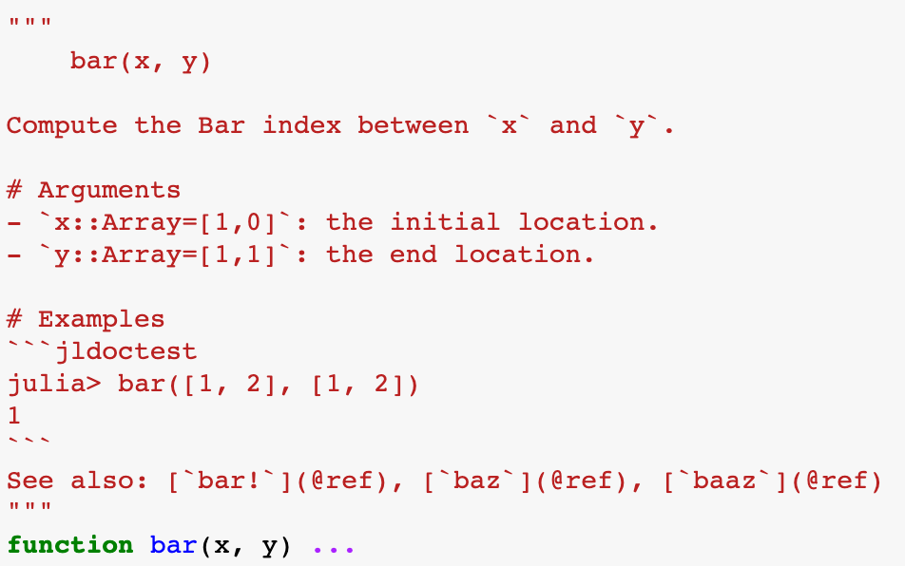
Writing Good Functions
(Credit: Jeff Knupp -> https://hackernoon.com/write-better-python-functions-c3a9a36382a6)
Functions should:
Be sensibly named
Have a single responsibility
Use docstrings

Slide 15
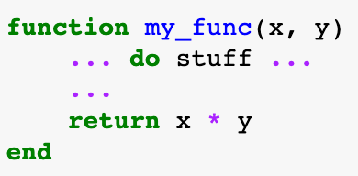
Writing Good Functions
(Credit: Jeff Knupp -> https://hackernoon.com/write-better-python-functions-c3a9a36382a6)
Functions should:
Be sensibly named
Have a single responsibility
Use docstrings
Return an explicit value

Slide 16
Writing Good Functions
(Credit: Jeff Knupp -> https://hackernoon.com/write-better-python-functions-c3a9a36382a6)
Functions should:
Be sensibly named
Have a single responsibility
Use docstrings
Return an explicit value
Be brief
Ideally fit on a single screen without scrolling
Max 50 lines
Refactor if it gets too big

Slide 17
Writing Good Functions
(Credit: Jeff Knupp -> https://hackernoon.com/write-better-python-functions-c3a9a36382a6)
Functions should:
Be sensibly named
Have a single responsibility
Use docstrings
Return an explicit value
Be brief
Aspirational Goals:
Idempotent
Same result each time for same arguments.
No side effects
Only return value is modified

Slide 18
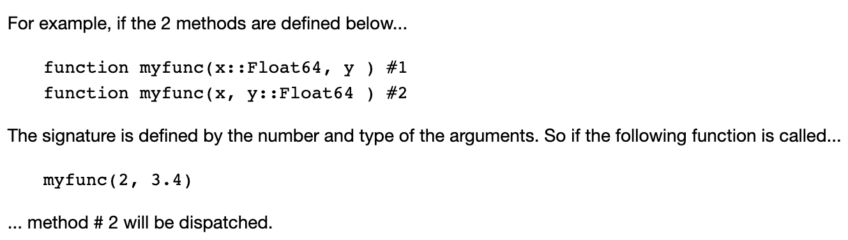
Multiple Dispatch
When there are multiple methods for the same function name then the method that is chosen is based on the method signature of the calling function.

Slide 19
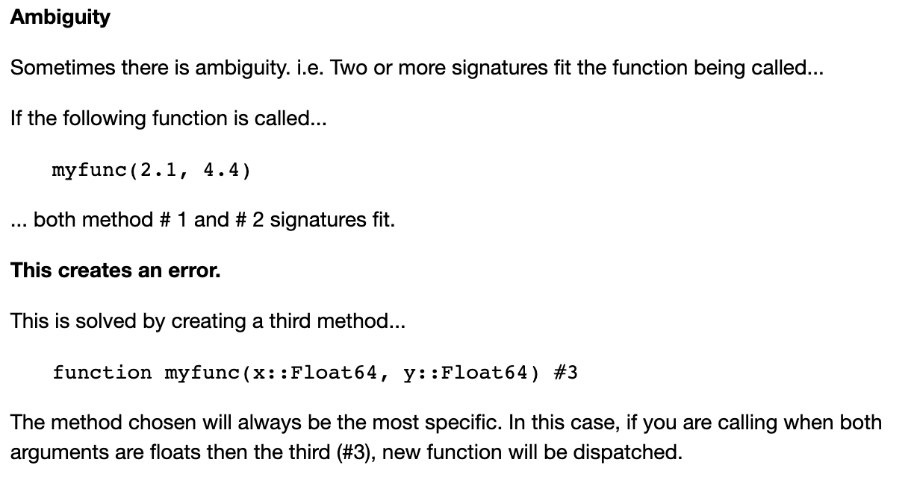
Multiple Dispatch

