Slide 1

Quality Analysis of CloudPBX VoIP Calls
Notes:
Stefan

Slide 2
A phone call
CloudPBX
B
A`
Caller
Callee
A
B`
Notes:
Stefan

Slide 3
The dataset - a call metadata log
From May 1, 2018 to present
Each record represents one leg of a phone call.
Relevant statistics for each call:
RTP (Real-time Transit Protocol) IP address for A & B
Total call delay
Total call jitter
Total packet loss
MOS (Mean Opinion Score)
Call duration
Phone type
Notes:
Stefan
Question times
(Real-time Tr(Reael-time Transit Protocol)ansit Protocol), [ quickly explain jitter]

Slide 4
Reduce the dataset - When does a record correspond to a real phone call?
Call duration > 0 ms
Valid RTP IP address for A
Valid RTP IP address for B
~140M records
~1GB
This reduced our data set by ~ 40%.
Notes:
Stefan

Slide 5
MOS (Mean Opinion Score)
MOS gives numerical indication of perceived quality of the media received
value of 4.0 to 4.5 referred to as toll-quality
normal value of PSTN and many VoIP services
Notes:
Connor + Julian For instance, a value of 4.0 to 4.5 is referred to as toll-quality and causes complete satisfaction. This is the normal value of PSTN and many VoIP services, including CloudPBX.

Slide 6
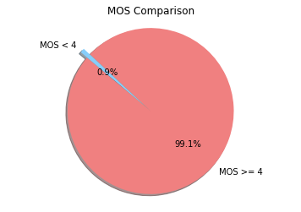
Limitations of MOS
Any jitter below 35ms is disregarded
longer the distance of a call, higher the tolerance of signal disturbances
“Bad call events” (i.e. dense periods of high jitter) get lost when averaged over the time duration of the call
*
Notes:
Connor + Julian

Slide 7
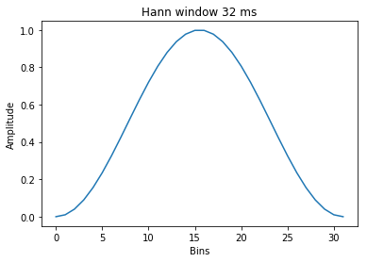
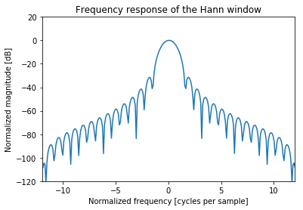
Source: ITU-T P.862
Notes:
Connor + Julian

Slide 8
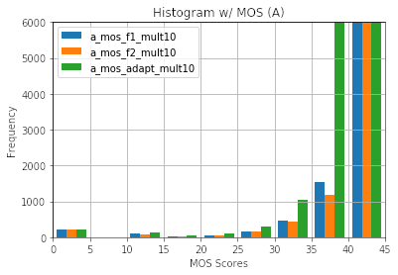
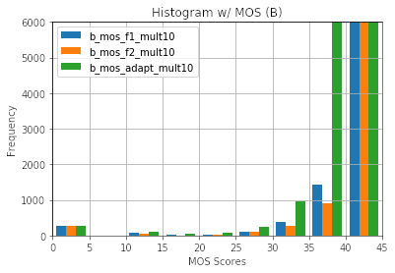
Inaccuracies of MOS
Notes:
Eric

Slide 9
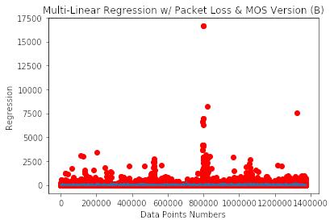
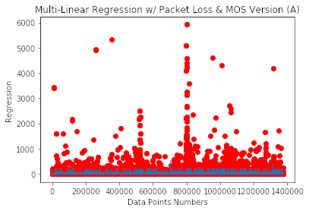
Limitations of MOS
Notes:
Eric Regression Score of Packet Loss & Mos Version B 0.011227069683
Regression Score of Packet Loss & Mos Version A 0.0237224153003

Slide 10
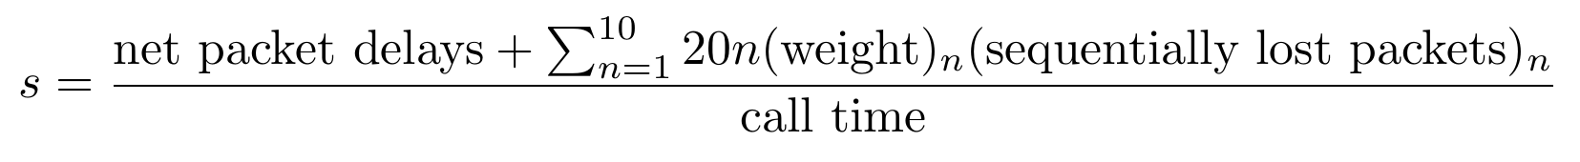
Qual-Fun (Quality Function)
Current approach (MOS): essentially dividing delay time (jitter) by the call duration.
Improvements made (Qual-Fun): added sensitivity to the density of jitter.
Notes:
Connor + Julian

Slide 11
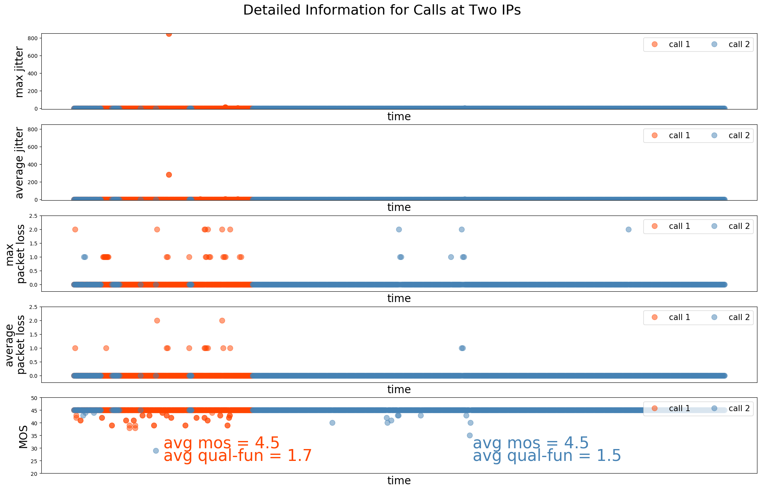
Notes:
Idelia

Slide 12
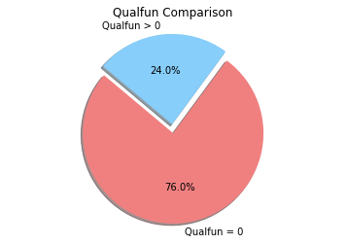
Increased Sensitivity
Notes:
Julian

Slide 13
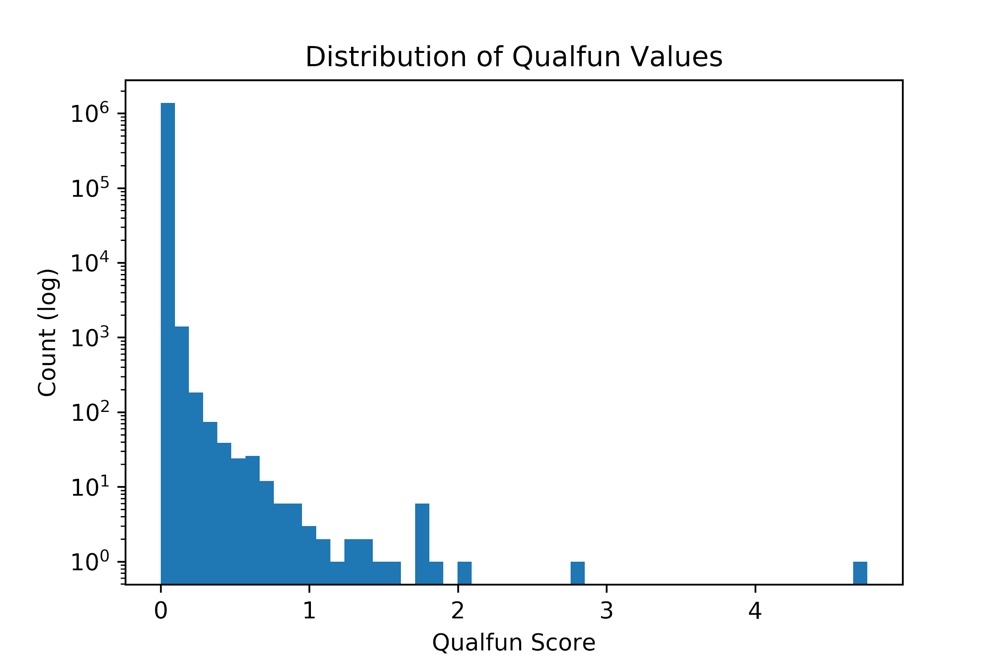
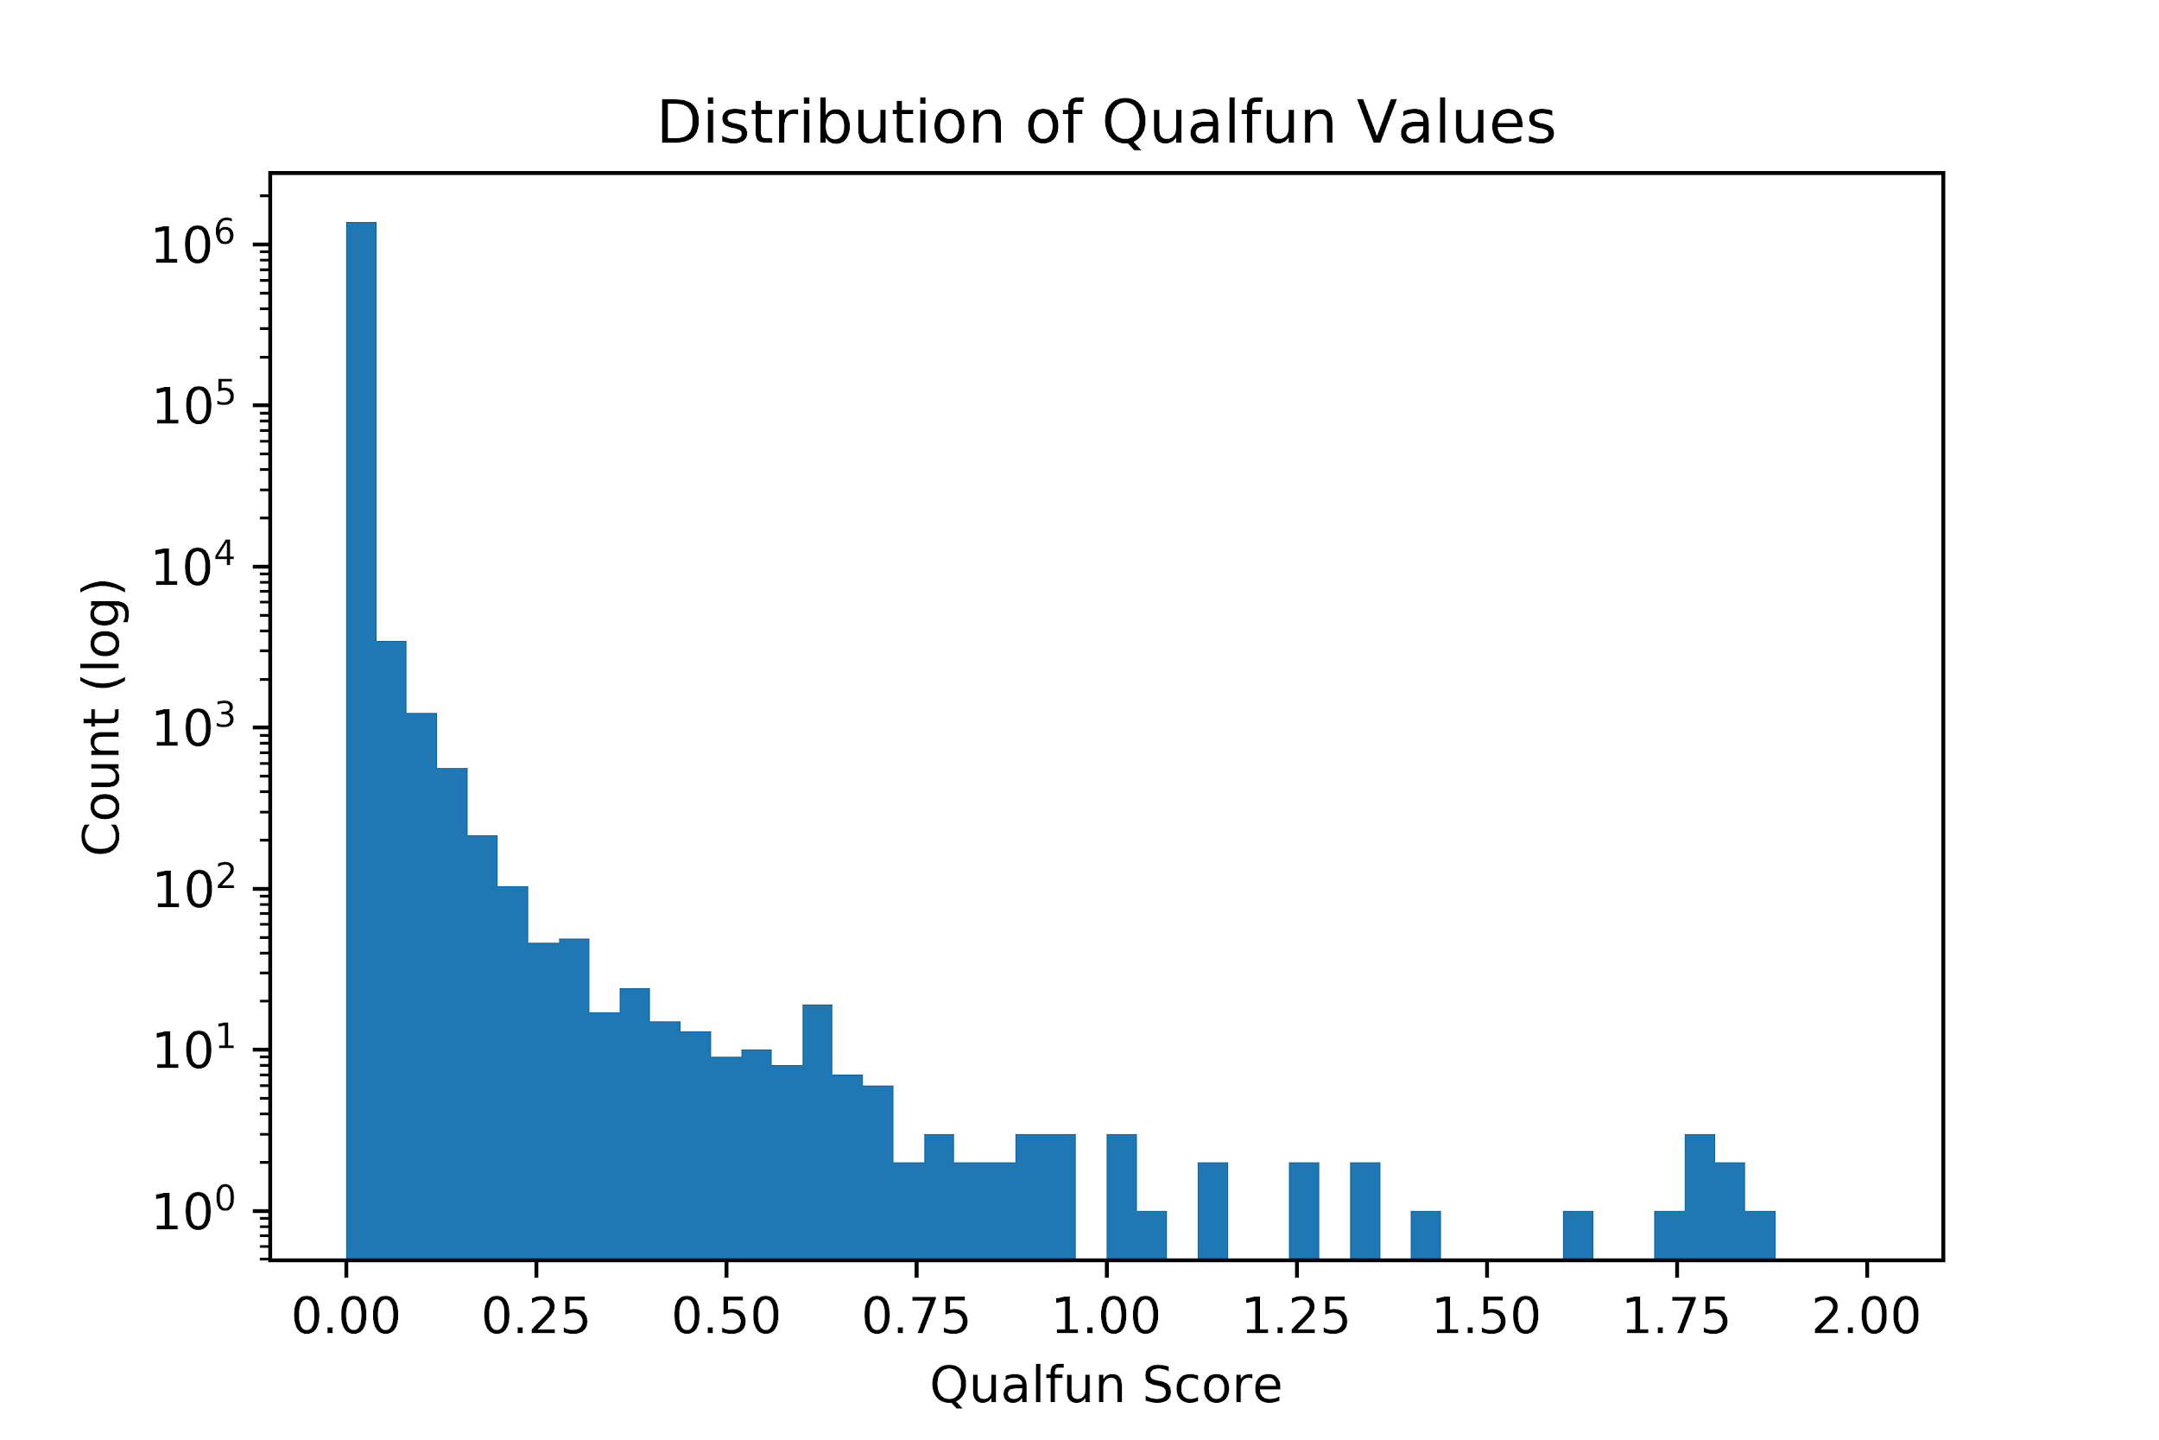
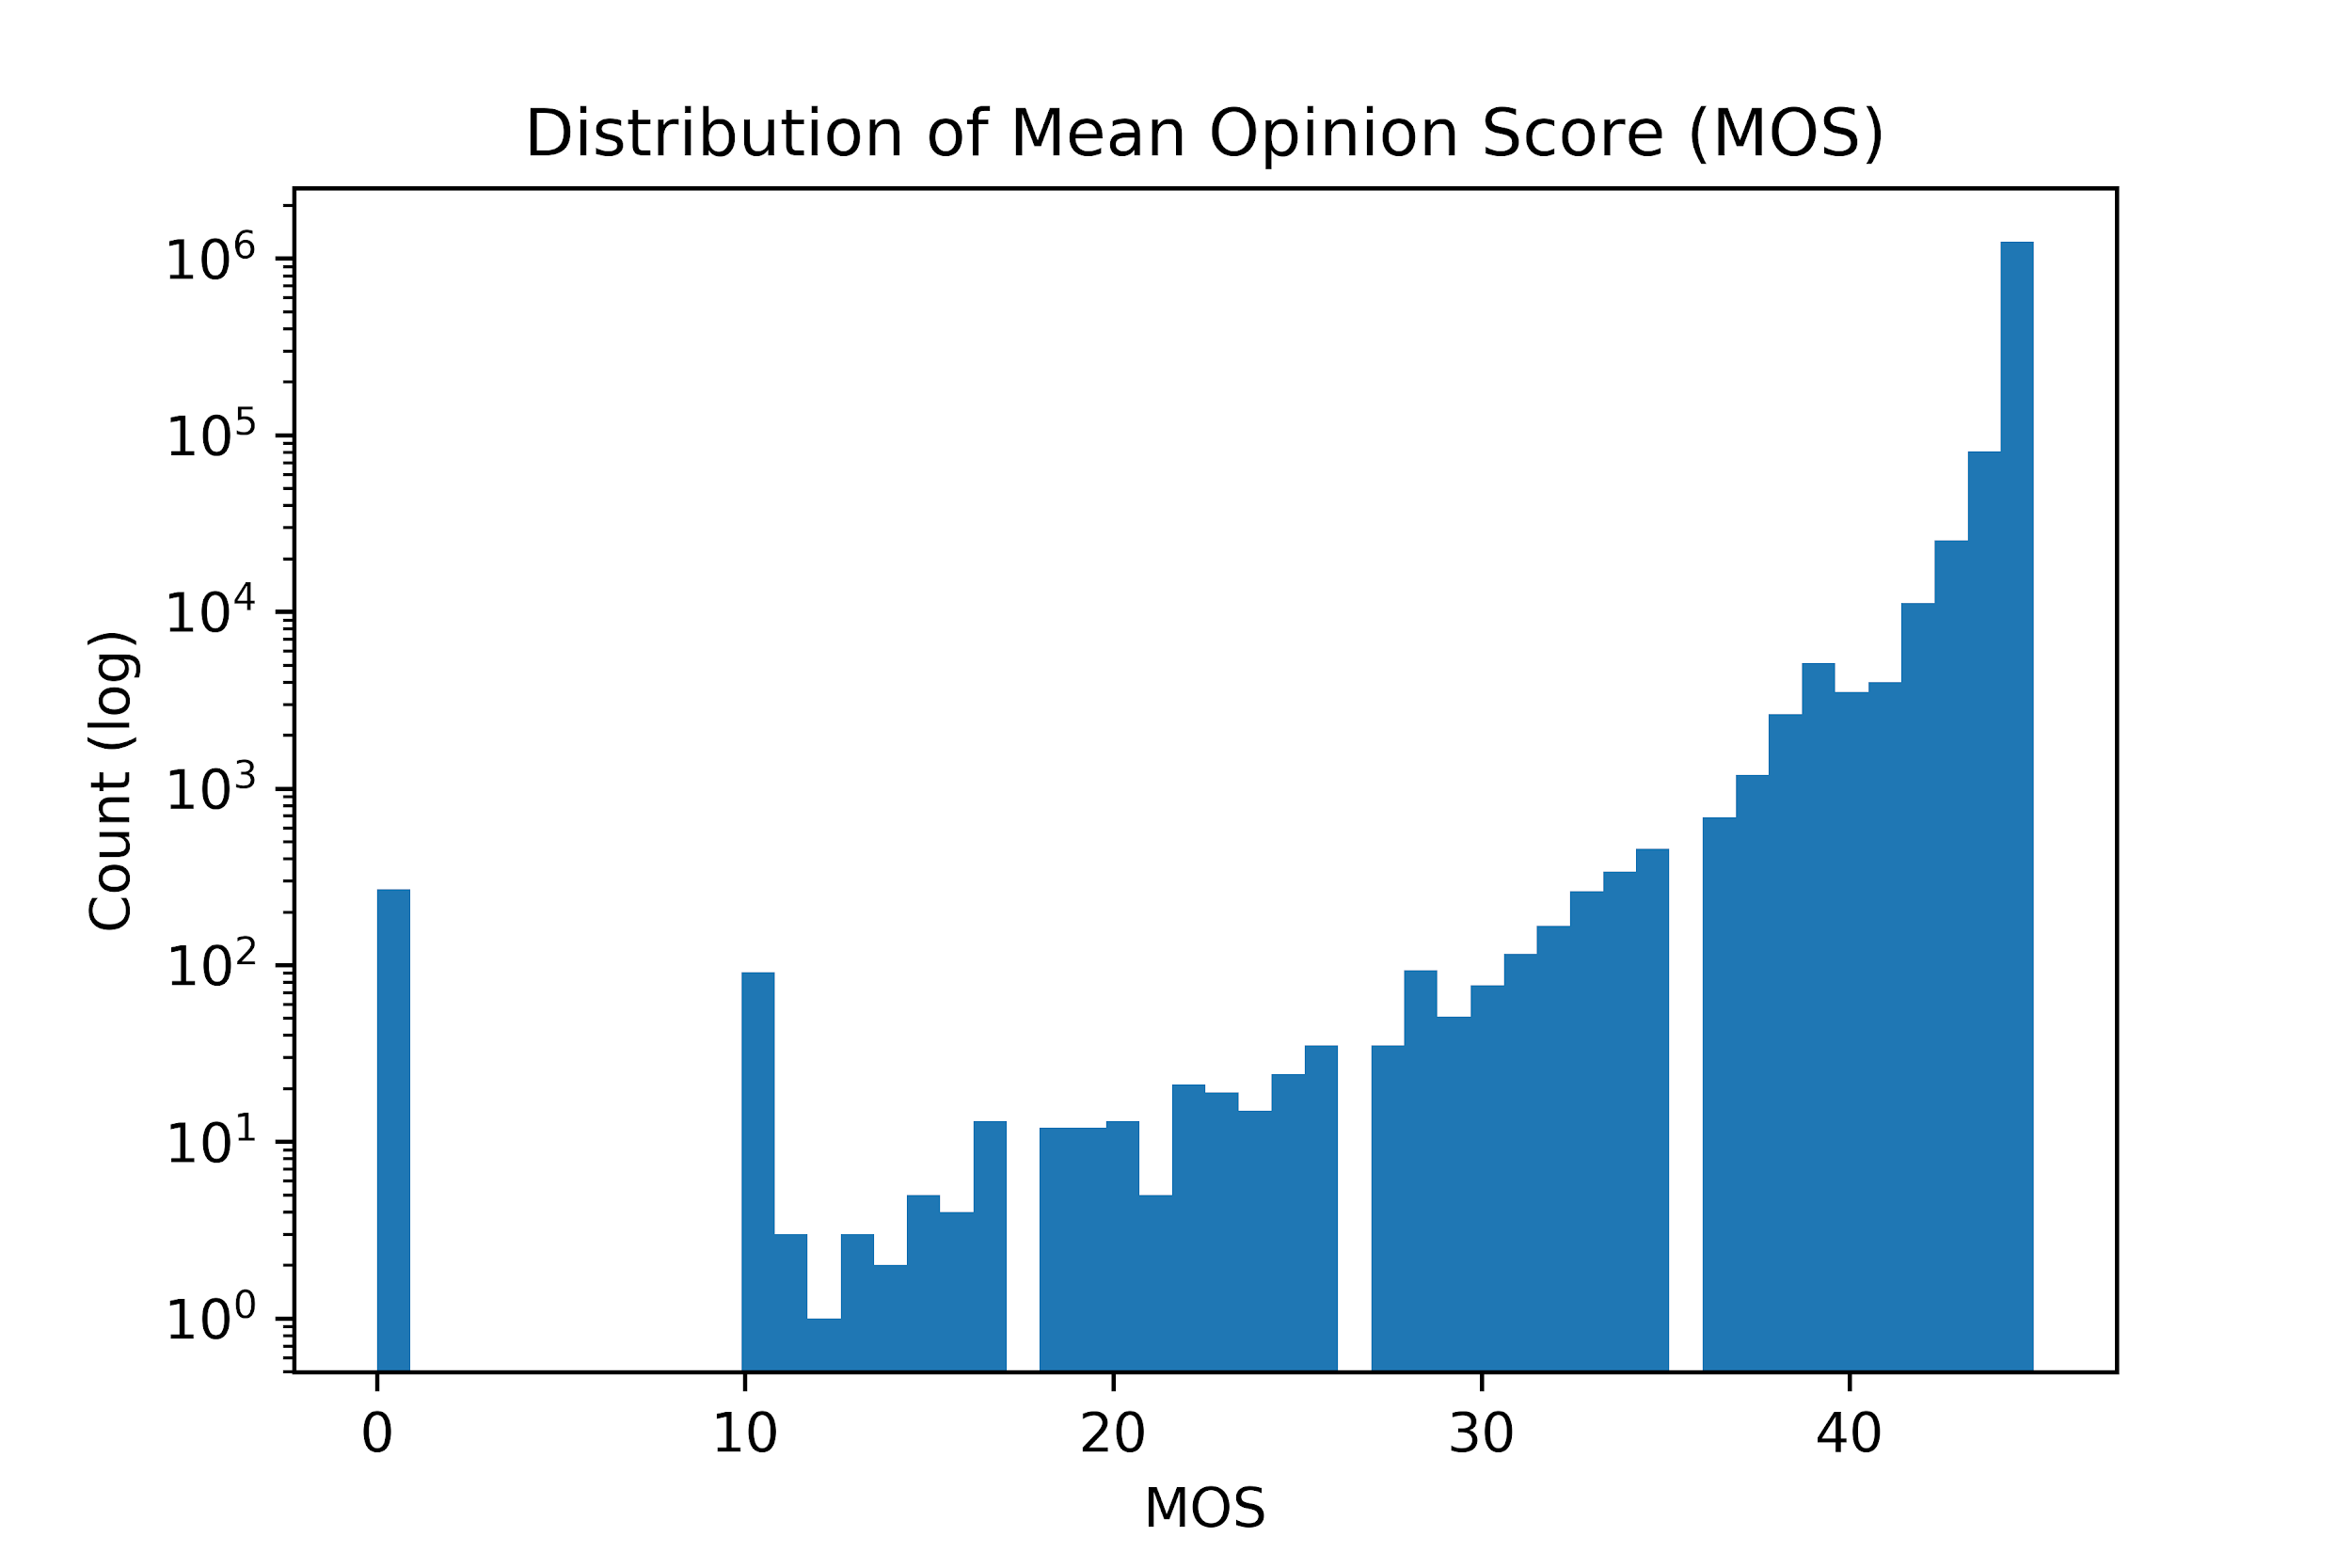
Notes:
Mohamed

Slide 14
CloudPBX Network Topology
~1.8K unique subscriber IP addresses
~ 4K unique IP address pairs
~ 1.3K unique IP address pairs in each city
Vancouver - VAN
Toronto - TOR
Montreal - MTL
How popular is each IP address pair?
What's the average call quality of each IP address pair?
Notes:
Stefan

Slide 15
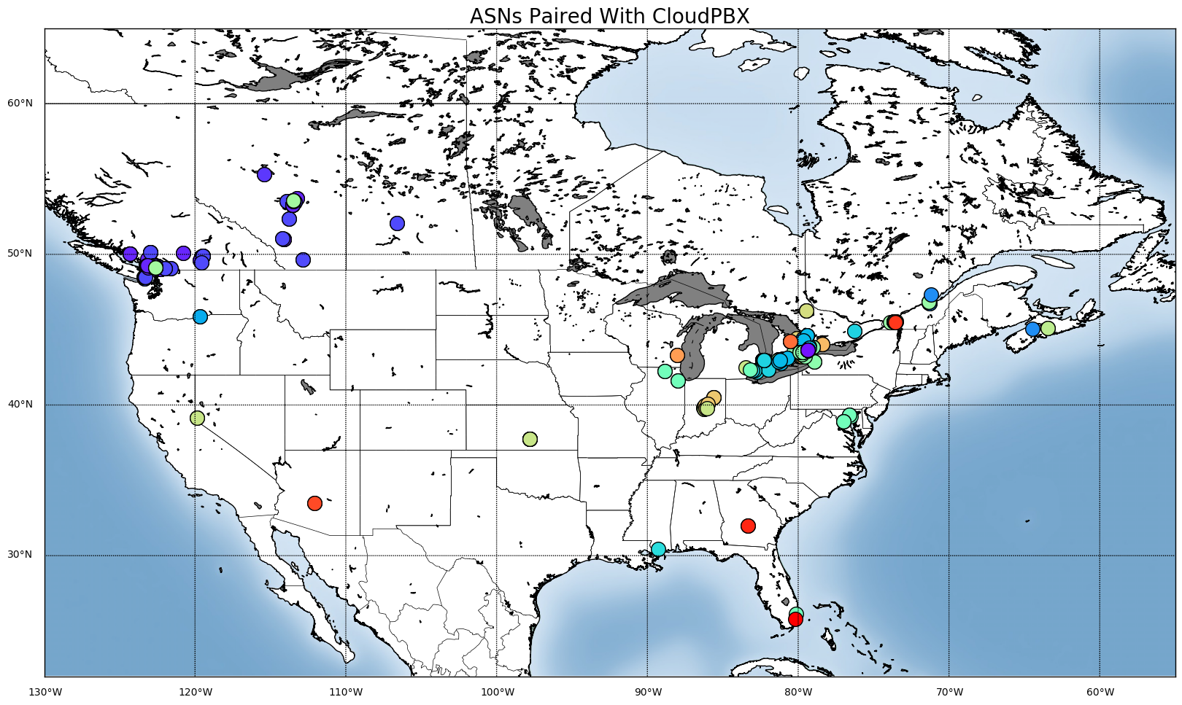
Notes:
Idelia GEOLite (convert IP address to coordinates), mapped with Basemap, calls made to Vancouver from various places in Canada and the US

Slide 16
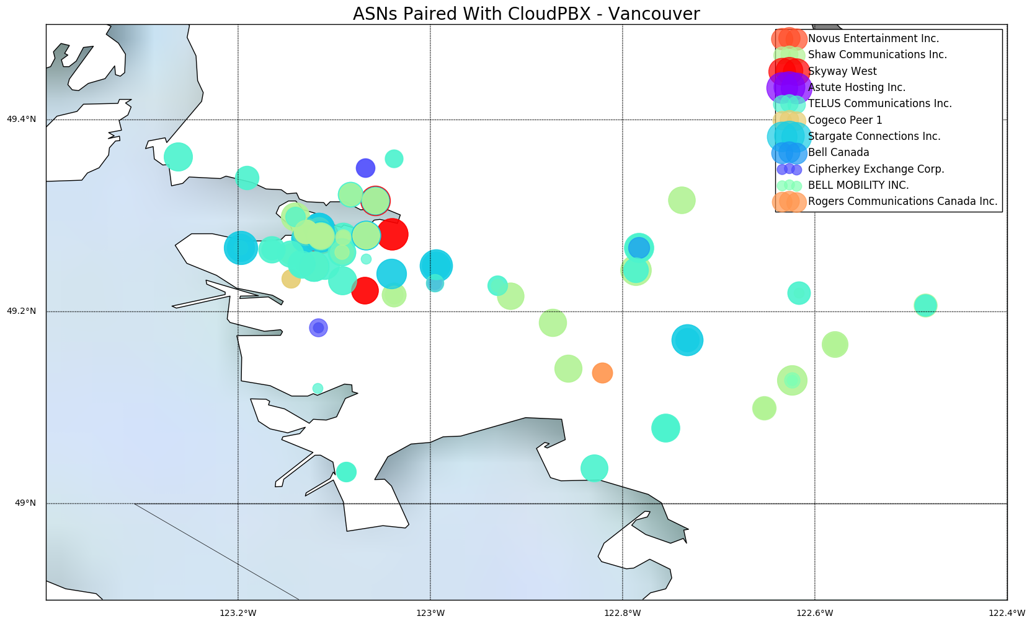
Most popular: Skyway West to CloudPBX ~7K calls
Worst performance: Claro S.A. to CloudPBX ~ 2.85 Avg Qual-Fun

Slide 17
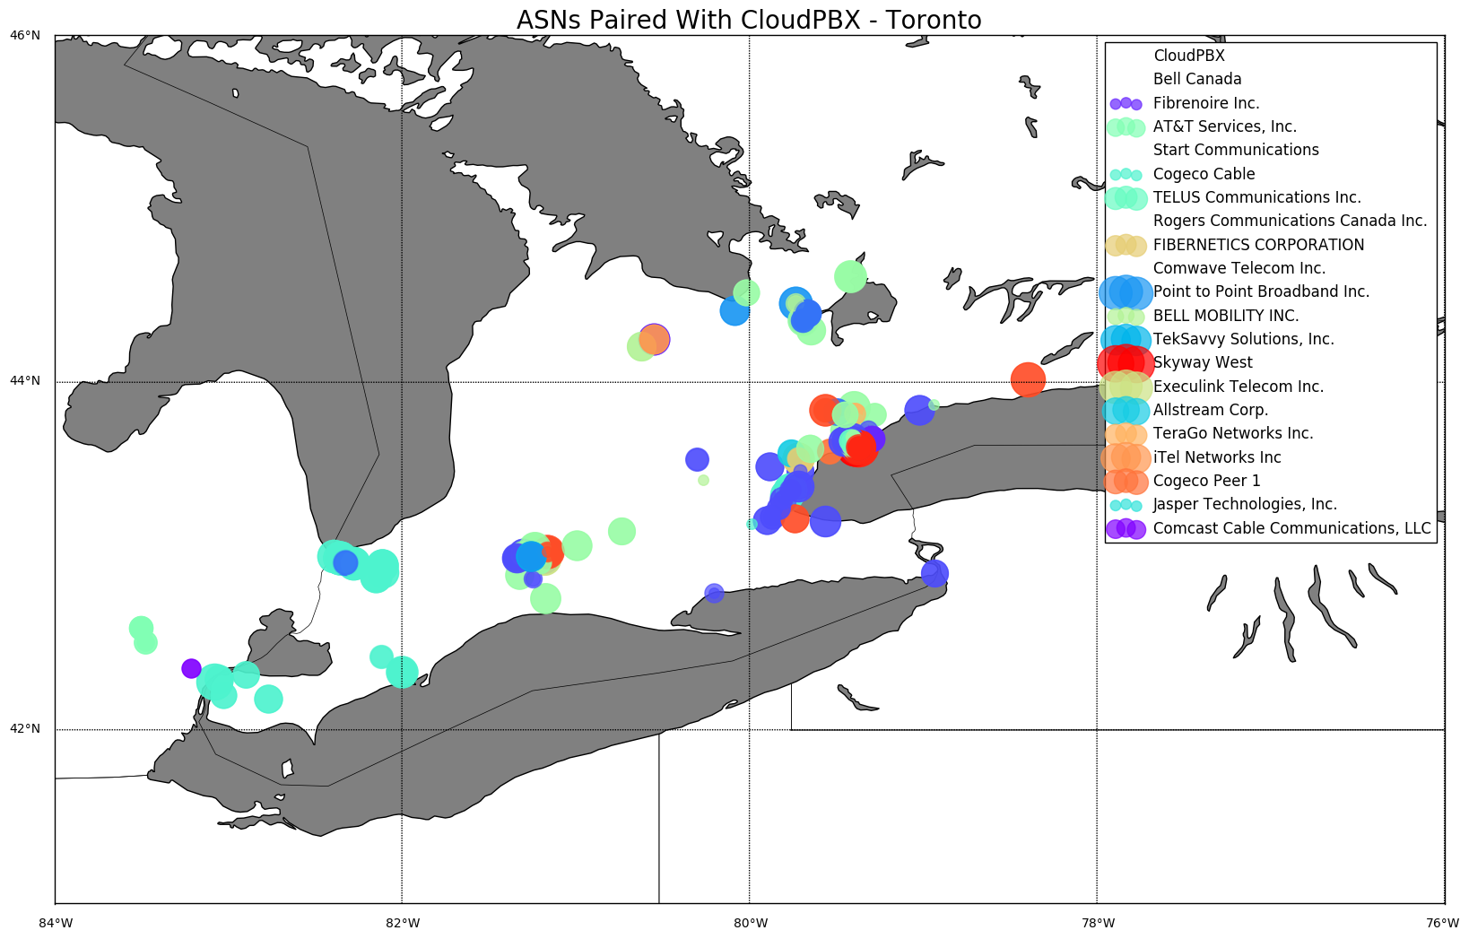
Most popular: CloudPBX to AT&T ~25K calls
Worst performance: Shaw to CloudPBX ~ .36 Avg Qual-Fun
Notes:
Idelia + Stefan

Slide 18
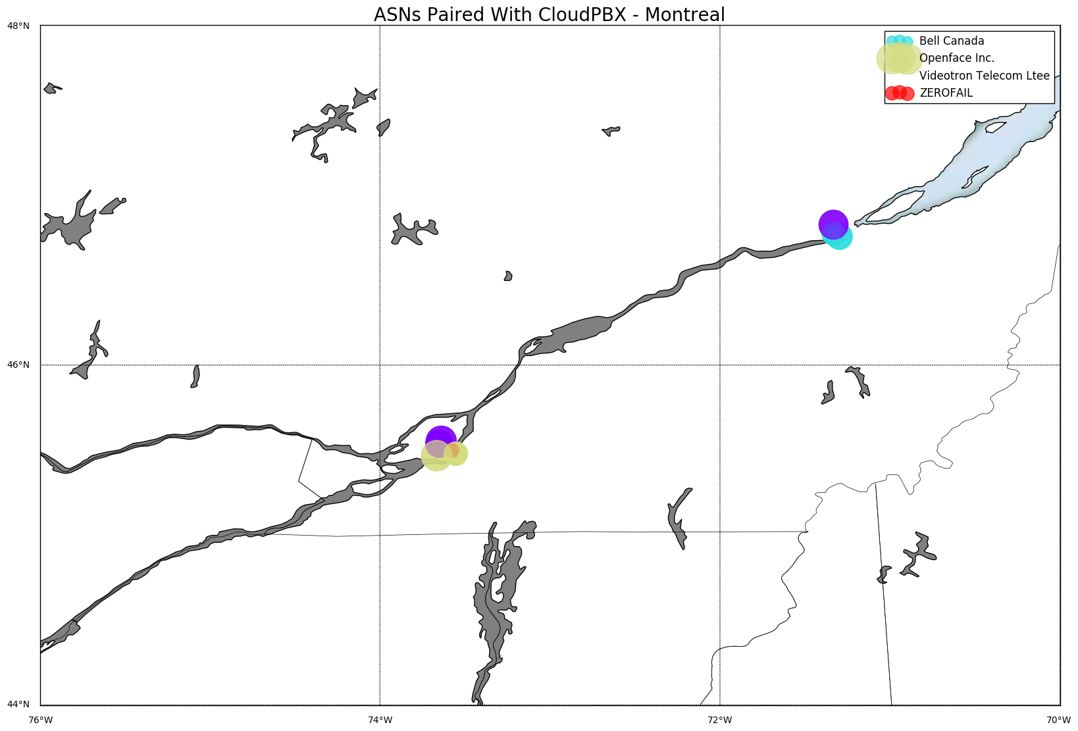
Most popular: EastLink to CloudPBX ~4K calls
Worst performance: Cable Onda to CloudPBX ~ .41 Avg Qual-Fun
Notes:
Idelia + Stefan

Slide 19
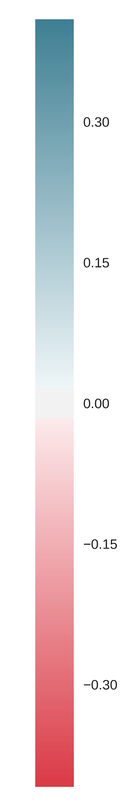
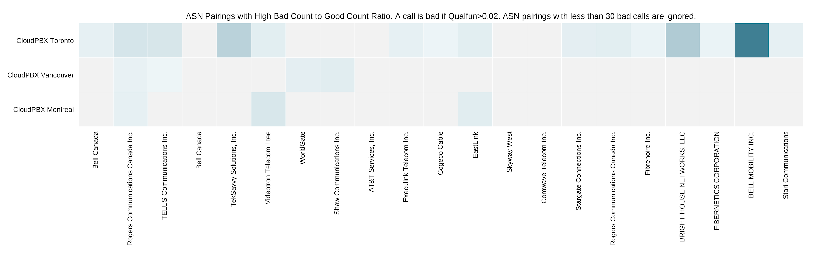
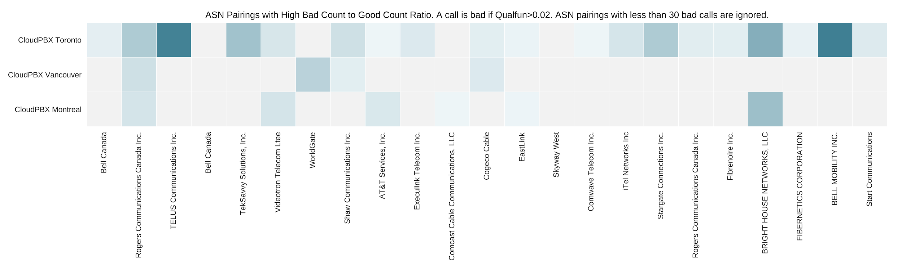
Heatmap of Bad Call ASN Distribution
Calls from CloudPBX:
Calls to CloudPBX:
Notes:
Mohamed
Toronto, Vancouver, Montreal
BrightHouse is bad for calling to CloudPBX

Slide 20
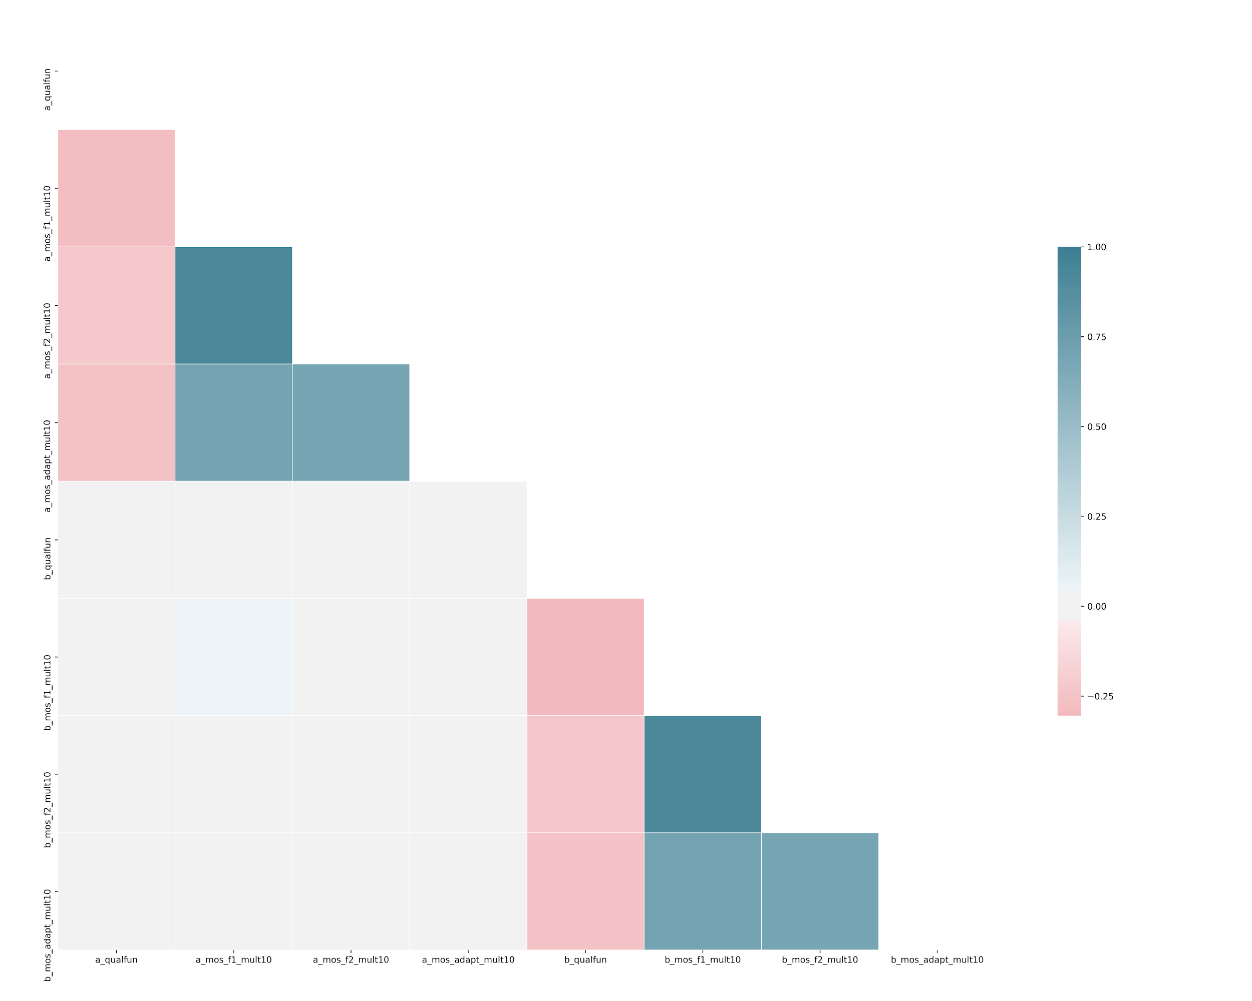
Some Correlations
There are three different MOS’s, which differ in jitter buffer size, for each leg of the phone call.
As expected, MOS’s of the same leg have strong correlations with each other, and MOS’s of different legs have no correlation.
Qualfun weakly correlates with MOS. This partly validates Qualfun.
Notes:
Mohamed A_qualfun
A_mos_1
A_mos_2
A_mos_adapt
B_….

Slide 21
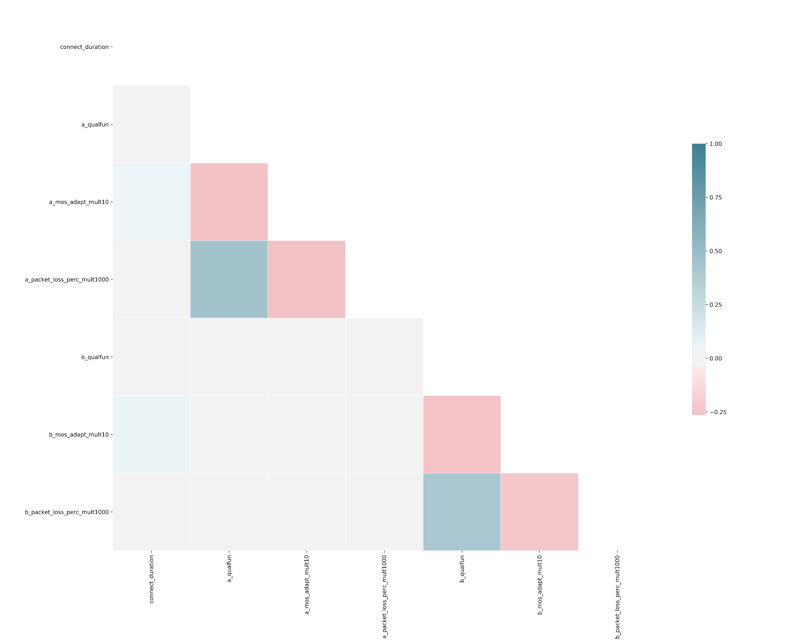
Some Correlations
Percentage Packet Loss (PPL) is another useful measure of call quality.
PPL weakly correlates with Qualfun, and does not correlate with MOS.
Notes:
Mohamed
A_qualfun, a_mos_adapt, a_packet_loss_percent

Slide 22
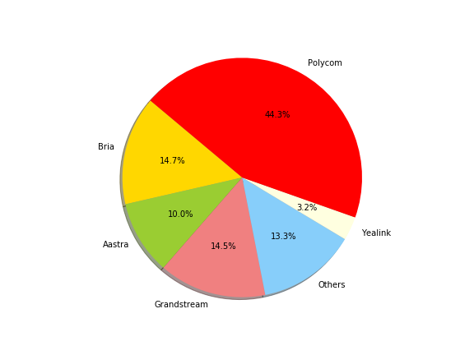
Phone Model Analysis
Notes:
Jackie

Slide 23
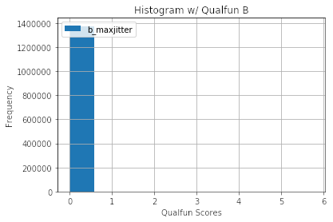
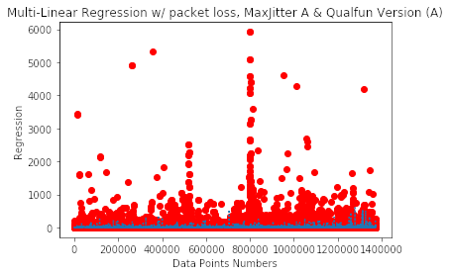
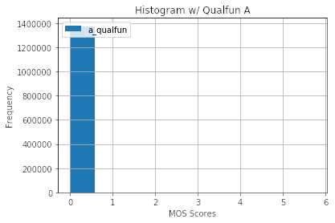
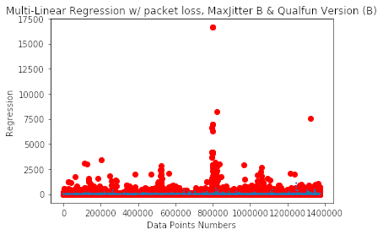
Qual-fun’s Shortcomings
Notes:
Eric Regression Score for MaxJitter A, Packet Loss & Qualfun Version A 0.00940912296338 and for version B is 0.00825308105551

Slide 24
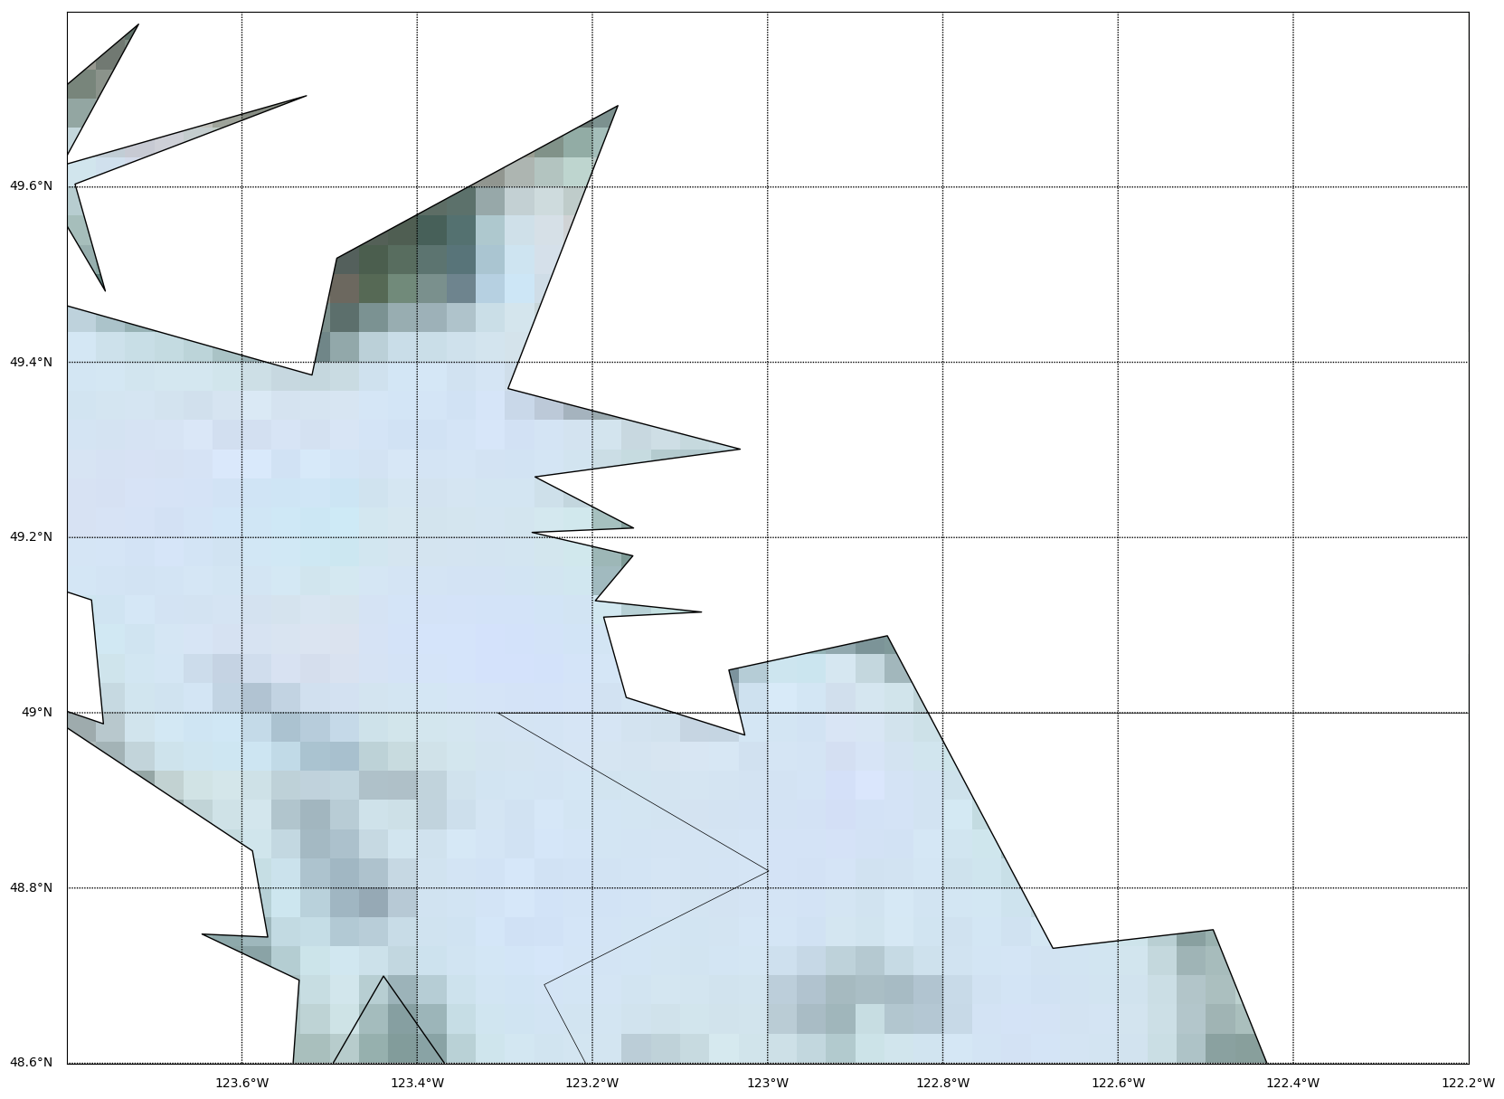
Traceroute
49.4635, -122.82
49.2788, -123.1139
43.6319, -79.3716
Notes:
Stefan

Slide 25
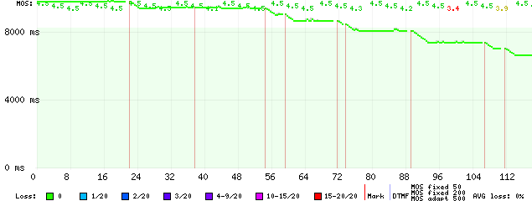
Developing Prognostic Model
Notes:
Julian, Idalia, stefan
Creation of a proper grading standard for VoIP calls
Large File Sizes with

Slide 26
Challenges and Future Questions
What is the statistical significance of the correlation findings (p-value)?
What is the distribution of phone calls, grouped by ASN, over different time periods?
What data structure and data analysis tools will be beneficial for the company’s big data analysis needs (Dask)?
Notes:
Mohamed

Slide 27
Any Questions?
Notes:
Anybody

