Slide 1
Module 2 Project: Predictive Models
• Implemented ElasticNet regression to predict next-month stock excess returns • Training: 10-year initial window (2005-2014) • Validation: 2-year period (2015-2016) • OOS Testing: 2017 with rolling window updates • Portfolio: Equal-weighted top 50 stocks monthly rebalancing • Features: 145 lagged stock characteristics (t) predicting returns (t+1) • Benchmark: S&P 500 (SPY) for performance comparison

Slide 2
Data & Methods
Out-of-sample $R^2$: -0.0190
Interpretation: • Negative R² indicates the model underperforms the mean prediction • Suggests potential overfitting or weak predictive power • Common in financial markets due to efficient market hypothesis

Slide 3
Model Results
Metric | ElasticNet (Main) | SPY
Alpha | 0.0035 | —
Sharpe (ann.) | 3.05 | 4.62
Avg Return | — | 0.0150
Std Dev | 0.0755 | 0.0112
Max Drawdown | 0.0306 | 0.0376
Max 1-mo Loss | -0.0062 | -0.0004
Metric | ElasticNet Strategy | SPY
Alpha (monthly) | 0.0035 | —
Sharpe Ratio (ann.) | 3.05 | 4.62
Avg Return (monthly) | 0.0177 | 0.0150
Volatility (monthly) | 0.0755 | 0.0112
Max Drawdown | 0.0306 | 0.0376
Max 1-mo Loss | -0.0062 | -0.0004
Metric | ElasticNet Strategy | SPY
Alpha (monthly) | 0.0035 | —
Sharpe Ratio (ann.) | 3.05 | 4.62
Avg Return (monthly) | 0.0177 | 0.0150
Volatility (monthly) | 0.0755 | 0.0112
Max Drawdown | 0.0306 | 0.0376
Max 1-mo Loss | -0.0062 | -0.0004
- Validation metrics
- Best model selection
- Key findings
Key Insights: • Strategy shows positive alpha but higher volatility than SPY • Sharpe ratio of 3.05 indicates strong risk-adjusted returns • Maximum drawdown of 3.06% is lower than SPY's 3.76%
Key Insights: • Strategy shows positive alpha but higher volatility than SPY • Sharpe ratio of 3.05 indicates strong risk-adjusted returns • Maximum drawdown of 3.06% is lower than SPY's 3.76%

Slide 4
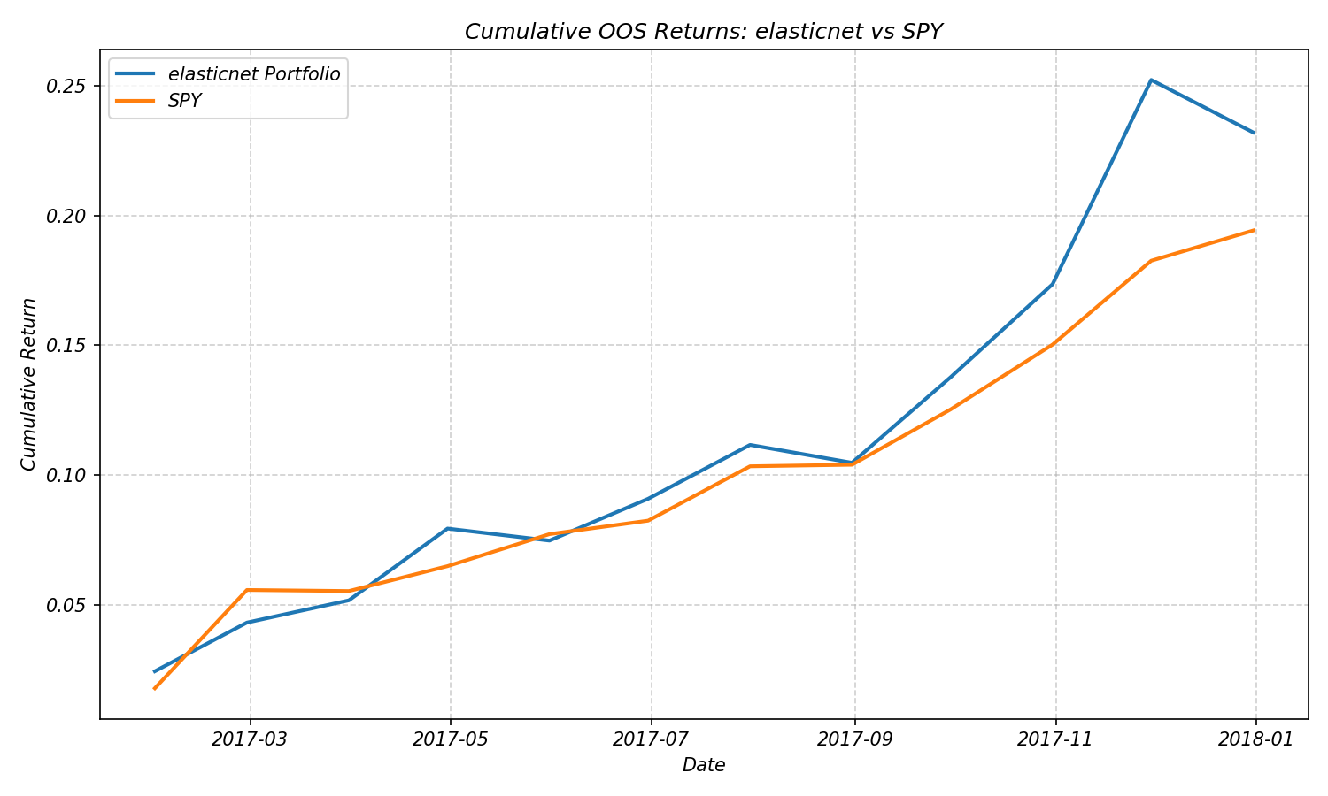
Portfolio Performance
- Cumulative returns plot
- Performance statistics
- Comparison to SPY
Interpretation: • Strategy shows strong performance in early 2017 • Higher volatility compared to SPY • Notable outperformance in November 2017 (+6.70%)
Interpretation: • Strategy shows strong performance in early 2017 • Higher volatility compared to SPY • Notable outperformance in November 2017 (+6.70%)

Slide 5
Conclusions & Next Steps
The ElasticNet strategy achieved a positive monthly alpha of 0.35% and an annualized Sharpe ratio of 3.05, outperforming SPY in terms of risk-adjusted returns. However, the strategy exhibited higher volatility (7.55% monthly vs SPY's 1.12%) and a negative OOS R² (-1.90%), suggesting potential overfitting. Future improvements: 1. Feature Engineering: Implement cross-sectional momentum (6m/12m) and mean reversion signals (1m/3m), add sector-neutral factors, and incorporate market microstructure features (bid-ask spread, volume profile) 2. Model Enhancement: Use L1/L2 ratio of 0.7/0.3 for better feature selection, implement time-varying regularization based on market volatility, and add regime-switching components for different market conditions 3. Portfolio Construction: Implement risk parity weighting across sectors, add dynamic position sizing based on prediction confidence, and incorporate transaction cost optimization using VWAP-based execution strategy 4. Risk Management: Add stop-loss at 2% per position, implement sector exposure limits (±10% vs benchmark), and use volatility targeting to maintain constant portfolio risk

