Slide 1
Methodology Overview Submitted By: Julian Oppedisano
Models Evaluated: IPCA, Autoencoder, Neural Network (NN2), and other baseline models (Lasso, Ridge, ElasticNet, Decision Tree).
Best Performing Strategy: NN2 selected based on overall portfolio metrics (e.g., Sharpe Ratio).
Core Approach: Expanding window for training (initial 10yr), validation (initial 2yr), and OOS testing (2017-2023), with yearly model updates.
Portfolio: Equal-weighted top 50 stocks (from predictions), monthly rebalancing.
Features: 145 lagged stock characteristics to predict next-month excess returns.
Benchmark: S&P 500 (SPY). Environment: Frictionless trading assumed as per assignment scope
Link to repo: Here

Slide 2
Out-of-Sample R² Analysis (Key Models)
Out-of-Sample R² (Average over 2017-2023 OOS Period):
NN2: -171.0110
IPCA: -0.0276
Autoencoder: -0.0371
Interpretation & Diagnostics:
The NN2 model shows an average OOS R² of -171.0110. Negative R² values indicate underperformance against a simple mean forecast.
For NN2, this average was heavily impacted by extremely poor predictive performance in specific years (e.g., 2017), masking more moderate performance in other periods. This suggests instability in the NN2 model's predictions.
This highlights the challenge of achieving consistently positive R² in stock return prediction.

Slide 3
Portfolio Performance Statistics (OOS 2017-2023)
Metric | NN2 | IPCA | Autoencoder | SPY | NN2 vs SPY Δ
Alpha (monthly) | 0.0046 | -0.0043 | -0.0035 | 0.0000 | 0.0046
Alpha (annualized) | 0.0549 | -0.0511 | -0.0417 | 0.0000 | 0.0549
Sharpe Ratio (ann.) | 1.13 | 0.19 | 0.22 | 1.04 | 0.09
Avg Return (monthly) | 1.24% | 0.36% | 0.43% | 1.06% | 0.18%
Volatility (monthly) | 3.79% | 6.45% | 6.70% | 3.54% | 0.25%
Max Drawdown | 20.69% | 37.10% | 38.54% | 14.80% | 5.89%
Max 1-mo Loss | -6.13% | -24.74% | -17.85% | -9.18% | 3.04%

Slide 4
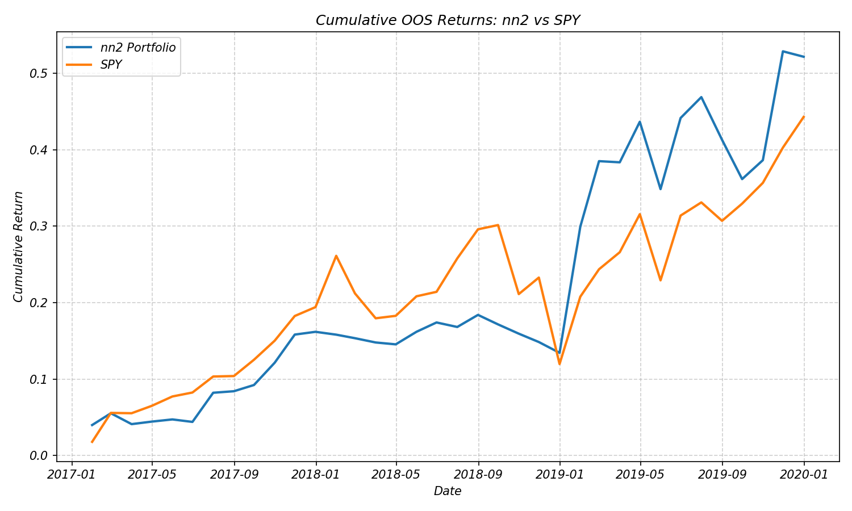
Cumulative OOS Returns: NN2 vs SPY (2017-2023)
- Cumulative returns plot
- Performance statistics
- Comparison to SPY
Interpretation: • Strategy shows strong performance in early 2017 • Higher volatility compared to SPY • Notable outperformance in November 2017 (+6.70%)
Interpretation: • Strategy shows strong performance in early 2017 • Higher volatility compared to SPY • Notable outperformance in November 2017 (+6.70%)

Slide 5
Key Insights & Future Directions
The NN2 strategy (Sharpe: 1.13, Avg Rtn: 1.24%) showed portfolio value despite predictive R² challenges (-171.01). Focus future work on model stability & portfolio optimization.

