Slide 1

Accelerated Encryption techniques
Julian Singkham
Trenton Bowser
Joseph Weller
Chip Hennig
Nathan DuPont
GPU Programming
CS 4981/031
Dr. Berisha

Slide 2
Algorithm Overview

Slide 3
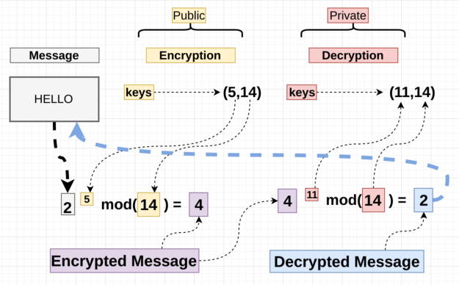
RSA Encryption
How does it work
Generate & multiply two large prime numbers (n = p * q)
Generate asymmetric public/private key pair ({e,n} & {d,n})
Encrypt & decrypt message blocks w/ key
CPU Bottleneck
Message blocks computed serially
Blocks are independent
https://medium.com/hackernoon/how-does-rsa-work-f44918df914b

Slide 4
AES Encryption
Developed by the US National Institute of Standards and Technology (NIST) from 1998-2001
Based on the Rijndael block cipher
Symmetric key
Key Sizes: 128, 192 or 256 bits
Block Size: 128 bits
AES Animation

Slide 5
AES Parallelization
AES blocks are independent from each other
Each AES block could be a thread
Possible parallelization in the encryption process
Each byte in Sub-bytes can be a thread
Each row in shift rows can be a thread
Each column in mix columns can be a thread
Each column in add round key can be a thread
CPU Bottleneck
Each block is computed sequentially

Slide 6
GPU Implementations

Slide 7
Parallelized RSA Encryption
How does it work
Each thread is assigned a message block to encrypt & decrypt
Blocks encrypted in parallel
Keys and modulus values stored in constant
GPU Bottleneck
Exponential operation results in very large number and must be performed in several steps
Notes:
Exponential operation must be modded each time to reduce the size of the output value

Slide 8
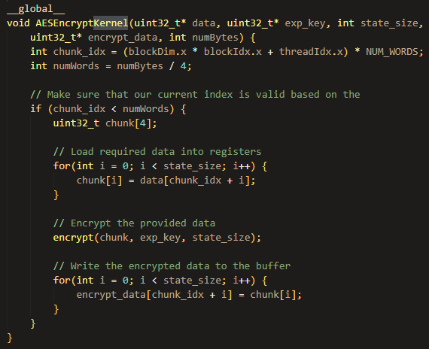
Parallelized AES Encryption
AES is also a block cipher, so data segments (128 bits) are encrypted individually and can be parallelized
Each thread corresponds to a block cipher (encryption & decryption)
Lookup tables are put into __constant__

Slide 9
Results
Notes:
Nathan

Slide 10
RSA Encryption Performance
File Size (bytes) | Average CPU Time (ms) | Average GPU Time (ms) | CPU : GPU Ratio
100 | 72.9140 | 15.3449 | 4.7517
1000 | 633.5960 | 27.2004 | 23.2937
2000 | 1283.0883 | 27.2072 | 47.1599
5000 | 3253.4970 | 27.2121 | 119.5608
10000 | 6272.3776 | 27.2160 | 230.4663
50000 | 31439.8594 | 54.3959 | 577.9817
100000 | 62714.8503 | 81.5753 | 768.7967
Notes:
RSA encryption and decryption = same algorithm
Public and private exponents – determine run time [set to static number for benchmarks]
GPU run times are similar for multiple benchmarks – enough SMs to calculate all bytes of data
Output files to verify correctness

Slide 11
AES Encryption Performance
Took 10 trials and averaged the performance
Near linear speedup (maximum achieved is 32 times)
Notes:
With AES, we experienced a similar profile
Consistently linear improvement
In this case, also looked at the overall speedup including FileIO, which achieved a roughly 13000 time speedup

Slide 12
AES Encryption Performance
Took 10 trials and averaged the performance
Near linear speedup (maximum achieved is 32 times)
Encryption (10 Iterations)
File Size (bytes) | Average CPU Time (ms) | Average GPU Time (ms) | CPU : GPU Ratio
100 | 0.0446 | 0.0425 | 1.0504
1000 | 0.6394 | 0.1366 | 4.6800
2000 | 0.9148 | 0.2066 | 4.4289
5000 | 2.7351 | 0.4637 | 5.8979
10000 | 4.7744 | 0.8938 | 5.3419
50000 | 22.9175 | 1.4498 | 15.8069
100000 | 47.0137 | 1.4551 | 32.3091
Decryption (10 Iterations)
File Size (bytes) | Average CPU Time (ms) | Average GPU Time (ms) | CPU : GPU Ratio
100 | 0.0616 | 0.0408 | 1.5077
1000 | 0.7047 | 0.1892 | 3.7254
2000 | 1.3748 | 0.3167 | 4.3416
5000 | 3.4863 | 0.7541 | 4.6229
10000 | 6.1499 | 1.4825 | 4.1482
50000 | 33.2069 | 2.4214 | 13.7137
100000 | 67.4437 | 2.4213 | 27.8543
Notes:
With AES, we experienced a similar profile
Consistently linear improvement
In this case, also looked at the overall speedup including FileIO, which achieved a roughly 13000 time speedup

Slide 13
Questions

