Slide 1

Accelerated Encryption techniques
Julian Singkham
Trenton Bowser
Joseph Weller
Chip Hennig
Nathan DuPont
GPU Programming
CS 4981/031
Dr. Berisha

Slide 2
Algorithm Overview

Slide 3
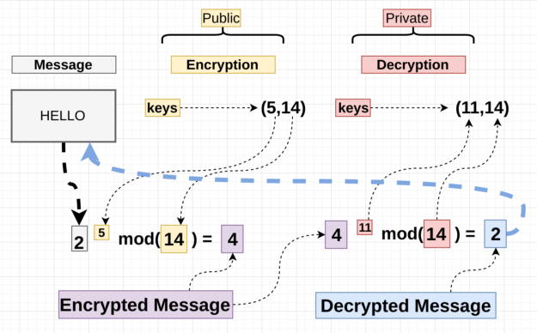
RSA Encryption
How does it work
Generate & multiply two large prime numbers (n = p * q)
Generate asymmetric public/private key pair ({e,n} & {d,n})
Encrypt & decrypt message blocks w/ key
CPU Bottleneck
Message blocks computed serially
Blocks are independent
https://medium.com/hackernoon/how-does-rsa-work-f44918df914b

Slide 4
AES Encryption
Developed by the US National Institute of Standards and Technology (NIST) from 1998-2001
Based on the Rijndael block cipher
Symmetric key
Key Sizes: 128, 192 or 256 bits
Block Size: 128 bits
AES Animation

Slide 5
AES Parallelization
AES blocks are independent from each other
Each AES block could be a thread
Possible parallelization in the encryption process
Each byte in Sub-bytes can be a thread
Each row in shift rows can be a thread
Each column in mix columns can be a thread
Each column in add round key can be a thread
CPU Bottleneck
Each block is computed sequentially

Slide 6
Background

Slide 7
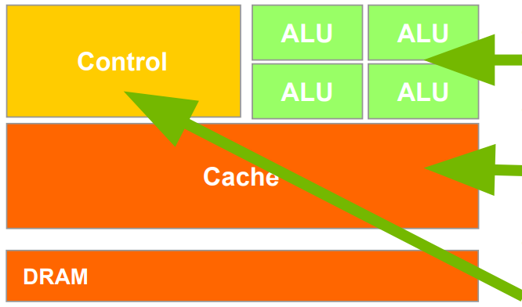
CPUs: Latency Oriented Design
Powerful ALU
Reduced operation latency
Large caches
Convert long latency memory accesses to short latency cache accesses
Sophisticated control
Branch prediction for reduced branch latency
Data forwarding for reduced data latency

Slide 8
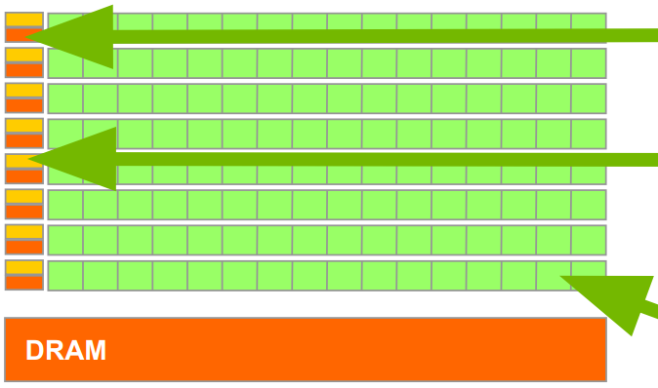
GPUs: Throughput Oriented Design
Small caches
To boost memory throughput
Simple control
No branch prediction
No data forwarding
Energy efficient ALUs
Many, long latency but heavily pipelined for high throughput
Require massive number of threads to tolerate latencies
Threading logic
Thread state

Slide 9
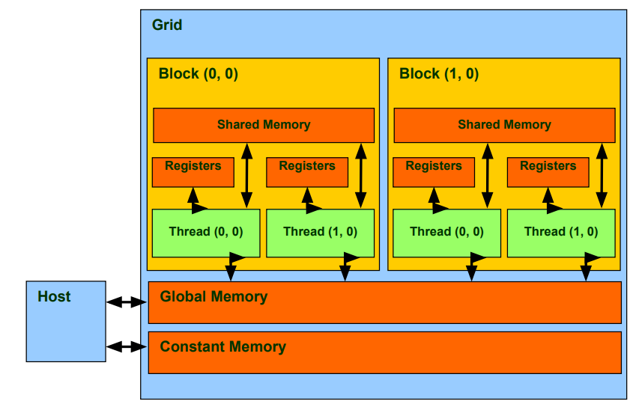
CUDA MEMORY
Device code can:
R/W per-thread registers
R/W all-shared global memory
Host code can
Transfer data to/from per grid global memory

Slide 10
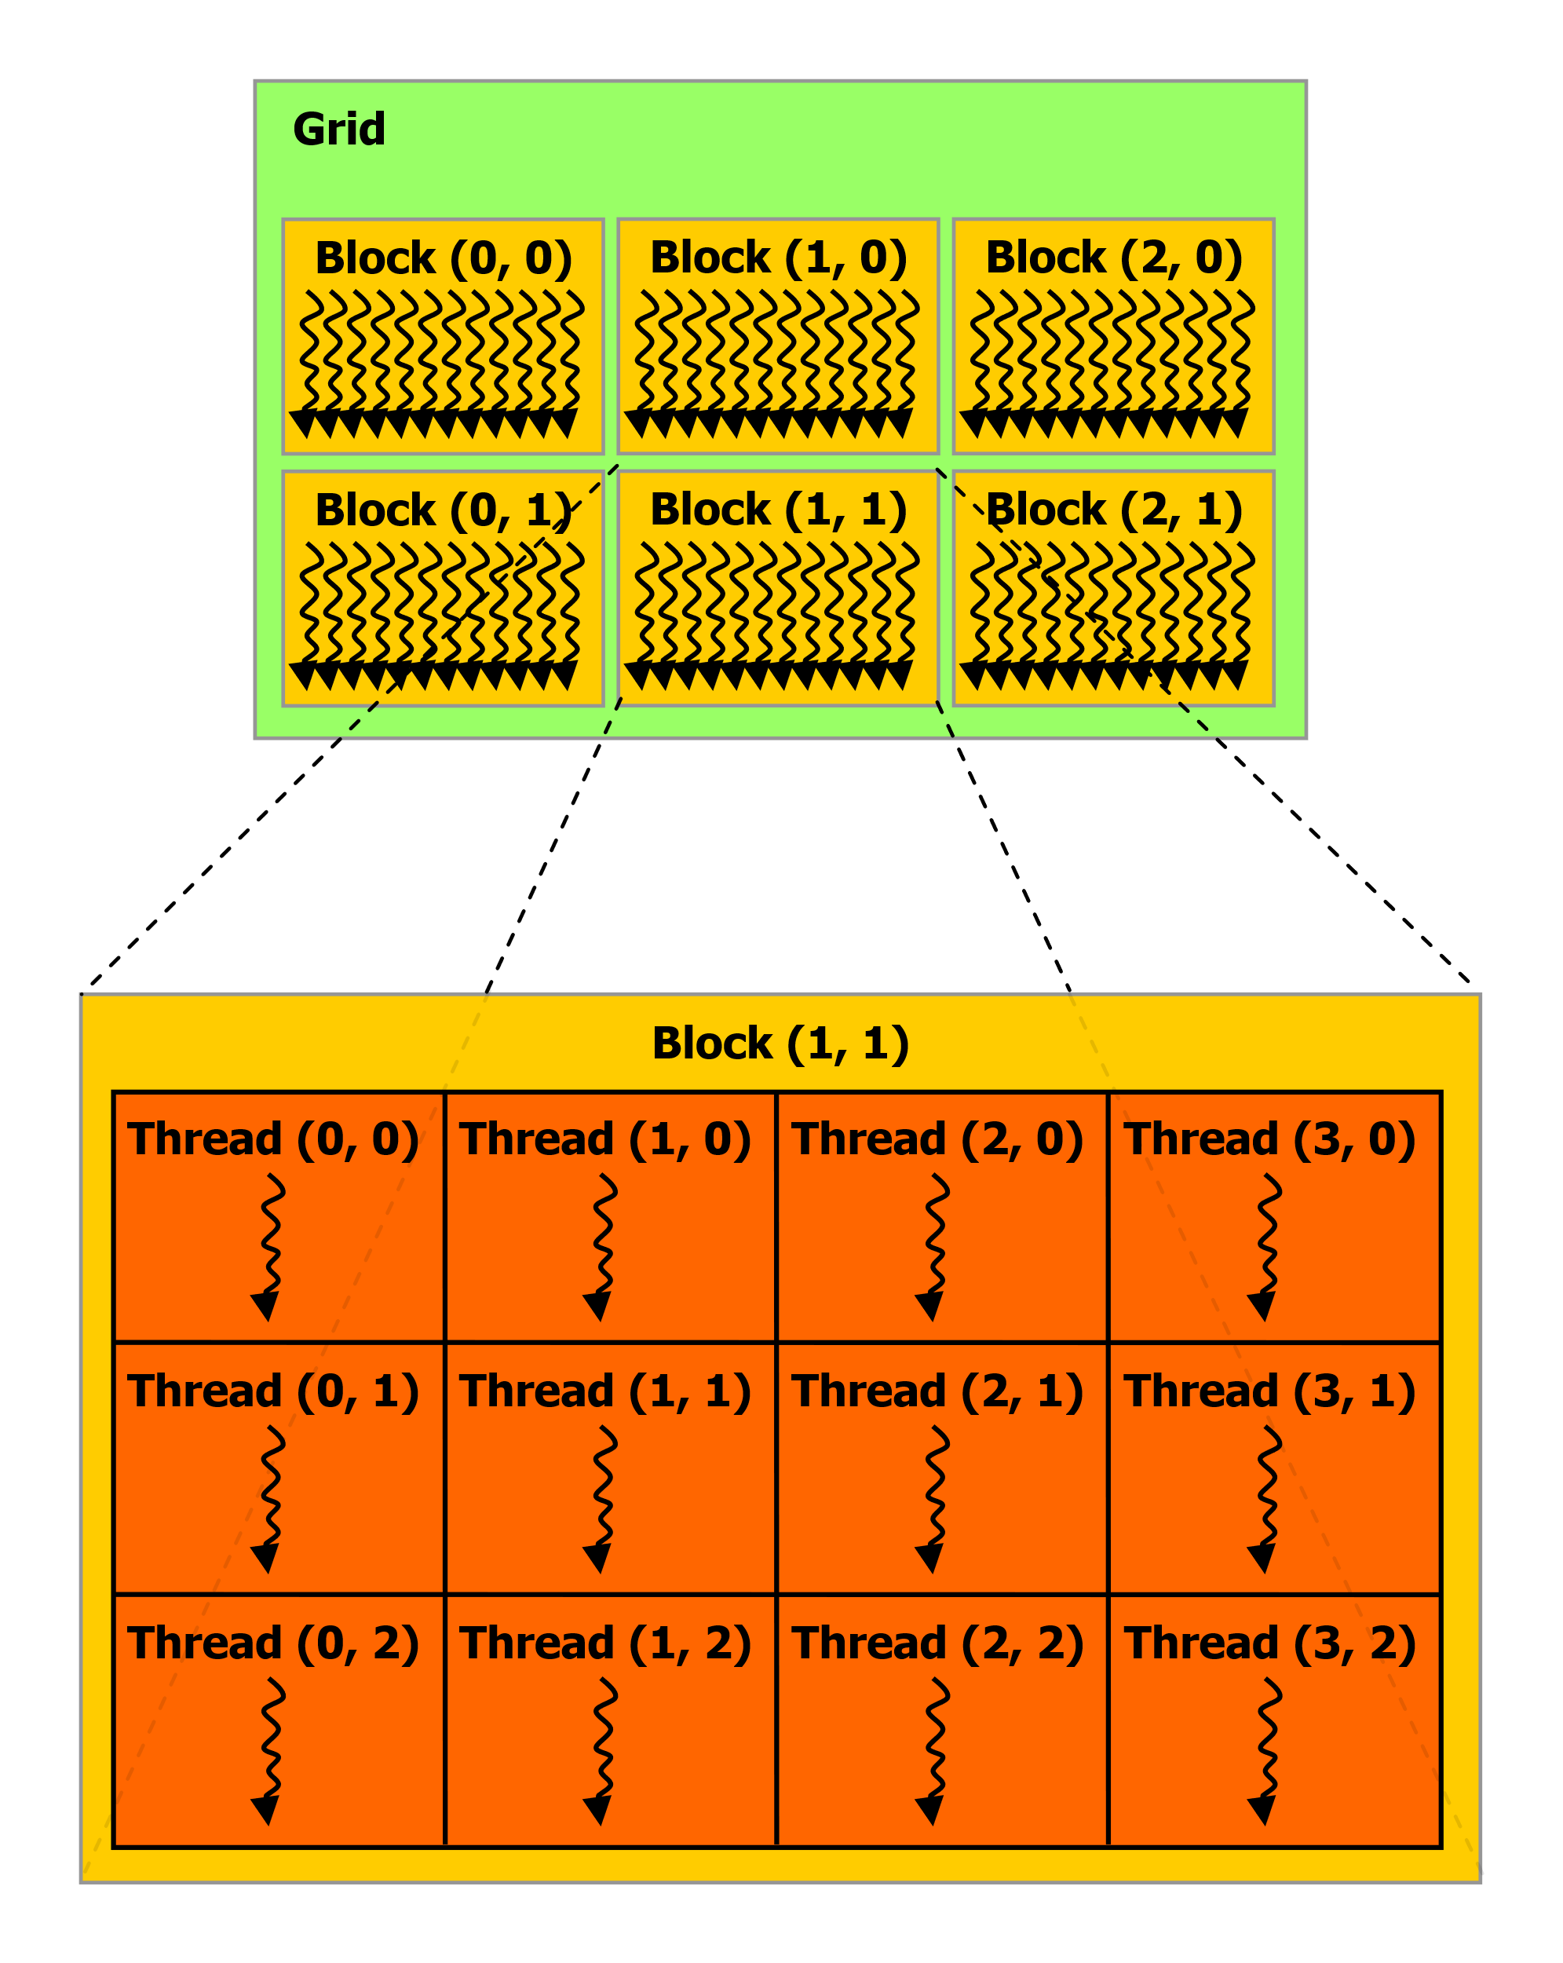
CUDA Grid System
Threads can be grouped into a logical 3-D Thread Block
A Thread Block must be fully contained in a singular SM
The amount of threads in a thread block is constrained by the amount of available registers in the SM
Large threads = Less threads
Multiple Thread Blocks create a Grid
Example T700
64K 32-bit registers per SM
Max of 255 32-bit registers per thread
Max of 1024 threads per block
Max of 16 blocks per SM
14 SM per GPU
Max of 128 grids per GPU

Slide 11
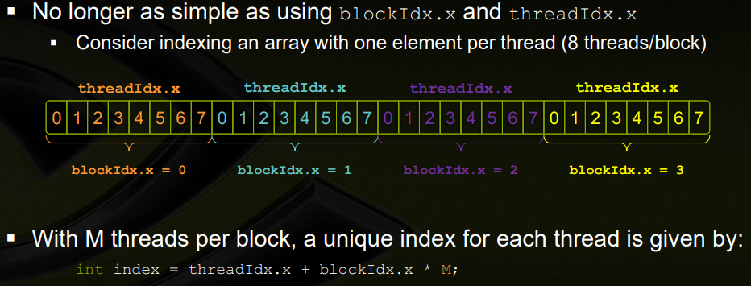
Indexing arrays with blocks and threads

Slide 12
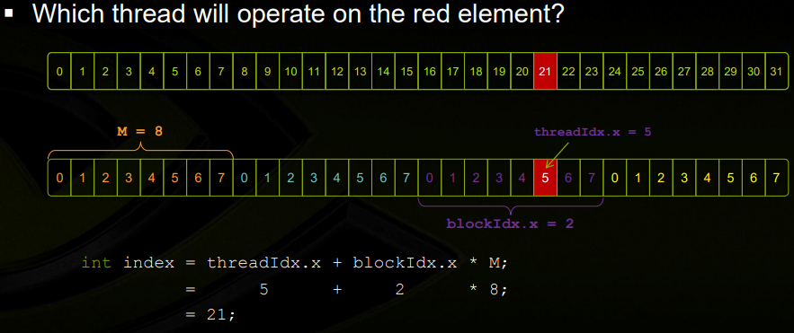
Indexing example

Slide 13
Setup

Slide 14
GPU Configuration
Initial Setup
Demo Setup
Nvidia Tesla T4 (Datacenter)
Compute Capability: 7.5
Turing Tensor Cores: 320
CUDA Cores: 2560
64 Cores per SM
GPU Memory: 16GB
Bus: 256-bit
Bandwidth: 300 GB/Sec
Interface: PCIE 3x16 – 16 GB/s
https://www.nvidia.com/content/dam/en-zz/Solutions/Data-Center/tesla-product-literature/T4%20Product%20Brief.pdf
Nvidia (RTX) T600 (Notebook)
Compute Capability: 7.5
Turing Tensor Cores: 0
CUDA Cores: 896
64 Cores per SM
GPU Memory: 4GB
Bus: 128-bit
Bandwidth: 160 GB/Sec
Interface: PCIE 4x8 – 16 GB/Sec
https://www.nvidia.com/content/dam/en-zz/Solutions/design-visualization/documents/nvidia-rtx-line-card-for-mobile-workstation.pdf

Slide 15
Compute Capability 7.5
Details what features the GPU has
Frist digit signifies major, which contain key features
Second digit signifies minor, which differs in hardware
128 grids (individual compute process)
Max Dimension of a Grid of Thread Blocks
Dimensionality: 3
Max X Dimension: 2^³¹-1
Max Y or Z Dimension: 65535
Max Dimension of a Thread Block
Dimensionality: 3
Max X or Y Dimension: 1024
Max Z Dimension: 64
Max Number of Threads per Block: 1024
Warp Size: 32
Max resident blocks per SM: 16
Max resident warps per SM: 32
Max resident threads per SM: 1024
32-bit registers per SM: 64K
Max 32-bit registers per thread block: 64K
Max 32-bit registers per thread: 255
Max shared memory per SM: 64KB
Max shared memory per thread block: 64KB
Shared memory banks: 32
Max local memory per thread: 512KB
Constant memory size: 64KB
https://docs.nvidia.com/cuda/cuda-c-programming-guide/index.html#compute-capabilities

Slide 16
Working with cuda on WSL Windows 10
NVIDIA Guide: https://docs.nvidia.com/cuda/wsl-user-guide/index.html#abstract
CUDA Toolkit Doc: https://docs.nvidia.com/cuda/cuda-c-programming-guide/index.html#compute-capabilities

Slide 17
GPU Implementations

Slide 18
Parallelized RSA Encryption
How does it work
Each thread is assigned a message block to encrypt & decrypt
Blocks encrypted in parallel
Keys and modulus values stored in constant
GPU Bottleneck
Exponential operation results in very large number and must be performed in several steps
Notes:
Exponential operation must be modded each time to reduce the size of the output value

Slide 19
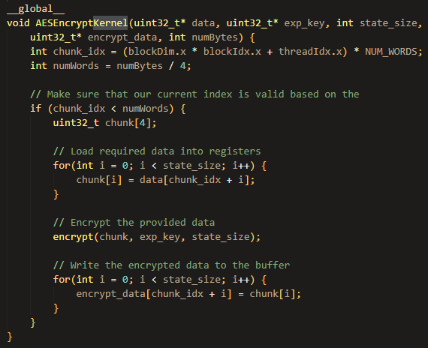
Parallelized AES Encryption
AES is also a block cipher, so data segments (128 bits) are encrypted individually and can be parallelized
Each thread corresponds to a block cipher (encryption & decryption)
Lookup tables are put into __constant__

Slide 20
Results
Notes:
Nathan

Slide 21
RSA Encryption Performance
File Size (bytes) | Average CPU Time (ms) | Average GPU Time (ms) | CPU : GPU Ratio
100 | 72.9140 | 15.3449 | 4.7517
1000 | 633.5960 | 27.2004 | 23.2937
2000 | 1283.0883 | 27.2072 | 47.1599
5000 | 3253.4970 | 27.2121 | 119.5608
10000 | 6272.3776 | 27.2160 | 230.4663
50000 | 31439.8594 | 54.3959 | 577.9817
100000 | 62714.8503 | 81.5753 | 768.7967
Notes:
RSA encryption and decryption = same algorithm
Public and private exponents – determine run time [set to static number for benchmarks]
GPU run times are similar for multiple benchmarks – enough SMs to calculate all bytes of data
Output files to verify correctness

Slide 22
AES Encryption Performance
Took 10 trials and averaged the performance
Near linear speedup (maximum achieved is 32 times)
Notes:
With AES, we experienced a similar profile
Consistently linear improvement
In this case, also looked at the overall speedup including FileIO, which achieved a roughly 13000 time speedup

Slide 23
AES Encryption Performance
Took 10 trials and averaged the performance
Near linear speedup (maximum achieved is 32 times)
Encryption (10 Iterations)
File Size (bytes) | Average CPU Time (ms) | Average GPU Time (ms) | CPU : GPU Ratio
100 | 0.0446 | 0.0425 | 1.0504
1000 | 0.6394 | 0.1366 | 4.6800
2000 | 0.9148 | 0.2066 | 4.4289
5000 | 2.7351 | 0.4637 | 5.8979
10000 | 4.7744 | 0.8938 | 5.3419
50000 | 22.9175 | 1.4498 | 15.8069
100000 | 47.0137 | 1.4551 | 32.3091
Decryption (10 Iterations)
File Size (bytes) | Average CPU Time (ms) | Average GPU Time (ms) | CPU : GPU Ratio
100 | 0.0616 | 0.0408 | 1.5077
1000 | 0.7047 | 0.1892 | 3.7254
2000 | 1.3748 | 0.3167 | 4.3416
5000 | 3.4863 | 0.7541 | 4.6229
10000 | 6.1499 | 1.4825 | 4.1482
50000 | 33.2069 | 2.4214 | 13.7137
100000 | 67.4437 | 2.4213 | 27.8543
Notes:
With AES, we experienced a similar profile
Consistently linear improvement
In this case, also looked at the overall speedup including FileIO, which achieved a roughly 13000 time speedup

Slide 24
Questions

Slide 25
Learn CUDA REsources

Slide 26
https://tschmidt23.github.io/cse599i//
https://newfrontiers.illinois.edu/news-and-events/introduction-to-parallel-programming-with-cuda/

