Slide 1


The best way to reach your destination safely and quickly using area index

Slide 2
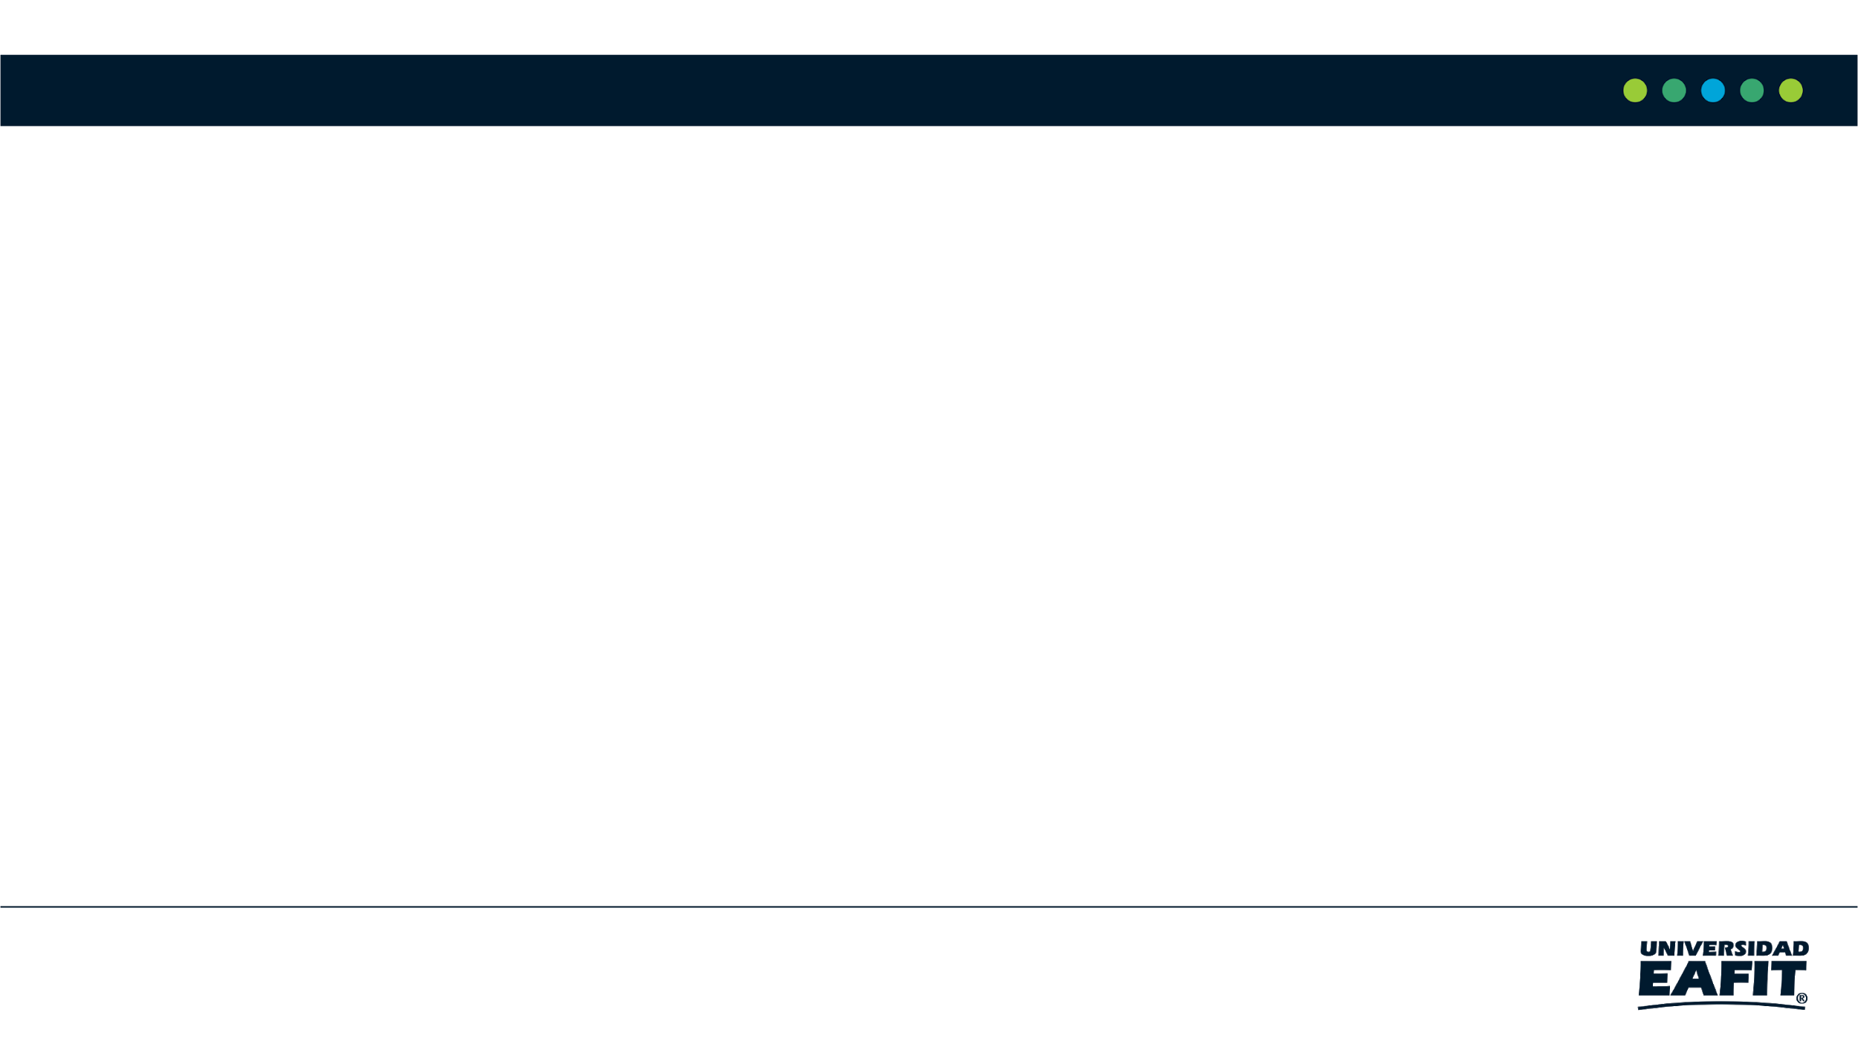

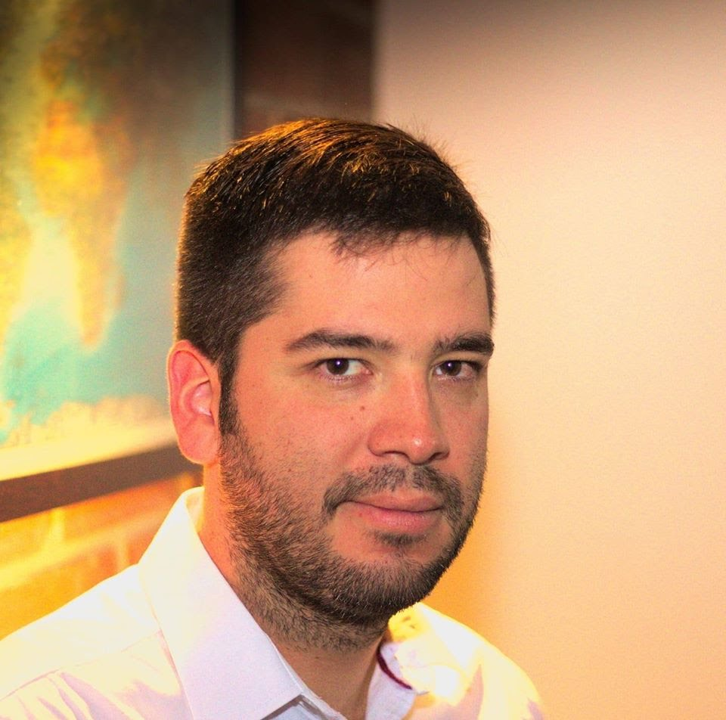
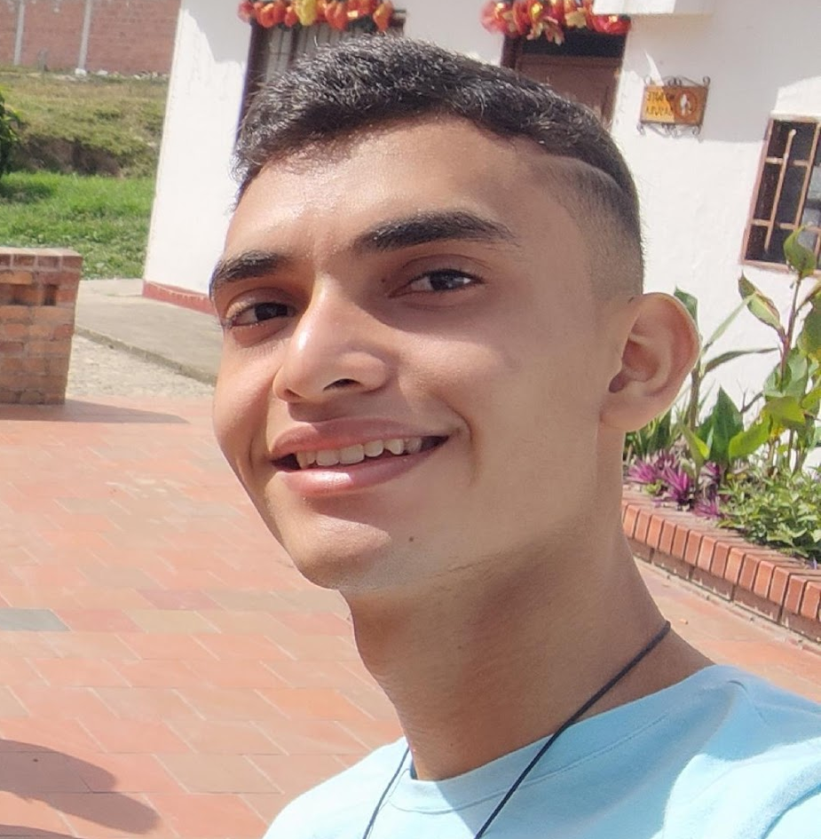
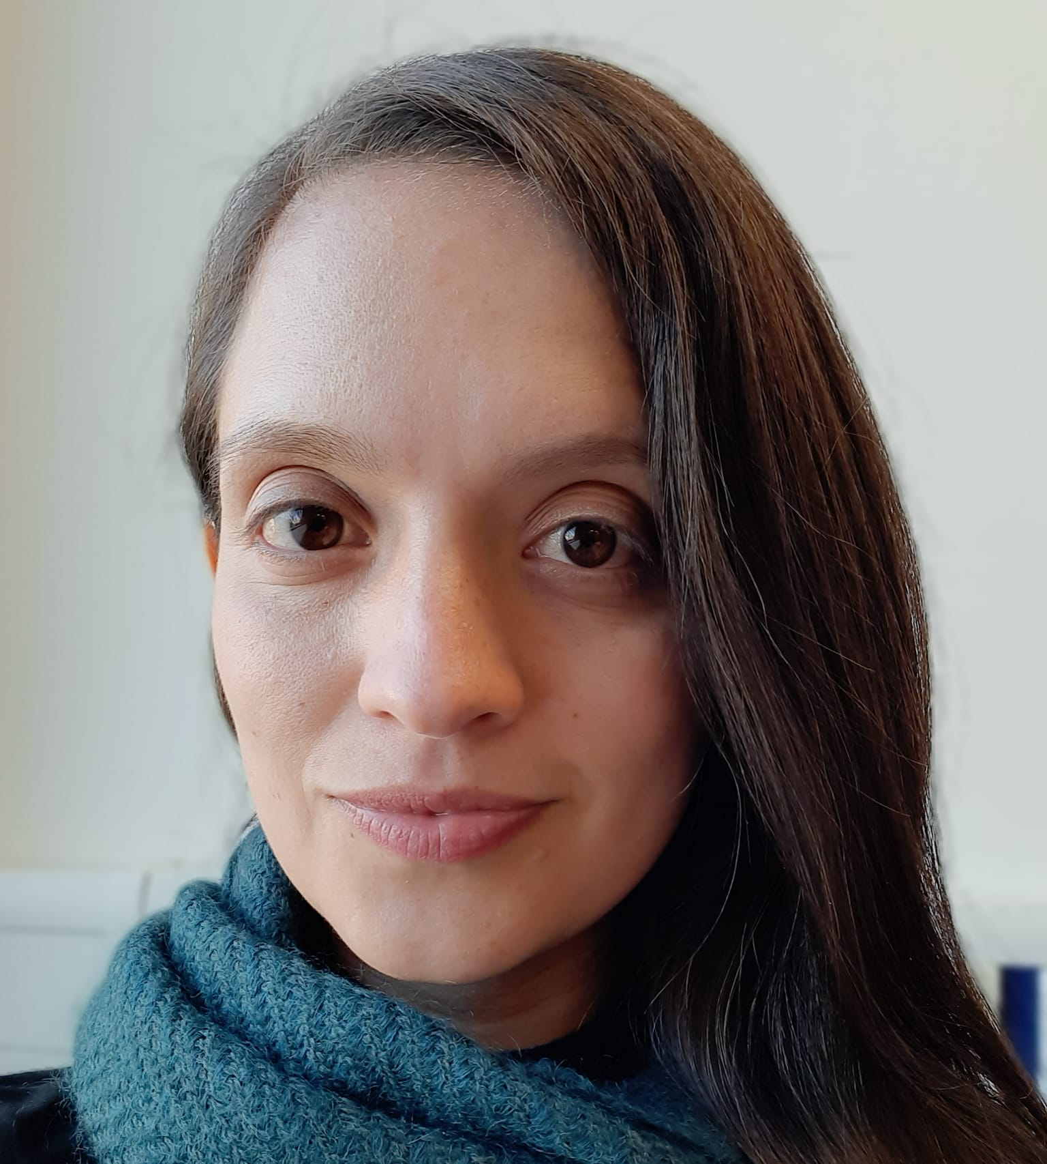

Presentation of the team
Victor Villadiego
Data Analysis
Julián Agudelo
Data Analysis
Andrea Serna
Literature review
Mauricio Toro
Data preparation
https://github.com/jac123desu/Project/upload

Slide 3
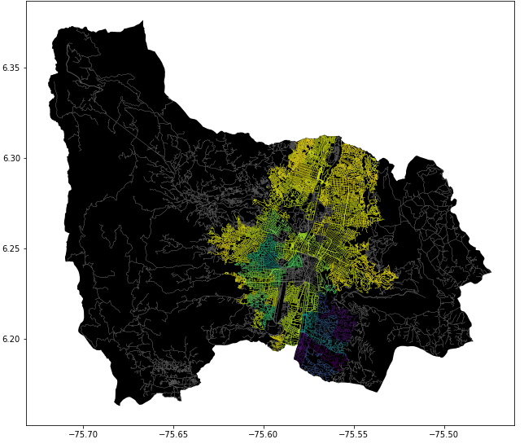
Problem Statement
Shortest path algorithm
Streets
of Medellín, Origin and Destination
Three paths that reduce both the risk of harassment and distance

