Slide 1
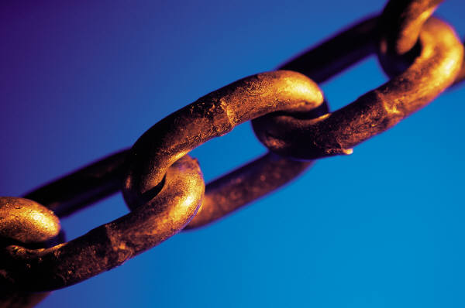

Object Storage on CRAQ
High throughput chain replication for
read-mostly workloads
Jeff Terrace
Michael J. Freedman

Slide 2
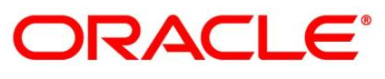
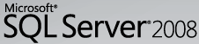
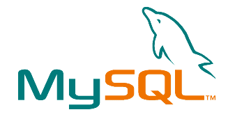

Data Storage Revolution
Relational Databases
Object Storage (put/get)
Dynamo
PNUTS
CouchDB
MemcacheDB
Cassandra
Speed
Scalability
Availability
Throughput
No Complexity
Notes:
Big table

Slide 3
Eventual Consistency
Replica
Read Request
Write Request
Replica
Manager
A
Replica
Replica
B
Read Request

Slide 4


Eventual Consistency
Writes ordered after commit
Reads can be out-of-order or stale
Easy to scale, high throughput
Difficult application programming model

Slide 5
Traditional Solution to Consistency
Replica
Two-Phase Commit:
Prepare
Vote: Yes
Commit
Ack
Write Request
Replica
Manager
Replica
Replica

Slide 6
Strong Consistency
Reads and Writes strictly ordered
Easy programming
Expensive implementation
Doesn’t scale well

Slide 7
Our Goal
Easy programming
Easy to scale, high throughput

Slide 8
Chain Replication
van Renesse & Schneider
(OSDI 2004)
W1
R1
W2
R2
R3
W1
R1
R2
W2
R3
Replica
Write Request
Replica
Read Request
Manager
HEAD
TAIL
Replica
Replica

Slide 9
Chain Replication
Strong consistency
Simple replication
Increases write throughput
Low read throughput
Can we increase throughput?
Insight:
Most applications are read-heavy (100:1)

Slide 10
CRAQ
Two states per object – clean and dirty
Read Request
Read Request
Read Request
Read Request
Read Request
HEAD
Replica
Replica
Replica
TAIL
V₁
V₁
V₁
V₁
V₁

Slide 11
CRAQ
Two states per object – clean and dirty
If latest version is clean, return value
If dirty, contact tail for latest version number
Write Request
Read Request
Read Request
2
V₂
1
V₁
V₁
HEAD
Replica
Replica
Replica
TAIL
V₂
,V₂
V₁
,V₂
V₁
V₂
,V₂
V₁
V₂
,V₂
V₁
V₂
V₂
V₁

Slide 12
Multicast Optimizations
Each chain forms group
Tail multicasts ACKs
HEAD
Replica
Replica
Replica
TAIL
V₂
V₁
,V₂
V₁
V₂
,V₂
V₁
V₂
,V₂
V₂
V₁
,V₂
V₂

Slide 13
Multicast Optimizations
Each chain forms group
Tail multicasts ACKs
Head multicasts write data
Write Request
HEAD
Replica
Replica
Replica
TAIL
V₂
,V₃
V₂
,V₃
V₂
,V₃
V₂
,V₃
V₂
,V₃
V₃

Slide 14
CRAQ Benefits
From Chain Replication
Strong consistency
Simple replication
Increases write throughput
Additional Contributions
Read throughput scales :
Chain Replication with Apportioned Queries
Supports Eventual Consistency

Slide 15
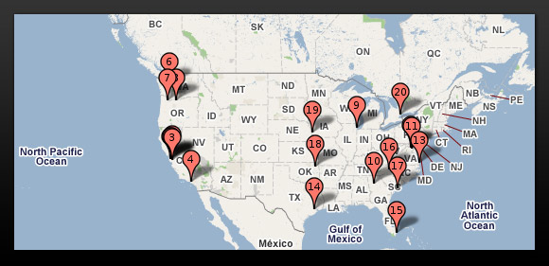

High Diversity
Many data storage systems assume locality
Well connected, low latency
Real large applications are geo-replicated
To provide low latency
Fault tolerance
(source: Data Center Knowledge)

Slide 16
Multi-Datacenter CRAQ
DC1
HEAD
TAIL
Replica
Replica
DC3
TAIL
Replica
Replica
Replica
Replica
Replica
DC2

Slide 17
Multi-Datacenter CRAQ
DC1
HEAD
TAIL
Replica
Replica
DC3
Replica
Client
Replica
Client
Replica
Replica
Replica
DC2

Slide 18
Chain Configuration
Motivation
Solution
Popular vs. scarce objects
Subset relevance
Datacenter diversity
Write locality
Specify chain size
List datacenters
dc₁, dc₂, … dc_{N}
Separate sizes
dc₁, chain_size₁, …
Specify master

Slide 19
Master Datacenter
DC1
Writer
HEAD
TAIL
Replica
TAIL
Replica
Replica
Replica
DC3
Replica
Replica
HEAD
Replica
DC2

Slide 20
Implementation
Approximately 3,000 lines of C++
Uses Tame extensions to SFS asynchronous I/O and RPC libraries
Network operations use Sun RPC interfaces
Uses Yahoo’s ZooKeeper for coordination

Slide 21
Coordination Using ZooKeeper
Stores chain metadata
Monitors/notifies about node membership
DC1
DC2
CRAQ
CRAQ
CRAQ
CRAQ
ZooKeeper
CRAQ
ZooKeeper
CRAQ
ZooKeeper
CRAQ
CRAQ
DC3
CRAQ

Slide 22
Evaluation
Does CRAQ scale vs. CR?
How does write rate impact performance?
Can CRAQ recover from failures?
How does WAN effect CRAQ?
Tests use Emulab network emulation testbed
Notes:
5kb

Slide 23
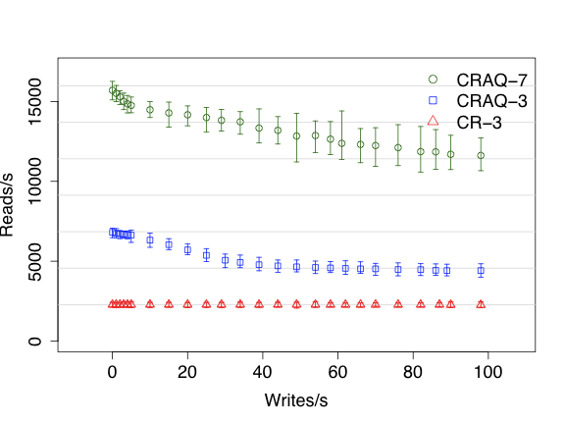
Read Throughput as Writes Increase
7x-
3x-
1x-
Notes:
5KB

Slide 24
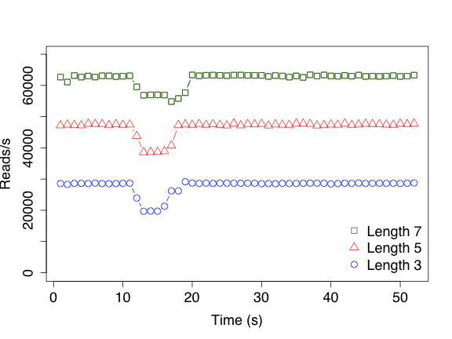
Failure Recovery (Read Throughput)
Notes:
500 Byte

Slide 25
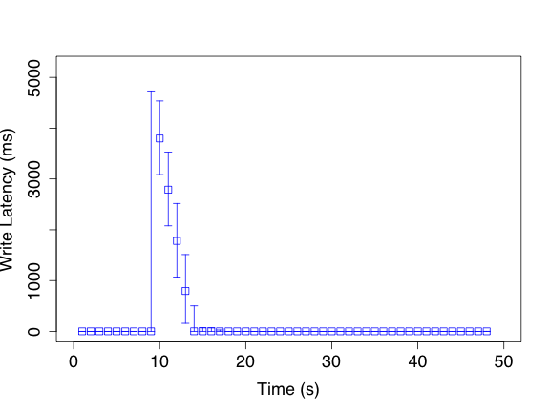
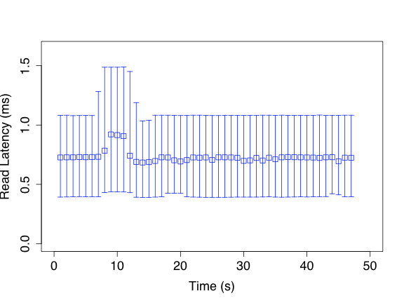
Failure Recovery (Latency)
Time (s)
Time (s)
Notes:
median, 99th percentile

Slide 26
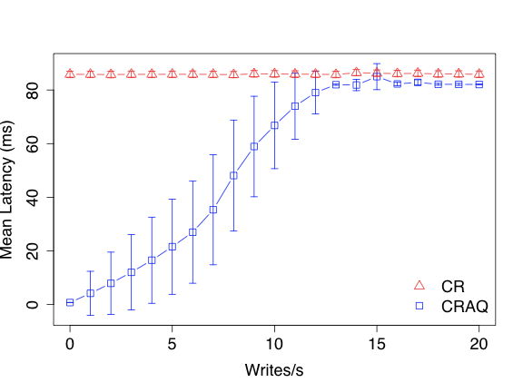
Geo-replicated Read Latency
Notes:
5KB
Mean/std dev

Slide 27
If Single Object Put/Get Insufficient
Test-and-Set, Append, Increment
Trivial to implement
Head alone can evaluate
Multiple object transaction in same chain
Can still be performed easily
Head alone can evaluate
Multiple chains
An agreement protocol (2PC) can be used
Only heads of chains need to participate
Although degrades performance (use carefully!)

Slide 28
Summary
CRAQ Contributions?
Challenges trade-off of consistency vs. throughput
Provides strong consistency
Throughput scales linearly for read-mostly
Support for wide-area deployments of chains
Provides atomic operations and transactions
Thank
You
Questions?
Notes:
x

