Slide 1


Bringing P2P to the Web: Security and Privacy in the Firecoral Network
Jeff Terrace
Sean Stern
Hao Eric Liu
Harold Laidlaw
Michael Freedman
Notes:
- Jeff Terrace
Firecoral, p2p network for web content
Joint Work

Slide 2
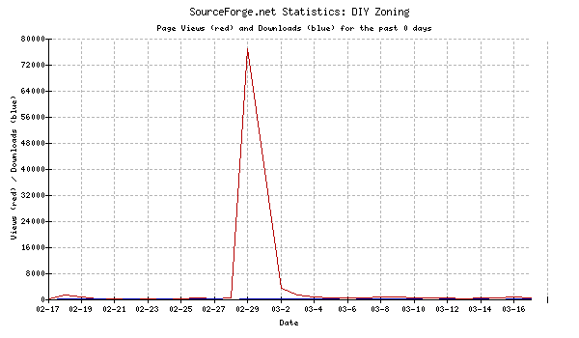
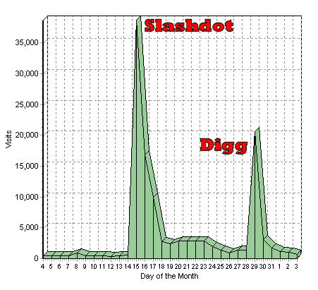
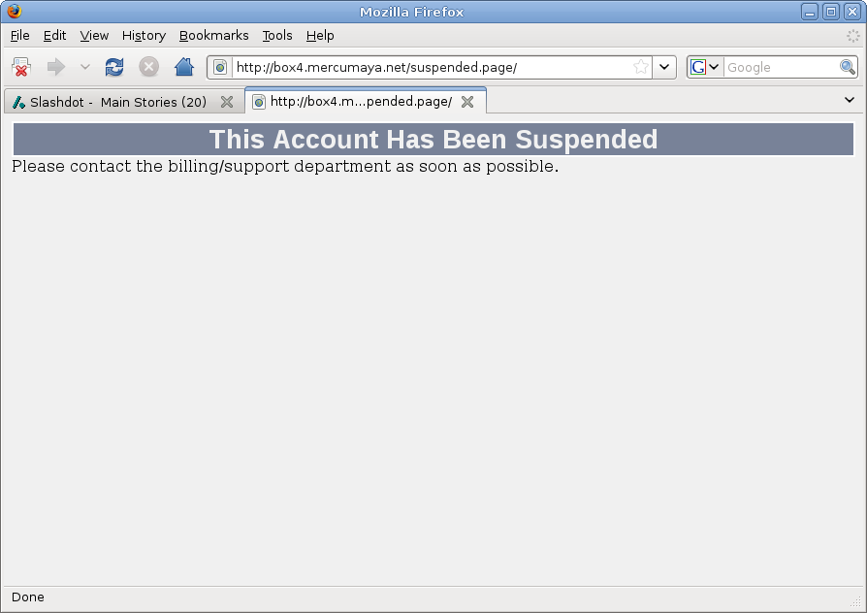
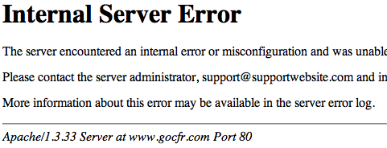
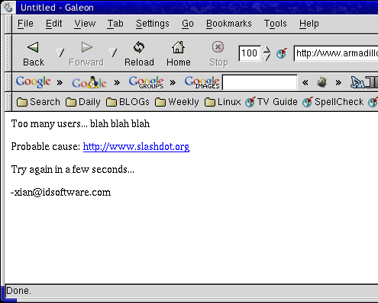
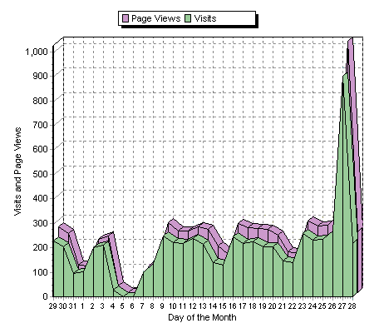
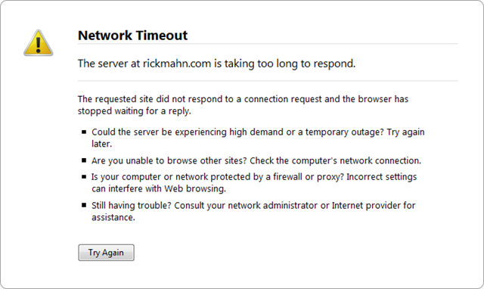
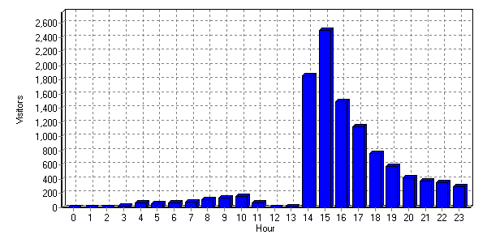
Slashdot Effect

Slide 3






Existing Commerical CDNs
Build your own solution
Expensive to set up
Only cost effective at massive scale
Purchase from provider
Expensive
Requires prior knowledge of demand

Slide 4



Existing Free CDNs
Peer-to-peer CDNs
Easy to use
Free!
Automatic redirection
Unfortunately…
Over-subscribed
Under-provisioned
Scalability limited due to trust

Slide 5





Existing P2P Networks
Leverage file-sharing networks
Demonstrated to provide scalability, fairness, and high-performance
Design Mismatch
Not easily integrated into web browsers
High latency cost for small files

Slide 6

Introducing Firecoral
What is Firecoral?
A peer-to-peer network for the web
Integrates directly into a user’s web browser
Ensures authenticity of content
Preserves user privacy
Backwards compatible
This talk’s focus
Security
Privacy
Usability
Not focused on
P2P Algorithms
Incentives
Evaluation

Slide 7
Firecoral Goals
Content Providers
Easily integrate into existing web servers
Backwards compatibility
Not interfere with advertisements and analytics
End Users
Easy to install and transparent to use
Provide content integrity
Respect privacy/sharing policies

Slide 8



Modified Content Provider
Content Provider
Acts as tracker
Ensures authenticity
Content
Provider
<URL>
Client
<Content Hash>
<Peer List>
Peer
URL
Peer
URL
But content provider
Still handles every request
URL
Peer

Slide 9
External Tracker
Tracker
Content
Provider
<URL>
URL
Client
<Content Hash>
<Peer List>
Peer
URL
Content provider
Still needs to provide authenticity
Still requires modification
Peer
URL
URL
?
Peer

Slide 10
Signing Service
Tracker
Content
Provider
URL
Sig_{SS}<Content Hash>
Client
<Peer List>
URL
Peer
URL
Signing
Service
Peer
URL
URL
Peer
✓
Private Key = SS
Computes
Sig_{SS}<Content Hash>

Slide 11

When to Use Firecoral
Content to avoid
HTTPS
Banking
Online Shopping
POST Requests
Web mail
Feedback forms
Other private content?

Slide 12
When to Use Firecoral
Simply list domains
Too coarse grained
Requires site lists be known
Use HTTP referrer header
Captures 3rd party advertisements
Interferes with analytics

Slide 13
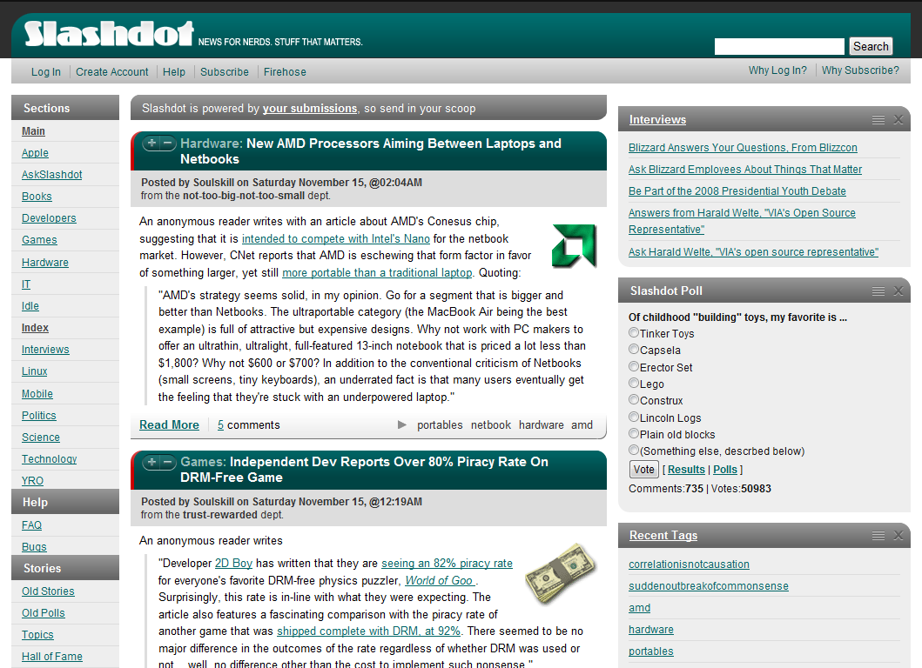
Configuration Example

Slide 14
Configuration Solution
HTML Text
Difficult to parse
Requires maintenance
Web standards!
XML Path Language (XPath)
Queries can select XML nodes from HTML
XPath rules are simple and easy to write
Firefox executes XPath very quickly

Slide 15
XPath Example
Query for digg.com used to be:
//div[@class='news-summary'] /descendant::a[starts-with(@href, 'http://') and not(contains(@class, 'thumb'))]/@href
Digg releases “DiggBar” feature which changes HTML
New query only changes one word:
//div[@class='news-summary'] /descendant::a[starts-with(@href, 'http://') and not(contains(@class, 'thumb'))]/@title

Slide 16
Subscriptions
List of Domain/XPath pairs
Whitelist
Use Firecoral
Contains popular news aggregators
Blacklist
Don’t use Firecoral
Contains known well-provisioned sites
Notes:
Make clear this is in browser
Only urls selected are used

Slide 17
Implementation
Tracker
1000 lines of PHP running on Apache
Uses MySQL, Memcachedb, and Memcached
Signing Service
700 lines of Python
Firefox Extension
7000 lines of JavaScript, XUL, and CSS
Runs an HTTP proxy server within Firefox
Uses Mozilla XPConnect API for access to low-level network functions
Cross platform

Slide 18
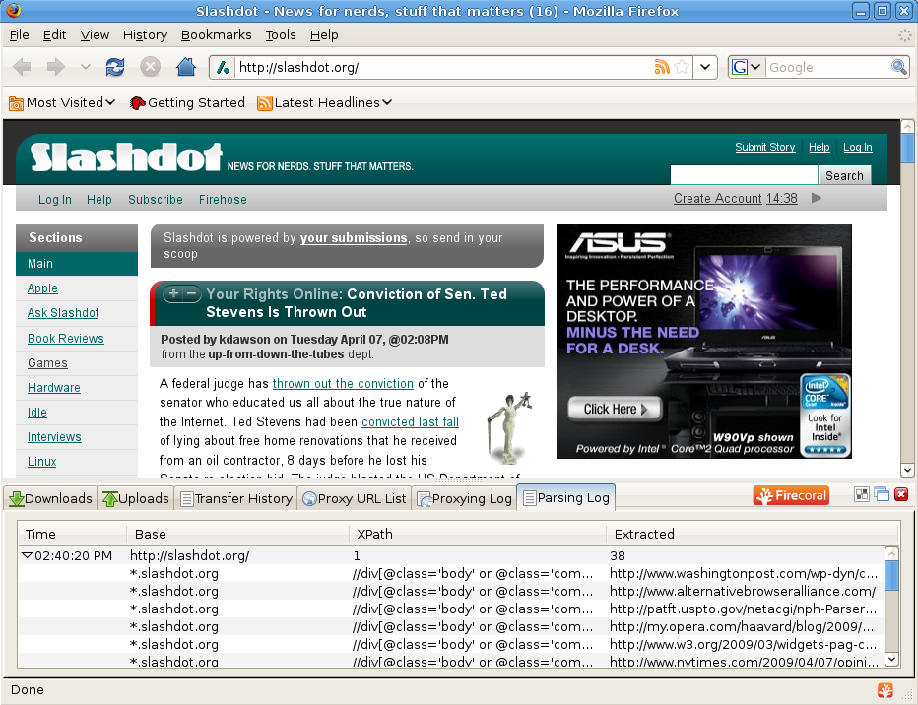
Demo

Slide 19
Conclusions
Firecoral brings P2P to the web
Firecoral provides
Security
Privacy
Usability
Allows content providers to easily support Firecoral
Allows users to easily configure sharing and privacy policy

Slide 20
Future Work
Implementation
NAT traversal
Apache plug-in for signing and redirection
Design
Incentives
Peer selection
Measurement study

Slide 21
Thank You
Questions?
http://firecoral.net/

