Slide 1

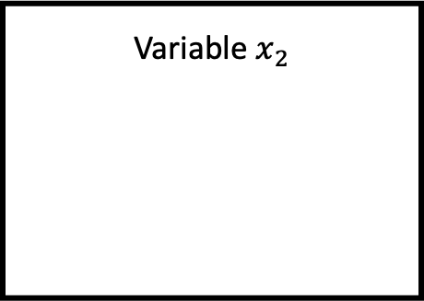

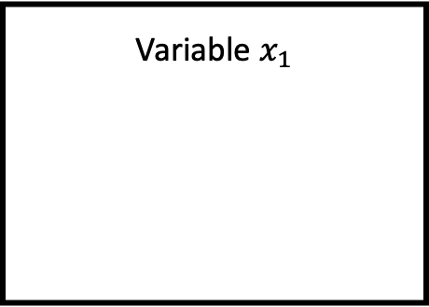






Thread 1
$$C_{1}$$
1
1
1
Variable $x_{1}$
$$W_{x_{1}}$$
0
0
0
Thread 2
$$R_{x_{1}}$$
0
0
0
Lock 1
$$C_{2}$$
1
1
1
$$L_{1}$$
0
0
0
Variable $x_{2}$
$$W_{x_{2}}$$
0
0
0
Thread 3
$$R_{x_{2}}$$
0
0
0
$$C_{3}$$
1
1
1

Slide 2



Thread 1
$$C_{1}$$
0
0
0
Lock 1
$$L_{1}$$
0
0
0
Thread 2
$$C_{2}$$
0
0
0

Slide 3







DJIT+ Locking
$$t$$
$$C_{1}$$
$$C_{2}$$
$$L_{m}$$
0
0
0
2
0
0
$$acq(1, m)$$
0
0
0
2
0
0
$$rel(1, m)$$
1
0
0
2
1
0
$$acq(2, m)$$
0
0
1
2
1
0

Slide 4






DJIT+ Variable Writes
$$t$$
$$C_{1}$$
$$C_{2}$$
$$W_{1}$$
0
0
0
2
0
0
$$wr(2, x_{1})$$
0
0
0
2
0
2
$$rel(1)$$
1
0
0
2
1
0
$$acq(1)$$
0
0
1
2
1
0

Slide 5
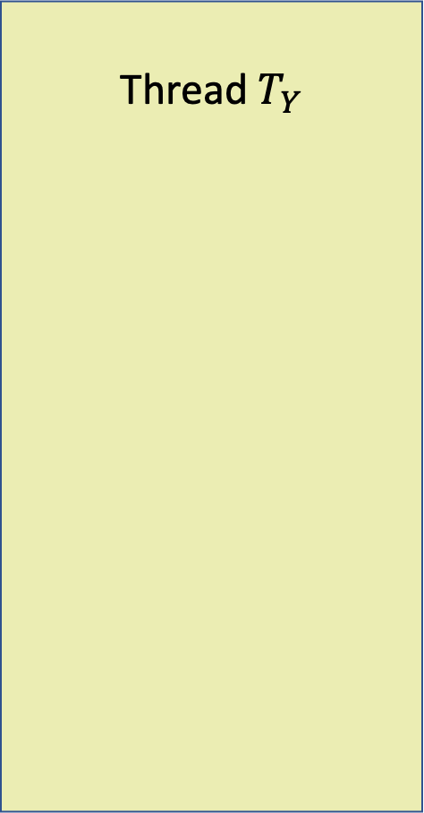
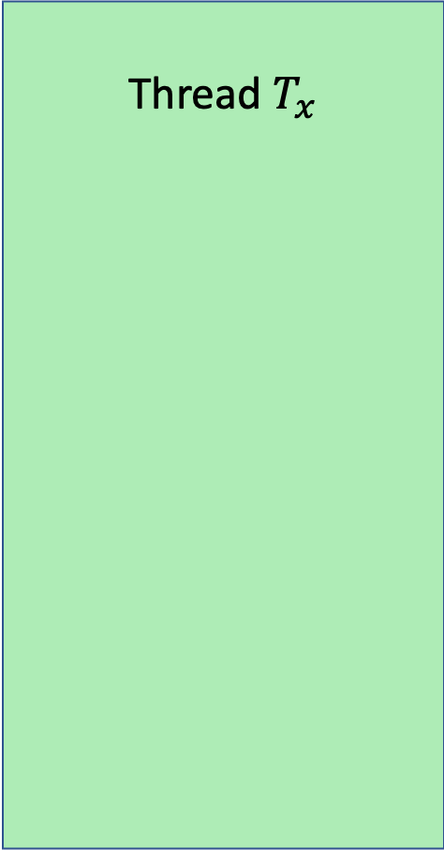



Happens-before arc
Thread $T_{x}$
Thread $T_{Y}$
$$ACQUIRE_{T_{X}}(A)$$
Time $t$
$$ACQUIRE_{T_{Y}}(A)$$
Waits for free
Locks
Lock A

Slide 6



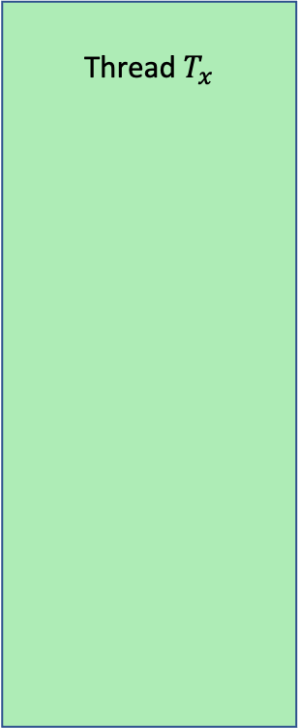








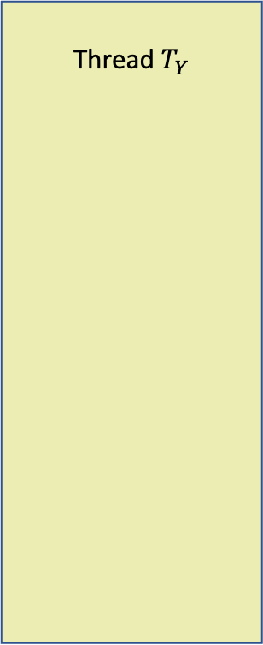


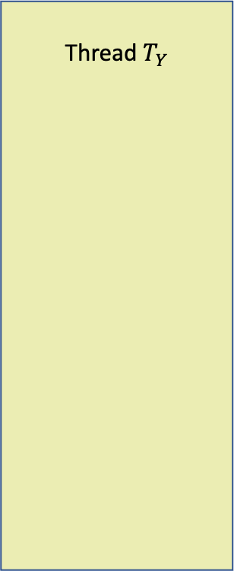

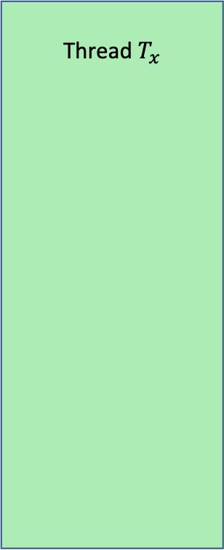
Happens-before relation $≼$
Same thread
Happens-before arc
Transitive Happens-before arc
Thread $T$
Thread $T_{x}$
Thread $T_{Y}$
Thread $T_{x}$
Thread $T_{Y}$
$$ACQUIRE_{T_{X}}(A)$$
$$EVENT E_{1}$$
$$ACQUIRE_{T_{X}}(A)$$
Time $t$
$$ACQUIRE_{T_{Y}}(A)$$
$$EVENT E_{T_{X}}$$
Time $t$
$$EVENT E_{T_{Y}}$$
$$EVENT E_{2}$$
$$ACQUIRE_{T_{Y}}(A)$$
$$EVENT E_{2}$$
Locks
Waits for free
Locks
Waits for free
Lock A
Lock A
$$EVENT E_{2}$$

Slide 7













Thread T
Writer Lock Set $LS_{Wr}$
All write-held locks of the thread
Reader Lock Set $LS_{Rd}$
All read locks of the thread
Segment
Sequence of events (only memory access events)
$$WRITE_{T_{1}}$$
$$WL_{1}$$
$$WL_{2}$$
$$RL_{1}$$
$$RL_{2}$$
$$READ_{T_{2}}$$
$$WL_{3}$$
$$RL_{3}$$
$$READ_{T_{3}}$$
$$WRITE_{T_{4}}$$
$$READ_{T_{5}}$$

Slide 8




Global State Machine
State Machine for Memory ID #1
Writer Segment $SS_{Wr}$
Reader Segment $SS_{Rd}$
State Machine for Memory ID #2
Writer Segment $SS_{Wr}$
Reader Segment $SS_{Rd}$

