Slide 1
EIC · Zero Degree Calorimeter · Monte Carlo Study
ZDC Energy Reconstruction
Gamma (0.7 – 40 GeV) | Neutron (20 – 300 GeV)
Background
The Electron-Ion Collider (EIC) will collide electrons with protons and nuclei. The Zero Degree Calorimeter (ZDC) sits at 0° and catches neutral particles (neutrons, photons) that travel straight through the bending magnets.
Goal
Determine how well the ZDC can measure the energy of these particles using Monte Carlo simulations, and check if performance meets physics requirements.
Detector layers
ECAL — LYSO crystals + SiPM
Detects: photons, electrons
HCAL — Steel + scintillator
Detects: neutrons, hadrons
Both layers needed to fully
reconstruct particle energy.
ASIoP · Explore MC-sim data for ZDC

Slide 2
From Raw Data to Graph Axes
Every variable defined — step by step
Step 1 — Simulation output (raw data)
Each simulated particle event gives:
E_beam True beam energy (GeV). Set by simulation. This is what we want to reconstruct.
E_ECAL Energy deposited in the ECAL layer (GeV). Measured signal.
E_HCAL Energy deposited in the HCAL layer (GeV). Measured signal.
These three numbers exist for every event. All other quantities are derived.
Step 2 — Energy reconstruction
Combine the two detector signals into one energy estimate:
E_rec = p0 + p1·E_ECAL + p2·E_HCAL
p0, p1, p2 are fit parameters found by least-squares regression across all simulated events. Three regression methods are used:
m0 — Linear m1 — Ratio m2 — Quadratic
Two weighting schemes:
w0 — all energies equal weight
w1 — weight each event by √E_beam (emphasises low-energy accuracy)
Step 3 — Per-event ratio
r = E_rec / E_beam
r = 1.0 → perfect reconstruction
r > 1.0 → overestimated
r < 1.0 → underestimated
Step 4 — Histogram & DCB fit
Collect r for all events at one beam energy.
Fit with Double Crystal Ball (bell curve with power-law tails).
Extract two numbers:
μ (mu) = mean of fit → bias
σ (sigma) = width of fit → resolution
Step 5 — Graph axes
Slide 5 x-axis: E_beam (GeV)
Slide 5 y-axis: mean(E_subdetector / E_beam) per beam energy
Slide 6 x-axis: r = E_rec / E_beam (single energy)
Slide 6 y-axis: event count
Slides 7-8 x: E_beam (GeV)
Slides 7-8 y: σ (resolution) or μ (bias) from DCB fit

Slide 3
Method & Thinking
How we go from signals to performance numbers
Why two detectors?
Gammas deposit ~30–50% of energy in ECAL, almost none in HCAL. Neutrons are the opposite. Using both signals together gives a more complete picture.
Why regression?
Raw signals are not equal to energy — there is leakage, dead material, and non-linearity. Regression learns the correction from simulation.
Why √E weighting?
Equal weighting lets high-energy events dominate the fit (they have bigger absolute residuals). √E weighting balances accuracy across the full energy range.
Why DCB fit?
Real detector distributions have heavier tails than a pure Gaussian — energy leaking out the sides creates a low-side tail, shower fluctuations create a high-side tail. The Double Crystal Ball handles both.
The requirement curve
σ(E) = p0 / √E + 0.05
Physics demands resolution better than this threshold.
Gamma: p0 = 0.20 (new target)
Neutron: p0 = 0.35 (new target)
The 0.05 floor is irreducible — calibration and geometry limits.
6 method combinations
m0 w0 — Linear, Equal
m1 w0 — Ratio, Equal
m2 w0 — Quadratic, Equal
m0 w1 — Linear, √E-weighted
m1 w1 — Ratio, √E-weighted
m2 w1 — Quadratic, √E-weighted
All six appear on resolution
and bias plots. Compare them
to find best-performing method.
Output files:
res2_1_m{0-2}_w{0-1}_{particle}.root
Each stores gReso_dcb and
gBias_dcb — one point per
beam energy tested.

Slide 4
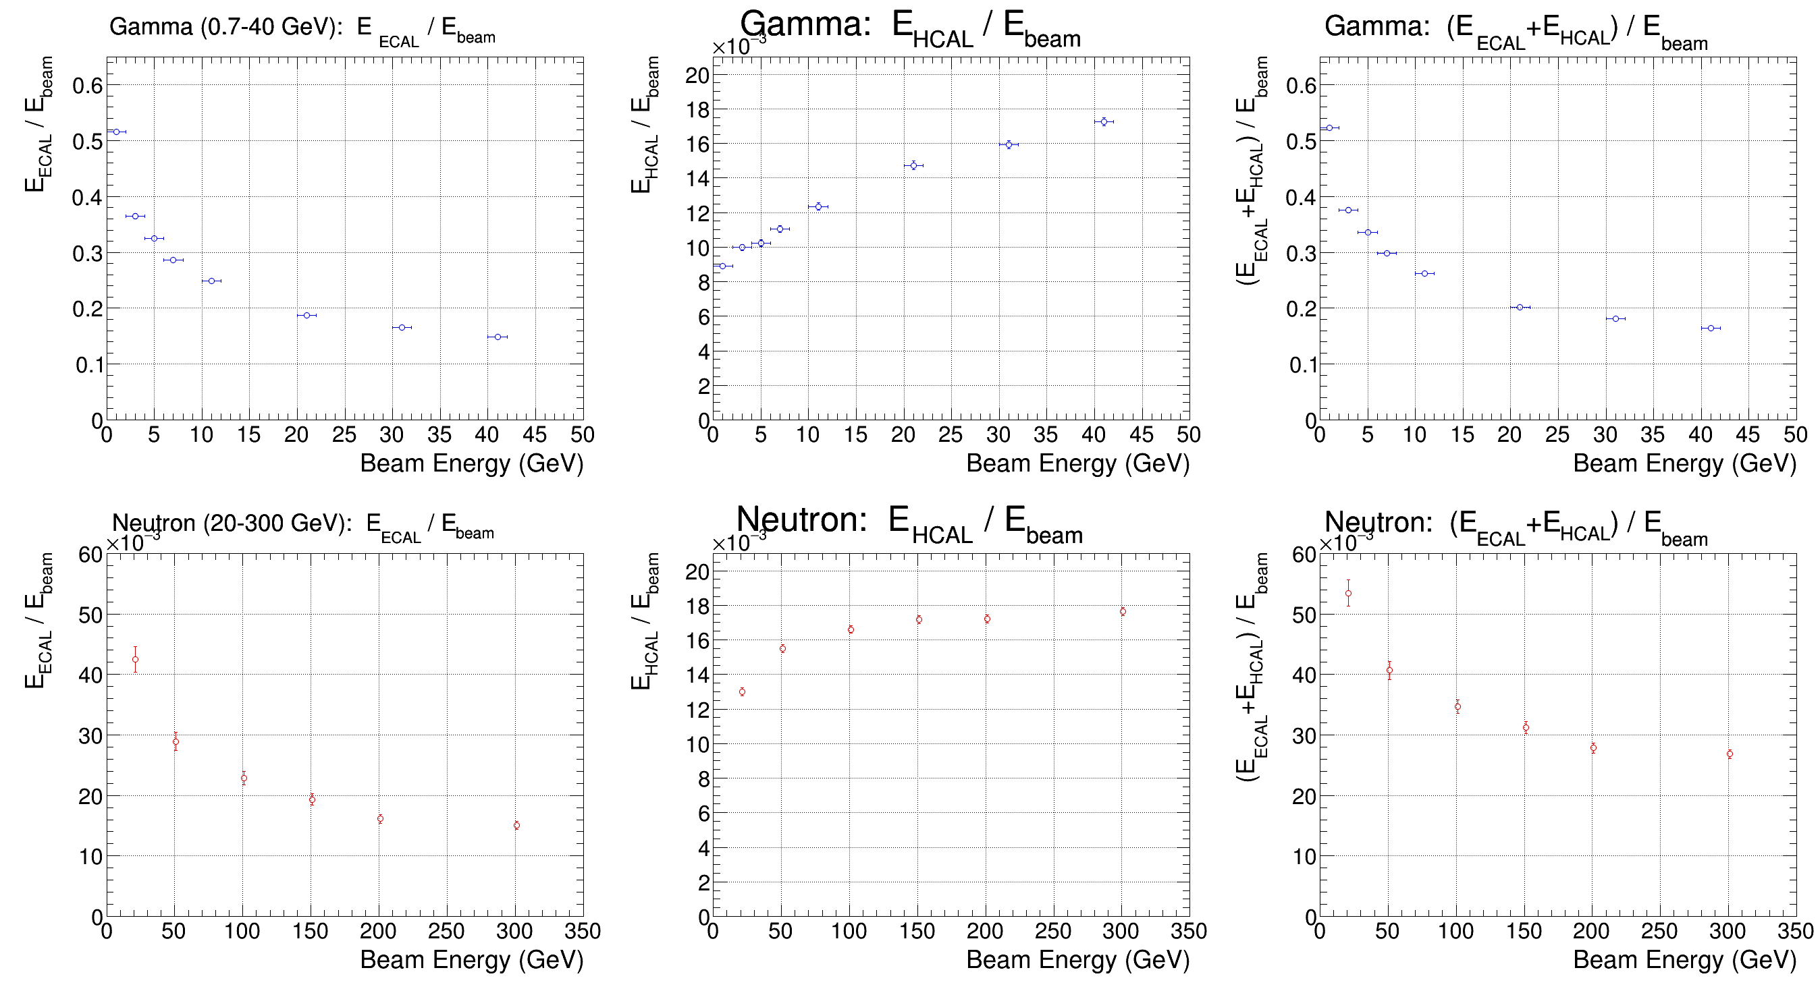
Energy Deposition vs Beam Energy
How much of the particle's energy does each detector layer actually see?
What the axes mean
x-axis: E_beam (GeV)
True simulated beam energy.
y-axis: E_sub / E_beam
Fraction of beam energy seen
by ECAL, HCAL, or both.
Averaged over all events at
that beam energy.
Observations
Gamma ECAL: 0.5 → 0.15
Falls with energy (saturation).
HCAL: tiny (10⁻³ scale).
Neutron ECAL: near zero.
HCAL: 0.01–0.02, rises slowly.
Neither detector alone is enough.

Slide 5
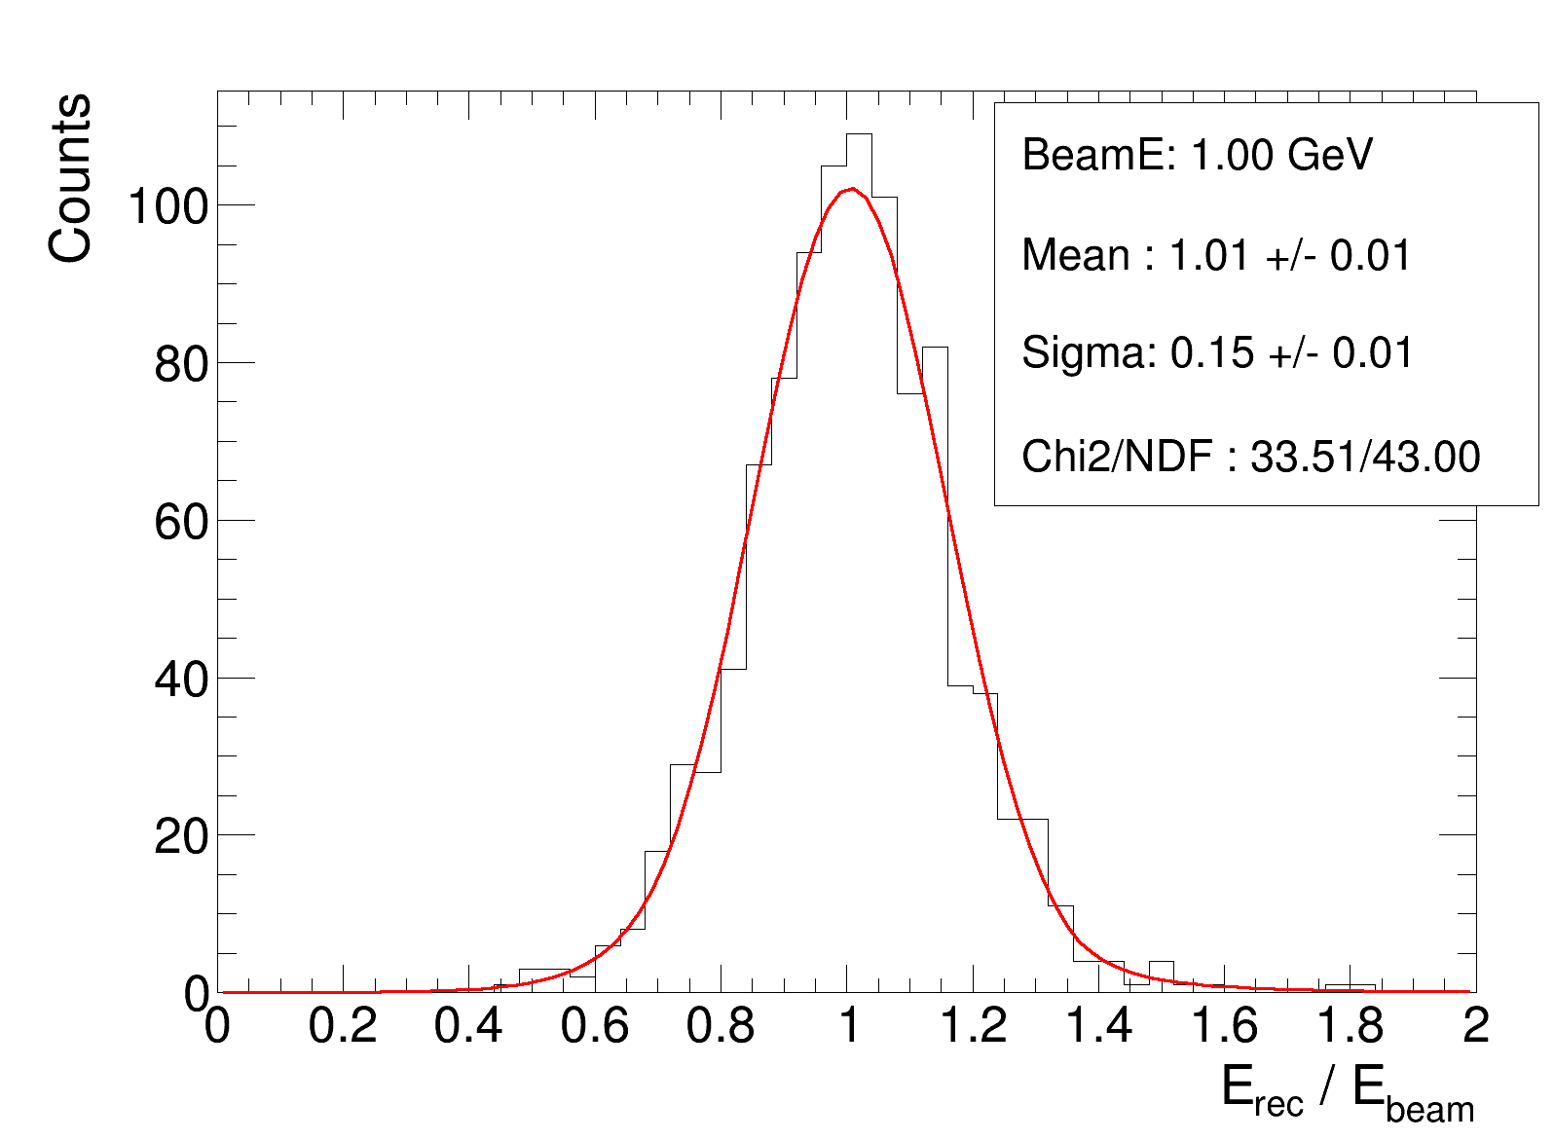
E_rec / E_beam Distribution — 1 GeV Gamma
The shape of reconstructed energy tells us resolution and bias
What the axes mean
x-axis: r = E_rec / E_beam
Reconstructed energy divided by
true beam energy, per event.
r = 1.0 is perfect.
y-axis: Counts
How many events fell in each r bin.
Red curve: DCB fit
Bell curve with heavier tails.
Fit extracts μ and σ.
Stats box
Mean = 1.01 → bias near 0%
Sigma = 0.15 → 15% resolution
at 1 GeV (expected)
Chi2/NDF = 0.78 → good fit
Note: left tail = energy leakage.
Right tail = shower fluctuations.

Slide 6
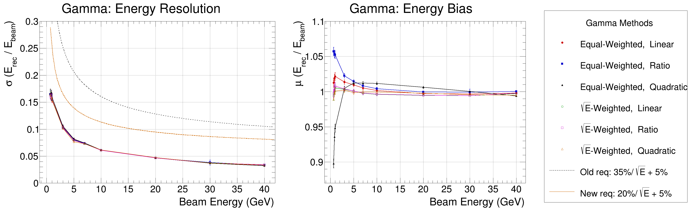
Gamma: Resolution & Bias vs Beam Energy (0.7 – 40 GeV)
Does the detector meet requirements? How accurate is reconstruction?
Resolution (left panel):
y = σ from DCB fit. x = E_beam. Dashed lines = requirements σ = p0/√E + 0.05. All methods fall below new requirement (p0=0.20) → detector passes.
Bias (centre panel):
y = μ from DCB fit. Ideal = 1.0. Gamma bias is well-behaved across all methods (0.90–1.06). Small dip at 0.7 GeV for quadratic equal-weighted (m2 w0).

Slide 7
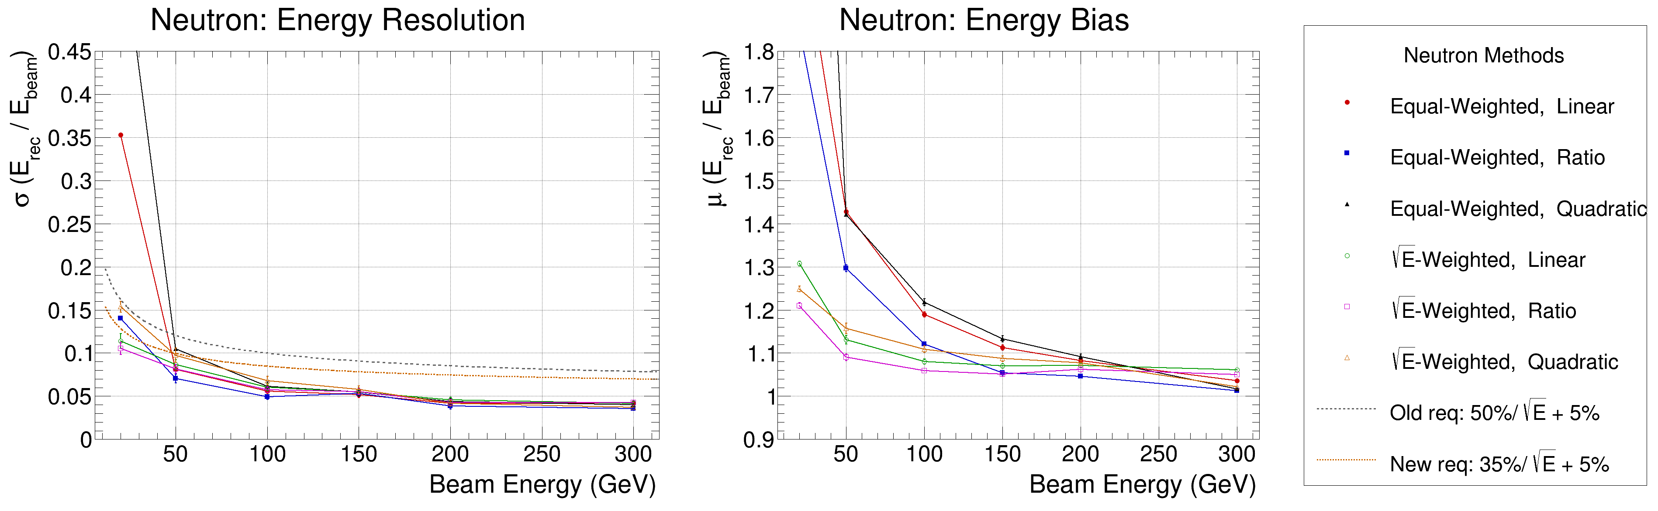
Neutron: Resolution & Bias vs Beam Energy (20 – 300 GeV)
Equal-weighting struggles at low energy — sqrt-E weighting fixes it
Resolution (left panel):
y = σ from DCB fit. x = E_beam. √E-weighted methods (open markers) meet the new requirement (p0=0.35) at most energies. Equal-weighted methods are worse, especially below 50 GeV.
Bias (centre panel):
y = μ from DCB fit. Equal-weighted methods: μ up to 2–3.5 at 20 GeV (regression dominated by high-energy events, fails to extrapolate low). √E-weighted: μ ≈ 1.1–1.3 at 20 GeV — far more controlled.

Slide 8
Observations
What the data tells us
Energy deposition
Gammas are almost entirely ECAL particles — HCAL contribution is 1000× smaller. Neutrons are HCAL particles with essentially zero ECAL signal. Neither sub-detector alone is sufficient — both are required for reconstruction.
Reconstruction distribution
At 1 GeV gamma: mean = 1.01 (near-perfect accuracy), sigma = 0.15 (15% resolution). The DCB fit captures the asymmetric tails well (chi2/NDF ≈ 0.78). The left tail is caused by leakage; the right by upward shower fluctuations.
Gamma performance
All six reconstruction methods meet the new resolution requirement (20%/√E + 5%) across 0.7–40 GeV. Bias is controlled within ±6%. Linear and quadratic methods perform similarly — ratio method slightly worse at low energy.
Neutron performance
√E-weighted methods are clearly superior. Equal-weighted bias reaches 3.5× at 20 GeV — reconstruction is unreliable there. √E-weighted bias stays below 1.35× across all energies tested. Resolution with √E-weighting is close to the new requirement (35%/√E + 5%) but may need further tuning at low energies.

Slide 9
Outlook
What comes next
Optimise neutron at low energy
The 20–50 GeV range shows the largest bias and worst resolution. Consider energy-dependent regression coefficients or a neural-network-based approach.
Validate with full EIC simulation
Current MC uses idealized geometry. Full GEANT4 simulation with beam backgrounds, crossing angle, and realistic hit digitization will stress-test these results.
Extend to ML regression
Linear regression is a baseline. Gradient-boosted trees or a simple feed-forward network using ECAL+HCAL hit maps (not just sums) could reduce σ and bias further.
Cross-check with data
Once EIC test-beam data is available, compare MC resolution to real measurements to validate simulation accuracy and calibrate systematic uncertainties.

