Slide 1
ZDC Energy Reconstruction
Gamma (0.7 – 40 GeV) | Neutron (20 – 300 GeV)
EIC · Zero Degree Calorimeter · Monte Carlo Study
ASIoP · Academia Sinica · Taiwan Group
2026/06/24
ZDC Energy Reconstruction
1/9

Slide 2
Background
What is the EIC and ZDC?
The Electron-Ion Collider (EIC) collides electrons with protons and heavy nuclei to study the internal structure of matter. The Zero Degree Calorimeter (ZDC) sits at 0 degrees at the end of the beamline, catching neutral particles that fly straight through the bending magnets — primarily neutrons and photons (gammas).
Detector design
ECAL — Electromagnetic Calorimeter
Material: LYSO crystal + SiPM
Size: 20x20 cells, 3x3x7 cm/cell, 60x60 cm total
Detects: photons, electrons
Radiation length: 7 cm ~ 6.5 X0 in Z
HCAL — Hadronic Calorimeter (sampling)
Material: steel absorber + scintillator tile + SiPM
Size: 64 layers, 65x60 cm face, 163 cm deep
Detects: neutrons, hadrons
Layer: 1 steel + 1 scintillator per sampling unit
Goal of this study
Using Monte Carlo simulation with a 25-degree opening angle beam spread, determine how well the ZDC reconstructs the energy of incident gammas (0.7 – 40 GeV) and neutrons (20 – 300 GeV), and verify whether performance meets the EIC physics requirements.
2026/06/24
ZDC Energy Reconstruction
2/9

Slide 3
From Raw Data to Graph Axes
Step 1 — Simulation output (raw data)
Step 3 — Per-event ratio
E_beam True beam energy (GeV)
Set by simulation. What we want to reconstruct.
E_ECAL Energy deposited in ECAL layer (GeV)
Measured detector signal.
E_HCAL Energy deposited in HCAL layer (GeV)
Measured detector signal.
r = E_rec / E_beam
r = 1.0 -> perfect reconstruction
r > 1.0 -> overestimated energy
r < 1.0 -> underestimated energy
Step 4 — DCB fit on r distribution
mu = mean of fit -> BIAS value
sigma = width of fit -> RESOLUTION value
Bell curve with power-law tails (DCB).
Step 2 — Energy reconstruction
E_rec = p0 + p1*E_ECAL + p2*E_HCAL
p0, p1, p2 fit by least-squares regression.
3 methods (m0 linear / m1 ratio / m2 quadratic).
2 weightings (w0 equal / w1 sqrt(E_beam)).
Step 5 — What each graph axis is
Slide 5 x: E_beam y: mean(E_sub/E_beam)
Slide 6 x: E_rec/E_beam y: event count
Slide 7-8 x: E_beam
y: sigma (resolution plot)
y: mu (bias plot)
2026/06/24
ZDC Energy Reconstruction
3/9

Slide 4
Method
Why two detectors?
Why regression?
Why sqrt(E) weighting?
Gammas deposit 20-60% of energy in ECAL, almost nothing in HCAL. Neutrons are the opposite — nearly all energy in HCAL. Using both signals together gives a complete picture.
Raw signals are not equal to energy. There is leakage, dead material, and detector non-linearity. Regression learns the correction from simulation.
Equal weighting lets high-energy events dominate the fit (bigger absolute residuals in GeV). sqrt(E_beam) weighting balances accuracy across the full energy range.
Why DCB fit?
Real shower distributions have heavier tails than a Gaussian — energy leaking out the sides creates a slow left tail; upward shower fluctuations create a slow right tail. The Double Crystal Ball uses a Gaussian core with power-law tails to match this.
The requirement curve
sigma(E) = p0 / sqrt(E) + 0.05
p0/sqrt(E) stochastic term: shower fluctuations scale as
1/sqrt(E) from Poisson statistics.
0.05 constant floor: calibration, dead material,
leakage — cannot improve with more energy.
Gamma requirement: p0 = 0.20 (new) p0 = 0.35 (old)
Neutron requirement: p0 = 0.35 (new) p0 = 0.50 (old)
6 method/weighting combos tested:
m0w0 m1w0 m2w0 (equal-weighted)
m0w1 m1w1 m2w1 (sqrt(E)-weighted)
2026/06/24
ZDC Energy Reconstruction
4/9

Slide 5
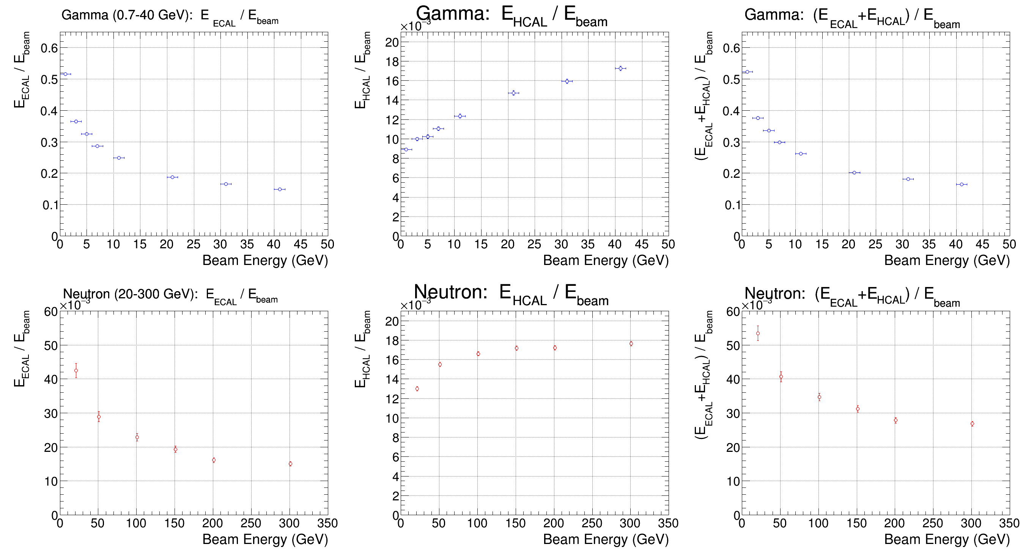
Energy Dump
Axes
x-axis: E_beam (GeV)
True simulated beam energy.
y-axis: E_sub / E_beam
Fraction of beam energy seen
by one detector layer.
Observations
Gamma (top row):
ECAL fraction 0.5 -> 0.15.
Falls with energy (saturation).
HCAL fraction ~10^-3 — tiny.
Gammas are ECAL particles.
Neutron (bottom row):
ECAL fraction ~0 — near zero.
HCAL fraction 0.01 – 0.02.
Neutrons are HCAL particles.
Neither detector alone is enough.
2026/06/24
ZDC Energy Reconstruction
5/9

Slide 6
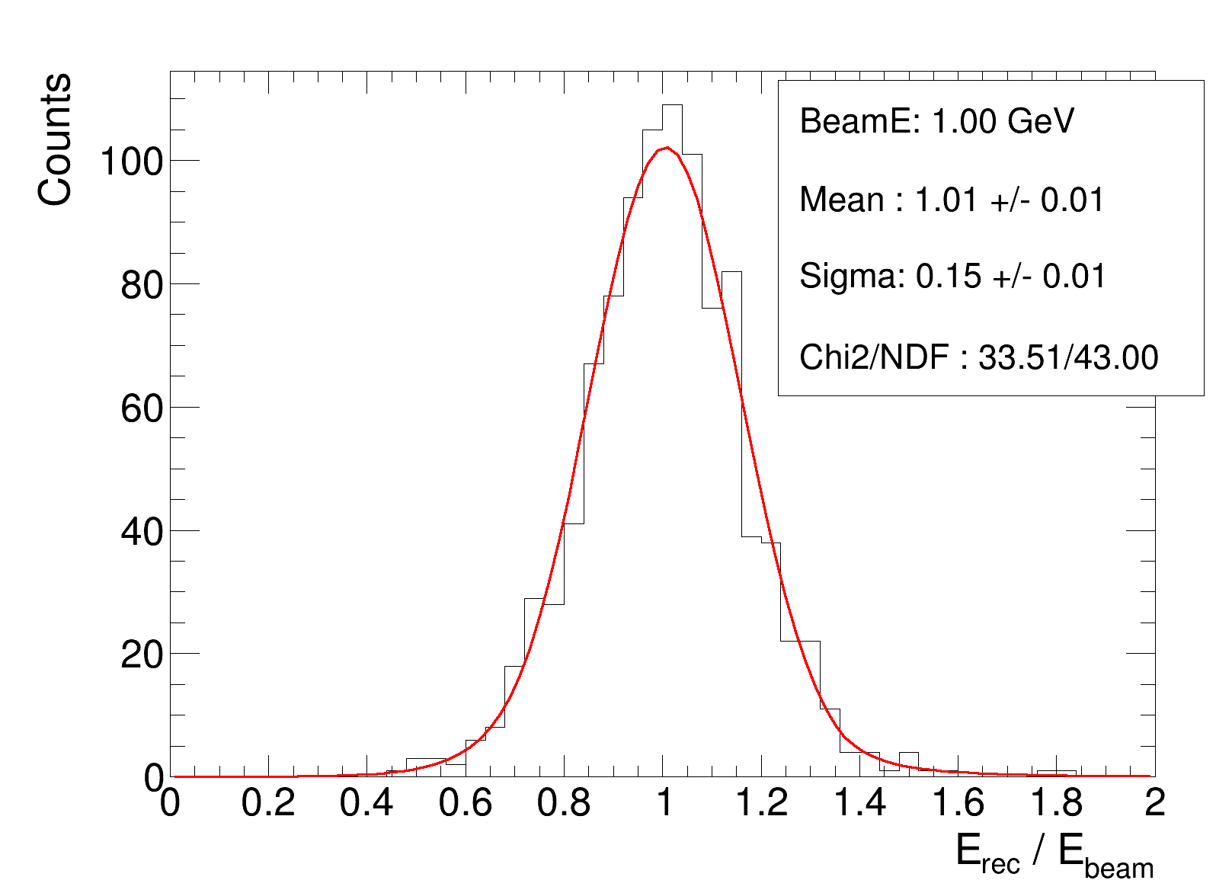
E_rec / E_beam Distribution — 1 GeV Gamma
Axes
x-axis: r = E_rec / E_beam
Reconstructed over true energy.
r = 1.0 is perfect.
y-axis: Counts
Events per r bin.
Red curve: DCB fit
Observations
Mean = 1.01 -> bias < 1%
Near-perfect reconstruction.
Sigma = 0.15 -> 15% resolution
Expected: 1/sqrt(1 GeV) term large.
Chi2/NDF = 0.78 -> good fit
Left tail: energy leakage out
detector sides/back.
Right tail: upward shower fluct.
2026/06/24
ZDC Energy Reconstruction
6/9

Slide 7
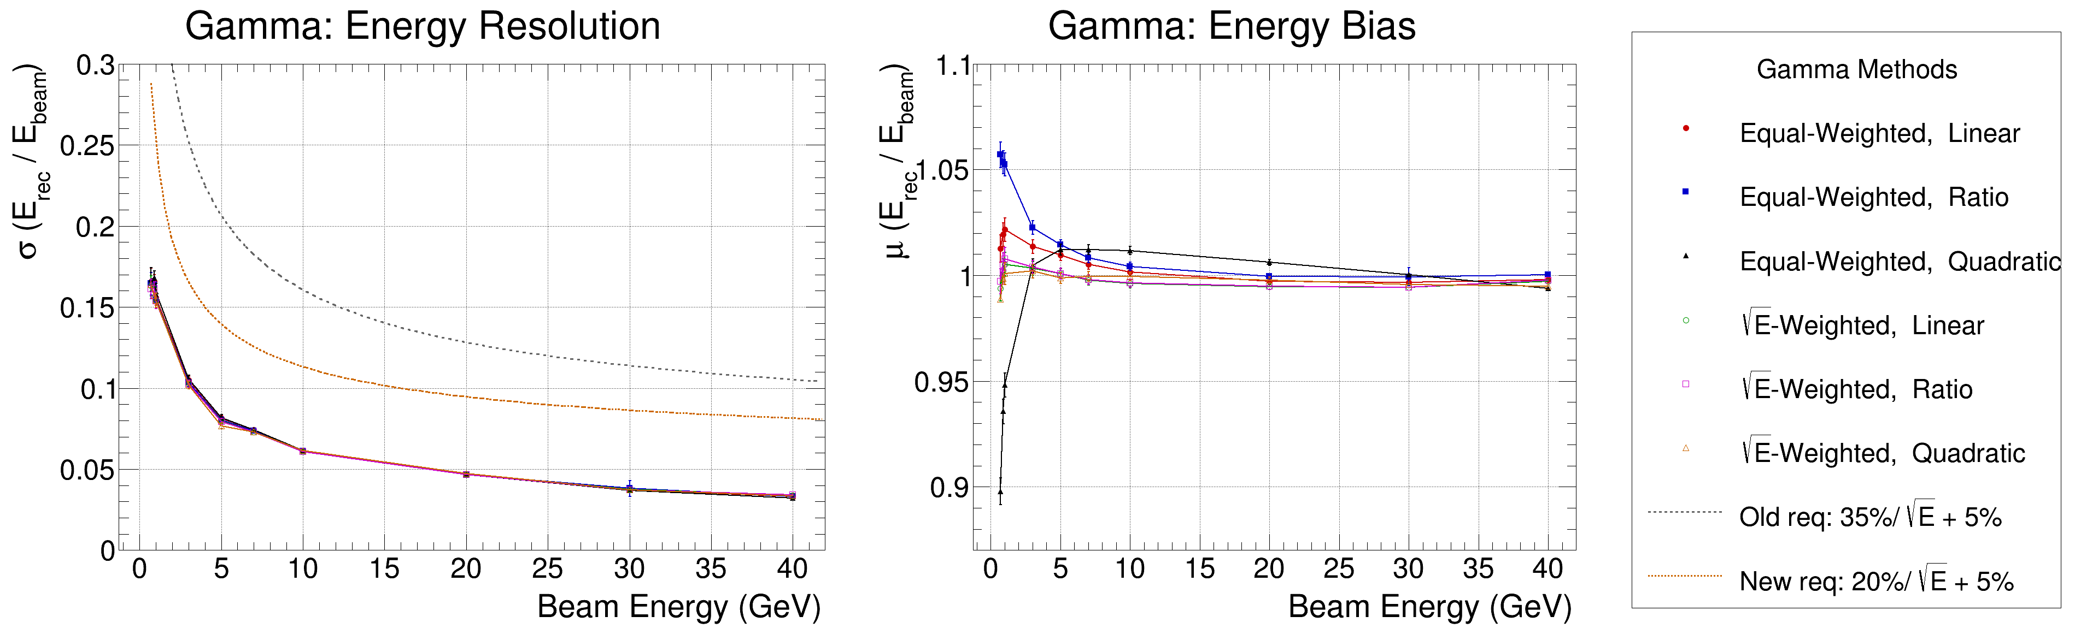
Gamma: Resolution & Bias (0.7 – 40 GeV)
Resolution (left panel):
y = sigma from DCB fit, x = E_beam.
Dashed lines = requirement curves sigma = p0/sqrt(E) + 0.05.
All methods fall below the new requirement (p0 = 0.20).
Detector passes for gamma.
Bias (centre panel):
y = mu from DCB fit, ideal = 1.0.
All methods within 0.90 – 1.06 across full energy range.
Small dip at 0.7 GeV for quadratic equal-weighted (m2 w0).
Gamma bias is well-controlled for all methods.
2026/06/24
ZDC Energy Reconstruction
7/9

Slide 8
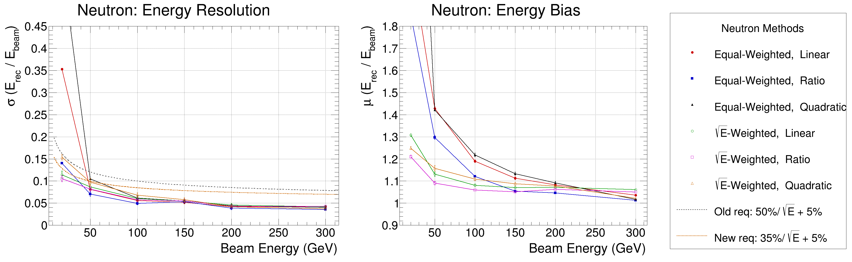
Neutron: Resolution & Bias (20 – 300 GeV)
Resolution (left panel):
y = sigma from DCB fit, x = E_beam.
sqrt(E)-weighted methods (open markers) meet the new requirement
(p0 = 0.35) at most energies.
Equal-weighted methods are worse, especially below 50 GeV.
Bias (centre panel):
Equal-weighted: mu up to 2 – 3.5 at 20 GeV.
Regression dominated by high-E events, fails at low energy.
sqrt(E)-weighted: mu = 1.1 – 1.3 at 20 GeV. Far more controlled.
sqrt(E) weighting is the recommended method for neutrons.
2026/06/24
ZDC Energy Reconstruction
8/9

Slide 9
Observations & Outlook
Observations
Gamma
All 6 methods meet the new resolution requirement
(20%/sqrt(E) + 5%) across 0.7 – 40 GeV.
Bias controlled within +/- 6% for all methods.
Linear and quadratic perform similarly.
Ratio method slightly worse at low energy.
Neutron
sqrt(E)-weighted methods are clearly superior.
Equal-weighted bias reaches 3.5x at 20 GeV — unreliable.
sqrt(E)-weighted bias stays below 1.35x across all energies.
Resolution close to new requirement (35%/sqrt(E) + 5%);
may need tuning at low energies.
Outlook
Optimise neutron at low energy
20–50 GeV range shows largest bias and worst resolution. Consider energy-dependent regression or neural-network approach.
Validate with full GEANT4 simulation
Current MC is idealized geometry. Full simulation with beam backgrounds, crossing angle, and realistic digitization will stress-test results.
Extend to ML regression
Linear regression is a baseline. Networks using ECAL+HCAL hit maps (not just sums) could reduce sigma and bias further.
2026/06/24
ZDC Energy Reconstruction
9/9

