Slide 1
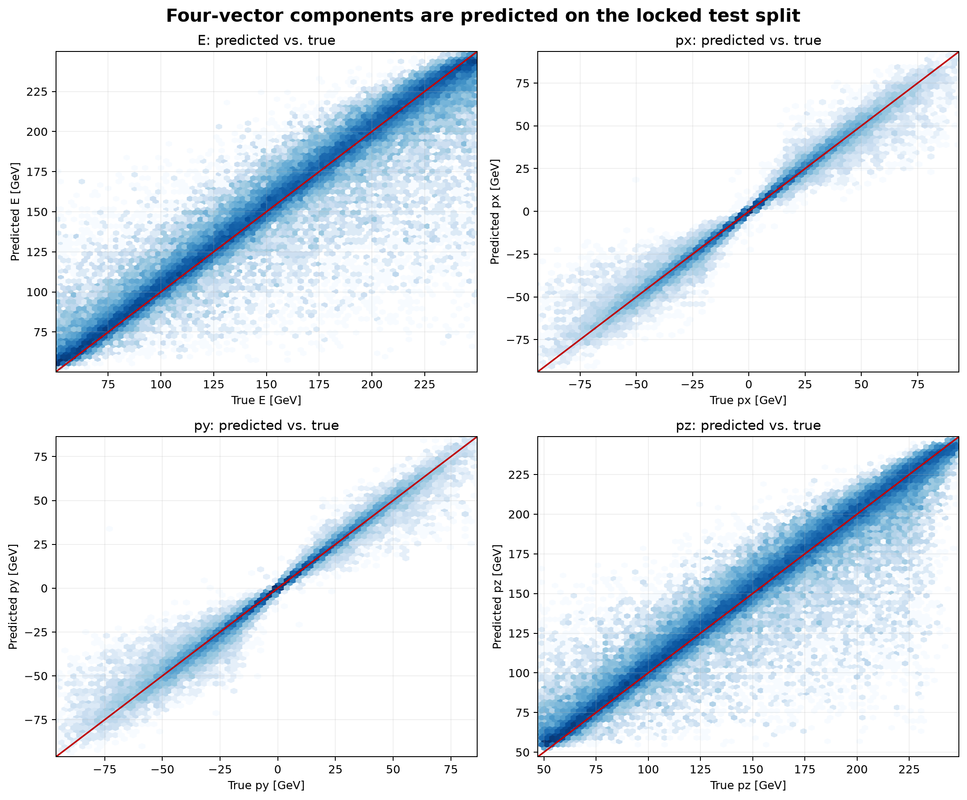
ASIoP ZDC
All-model
HEP analysis
Archived ML ZDC all results, ML ZDC all 1 results, historical Vertex runs, and the direct-kinetic-MSE retrain
Simulation study: single-neutron ZDC reconstruction of (E, px, py, pz)
Focus range: 50-250 GeV
Sources: ML ZDC all archive + ML ZDC all 1 Vertex artifacts
1

Slide 2
STUDY MAP
The two folders are linked by a shared finalfix2 artifact set
ML ZDC all
ML ZDC all 1
finalfix2
raw-K retrain
Archived presentation bundle: finalfix2 model, plots, loss curves, pencil-beam comparison.
>
Source, locked data contract, expanded diagnostics, historical Vertex run records.
>
The same accepted M1 XGBoost focus-only model appears in both folders.
>
New Vertex output in ML ZDC all 1: direct kinetic-energy target, same event IDs.
Deck handling
What is included
The shared finalfix2 artifact is displayed once. Historical runs are labeled by run ID. The direct-K retrain is shown as a separate target-parameterization result.
Trained models with saved results: B0, B1, M2, log-target M1 focus/full support, direct-K M1 focus/full support, and the archived run-level variants. Pencil-beam is labeled as a different energy-only task.
The N1 dual-grid network, H1 blend, and G1 Deep Sets/GNN appear in the design record but have no saved model output or performance metric in the supplied artifacts.
ASIoP ZDC all-neutron reconstruction studies
2

Slide 3
EVENT CONTRACT
Common data, split, and scoring range
764,940
80/10/10
50-250
50,685
events in myTree;865
train / validation / locked test split
headline generator-energy range, GeV
focus-test events
Object
Recorded contract
Particle
Exactly one neutron per selected event, PDG 2112.
Detector inputs
Jagged ECAL/HCAL hit positions and deposited signals; position scale 0.1 to cm; signal scale 1.0 GeV.
Truth
mcPar_energy and mcPar_momX/Y/Z create E, px, py, pz targets. Truth is not an inference feature.
Features
195 archived scalar detector features: totals, hit counts, shower centroid/RMS, depth, axis/PCA, leakage and quality flags.
Evaluation
Macro RMS relative four-vector error on locked 50-250 GeV test rows; component metrics use final calibrated physical GeV outputs.
ASIoP ZDC all-neutron reconstruction studies
3

Slide 4
PHYSICS CONSTRAINT
Common on-shell neutron reconstruction
ECAL + HCAL hits
Feature builder
Model heads
Direction unit vector
On-shell projection
Four-vector
positions and deposited energies
>
fixed-length detector-only scalar vector
>
energy head plus direction heads
>
u_hat = v_hat / ||v_hat||
>
E_hat = K_hat + m_n; |p_hat| = sqrt(K_hat(K_hat+2m_n))
>
(E_hat, px_hat, py_hat, pz_hat)
Constraint
Expression
Neutron mass
m_n = 0.93956542052 GeV
Momentum
p_hat = |p_hat| u_hat
Shell check
E_hat^2 - px_hat^2 - py_hat^2 - pz_hat^2 - m_n^2 = 0 up to floating-point precision
Reported numerical check
The finalfix2 focus-test maximum mass-shell residual is 3.277e-11 GeV^2. The raw-K retrain value is 2.550e-11 GeV^2.
ASIoP ZDC all-neutron reconstruction studies
4

Slide 5
MODEL FAMILIES
Trained candidates in the archived studies
ID
Model
Energy head
Direction / output
Saved status
B0
Visible-sum + axis baseline
positive linear ECAL+HCAL visible signal
analytic shower axis; on-shell
validation and test artifacts
B1
Ridge constrained baseline
regularized linear scalar-feature head
three unit-direction components; on-shell
validation and historical-champion artifacts
M2
Ridge direct four-vector diagnostic
four direct linear outputs
direction from predicted p; projected on shell
diagnostic validation artifact
M1 log
XGBoost focus-only / full-support
log1p(K)
ux, uy, uz tree heads; calibrated on shell
finalfix2 archived results
M1 raw
XGBoost focus-only / full-support
K in GeV
ux, uy, uz tree heads; calibrated on shell
raw-kinetic-MSE Vertex result
N1 / H1 / G1
dual-grid network / blend / GNN
design record only
no trained artifact or metric in supplied folders
not measured
ASIoP ZDC all-neutron reconstruction studies
5

Slide 6
XGBOOST VARIANTS
Measured M1 target and support variants
Variant
Energy target used by XGBoost
Training rows
Support weighting
Direction target
M1 log focus-only
log1p(K)
50-250 GeV focus only
focus bins balanced
ux, uy, uz
M1 log full-support
log1p(K)
0-300 GeV
shoulder events weighted 0.25
ux, uy, uz
M1 raw focus-only
K [GeV]
50-250 GeV focus only
focus bins balanced
ux, uy, uz
M1 raw full-support
K [GeV]
0-300 GeV
shoulder events weighted 0.25
ux, uy, uz
Squared-error training
Shared postprocessing
Each XGBoost head uses reg:squarederror. The log-target energy loss is squared error in log1p(K); the raw-target energy loss is squared error in K [GeV].
Both target choices normalize the direction and rebuild an on-shell four-vector. Locked-test component metrics are evaluated after this reconstruction and energy calibration.
ASIoP ZDC all-neutron reconstruction studies
6

Slide 7
MODEL OPERATION
Four scalar heads before physics reconstruction
x
f_E(x)
f_x/y/z(x)
K_hat, v_hat
u_hat
p_hat^mu
195 engineered hit features
>
energy head: log1p(K) or K
>
three direction-component heads
>
decode energy; stack direction components
>
normalize direction vector
>
rebuild (E, px, py, pz) on shell
Stage
Formula
log target decode
K_hat = max(expm1(f_E(x)), 0)
raw target decode
K_hat = max(f_E(x), 0)
direction
u_hat = v_hat / ||v_hat||
energy and momentum
E_hat = K_hat + m_n; p_hat = sqrt(K_hat(K_hat + 2m_n)) u_hat
ASIoP ZDC all-neutron reconstruction studies
7

Slide 8
LOG-TARGET CANDIDATES
Validation macro RMS relative four-vector error
Same 50-250 GeV validation focus events; archived finalfix2 candidate table.
Candidate
Energy rel. RMSE
Energy MAE [GeV]
B0_visible_sum_axis
0.2509
24.75
B1_ridge_constrained
0.2700
19.95
M2_ridge_direct_projected
0.2146
17.26
M1_xgb_focus_only
0.1515
11.28
M1_xgb_full_support
0.1584
12.27
M2 is a direct-four-vector diagnostic and is marked non-deployable in the archived validation table.
ASIoP ZDC all-neutron reconstruction studies
8

Slide 9
DIRECT-K CANDIDATES
Validation macro RMS relative four-vector error
Same 50-250 GeV validation focus events; raw-kinetic-MSE Vertex candidate table.
Candidate
Energy rel. RMSE
Energy MAE [GeV]
B0_visible_sum_axis
0.2509
24.75
B1_ridge_constrained
0.2144
17.97
M2_ridge_direct_projected
0.2146
17.26
M1_xgb_focus_only
0.1662
11.49
M1_xgb_full_support
0.1629
11.86
The raw-target XGBoost model file is stored as kinetic_energy.json; the log-target model file is stored as log1p_kinetic.json.
ASIoP ZDC all-neutron reconstruction studies
9

Slide 10
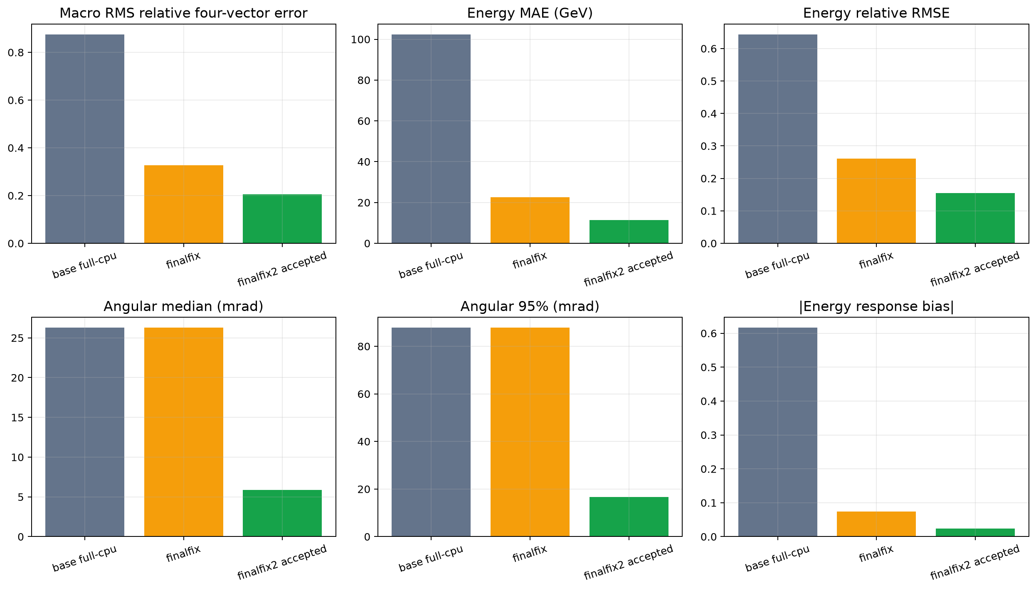
VERTEX RUN HISTORY
Saved focus-test metrics across base, finalfix, and finalfix2 runs
Run
Champion
Macro RMS
E MAE GeV
Angular 68 mrad
base full-cpu
B1_ridge_constrained
0.8754
102.41
39.46
finalfix
B1_ridge_constrained
0.3277
22.62
39.46
finalfix2 accepted
M1_xgb_focus_only
0.2044
11.48
7.98
Run labels
base full-cpu and finalfix selected B1 ridge constrained. finalfix2 selected M1 XGBoost focus-only. All values are archived locked focus-test metrics.
ASIoP ZDC all-neutron reconstruction studies
10

Slide 11
ACCEPTED LOG-TARGET RESPONSE
Finalfix2 predicted-versus-true component densities
Final calibrated physical components on the locked focus test. The red line is the identity reference in each panel.
ASIoP ZDC all-neutron reconstruction studies
11

Slide 12
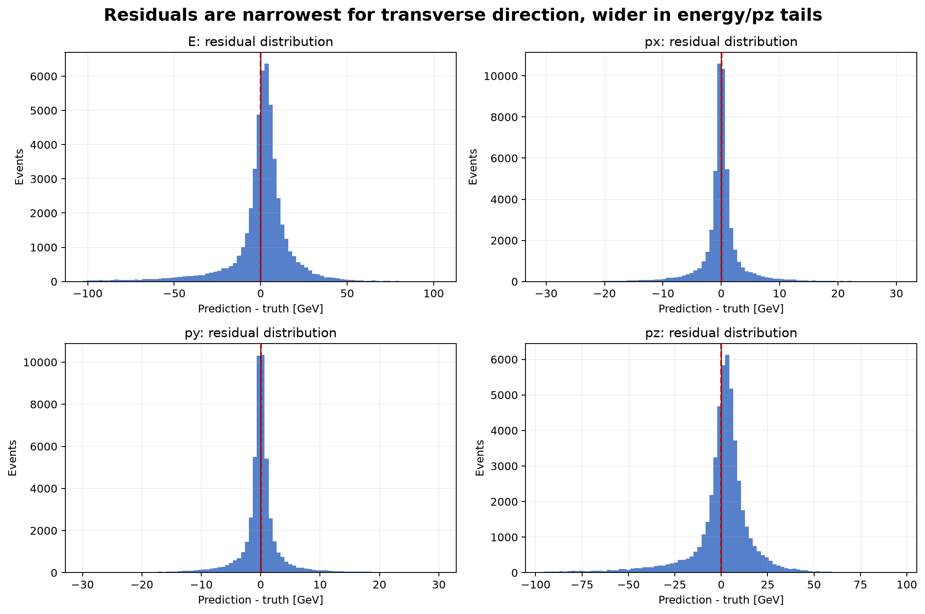
ACCEPTED LOG-TARGET RESIDUALS
Energy and longitudinal residuals occupy wider GeV ranges
Component
MAE [GeV]
RMSE [GeV]
R2
p95 abs. error [GeV]
E
11.48
20.06
0.879
42.86
px
2.37
5.06
0.968
9.85
py
2.38
5.06
0.967
10.11
pz
10.89
18.81
0.887
40.24
Definition
These are final calibrated physical GeV residuals: component prediction minus component truth. No log-energy values are used in this table.
ASIoP ZDC all-neutron reconstruction studies
12

Slide 13
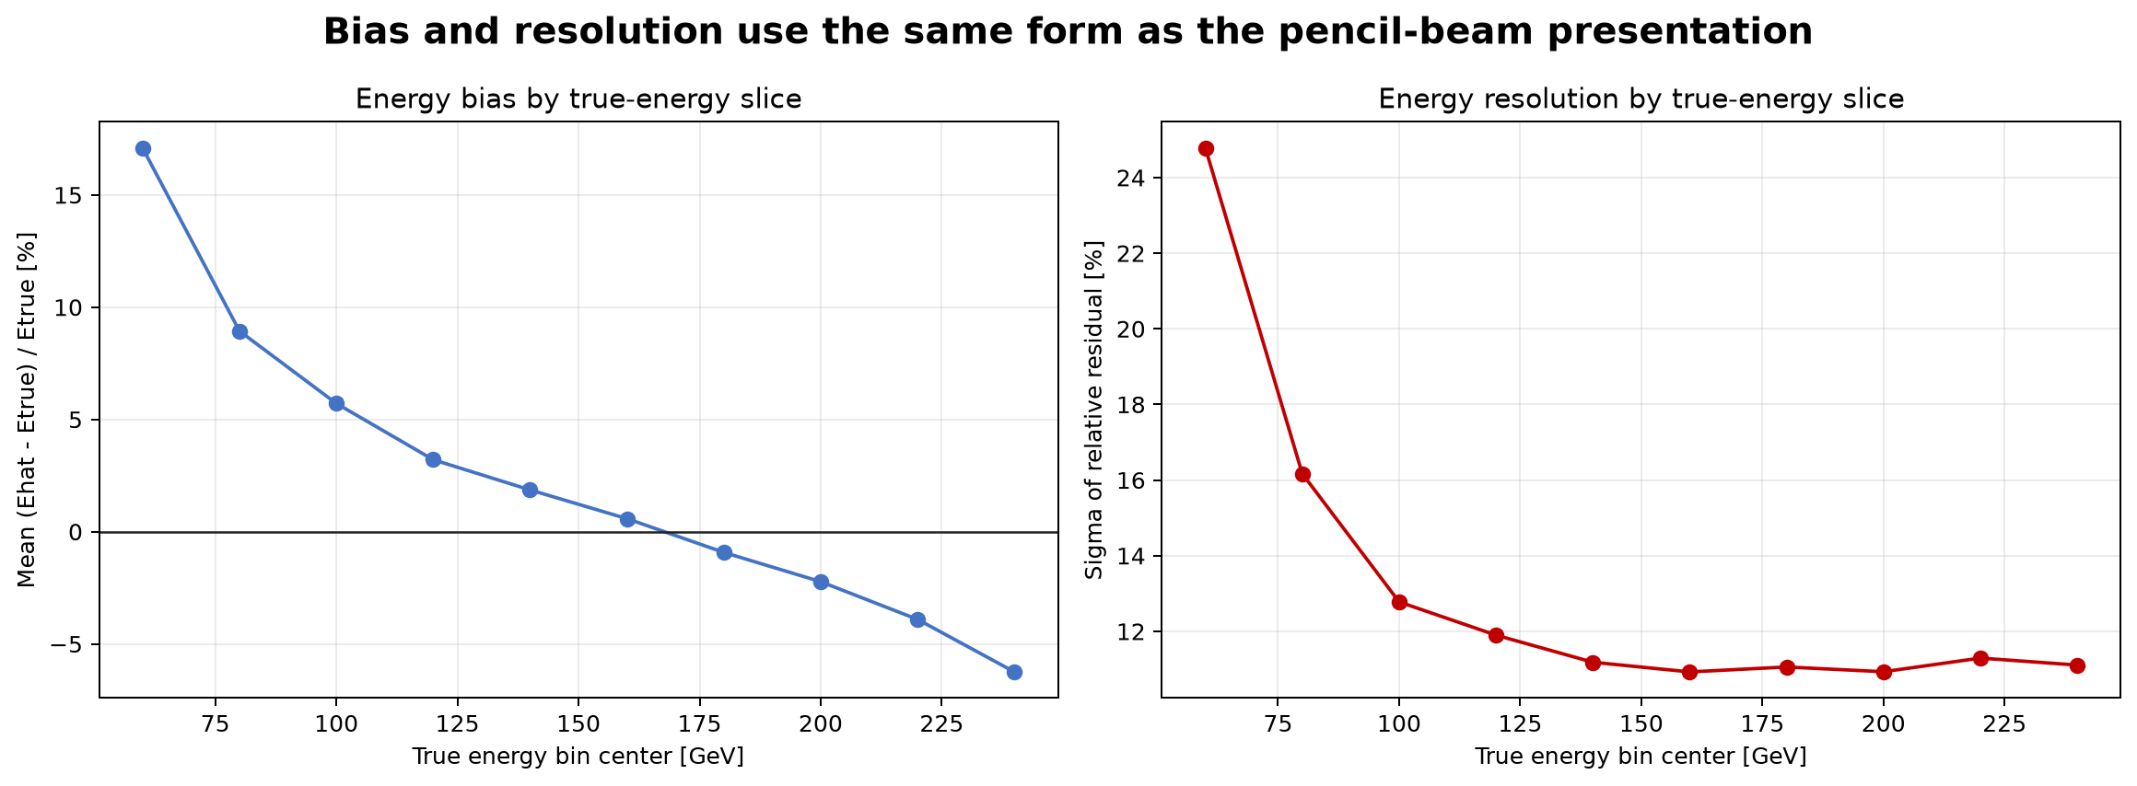
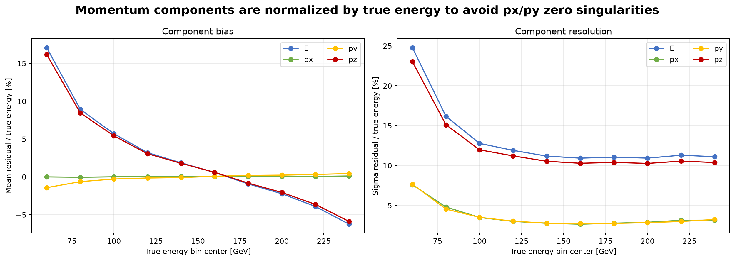
SLICE DIAGNOSTICS
Focus-bin energy and component behavior
Focus-bin edges: 50, 75, 100, 125, 150, 175, 200, 225, 250 GeV. Macro scoring averages the bin-level RMS values.
ASIoP ZDC all-neutron reconstruction studies
13

Slide 14
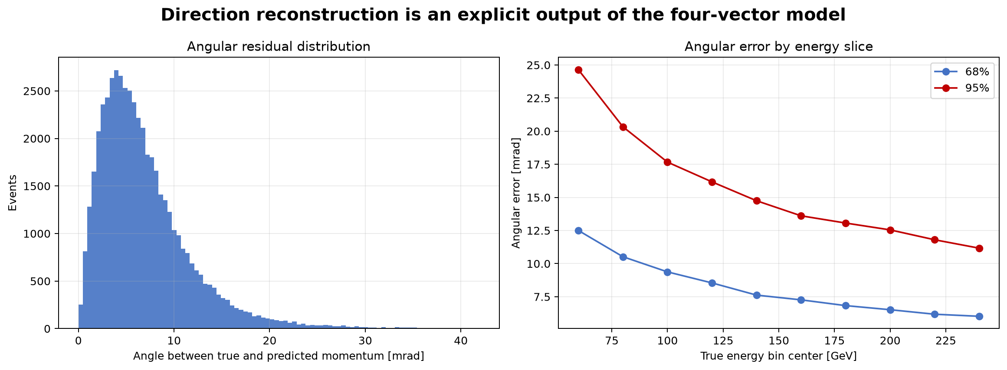
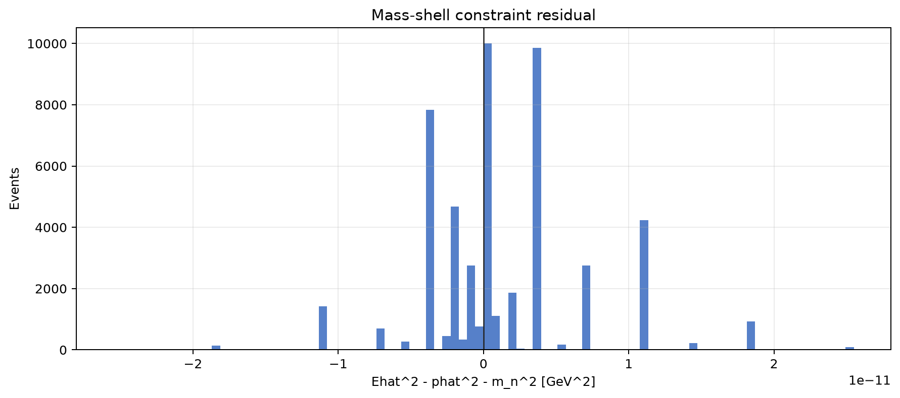
DIRECTION AND SHELL QA
Angular residuals and mass-shell closure are separate checks
5.87 mrad
16.62 mrad
3.28e-11
accepted median angular error
accepted angular 95%
accepted max shell residual, GeV^2
ASIoP ZDC all-neutron reconstruction studies
14

Slide 15
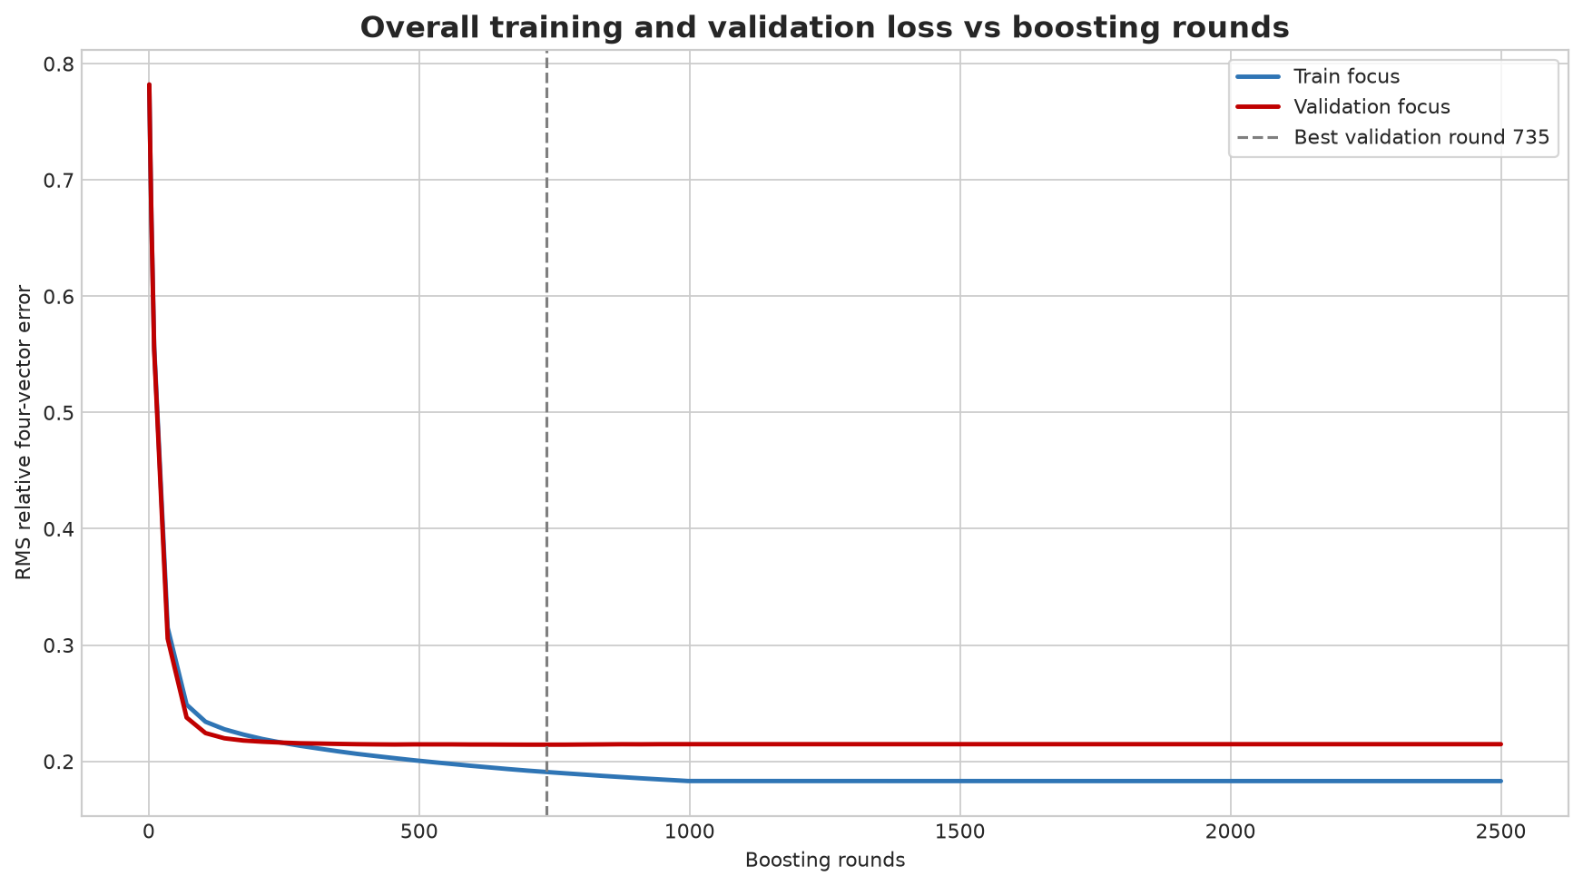
BOOSTING HISTORY
Boosting loss versus rounds
Overall relative four-vector RMS diagnostic from the archived Vertex loss-curve job.
Quantity
Best validation round
Validation RMSE
Train RMSE at that round
overall relative four-vector
735
0.2143
0.1908
E [GeV]
980
20.408
17.719
px [GeV]
2499
5.178
5.987
py [GeV]
2499
5.208
5.837
pz [GeV]
980
19.136
16.595
The overall curve is a physics-space diagnostic. It is distinct from the native XGBoost head target RMSE.
ASIoP ZDC all-neutron reconstruction studies
15

Slide 16
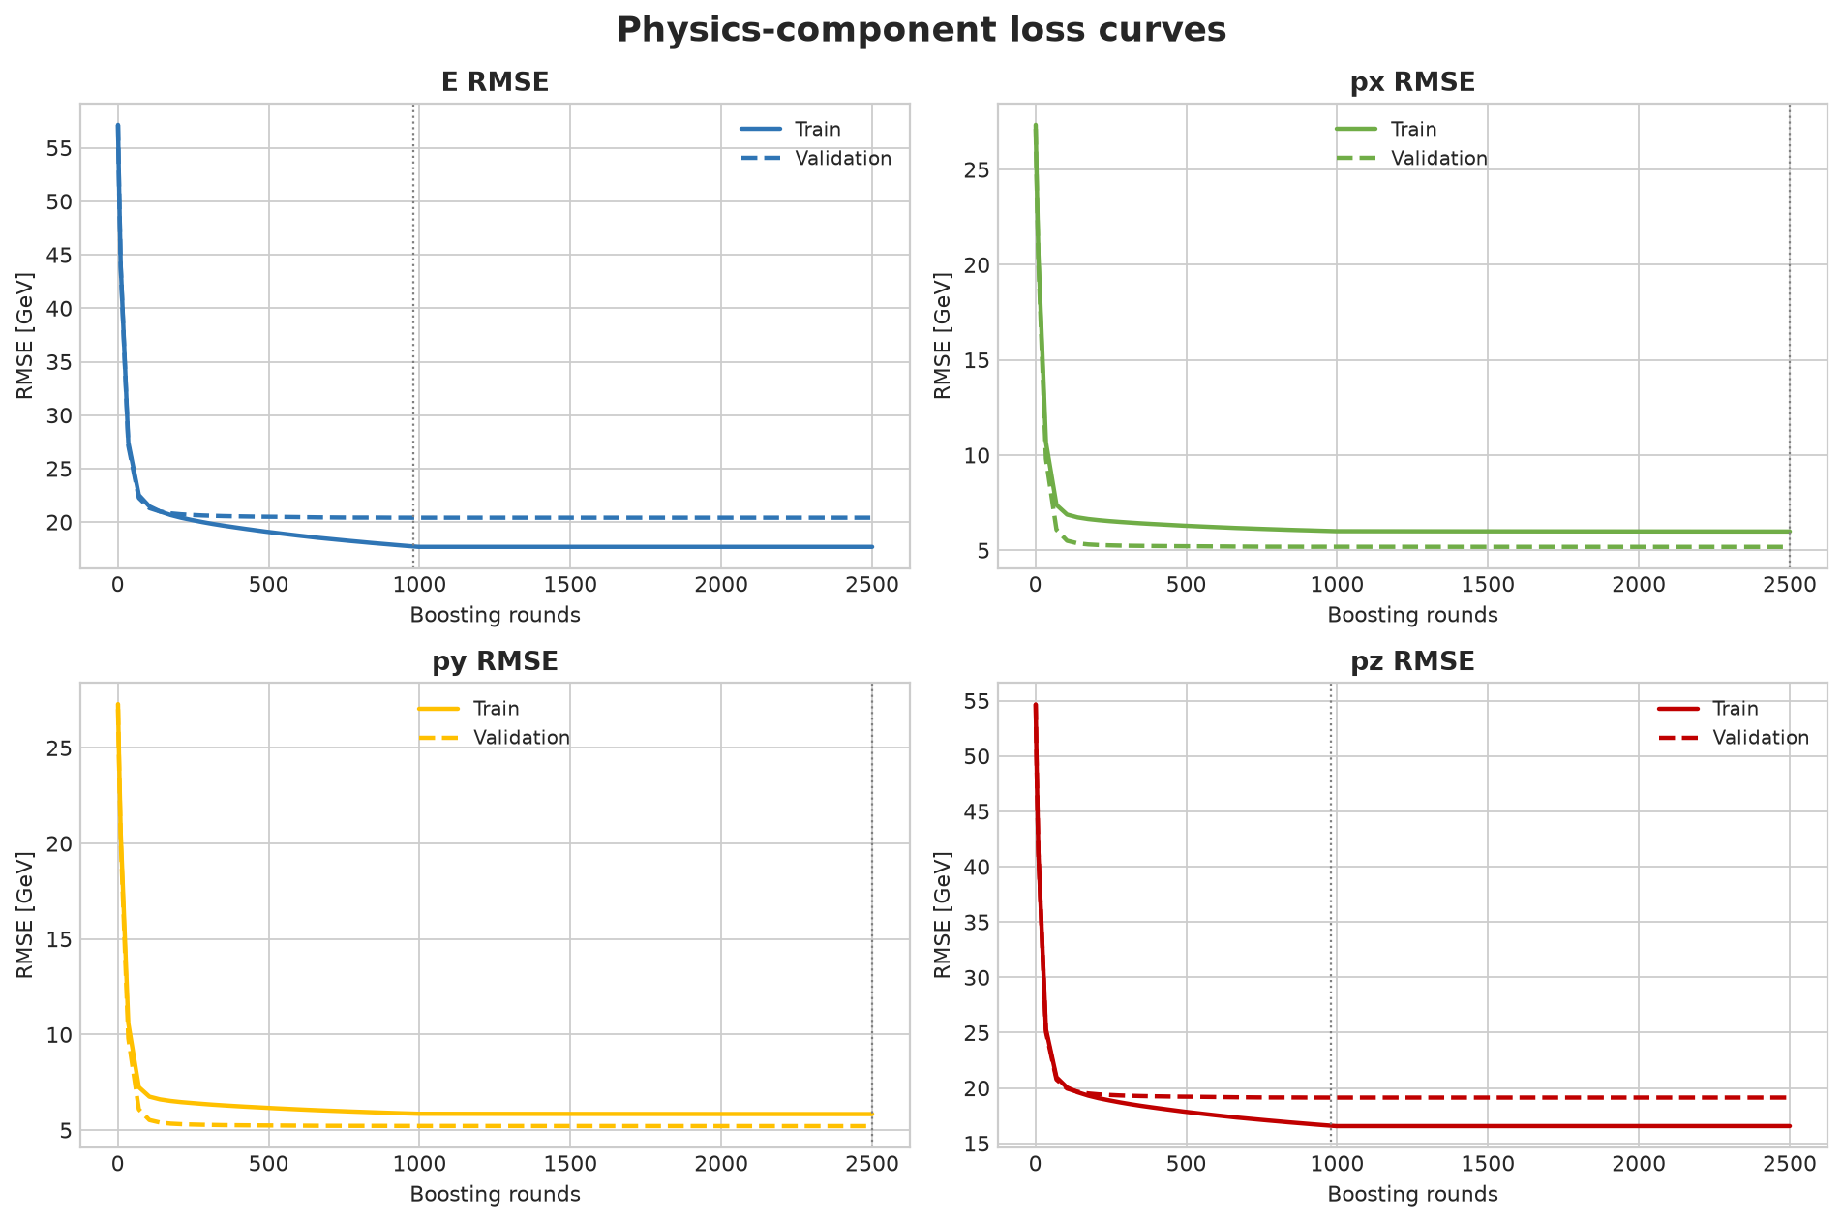
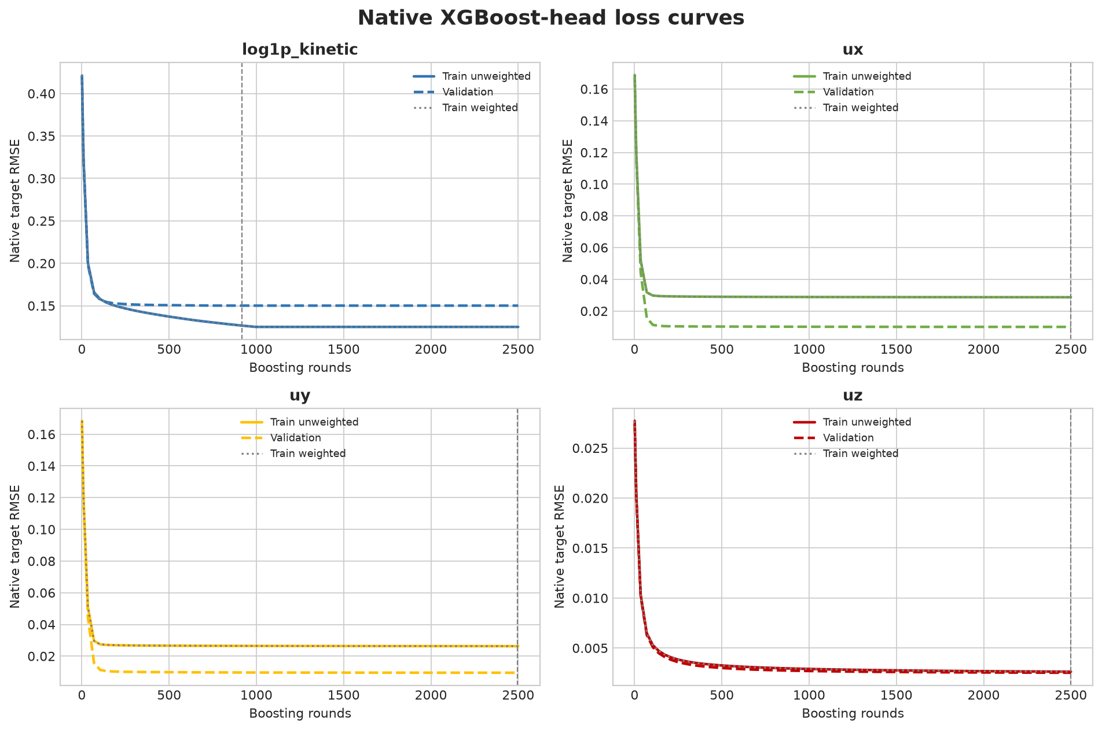
BOOSTING HISTORY
Component and native-head learning curves
Left: final physical-component RMSE in GeV. Right: native head RMSE for log1p(K), ux, uy, and uz. The axes therefore have different units and are not directly interchangeable.
ASIoP ZDC all-neutron reconstruction studies
16

Slide 17
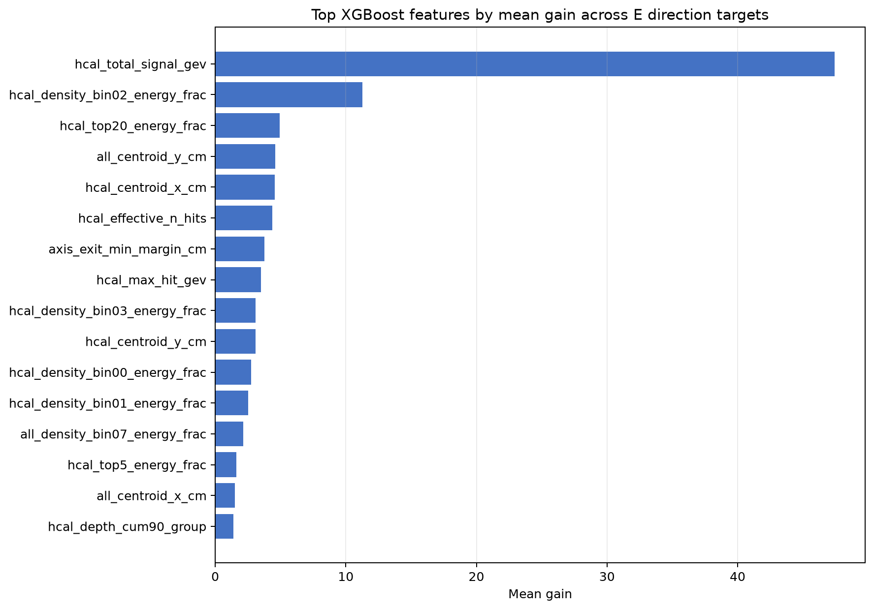
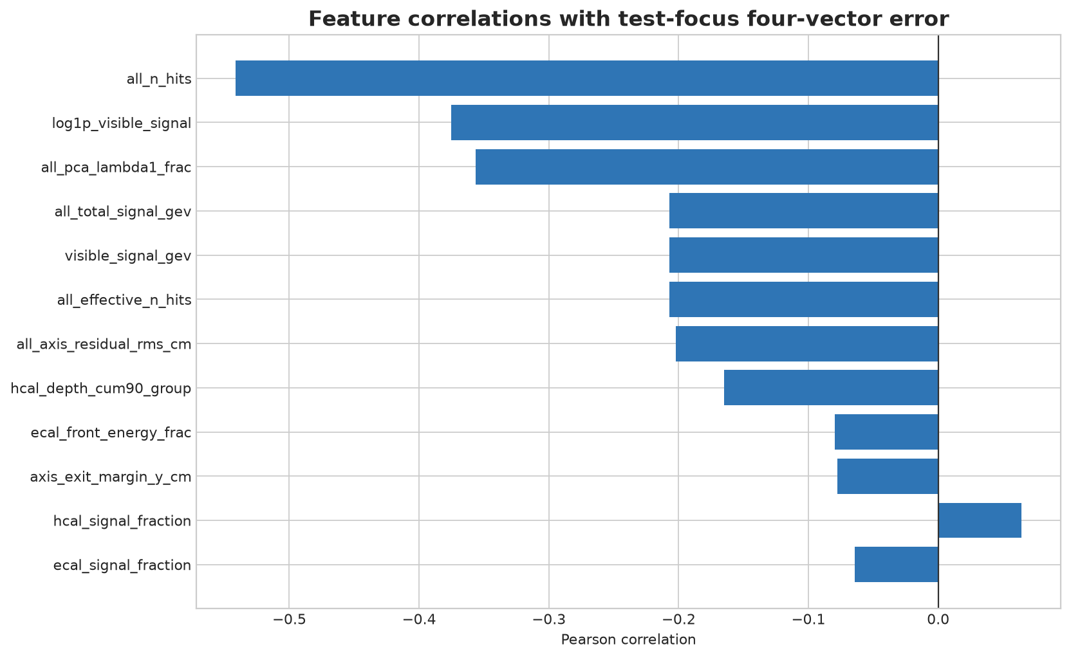
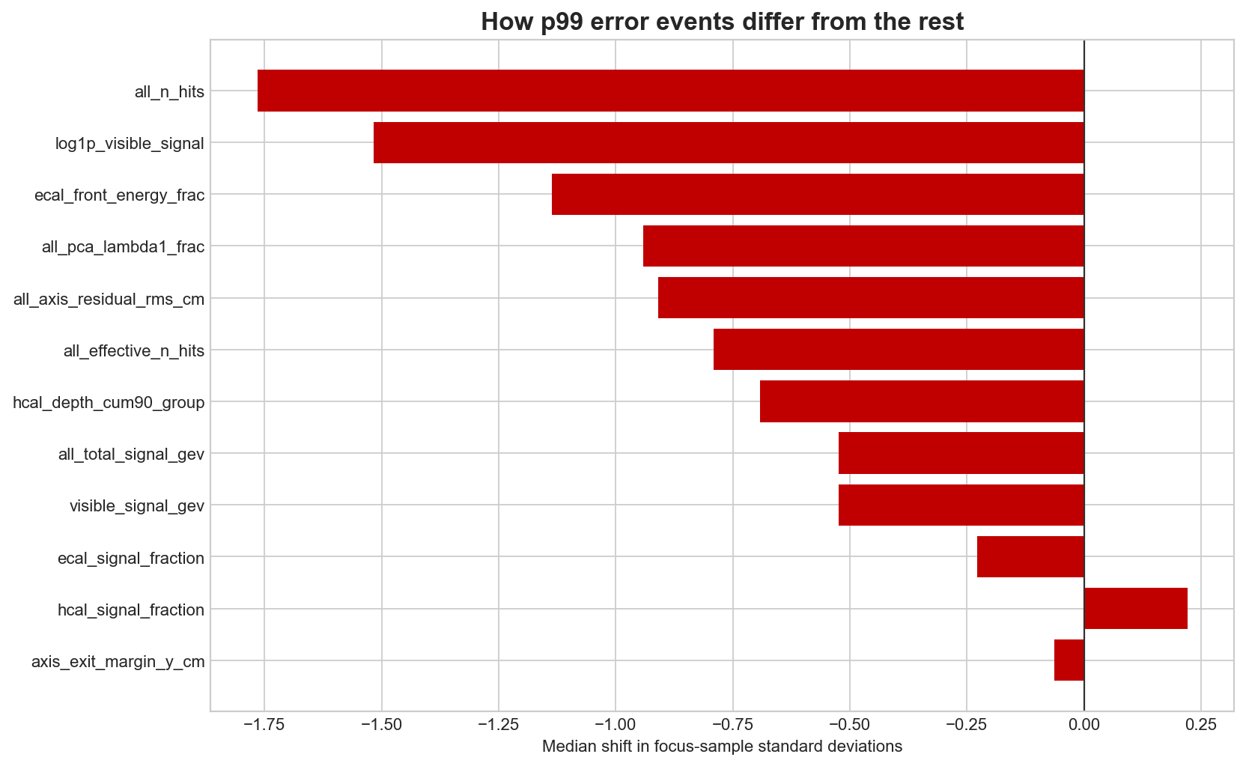
FEATURE DIAGNOSTICS
Saved feature-gain and error-association views
The gain chart is an XGBoost split-usage summary. Correlations and tail contrasts are descriptive associations computed on the test focus population.
ASIoP ZDC all-neutron reconstruction studies
17

Slide 18
TARGET COMPARISON
Direct-K and log-target final physical RMSE
Both rows use the same calibrated locked focus-test event IDs. Values are GeV, not training-space target units.
Component values: E RMSE 20.059 / 19.926, px 5.062 / 5.026, py 5.059 / 5.024, pz 18.811 / 18.690 GeV for log / direct-K respectively.
ASIoP ZDC all-neutron reconstruction studies
18

Slide 19
TARGET COMPARISON
Normalized component metrics and tolerance fractions
Normalization is residual divided by true total energy, avoiding a singular px/py component denominator near zero.
R2 values are also recorded: log/direct E 0.8789/0.8805, px 0.9676/0.9681, py 0.9671/0.9676, pz 0.8872/0.8887.
ASIoP ZDC all-neutron reconstruction studies
19

Slide 20
ENERGY RESPONSE COMPARISON
Binned energy response and relative RMSE
Eight 25-GeV focus bins. Both curves are built from final calibrated test predictions on the same event IDs.
ASIoP ZDC all-neutron reconstruction studies
20

Slide 21
TARGET COMPARISON
Exact locked focus-test component metrics
Physical GeV quantities after calibration and on-shell reconstruction; n = 50,685 for both rows.
Component
Target
MSE GeV^2
RMSE GeV
MAE GeV
Norm. RMSE
R2
within 10% E_true
E
log1p(K)
402.369
20.059
11.480
0.15435
0.8789
75.127%
E
direct K
397.044
19.926
11.419
0.16470
0.8805
75.997%
px
log1p(K)
25.619
5.062
2.370
0.03891
0.9676
96.881%
px
direct K
25.263
5.026
2.383
0.04168
0.9681
96.747%
py
log1p(K)
25.597
5.059
2.375
0.03911
0.9671
96.685%
py
direct K
25.242
5.024
2.388
0.04214
0.9676
96.514%
pz
log1p(K)
353.842
18.811
10.891
0.14468
0.8872
76.220%
pz
direct K
349.318
18.690
10.826
0.15418
0.8887
77.023%
The direct-K row is trained with squared error in kinetic energy. The log-target row is trained with squared error in log1p(K), but all values above use reconstructed total energy and momentum in GeV.
ASIoP ZDC all-neutron reconstruction studies
21

Slide 22
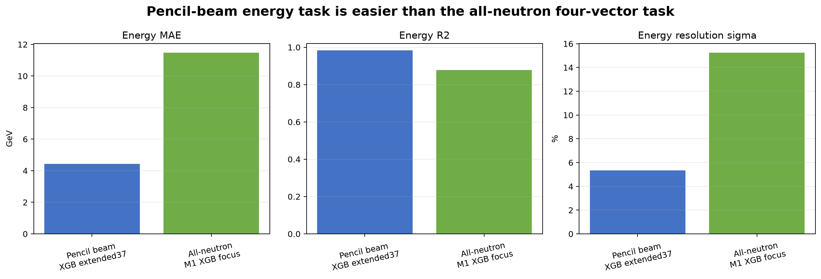
SCOPE COMPARISON
Pencil-beam and all-neutron scopes
Dataset/model
Scope
Energy MAE [GeV]
Energy RMSE [GeV]
Energy R2
Pencil beam
100k neutrons, 50-250 GeV, energy-only
4.425
7.365
0.9838
All neutron
765k broad-angle neutrons, focus 50-250 GeV, E+px+py+pz
11.480
20.059
0.8789
Task boundary
The pencil-beam comparison is retained as an energy-only reference. It does not provide px, py, pz, angular, or four-vector metrics and is not merged into the all-neutron model ranking.
ASIoP ZDC all-neutron reconstruction studies
22

Slide 23
CALIBRATION AND COVERAGE
Locked-test interval coverage
Model
Nominal
Validation abs-energy width [GeV]
Focus-test coverage
finalfix2 log target
68%
10.017
68.077%
finalfix2 log target
90%
27.994
90.212%
finalfix2 log target
95%
43.114
95.056%
direct-K retrain
68%
stored calibration
68.200%
direct-K retrain
90%
stored calibration
90.038%
direct-K retrain
95%
stored calibration
95.178%
Procedure
Coverage label
A linear energy calibration is fitted after validation model selection. The direction is retained, kinetic energy is recomputed, and the output is projected on shell before test scoring.
These are empirical validation-residual intervals verified once on test. They are not presented as a separate formal split-conformal guarantee.
ASIoP ZDC all-neutron reconstruction studies
23

Slide 24
RECORD
Artifacts, metrics, and model status in one view
Artifact class
Location
What it contains
Archived finalfix2
ML ZDC all / outputs/presentation_analysis/all_neutron_finalfix2
candidate models, calibrated predictions, validation leaderboard, locked test metrics, plots
Loss-curve extension
ML ZDC all / outputs/presentation_analysis/loss_curves_vertex
overall/component/native losses, feature-error diagnostics, slice diagnostics
Historical Vertex runs
ML ZDC all 1 / outputs/reports/previous_vertex_jobs
base full-cpu, finalfix, finalfix2 job records and metrics
Direct-K retrain
Vertex gs://.../runs/raw-kinetic-mse-20260713-51b0ff0/outputs
raw kinetic target models, calibration, locked test metrics, component comparison
Design-only entries
ML ZDC all 1 / docs/MODEL_DESIGN.md
N1 dual-grid, H1 blend, G1 Deep Sets/GNN definitions without archived training result
Presentation evidence: saved Vertex artifacts and archived diagnostic figures. No new model training is performed for this deck.
ASIoP ZDC all-neutron reconstruction studies
24

