Slide 1
ASIoP ZDC - FOUR-VECTOR RECONSTRUCTION
All-neutron ZDC model deep dive
Scalar-feature XGBoost model that reconstructs an on-shell neutron (E, px, py, pz) from ECAL/HCAL simulated hit deposits
Accepted Vertex result: M1_xgb_focus_only - focus range 50-250 GeV - 2026-07-11
github.com/JulianAttemptsCoding/ASIoP-ZDC-2
ASIoP ZDC - FOUR-VECTOR RECO
1

Slide 2
THE TASK
Reconstruct a neutron four-vector from calorimeter hits
What goes in
What comes out
Jagged ECAL and HCAL hit lists: x, y, z position plus hit energy deposit.
A total energy E_hat in GeV and three momentum components px_hat, py_hat, pz_hat.
Branch contract: ecal_posX/Y/Z, ecal_energy, hcal_posX/Y/Z, hcal_energy.
The output is forced back onto the neutron mass shell, so E_hat^2 - |p_hat|^2 = m_n^2.
Positions are converted to cm with scale 0.1; hit signals use scale 1.0 GeV.
Headline scoring uses the locked test subset from 50 to 250 GeV.
4
195
50,685
0.2044
model heads: log kinetic + ux + uy + uz
input scalar features from hits
locked focus-test events
macro RMS rel. 4-vector error
ASIoP ZDC - FOUR-VECTOR RECO - The task
2

Slide 3
BEFORE WE START
Key terms, in plain English
Term
Meaning for this deck
ZDC
Zero Degree Calorimeter: a forward detector that measures neutral particles close to the beam line.
ECAL / HCAL
Electromagnetic and hadronic sections. Neutrons mostly shower in HCAL, but ECAL still contributes geometry and early deposits.
Hit
One simulated detector cell/sampling spot with a position and energy deposit. Each event has a variable number of hits.
Feature
One fixed-length number derived from the hit cloud: total HCAL signal, shower centroid, depth profile, leakage proxy, and more.
Four-vector
The physics output (E, px, py, pz). It contains both energy and direction/momentum.
On shell
The output obeys the neutron mass relation. This keeps the prediction physically valid.
Boosting round
One more tree added to an XGBoost head. Curves vs boosting show learning and overfitting behavior.
Practical reading rule
When a plot says 'focus', it means generator energy in the 50-250 GeV headline range. 'All test' means the full 0-300 GeV test support.
ASIoP ZDC - FOUR-VECTOR RECO - Before we start
3

Slide 4
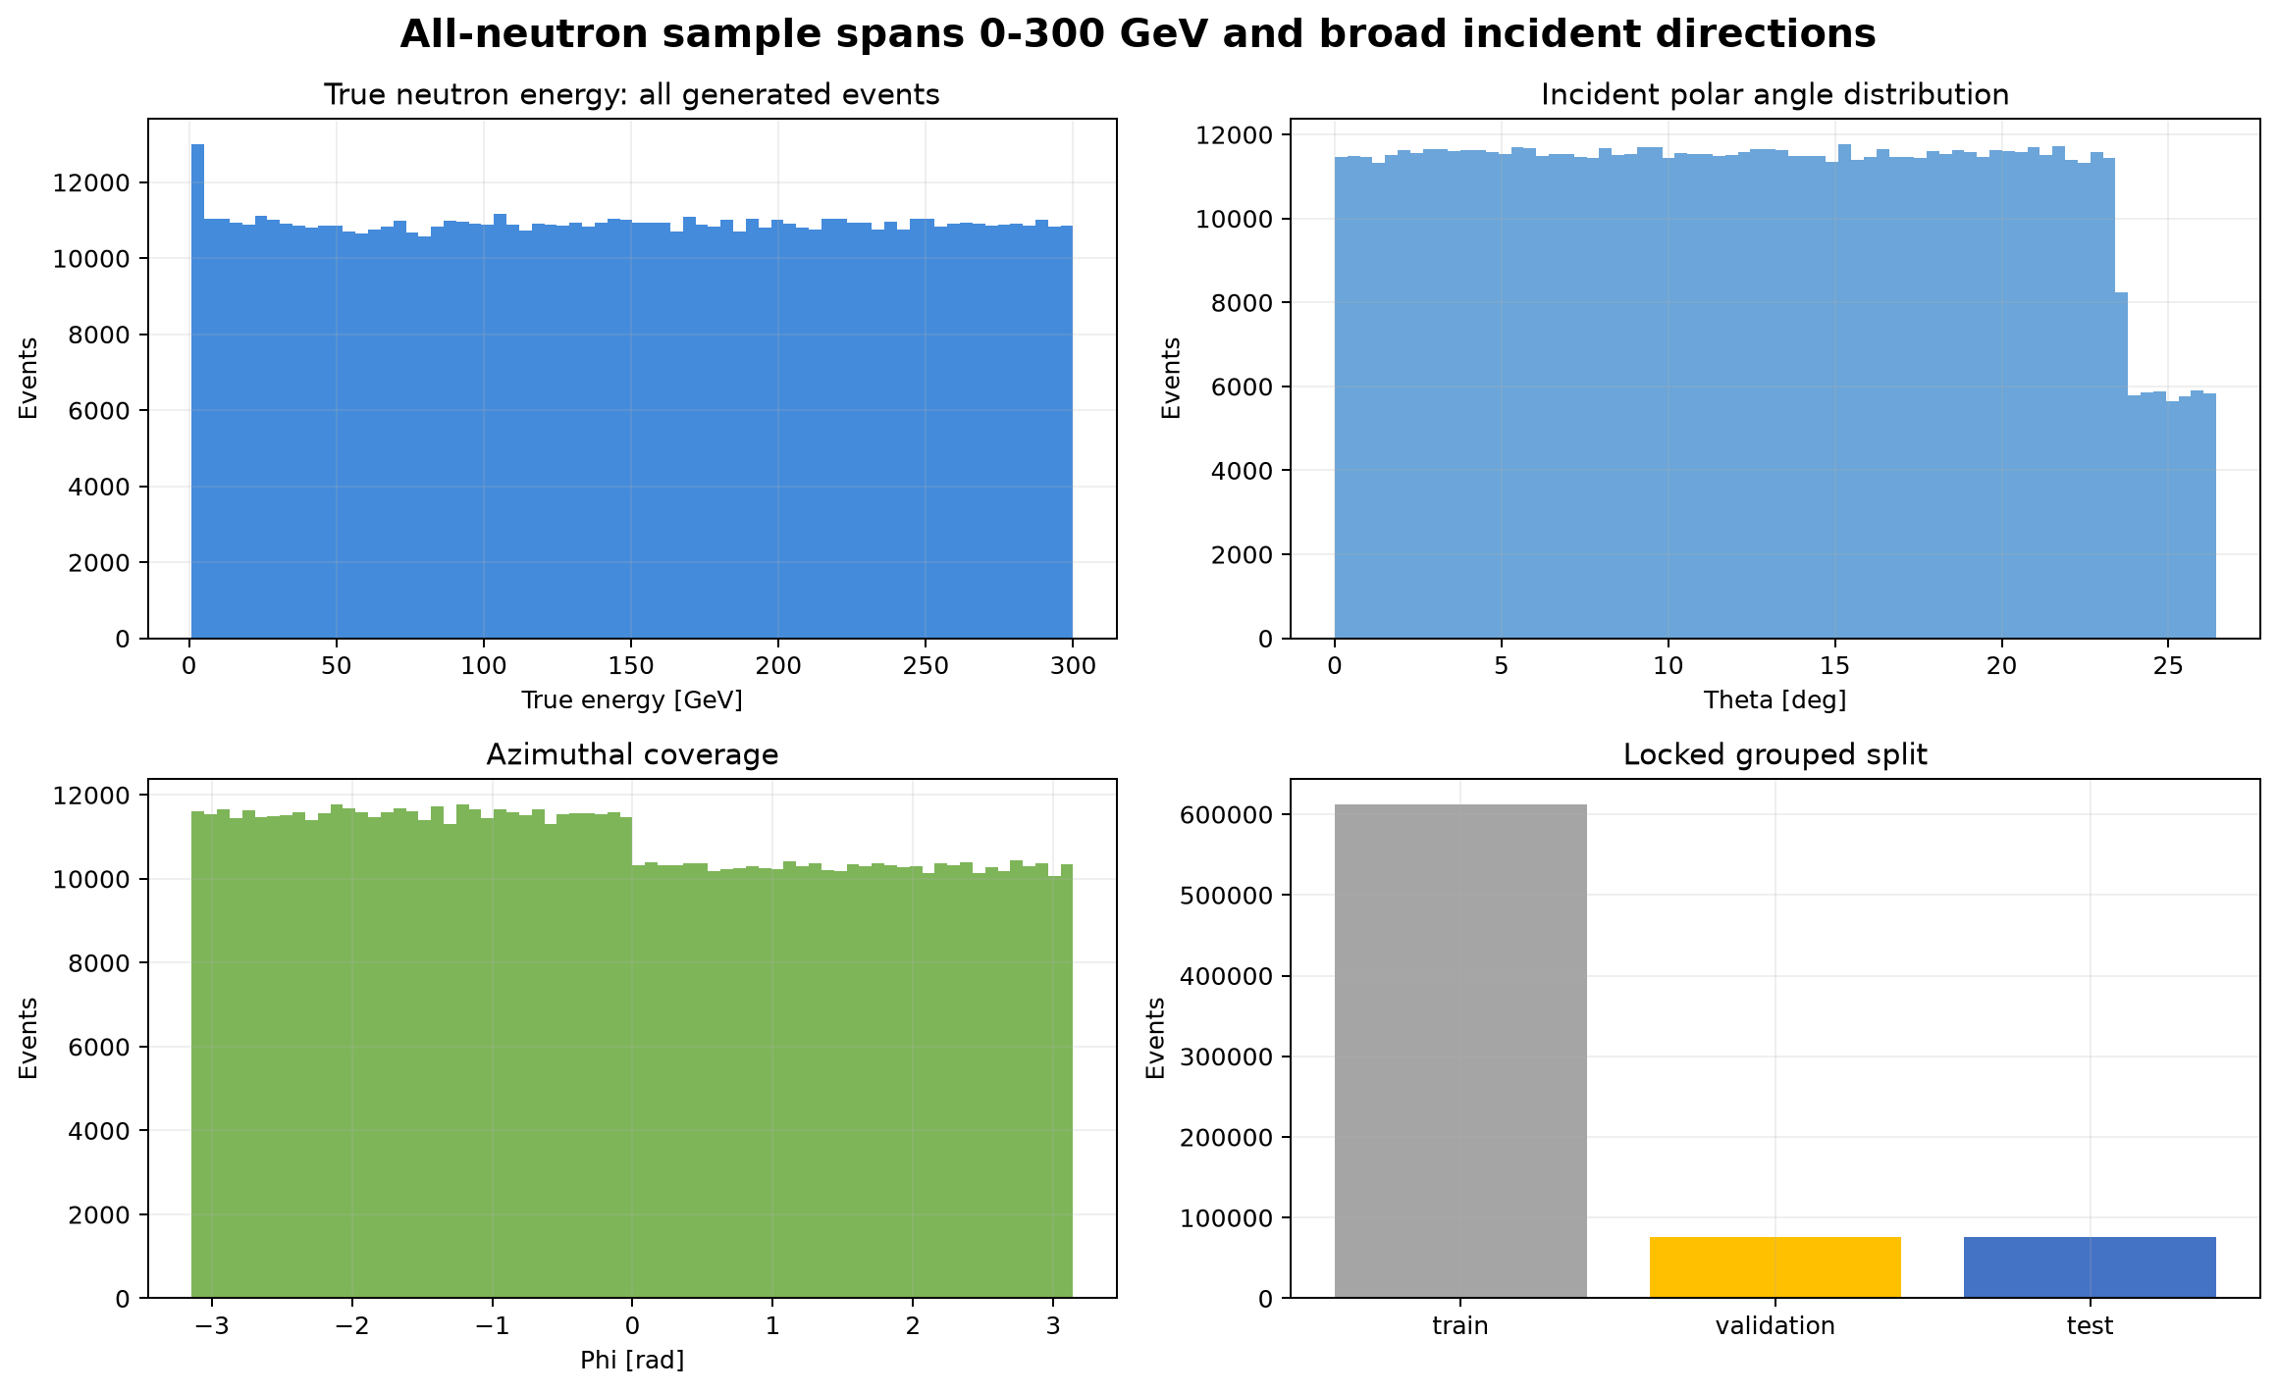
DATA
Dataset and split contract
The model uses the same ROOT object staged for Vertex and verified locally by size, CRC32C, and SHA-256.
764,940
25.02 GB
PDG 2112
entries in latest tree myTree;865
ROOT object size
one neutron per event
Split counts
Split
All 0-300 GeV
Focus 50-250 GeV
Train
612,825
408,276
Validation
76,010
50,626
Test
76,105
50,685
Data URI used by Vertex
gs://asiop-zdc-1-zdc-reco-us-central1/data/myTree_20251117_765k_0to300GeV_neutron_All.root
ASIoP ZDC - FOUR-VECTOR RECO - Data
4

Slide 5
DETECTOR INPUTS
ECAL and HCAL are resolved by branch names and geometry
Logical input
ROOT branch
Unit / role
ECAL hit position
ecal_posX, ecal_posY, ecal_posZ
global position; multiplied by 0.1 to cm
ECAL hit signal
ecal_energy
ideal simulated deposit, GeV scale 1.0
HCAL hit position
hcal_posX, hcal_posY, hcal_posZ
global position; multiplied by 0.1 to cm
HCAL hit signal
hcal_energy
ideal simulated deposit, GeV scale 1.0
Truth particle
mcPar_PDG, mcPar_energy, mcPar_momX/Y/Z
used only for targets and metrics
Cell IDs
ecal_cellID, hcal_cellID, hcal_LayerID
used for fingerprint and detector provenance
ECAL vs HCAL common sense
No truth leakage
The ecal_* branches are the electromagnetic calorimeter hit cloud; the hcal_* branches are the downstream hadronic calorimeter hit cloud. The locked detector frame points from ECAL center to HCAL center.
Features come from hit positions and calibrated hit signals. Truth branches are excluded from inference features and appear only in target building and scoring.
ASIoP ZDC - FOUR-VECTOR RECO - Detector inputs
5

Slide 6
PREFLIGHT QA
The run locks units, truth convention, and detector frame before training
2.48e-12
1.0
0.1 cm
0
median truth mass-shell residual
ECAL and HCAL signal scale to GeV
position scale applied to hit coordinates
negative hit signals allowed
Checks that matter
Every event has exactly one selected neutron; all selected particles are PDG 2112.
Locked local detector frame
origin = median ECAL center
z_axis = unit(HCAL center - ECAL center)
x/y axes = right-handed orthonormal basis
local_points = (global_points - origin) @ rotation.T
mcPar_energy is total energy in GeV, confirmed by E^2 - |p|^2 = m_n^2.
energySum_* evidence and prior accepted pipeline lock ecal_energy and hcal_energy as GeV hit deposits.
The local ROOT object and staged GCS object match by size/CRC32C/SHA-256; no duplicate upload was needed.
ASIoP ZDC - FOUR-VECTOR RECO - Preflight QA
6

Slide 7
PIPELINE
End-to-end path from ROOT file to final metrics
Inspect ROOT
Build targets
Make split
Build features
Train
Select/calibrate
Unlock test
branch map, truth convention, detector frame, data hash
>
single-neutron truth, kinetic energy, unit direction, event fingerprints
>
group-safe 80/10/10 split stratified by energy and angle
>
jagged ECAL/HCAL hits become 195 scalar features
>
baselines plus XGBoost focus/full-support candidates
>
validation-focus macro score, energy affine calibration
>
one final focus-test read, plots, verification
What is heavy compute?
ROOT scan, feature materialization, XGBoost training, and loss-curve jobs were run from Vertex/GCS outputs, not repeated locally.
Accepted Vertex prefix
gs://asiop-zdc-1-zdc-reco-us-central1/runs/full-cpu-20260710-finalfix2/outputs
Local work here is presentation/report generation and QA using saved metrics, predictions, and diagnostic figures.
Loss-curve prefix
gs://asiop-zdc-1-zdc-reco-us-central1/runs/loss-curves-20260711/outputs
ASIoP ZDC - FOUR-VECTOR RECO - Pipeline
7

Slide 8
FROM HITS TO FEATURES
The model sees fixed-length scalar summaries, not raw jagged arrays
Feature family
Examples
Why it helps
Energy totals
ecal_total_signal_gev, hcal_total_signal_gev, visible_signal_gev
First-order energy scale.
Hit intensity
max_hit_gev, effective_n_hits, top-N energy fractions
Separates diffuse and concentrated showers.
Centroid / RMS
centroid_x/y/z, rms_x/y/z
Encodes shower position and spread.
Depth profile
2 ECAL groups, 8 HCAL groups, cumulative depth quantiles
Captures shower start, peak, and back leakage.
Axis/PCA
line-fit slopes, axis_u, residual RMS, PCA eigenvalue fractions
Approximates incoming direction and shower elongation.
Leakage / boundary
axis_exit_x/y, exit margins, hcal_back_leakage_proxy
Flags events likely to leak out of the detector volume.
Quality flags
empty, degenerate, no_detector_signal
Makes zero/degenerate cases explicit instead of silent.
Feature count
The final manifest has 195 detector-only scalar features. All source branches are ECAL/HCAL hit positions/signals; truth features are disallowed.
ASIoP ZDC - FOUR-VECTOR RECO - From hits to features
8

Slide 9
FEATURE DISTRIBUTION
What the focus-test hit summaries look like
Feature
p05
median
p95
Plain reading
visible_signal_gev
0.68
2.91
14.48
Calorimeter deposits are much smaller than neutron total energy; regression is essential.
hcal_signal_fraction
0.11
0.92
1.00
Most visible signal sits in HCAL, as expected for neutrons.
all_n_hits
504
1,908
3,429
Each event is a large variable-length hit cloud.
hcal_back_energy_frac
0.00
0.00006
0.030
Back leakage is usually small but important for tails.
axis_exit_min_margin_cm
-24.19
4.02
27.16
Some fitted axes leave the detector footprint; margin is a risk feature.
Interpretation
The model is not doing simple E_visible -> E_true scaling. It combines visible energy with shower location, direction, depth development, concentration, and leakage proxies.
ASIoP ZDC - FOUR-VECTOR RECO - Feature distribution
9

Slide 10
THE MATH, PART 1
Training target: log kinetic energy plus true direction
Truth quantities
Target vector used by XGBoost
m_n = 0.93956542052 GeV
E_true = sqrt(px_true^2 + py_true^2 + pz_true^2 + m_n^2)
K_true = E_true - m_n
u_true = p_true / ||p_true|| = (ux, uy, uz)
y = [ log1p(K_true), ux_true, uy_true, uz_true ]
log1p(K) = log(1 + K)
Why log kinetic energy? It keeps low energy resolution visible
while still representing the full 0-300 GeV support.
Why not train E, px, py, pz directly?
Direct four-vector regression can produce physically impossible outputs that violate the neutron mass relation.
Target names in code
log1p_kinetic, ux, uy, uz. The saved champion model contains one XGBoost booster per target head.
Separating kinetic energy from direction gives the model an easier structure: one positive scale plus a unit vector.
The final conversion guarantees an on-shell neutron four-vector after calibration.
ASIoP ZDC - FOUR-VECTOR RECO - The math, part 1
10

Slide 11
THE MATH, PART 2
Prediction is projected back to an on-shell neutron
Raw model outputs
Physics projection
y_hat_K = model_K(features)
v_hat = [model_ux(features), model_uy(features), model_uz(features)]
K_hat_raw = max(expm1(y_hat_K), 0)
u_hat = v_hat / ||v_hat||
E_hat_raw = K_hat_raw + m_n
|p_hat| = sqrt(max(E_hat_raw^2 - m_n^2, 0))
p_hat = |p_hat| * u_hat
four-vector = (E_hat_raw, px_hat, py_hat, pz_hat)
Validation energy calibration
Mass-shell QA
E_hat_cal = max(0.988213 * E_hat_raw + 3.103, m_n)
direction is kept from p_hat_raw
p_hat_cal = sqrt(E_hat_cal^2 - m_n^2) * u_hat
source: validation focus after model selection
residual = E_hat^2 - px_hat^2 - py_hat^2 - pz_hat^2 - m_n^2
max |residual| on focus test = 3.28e-11 GeV^2
This checks numerical consistency, not predictive accuracy.
ASIoP ZDC - FOUR-VECTOR RECO - The math, part 2
11

Slide 12
THE ML METHOD
XGBoost here means four boosted-tree regressors plus physics postprocessing
195 features
Booster 1
Boosters 2-4
Normalize
Project
Calibrate
fixed vector from ECAL/HCAL hits
>
predict log1p kinetic energy
>
predict ux, uy, uz direction heads
>
turn direction heads into unit vector
>
build on-shell neutron four-vector
>
validation affine correction on total energy
How boosting works
Start with a simple prediction, then add small decision trees that correct the remaining errors.
Important caveat
This accepted result is scalar-feature XGBoost. It is not the newer dual-grid neural model requested in the original one-shot; no dual-grid neural artifact is claimed here.
Each head trains independently but receives the same feature matrix and the same event weights.
The final four-vector is not just the raw tree output; the physics layer enforces nonnegative kinetic energy, unit direction, and neutron mass.
ASIoP ZDC - FOUR-VECTOR RECO - The ML method
12

Slide 13
TRAINING SETUP
Every major parameter needed to rebuild the accepted run
Setting
Value
Meaning
target
log1p(K) + ux,uy,uz
four heads, later converted to on-shell four-vector
support candidates
focus_only; full_support
train on 50-250 only or include shoulders with lower weight
energy bin balance
true
equalizes training influence across required energy bins
objective
reg:squarederror
squared-error loss per head
eval_metric
rmse
validation monitor used for early stopping
tree_method / device
hist / cpu
histogram tree builder on CPU Vertex job
learning_rate
0.04
small contribution from each added tree
max_depth
7
maximum tree depth
min_child_weight
20
regularizes small leaves
subsample / colsample
0.9 / 0.9
random event and feature subsampling per tree
reg_lambda / reg_alpha
3.0 / 0.0
L2 and L1 regularization
max rounds / early stop
2500 / 80
hard cap and stop patience
seed
20260710
reproducible split/config seed
ASIoP ZDC - FOUR-VECTOR RECO - Training setup
13

Slide 14
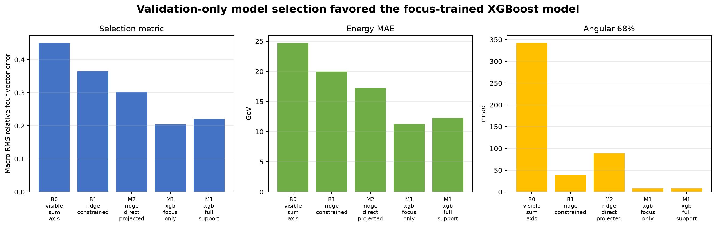
SELECTION POLICY
Validation chooses the model; test is opened once
Candidate path
Baselines: visible-sum axis, constrained ridge, direct ridge diagnostic.
XGBoost candidates: M1_xgb_focus_only and M1_xgb_full_support.
Ranking metric: validation-focus macro RMS relative four-vector error.
Champion: M1_xgb_focus_only, validation macro RMS 0.2039.
Calibration order
Tuning ends before calibration and test access. The selected model receives an affine validation energy calibration, then the test split is unlocked once.
ASIoP ZDC - FOUR-VECTOR RECO - Selection policy
14

Slide 15
SCORING
The exact metrics used in the deck
Metric
Definition
Plain reading
relative four-vector error
||p_hat^mu - p_true^mu||_2 / max(E_true, eps)
one event-level four-vector miss, scaled by true energy
macro RMS rel. 4-vector
mean over 25-GeV focus bins of sqrt(mean(error^2))
headline score; prevents dense bins from dominating
energy relative RMSE
sqrt(mean((E_hat/E_true - 1)^2))
fractional energy scatter, including bias
energy width68
0.5 * (q84 - q16) of E_hat/E_true - 1
central 68% half-width of energy response
angular error
1000 * arccos(u_true dot u_hat)
direction error in milliradians
mass-shell residual
E_hat^2 - px_hat^2 - py_hat^2 - pz_hat^2 - m_n^2
physics consistency check after projection
Focus bins
Required bin edges: 50, 75, 100, 125, 150, 175, 200, 225, 250 GeV. Empty bins are a hard error.
ASIoP ZDC - FOUR-VECTOR RECO - Scoring
15

Slide 16
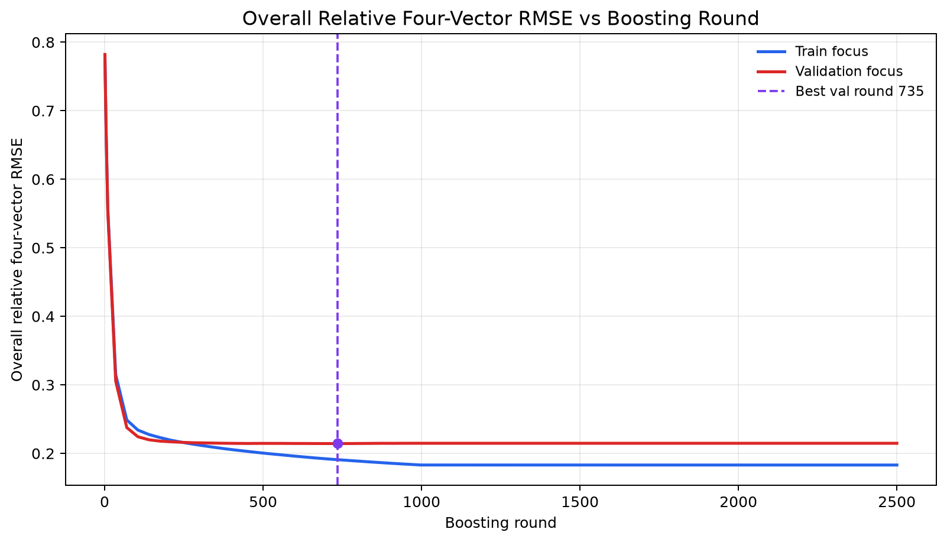
BOOSTING CURVES
Overall train and validation loss vs boosting round
Best validation point
round 735
best validation round
0.2143
validation rel. 4-vector RMSE
+0.0235
validation minus train gap
The gap is positive but not exploding. The validation curve improves with training and does not separate sharply from train loss.
ASIoP ZDC - FOUR-VECTOR RECO - Boosting curves
16

Slide 17
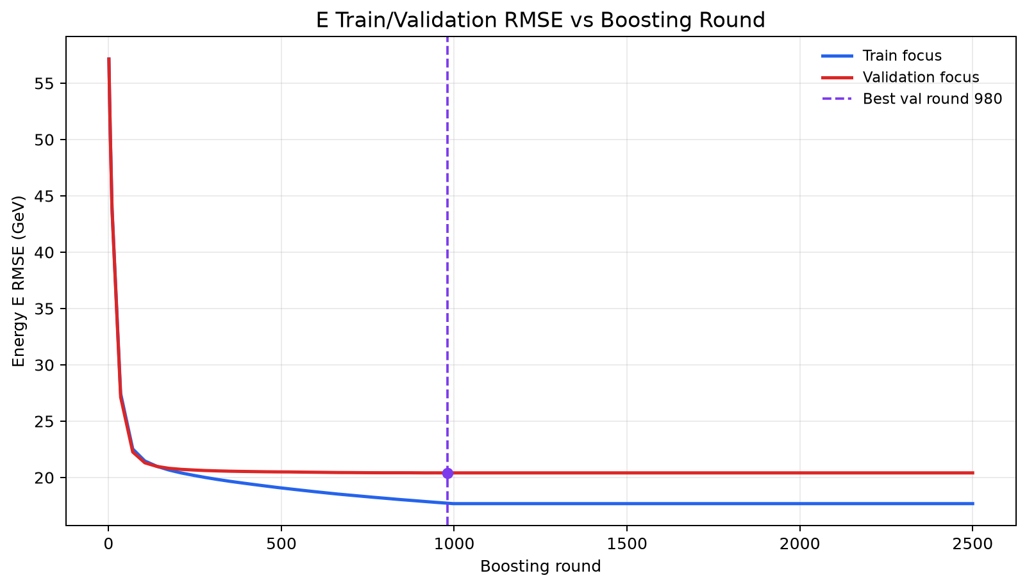
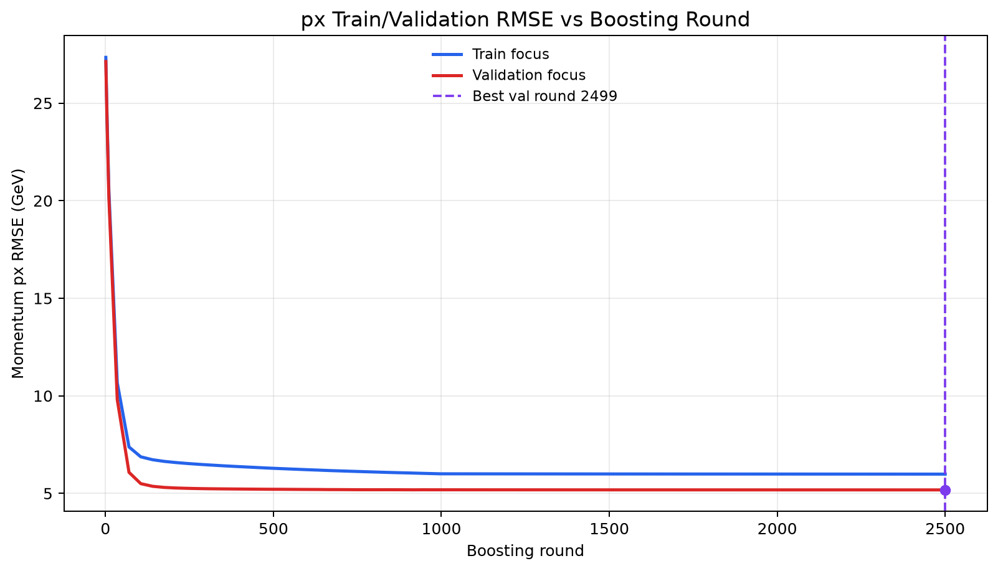
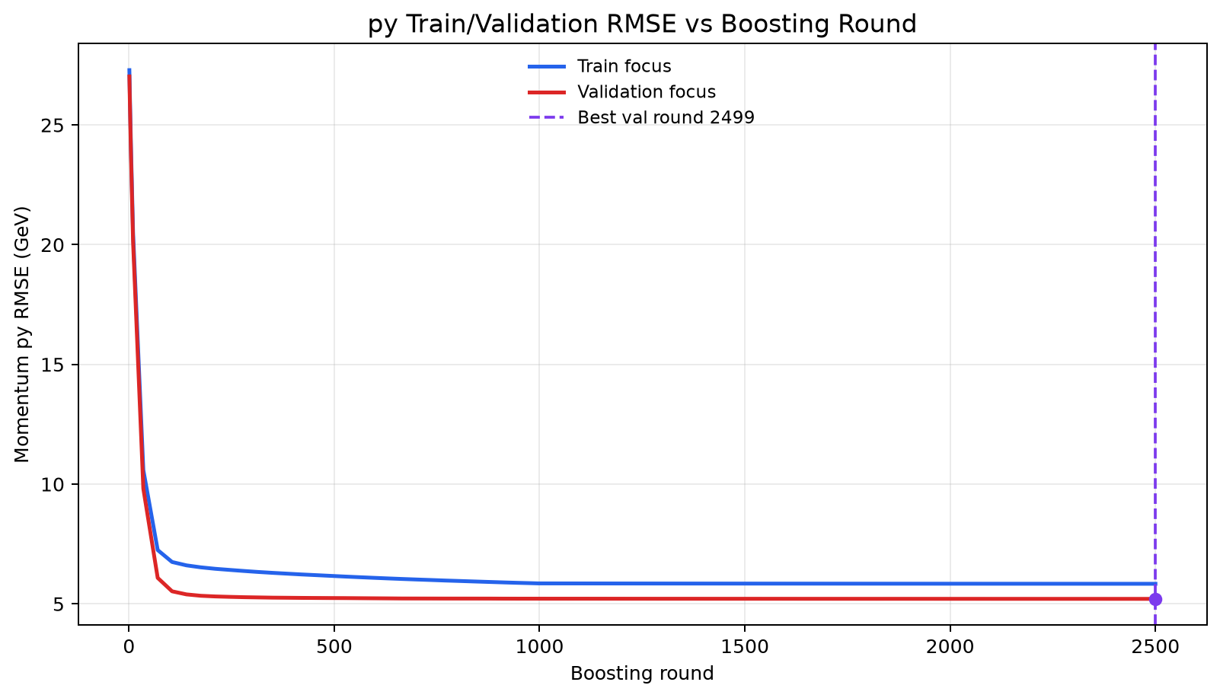
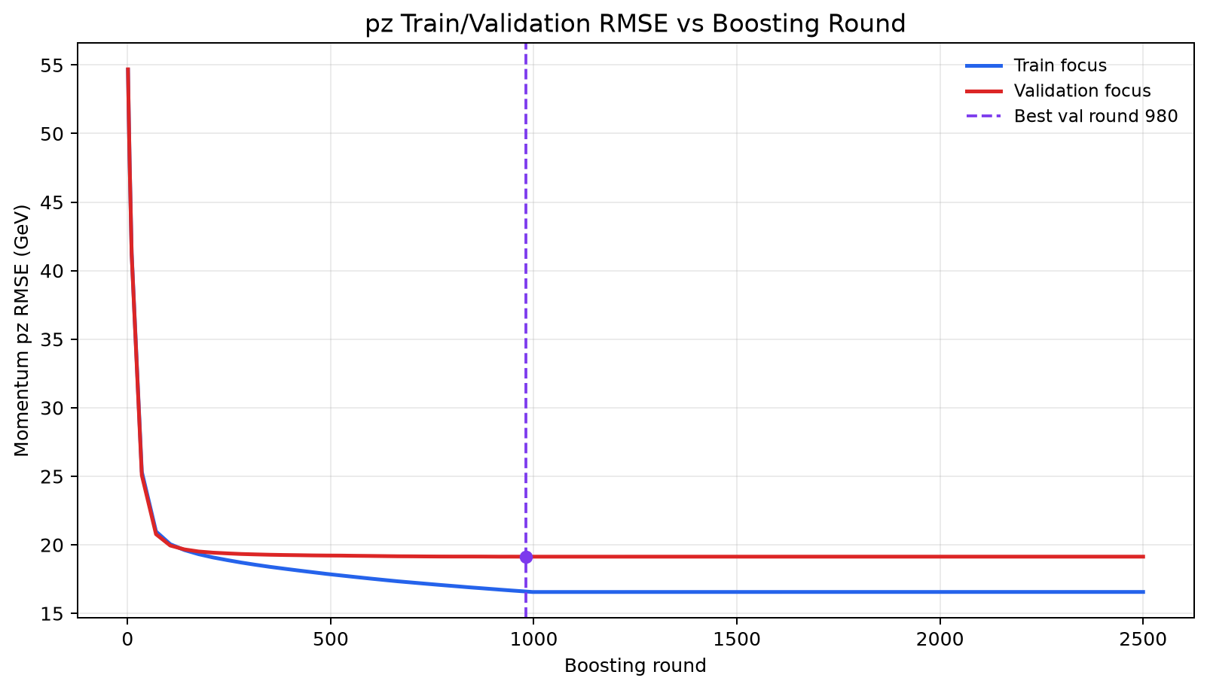
BOOSTING CURVES
Separate E, px, py, pz train/validation losses
ASIoP ZDC - FOUR-VECTOR RECO - Boosting curves
17

Slide 18
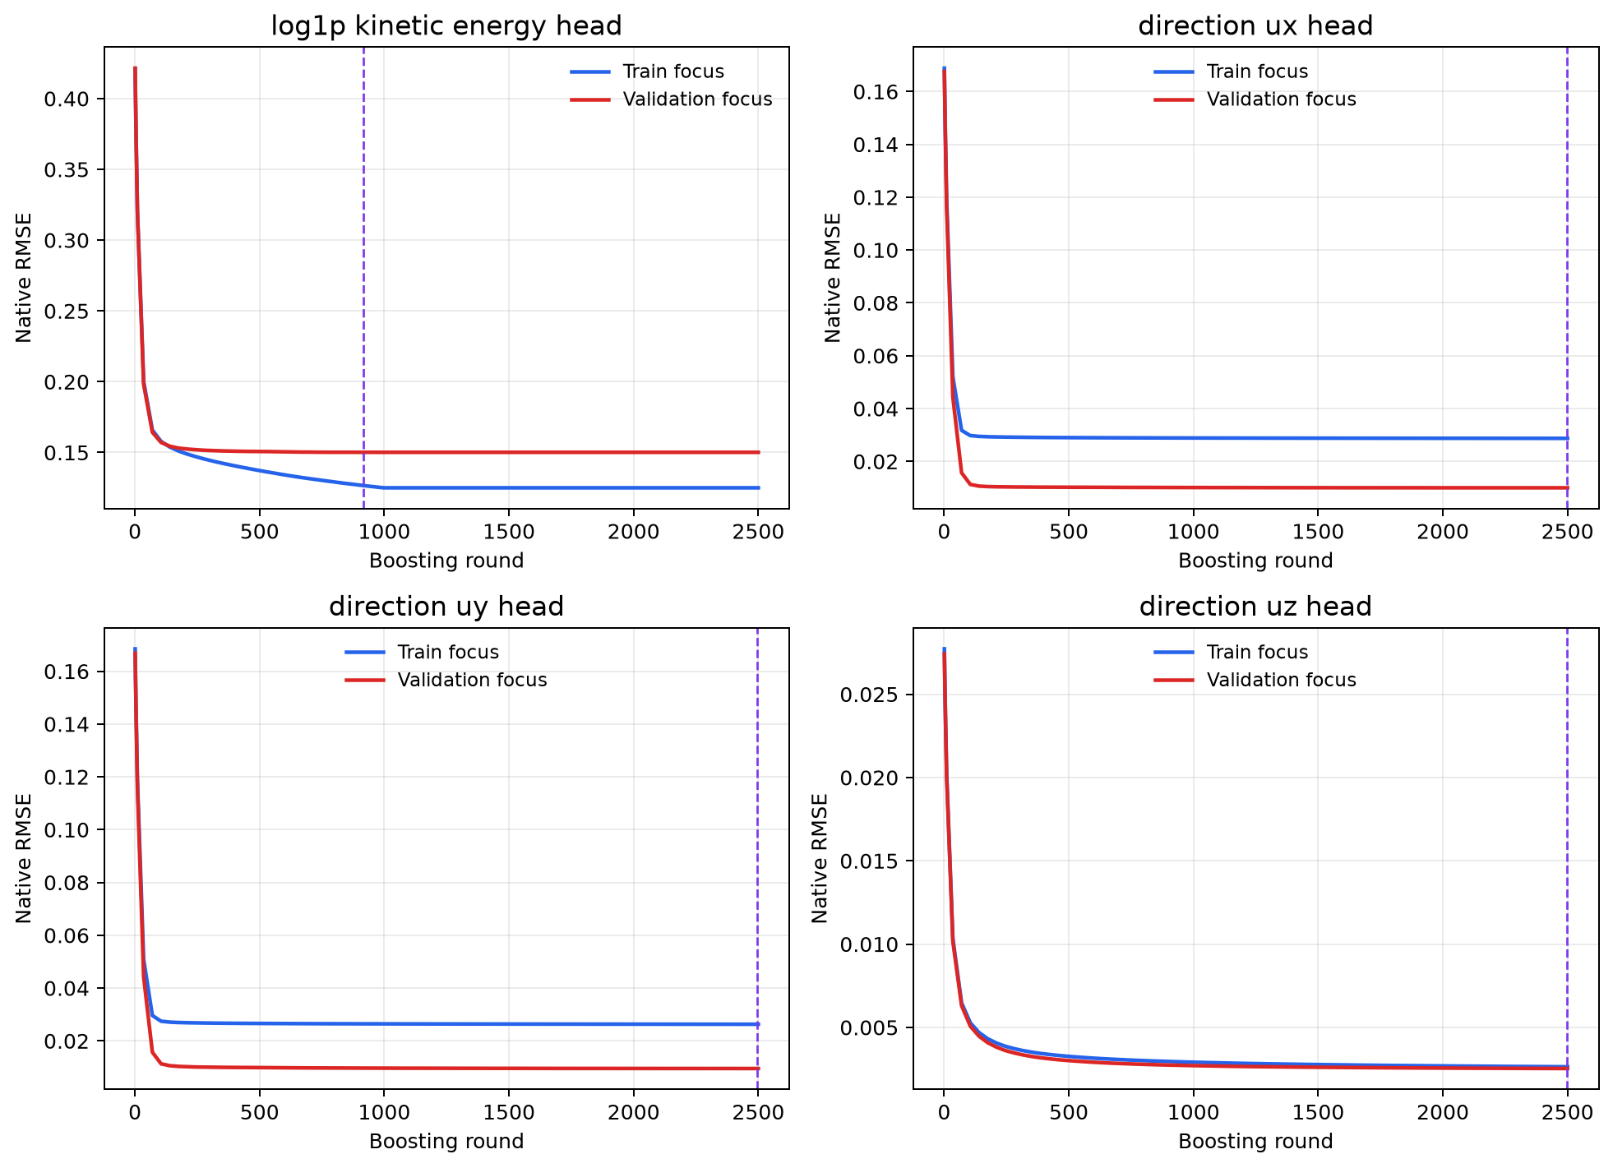
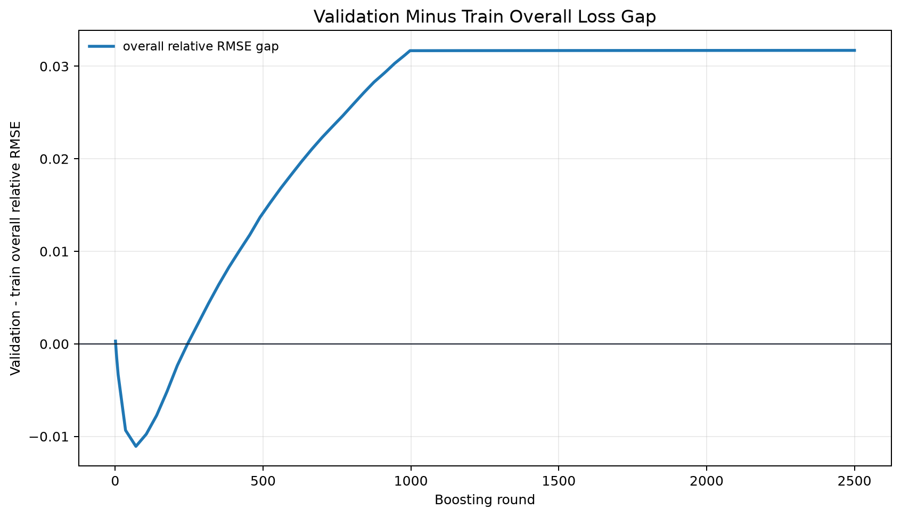
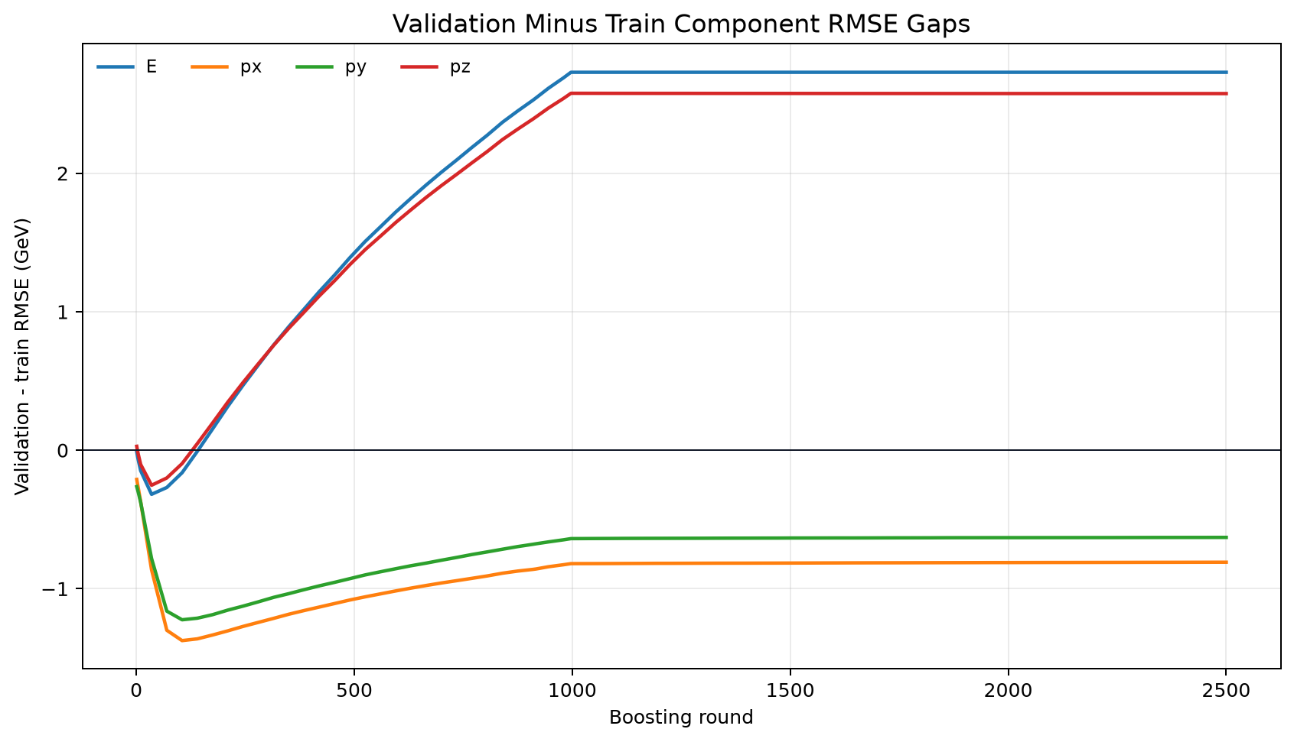
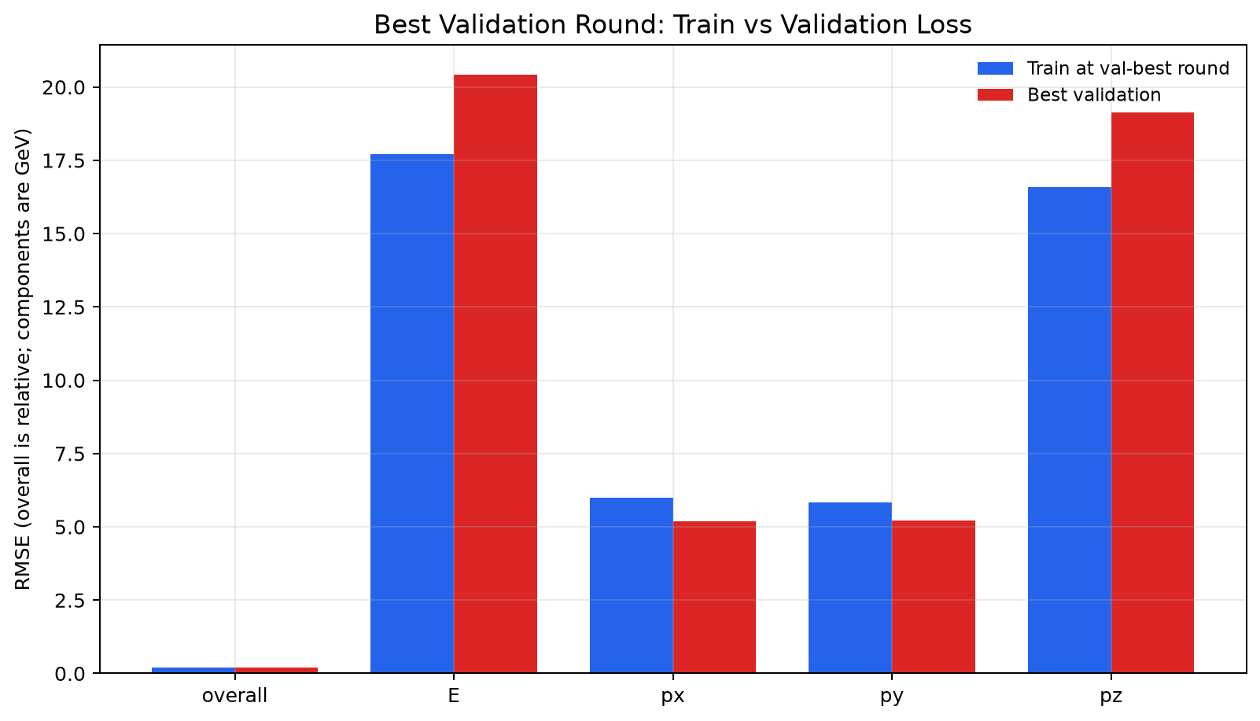
BOOSTING CURVES
Native head losses and train-validation gaps
ASIoP ZDC - FOUR-VECTOR RECO - Boosting curves
18

Slide 19
HEADLINE RESULT
Locked focus-test performance for M1_xgb_focus_only
0.2044
0.2186
11.48
15.44%
macro RMS relative four-vector error
micro RMS relative four-vector error
energy MAE, GeV
energy relative RMSE
+2.38%
7.15%
5.87
16.62
mean energy response bias
central-68 energy width
median angular error, mrad
95% angular error, mrad
Read this slide carefully
These are final locked-test metrics on 50-250 GeV events. They are not validation numbers and they are not previous-model comparison numbers.
ASIoP ZDC - FOUR-VECTOR RECO - Headline result
19

Slide 20
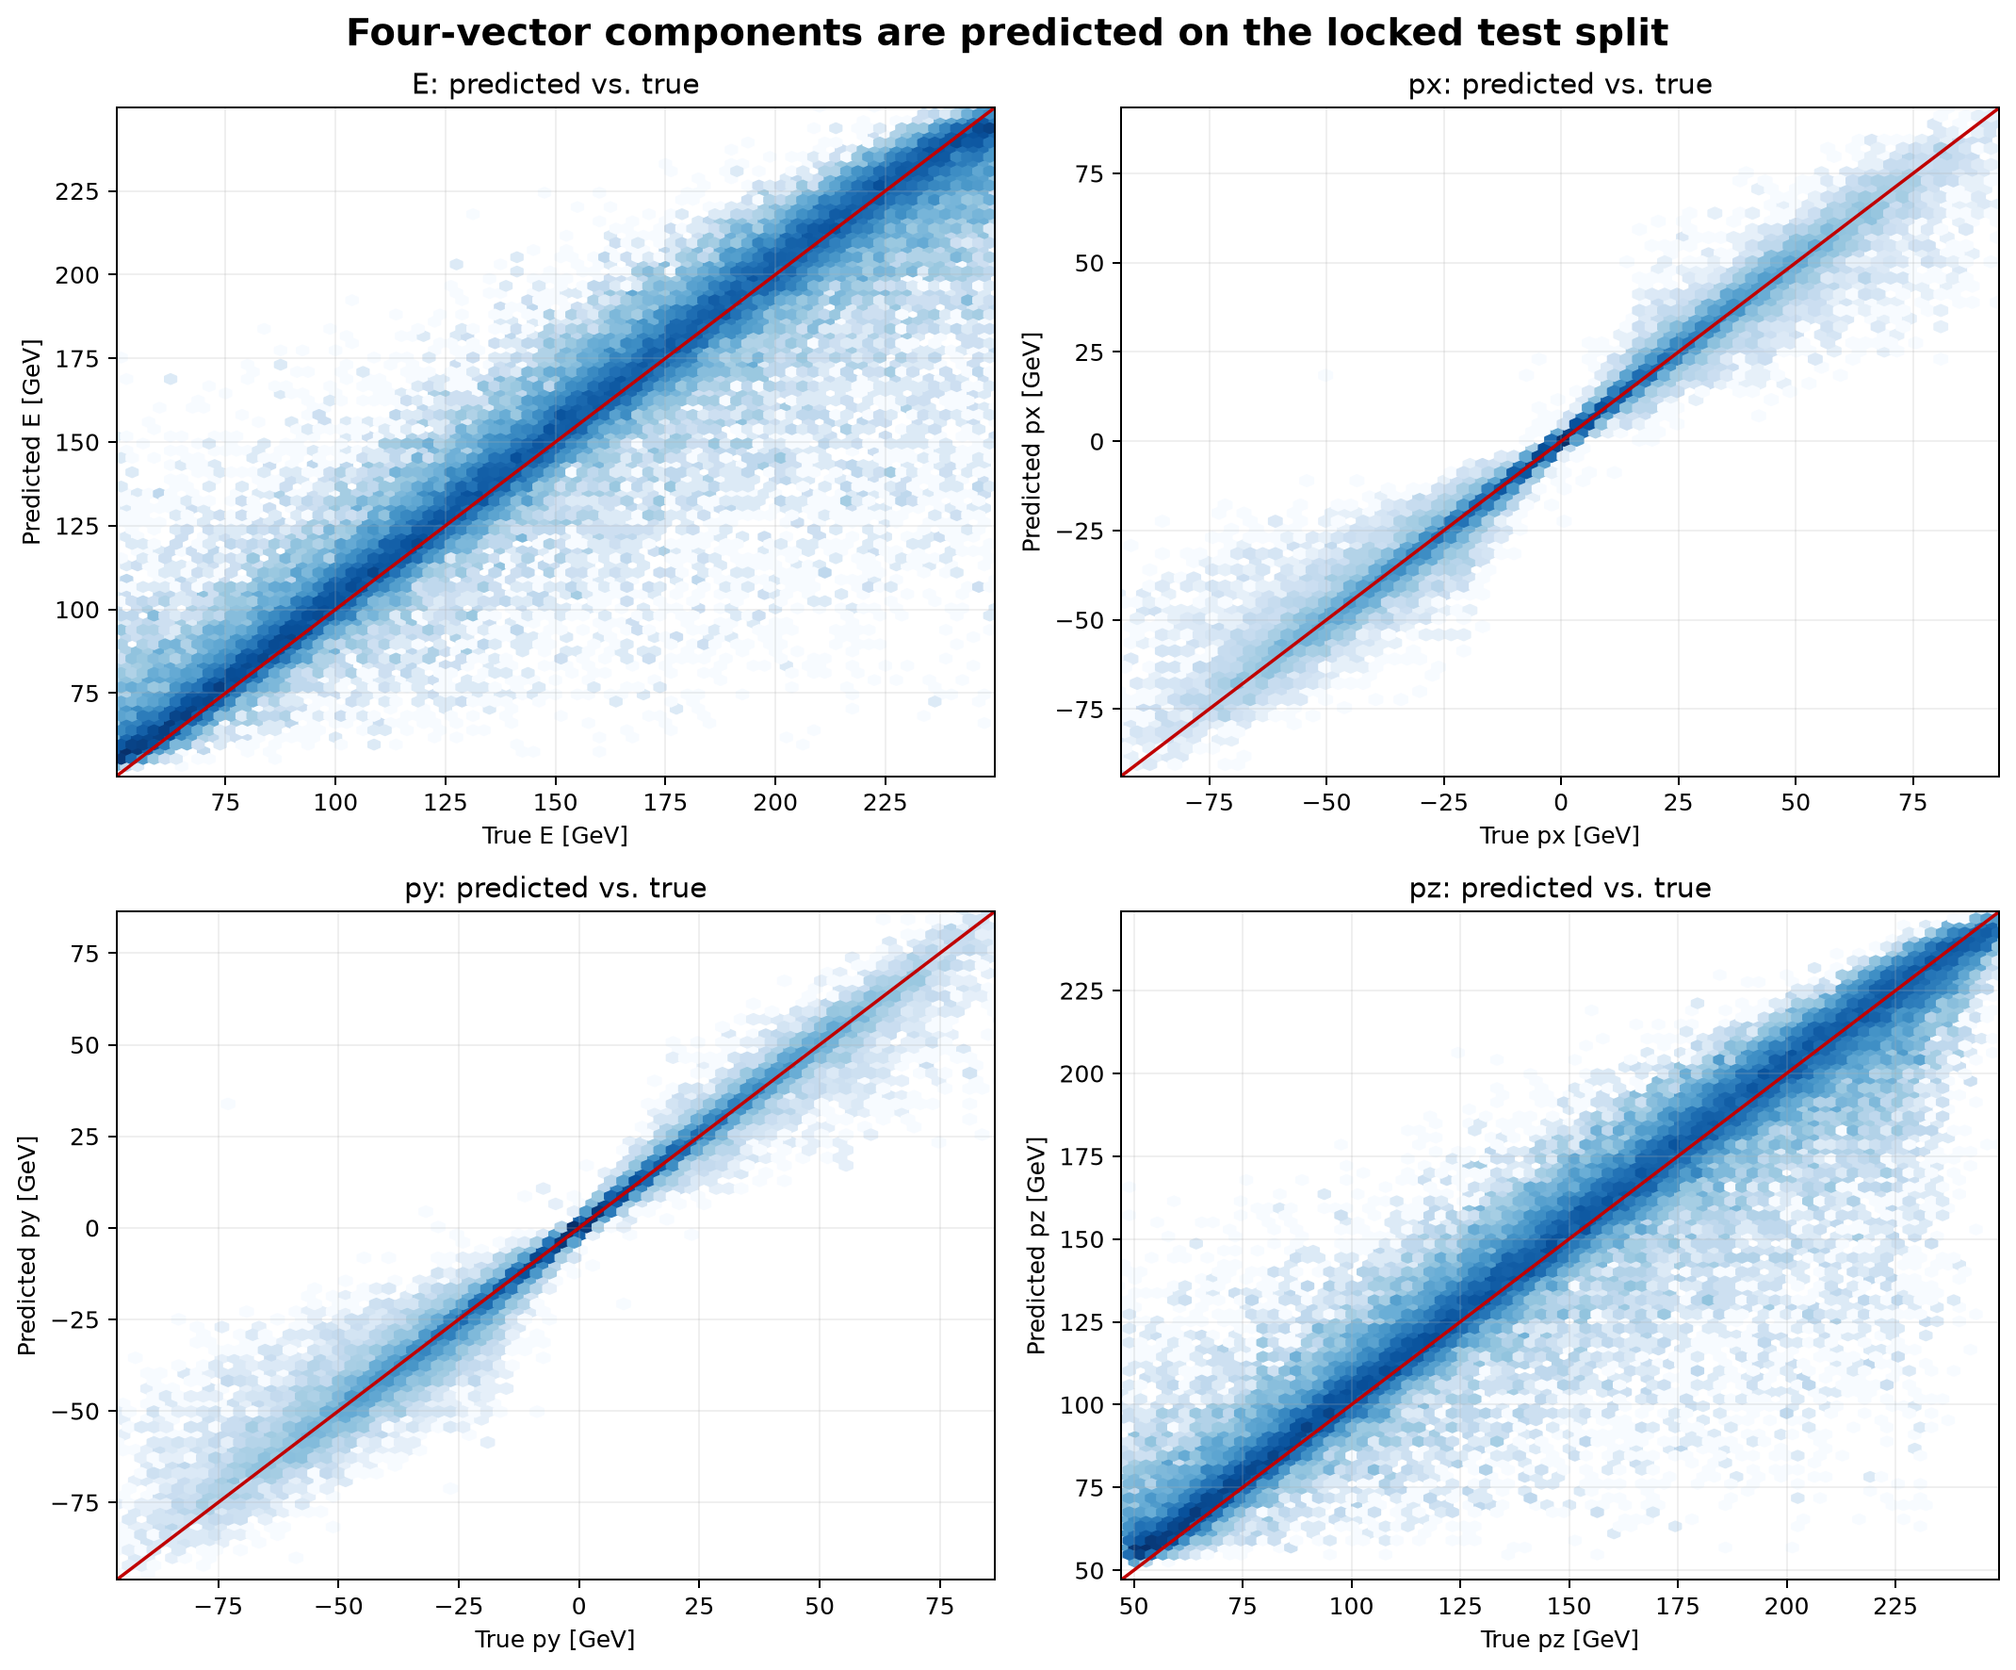
RESULTS
Predicted vs true components
The diagonal pattern shows the four outputs track truth across the focus population. Energy and pz are harder because forward energy and longitudinal momentum carry the main scale.
ASIoP ZDC - FOUR-VECTOR RECO - Results
20

Slide 21
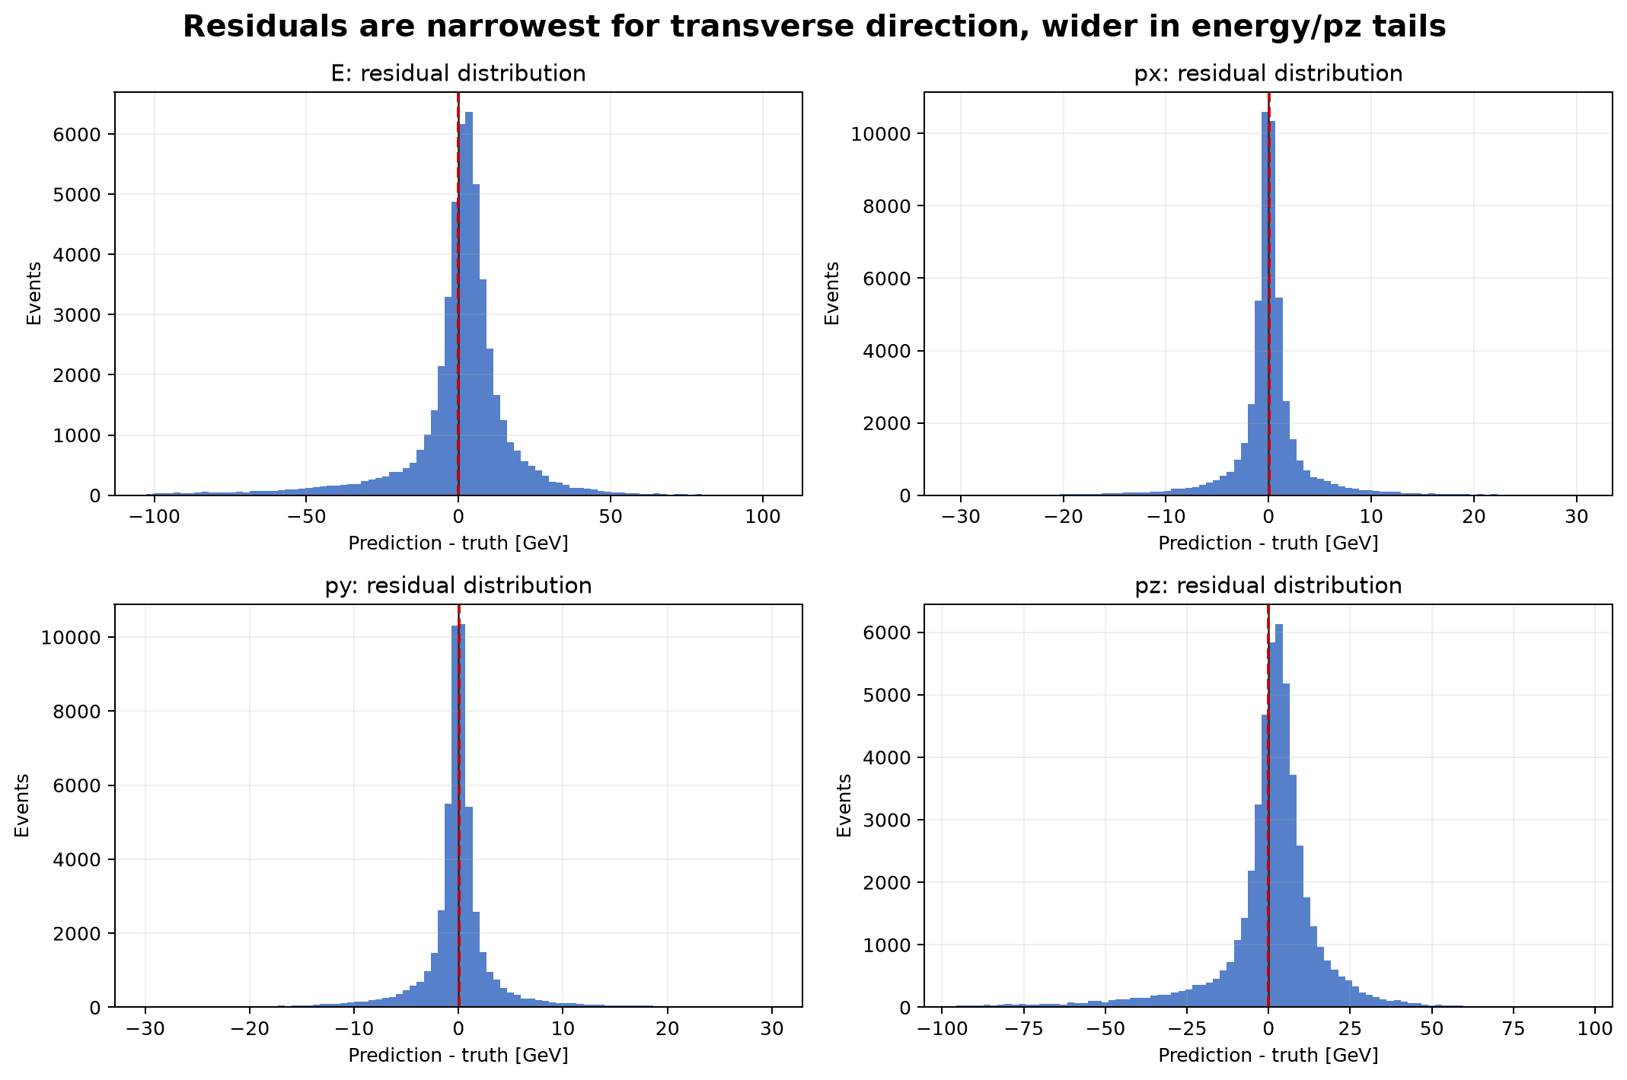
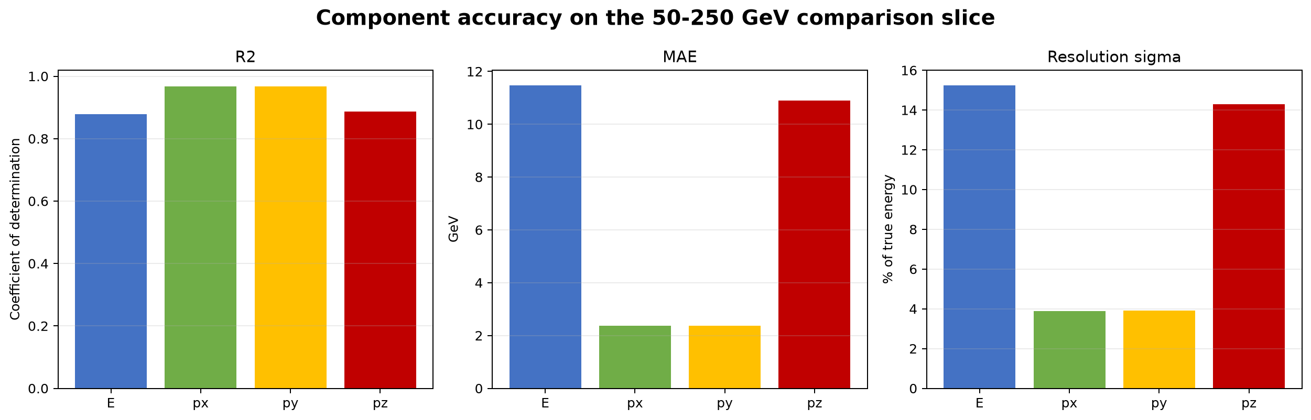
RESULTS
Component residual sizes explain where the error lives
Component
MAE GeV
RMSE GeV
R2
p95 abs err GeV
Focus test only
E
11.48
20.06
0.879
42.86
Transverse components are much tighter than E and pz; that is normal for a forward neutron where most momentum is longitudinal.
px
2.37
5.06
0.968
9.85
py
2.38
5.06
0.967
10.11
pz
10.89
18.81
0.887
40.24
ASIoP ZDC - FOUR-VECTOR RECO - Results
21

Slide 22
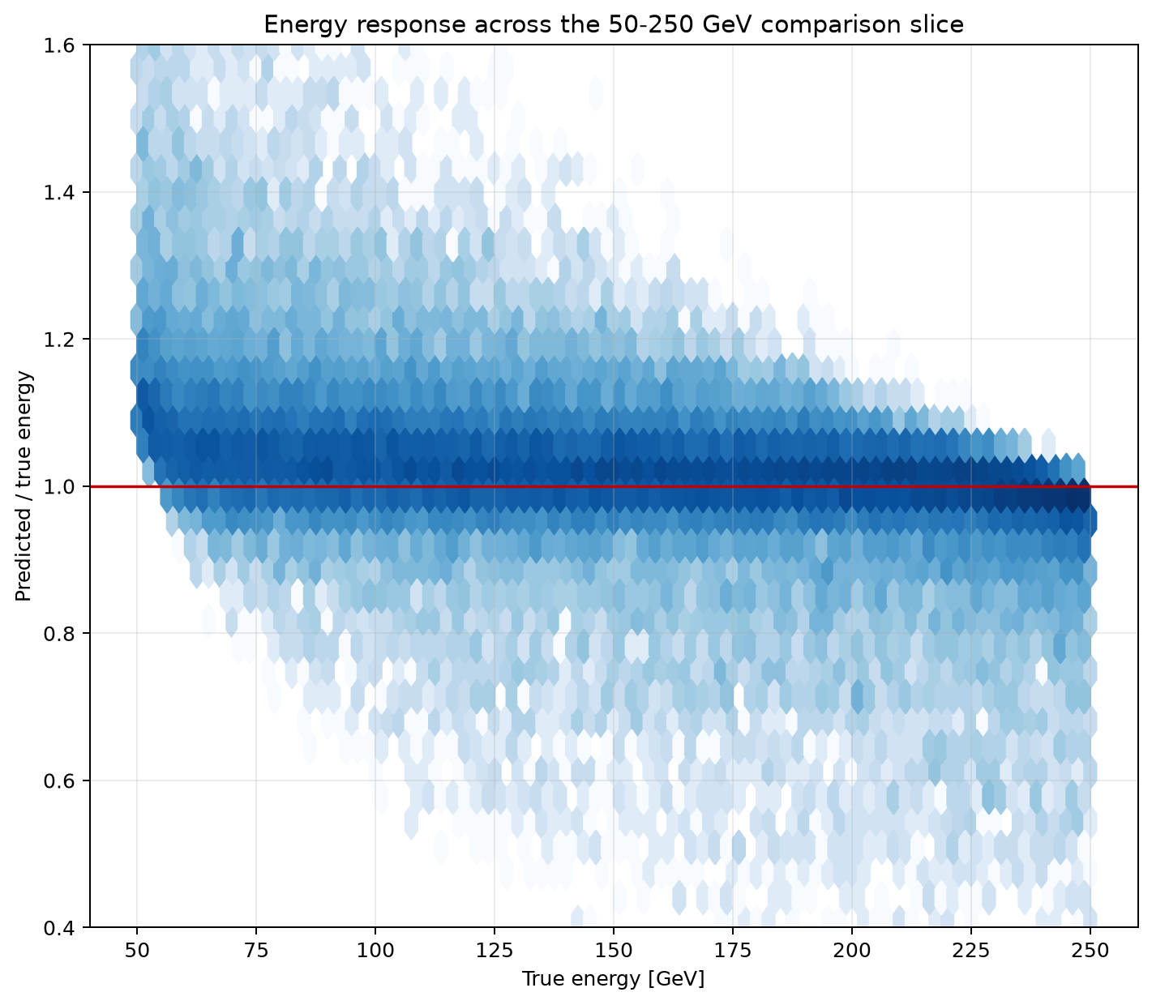
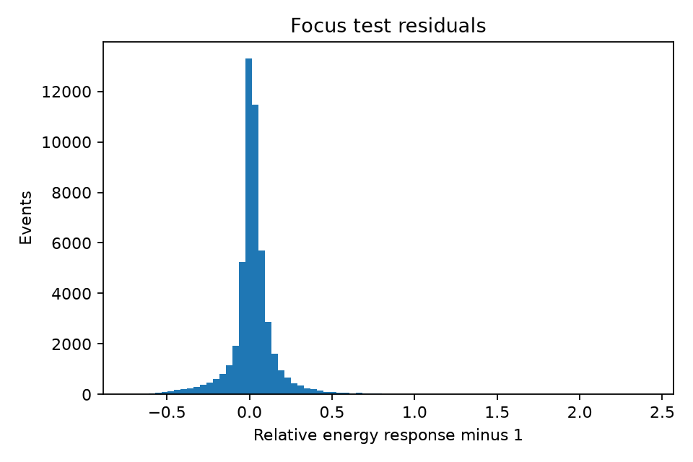
ENERGY BEHAVIOR
Response density and one-dimensional residual view
Mean response: 1.0238; median response: 1.0166.
Energy MAE is 11.48 GeV on the focus test population.
Central 68% width of relative energy response: 7.15%.
The residual tail drives RMSE above the central width, so slice and tail plots matter.
ASIoP ZDC - FOUR-VECTOR RECO - Energy behavior
22

Slide 23
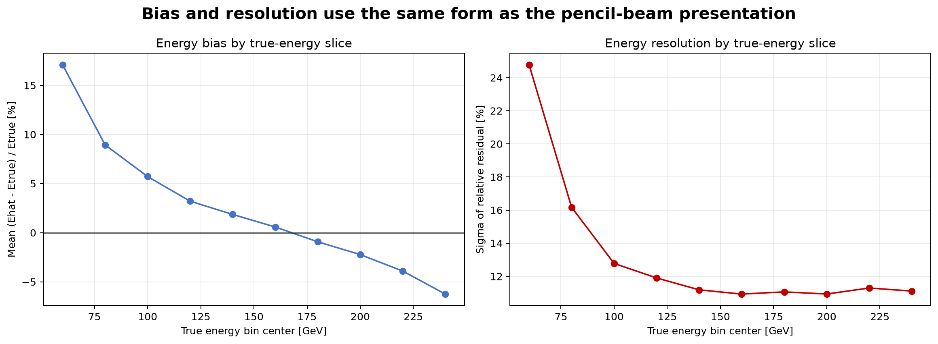
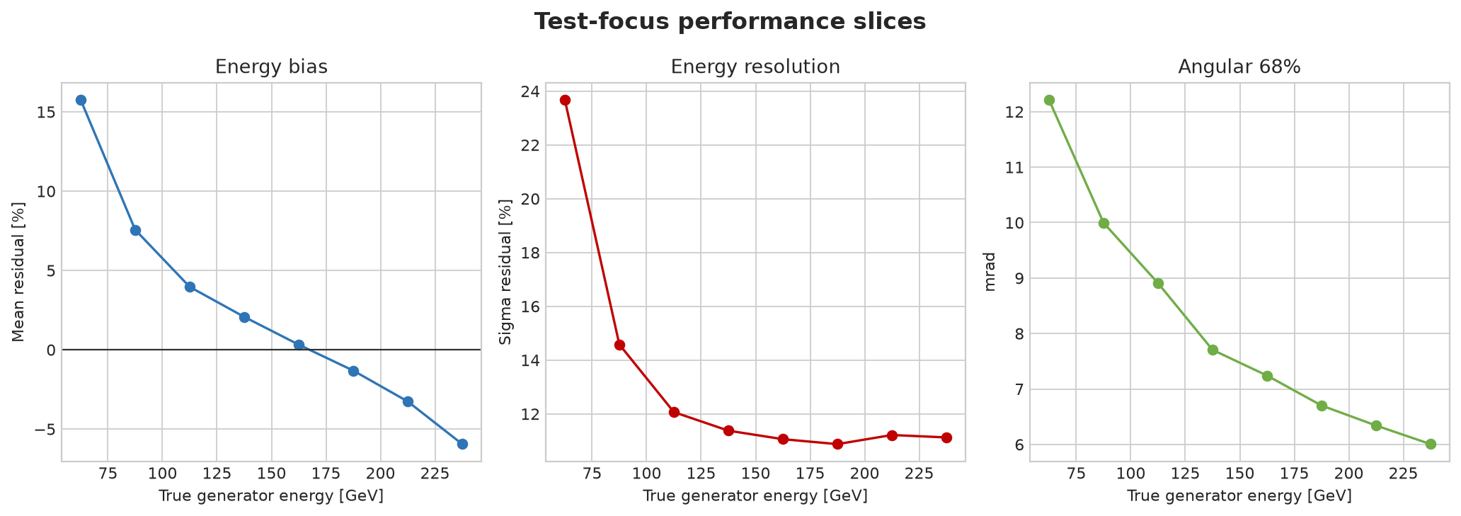
ENERGY SLICES
Bias and resolution by generator-energy region
Why this matters
A single headline error can hide low-energy or high-energy slice problems.
The model is selected on macro RMS across focus bins to keep slices visible.
ASIoP ZDC - FOUR-VECTOR RECO - Energy slices
23

Slide 24
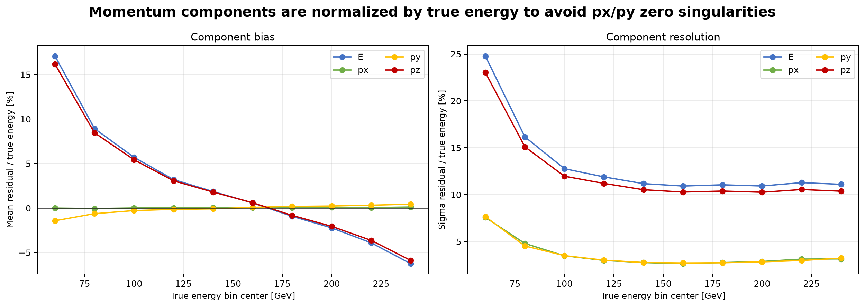
MOMENTUM SLICES
Component bias and resolution by energy
px and py behave similarly and remain much narrower than pz. Longitudinal momentum follows the energy scale, so pz inherits much of the energy-resolution challenge.
ASIoP ZDC - FOUR-VECTOR RECO - Momentum slices
24

Slide 25
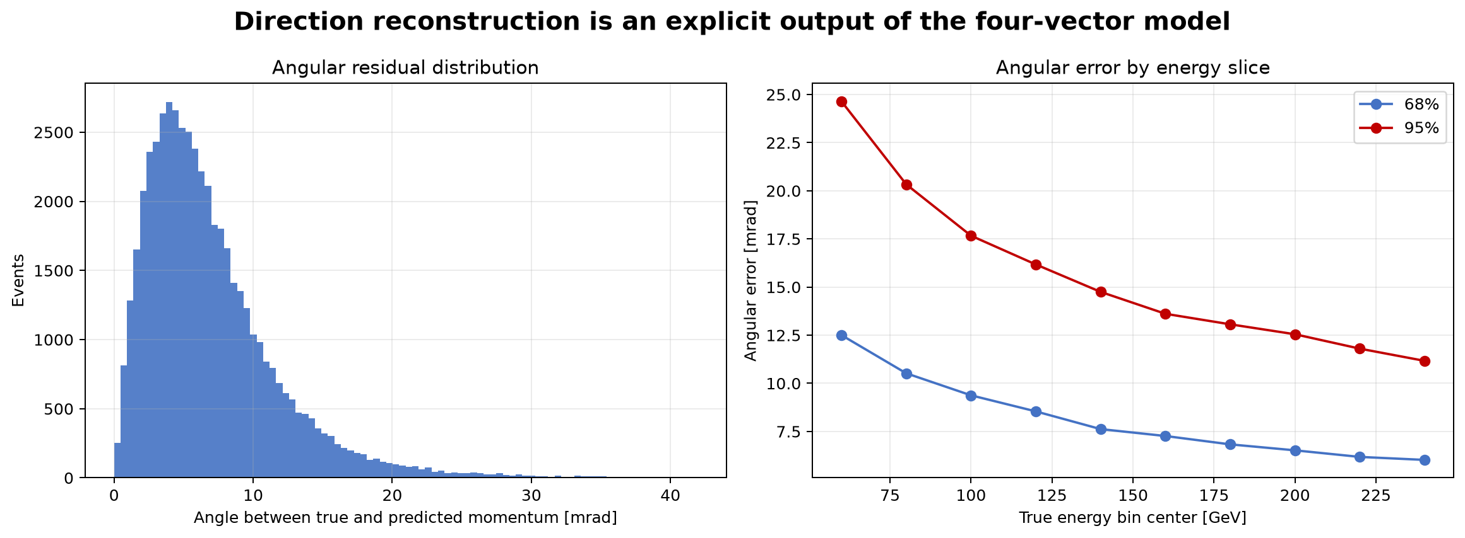
DIRECTION
Angular error is small for the focus-test population
1.000
valid direction fraction
5.87
median angular error, mrad
7.98
68% angular error, mrad
16.62
95% angular error, mrad
Angular error is computed from the dot product of true and predicted unit directions, then converted from radians to milliradians.
ASIoP ZDC - FOUR-VECTOR RECO - Direction
25

Slide 26
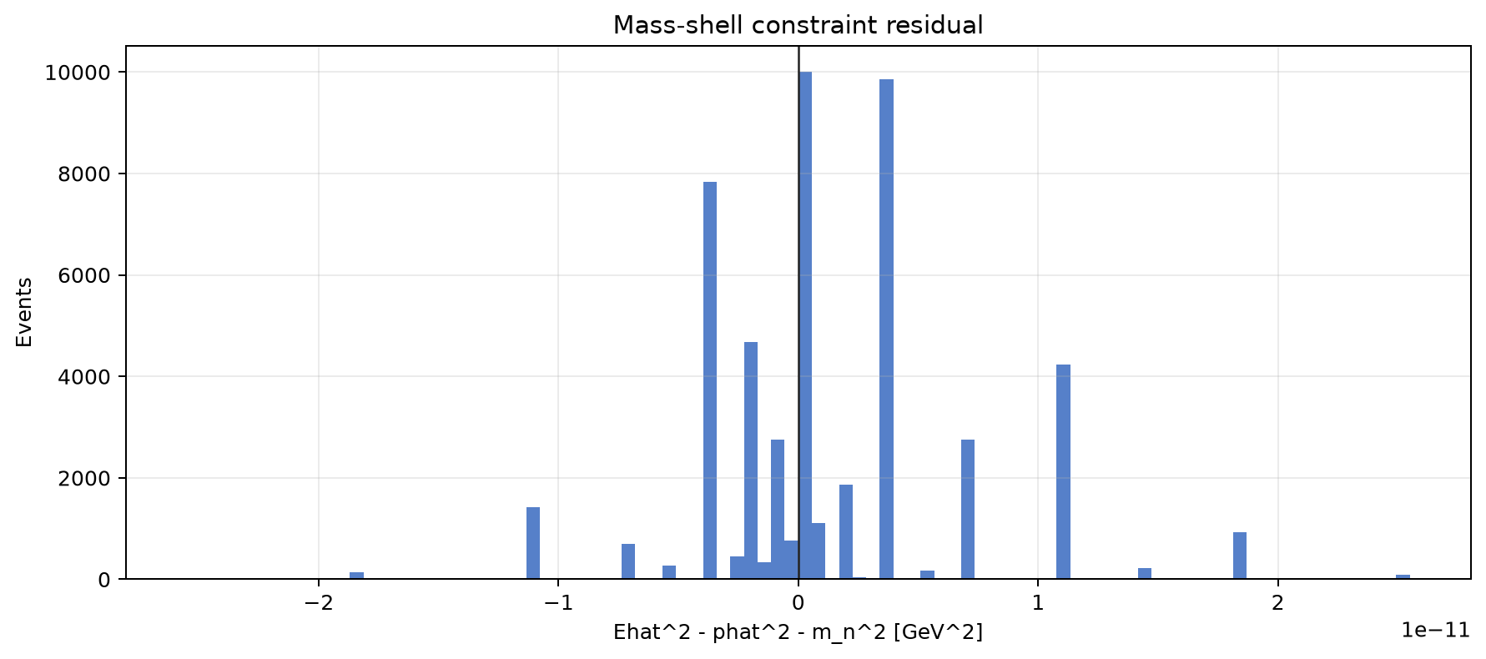
PHYSICS QA
Mass-shell residual confirms the projection is numerically clean
Check
residual = E_hat^2 - px_hat^2 - py_hat^2 - pz_hat^2 - m_n^2
max |residual| = 3.277e-11 GeV^2
RMS residual = 5.62e-12 GeV^2
Meaning
This does not say the model is perfect. It says the prediction is physically formatted as a neutron after postprocessing, so downstream analysis does not receive impossible four-vectors.
ASIoP ZDC - FOUR-VECTOR RECO - Physics QA
26

Slide 27
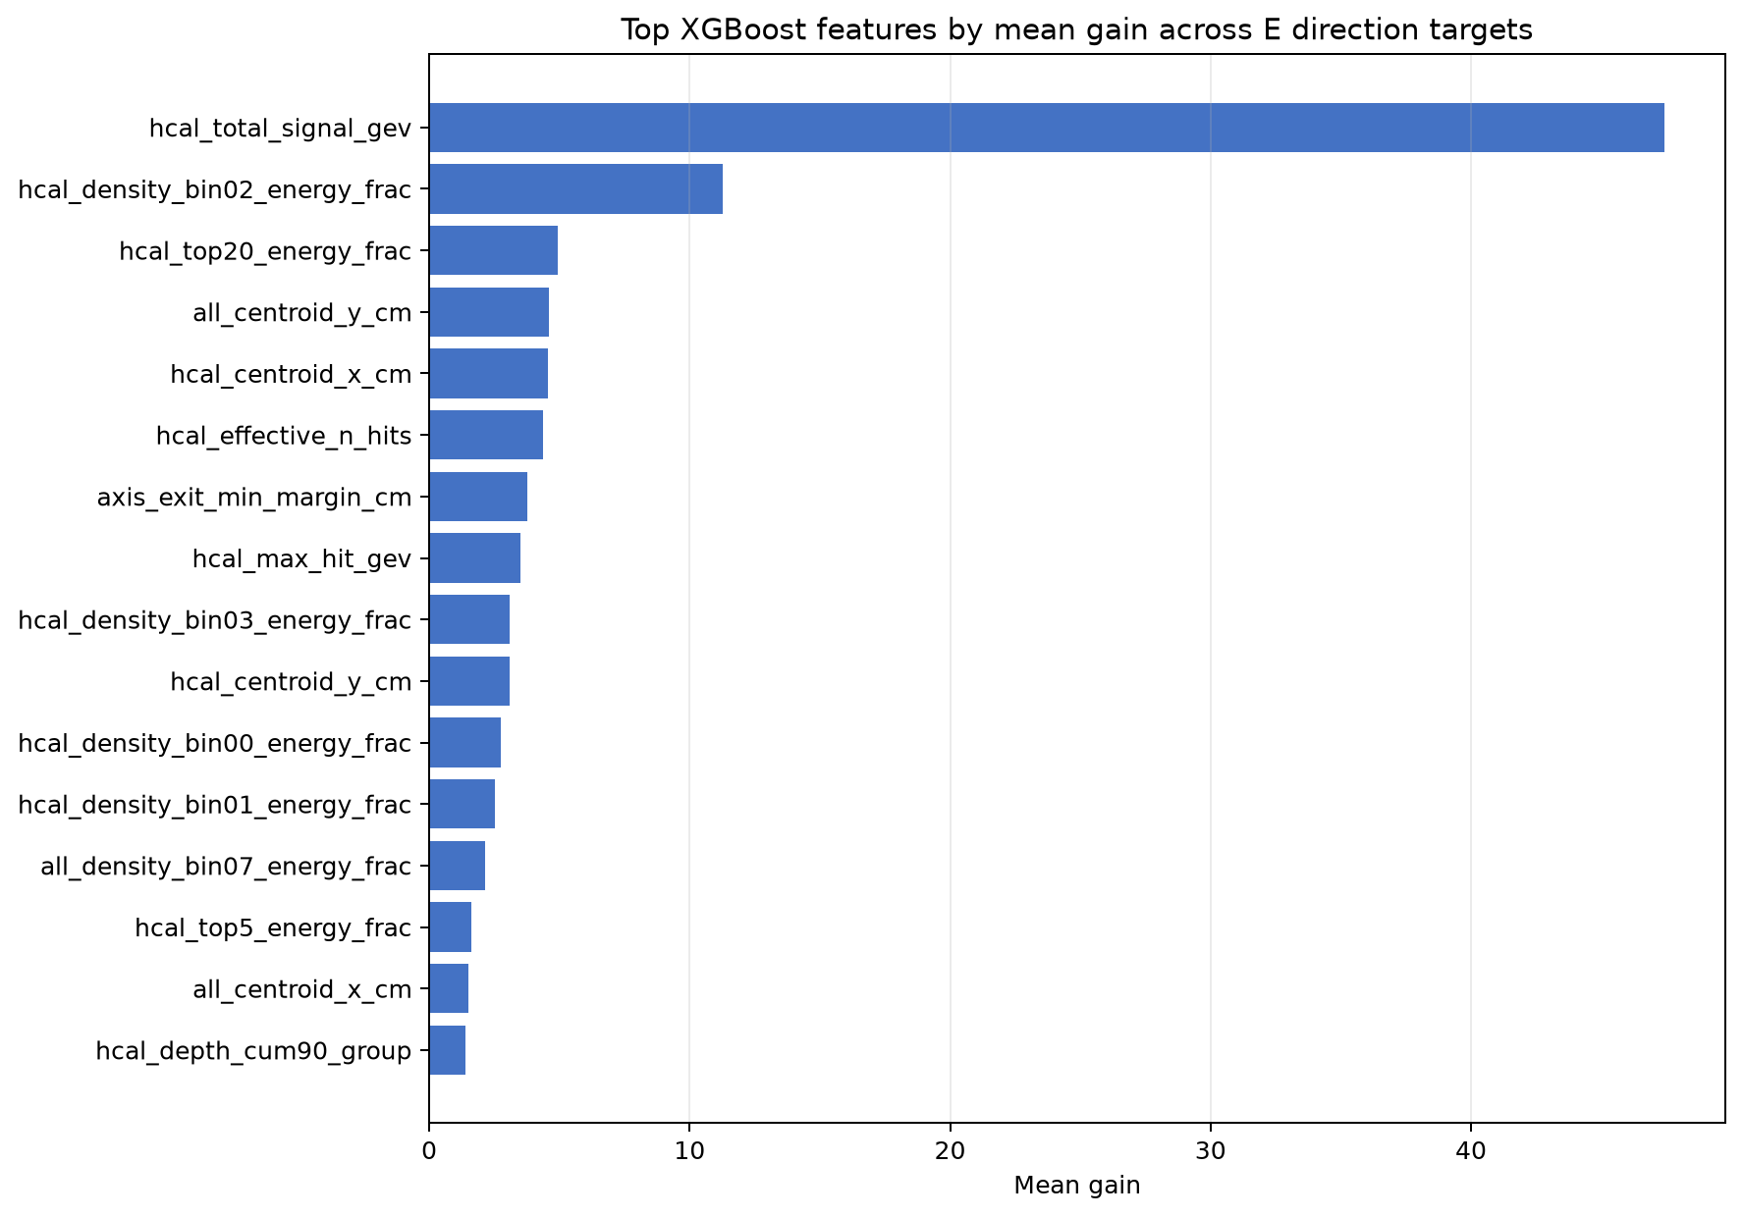
INTERPRETATION
Which features does XGBoost use most?
Top mean-gain features
Rank
Feature
Mean gain
1
hcal_total_signal_gev
47.41
2
hcal_density_bin02_energy_frac
11.27
3
hcal_top20_energy_frac
4.95
4
all_centroid_y_cm
4.59
5
hcal_centroid_x_cm
4.54
6
hcal_effective_n_hits
4.38
7
axis_exit_min_margin_cm
3.78
Honest read
HCAL total signal dominates, but the model also uses shower concentration, centroid, effective hit count, and edge/leakage information.
ASIoP ZDC - FOUR-VECTOR RECO - Interpretation
27

Slide 28
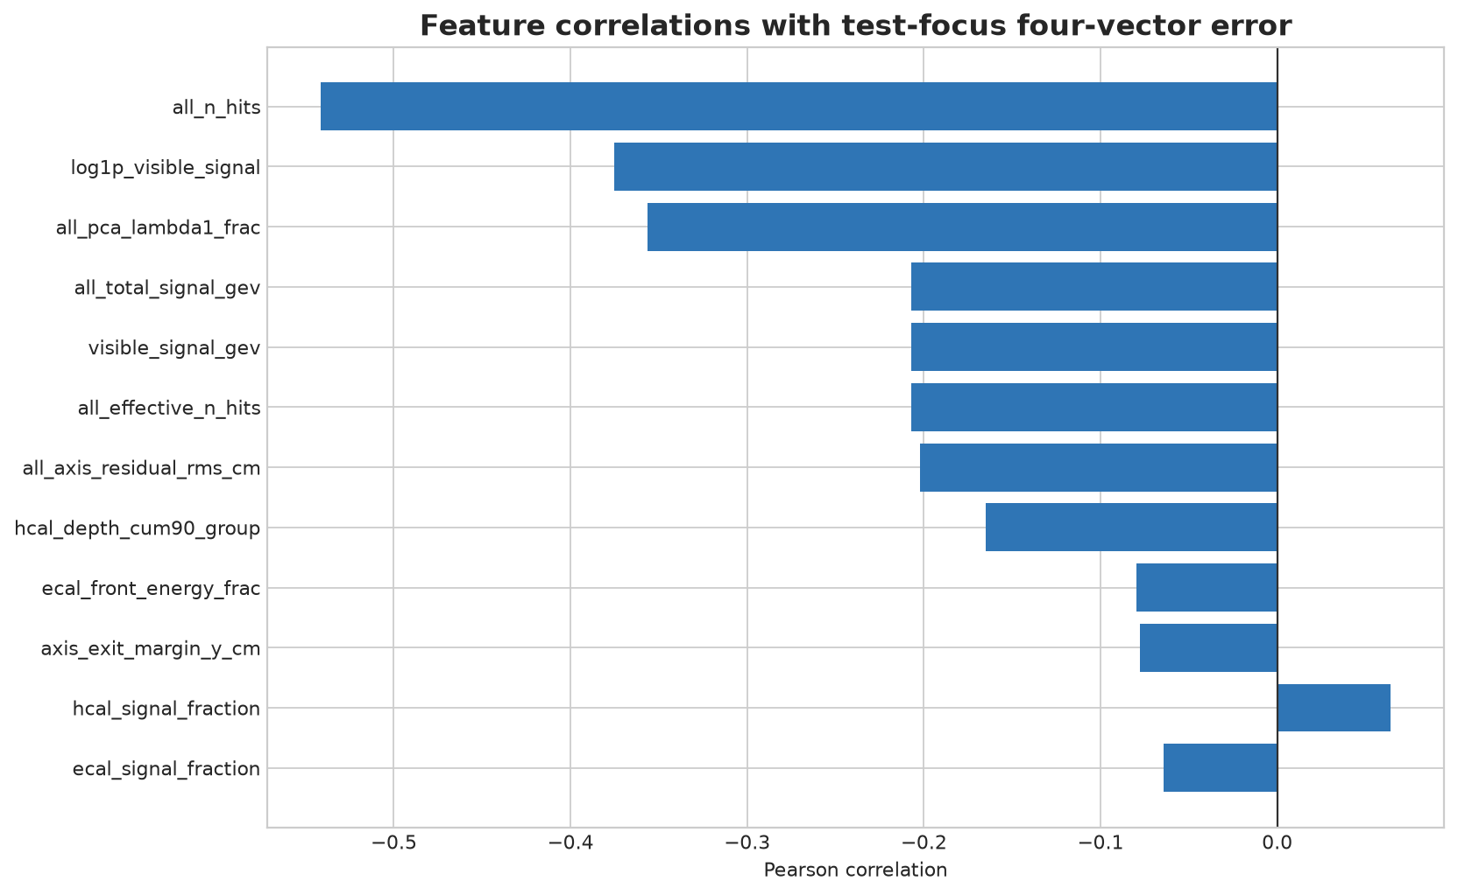
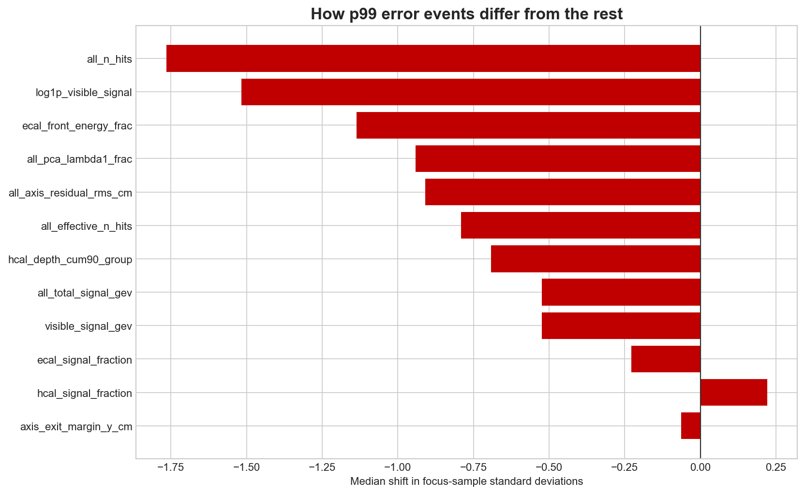
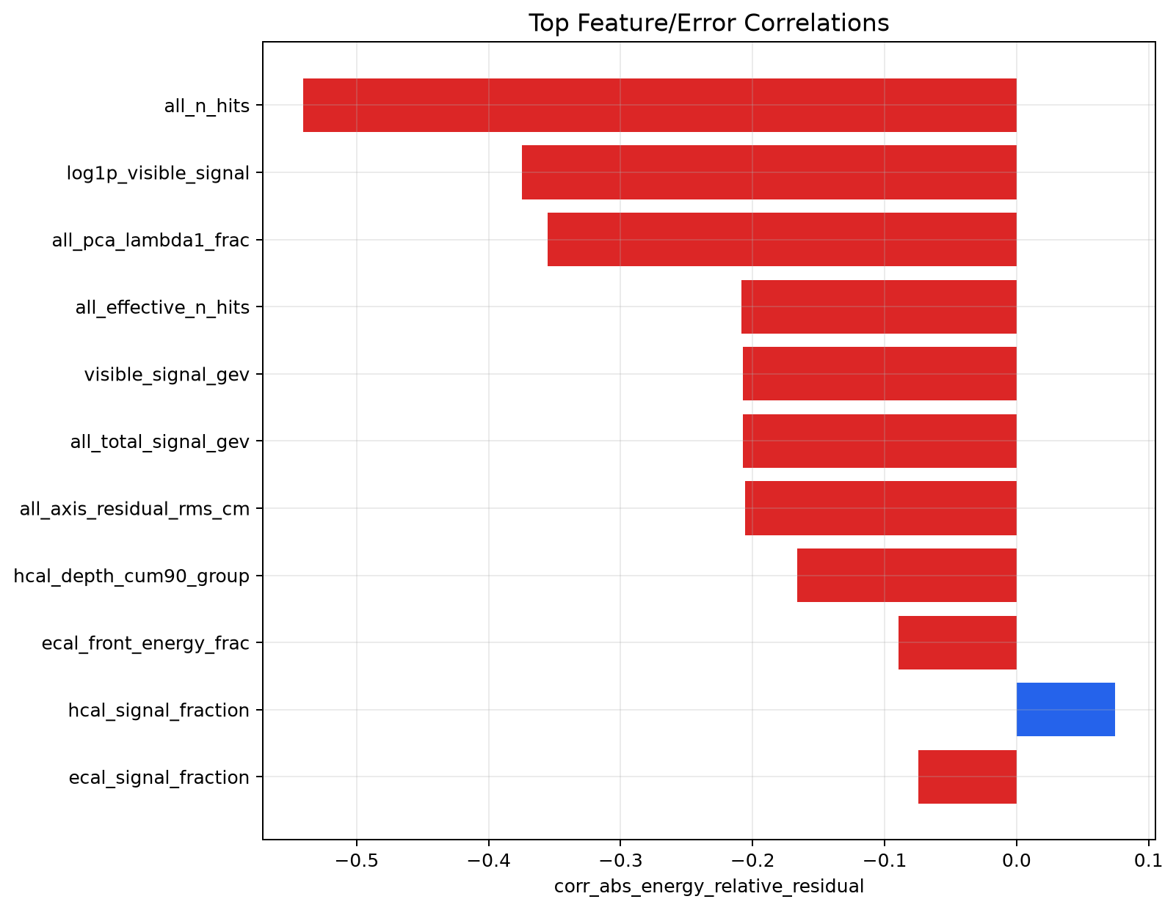
ERROR DRIVERS
Tail events line up with leakage and shower-shape features
Use these as diagnostic clues, not causal proof. They point to which event shapes should be inspected when errors get large.
ASIoP ZDC - FOUR-VECTOR RECO - Error drivers
28

Slide 29
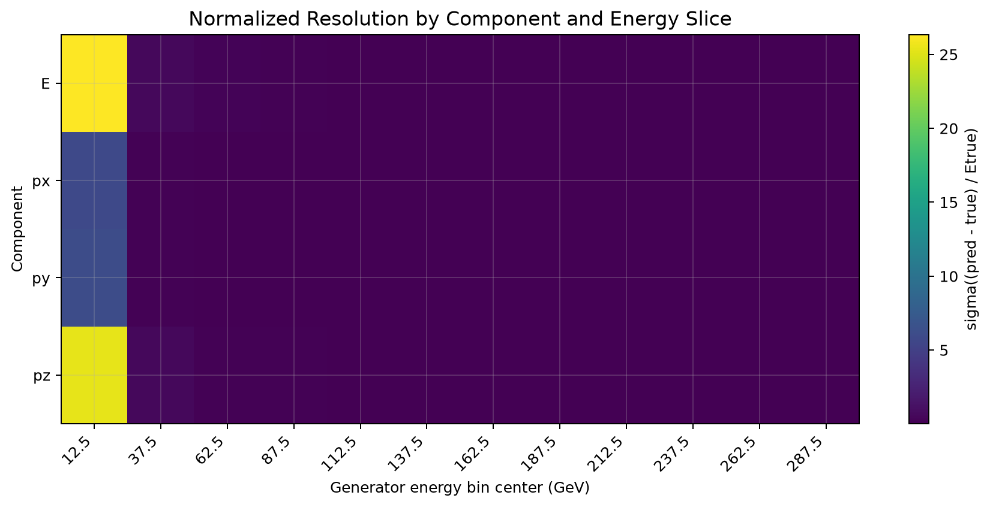
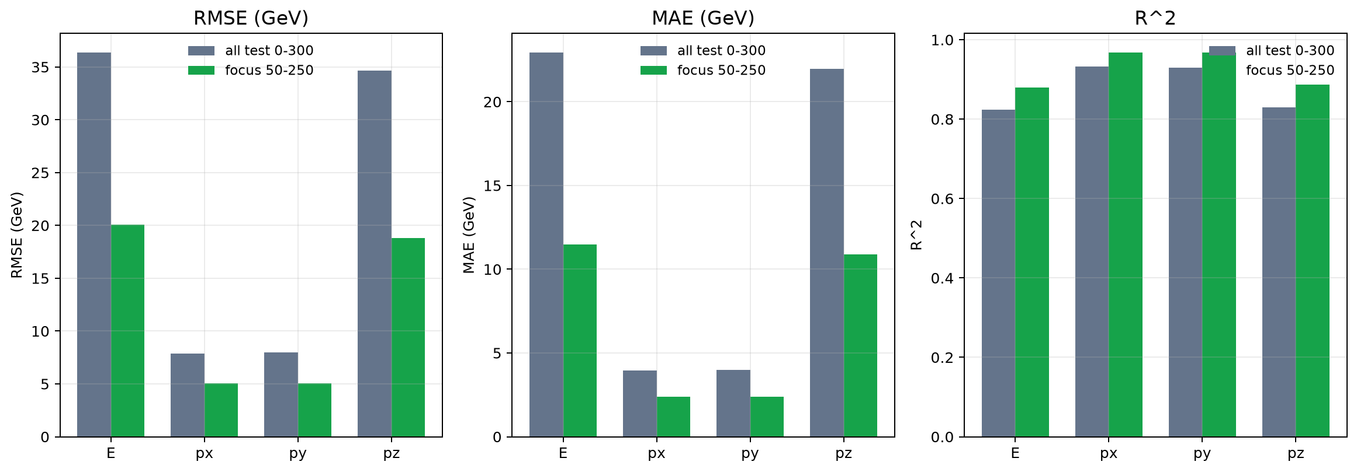
STUDY RANGE
Focus behavior vs full 0-300 GeV test support
Why focus is the headline
Do not extrapolate
The one-shot target is 50-250 GeV. The model can be evaluated on all 0-300 GeV test rows, but the accepted claim is the locked focus-test result.
No slide in this deck claims validity for other particle species, real-detector electronics, or data outside the simulated distribution.
ASIoP ZDC - FOUR-VECTOR RECO - Study range
29

Slide 30
UNCERTAINTY
Empirical validation intervals were checked once on test
Nominal interval
Validation abs-energy width
Focus-test coverage
Interpretation
68%
10.02 GeV
68.08%
matches target closely
90%
27.99 GeV
90.21%
matches target closely
95%
43.11 GeV
95.06%
matches target closely
Calibration source
Caveat
Validation focus is reused for model selection and calibration.
interval_width_c = quantile(|E_true - E_hat_cal|, c)
coverage_c = mean(|E_true - E_hat_cal| <= interval_width_c) on test
These are empirical intervals, not a formal split-conformal guarantee, because there is no independent calibration split after model selection.
ASIoP ZDC - FOUR-VECTOR RECO - Uncertainty
30

Slide 31
QA AND QC
What was checked before accepting the result
Gate
Status
Evidence
Repository/read-me intake
pass
read task files and repo structure before continuing
Local source sanity
pass
compileall, unittest, pytest, Ruff, smoke from clean package
Data staging
pass
local ROOT matches US-CENTRAL1 GCS object
Truth convention
pass
single neutron; total-energy GeV mass-shell closure
Hit unit contract
pass
ecal_energy/hcal_energy locked as GeV simulated deposits
Split integrity
pass
group-safe deterministic split; no duplicate fingerprint leakage
Model selection
pass
validation-focus macro score selects M1_xgb_focus_only
Test unlock
pass
test read occurs after selection and calibration
Physics output
pass
mass-shell residual max 3.28e-11 GeV^2
Presentation QA
pass
render, montage, overflow test, and visual inspection
ASIoP ZDC - FOUR-VECTOR RECO - QA and QC
31

Slide 32
REBUILD RECIPE
How a colleague can reproduce this if they have the data
1. Data
Place the ROOT file in GCS or local disk. Expected object: myTree_20251117_765k_0to300GeV_neutron_All.root, SHA-256 b7c666040e42352e158a9a3f78158d147cb2e056c6c88248d892c956f5c7b533.
2. Config
Use configs/legacy_vertex_default.yaml. Critical values: neutron mass 0.93956542052 GeV, focus 50-250 GeV, train/validation/test 80/10/10, ECAL/HCAL signal scale 1.0, position scale 0.1 cm, 195 scalar detector features, XGBoost params from slide 13.
3. Run on Vertex
Command
DATA_GCS=gs://asiop-zdc-1-zdc-reco-us-central1/data/myTree_20251117_765k_0to300GeV_neutron_All.root
OUT_GCS=gs://asiop-zdc-1-zdc-reco-us-central1/runs/rebuild-<DATE>/outputs
python -m zdc_reco.cli run-all-gcs \
--data-gcs $DATA_GCS --output-gcs $OUT_GCS \
--config configs/legacy_vertex_default.yaml \
--workdir /tmp/zdc_run
4. Verify and present
Verify outputs: inspection report, schema lock, targets, splits, feature manifest, leaderboard, champion, calibration, test metrics, interval coverage, and plots.
Expected headline result for this accepted run: macro RMS 0.2044, energy MAE 11.48 GeV, angular median 5.87 mrad, on-shell residual max 3.28e-11 GeV^2.
ASIoP ZDC - FOUR-VECTOR RECO - Rebuild recipe
32

