Slide 1
CBSC-ZDC Fast Monte Carlo
Status update — what has changed since the last review
Conditional generative shower model for the ZDC · 6,790 channels · 65 layers
5 August 2026
Optimization and diagnostic evidence on a validation bank. Geant4 fidelity is NOT established.
Notes:
Framing: this is a progress update, not a validation claim. The headline is that energy reconstruction now exists and is quantified against a Geant4 control, and that the loss has moved a long way — but the classifier still separates the two generators easily.

Slide 2
1
Since you last saw this
Left: the state you were shown. Right: today.
PREVIOUSLY · 28 July
NOW · 5 August
Epochs trained
4
up to 40
Best validation loss
4.738041
4.597152
Energy reconstruction
not measured
measured, vs Geant4 control
Per-epoch diagnostics
none
4,000 events every epoch
Classifier separability
AUROC 0.99945
AUROC 0.8727
Training backend
Vertex AI, T4
DiCOS, RTX 4090 + 3090
The two AUROC numbers are not the same measurement. July: 40,000 test-split events, hybrid classifier, epoch-4 models. Today: 8,000 validation events, 3-seed ensemble, epoch-38 model. Read them as two studies that agree qualitatively — a classifier separates Fast-MC from Geant4 easily — not as a clean 0.999 → 0.873 delta.
Validation loss is the frozen weighted joint objective on the pilot validation split. Lower is better. Zero test events informed any training decision.
Notes:
The caveat box matters: do not let anyone leave thinking AUROC fell from 0.999 to 0.873 as a single tracked quantity. Different split, different sample size, different evaluator.

Slide 3
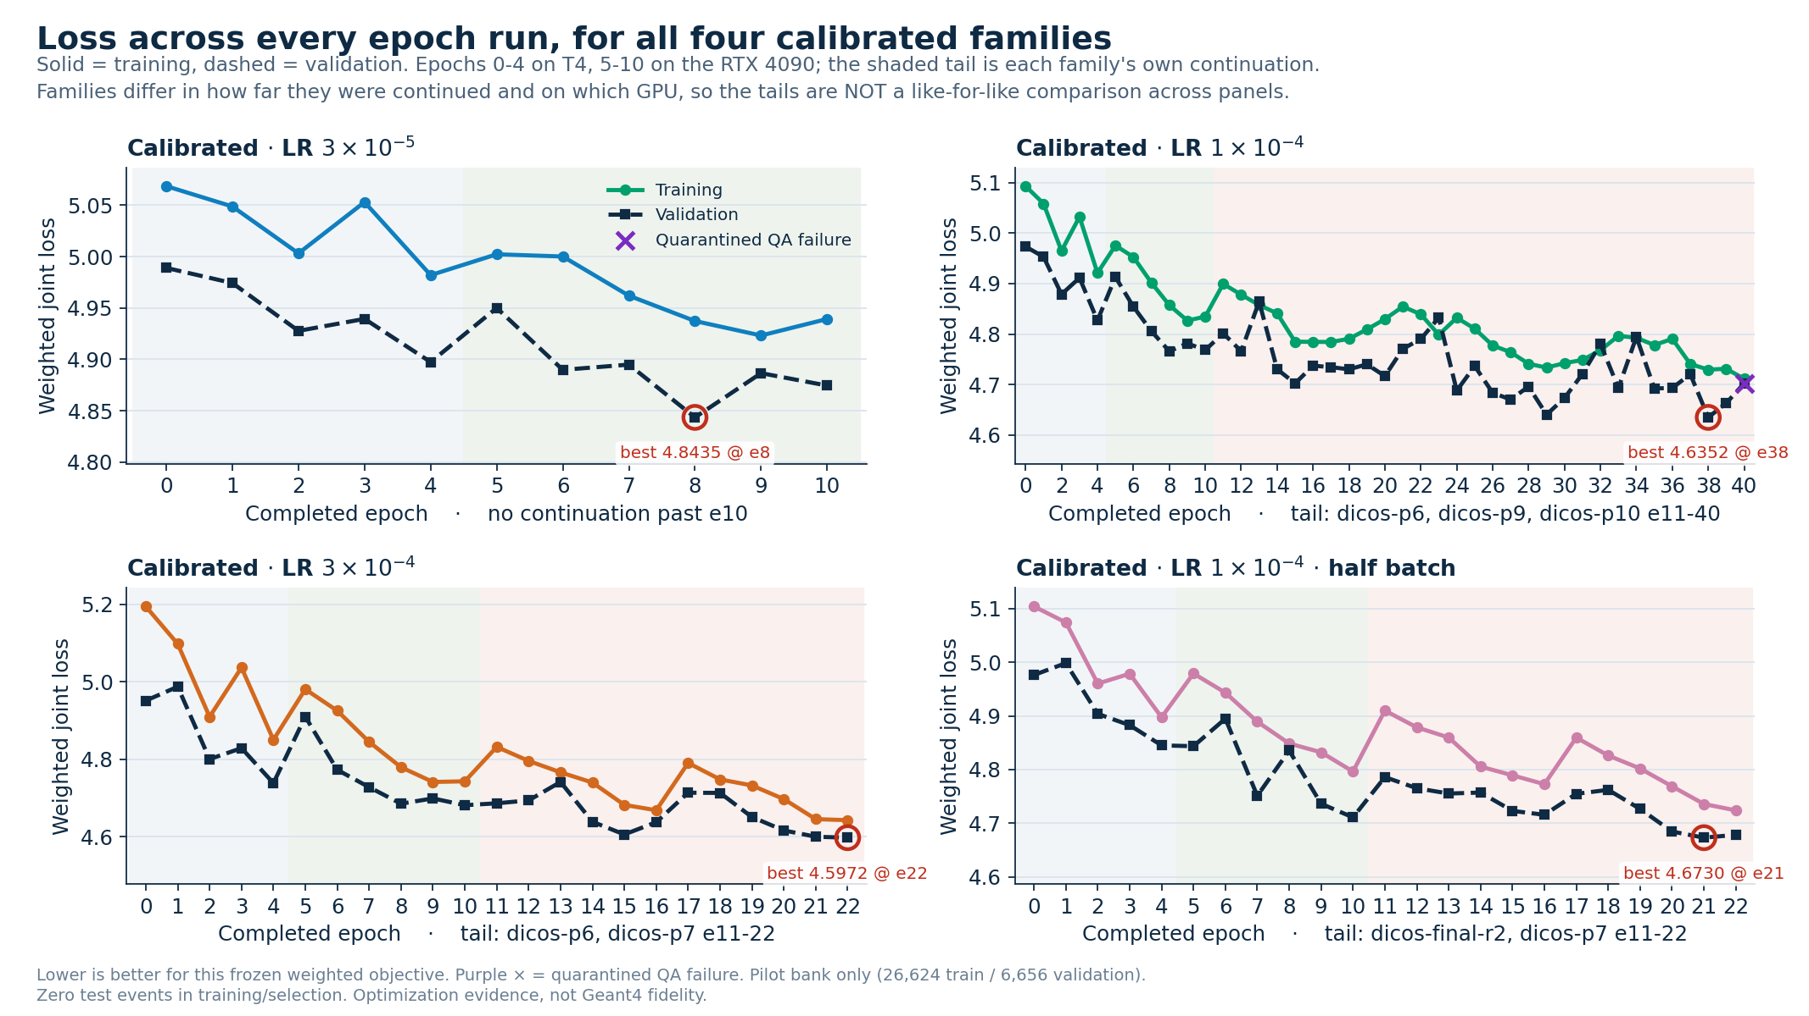
2
Optimization progress — all four calibrated families
Every epoch ever run. Solid = training, dashed = validation.
Purple × marks a quarantined QA failure. Families were continued to different depths on different GPUs, so the tails are not a like-for-like comparison.
Notes:
Point out that lr3e4 (bottom left) holds the lowest loss at 4.5972, and lr1e4 (top right) has had by far the most epochs.

Slide 4
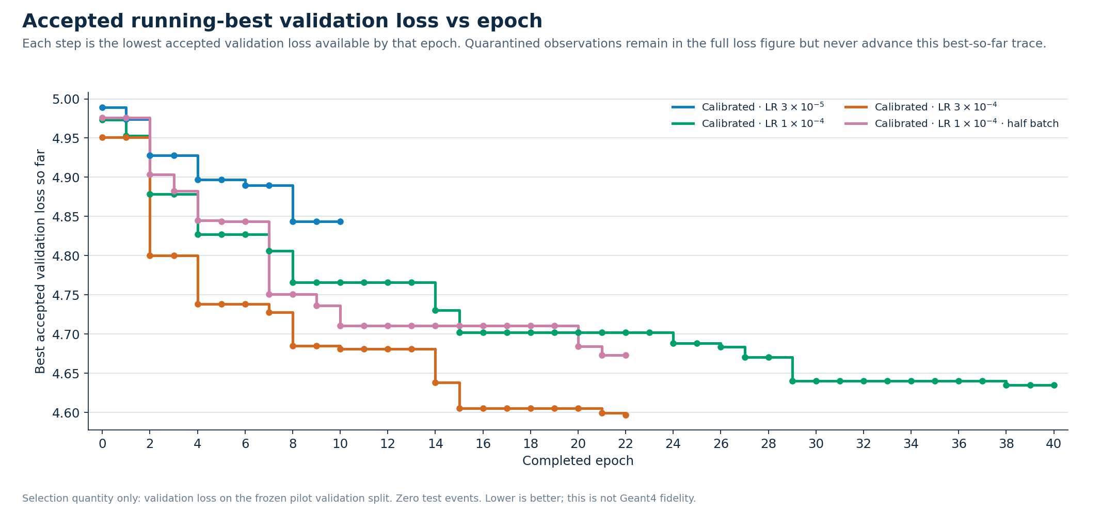
3
Running-best loss — the four families side by side
Each step is the lowest accepted validation loss available by that epoch.
4.597152
4.635220
4.673036
4.843471
lr3e4 · epoch 22 · best overall
lr1e4 · epoch 38
lr1e4 half batch · epoch 21
lr3e5 · epoch 8
Quarantined observations stay in the full loss figure but never advance this best-so-far trace.
Notes:
lr3e4 leads lr1e4 by 0.038. Run-to-run resolution is about 0.02, so the lead is real but no longer commanding — it was 0.105 two phases ago.

Slide 5
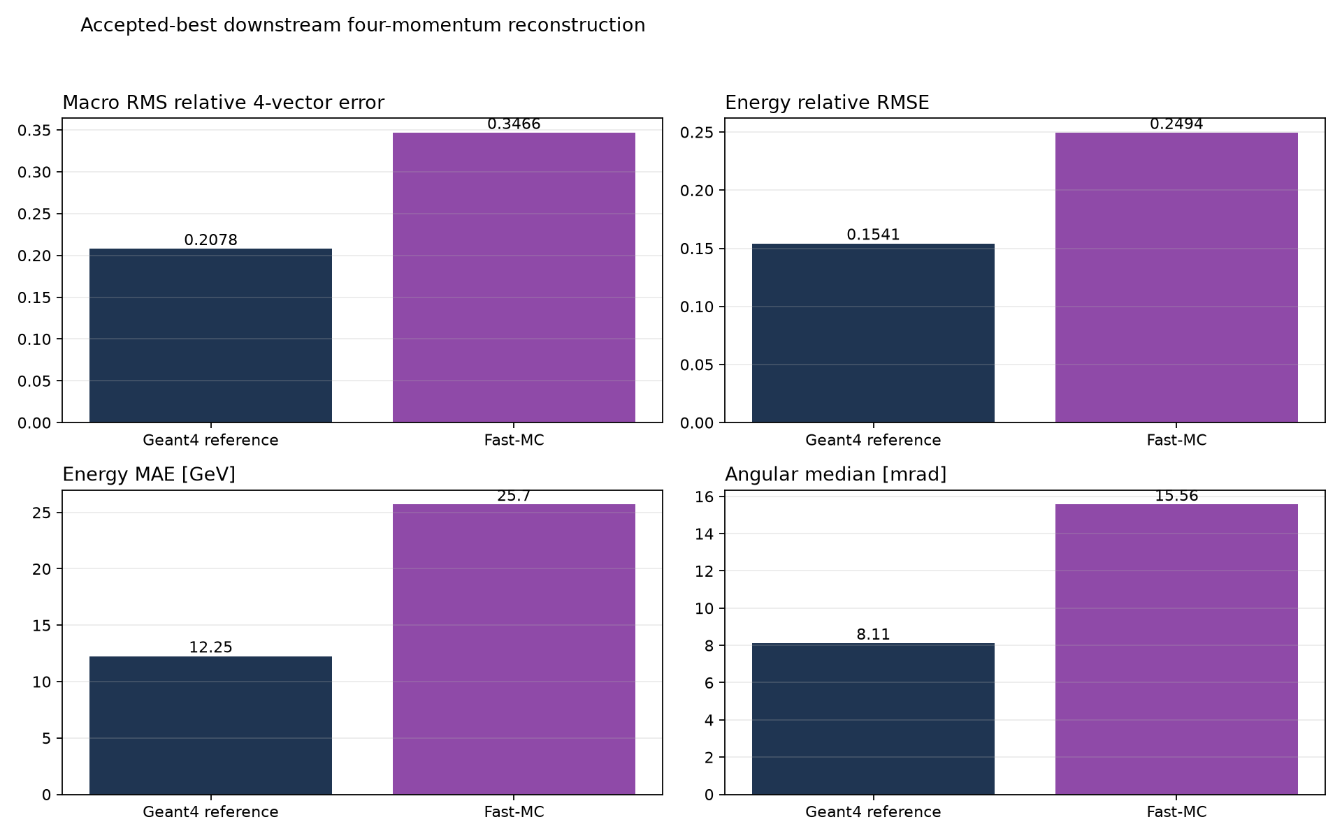
4
New since last time: energy reconstruction, against a Geant4 control
The same frozen 6,790-channel readout adapter is run on both generators, so the Geant4 bar is the reference floor.
1.62×
energy relative RMSE vs Geant4
2.52×
energy 68% width vs Geant4
1.92×
angular median vs Geant4
Fast-MC mean energy response 0.9490 against the Geant4 control's 0.9941 — a −5.1% bias against −0.6%.
Accepted best checkpoint, lr1e4 epoch 38. Validation events only; zero test events. Descriptive downstream evaluation — it cannot select or tune the generator.
Notes:
This is the slide colleagues have never seen. Fast-MC showers now reconstruct energy, and the degradation against a Geant4 control run through the identical adapter is roughly a factor 1.6 to 2.5 depending on the observable.

Slide 6
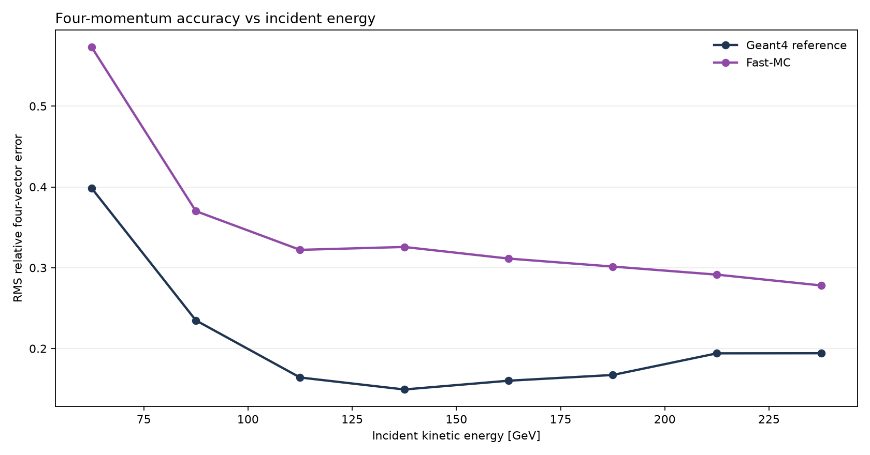
5
Reconstruction error against incident energy
The gap to the Geant4 control is widest at low energy and narrows as the shower gets larger.
0.399 → 0.195
0.280 → 0.137
~500 events
Fast-MC energy RMSE, 50 → 250 GeV
Geant4 control, same bins
per energy bin
Notes:
Both curves improve with energy, as expected for a sampling calorimeter. Fast-MC tracks the shape but sits consistently above the control.

Slide 7
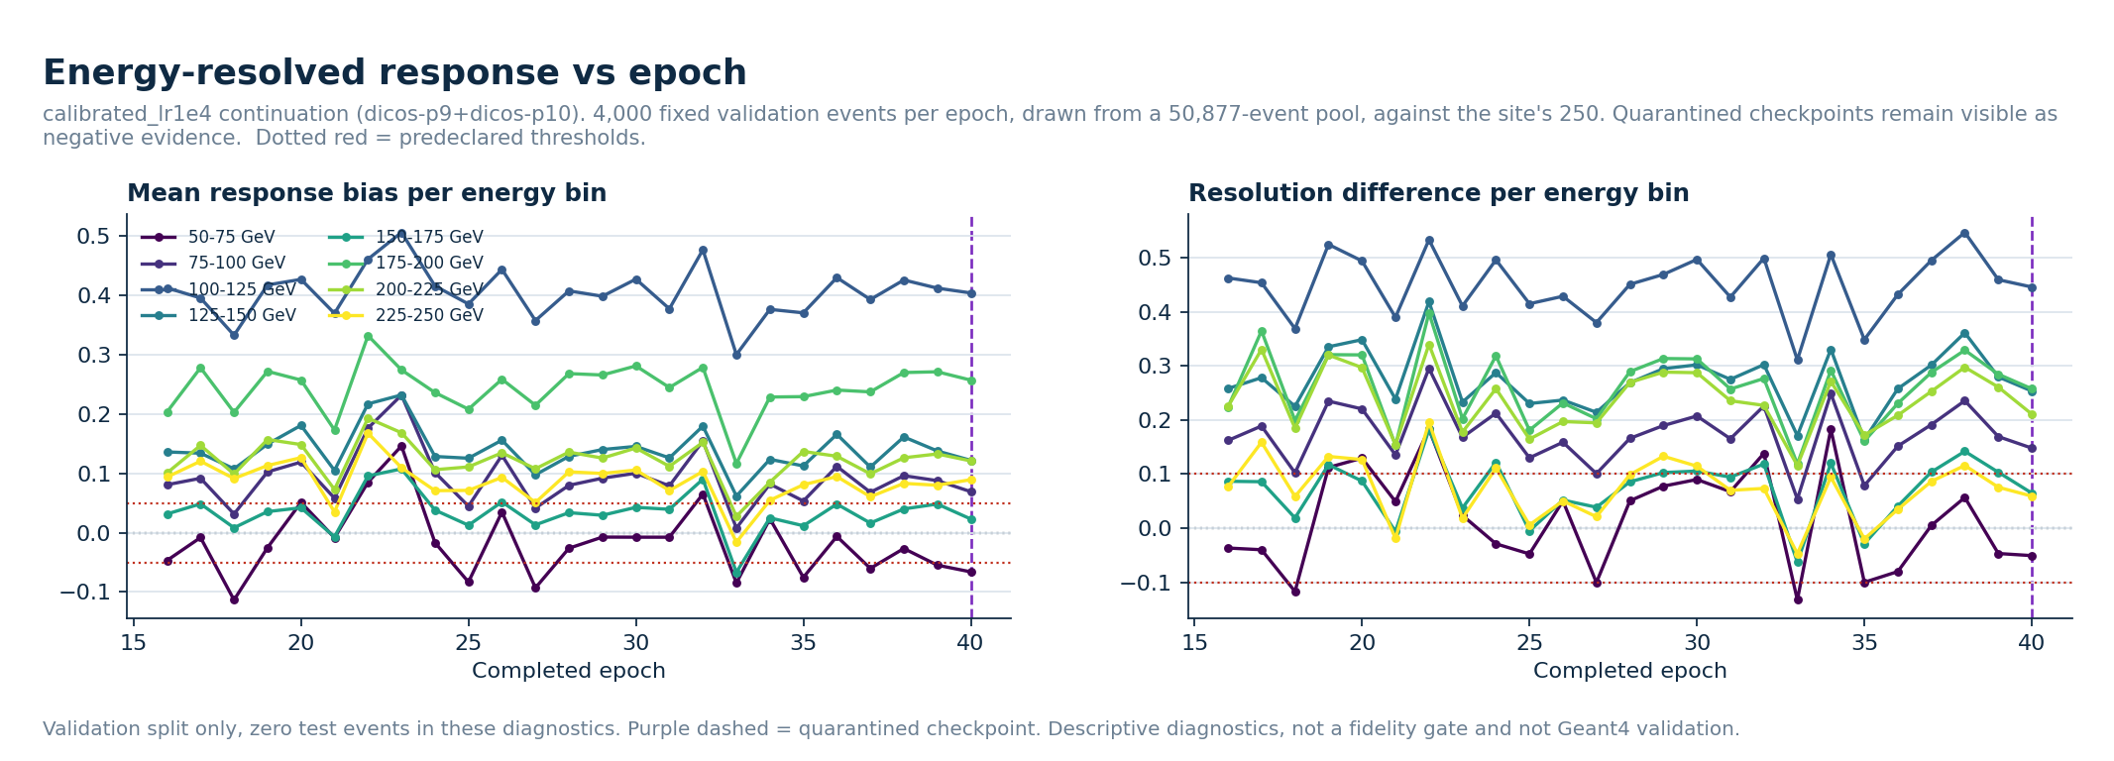
6
Response bias resolved by incident energy, every epoch
Dotted red are the predeclared thresholds. Purple dashed marks a quarantined checkpoint.
The 100–125 GeV bin sits near +0.40 mean response bias for 25 consecutive epochs, far outside the ±0.05 band, and does not improve as the loss falls. Most other bins stay inside or near the band.
Notes:
This is a structured, energy-localised defect rather than global noise, and it is not being fixed by further optimization.

Slide 8
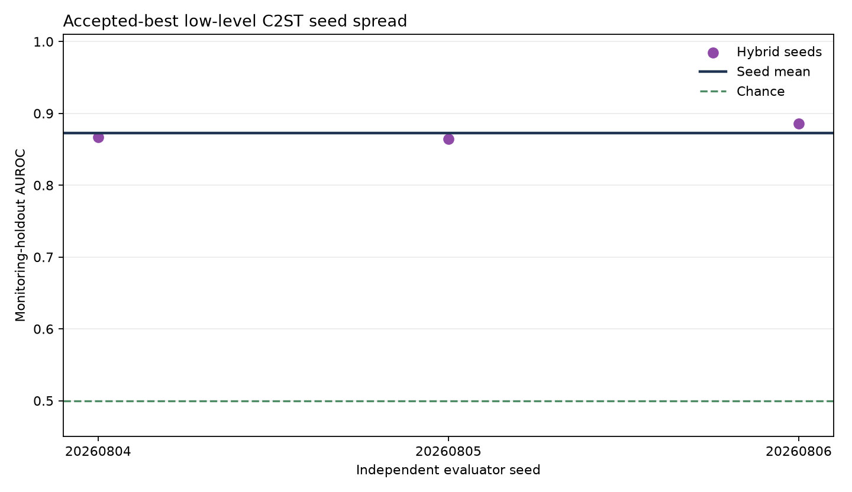
7
Can a classifier still tell the two generators apart?
Yes — and this is the single most important negative result in the project.
Today, epoch 38
Low-level hybrid, 3 seeds
0.8727 ± 0.0117
High-level GBM control
0.9291
Condition-only control
0.5000 (p = 1.0)
The acceptance gate is AUROC ≤ 0.65. No checkpoint the project has ever produced comes close.
The condition-only control sits exactly at chance, so the separation comes from the calorimeter deposits and not from mismatched incident conditions.
Notes:
The condition-only control at exactly 0.5 with p = 1.0 is the important sanity check. Also note the high-level GBM beats the low-level hybrid here, which says the remaining discrepancy lives in summary shower observables, not in fine per-cell structure.

Slide 9
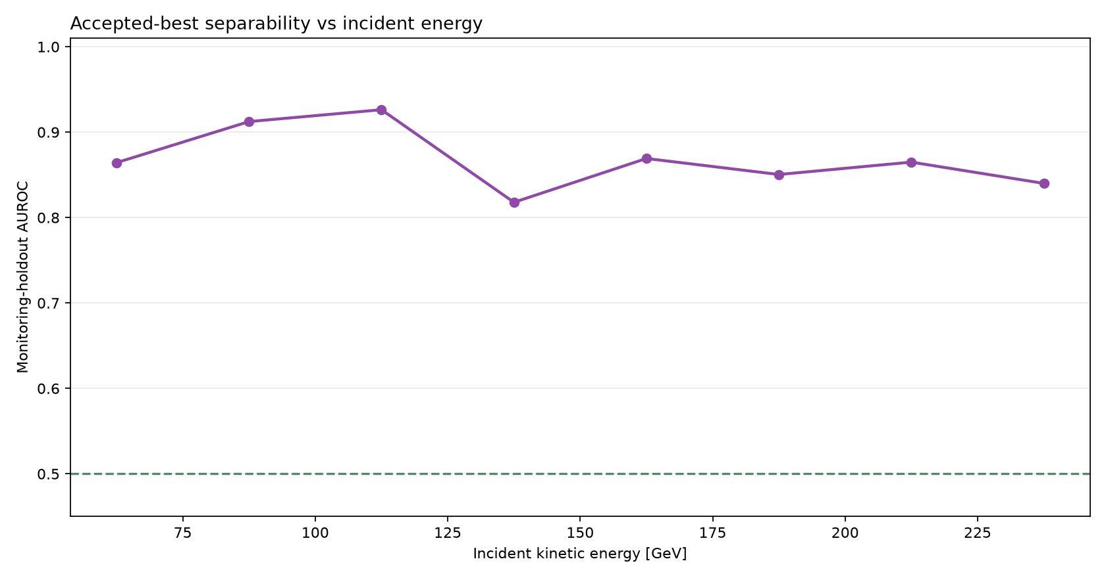
8
Separability does not depend on incident energy
Monitoring-holdout AUROC per energy bin, accepted best checkpoint.
0.82 – 0.93
0.65
0.50
AUROC across every energy bin
acceptance gate, never reached
chance, for reference
Notes:
There is no energy window in which the generator becomes hard to distinguish. The discrepancy is present across the whole claim domain.

Slide 10
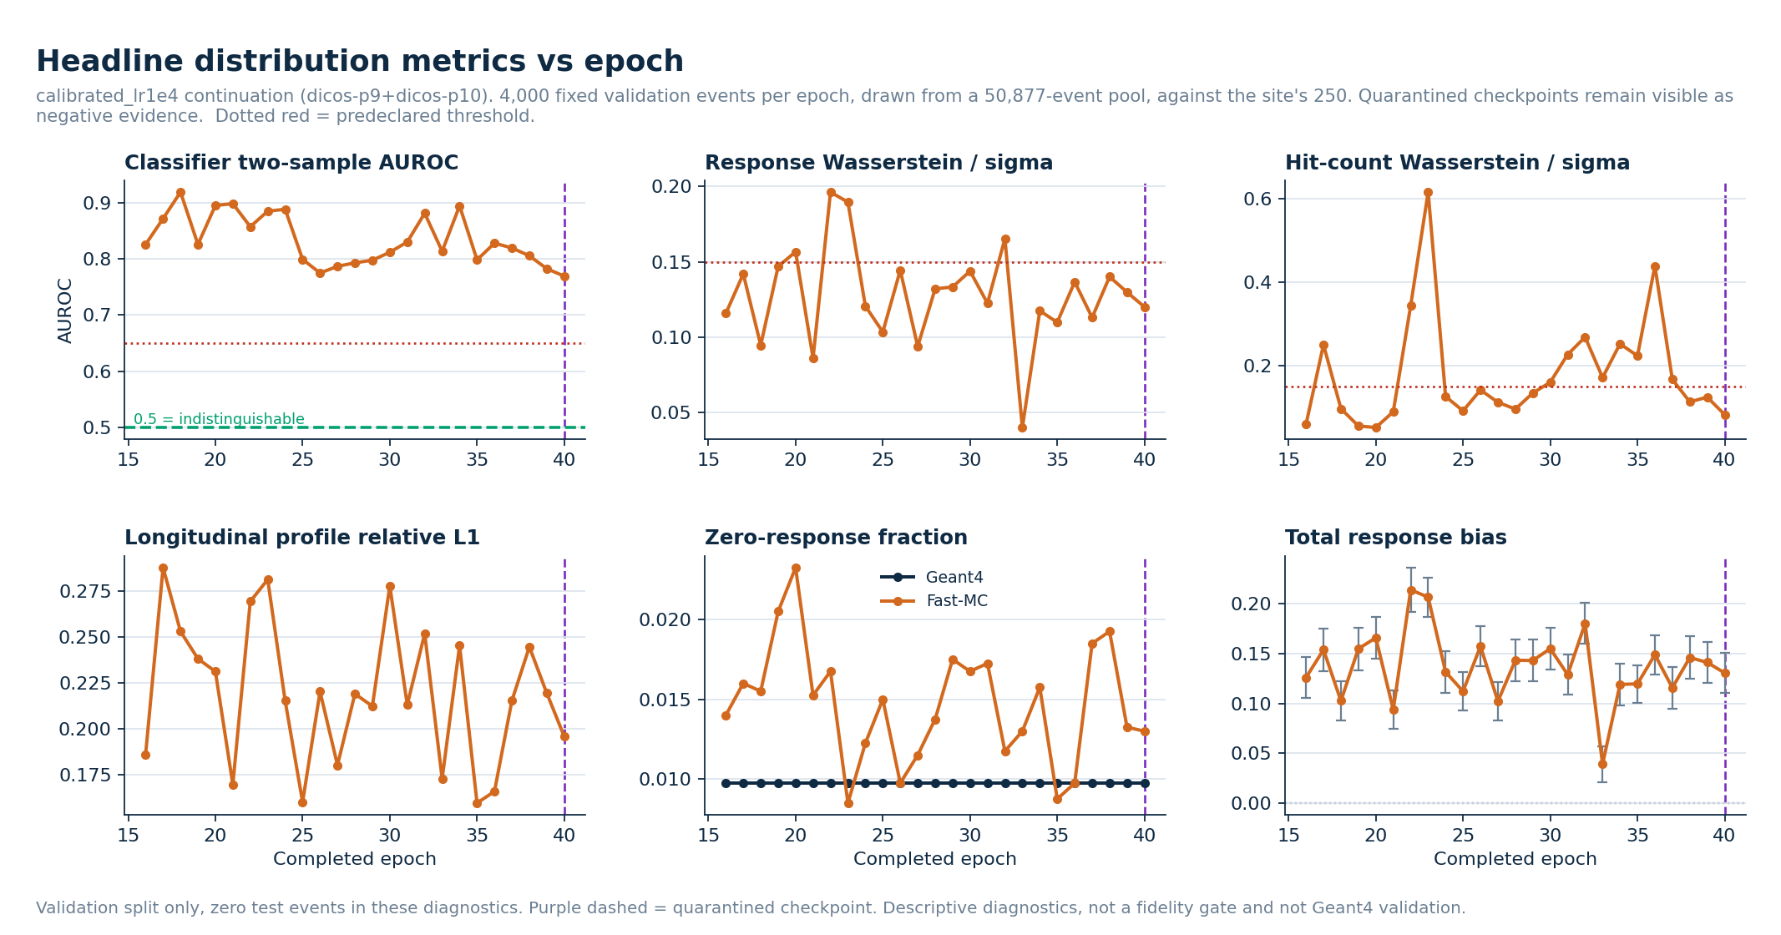
9
Distribution metrics across 25 consecutive epochs
4,000 fixed validation events per epoch. Dotted red are predeclared thresholds.
Top left is the whole fidelity story: AUROC moves between 0.77 and 0.92 over 25 epochs and never approaches the 0.65 gate, while the validation loss improves steadily. Bottom centre: Fast-MC emits roughly twice as many zero-response events as Geant4 throughout.
Notes:
The key point for colleagues: optimization progress and distribution fidelity are decoupled here. A better loss has not bought a less detectable generator.

Slide 11
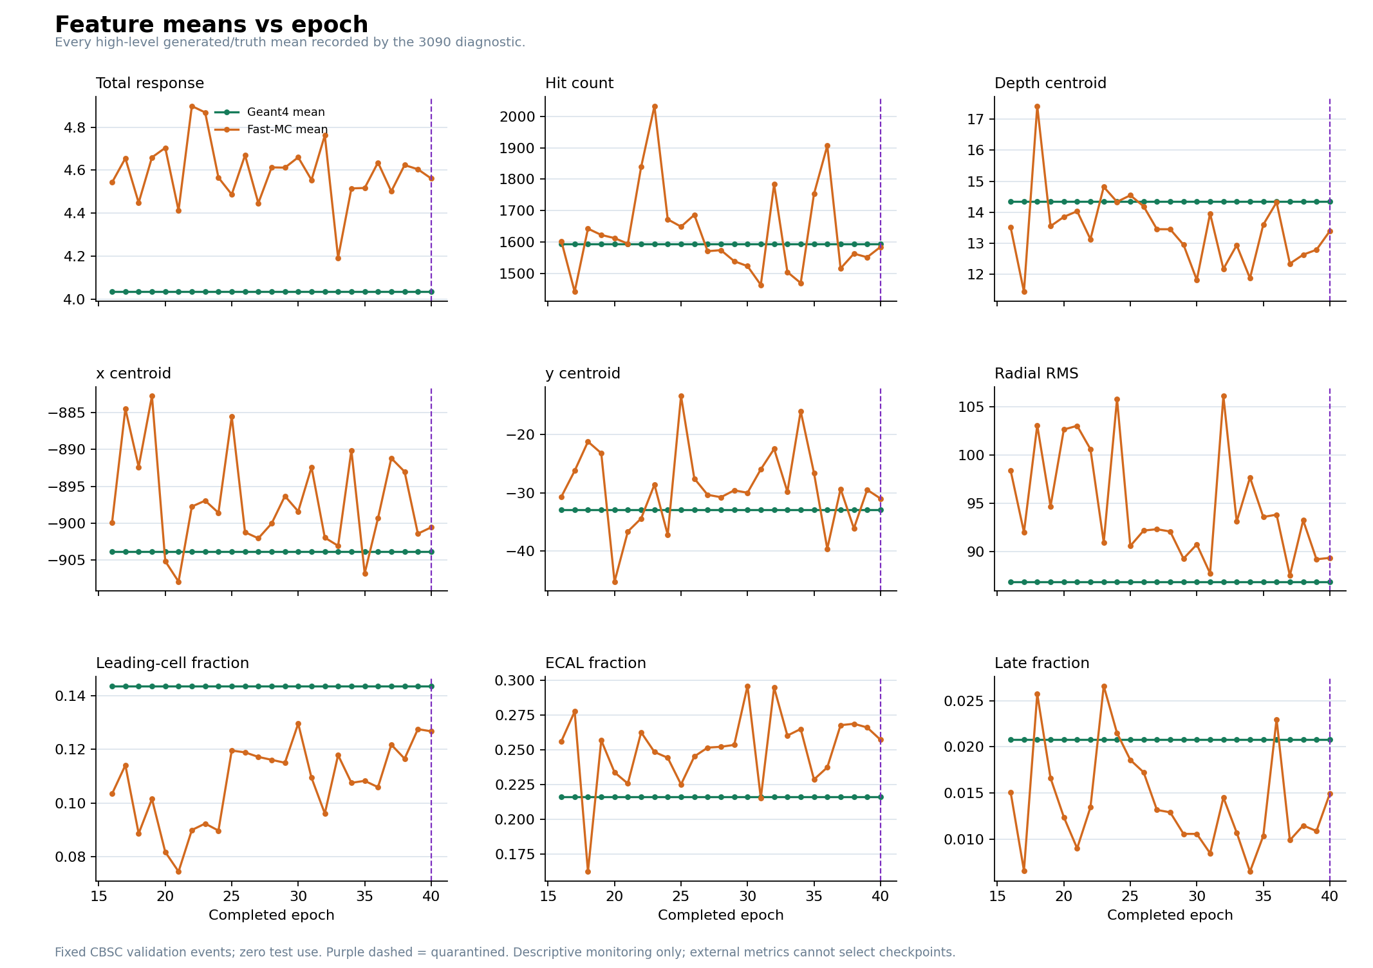
10
Nine shower observables: means against Geant4, every epoch
Green is the Geant4 mean on the same fixed validation events; orange is Fast-MC.
Systematic offsets, not noise. Total response runs about 14% high.
Radial RMS is consistently too wide.
Leading-cell fraction is too low and ECAL fraction too high.
Hit count and the two transverse centroids sit close to Geant4.
Notes:
These are the observables a reconstruction would actually use, so the offsets matter more than the aggregate loss.

Slide 12
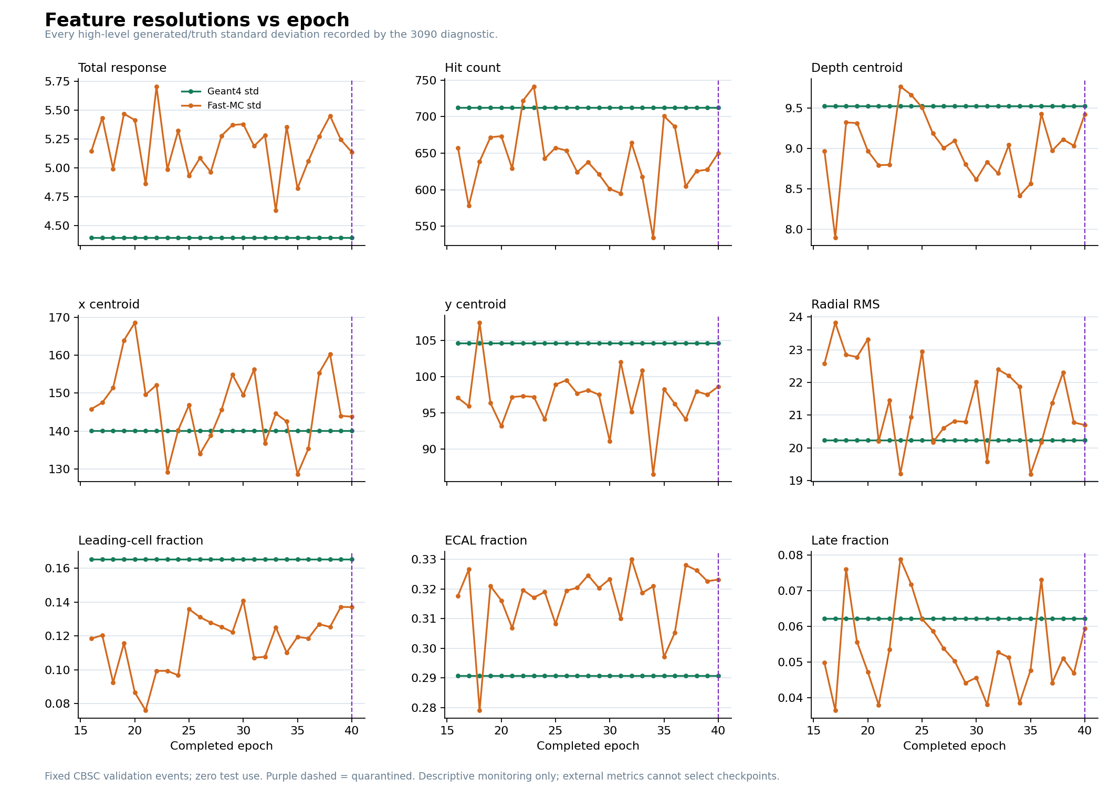
11
The same nine observables: spreads against Geant4
Event-to-event standard deviation. Getting the mean right is not the same as getting the width right.
Right mean, wrong width. Fast-MC over-disperses total response: about 5.1 against Geant4's 4.4.
It under-disperses hit count and leading-cell fraction.
Hit count is the clearest case - the mean matches on the previous slide, the width does not.
This is exactly the kind of mismatch a classifier exploits.
Notes:
Worth pausing on: several observables have the right central value and the wrong spread, which is exactly what a classifier picks up on.

Slide 13
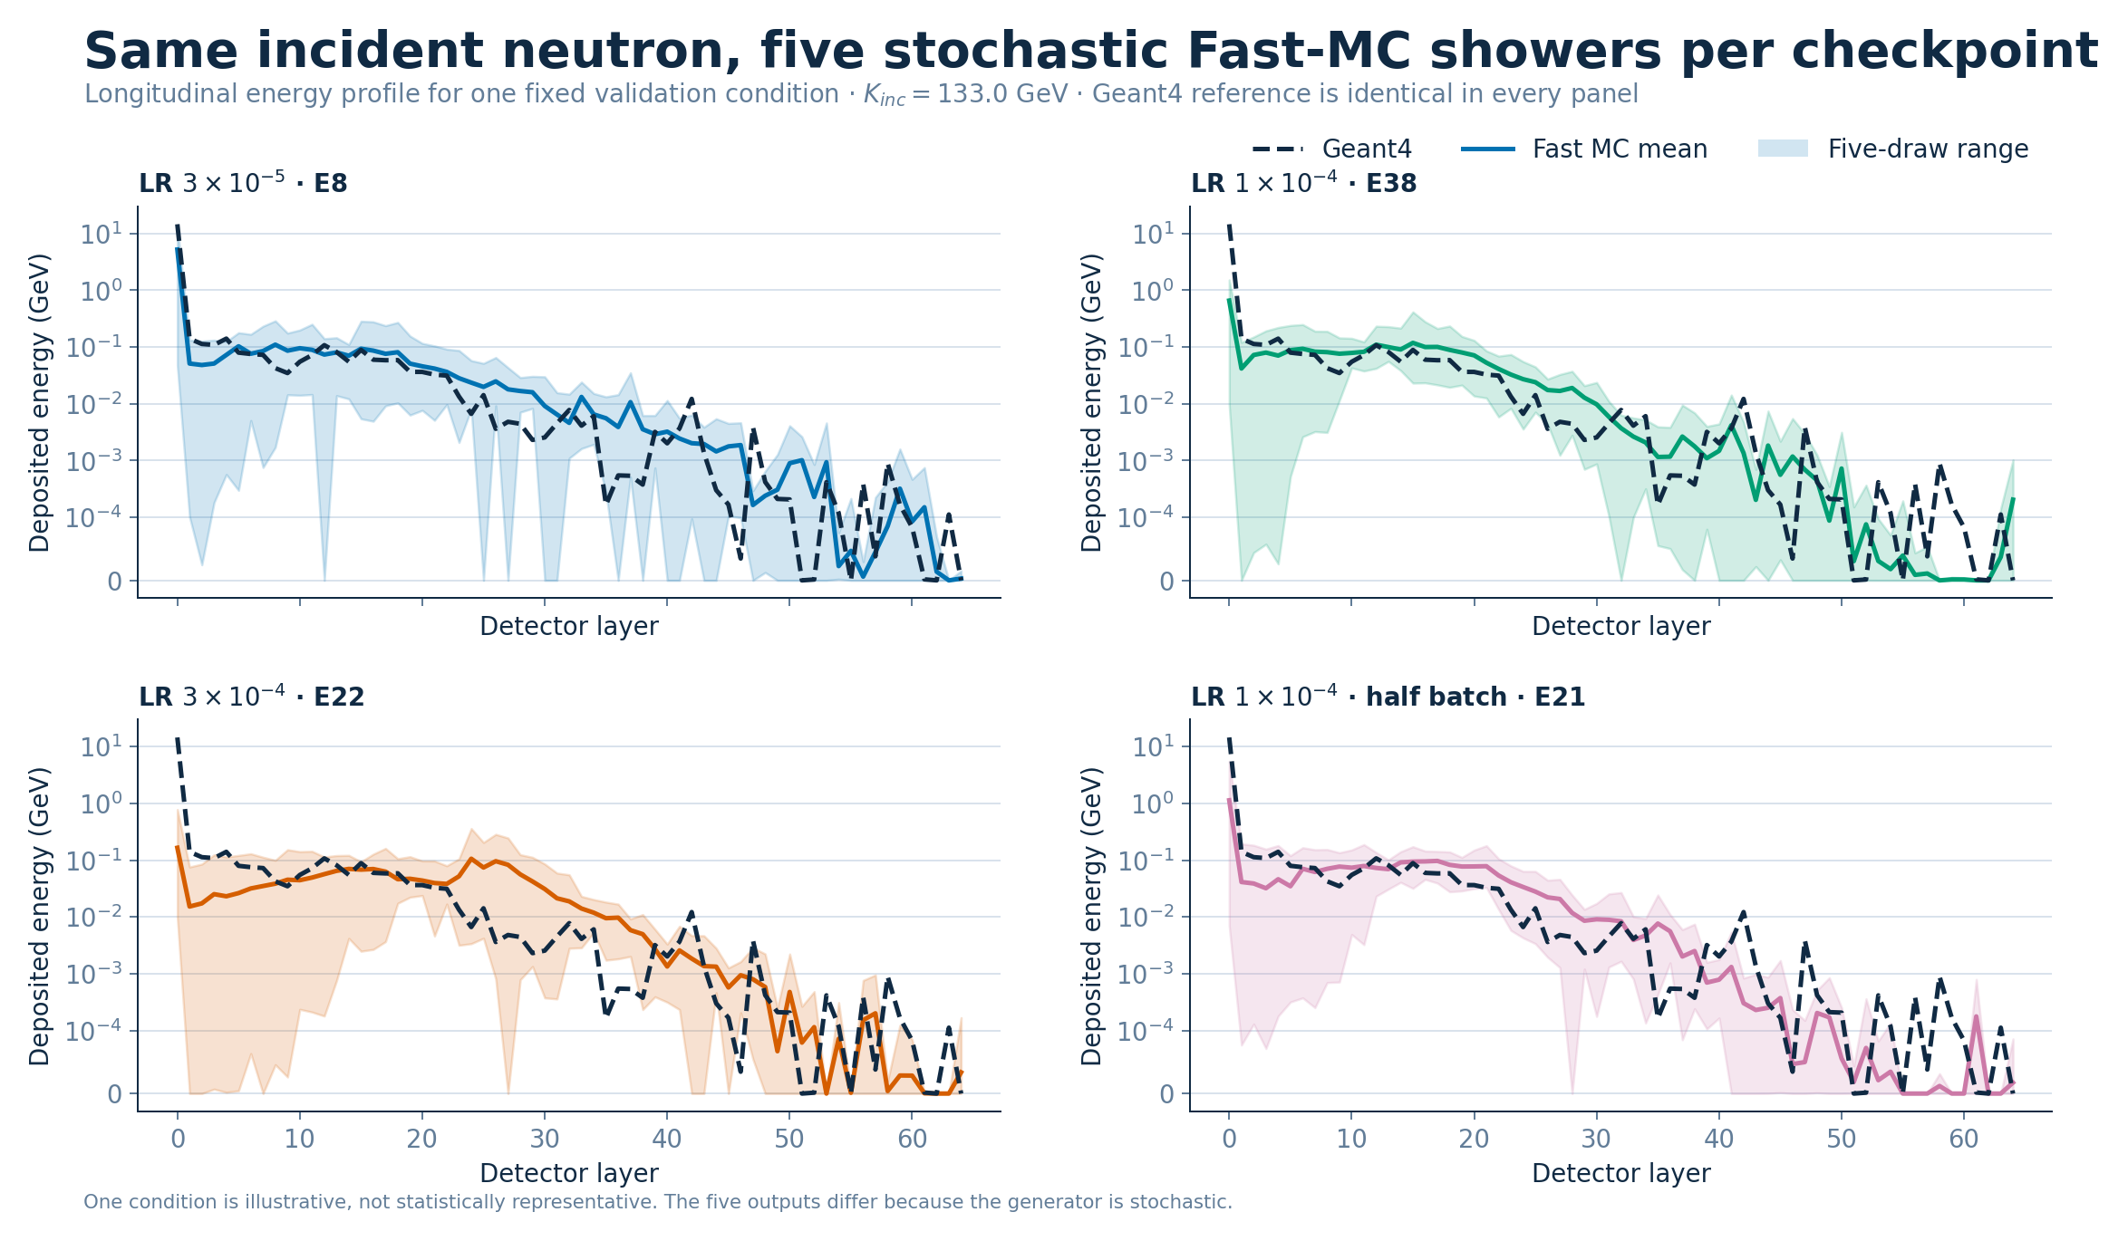
12
Same incident neutron, five stochastic Fast-MC showers
Longitudinal energy profile for one fixed validation condition, per family. The Geant4 reference is identical in every panel.
One condition, illustrative rather than statistically representative. Note the ECAL layer-0 spike: Geant4 deposits ~10 GeV there and Fast-MC undershoots it by two orders of magnitude.
Notes:
The layer-0 undershoot is a real, visible, unresolved defect and worth raising explicitly — it is the clearest single structural discrepancy in the model.

Slide 14
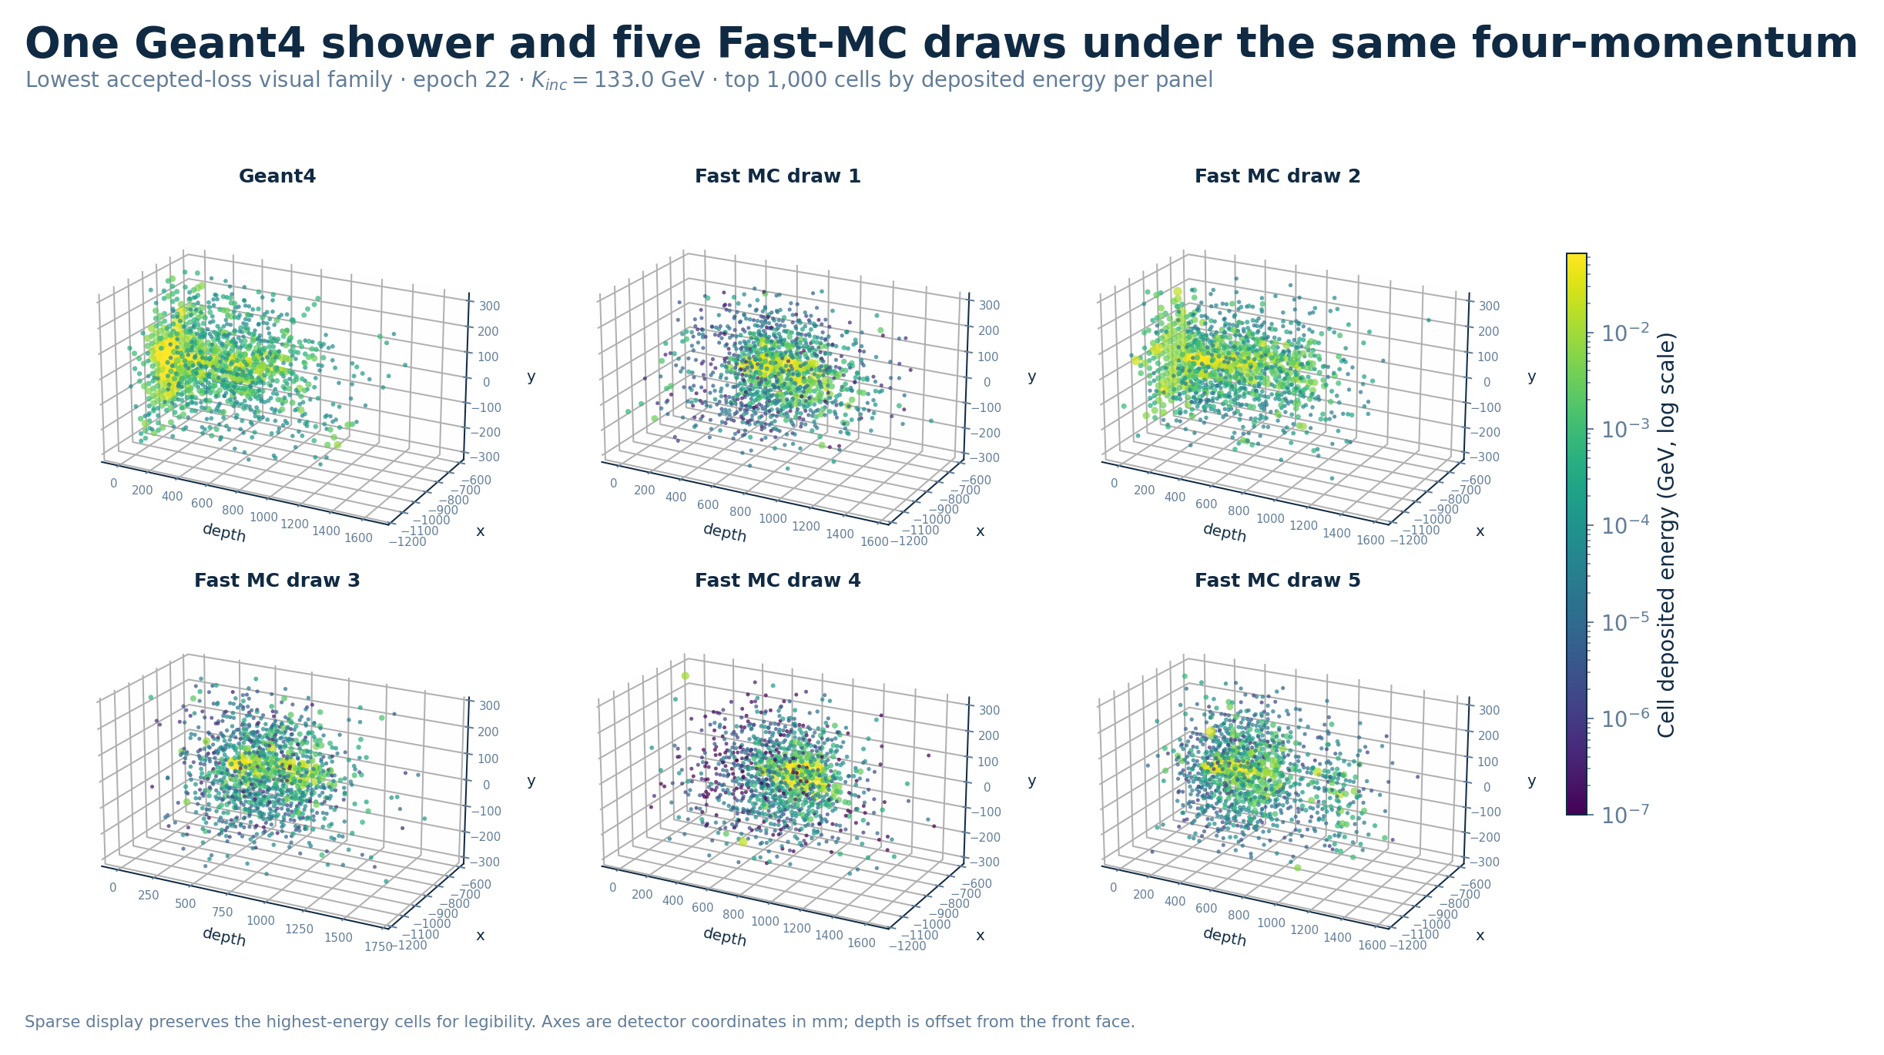
13
One Geant4 shower and five Fast-MC draws, same four-momentum
Lowest accepted-loss family · epoch 22 · K_inc = 133 GeV · top 1,000 cells by deposited energy per panel.
The five draws differ because the generator is stochastic. Plausible-looking events are not evidence of fidelity.
Notes:
Useful for intuition. The Geant4 panel is visibly denser and brighter in the core than any of the five draws.

Slide 15
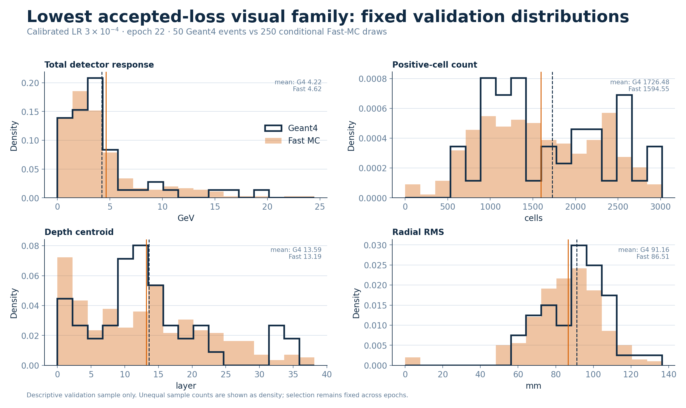
14
Fixed-condition validation distributions
50 Geant4 events against 250 conditional Fast-MC draws, best family, epoch 22.
Total response and radial RMS track well; positive-cell count and depth centroid show the largest residual disagreement.

Slide 16
Where the evidence actually stands
Established
Not established
Production ROOT conversion, frozen geometry and graph
End-to-end FP32 GPU execution, checkpoint and recovery
Zero structural-invariant failures in accepted runs
Short-horizon optimization improvement, four families
Exact decoder: exact zeros, exact hit counts, exact layer budgets
Fixed-condition validation-only visual QA and a public site
Geant4 fidelity — AUROC 0.77–0.92 at every epoch measured
Three-seed behaviour — not yet run
Untouched-test performance — the split stays sealed
Downstream reconstruction — first numbers exist, 1.6–2.5× the Geant4 control
Diversity and memorization acceptance
Fast-MC emits ~2× as many zero-response events as Geant4
The loss and the distribution metrics disagree about which epoch is best. Checkpoint selection follows the validation loss, as declared, and does not switch to whichever metric flatters a run.
Notes:
Do not soften this slide. The honest position is that optimization has moved a long way and fidelity has not been demonstrated.

Slide 17
Running right now
An unattended campaign on two GPUs at Academia Sinica
1
lr3e4, 20 more epochs
Absolute epochs 23–42, resuming from the epoch-22 best. Epoch 23 came in at 4.600282.
2
Then, only if it plateaus
If the best epoch falls more than 6 behind the latest, the campaign advances to lr1e4 half batch, then lr3e5.
3
Diagnostics every epoch
The second GPU generates 4,000 validation events per checkpoint and records 348 metrics, namespaced per run.
The largest untested lever remains the training bank: every result here uses 26,624 events, which is 4.3% of the available training data.
Notes:
If asked what would most likely move fidelity: the pilot bank is 4.3% of the corpus and has never been increased.

