Slide 1
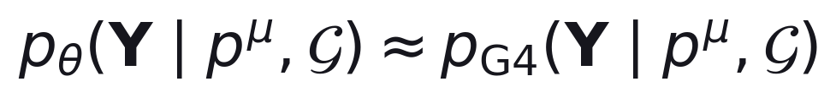
CBSC-ZDC Fast Monte Carlo
Constrained Budgeted Stochastic Cascade v2.2 — construction, objective, and measured state at epoch 4
Target:
State: epoch 4, 26,624 of 612,482 train events (4.3%)
All quoted values traceable to hashed artifacts

Slide 2
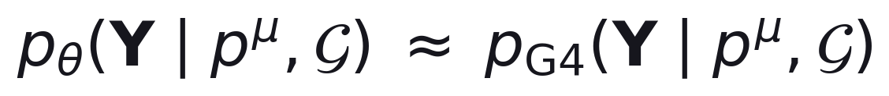
PROBLEM
What is being learned
One event is 6,790 channel energies in GeV. The only conditioning input is the incident neutron four-momentum: total energy and three-momentum.
θ are the network's adjustable numbers; G is the frozen detector geometry. The target is a probability distribution over showers, not one shower: two Geant4 events with the same incident neutron differ, because hadronic interactions are themselves random.
A typical event lights up about 22% of channels. The rest are exactly zero, not nearly zero — that distinction is what the architecture has to protect.
Under an ordinary squared-error fit, a network can lower its score by placing a tiny positive energy in every empty channel: 6,790 hits instead of 1,512, a physically wrong but numerically cheaper answer. Every design choice below exists to make that outcome impossible, not merely discouraged.
2 / 46

Slide 3
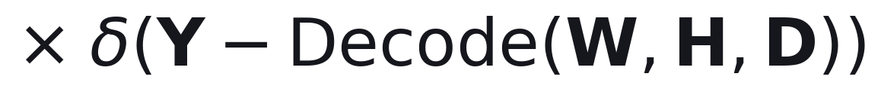
FORM
Nine simpler questions instead of one hard one
The full joint distribution over the shower and every intermediate physical quantity used to build it.
One factor per physical question: did anything happen (V), how much energy in total (T), which layer starts it (L0), which layers are on (A), how the energy splits across layers (D), how many cells per layer (K), which exact cells (H), how energy splits across those cells (W). Every symbol is defined on the 'Symbols' slide.
The last factor is not learned: it is plain arithmetic that turns the choices above into the final 6,790 energies.
In plain terms: decide roughly first (did anything happen, how much energy), then decide precisely (which cells, exactly how the energy is split). Each later decision is only ever allowed to divide up what an earlier decision already fixed.
3 / 46

Slide 4
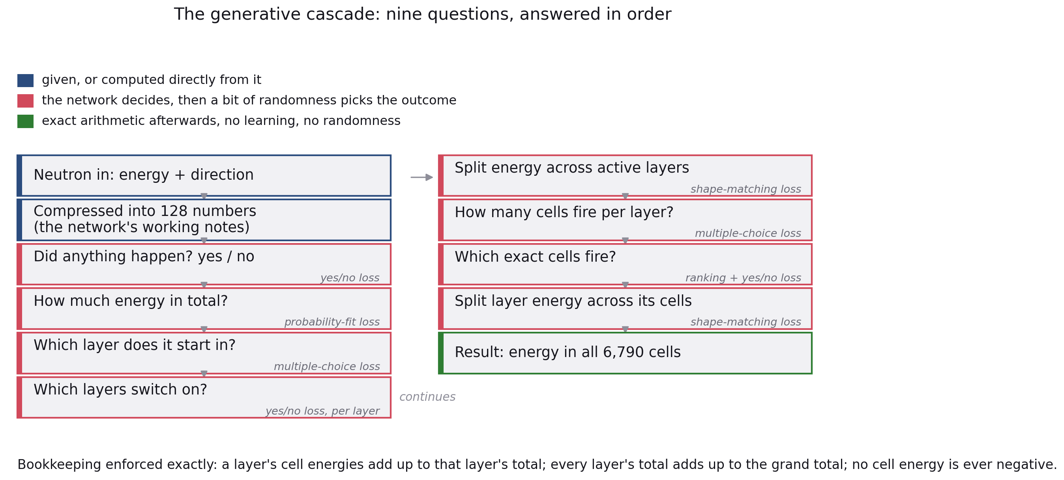
FORM
The cascade, as nine questions
4 / 46

Slide 5
NOTATION
Symbols: the detector's fixed geometry
These five are given directly by the frozen detector; nothing here is learned.
Symbol
Meaning
Value
N
readout channels
6,790
L
longitudinal layers
65
N_l
channels in layer l
400, then 63x100, then 90
layer(i)
the layer that contains channel i
0 .. 64
edges
directed graph edges between channels
107,920
Geometry SHA-256 e22d4cfb1e9293a33dd13151587910268ba64cd8…
5 / 46

Slide 6
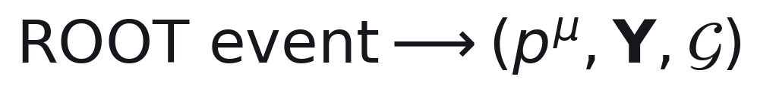
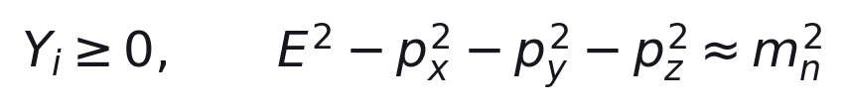
CONVERSION
Raw event conversion and truth construction
INPUTS
frozen geometry map, hit to channel
MODEL
None — deterministic preprocessing.
mass-shell energy; multiple hits per cell summed
LOSS
no trainable loss — validation checks only
OUTPUT
and the frozen detector geometry and graph, G
6 / 46

Slide 7
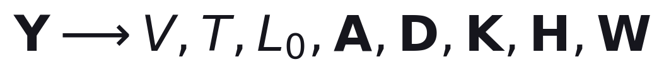
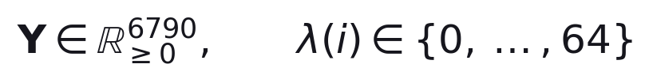
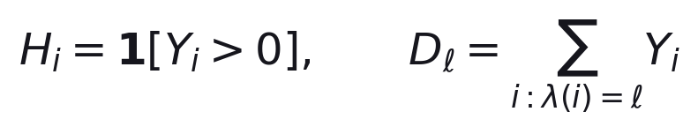
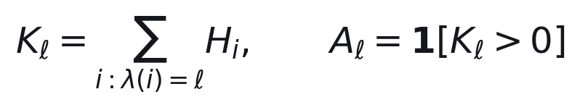
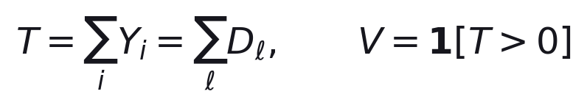
TRUTH
Derived truth variables
INPUTS
MODEL
None — every quantity below is a deterministic derivation.
LOSS
None — these are training targets, not trained losses.
OUTPUT
cell support; layer energy
first active layer; within-layer energy share
7 / 46

Slide 8
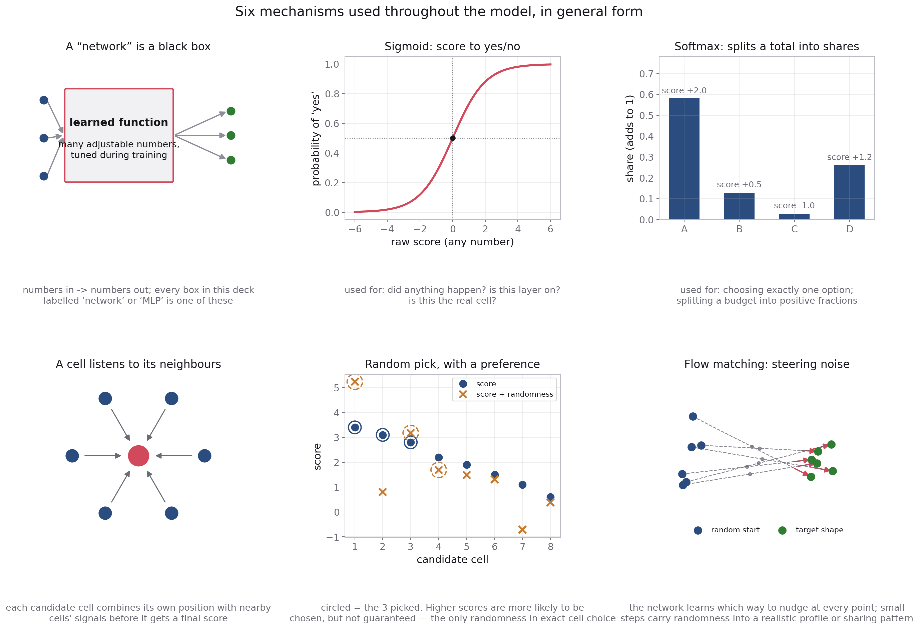
TOOLKIT
Six mechanisms this model reuses throughout
Later slides name a mechanism and point back here rather than re-deriving it. The physics reasoning for each stage — why a mixture of Gaussians, why a count instead of a fixed rule, why some channels are weighted more than others — stays on that stage's own slide; this page covers only the reusable machinery.
8 / 46

Slide 9
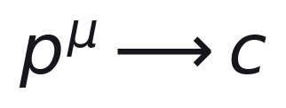
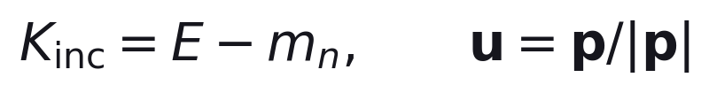
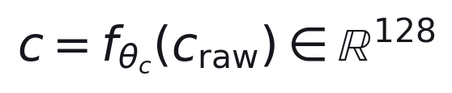
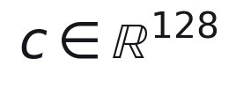
ENCODER
Neutron condition encoder
INPUTS
kinetic energy; unit direction
MODEL
Residual MLP: 5 -> 128 -> residual blocks -> LayerNorm (see toolkit).
LOSS
None — shaped only by gradients from the nine downstream losses.
OUTPUT
supplied to every later stage
9 / 46

Slide 10
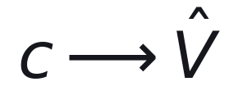


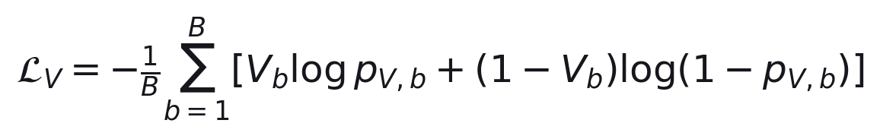
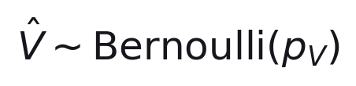
VISIBILITY
Visibility model
INPUTS
MODEL
Binary MLP (see toolkit: sigmoid).
score from c
LOSS
binary cross-entropy
OUTPUT
gates every later stage
10 / 46

Slide 11
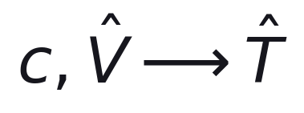
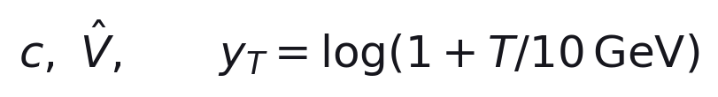
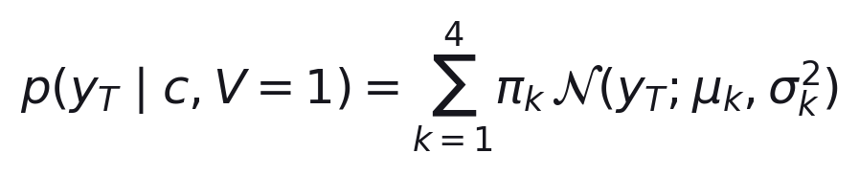
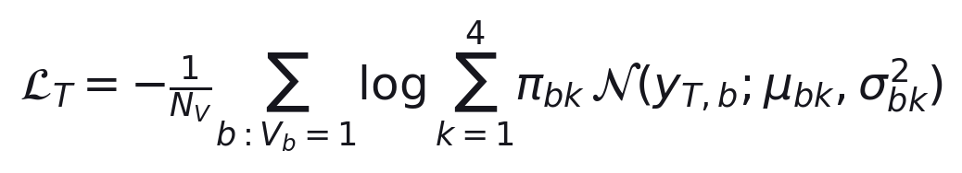
RESPONSE
Total-Response Model
INPUTS
training target
MODEL
4-component Gaussian-mixture MLP.
LOSS
negative log-likelihood
OUTPUT
sampled, clamped, safety-capped
11 / 46

Slide 12
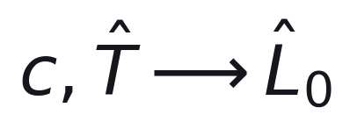
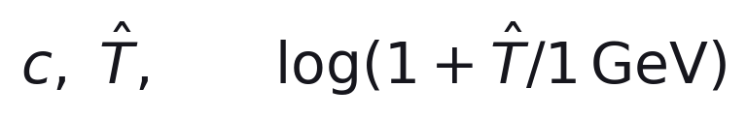
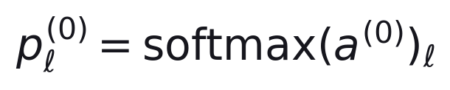
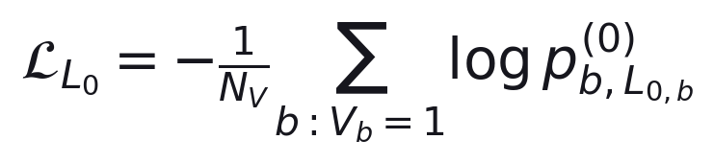
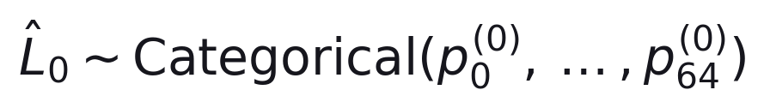
FIRST LAYER
First-Positive-Layer Model
INPUTS
MODEL
Categorical MLP, 65 logits (see toolkit: softmax).
LOSS
categorical cross-entropy
OUTPUT
12 / 46

Slide 13
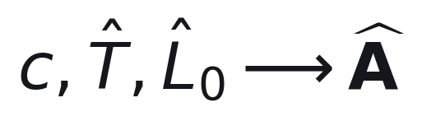
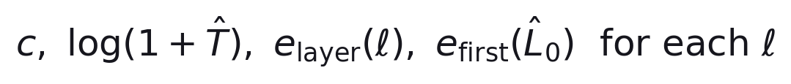
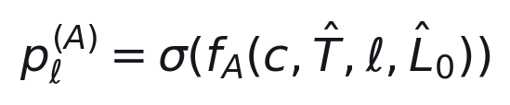
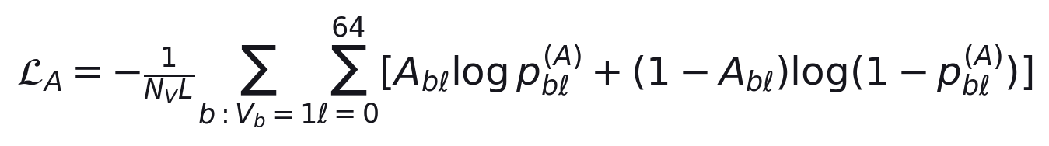
ACTIVITY
Layer-Activity Model
INPUTS
MODEL
Per-layer binary MLP (see toolkit: sigmoid).
LOSS
binary cross-entropy, per layer
OUTPUT
sampled, then constrained
13 / 46

Slide 14
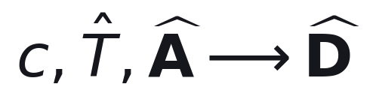
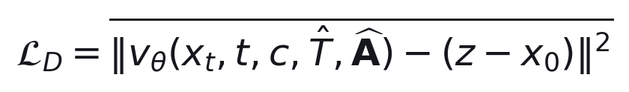
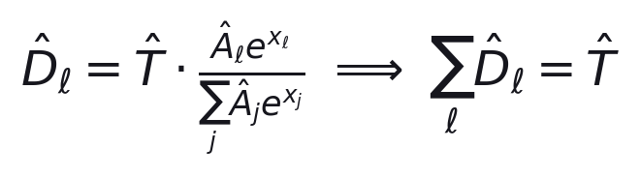
PROFILE
Longitudinal-Profile Model
INPUTS
training target
MODEL
Conditional flow matching, Transformer over 65 layers (see toolkit).
LOSS
masked flow-velocity MSE
OUTPUT
8 Euler steps, then masked softmax
14 / 46

Slide 15
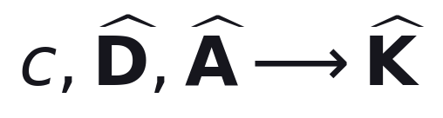
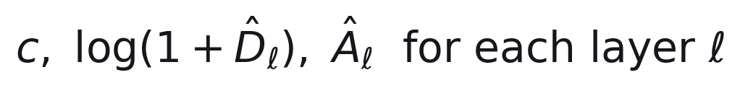
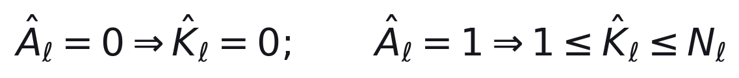
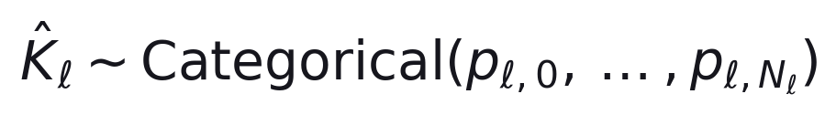
HIT COUNT
Layer Hit-Count Model
INPUTS
MODEL
Categorical MLP, masked by layer capacity N_l.
LOSS
weighted categorical cross-entropy
OUTPUT
15 / 46

Slide 16
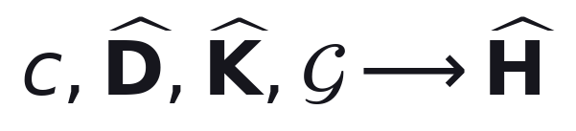
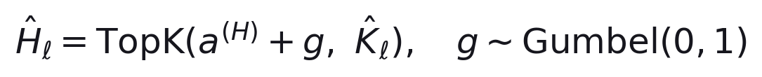
SUPPORT
Geometry-Aware Support Model
INPUTS
per-cell geometry, condition, requested occupancy, graph
MODEL
GNN message passing + layer-level Transformer (see toolkit).
LOSS
weighted binary cross-entropy
pairwise ranking
OUTPUT
see toolkit: Gumbel-Top-K
16 / 46

Slide 17

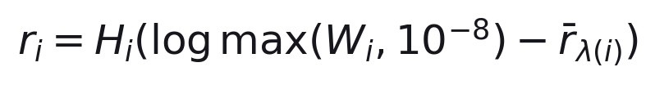
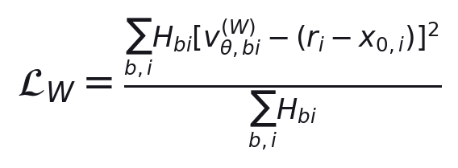
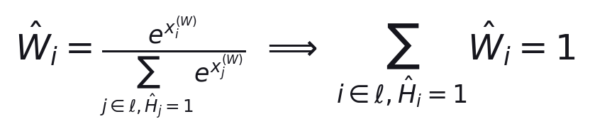
SHARE
Within-Layer Energy-Share Model
INPUTS
training target
MODEL
Second conditional flow-matching field, GNN + Transformer (see toolkit).
LOSS
masked flow-velocity MSE, hit cells only
OUTPUT
masked softmax over selected cells
17 / 46

Slide 18
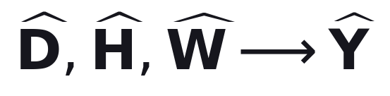
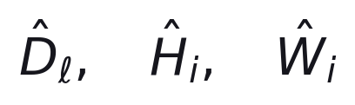
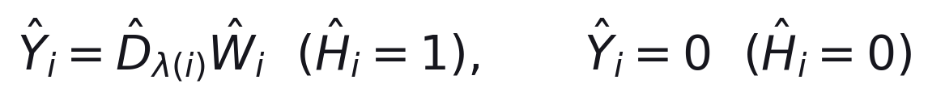
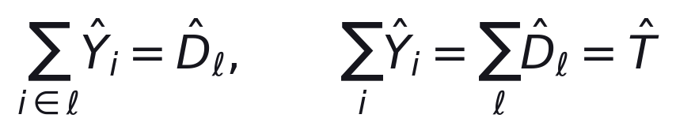
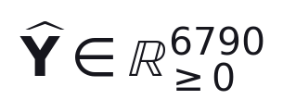
DECODER
Exact Constrained Decoder
INPUTS
MODEL
None — deterministic decoder, no learned parameters.
LOSS
exact by construction, not a training penalty
OUTPUT
closure residual measured below 0.00002 GeV/event
18 / 46

Slide 19
OBJECTIVE
What each loss physically measures
Nine questions, nine losses. The table below states what each one measures in the detector, not its formula — the formulas are on the stage slides above.
Stage
What it measures physically
Loss type — why
Visibility
did the detector see anything at all?
yes/no loss — the outcome is binary
Total energy
how much energy in total, given something happened?
probability-fit loss — many totals are physically possible
First layer
which of the 65 layers does the shower start in?
multiple-choice loss — exactly one starting layer
Active layers
which layers switch on?
yes/no loss per layer — each layer switches independently
Layer energy
how is the total energy split along the depth?
shape-matching loss — a continuous shape, many valid answers
Hit counts
how many cells fire in each layer?
multiple-choice loss — a whole number with an arbitrary spread
Which cells (2 losses)
which exact cells fire?
ranking + yes/no loss — needs a reliable order over 6,790 candidates
Cell energy shares
how is a layer's energy split among its cells?
shape-matching loss — a continuous shape again
These nine numbers are not on the same scale, so their raw values cannot be compared to judge importance — only each one's own trend over time means anything. That is exactly why the next two slides exist: nine losses pulling on one shared network need their pull deliberately balanced.
19 / 46

Slide 20
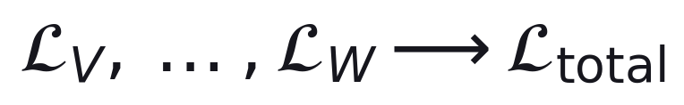
OBJECTIVE
Joint Training Objective
INPUTS
the nine stage losses above
MODEL
None — combines existing losses, sends gradients through every stage.
LOSS
weights from the calibration on the next slide
OUTPUT
20 / 46

Slide 21






CALIBRATION
Loss-Weight Calibration
INPUTS
sample batches, one fixed checkpoint
MODEL
None — deterministic calibration procedure.
LOSS
reference scale; inverse-loudness proposal
capped, then renormalised to mean 1
OUTPUT
fixed for all of joint training
21 / 46

Slide 22

OBJECTIVE
The four balancing steps
Panel 1: how loud each loss naturally is (log scale). Panel 2: the proposed opposite volume-knob turn. Panel 3: the turn is capped at a factor of 16 either way — red bars were capped. Panel 4: everything is rescaled so the average knob position is 1. Five of nine losses are never capped, so they end up exactly equally loud after rebalancing.
22 / 46

Slide 23
STATUS
Training configuration and current state
Quantity
Value
Meaning
Epochs
4
each epoch is one pass over the bounded bank
Train bank
26,624
4.3% of the 612,482 available
Validation bank
6,656
checkpoint selection only
Test events used
0
the sealed split was not touched during training
Optimiser
AdamW
learning rate 1e-4 down to 1e-6, gradually
Gradient clip
1.0
caps how large a single update step can be
Effective batch
24 (6 x 4)
12 for the half-batch control
Precision
FP32
a faster mode was tried and produced broken numbers
Solver steps
8 + 8
profile and share flow, 8 steps each
Every result that follows is measured at epoch 4 on 4.3% of the training data. It bounds what the architecture has done SO FAR, not what it can do.
23 / 46

Slide 24

STATUS
The overall training signal against epoch
Four variants differing only in learning rate and effective batch. Epoch 3 regressed for two variants before epoch 4 recovered to a new minimum for all four. Final validation objective ranges from 4.738041 to 4.897327, a spread of 3.4% — this is optimisation progress, not a physics measurement.
24 / 46

Slide 25

STATUS
The nine losses, plotted separately
Vertical scales differ by orders of magnitude between panels — do not compare one panel's numbers with another's. The total-energy loss is negative throughout: a likelihood-based loss can legitimately go negative when the fitted distribution is narrow and correct, which is a sign of a tight fit, not an error.
25 / 46

Slide 26

TEST
Classifier two-sample test
If the two sources were truly identical, no classifier could beat chance on data it has not seen. This turns 'are the distributions the same?' into an ordinary supervised-learning problem: mix the two sources, label which is which, and see if a classifier can be trained to tell them apart.
Probability that a randomly chosen Geant4 event scores higher than a randomly chosen generated one. 0.5 = a coin flip, indistinguishable. 1.0 = the classifier is always right. This measure needs no chosen threshold.
A closed-form reference for how far from 0.5 pure chance could plausibly land: with 12,000 held-out events, a 5%-significance threshold sits at 0.5089.
A single training's AUROC varies more than its own statistical interval suggests, so one number is not reportable on its own. Repeating the training and reporting a spread follows the same convention used in the CaloChallenge 2022 community comparison of fast-simulation models.
The asymmetry that matters: a HIGH AUROC proves the two distributions differ — a positive result either way. A LOW AUROC only shows that this particular classifier, on this representation, at this sample size, did not find a difference — it is never proof that no difference exists.
26 / 46

Slide 27
TEST
What was actually run
Element
Value
Purpose
Geant4 events
40,000
drawn from the sealed test split
Fast-MC events
40,000
10,000 from each of the four trained variants
Conditions
train-split four-vectors
keeps test conditions out of the generator
Classifier input
6,790 channels + geometry + four-vector
the full readout
Partition
70 / 15 / 15
the scored 15% is touched exactly once
Repeats
5
reported as mean +/- spread
Controls
3
described on the next slide
The most important row is 'conditions': feeding the generator only train-split four-vectors means the two classes' incident energies and directions cannot differ, so a classifier cannot cheat by reading the input instead of the shower.
27 / 46

Slide 28

TEST
What each classifier looks like
One primary model plus three controls, all producing a single number: how Geant4-like is this event? The condition-only control is the validity check for the whole test — if it alone can separate the classes, the two sets of four-vectors were mismatched and every other result on the next slides is void.
28 / 46

Slide 29

RESULT
How well can a classifier tell them apart?
A classifier was shown real Geant4 events and generated events, mixed together and unlabelled, and asked to guess which is which. A score of 0.5 is a coin flip. A score of 1.0 means it is always right.
0.99945
AUROC, mean +/- 0.00009 over 5 independent trainings
0.99945
0.5 = can't tell them apart
1.0 = always right
The measured accuracy sits 107 chance-level standard deviations above a coin flip — background noise essentially never produces this by luck.
A version of the same test that is shown ONLY the neutron's energy and direction, no detector data at all, scores at the exact chance level to five decimal places. This confirms the high score above comes from real differences in the simulated detector data, not from any mismatch in how the two datasets were built.
29 / 46

Slide 30

RESULT
ROC curves, primary model and controls
Hybrid (primary, sees geometry): 0.9996.
Dense (geometry-blind, all 6,790 channels): 0.9962.
Feature GBM (15 shower-shape numbers only): 0.9852.
Condition-only (no detector data): 0.5036, on the diagonal.
Separability survives every simplification of the input representation, so it is not an artefact of one particular way of encoding the event.
30 / 46

Slide 31
DIAGNOSIS
Which observables carry the signal?
Each observable scored on its own. 0.5 = carries no information about which class it is.
At chance
Separating
hit count
0.5024
radial RMS
0.7558
depth centroid
0.5043
top-5 fraction
0.6856
ECAL fraction
0.5063
top-1 fraction
0.6422
total response
0.5104
hit-energy Gini
0.6392
The pooled classifiers reach 0.985-0.9995 while no single observable exceeds 0.756, so the separation is spread across many observables at once. The global energy budget is right; the arrangement WITHIN each layer is not.
31 / 46

Slide 32

DIAGNOSIS
Transverse energy density
Core deficit of a factor 2.5-3; tail excess of a factor 1.5-2 beyond about 50 mm, roughly one HCAL channel width. The crossing point does not depend on energy.
32 / 46

Slide 33

DIAGNOSIS
Radial RMS distribution
Mean shifted +22% to +27% and width inflated +31% to +38% in all four energy windows shown. Both the centre and the spread of the distribution are wrong, not only the mean.
33 / 46

Slide 34

DIAGNOSIS
Hottest-channel energy fraction
Deficit deepens with energy: -41.3%, -45.0%, -49.0%, -54.4% across the four windows shown. Geant4's tail above a 0.2 fraction is largely absent in the generated events — energy rarely concentrates as strongly in one channel.
34 / 46

Slide 35

DIAGNOSIS
Total response distribution
Mean and width agree to within a few percent in every window shown. The energy budget is reproduced correctly — the defect is in how that budget is spatially arranged, not in its size.
35 / 46

Slide 36

DIAGNOSIS
Hit multiplicity distribution
Bias stays between -1% and -3% throughout. Both the count model and the exact-K decoder reproduce multiplicity correctly, which narrows the defect down to WHICH channels are chosen and how much energy each receives.
36 / 46

Slide 37

DIAGNOSIS
Longitudinal structure
Depth centroid agrees within 4%. Combined with the late-shower deficit measured elsewhere, this places the longitudinal defect in the shape of the tail, not in where the shower is centred.
37 / 46

Slide 38

DIAGNOSIS
Every observable, every energy
Radial RMS sits at a flat +22% to +27% across the whole 0-300 GeV range. Top-1 fraction worsens steadily from -45% to -56% as energy rises. The bottom two rows have a reference value that crosses zero at low energy, which makes their percentage unstable there — read those two from the earlier absolute-value figures instead.
38 / 46

Slide 39

COMPARISON
Do the four trained variants differ?
Yes, and consistently: three independent classifiers rank the four variants in the same order, and that order matches their validation loss.
Best validation loss (lr3e4): loss 4.738041, AUROC 0.99945 — hardest to tell apart.
Worst validation loss (lr3e5): loss 4.897327, AUROC 0.99983 — easiest.
The two extremes have non-overlapping 95% bootstrap intervals: this is a real, measured ordering, not noise.
A 3.4% improvement in validation loss moved the feature-classifier's AUROC by only 0.014, so continuing to optimise this same objective is unlikely to close the remaining gap on its own.
39 / 46

Slide 40

ROOT CAUSE
The exact-cell choice is dominated by its own randomness
Stage 7's 'random pick with a preference' (see toolkit). The random part has a fixed size, whether small or large next to the network's own preference.
Measured on the trained network, 616 populated layers, 25-275 GeV. The added randomness is about 55 times larger than the last-selected/first-rejected gap.
Sharpness on a 0-to-1 scale: 1 is exact ranking, 0 is no better than a uniform random pick. The measured value, 0.4658, sits just under halfway between them.
Turning down a 'temperature' tau shrinks the randomness, roughly doubling sharpness — tuned against the measured defects, not driven to zero.
A sharpness of 0.47 means roughly one selected channel in two is placed by randomness, not the geometry network's preference. Those channels land away from the shower core, and the exact energy budget makes the core fund them — matching both the width excess and the top-1 deficit measured above.
40 / 46

Slide 41

ROOT CAUSE
Sharpness against temperature
Current setting (temperature 1): sharpness 0.466.
Temperature 0.5: sharpness 0.647.
Temperature 0.25: sharpness 0.794.
Temperature 0.10: sharpness 0.908.
This can be tested on an existing trained checkpoint, at inference time only, with no retraining required.
41 / 46

Slide 42

ROOT CAUSE
Loudness after balancing versus size of defect
Cell-energy sharing (weight 0.445) governs the top-1 defect, measured at 0.476.
Layer-depth shaping (weight 0.161) governs the late-fraction defect, measured at 0.445.
Visibility (weight 2.574) governs a rate already correct to 0.010.
The gradient-balancing step evens out how loudly each loss speaks; it has no way to know which loss governs the biggest physical defect.
42 / 46

Slide 43

NOISE TEST
What does 'adding noise' mean here?
Treat each cell's deposited energy as a small cloud of particles that can drift randomly, the way heat spreads outward from a point source. The amount of drift is called lambda, given in millimetres or in units of one detector-channel width (36.8 mm here).
Drifting never creates or destroys energy: every panel above captures exactly the same total, 1.000, just arranged differently across neighbouring cells.
Next: how much drift is needed before a classifier can no longer tell real events from generated ones.
43 / 46

Slide 44

NOISE TEST
How much drift is needed to hide the difference?
x-axis: how far each cell's energy is allowed to drift, in channel widths. y-axis: how well a classifier tells real from generated apart at that drift.
Blue: the SAME already-trained classifier, tested again at increasing drift. It appears to lose the ability to tell the difference after about 1 channel width.
Orange: a FRESH classifier, retrained from scratch on the drifted data at each point. It still separates the classes almost as well as with no drift at all (0.984 versus 0.985).
Why this matters: the blue line is not fooled because the physical difference vanished. It is fooled because drift removed the one specific signal it had learned to look for — the orange line proves a different signal survives. No amount of drift tested, up to a full detector-face width, made the two sources genuinely indistinguishable.
A second check using random particle-counting noise instead of smooth drift reaches the same conclusion.
44 / 46

Slide 45
NEXT
Ranked changes
Change
Predicted effect
Cost
Support temperature tau ~ 0.25-0.35
sharpness 0.466 to 0.73-0.79; targets radial RMS and top-1
inference sweep, < 1 h
Train on the full 612,482-event split
separates undertraining from an architectural limit
a full training run
Add distance-from-axis as a per-cell input
shower axis moves up to 5.8 HCAL cells across depth; currently unrepresented
a new geometry build
Raise the weight on layer-shape and cell-sharing losses
targets top-1 fraction, energy concentration, late fraction
a validation-only scan
Weight the cell-choice loss by energy
privileges the shower core in both loss terms
a loss change
Post-hoc reweighting of generated events (DCTR)
not viable yet: degenerate at AUROC 0.9995
revisit once AUROC is below 0.6
45 / 46

Slide 46
BOUNDARY
Established and not established
Established
Not established
structural invariants
0 failures
Geant4 fidelity
no
energy closure
< 0.00002 GeV
three-seed behaviour
no
exact hit counts
0 mismatches
untouched-test performance
no
optimisation progress
4 epochs
downstream reconstruction
no
separability measurement
reproducible
diversity and memorisation
no
A decreasing weighted objective is not evidence of physics fidelity. The separability measurement in this deck exists precisely because the training objective cannot answer that question on its own.
46 / 46

