Slide 1
FINAL PROJECT

Slide 2
Introduction
This project explores how image resolution and Gaussian blur affect facial recognition accuracy
Controlled experiments were conducted using the Caltech Faces Dataset and Mediapipe FaceMesh, adjusting image resolution and applying varying levels of Gaussian blur
This project investigates two key research questions: How does image resolution affect the accuracy of facial recognition? How does adding a Gaussian blur to the images impact recognition accuracy?
Results showed higher resolution and mild Gaussian blur (kernel size 7) improved recognition performance, offering insights for optimizing biometric systems.

Slide 3
Related Work
Al-Nuimi & Mohammed [1]: Used Mediapipe FaceMesh for facial direction estimation with trigonometric models, while my study applied the same tool for recognition accuracy under image quality changes.
Liu et al. [2]: Focused on estimating Gaussian blur kernels for deblurring images, providing essential background that informed my intentional use of blur to study its effect on facial recognition.
Lee et al. [3]: Investigated low-resolution face recognition using CNNs, offering a deep learning perspective complementary to my classical classifier approach focused on resolution impact.
Thaman et al. [4]: Applied Mediapipe FaceMesh for mask detection and facial feature segmentation, demonstrating its versatility and informing my use of it for landmark-based face recognition.
Matin et al. [5]: Implemented a score-level fusion system combining iris and face biometrics, while my study averaged outputs from two facial recognition classifiers to improve system accuracy.

Slide 4
Methods
Image Preprocessing: Adjusted image resolutions (50×50, 100×100, 200×200, 400×400 pixels) using OpenCV’s cv2.resize(), with 100×100 as the baseline for Gaussian Blur
Blur Application: Applied varying levels of blur (kernel sizes 3, 5, 7, 9, 11) using cv2.GaussianBlur() to evaluate its impact on recognition accuracy.
Feature Extraction: Used MediaPipe FaceMesh for extracting facial landmarks as (x, y) coordinates, chosen for its real-time performance and easy integration.
Classification & Fusion: Performed recognition using K-Nearest Neighbors (KNN) and Support Vector Machine (SVM), combining their probability scores via score-level fusion to improve final recognition accuracy.

Slide 5
Results
Resolution Impact: Reducing image resolution below 100×100 (like 50×50) significantly worsened recognition accuracy due to loss of facial detail, while increasing to 200×200 improved performance; gains beyond 200×200 were marginal.
Gaussian Blur Effect: Mild Gaussian blur (kernel sizes 3, 5, 7) improved accuracy by reducing image noise, with a kernel size of 7 achieving the best separation between genuine and impostor scores.
Excessive Blur: Larger blur kernels (9, 11) still outperformed no blur but started to degrade performance as important facial details were lost.
Score-Level Fusion Benefits: Combining KNN and SVM probability scores via fusion greatly improved system reliability, especially under degraded image conditions.
Without Fusion: Disabling score-level fusion caused the system’s error rates to spike, confirming its essential role in achieving clear decision boundaries and robust accuracy.

Slide 6
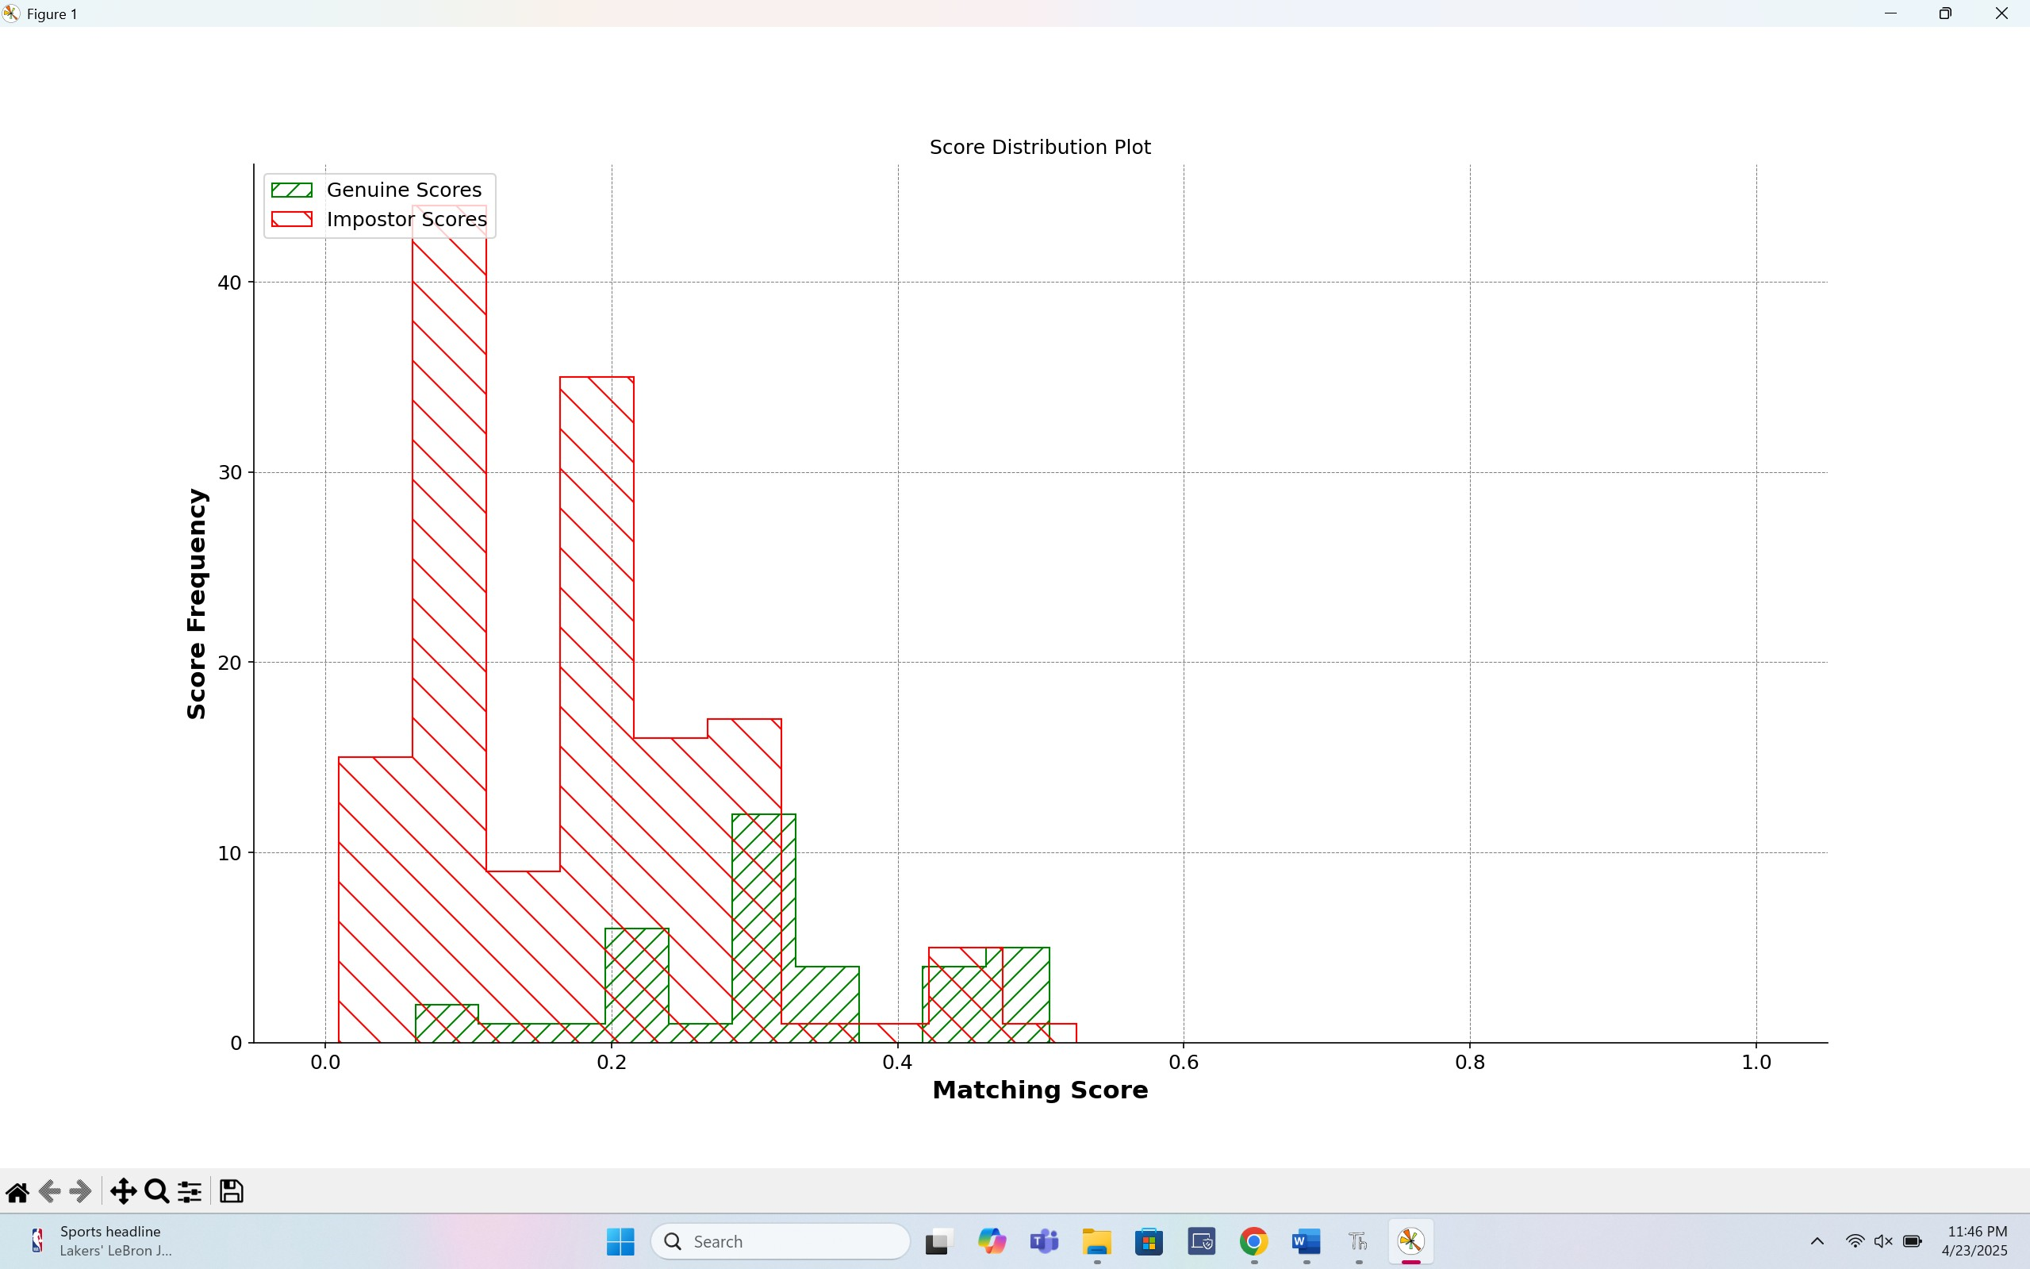
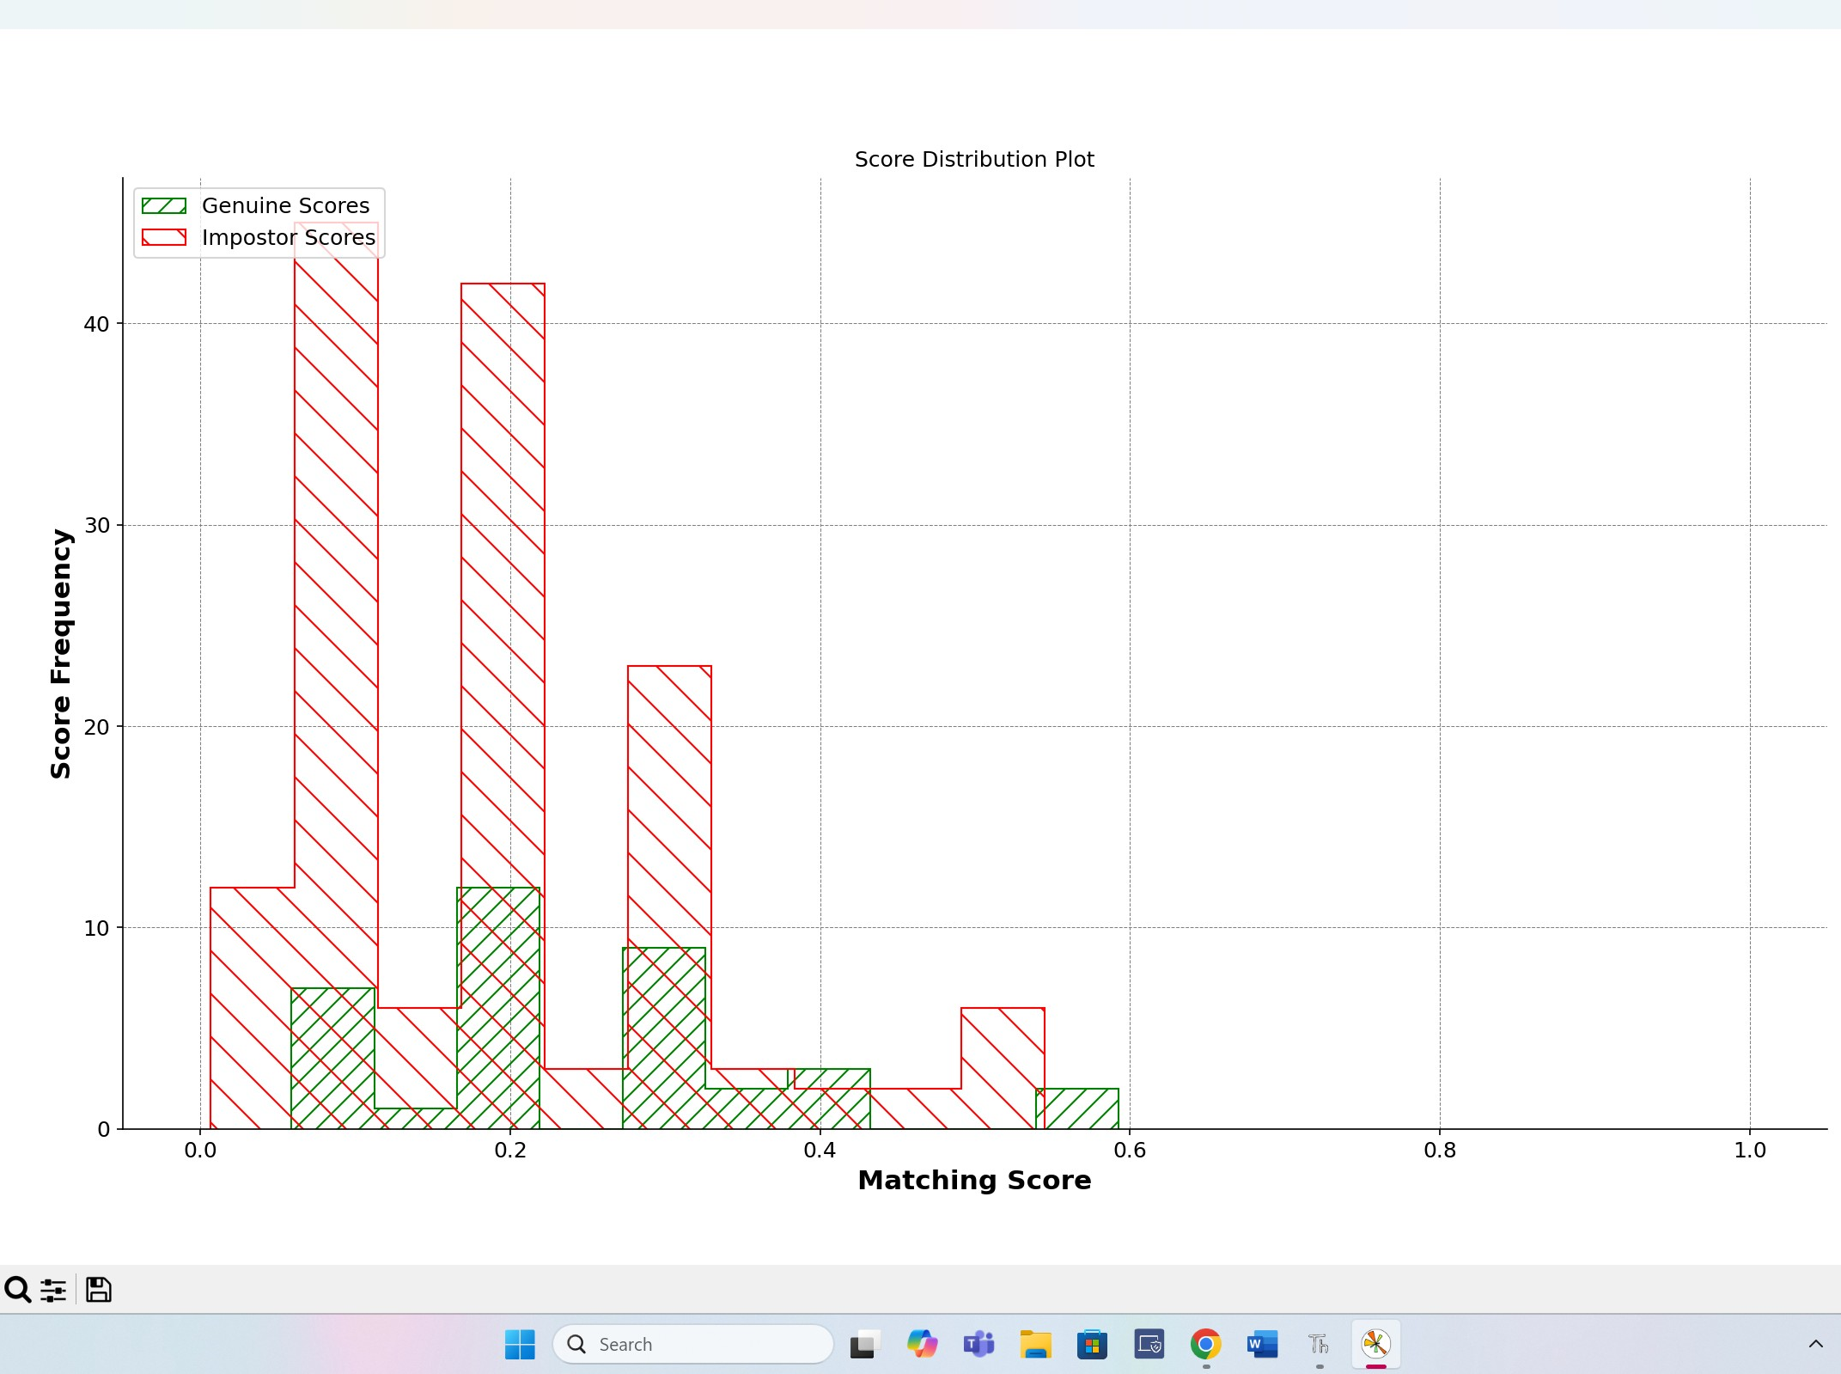
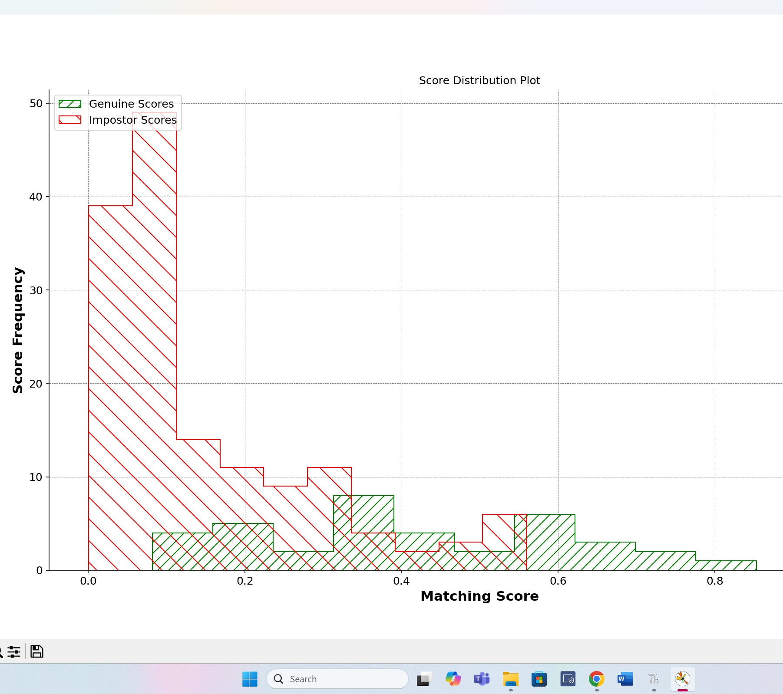
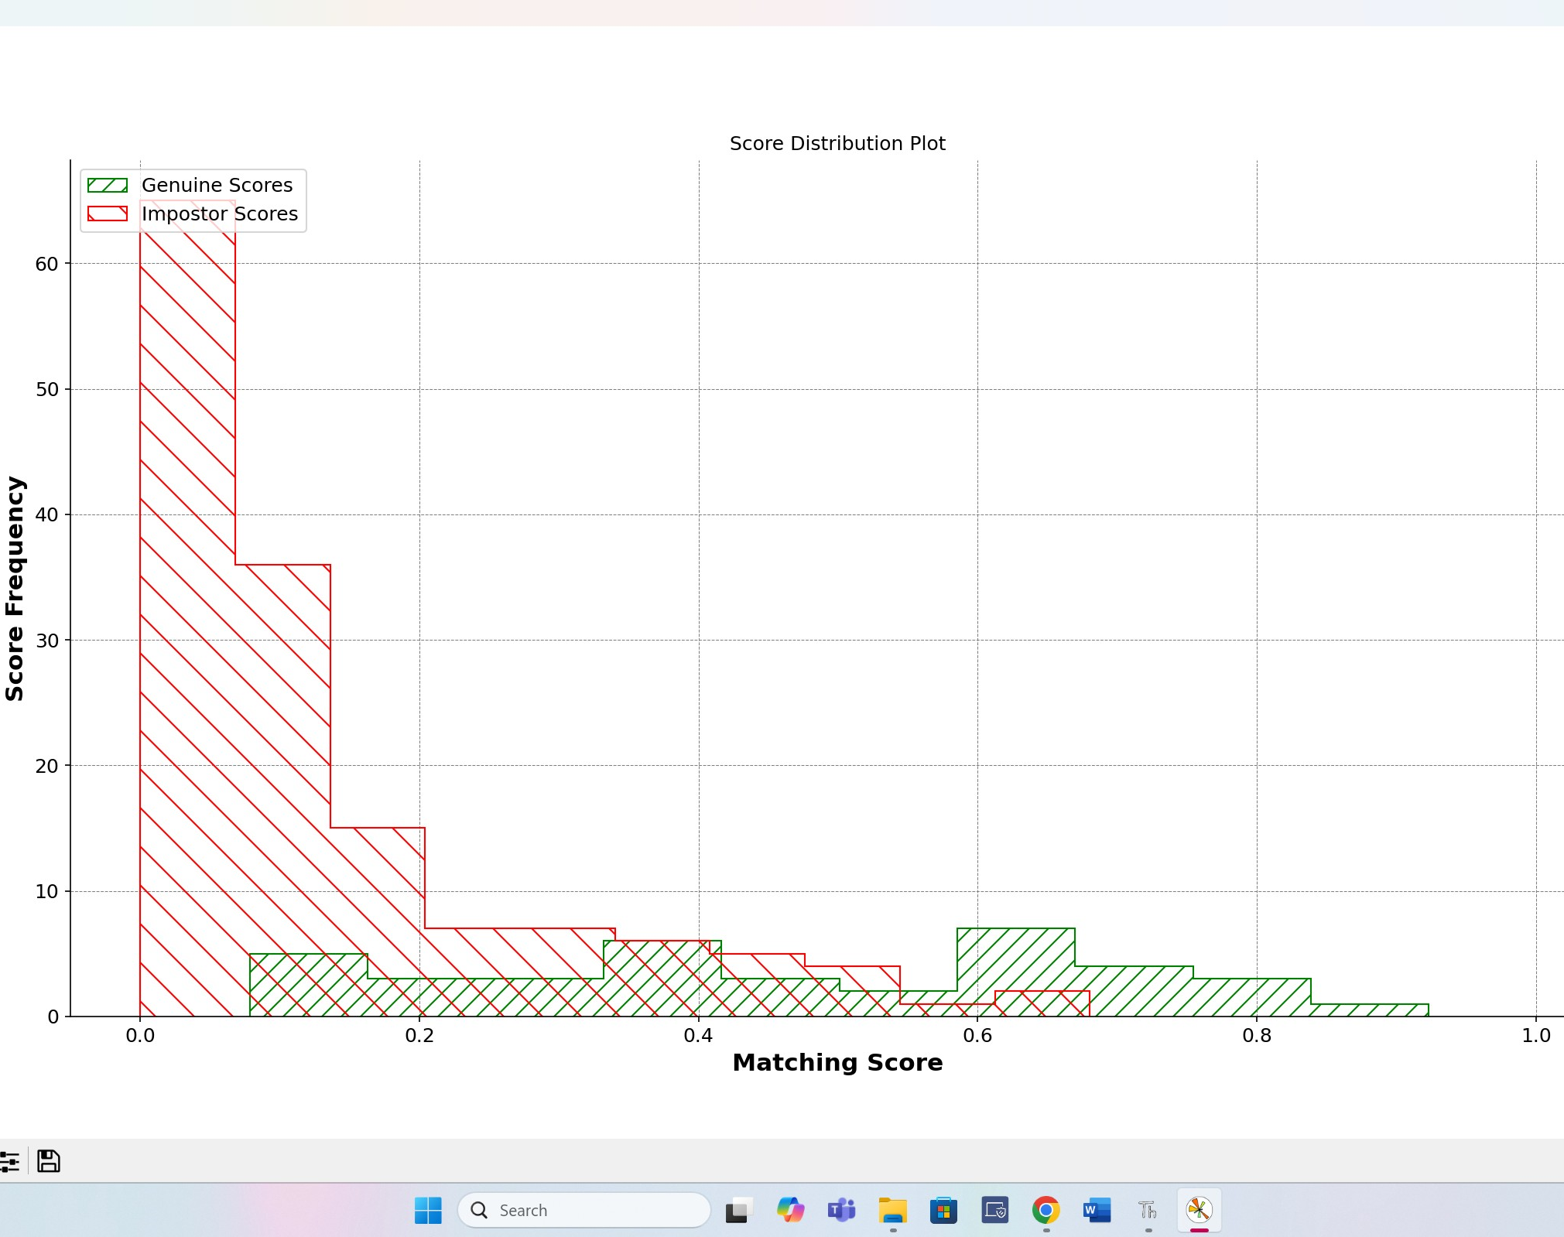
Baseline
ResolutionX50
ResolutionX400
ResolutionX200

Slide 7
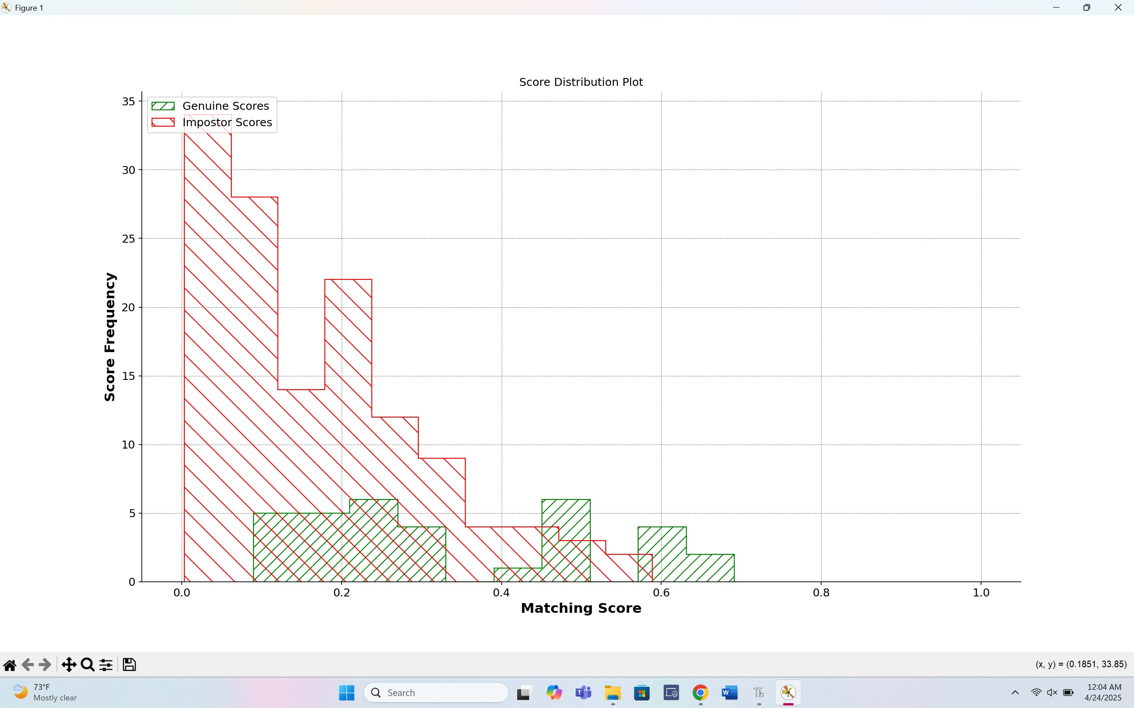
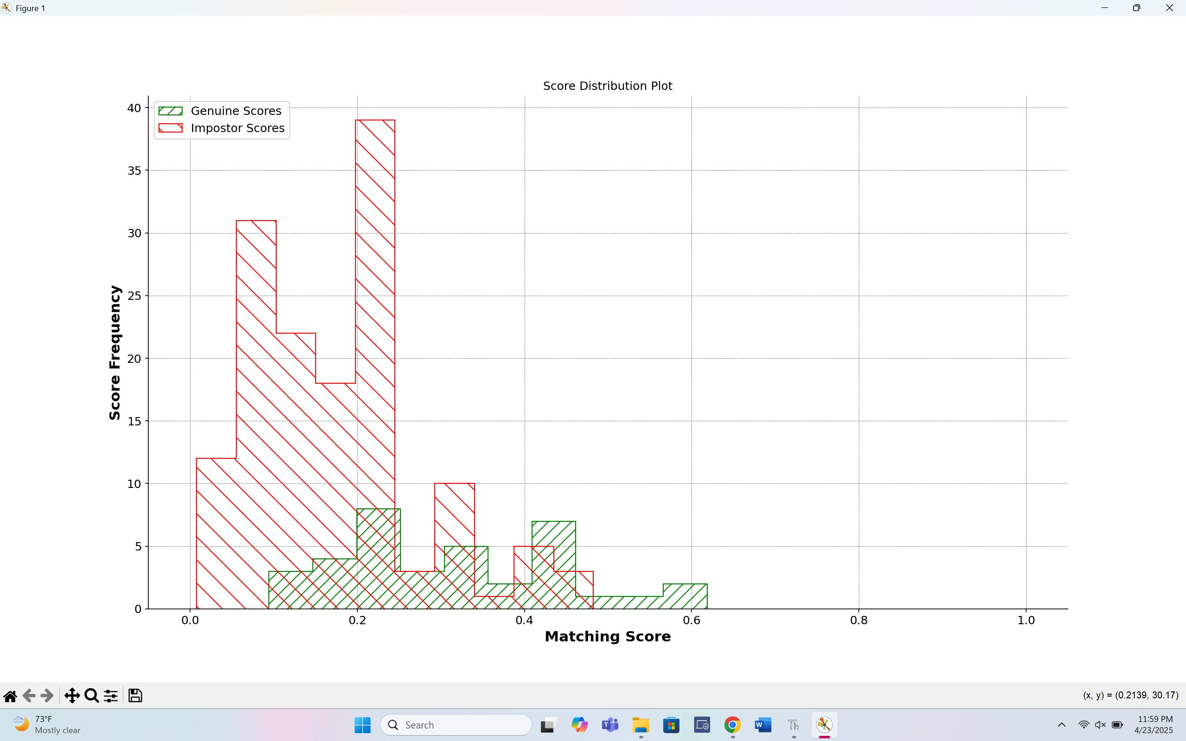
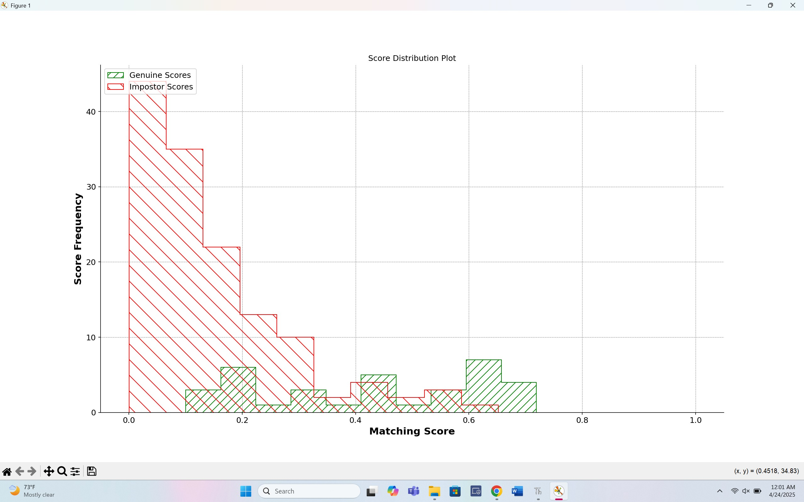
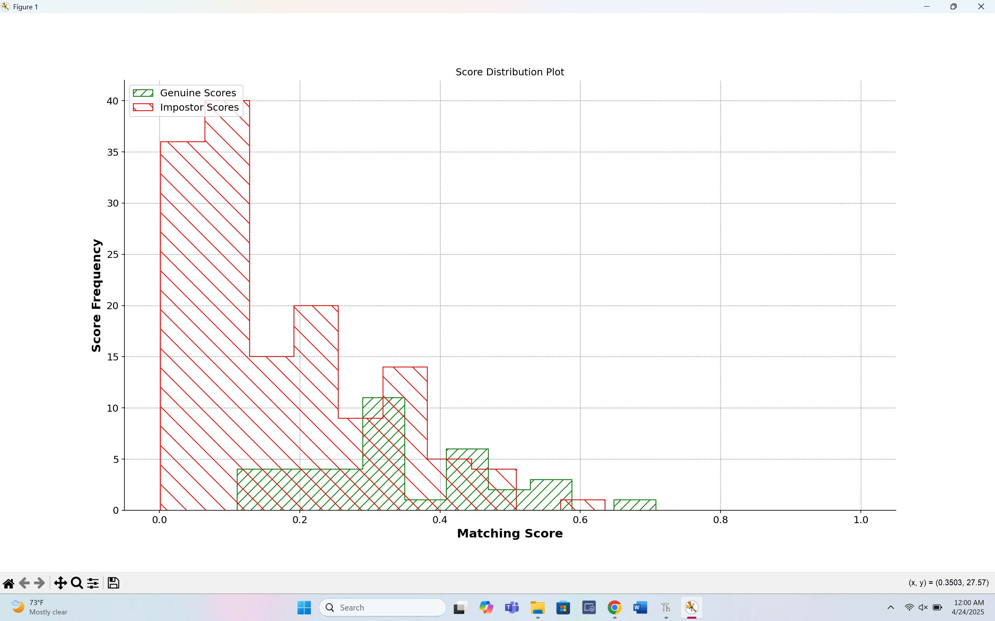
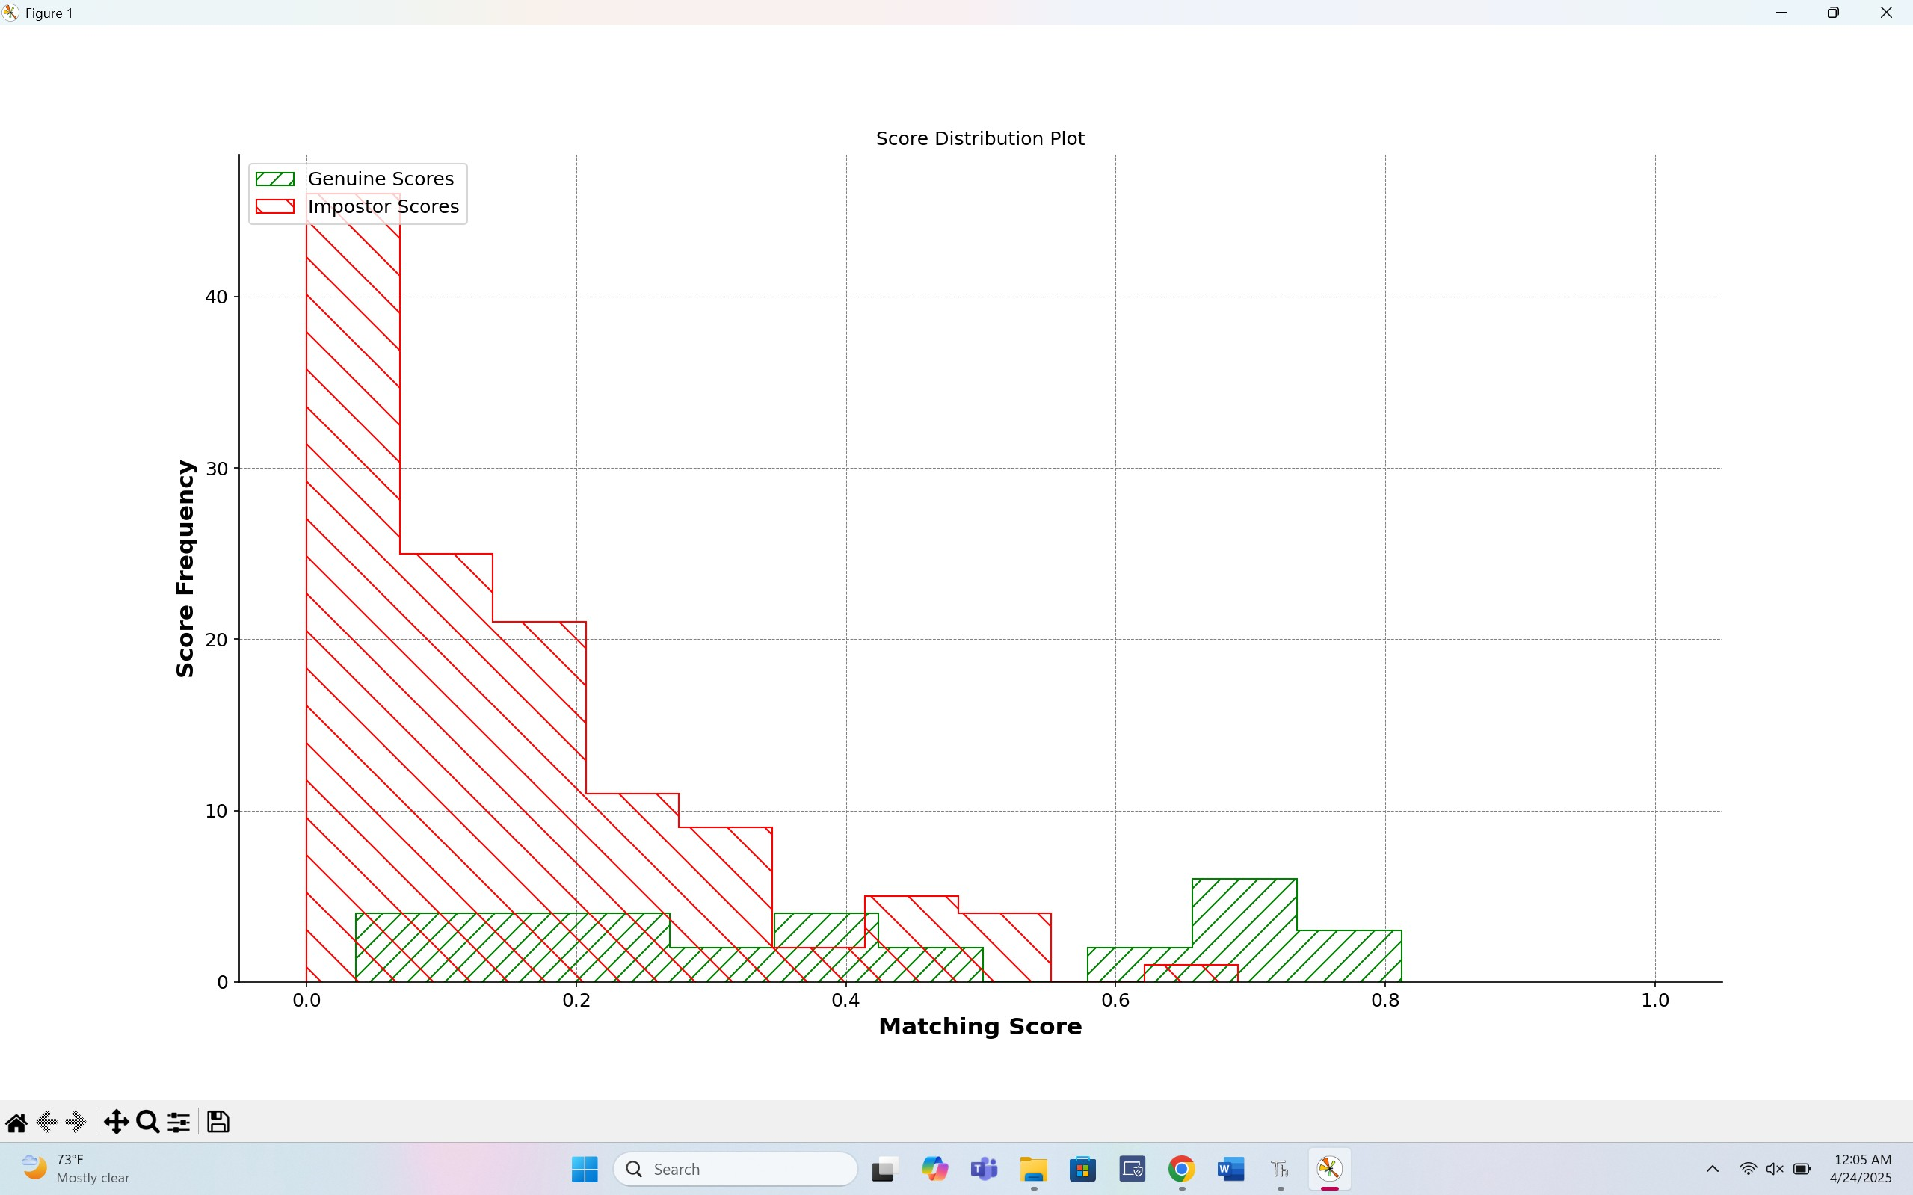
9
3
7
5
11

Slide 8
Ethics
Privacy Risks: Facial images are highly personal data, and mishandling can lead to identity theft or unauthorized surveillance; this project processed all images locally with no personally identifiable info.
Informed Consent: Future applications must require clear, voluntary, and withdrawable participant consent, ensuring individuals understand how their biometric data is used and protected.
Bias & Fairness: Biometric systems, including facial recognition, risk accuracy disparities across demographic groups; while this project didn’t assess those, future systems must audit for bias.
Data Security: Biometric data should be securely stored in encrypted, access-controlled environments with strong deletion policies to prevent unnecessary retention.
Ethical Deployment: Responsible biometric system development demands fairness, transparency, privacy protection, and proactive steps to maintain public trust.

