Slide 1
Introduction (Big Data)

Slide 2
Hadoop what is it?

Slide 3
Components of Hadoop 1.0

Slide 4
Component 1 explain (HDFS)

Slide 5
Component 2 explain

Slide 6
Problems with Hadoop 1.0
Scalability
Availability
Resource Utilization
Lack of Support for alternative Programming Paradigms and Services

Slide 7
Scalability
- Maximum cluster size was about 4000 nodes.
- Maximum number of concurrent tasks was about 40,000 processes
- Coarse synchronization in the job tracker limited scalability

Slide 8
availability
- Any failure in the job tracker will kill all queued and running jobs.

Slide 9
Resource utilization
- fixed MapReduce resource allocation often results in low resource utilization

Slide 10
Lack of Support for alternative Programming Paradigms and Services
- iterative programs implemented with mapReduce run 10 times slower.
- only java can be used to write programs in mapReduce

Slide 11
Hadoop 2.0 Features & Enhancements
- YARN framework and Next Generation MapReduce (MRv2): YARN provides better resource management in Hadoop, resulting in improved cluster efficiency and application performance. It’s a pure scheduler.
- MapReduce Becomes User library or one of the application that runs inside YARN for cluster services.
- HDFS High Availability (aka NameNode High Availability): In Hadoop 1.0 NameNode was the single point of failure in a Cluster, resulting in data loss in case of a NameNode failure. Hadoop 2.0 Architecture supports multiple Name Nodes to remove this bottleneck, making Hadoop attractive to enterprises.
- HDFS Federation: This feature allows horizontal scalability for Hadoop file system.
There are additional features such as Data Snapshot, Support for Windows, NFS access which will increase Hadoop adoption in the Industry to solve Big Data problems.

Slide 12
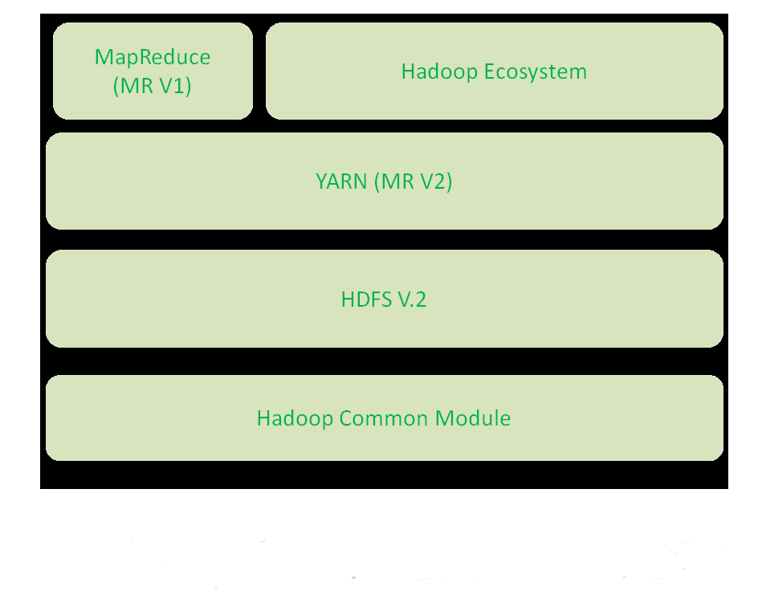
Hadoop 2 Architecture
- The introduction of YARN as an alternative to MapReduce is a huge improvement to the product.
- HDFS was also modified to overcome problems of release 1.0
Notes:
http://cdn.journaldev.com/wp-content/uploads/2015/08/hadoop2.x-components.png

Slide 13
YARN (Yet Another Resource Negotiator)
- Provides all resources and resource management for the cluster.
- Yarn is framework for developing processing applications
-
- YARN is a software that separates MapReduce's job tracker and task tracker capabilities into separate entities, enabling Hadoop to support more varied processing approaches and a broader array of applications.

Slide 14
YARN components
- resource manager
- application master
- node manager

Slide 15
Resource manager
- resource manager and node manager form the basis for managing applications in distributed manner
- the responsibility of the resource manager is to distribute the available resources to the applications using its scheduler
- the scheduler performs the allocations according to constraints which can be user limits or queue capacities limits
- the scheduling is done based on the resource requirements of the applications
-

Slide 16
application master
- is a framework specific entity it communicates with the resource manager and node manager
- it negotiates resources from resource manager and works with node managers to execute and monitors the componenets tasks

Slide 17
Node manager
- monitors resource usage of cpu, memory, disk, and network and report back to the resource manager

Slide 18
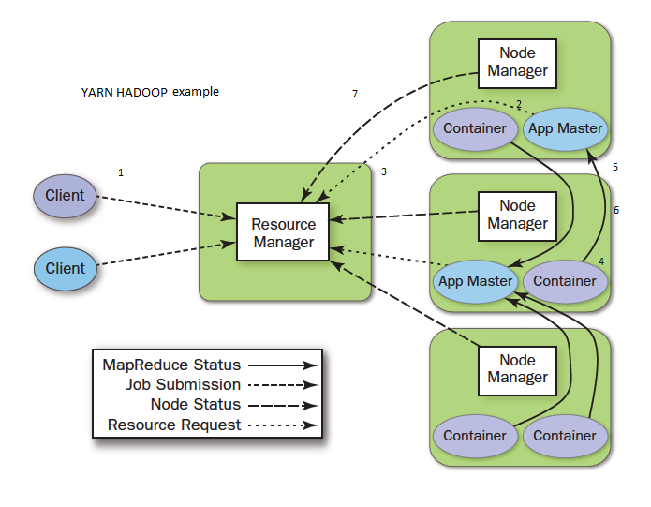
Simple example of yarn with diagram
Notes:
http://www.avante.es/wp-content/uploads/2016/04/Res-Manager.png

