Slide 1
Enhancement Proposal
Reverse Em’ All

Slide 2
Overview
What is HDFS Balancer
Motivation and Drawbacks
Balancer Enhancement
2 Approaches
Automated Script
Modifying Data Replication Policy
Change in Architecture
Impact on Other Features
Limitations
Lessons Learned
Conclusion

Slide 3
Motivation – HDFS Block Allocation
Objective of current block allocation strategy:
} Rack aware: Improve data reliability, availability and network
} Bandwidth utilization
} Minimize write cost
} Reduce inter-rack and inter-node write
Issue of current block allocation strategy:
} Cluster of unbalanced nodes
Notes:
Objecetive of current block allocation strategy:
Rule1: No Datanode contains more than one
replica of any block
Rule2: No rack contains more than two replicas of
the same block, provided there are sufficient racks
on the cluster
Issue of current block allocation strategy: Cluster of unbalanced Nodes
Over time the distribution of the blocks across data nodes become unbalanced.
An unbalanced cluster can affect locality for MapReduce, and it puts a greater strain on the highly utilized data nodes.

Slide 4
Motivation – About HDFS Balancer tool
Balancer rebalances data across the data nodes
It moves blocks from overutilized DataNodes to underutilized nodes
Balanced when the utilization of every DataNode differs from the utilization of the cluster by no more than a given threshold percentage (ex 10% threshold)
40% Datanode utilization -> 30%-50% cluster Utilization

Slide 5
Motivation – Drawback of current Balancer
Needs manual call
Take a long time to run, especially if it is ran for the first or if it is not ran regularly.
While it is running, it will significantly slow down the process of other work
Notes:
In fact, it is recommended to run balancer on the period whereby there are less user/trafic

Slide 6
Motivation – proposed of ‘auto-balancer'
More 'real-time' balanced cluster of nodes
Decrease processing time to balance the cluster
New feature: The auto-balancer within operation of HDFS
Idea: Incremental balancing leading to lower average processing time

Slide 7
Stakeholders
System Users
Especially Users who have write/edit access to the HDFS files
Time to process, access and write data
System Administrator
Reduce the frequency of 'manual' maintenance to balance the whole cluster

Slide 8
Approach 1: Automated Script
Create a script that automatically runs the balancer at different times
Script is ran through the command line
Run at times when HDFS usage is at the lowest
hdfs balancer 10

Slide 9
Advantages and Disadvantages of Approach 1: Automated Script
Advantages
No change in the code or architecture
Simple to make and customize when to run the balancer
Disadvantage
May run at inopportune time and slow down the system (when HDFS is nearly full)
May run at times when there is no need to rebalance

Slide 10
Approach 2: Modifying Replica Placement Policy
Balance data during block replication
Replicate data to underutilized DataNodes
Modify the code itself, instead of using a script

Slide 11
Advantages and Disadvantages of Approach 2 : Modifying Replica Placement Policy
Advantage:
Minimum Impact on most procedures
Retain most of the objective of original block placement policy
Disadvantage:
Require modifying current implementation / logic of choosing DataNode
Affect runtime of process involving choosing of DataNodes to store data block

Slide 12
Proposed Implementation of approach – Modifying Replica Placement Policy
1. Place the first replica somewhere – either a random rack and node
a. on the local node (if the HDFS client is running on a node inside the cluster).
Search within the rack for node with lowest capacity.
If the node capacity is not over-utilized, it will be the node hosting the first replica.
Else look for rack with the lowest capacity node (proceed to option
b. anywhere(if the HDFS client is outside the Hadoop cluster)
Pick a node with the lowest capacity

Slide 13
Proposed Implementation of approach – Modifying Replica Placement Policy
2. The second replica is written to a different rack from the first, chosen at random
Pick a node, at a different rack from the first, with the lowest capacity
3. The third replica is written to the same rack as the second replica, but on a different node
Pick a node, in that same rack, with the lowest capacity

Slide 14
Proposed Implementation of approach – Modifying Replica Placement Policy
4. If there are more replicas – spread them across the rest of the racks, following the policy of no more than two replicas in the same rack and no more than one replica in the same node:
When choosing a rack, pick the rack with the node of lowest capacity and place the replica in that node
When choosing within a rack, pick the node with the lowest capacity

Slide 15
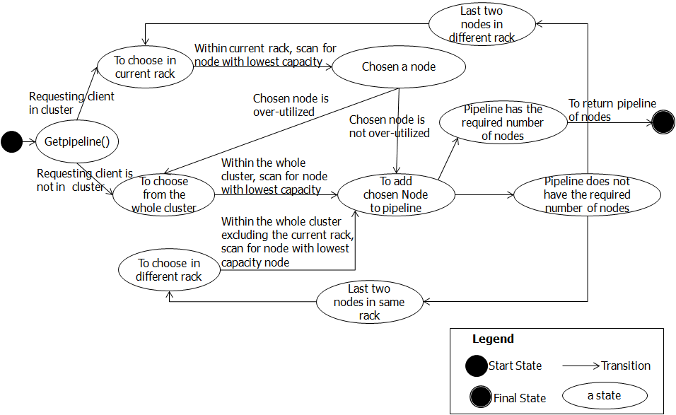
Replica Allocation Decision - Write

Slide 16
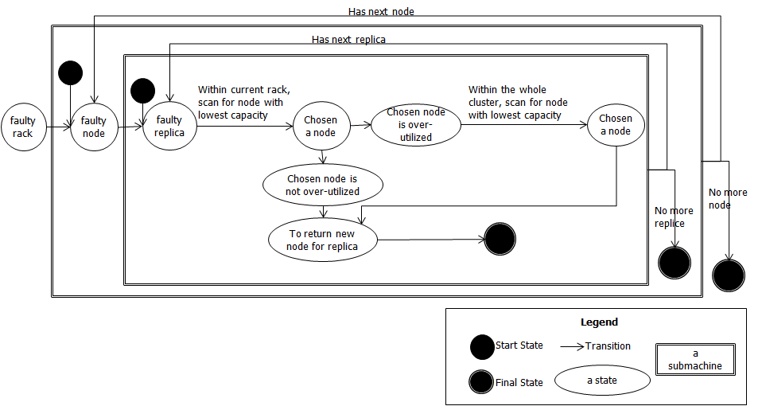
Replica Allocation Decision - Faulty Replica, Node or Rack

Slide 17
Architecture – Effects on concurrency & Team Issues
Due to HDFS’s highly coupled design, the changes won’t affect mechanism of the other subcomponent
Concurrency of other subcomponent won’t be affected
Runtime of MapReduce might be affected since there are changes in the logic of the placement of data

Slide 18
Impact on the Architecture – within HDFS Component
Mainly on NameNode – the Master server that manage and decide on block allocation
There is no implementation impact on other main subcomponent Client and DataNode (they do not need to know the method of retrieving the requested nodes to add block)

Slide 19
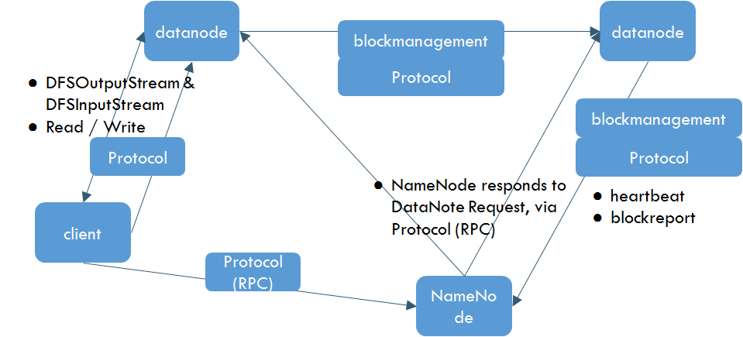
Impact on the Architecture – within HDFS Component

Slide 20
Testing plan
Test to compare with and without this new feature:
run time
fault-tolerance level (if any error / fault occur)
average balance-ness(counting the number of under/over utilized nodes)
For each of the following process:
Run a MapReduce process
Write a file
Read a file
Appending a file
Faulty node / Faulty replica
Adding a DataNode
Decommissioning a DataNode
Running balancer tool

Slide 21
Testing plan - Metrics
Processes | Run Time | Fault Tolerance (no. of error /exception) | Balanced Storage (no. of under/over-utilized nodes)
MapReduce process
Write a file
Read a file
Append a file
Faulty Node/Replica
Adding a DataNode
Decommission a DataNode
Running balancer

Slide 22
Limitation & Potential Risk
Limitation:
} Longer write time
} Schema to auto-balance, when new node is added into the cluster, is not included
} Does not consider the 'latest' or more 'visited' data
Notes:
- Still need to use Balancer in cases of adding new nodes (but the time taken will be much shorter than without the proposed auto-balancer)
- Bottleneck problem when new node is introduce. (Unless, run the usual balancer when new node(s) are added, and the time taken will be reduced than running usual balancer without the new feature).

Slide 23
Lesson learned
There are still many area of improvement within Hadoop System
Current Hadoop System has good design of being highly coupled – making the system highly extendible
Implementing an improvement might have overhead cost (give and take: more distributed data which induces improved MR runtime but at the cost of increasing write runtime)

Slide 24
Conclusion
What is HDFS Balancer
Motivation and Drawbacks
Balancer Enhancement
2 Approaches
Automated Script
Modifying Data Replication Policy
Change in Architecture
Impact on Other Features
Limitations
Lessons Learned

