Slide 1
4314-HDFS Concrete Architecture
By: Reverse ‘em all group

Slide 2
HDFS- Conceptual Diagram
Metadata (Name, replicas, …):
NameNode
Metadata ops
Client
Block Ops
Read
Datanodes
Datanodes
Replication
Client
Write
Rack 1
Rack 2

Slide 3
Concrete Diagram- Before Repairing
NameNode
DataNode
*Derived from lsedit
Protocol
Block-ManageMent
Common
Mover
Balancer

Slide 4
Tools used to extract concrete architecture
Excel
lsEdit
NotePad++

Slide 5
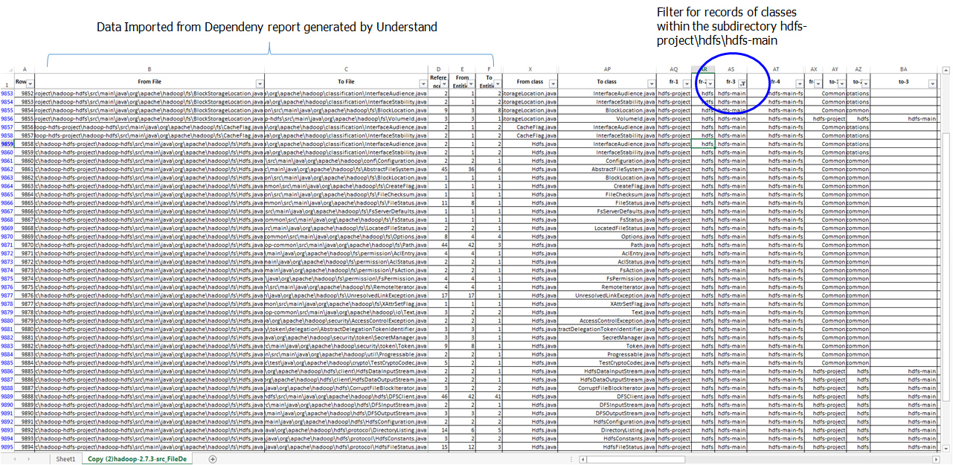
Tools used to extract concrete architecture
Notes:
Deriving sub-system via Excel:
1. Generate the dependency report using Understand
2. Import the data into MS Excel
3. For every “From” and “To” file path, tokenize the filepath by identifying the delimiter ‘\’
4. Use the ‘Filter’ Tool of Microsoft Excel to identify the location of the main sub-system of HDFS
5. ScreenShot, show:
Part of the tokenize “from” file path
Filter to show only records of Filepaths of project-hdfs files dependencies.

Slide 6
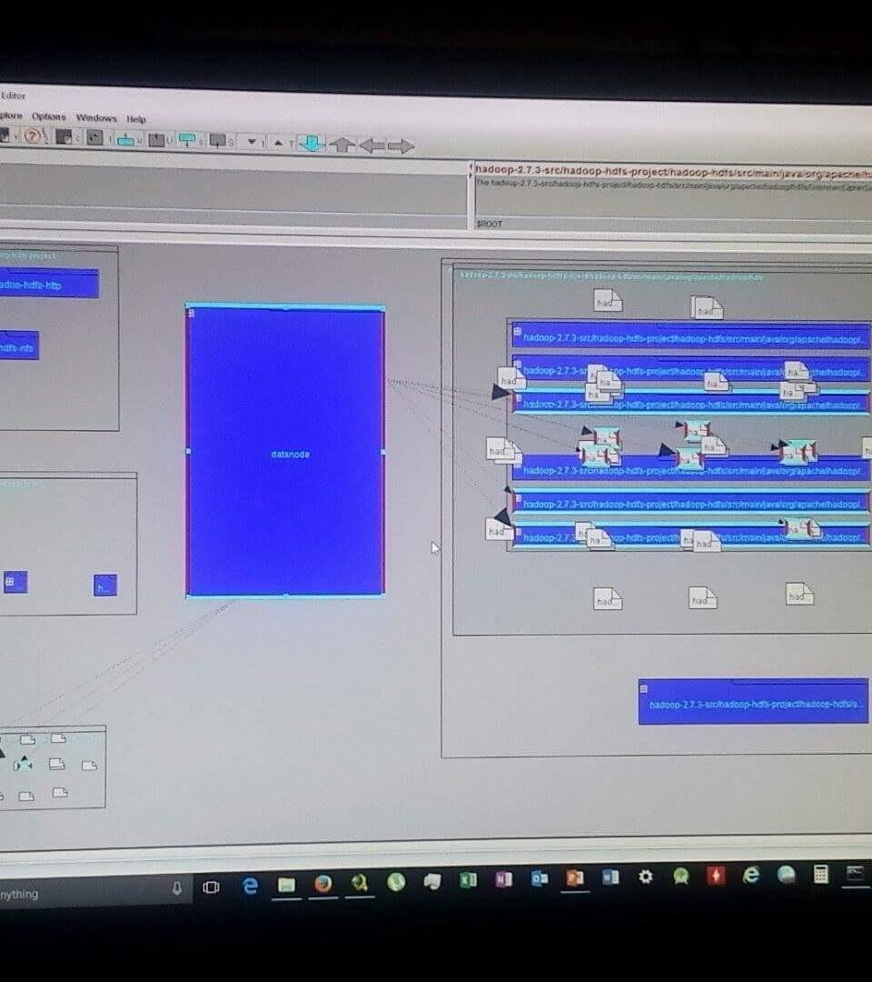
Concrete Diagram- Before Repairing
Tools used to extract concrete architecture

Slide 7
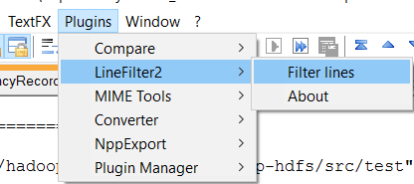
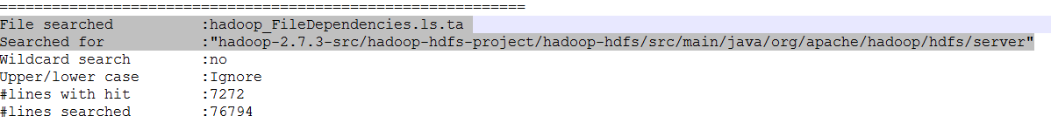
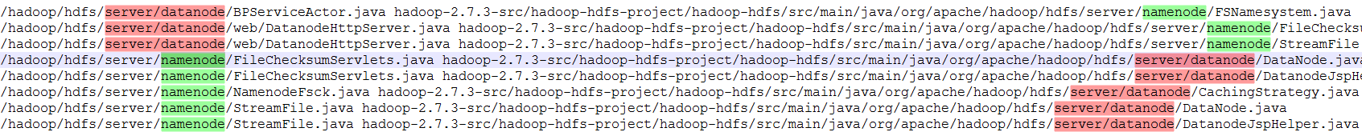
Tools used to extract concrete architecture

Slide 8
Concrete Diagram- After Repairing
Legend
DataNode
subsystem
NameNode
dependency
arrow
Protocol
Common
Block-ManageMent
Balancer
Client

Slide 9
NameNode
NameNode
Protocol
NameNode
Block-ManageMent
Common

Slide 10
NameNode
Fsimage, Editlog: is to store the “snapshot” of namenode
Secondary node
Checkpointer
Backup node
HA
Guess: secondary node is going to be replaced by warm standby node. To keep it in same folder easier for development. It is not confirmed.

Slide 11
NameNode
Remove dependency relation between datanode and namenode.
Intuitively, it is thought that there is strong coupling relation between datanode and namenode.
In fact, the dependence relation is not strong.
Namenode communicate with datanode via protocol.

Slide 12
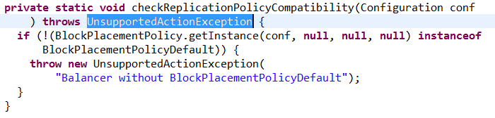
NameNode
Removal of the dependence relation between balancer and namenode
Balancer invokes only one class from namenode. And the class is an exception class.

Slide 13
DataNode
DataNode
NameNode
Protocol
Common

Slide 14
DATANODES- How it works?
It cannot contact the namenode directly instead it relies on another component to talk to namenode.
It uses the server.protocol to contact the nameNode.
It can contact the client directly using protocol -> clientprotocol.java
Datanodes send heart beats to the nameNode using the class BPServiceActor.java
Notes:
uses web interface package to display information about status of datanodes in a web page.

Slide 15
Protocol
Protocol

Slide 16
Protocol
Protocols define how each subsystem speaks, communicates, and gives commands between each other
Communication between NameNode and DataNode as well as NameNode and balancer
Examples: block information, block replication, heartbeat response
Many classes within Protocol are defined as demands
Instructions are wrapped around an object along with any necessary information about that instruction

Slide 17
Protocol
The conceptual diagram did not define a way in which NameNodes and DataNodes interact except through dependency
After repairment, there was also no change. Every subsystem needs protocols for communication

Slide 18
COMMON
Common

Slide 19
Common
GenerationStamp.java
DataNode, Block Management
HdfsServerConstants.java
NameNode, DataNode, server,protocol, Block Management, Balancer
JspHelper.java
NameNode, HDFS (web) main system
Util.java
NameNode

Slide 20
Common
Storage.java
StorageInfo.java
InconsistentFSStateException.java
IncorrectVersionException.java
NameNode, DataNode, server.protocol

Slide 21
CLIENT
User Applications access HDFS using CLIENT
Support general conventional file system operation
Create, read, delete
Rename, open, close
Include classes supporting ‘Staging’: caching of block of data before flushing to DataNode

Slide 22
CLIENT - Staging
Data cached locally until reached block size
Client request to NameNode for DataNode id and destination for the data block
Client flushed the block of data to DataNode
Rationale:
Process use streaming write to file
Without buffering will impact throughput
Because writing remote file directly will affect network speed and congestion in network
Notes:
These applications need streaming writes to files. If a client writes to a remote file directly without any client side buffering,
The network speed and the congestion in the network impacts throughput considerably.

Slide 23
Client <-> NameNode
Client communicate with NameNode via Protocol
I.e Protocol acts as Facade between NameNode and Client
Client notify NameNode when it is done accessing a file or if there is ‘faulty’ file
Rationale:
To decouple the subsystem
client
protocol
namenode

Slide 24
Client <-> DataNode
Client communicate with DataNode via Protocol
Rationale: decoupling via facade
Send/receive Data directly to DataNode
Transfer via streaming, not RPC (as mentioned in Staging)
client
DFSInputStream
DFSOutStream
Protocol
datanote
Notes:
A client communicates with a DataNode directly to transfer (send/receive) data using the DataTransferProtocol, defined in DataTransferProtocol.java. For performance purposes this protocol is a streaming protocol, not RPC. The client buffers data until a full block (the default is 64 Mbytes) has been created and then the block is streamed to the DataNode.
The DataTransferProtocol defines operations to read a block (opReadBlock()), write a block (opWriteBlock()), replace a block (opReplaceBlock()), copy a block (opCopyBlock()), and to get a block’s Checksum (opBlockChecksum()).

Slide 25
blockmanagement
Handles the replication of blocks
1st choice: within the same rack
2nd choice: within the same switchband
3rd choice: external
Replication implement pipe & filter design
Send Heartbeat and Blockreport messaged to Namenode

Slide 26
BALANCER
Rebalances data across DataNotes
Moving blocks from over-utilized to under-utilized nodes
Threshold set is relative to usage of overall cluster
Rationale:
Avoid recently added nodes into the cluster become bottleneck
Drawback:
Time-consuming Mechanism
Notes:
HDFS data might not always be distributed uniformly across DataNodes. One common reason is addition of new DataNodes to an existing cluster. HDFS provides a balancer utility that analyzes block placement and balances data across the DataNodes. The balancer moves blocks until the cluster is deemed to be balanced, which means that the utilization of every DataNode (ratio of used space on the node to total capacity of the node) differs from the utilization of the cluster (ratio of used space on the cluster to total capacity of the cluster) by no more than a given threshold percentage. The balancer does not balance between individual volumes on a single DataNode

Slide 27
Amended Conceptual Architect after repair
Block replication
datanode
datanode
blockmanagement
DFSOutputStream & DFSInputStream
Read / Write
Protocol
blockmanagement
Protocol
Protocol
NameNode responds to DataNote Request, via Protocol (RPC)
heartbeat
blockreport
client
Protocol
(RPC)
NameNode

Slide 28
Master-Slaves design in Hadoop
NameNode being the master, where the central data control is, and multiple DataNodes being the slaves, constantly reporting their status to NameNode
DataNodes, being the slaves, can run on low commodity machine, thus reducing cost
Support concurrency, boosting performance

Slide 29
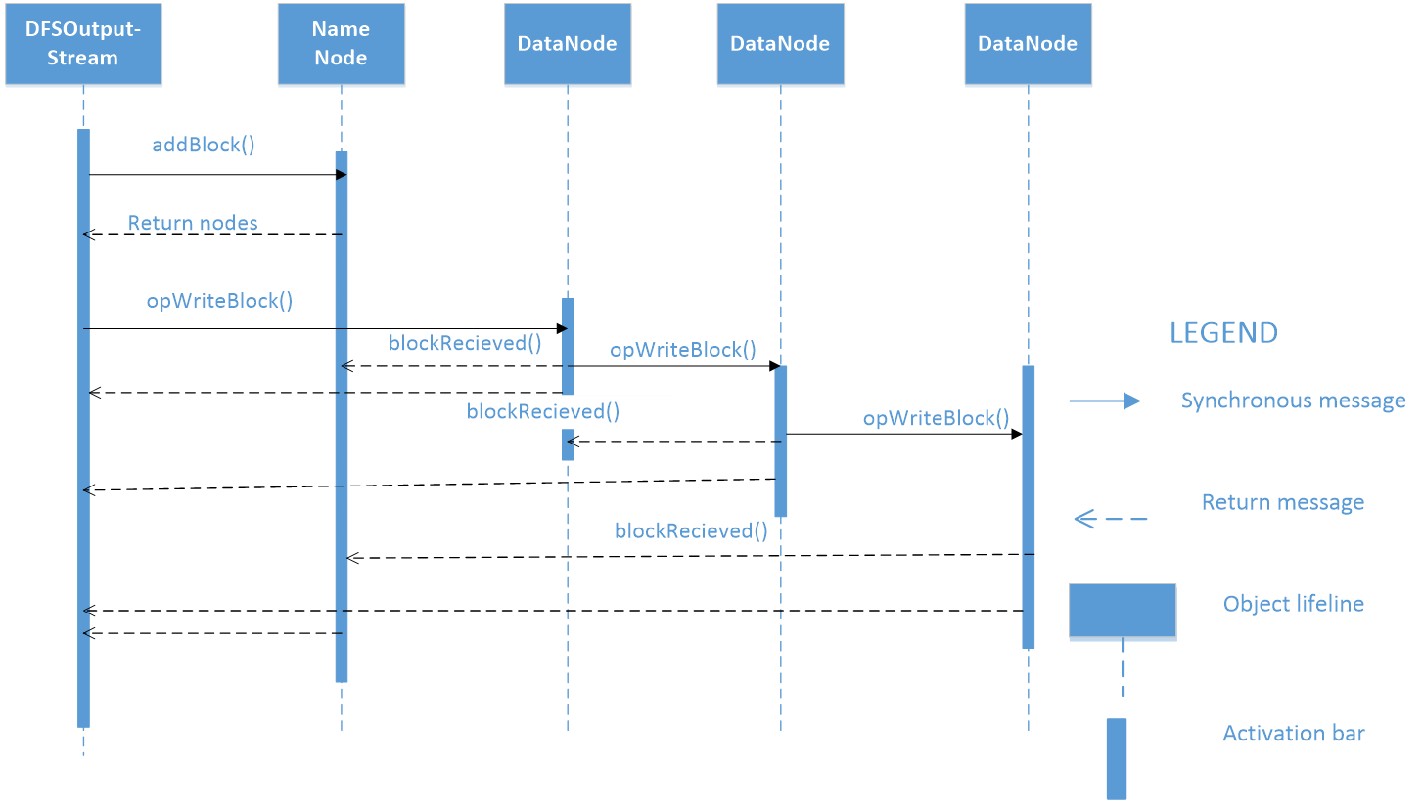
Use Case: Writing to HDFS

Slide 30
Lessons Learned
Process of finding actual architecture is complex; it involves many search & investigate operations.
Concrete architecture contains more dependencies than the conceptual ones.
Going over classes one by one is not feasible in large programs instead using the dependency files is an important asset to use but still requires time to do it but it’s an accurate process.
There might be different versions of concrete architecture.

Slide 31
Limitations of reported Findings
There are an overwhelmingly large number of classes
We chose the most relevant ones based on what we observed during the process of extracting the concrete architect
Hence we might missed out certain points by ignoring those classes

