Slide 1

EECS 4413 Assignment 1
Instructed by: Prof. Jack Jiang
Presented by: Zhongran (Julian) Deng
Sied Hoa (Heny) Tjin
Hashim Al-Helli
Randy Agyapong
David Iliaguiev

Slide 2
big data
Internet generates data everyday at a petabyte scale.
This includes structured data and unstructured data.
Big data is a collection of large datasets that cannot be processed using traditional computing techniques.

Slide 3

what is Hadoop?
Feature:
Open source
Break through the limit of traditional database
Support commodity computing
High scalability
Hadoop is an open-source software framework to process and store big data.
Notes:
Commodity computing is the use of large numbers of already-available computing components for parallel computing

Slide 4
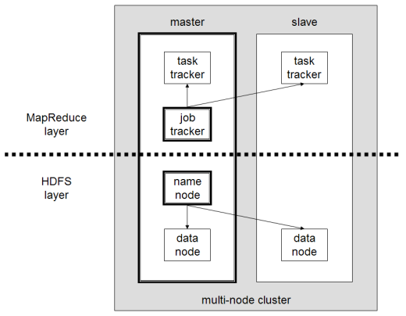
Typical architecture of Hadoop
HDFS – distributed file system.
Map reduce – offline computing engine.
As versions updates, Hadoop is gaining more function modules such as Yarn which improves the performance of Hadoop.
Master-slave diagram
Notes:
In today’s presentation, our team will mainly focus on HDFS, Map Reduce and Yarn. We will also cover Hadoop’s ecosystem in the last section.

Slide 5
HDFS
A distributed file system for Hadoop

Slide 6
Traditional vs. hdfs
Each block of data is small.
Approximately 51 bytes.
Huge amount of I/O operations while reading large data.
Each block of data is large.
By default 64MB and could be more.
Reading large data sequentially after single seek operation.
Notes:
Restricts file format diversity. Consume processing power. Save processing power

Slide 7
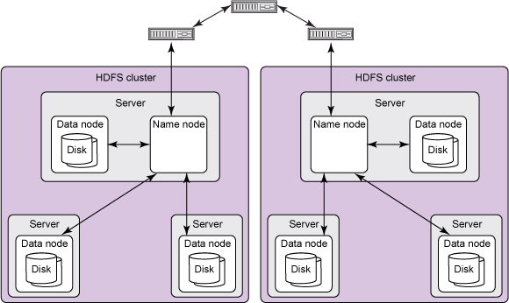
HDFS ARCHITECTURE -HADOOP 1.0
A typical HDFS cluster contains a single name node plus a cluster of data nodes
The server holding the name node is very crucial as there is only one existing per cluster.
Data nodes belong to name node and it can be stored in different server.

Slide 8
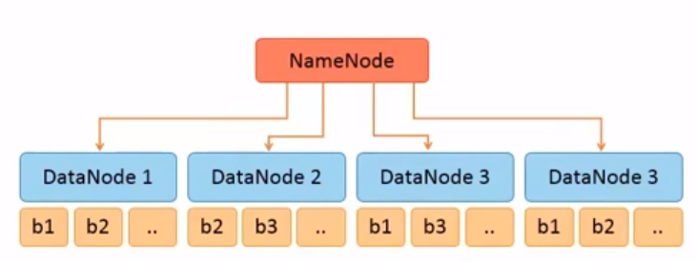
Name node
Stores metadata and information of the file system.
Knows the data is stored in which certain data node.
In early version, it was a single point of failure, that means, if the name node becomes unavailable ,the whole cluster goes down.

Slide 9
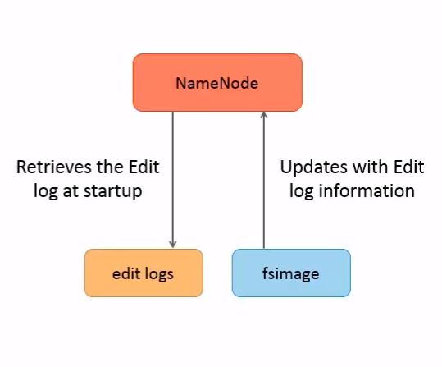
Name node
Name node holds two persistent files which are transaction log called edit logs and namespace image called fsImage.
Edit logs records changes of metadata.
Fsimage keeps the information of the entire file system namespace.
Notes:
Creating new file; mapping of blocks and file property.

Slide 10
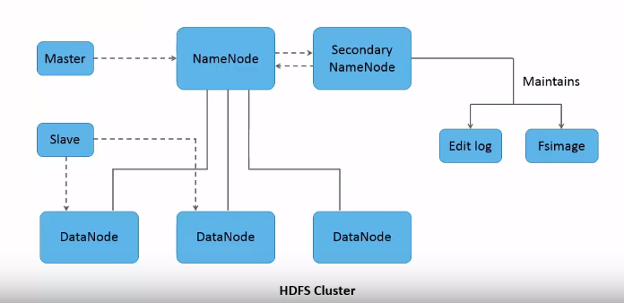
SECONDARY NAME NODE
Not a backup daemon for name node. Can partially restore name node but can’t completely depend on it for disaster recovery.
Maintains edit logs and fsimage.
Helps to lower down name node’s restart time.

Slide 11
Data nodes
Stores and maintains data blocks.
Responsible to store and retrieve data blocks upon request from name node or the client.
There can be N numbers of data nodes depending on the system requirement.
Perform operations such as read, write, block creation, deletion, replication, etc.

Slide 12
DATA BLOCK
Each file is split into one or more blocks stored and replicated in data nodes.
By default, each block is 64MB.
The size can be increased to 128MB or bigger.
Notes:
Point 3 try to shorten the sentence and explain it in presentation
Point 1 remember to say that replication is for fault tolerance principle where data are stored in many datanodes in case one datanode goes down
The size can be increased to 128MB. Doing this can reduce the pressure on name node’s memory. However, this will also reduce computation parallelism as the number of blocks per file decreases.

Slide 13

Data block replication
The data blocks are replicated for fault tolerance.
The data blocks are distributed in data node system within the cluster and thus ensures the replica of data is maintained.
Rack-awareness.
Notes:
Typically, large HDFS clusters are arranged across multiple installations (racks). Network traffic between different nodes within the same installation is more efficient than network traffic across installations. A name node tries to place replicas of a block on multiple installations for improved fault tolerance. However, HDFS allows administrators to decide on which installation a node belongs. Therefore, each node knows its rack ID, making it rack aware.

Slide 14
Interaction of each components
All HDFS communication protocols build on the TCP/IP protocol.
Client communicate with the name node using a proprietary RPC (Remote Procedure Call)-based protocol.
Each data node serves up blocks of data over the networking using block protocol specific to HDFS.

Slide 15
Weakness of HDFS in Hadoop 1.0
Single point of failure. Once name node is unavailable, the whole cluster goes down.

Slide 16
HDFS ARCHITECTURE-HADOOP 2.0+
Running two name nodes.
The back-up name node (or checkpoint node) is in the same cluster.
Each name node is configured as Active/Passive. Only one name node is in Active state.

