Slide 1
HDFS
A distributed file system for Hadoop

Slide 2
Traditional vs. hdfs
Each block of data is small.
Approximately 51 bytes.
Huge amount of I/O operations while reading large data.
Each block of data is large.
By default 64MB and could be more.
Read huge data sequentially after single seek operation.

Slide 3
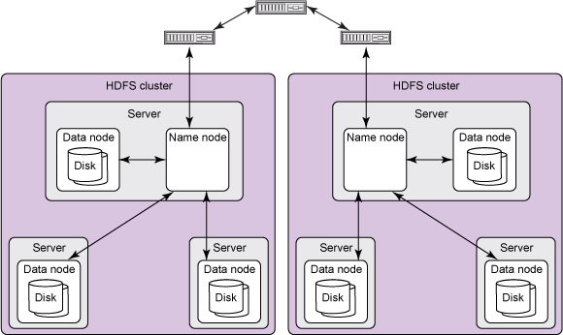
HDFS ARCHITECTURE -HADOOP 1.0
A typical HDFS cluster contains a single name node plus a cluster of data nodes
The server holding name node is very crucial as there is only one.
Data nodes can be stored in different server.

Slide 4
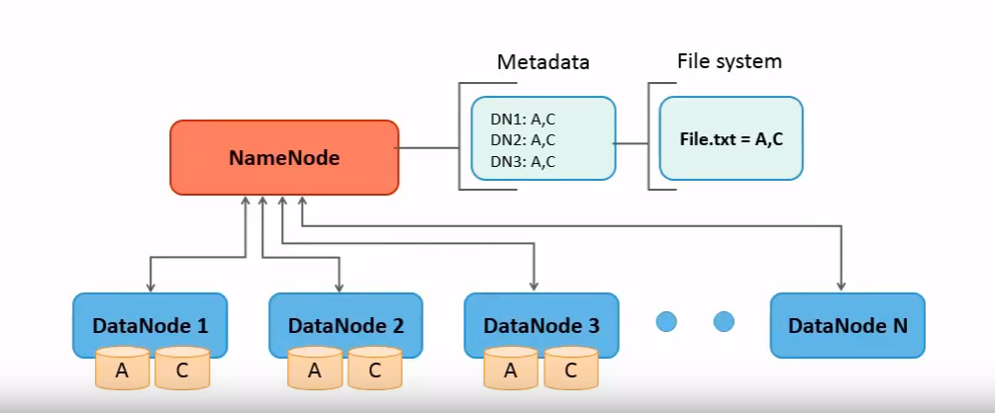
Name node
Stores metadata and information of the file system.
Knows which data nodes a file is stored.
Creates replica blocks when necessary after a data node failure.
In early version, it was single point of failure, that means, if the name node becomes unavailable ,the whole cluster will become unavailable.

Slide 5
Data nodes
Stores actual data.
Notifies name node of what blocks it has.
There can be N numbers of data nodes depending on the system requirement.
Perform operations such as read, write, replication, etc.

Slide 6
DATA BLOCK SPLIT
Each file is split into one or more blocks stored and replicated in data nodes.
By default, each block is 64MB.
The size can be increased to 128MB. Doing this can reduce the pressure on name node’s memory. However, this will also reduce computation parallelism as the number of blocks per file decreases.

Slide 7
Interaction of each components
Data nodes continuously asks the name node for instructions using a RPC (Remote Procedure Call)-based protocol. Then name node returns value from functions invoked by the data node.
All HDFS communication protocols build on the TCP/IP protocol.W

Slide 8
Shortcoming in Hadoop 1.0
Single point of failure. Once name node is unavailable, the whole cluster becomes unavailable.

Slide 9
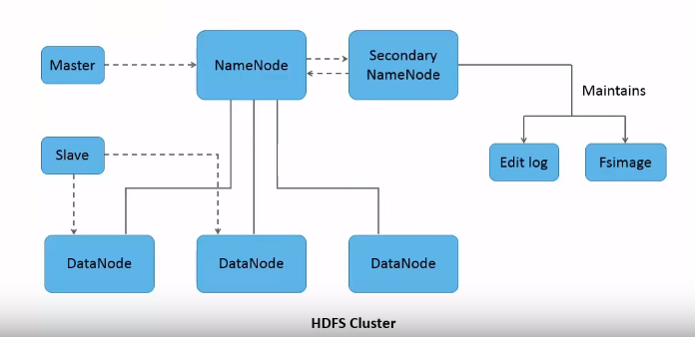
HDFS ARCHITECTURE -HADOOP 2.0+
Secondary name node is introduced.
Both name nodes in the same cluster.
Two major implementations:
1. Quorum-based Storage
2. Shared storage using NFS

Slide 10
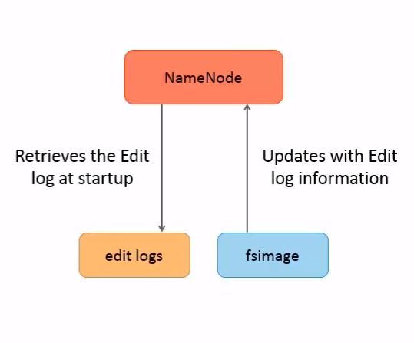
SECONDARY NAME NODE
Builds snapshots by continuously connecting with primary name node.
Snapshots can be used to re-launched a failed primary name node without replaying everything.
Edits the log to reflect latest directory structure.

