Slide 1
Dependency Extraction of Hadoop
Reverse 'em all

Slide 2
Overview
Include VS Understand
Extraction Process
Comparison Results
Qualitative Analysis
IDEA VS Understand
Extraction Process
Comparison Results
Qualitative Analysis
Alternative Dependency Tool : srcML
Lessons learned
Conclusion

Slide 3
Tools Used
Include.java vs understand

Slide 4
Understand
Understand is a static analysis tool focused on source code comprehension, metrics, and standards testing.
Used for dependency extraction
A file depends on another through:
Imports
Inheritance
Implementations
Throws
Method calls and object initializations
@ Java annotations
Extracted the dependencies by exporting a CSV file
File A, File B

Slide 5
Include.java
Coded in Java
Recursively goes through each folder in the Hadoop Project
Searches for import statements ONLY
Checks list of files to see if the pathway matches
If so, it creates a dependency line
import org.apache.hadoop.hdfs.protocol.Block;
import java.io.*

Slide 6
Include VS Understand
Quantitative analysis

Slide 7
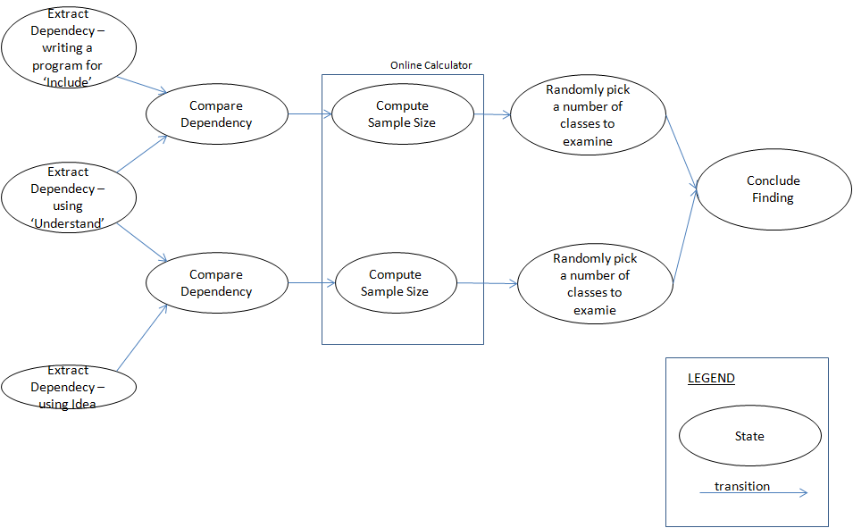
Extraction / Comparison process

Slide 8
Comparison Process
Used a Java program Compare.java
Made sure both files are in the same format ie Understand and IDEA/Include.java
File A → File B
Simply compared the two files line by line to see which is the same
Stored the result in a text file

Slide 9
Venn Diagram of Understand VS Include
Overlap
Understand
Include
35%
64.%
1%
21830
dependencies
40404
dependencies
889
dependencies

Slide 10
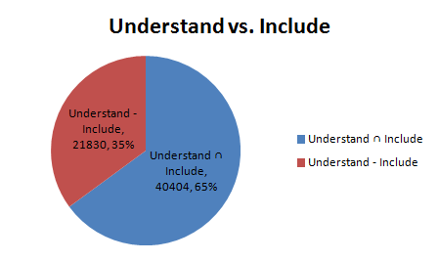
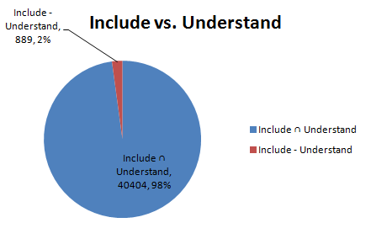
Statistics: Understand vs. Include
 | Intersect | Excluding | Total
Undertand | 40404 | 21830 | 62234
Include |  | 889 | 41293
Total Dependencies | 63123

Slide 11
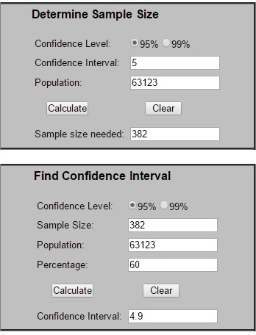
Sample Calculator for Include VS Understand
Confidence
Level: 95%
Sample Size: 382
Confidence
Interval: 5
Population:
63123

Slide 12
Comparison Result Summary – Understand versus Include
Most of the dependency Extracted by Include are captured by Understand
→ Understand extract dependency by looking at method-to-method class of every class, at which most of the time need import of the classes of the method used.
34.5% of the total dependencies is captured only by Understand but not by Include
→ Understand extract dependency by looking at the calling of methods to methods, and many of the 'supplier' classes are not imported but explicitly written it's full path namespace
è Undertand extract dependency by looking at the interfaces extended or classes inherited by every class
Example case(1):
From: hadoop-2.7.3-src\hadoop-mapreduce-project\hadoop-mapreduce-client\hadoop-mapreduce-client-core\...\mapred\lib\aggregate\ValueAggregator.java
To: hadoop-2.7.3-src\hadoop-mapreduce-project\hadoop-mapreduce-client\hadoop-mapreduce-client-core\...\mapreduce\lib\aggregate\ValueAggregator.java

Slide 13
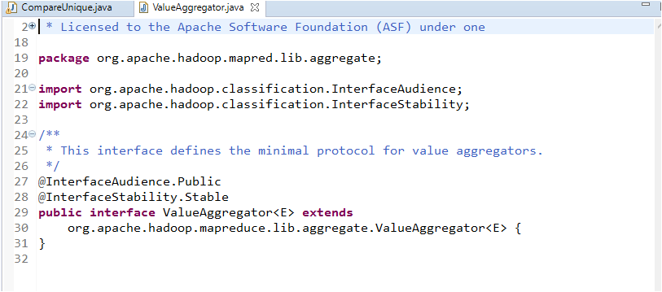
Example case:
From: hadoop-2.7.3-src\hadoop-mapreduce-project\hadoop-mapreduce-client\hadoop-mapreduce-client-core\...\mapred\lib\aggregate\ValueAggregator.java
To: hadoop-2.7.3-src\hadoop-mapreduce-project\hadoop-mapreduce-client\hadoop-mapreduce-client-core\...\mapreduce\lib\aggregate\ValueAggregator.java "mapred. … .ValueAggregator" extends "mapreduce. … .ValueAggregator"

Slide 14
Comparison Result Summary – Understand versus Include
1% of total dependencies is capture only by Include and not by Understand
è Those capture by Include but not by Understand are those import used not for method invocation, but as variable/attribute type declaration
Case Example(1):
From: hadoop-2.7.3-src\hadoop-yarn-project\...\server\nodemanager \containermanager\localizer\event\ApplicationLocalizationEvent.java
To: hadoop-2.7.3-src\hadoop-yarn-project\...\server\nodemanager \containermanager\application\Application.java
Case Example(2):
From: hadoop-2.7.3-src\hadoop-yarn-project\...\yarn\server\resourcemanager\reservation\TestCapacityOverTimePolicy.java
To: hadoop-2.7.3-src\hadoop-yarn-project\...\yarn\server\resourcemanager\reservation\exceptions\ResourceOverCommitException.java

Slide 15
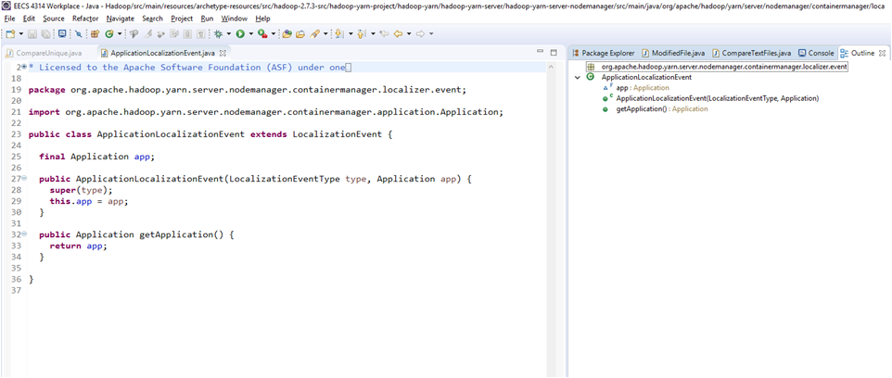
Comparison Result Summary – Understand versus Include
Case Example (1) - The application object is used as an attribute, and method of Application is not invoked

Slide 16
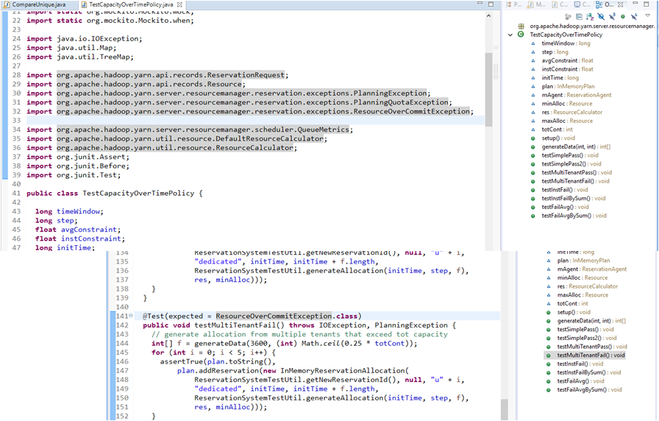
Case Example (2) From: hadoop-2.7.3-src\hadoop-yarn-project\...\yarn\server\resourcemanager\reservation\TestCapacityOverTimePolicy.java To: hadoop-2.7.3-src\hadoop-yarn-project\...\yarn\server\resourcemanager\reservation\exceptions\ResourceOverCommitException.java ResourceOverCommitException --> Used only as expected Exception, but never use within any method implementation as a catch item

Slide 17
Understand VS Include
OVERLAP
8297: …\hadoop\hdfs\server\namenode\FSDirSymlinkOp.java → …\hadoop\fs\permission\PermissionStatus.java
Both have an import statement
Understand contains method parameters and method calls
PermissionStatis dirPerms;
dirPerms.getUserName;

Slide 18
Understand Only
44087...\java\org\apache\hadoop\security\TestNetgroupCache.java → …\main\java\org\apache\hadoop\security\NetgroupCache.java
No import statement in TestNetgroupCache.java
Uses a method from NetGroupCache, both in same Hadoop project so import not needed
Static reference is allowed in Java
NetgroupCache.add(GROUP1, users)

Slide 19
Include Only
62615:…\hadoop\yarn\server\nodemanager\containermanager\container\ContainerImpl.java →… \hadoop\yarn\server\nodemanager\containermanager\application\ ApplicationContainerFinishedEvent.java
Import statement in file but not outputted in Understand csv file
Understand Dependency browser lists it as a dependency
File does create a new Application class
eventHandler.handle(new ApplicationContainerFinishedEvent(containerId))

Slide 20
Qualitative Overview (IncVUnd)
It is generally seen that the dependents not overlapping retrieved by Understand is due to children being imported but parents being used and data types being used without any imports at all. Thus having more dependencies that would not be found by Include as it only finds imports of the direct class
The Include tool finds some dependencies that are not found by Understand and those are generally imported classes used as parameters or links, or inherited classes that add features
The precision of the Include tool is 40404/41293 ~ 0.98
The recall of the Include tool is 40404/65650 ~ 0.64

Slide 21
Intellij IDEA vs. Understand
Quantitative analysis

Slide 22
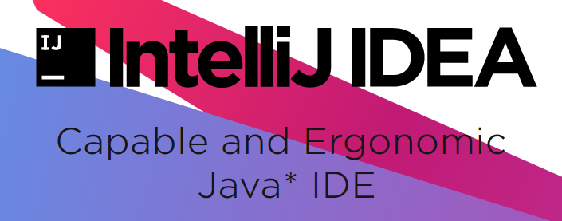
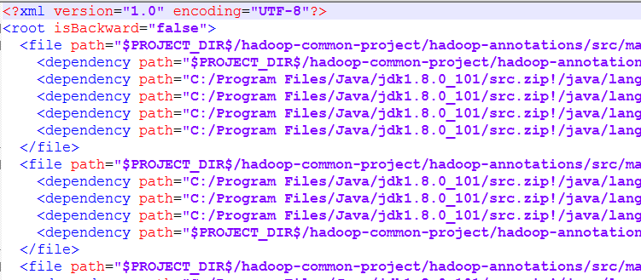
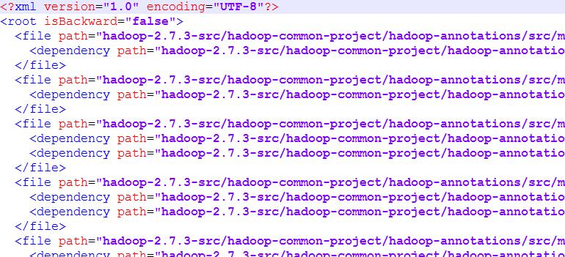
Extracting info from IDEA

Slide 23
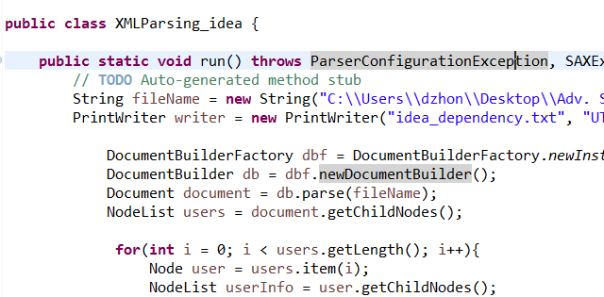
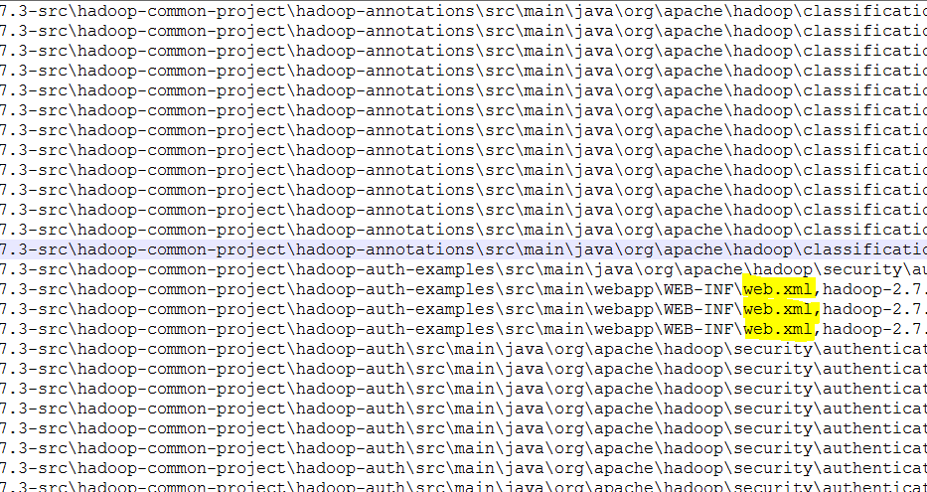
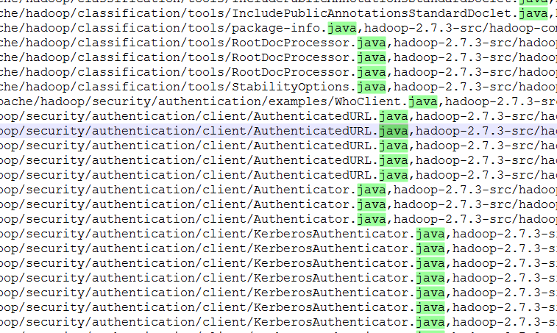
Extracting info from IDEA

Slide 24
Extraction philosophy
IDEA
Include .xml dependency
It grabs dependency relation in a different way than Understand
Implicit dependency such as Extend/implement is evaluated
Extract dependency base on parameters of methods of every class

Slide 25
Venn Diagram of Understand VS Intellij IDEA
Overlap
Understand
Intellij Idea
18%
77%
5%
11697
dependencies
50538
dependencies
3415
dependencies

Slide 26
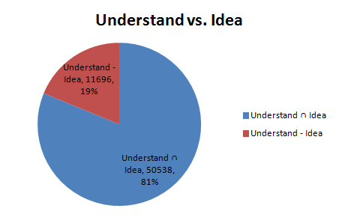
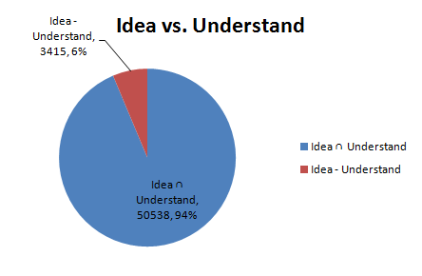
Statistics: Understand vs. IDEA
 | Intersect | Excluding | Total
Undertand | 50538 | 11696 | 62234
Idea |  | 3415 | 53953
Total Dependencies | 63123

Slide 27
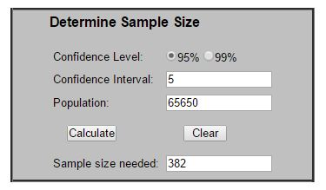
Sample Calculator for IDEA VS UNDERSTAND

Slide 28
Intellij IDEA vs. Understand
Qualitative analysis

Slide 29
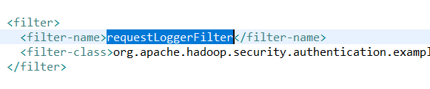
Non-Java dependency
Will be excluded from our research scope.
Dependency relation is defined in .xml file for namespace concern.
...\hadoop-common-project\hadoop-auth-examples\src\main\webapp\WEB-INF\web.xml
...\hadoop-common-project\hadoop-auth\src\main\java\org\apache\hadoop\security\authentication\server\AuthenticationFilter.java
dependent
dependee

Slide 30
IDEA only
62251:
...\src\main\java\org\apache\hadoop\fs\FileUtil.java
...\src\main\java\org\apache\hadoop\fs\FSDataInputStream.java
dependent
dependee
Notes:
FileSystem src
inside that FileSystem class is a method called public FSDataInputStream open(Path f)
it returns a FSDataInputStream

Slide 31
IDEA only
62303:
…\src\main\java\org\apache\hadoop\io\AbstractMapWritable.java
…\src\main\java\org\apache\hadoop\io\NullWritable.java
dependent
dependee

Slide 32

IDEA only
62357:
...\src\main\java\org\apache\hadoop\security\token\delegation\ZKDelegationTokenSecretManager.java
…\src\main\java\org\apache\hadoop\io\Writable.java
dependent
dependee
Notes:
Under the "private void ()" method
there's an object called DelegationKey key
DelegationKey implements Writable
that's why there's a dependency

Slide 33
IDEA only
62652：
...\src\main\java\org\apache\hadoop\hdfs\server\namenode\NameNode.java
...\src\main\java\org\apache\hadoop\hdfs\server\namenode\Namesystem.java
dependent
dependee

Slide 34
Understand only
50864:
...\src\main\java\org\apache\hadoop\security\authentication\client\KerberosAuthenticator.java
…\src\test\java\org\apache\hadoop\crypto\TestCryptoCodec.java
Seems to be error.
\main folder may not need to invoke a function in \test folder.
Found no clues in dependent class
dependent
dependee

Slide 35
Understand only
58802:
...\src\main\java\org\apache\hadoop\yarn\server\nodemanager\recovery\NMLeveldbStateStoreService.java
...\src\main\java\org\apache\hadoop\yarn\server\records\impl\pb\VersionPBImpl.java
dependent
dependee

Slide 36
Understand only
62206:
...\src\test\java\org\apache\hadoop\yarn\server\webproxy\TestAppReportFetcher.java
…\src\main\java\org\apache\hadoop\yarn\api\ApplicationBaseProtocol.java
TestAppReportFetcher.testHelper Calls ApplicationBaseProtocol.getApplicationReport
IDEA doesn't detect this, doesn't list most dependencies from file.
dependent
dependee

Slide 37
Overlap
15972:
…\src\test\java\org\apache\hadoop\fs\TestHDFSFileContextMainOperations.java
…\src\main\java\org\apache\hadoop\hdfs\DistributedFileSystem.java
dependent
dependee

Slide 38
Overlap
29322:
…\src\main\java\org\apache\hadoop\mapreduce\counters\CounterGroupBase.java
…\src\main\java\org\apache\hadoop\mapreduce\Counter.java
dependent
dependee

Slide 39
Qualitative Overview (IdVInc)
Similarly like the Include tool the dependencies missed by the IDEA tool are children that are imported but methods implemented by a parent
Unlike Include, the IDEA tool missed some dependencies that would have otherwise been found by Include
IDEA tool finds dependencies that aren't found by Understand, these are found to be implemented classes (may not be an actual dependency)
The precision of the IDEA tool is 50538/53954 ~ 0.94
The recall of the IDEA tool is 50538/65650 ~ 0.77

Slide 40
Alternative Tool: srcML

Slide 41
Other Alternative Tool Explore - srcML
About ScrML
Convert source code file into srcML format, which is an XML representation of source code. As xml representation, markup tags identify elements of the abstract syntax for the language.
It currently support the parsing of C, C++, C# and Java.
The transformation is lossless. No changes is made to the original source code file
How ScrML work
Once in srcML format, XML tools and technologies can be used for such things as extraction and transformation.
Using its query command ‘xpath’, it is capable of executing various fact extraction.

Slide 42
Initial Aim
extract dependency by listing the types of variables declared by every class.
srcml --xpath "//src:decl_stmt/src:decl/src:type" hadoop-2.7.3-src\hadoop-common-project >decl_stmt_common.xml
srcml --xpath "//src:decl_stmt/src:decl/src:type" hadoop-2.7.3-src\hadoop-hdfs-project >decl_stmt_hdfs.xml
(due to the large number of instances, run the query by subdirectory)

Slide 43
Challenges
Need to map every type to its associated file path and requires running additional query for list of all classes
Need to tackle type of generic class, and hence require further parsing of the parameter types
Need to map with associated packages, and requires running additional query for list of import statements (which makes this exercise almost similar to Include.java)

Slide 44
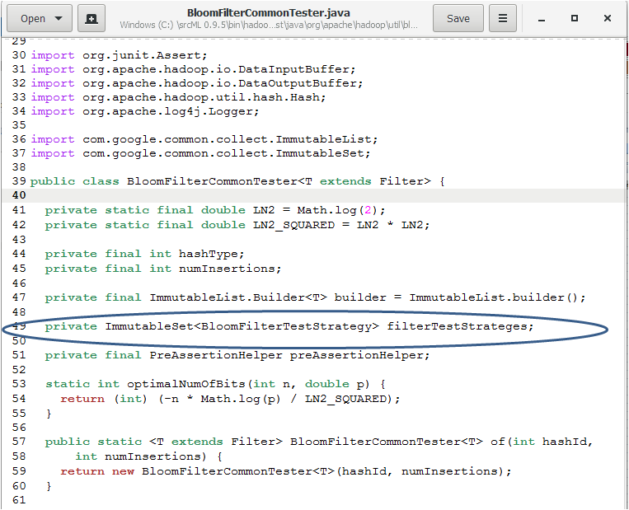
Other Alternative Tool Explore - srcML
Type of generic class

Slide 45
Lessons Learned
Powerful programs like Understand can make errors
There is a lot of digging to find dependencies between classes, especially in a sophisticated Java IDE like Intellij IDEA
Many Approaches at extracting Dependency (listing include, method-to-method, extending interface/inheriting classes, method's parameter types)
Focusing just at one approach is not advisable
Understand is more inclusive, but comprise many redundant non-inter-subcomponent's dependencies --> confusing and might lead to wrong conclusion
Include offers the most compact information, however it might omit important dependency by excluding the listing of its 'supplier' classes
Idea provides dependency based on type of parameter of every class methods. These reveals those classes as 'helper methods'. However, cross study with back dependency is required to fully utilize this information
Studying Dependency reveals a substantial part of the design of the whole system

Slide 46
Conclusion
We used 3 different extraction techniques
Include
Understand
Intellij IDEA
Quantitative and Qualitative Analysis of Include VS Understand
Quantitative and Qualitative Analysis of IDEA VS Understand
Alterantive tool: srcML
Lessons Learned

