Slide 1
Unlocking Insights from COVID-19 Data
Harnessing the Power of Analytics for a Healthier Future

Slide 2
Our Focus Questions
Do underlying conditions impact Covid-19 mortality rates, and which conditions are most significant in predicting fatalities?
How did the introduction of vaccinations impact Covid-19?
What types of lockdown measures were implemented by each state, when were they initiated, and were they mandatory or suggested?
What are the pandemic's demographic trends (age, sex, ethnicity/race) overall, and how do they vary across different states?

Slide 3
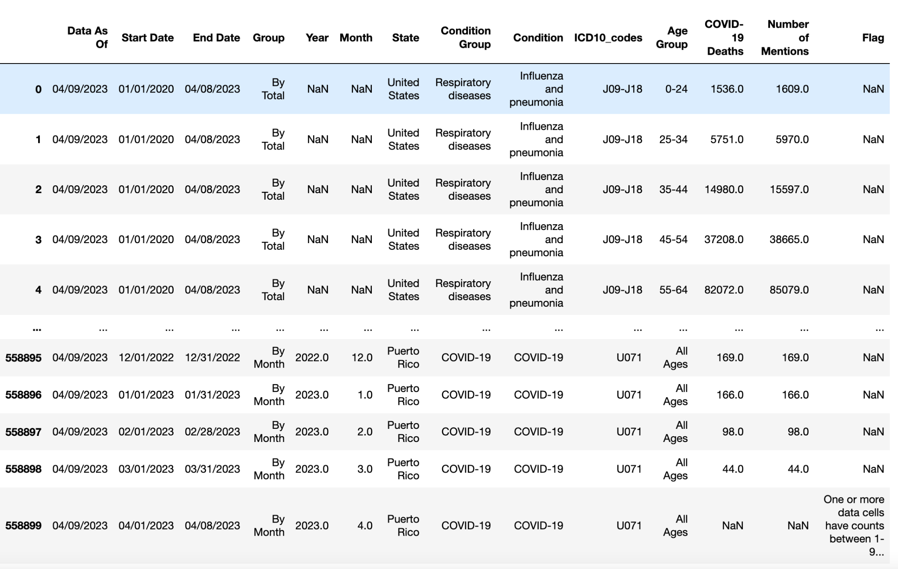
Underlying Conditions Data

Slide 4
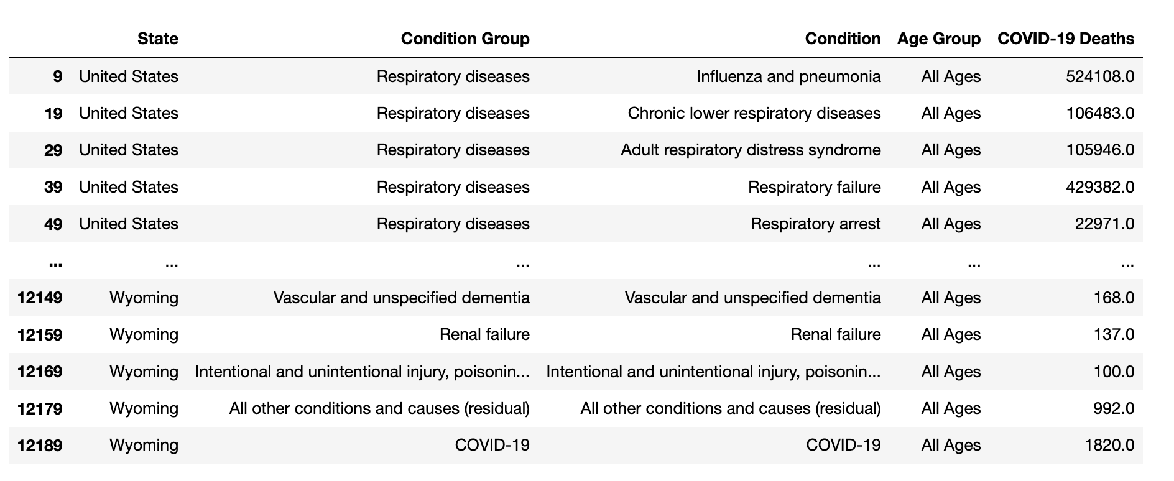

Slide 5
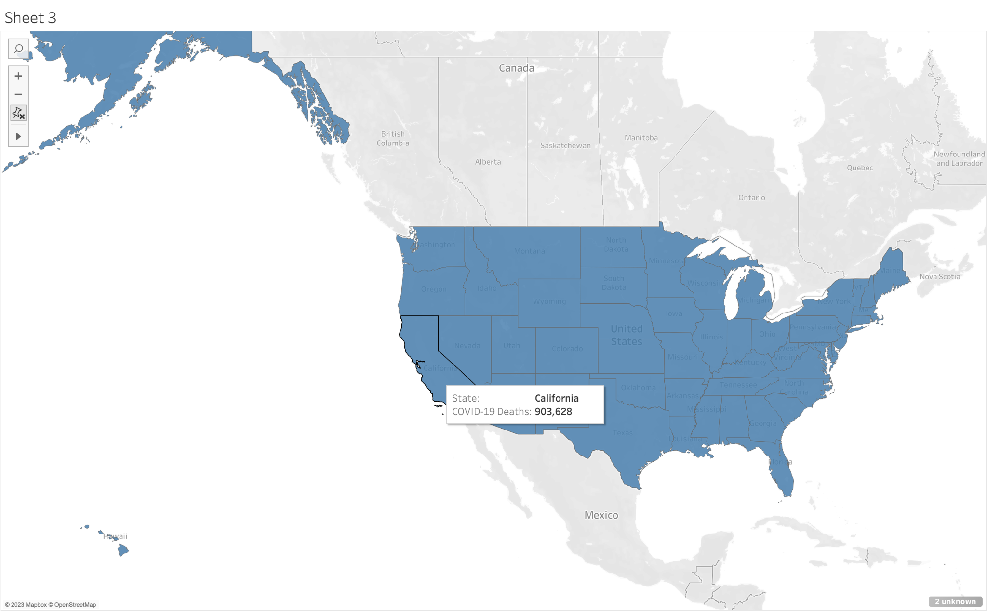

Slide 6
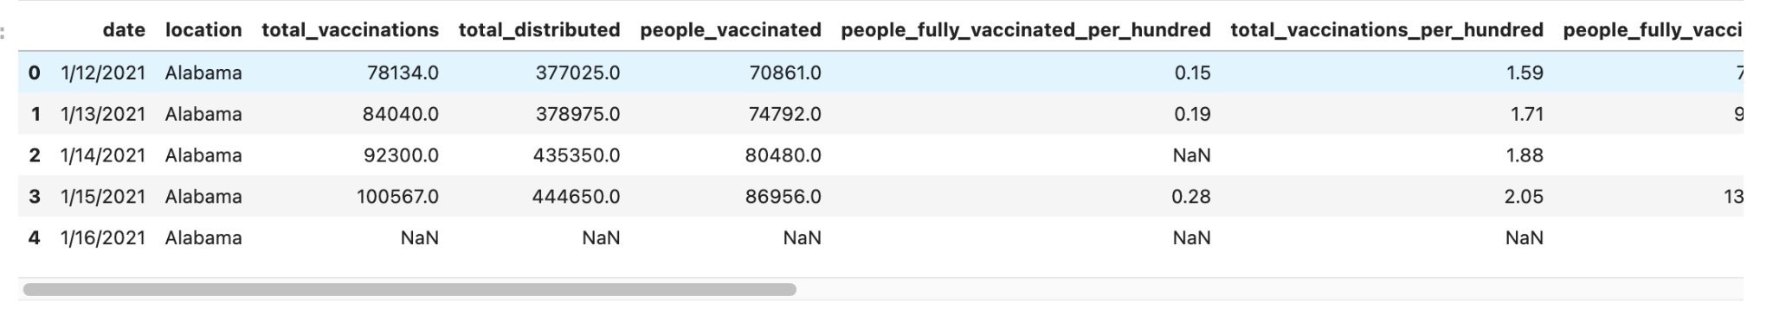
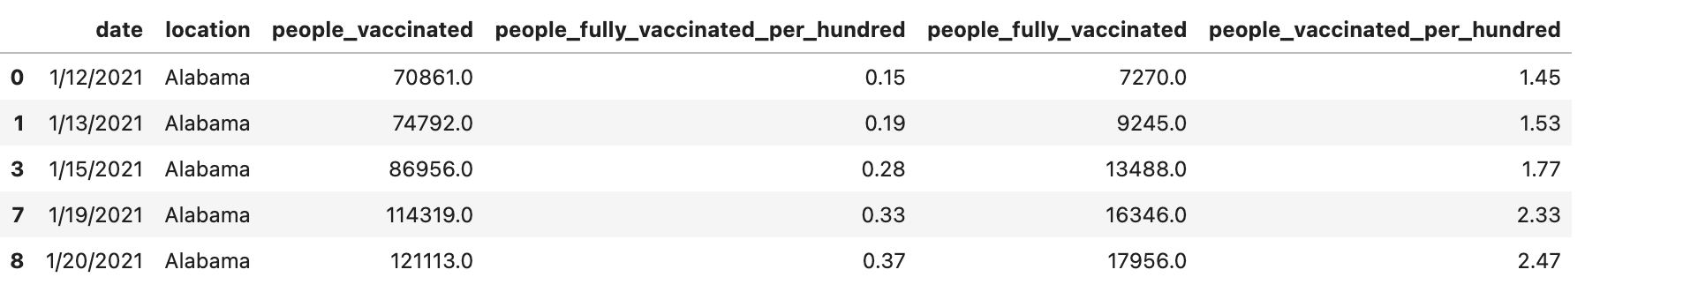
Vaccinations Data

Slide 7
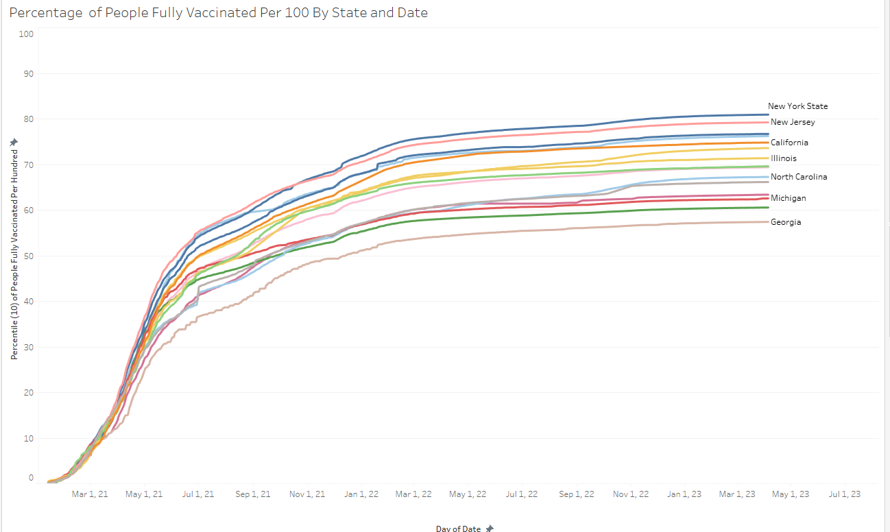

Slide 8
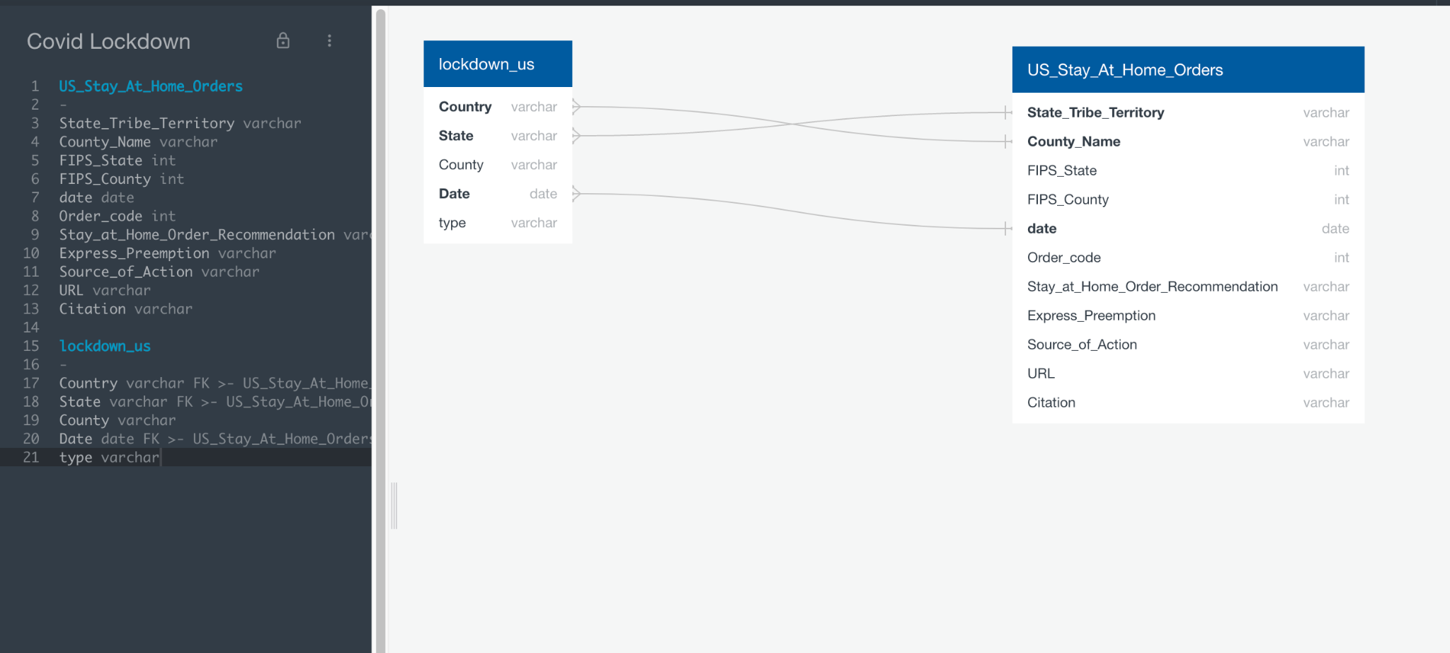
Lockdown Data

Slide 9
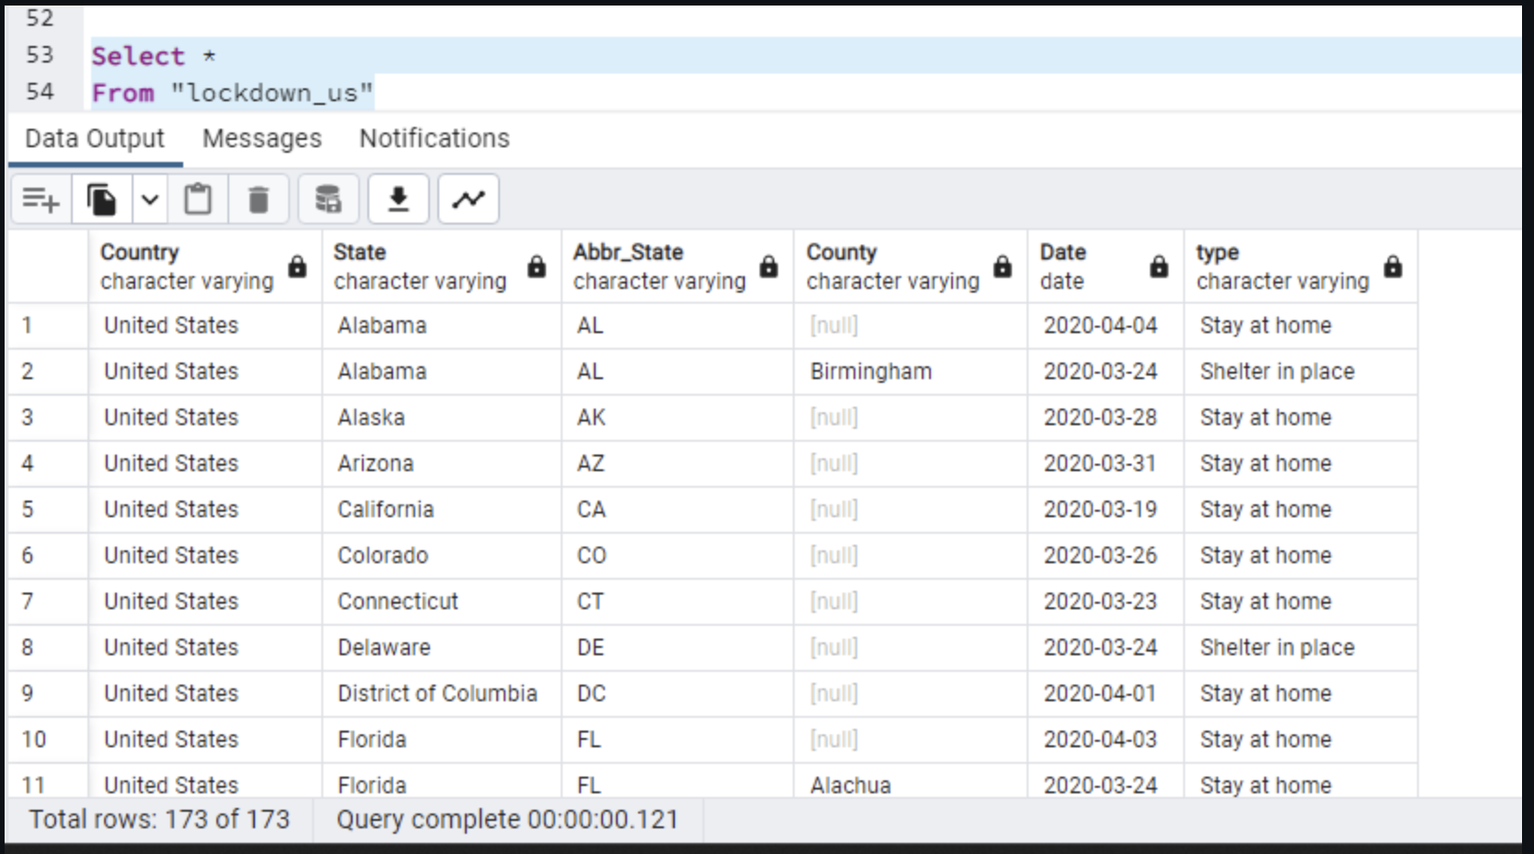

Slide 10
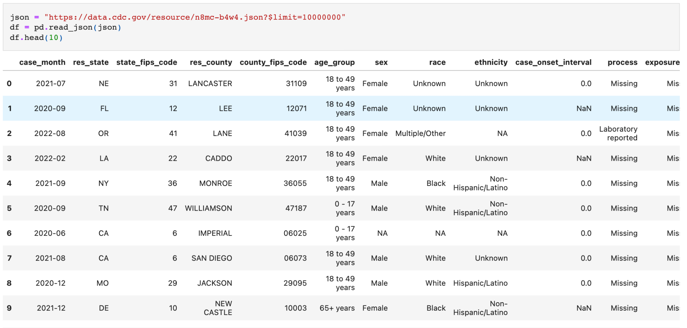
Demographic Data

Slide 11
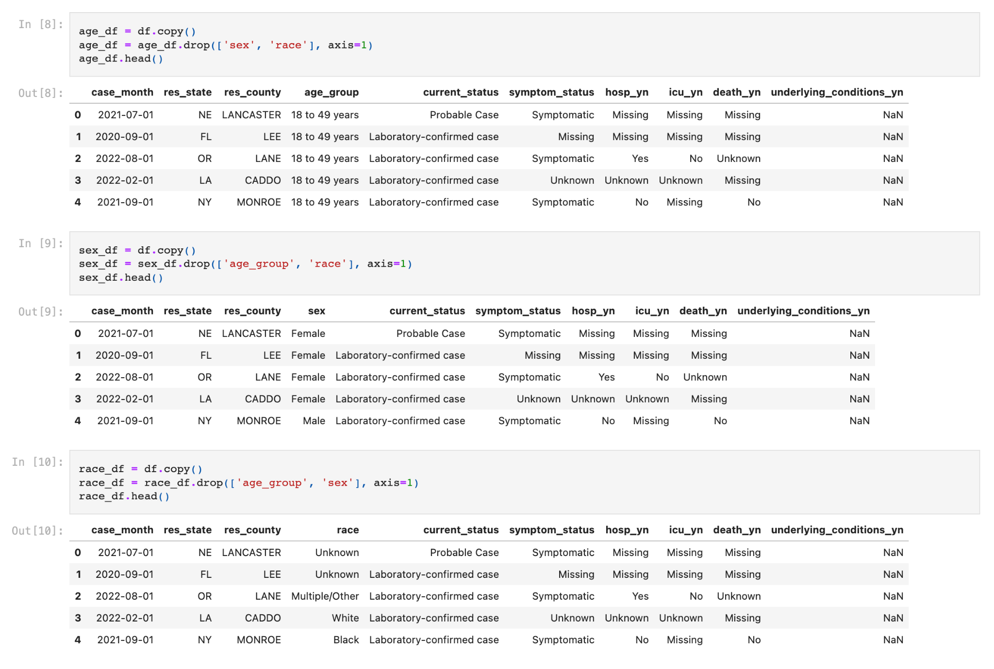

Slide 12
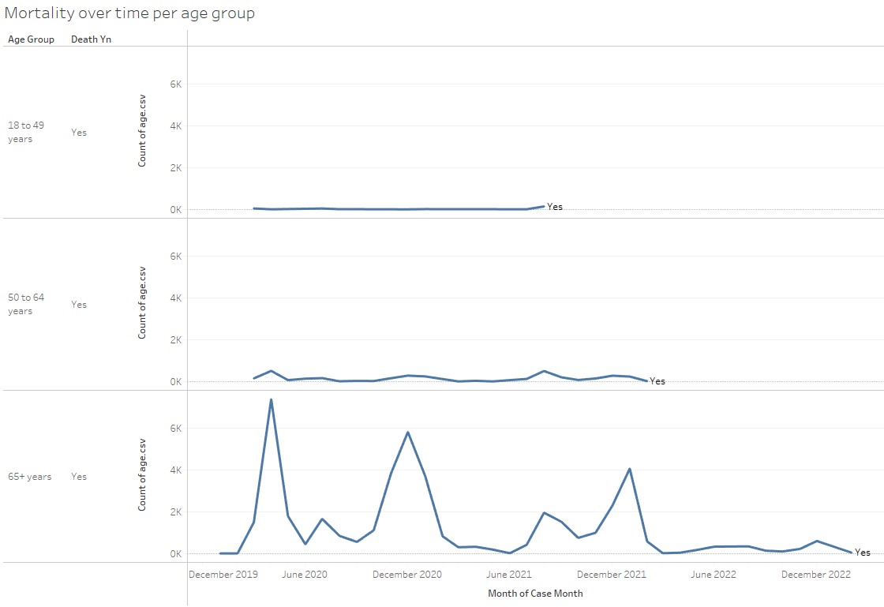

Slide 13
Roadblocks
Figuring out Tableau
Large file implementation
ML model planning (Regression?)

