Slide 1


Applied Bayesian Data Analysis
In Requirements Engineering
Julian Frattini, Ph.D.
Chalmers University of Technology, Sweden
https://julianfrattini.github.io/
JulianFrattini/bda4sci
Public
Copyright © 2026 Julian Frattini.
The source code is licensed under the MIT license.
This presentation is licensed under CC BY-NC-SA 4.0.

Slide 2

Applied Bayesian Data Analysis in Requirements Engineering
A Gentle Introduction to the Analysis of Quantitative Data within a Bayesian Framework
17-21 August 2026
Montreal, Canada
Monday, 17th of August, 13:45-17:15 in Room E-2021

Slide 3



Meet your Instructors
Richard Torkar
Full Professor
https://torkar.github.io/
Robert Feldt
Full Professor
http://www.robertfeldt.net/
Hans-Martin Heyn
Senior Lecturer
https://martinheyn.github.io/
Julian Frattini
Postdoctoral Researcher
https://julianfrattini.github.io/

Slide 4
Schedule
Session | Time | Content
Motivation | 13:00-13:15 | Motivation and learning goals
State-of-Practice | 13:15-13:45 | Frequentism and its issues
Bayes’ Theorem | 13:45-14:30 | Fundamentals of Bayes’ theorem
Break | 14:30-14:30
Bayesian Workflow I | 14:30-15:15 | Fundamental Bayesian workflow with simple normal data
Bayesian Workflow II | 15:15-15:45 | Advanced Bayesian workflow with non-normal data
Learning Path | 15:45-16:00 | Advice for the Bayesian journey
Feedback | 16:00-16:30 | Reflection, discussion, and closing

Slide 5
Motivation and Goals

Slide 6
Good Science
If we strive to do good science, we aim for rigorous and relevant empirical research contributions, where a rigorous contribution is a valid contribution.
Internal Validity
Cause Construct
impacts
Effect Construct
Construct Validity
impacts
Moderator
Theory
Observation
operationalized as
External Validity
operationalized as
Cause Indicator
impacts
Effect Indicator
Wohlin, C., Runeson, P., Höst, M., Ohlsson, M. C., Regnell, B., & Wesslén, A. (2012). Experimentation in software engineering (Vol. 236, p. P3). Berlin: Springer.
Conclusion Validity

Slide 7
Conclusion Validity
Even if we have ensured the internal, external, and construct validity of our study in the data collection phase, we might still draw the wrong conclusions from it.
Conclusion validity affects our “ability to draw the correct conclusion about relations between the treatment and the outcome of an experiment.”
Wohlin, C., Runeson, P., Höst, M., Ohlsson, M. C., Regnell, B., & Wesslén, A. (2012). Experimentation in software engineering (Vol. 236, p. P3). Berlin: Springer.

Slide 8
Conclusion Validity
The conclusion validity is determined by the statistical methods researchers apply to derive conclusions from our data.
Quantitative Data
Statistical Method
Conclusions
Toolbox of statistical methods
Descriptive statistics
Frequentist inferential statistics
Bayesian inferential statistics

Slide 9
Learning Outcomes
After this tutorial, you will be able to
Better understand the current state-of-practice in data analysis and its problems,
Understand Bayes’ theorem and the Bayesian perspective on probability, and
Apply a systematic Bayesian data analysis process.

Slide 10
State of Practice
Review of frequentist methods and their threats to conclusion validity

Slide 11
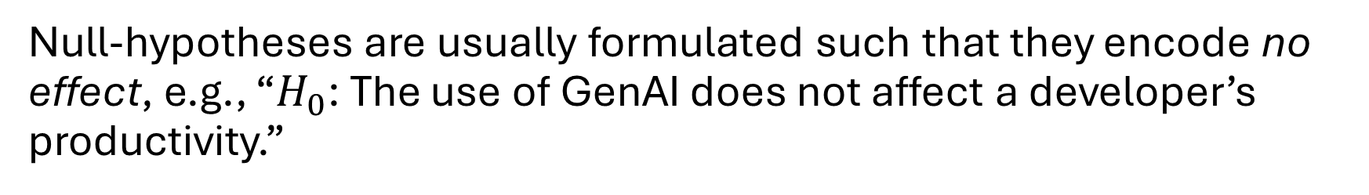
Null-Hypothesis Significance Tests
The state-of-practice for analyzing quantitative data in SE research focuses on Null-Hypothesis Significance Testing (NHST) commonly consisting of three components.
Null-hypothesis
Null-hypotheses are usually formulated such that they encode no effect, e.g., “$H_{0}$: The use of GenAI does not affect a developer’s productivity.”
de Oliveira Neto, F. G., Torkar, R., Feldt, R., Gren, L., Furia, C. A., & Huang, Z. (2019). Evolution of statistical analysis in empirical software engineering research: Current state and steps forward. Journal of Systems and Software, 156, 246-267.
Notes:
NH + data + appropriate test = p-value

Slide 12
Null-Hypothesis Significance Tests
The state-of-practice for analyzing quantitative data in SE research focuses on Null-Hypothesis Significance Testing (NHST) commonly consisting of three components.
Null-hypothesis
Data
Notes:
NH + data + appropriate test = p-value

Slide 13
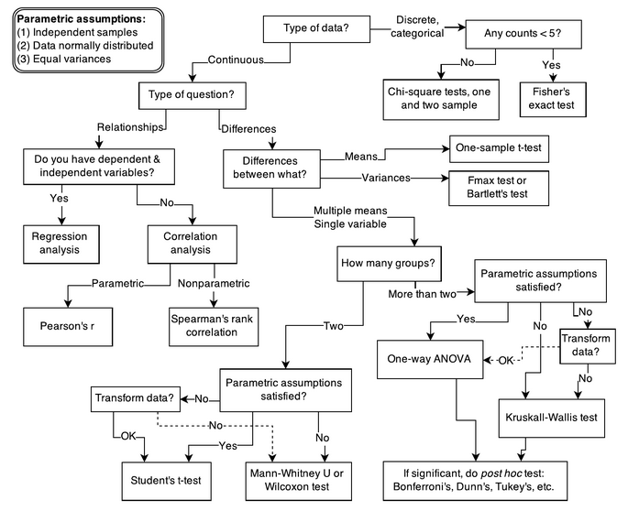
Null-Hypothesis Significance Tests
The state-of-practice for analyzing quantitative data in SE research focuses on Null-Hypothesis Significance Testing (NHST) commonly consisting of three components.
Null-hypothesis
Data
Appropriate test
McElreath, Richard. Statistical rethinking: A Bayesian course with examples in R and Stan. Chapman and Hall/CRC, 2018.
Notes:
NH + data + appropriate test = p-value

Slide 14

Null-Hypothesis Significance Tests
Null-hypothesis significance tests (NHSTs) work roughly as follows:
Null-hypothesis
NHST
Data
p-value $p∈[0, 1]$
Appropriate test
Notes:
NH + data + appropriate test = p-value

Slide 15
What exactly is this mysterious
p-value?

Slide 16
Null-Hypothesis Significance Tests
A p-value is a statement about the observed data.
A p-value is the probability of observing data at least as extreme as what you actually got, assuming the null hypothesis is true.
In other words: A null-hypothesis (describing “no effect”) receiving a p-value of 4% on observed data implies that – if that null-hypothesis were true and there is indeed no effect – there is a 4% chance we would observe the collected data.

Slide 17
Null-Hypothesis Significance Tests
A p-value is a not statement about the formulated hypothesis.
A p-value is not the probability that the null hypothesis is correct, given what they observed.
However, this is usually the question of interest: how likely is there no/an effect of one variable on another? NHSTs do not answer this question.

Slide 18
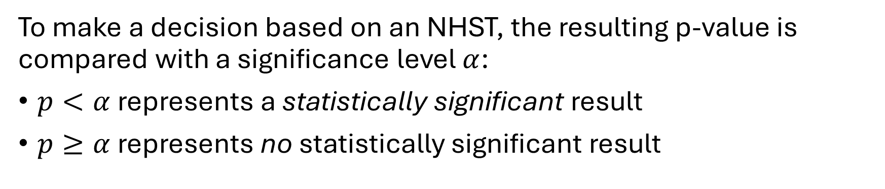
Null-Hypothesis Significance Tests
To make a decision based on an NHST, the resulting p-value is compared with a significance level $α$:
$p<α$ represents a statistically significant result
$p≥α$ represents no statistically significant result
Statistically significant results imply that two distributions are statistically unlikely to have come from the same population.

Slide 19
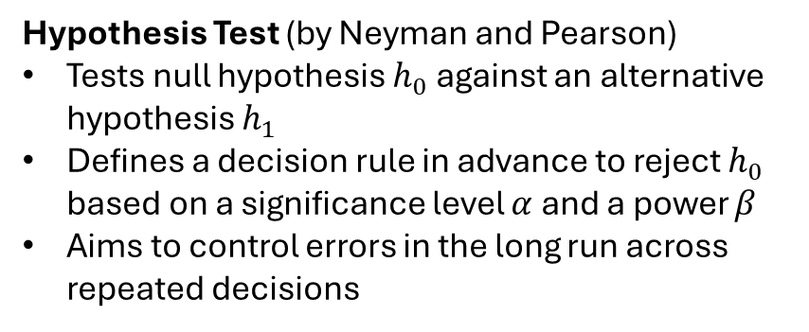
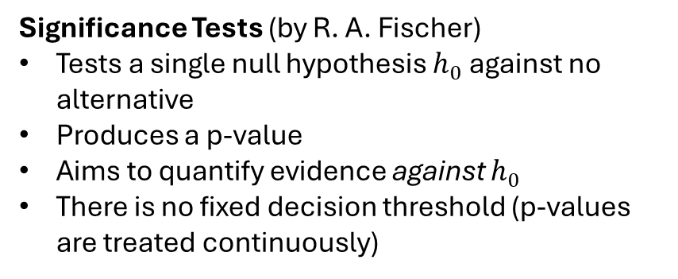
Origin of the NHST
The Null-Hypothesis Significance Test is actually an improper hybrid of two separate techniques:
Significance Tests (by R. A. Fischer)
Tests a single null hypothesis $h_{0}$ against no alternative
Produces a p-value
Aims to quantify evidence against $h_{0}$
There is no fixed decision threshold (p-values are treated continuously)
Hypothesis Test (by Neyman and Pearson)
Tests null hypothesis $h_{0}$ against an alternative hypothesis $h_{1}$
Defines a decision rule in advance to reject $h_{0}$ based on a significance level $α$ and a power $β$
Aims to control errors in the long run across repeated decisions

Slide 20
Confidence Intervals
Interpretation: even more unnatural

Slide 21
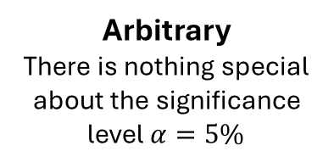
Null-Hypothesis Significance Tests
Analyzing data using only NHSTs has several issues:
Binary
NHSTs reduce complex data to binary, seemingly certain results
Normal
NHSTs distinguish only normal from non-normal data
Interpretability
The p-value is often misinterpreted
Arbitrary
There is nothing special about the significance level $α=5\%$

Slide 22
The Bayesian Paradigm

Slide 23
Paradigm of Probability
Next to the frequentist paradigm, the Bayesian paradigm of statistics assigns a different meaning to probability:
Frequentist Probability
Bayesian Probability
The proportion of times it would occur if you repeated the experiment an infinite number of times under identical conditions.
→ Probability applies to events
A statement about the state of knowledge of an observer that quantifies how confident a rational agent is that something is true, given their current information.
→ Probability applies to hypotheses

Slide 24
Paradigm of Probability
Next to the frequentist paradigm, the Bayesian paradigm of statistics assigns a different meaning to probability:
In the frequentist paradigm, probability is a property of a repeatable random process. The probability of an event is the proportion of times it would occur if you repeated the experiment an infinite number of times under identical conditions. Probability only assigns to random events, not hypotheses.
In the Bayesian paradigm, probability is a statement about the state of knowledge of an observer, not about physical processes in the world. A probability quantifies how confident a rational agent is that something is true, given their current information. Probability assigns to belief, not to events (as these are factual).

Slide 25
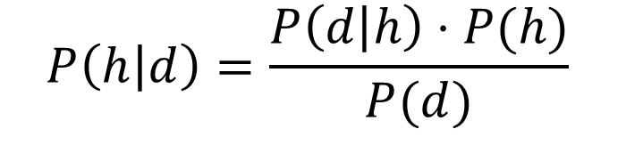
Bayes’ Theorem
The Bayesian paradigm is based on Bayes’ Theorem:
$$P\left(h | d\right)=\frac{P\left(d | h\right)⋅P(h)}{P(d)}$$

Slide 26
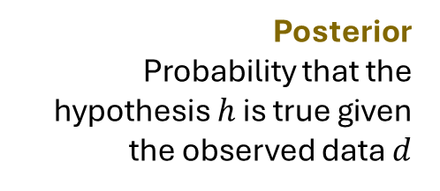
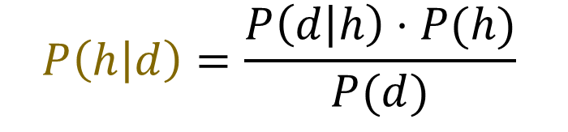
Bayes’ Theorem
The Bayesian paradigm is based on Bayes’ Theorem:
Posterior
Probability that the hypothesis $h$ is true given the observed data $d$
$$P\left(h | d\right)=\frac{P\left(d | h\right)⋅P(h)}{P(d)}$$

Slide 27
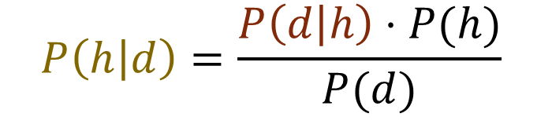
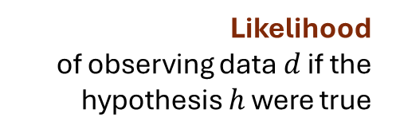
Bayes’ Theorem
The Bayesian paradigm is based on Bayes’ Theorem:
Likelihood
of observing data $d$ if the hypothesis $h$ were true
Posterior
Probability that the hypothesis $h$ is true given the observed data $d$
$$P\left(h | d\right)=\frac{P\left(d | h\right)⋅P(h)}{P(d)}$$

Slide 28
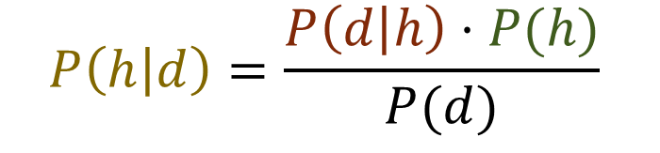
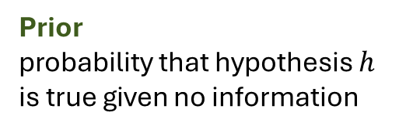
Bayes’ Theorem
The Bayesian paradigm is based on Bayes’ Theorem:
Likelihood
of observing data $d$ if the hypothesis $h$ were true
Prior
probability that hypothesis $h$ is true given no information
Posterior
Probability that the hypothesis $h$ is true given the observed data $d$
$$P\left(h | d\right)=\frac{P\left(d | h\right)⋅P(h)}{P(d)}$$

Slide 29
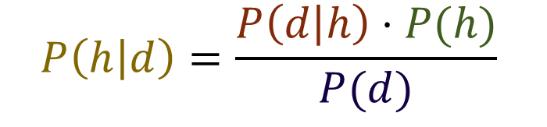
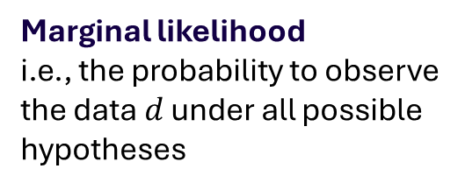
Bayes’ Theorem
The Bayesian paradigm is based on Bayes’ Theorem:
Likelihood
of observing data $d$ if the hypothesis $h$ were true
Prior
probability that hypothesis $h$ is true given no information
Posterior
Probability that the hypothesis $h$ is true given the observed data $d$
$$P\left(h | d\right)=\frac{P\left(d | h\right)⋅P(h)}{P(d)}$$
Marginal likelihood
i.e., the probability to observe the data $d$ under all possible hypotheses

Slide 30
Example
We are investigating a static code analysis tool. The tool has 90% sensitivity and 10% false positive rate. Only 5% of files actually have bugs. What's the probability that a flagged file is buggy?

Slide 31


Example
We are investigating a static code analysis tool. The tool has 90% sensitivity and 10% false positive rate. Only 5% of files actually have bugs. What's the probability that a flagged file is buggy?
$h$: the file has a bug
$d$: the tool flags the file as buggy

Slide 32
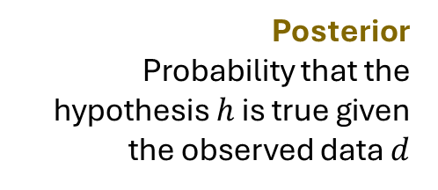

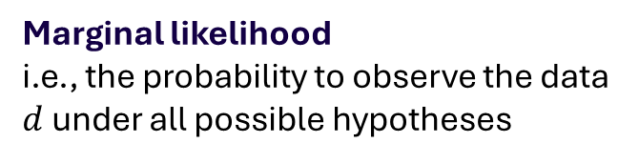

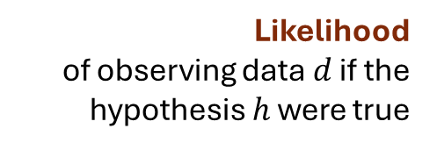
Example
We are investigating a static code analysis tool. The tool has 90% sensitivity and 10% false positive rate. Only 5% of files actually have bugs. What's the probability that a flagged file is buggy?
Likelihood
of observing data $d$ if the hypothesis $h$ were true
Prior
probability that hypothesis $h$ is true given no information
Posterior
Probability that the hypothesis $h$ is true given the observed data $d$
$$P\left(h | d\right)=\frac{P\left(d | h\right)⋅P(h)}{P(d)}$$
Marginal likelihood
i.e., the probability to observe the data $d$ under all possible hypotheses

Slide 33
Example
We are investigating a static code analysis tool. The tool has 90% sensitivity and 10% false positive rate. Only 5% of files actually have bugs. What's the probability that a flagged file is buggy?
Likelihood
of observing data $d$ if the hypothesis $h$ were true
Prior
probability that hypothesis $h$ is true given no information
Posterior
Probability that the hypothesis $h$ is true given the observed data $d$
$$P\left(h | d\right)=\frac{P\left(d | h\right)⋅P(h)}{P(d)}$$
Marginal likelihood
i.e., the probability to observe the data $d$ under all possible hypotheses

Slide 34
Example
We are investigating a static code analysis tool. The tool has 90% sensitivity and 10% false positive rate. Only 5% of files actually have bugs. What's the probability that a flagged file is buggy?
Likelihood
of observing data $d$ if the hypothesis $h$ were true
Prior
probability that hypothesis $h$ is true given no information
Posterior
Probability that the hypothesis $h$ is true given the observed data $d$
$$P\left(h | d\right)=\frac{P\left(d | h\right)⋅P(h)}{P(d)}$$
Marginal likelihood
i.e., the probability to observe the data $d$ under all possible hypotheses

Slide 35
Example
We are investigating a static code analysis tool. The tool has 90% sensitivity and 10% false positive rate. Only 5% of files actually have bugs. What's the probability that a flagged file is buggy?
The marginal likelihood $P(d)$ can be calculated from the other data:
$$P\left(d\right)=P\left(d | h\right)⋅P\left(h\right)+P\left(d | ¬h\right)⋅P(¬h)$$
$$=0.9⋅0.05+0.1⋅0.95=0.14$$
Marginal likelihood
i.e., the probability to observe the data $d$ under all possible hypotheses

Slide 36

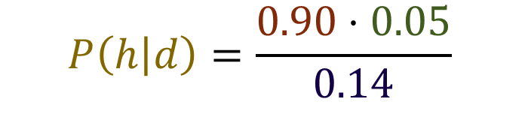
Example
We are investigating a static code analysis tool. The tool has 90% sensitivity and 10% false positive rate. Only 5% of files actually have bugs. What's the probability that a flagged file is buggy?
Likelihood
of observing data $d$ if the hypothesis $h$ were true
Prior
probability that hypothesis $h$ is true given no information
Posterior
Probability that the hypothesis $h$ is true given the observed data $d$
$$P\left(h | d\right)=\frac{0.90⋅0.05}{0.14}$$
Marginal likelihood
i.e., the probability to observe the data $d$ under all possible hypotheses

Slide 37
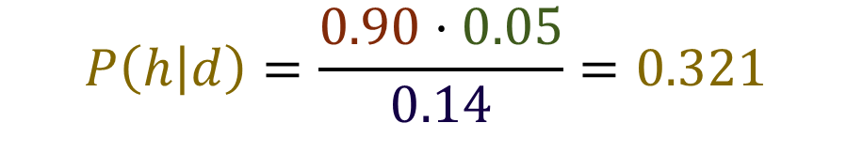
Example
We are investigating a static code analysis tool. The tool has 90% sensitivity and 10% false positive rate. Only 5% of files actually have bugs. What's the probability that a flagged file is buggy?
Likelihood
of observing data $d$ if the hypothesis $h$ were true
Prior
probability that hypothesis $h$ is true given no information
Posterior
Probability that the hypothesis $h$ is true given the observed data $d$
$$P\left(h | d\right)=\frac{0.90⋅0.05}{0.14}=0.321$$
Marginal likelihood
i.e., the probability to observe the data $d$ under all possible hypotheses

Slide 38
Application I
Using Bayesian Data Analysis in Practice

Slide 39
The Bayesian Workflow
The upcoming demonstration will teach you to understand or do the following steps of a practical Bayesian workflow:
Build a regression formula
Select and assess prior probability distributions
Generate posteriors with Markov chain Monte Carlo algorithms
Assess the model fit via training diagnostics
Interpret posterior distributions to draw conclusions from the Bayesian model
Notes:
(defining a regression formula)
Do select and assess priors: specifying priors, performing and evaluating a prior predictive check
Understand Markov chain Monte Carlo sampling
Do assess model fit: test various diagnostics
Do evaluate models: interpret posteriors

Slide 40
Precursor
Prior to the now presented workflow, we assume that
we have modelled our causal assumptions, e.g., in a directed, acyclic graph (DAG), and
we have collected data on all relevant variables.

Slide 41

Context
Research question: Does increased AI usage affect the ability to identify bugs (adjusting for reviewer skill)?
Var | Name | Type
x | Measure of AI usage | Continuous, Gaussian-distributed
y | Ability of identifying bugs in a code snippet | Continuous, Gaussian-distributed
z | Skill of a code reviewer | Continuous, Gaussian-distributed
AI usage
Bug identification
$$β_{x}$$
x
y
z
Skill

Slide 42

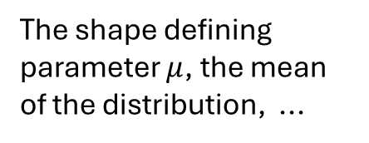
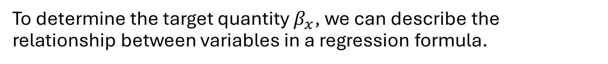
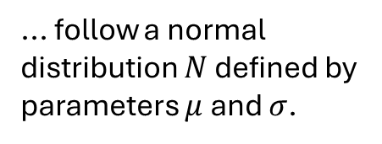
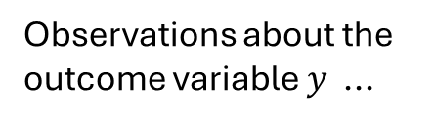

Building a Regression Formula
To determine the target quantity $β_{x}$, we can describe the relationship between variables in a regression formula.
... follow a normal distribution $N$ defined by parameters $μ$ and $σ$.
Observations about the outcome variable $y$ ...
Bayesian Model
$$y \sim N(μ, σ)$$
$$μ←α+β_{x}⋅x+β_{z}⋅z$$
... emerges from the sum of several factors.
The shape defining parameter $μ$, the mean of the distribution, ...

Slide 43


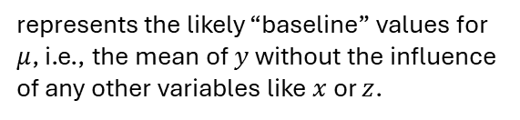
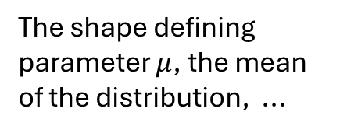
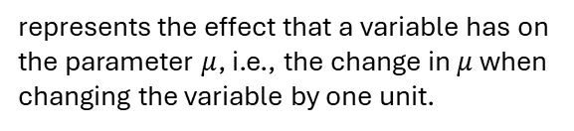
Building a Regression Formula
To determine the target quantity $β_{x}$, we can describe the relationship between variables in a regression formula.
The shape defining parameter $μ$, the mean of the distribution, ...
... emerges from the sum of several factors.
$$μ←α+β_{x}⋅x+β_{z}⋅z$$
Intercept
Terms
represents the likely “baseline” values for $μ$, i.e., the mean of $y$ without the influence of any other variables like $x$ or $z$.
consisting of a combination of
Coefficient
Data
represents the effect that a variable has on the parameter $μ$, i.e., the change in $μ$ when changing the variable by one unit.
are the actual values collected for the variables $x$ and $z$.

Slide 44

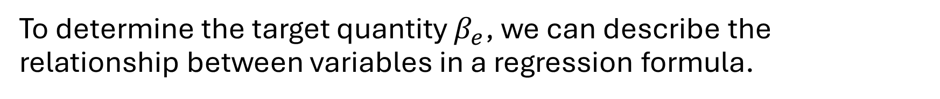

Building a Regression Formula
To determine the target quantity $β_{e}$, we can describe the relationship between variables in a regression formula.
Bayesian Model
R 4.5.0 using library(brms)
model <- brm(
y ~ 1 + x + z,
family = Gaussian
)
$$y \sim N(μ, σ)$$
$$μ←α+β_{x}⋅x+β_{z}⋅z$$
Intercept
Terms
Coefficient
Data

Slide 45


Selecting Priors
Every intercept and path coefficient is a probability distribution that we need to initialize with domain knowledge.
Bayesian Model
$$y \sim N(μ, σ)$$
$$μ←α+β_{x}⋅x+β_{z}⋅z$$

Slide 46
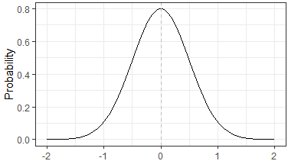





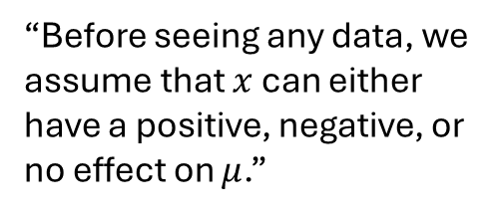

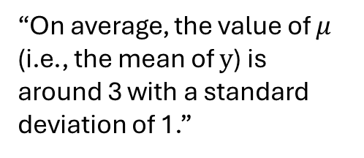
Selecting Priors
Every intercept and path coefficient is a probability distribution that we need to initialize with domain knowledge.
“On average, the value of $μ$ (i.e., the mean of $y$) is around 3 with a standard deviation of 1.”
Bayesian Model
“Before seeing any data, we assume that $x$ can either have a positive, negative, or no effect on $μ$.”
$$y \sim N(μ, σ)$$
$$μ←α+β_{x}⋅x+β_{z}⋅z$$
$$α∼N(3, 1)$$
$$β_{x}∼N(0, 0.5)$$
$$β_{z}∼N(0, 0.5)$$
$$σ∼exp(1)$$

Slide 47






Selecting Priors
Every intercept and path coefficient is a probability distribution that we need to initialize with domain knowledge.
Bayesian Model
R 4.5.0 using library(brms)
model <- brm(
y ~ 1 + x + z,
family = Gaussian,
priors = c(
prior(normal(3, 1), class = Intercept),
prior(normal(0, 0.5), class = b),
prior(exp(1), class = sigma))
)
$$y \sim N(μ, σ)$$
$$μ←α+β_{x}⋅x+β_{z}⋅z$$
$$α∼N(3, 1)$$
$$β_{x}∼N(0, 0.5)$$
$$β_{z}∼N(0, 0.5)$$
$$σ∼exp(1)$$

Slide 48
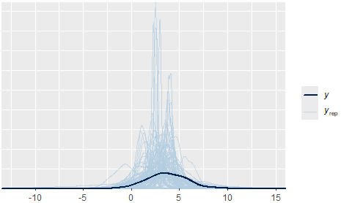






Assessing Priors
The actually observed data should be plausible given the prior probability distributions. We can assess this via a prior predictive check.
Collected Data
Bayesian Model
Prior Predictive Check
Bayesian Model
x | z | y
-0.63 | 0.95 | 3.35
0.24 | 1.00 | 4.00
-1.06 | -0.28 | 2.78
... | ... | ...
$$y \sim N(μ, σ)$$
$$μ←α+β_{x}⋅(−0.63)+β_{z}⋅0.95$$
$$α∼N(3, 1)$$
$$β_{x}∼N(0, 0.5)$$
$$β_{z}∼N(0, 0.5)$$
$$σ∼exp(1)$$

Slide 49
Assessing Priors
The actually observed data should be plausible given the prior probability distributions. We can assess this via a prior predictive check.
R 4.5.0 using library(brms)
model <- brm(
y ~ 1 + x + z,
family = Gaussian,
priors = c(
prior(normal(3, 1), class = Intercept),
prior(normal(0, 0.5), class = b),
prior(exp(1), class = sigma)),
sample_prior = “only”,
iter = 4000, warmup = 1000, chains = 4,
cores = 4, seed = 4
)
Force the model to sample from the priors directly
Additional configuration of the model (not important here)

Slide 50
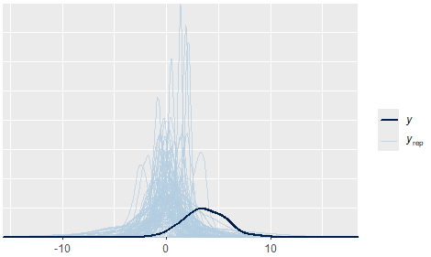
Assessing Priors
A successful prior probability check shows that sampling from the priors yields data encompassing the actual data while leaving variance around it.
Successful prior predictive check with
prior(normal(3, 1), class = Intercept)
Unsuccessful prior predictive check with
prior(normal(0, 1), class = Intercept)

Slide 51
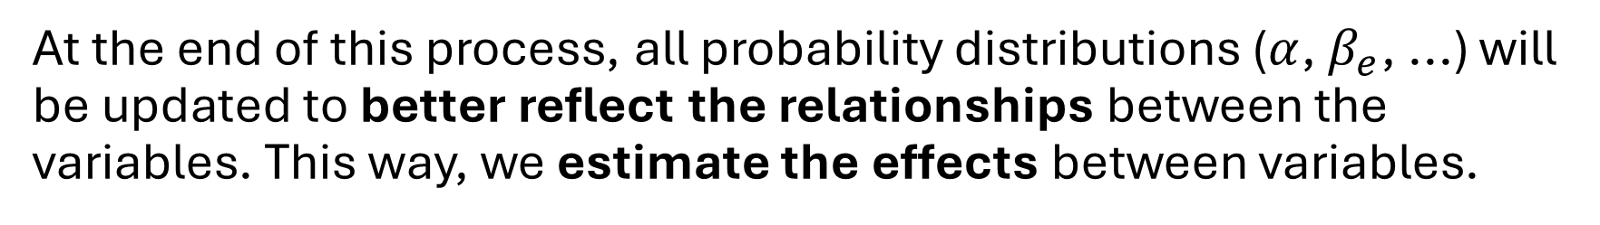
Bayesian Updating
With the prior probability distributions confirmed as plausible, we can perform the actual model training.
Selected Priors
Collected Data
Bayesian Updating
Engine
Posterior Distributions
At the end of this process, all probability distributions ($α$, $β_{e}$, ...) will be updated to better reflect the relationships between the variables. This way, we estimate the effects between variables.

Slide 52

Bayesian Updating
The model training is based on Bayes’ Theorem.
Selected Priors
Collected Data
Bayesian Updating
Engine
Posterior Distributions
$$P\left(h | d\right)=\frac{P\left(d | h\right)⋅P(h)}{P(d)}$$

Slide 53
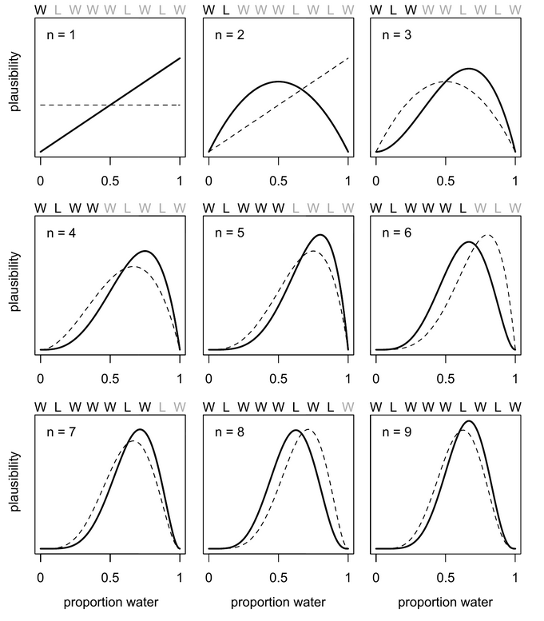
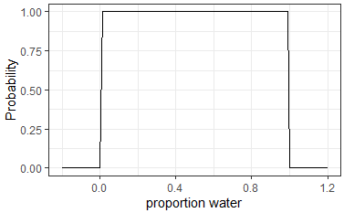
Bayesian Updating Engine
Imagine estimating the proportion of water on an unknown planet with zero prior knowledge. Every data point is a random probe from the planet’s surface, reporting either Water or Land.
Prior Probability Distribution
Collected Data
{W, L, W, W, W, L, W, L, W}

Slide 54
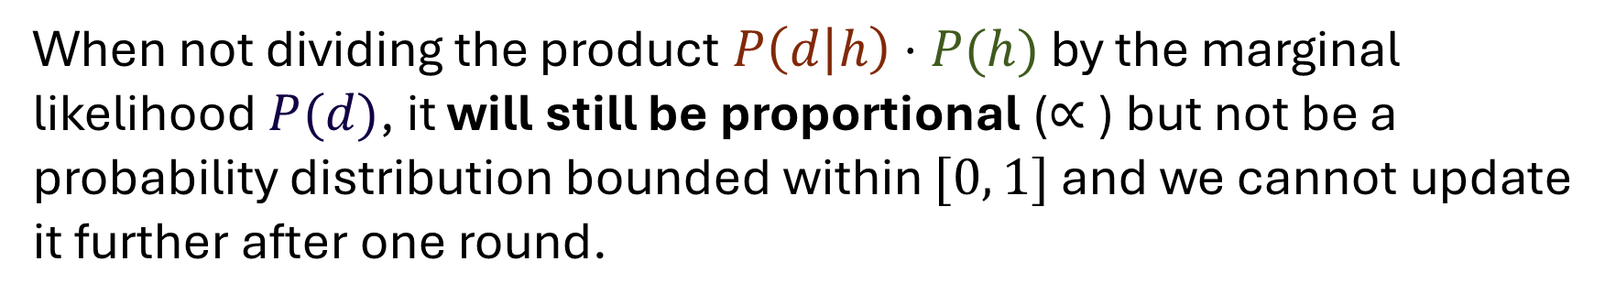



Bayesian Updating Engine
The computational challenge with this process is estimating the Marginal likelihood $P(d)$.
$$P\left(h | d\right)=\frac{P\left(d | h\right)⋅P(h)}{P(d)}$$
When not dividing the product $P\left(d | h\right)⋅P(h)$ by the marginal likelihood $P(d)$, it will still be proportional ($∝$) but not be a probability distribution bounded within $[0, 1]$ and we cannot update it further after one round.
$$P\left(h | d\right)∝P\left(d | h\right)⋅P(h)$$

Slide 55
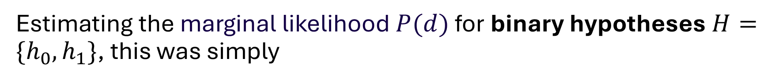
Bayesian Updating Engine
Estimating the marginal likelihood $P(d)$ for binary hypotheses $H=\{h_{0},h_{1}\}$, this was simply
$$P\left(d\right)= P\left(d | h_{0}\right)⋅P\left(h_{0}\right)+P\left(d | h_{1}\right)⋅P(h_{1})$$
But now our hypotheses are continuous, requiring to integrate over a complex parameter space. These integrals often have no closed form.

Slide 56
Markov chain Monte Carlo Sampling
We can sidestep computing the posterior directly by drawing samples from the posterior without knowing its normalizing constant. Sampling proportionally to the relative posterior density approximates the true posterior.
This can be realized via Markov chain algorithms, e.g., Markov chain Monte Carlo sampling.

Slide 57




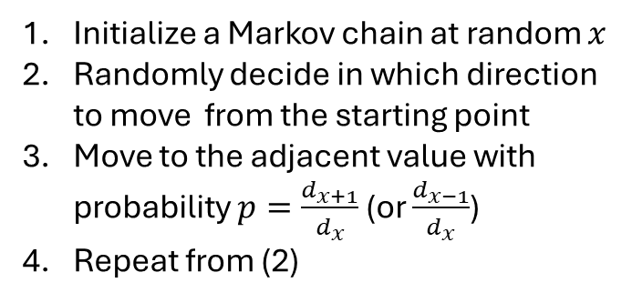






Markov chain Monte Carlo Sampling
Markov chain Monte Carlo samplers travel between adjacent parameter values based on their relative density:
$$d_{4}$$
Initialize a Markov chain at random $x$
Randomly decide in which direction to move from the starting point
Move to the adjacent value with probability $p=\frac{d_{x+1}}{d_{x}}$ (or $\frac{d_{x−1}}{d_{x}}$)
Repeat from (2)
$$d_{1}$$
$$d_{3}$$
$$d_{0}$$
Unnormalized posterior density
$$d_{2}$$
Parameter Values
$$θ_{0}$$
$$θ_{1}$$
$$θ_{2}$$
$$θ_{3}$$
$$θ_{4}$$

Slide 58
Markov chain Monte Carlo Sampling
Over time, the chain wanders through the parameter space drawing more samples from high-density regions. Since only the ratio of densities matters at each step, the (unknown) normalizing constant becomes irrelevant.
Visualization: https://chi-feng.github.io/mcmc-demo/app.html
This is also the reason why BDA has only been adopted so recently: these MCMC sampling algorithms were computationally infeasible just until recently.

Slide 59
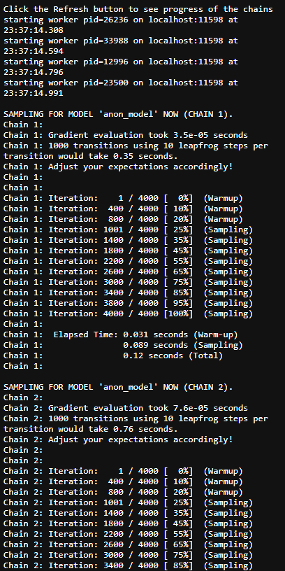
Markov chain Monte Carlo Sampling
Executing the MCMC sampler is similar to the prior predictive check, simply removing the sample_prior = “only” configuration.
R 4.5.0 using library(brms)
model <- brm(
y ~ 1 + x + z,
family = Gaussian,
priors = c(
prior(normal(3, 1), class = Intercept),
prior(normal(0, 0.5), class = b),
prior(exp(1), class = sigma)),
iter = 4000, warmup = 1000, chains = 4,
cores = 4, seed = 4
)

Slide 60
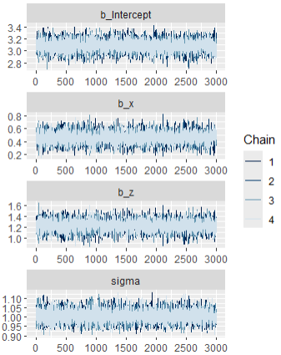
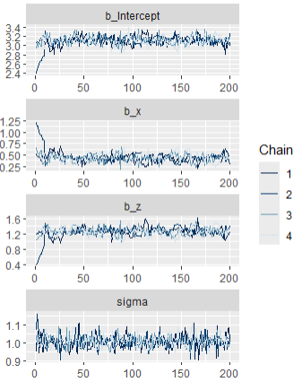
Assessing the Training
Bayesian data analysis excels at indicating when the training process has went wrong. To assess the training, there are several statistics we can consult, for example visual assessment (dubbed the “hairy caterpillar ocular inspection test” by Richard McElreath).
Positive visual assessment
Negative visual assesment
Notes:
Posterior predictive check
Gelman-Rubin Convergence Statistics $\hat{R}$
Effective sample sizes
Visual assessment (“hairy caterpillar ocular inspection test”)

Slide 61
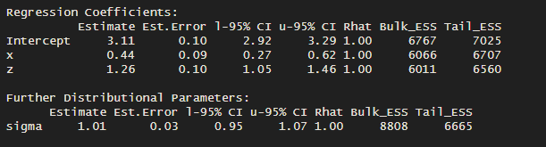
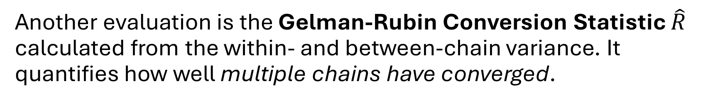
Assessing the Training
Another evaluation is the Gelman-Rubin Conversion Statistic $\hat{R}$ calculated from the within- and between-chain variance. It quantifies how well multiple chains have converged.
R 4.5.0 using library(brms)
summary(model)

Slide 62
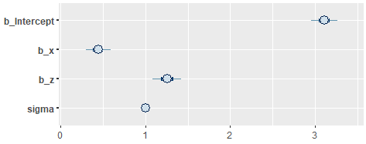
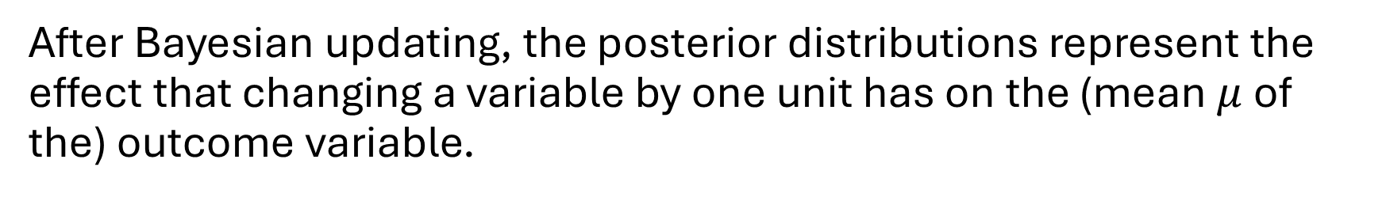


Interpreting the Results
After Bayesian updating, the posterior distributions represent the effect that changing a variable by one unit has on the (mean $μ$ of the) outcome variable.
Simulated Effects
Estimated Effects
$$β_{x}=0.5$$
x
y
$$β_{z}=1.2$$
z

Slide 63
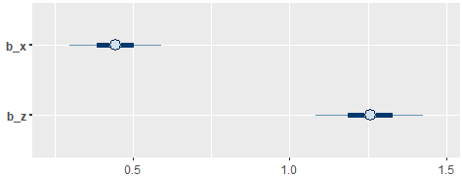
Credible Interval
The uncertainty around the estimation is a credible interval, not a confidence interval. It can be interpreted naturally: a 95% credible interval has a 95% chance of containing the true value of the parameter.
The further a CI is from 0.0, the stronger the effect. The narrower a CI, the more certain the effect.

Slide 64
Credible Interval
Credible interval consistent with 0 -> no significant effect.

Slide 65
Effect of Priors
By carefully selecting and assessing prior probability distributions, they act as a regularization: extreme results require extreme evidence.

Slide 66
Application II
Live demonstration of a BDA workflow in practice

Slide 67
The Bayesian Workflow
The upcoming demonstration will teach you to understand or do the following new steps of a practical Bayesian workflow:
Select a distribution family with maximum entropy
Build a regression formula with an appropriate link function
Select and assess prior probability distributions
Generate posteriors with Markov chain Monte Carlo algorithms
Assess the model fit via training diagnostics
Plot marginal effects to draw conclusions from Bayesian models
Notes:
(defining a regression formula)
Do select and assess priors: specifying priors, performing and evaluating a prior predictive check
Understand Markov chain Monte Carlo sampling
Do assess model fit: test various diagnostics
Do evaluate models: interpret posteriors

Slide 68
Normal Distribution
In Requirements and Software Engineering, not many variables follow a normal (i.e., Gaussian) distribution. Most frequentist data analyses only distinguishes between normal and non-normal distributions (via a simply Shapiro-Wilk test).
In most software engineering research, this distribution if often assumed to be normal (i.e. Gaussian), and if not, assumed to not exist and instead researchers use statistical tests based on ranks. However, this is a pity since there are many probability distributions that could create much better models for the collected data.
Gren, L., & Berntsson Svensson, R. (2021). Is it possible to disregard obsolete requirements? a family of experiments in software effort estimation. Requirements Engineering, 26(3), 459-480.

Slide 69
Besides the “normal” Gaussian, what other
Distributions
do you know?

Slide 70
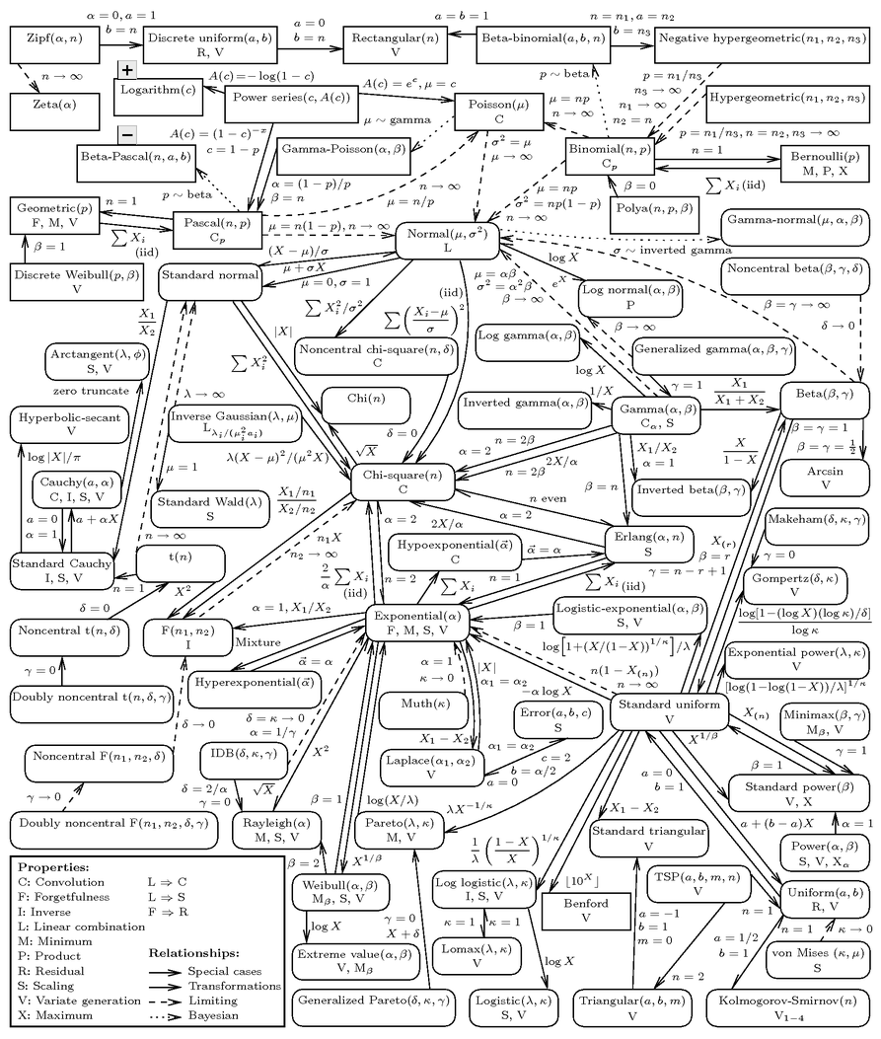

Slide 72
Distribution Families
There are plenty of distribution families, each with its own assumption about how data is distributed
https://www.math.wm.edu/~leemis/chart/UDR/UDR.html

Slide 73
Classic Misconception
One of the most common forms of statistical malpractice is treating ordinal data as continuous.
strongly agree
agree
Neither agree nor disagree
disagree
strongly disagree
... but on an ordinal scale they are not!
Adjacent values on a continuous interval scale are equidistant ...
5
4
3
2
1

Slide 74
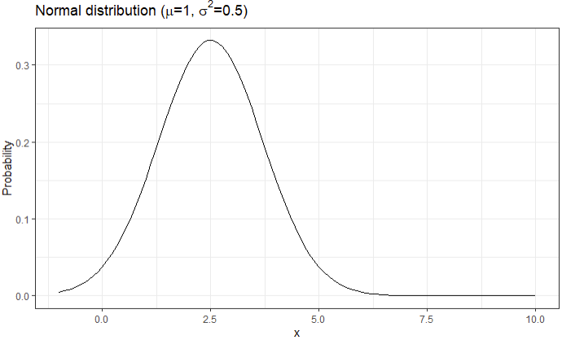
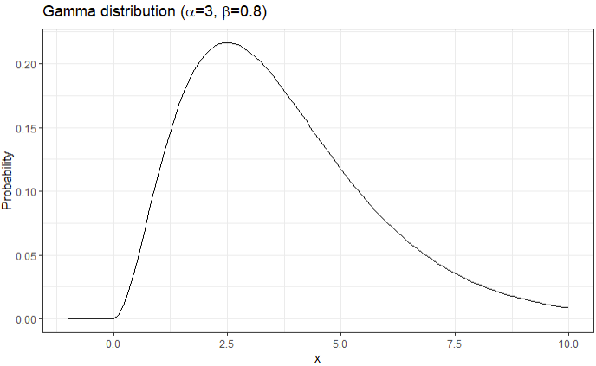
Picking the wrong Distribution
When we model our outcome variable with the wrong distribution family, we risk omitting important properties of the data.

Slide 75
Maximum Entropy
In order to decide, which distribution family to pick when modelling an outcome variable, we can use the maximum entropy criterion:
[The maximum entropy distribution] is the least biased estimate possible on the given information; i.e., it is maximally noncommittal with regard to missing information.
Jaynes, E. T. (1957). Information theory and statistical mechanics. Physical review, 106(4), 620.
Among all probability distributions consistent with what you actually know about a variable, the "best" distribution to use is the one with the largest entropy, i.e., the one that is maximally spread out and non-committal beyond those constraints.

Slide 76
Maximum Entropy
Examples of the maximum entropy criterion:
Normal distribution: continuous variable with fixed mean and variance
Binomial: fixed number of trials and probability of success
Beta-binomial: fixed number of trials but varying probability of success
Poisson: unbounded count with fixed mean at a constant rate
Pascal: unbounded count with fixed mean but at a non-constant rate (i.e., with a larger variance)

Slide 77


Updated Context
Considering the same research question, but now measuring the outcome variable $y$ as the number of times a code reviewer found the one bug in a code snippet.
Var | Name | Type
x | Measure of AI usage | Continuous, Gaussian-distributed
y | Number of code snippet where a bug was identified | Positive count of successful trials
z | Skill of a code reviewer | Continuous, Gaussian-distributed
AI usage
Bug identification
$$β_{x}$$
x
y
z
Skill
The binomial distribution has maximum entropy under these constraints.

Slide 78





Building a Regression Formula
Modelling the outcome variable y with the Binomial distribution requires updating our Bayesian model:
Bayesian Model
R 4.5.0 using library(brms)
model <- brm(
y | trials(n) ~ 1 + x + z,
family = binomial,
priors = c(
prior(normal(0, 1), class = Intercept),
prior(normal(0, 0.5), class = b)),
iter = 4000, warmup = 1000, chains = 4,
cores = 4, seed = 4
)
$$y \sim Binomial(n, p)$$
$$p←α+β_{x}⋅x+β_{z}⋅z$$
$$α∼N(0, 1)$$
$$β_{x}∼N(0, 0.5)$$
$$β_{z}∼N(0, 0.5)$$

Slide 79





Link Functions
Some probability distribution families have specific requirements for their parameters (e.g., $p∈[0, 1]$). Still, we would like to use “natural” linear models in our models. As a compromise, we can use link functions.
$$y \sim Binomial(n, p)$$
$$logit(p)←α+β_{x}⋅x+β_{z}⋅z$$
$$p←α+β_{x}⋅x+β_{z}⋅z$$

Slide 80





Bayesian Model
The link function must be specified in a mathematical model, but is included in brms by default.
Bayesian Model
R 4.5.0 using library(brms)
model <- brm(
y | trials(n) ~ 1 + x + z,
family = binomial(link=“logit”),
priors = c(
prior(normal(0, 1), class = Intercept),
prior(normal(0, 0.5), class = b)),
iter = 4000, warmup = 1000, chains = 4,
cores = 4, seed = 4
)
$$y \sim Binomial(n, p)$$
$$logit(p)←α+β_{x}⋅x+β_{z}⋅z$$
$$α∼N(0, 1)$$
$$β_{x}∼N(0, 0.5)$$
$$β_{z}∼N(0, 0.5)$$

Slide 81



Prior Predictive Checks, Training, and Posterior Predictive Checks
The link function complicates the selection of appropriate priors and makes prior predictive checks all-the-more-important.
Suboptimal prior predictive check with
prior(normal(0, 0.5), class = b)
Better prior predictive check with
prior(normal(0, 0.3), class = b)
Posterior Predictive Check

Slide 82






Model Interpretation
Due to the link function, it is no longer trivial to interpret the posterior distributions.
Bayesian Model
R 4.5.0 using library(brms)
$$y \sim Binomial(n, p)$$
summary(model)
$$logit(p)←α+β_{x}⋅x+β_{z}⋅z$$
$$α∼N(0, 1)$$
$$β_{x}∼N(0, 0.3)$$
$$β_{z}∼N(0, 0.3)$$
Instead, we can plot marginal effects.

Slide 83

Marginal Effects
A marginal effect is the effect of one variable on the outcome while holding all other variables constant at representative levels.
R 4.5.0 using library(brms)
conditional_effects(model, effects = "x")

Slide 84

Marginal Effects
A marginal effect is the effect of one variable on the outcome while holding all other variables constant at representative levels.

Slide 85
The Bayesian Workflow
Select a distribution family with maximum entropy
Build a regression formula with an appropriate link function
Select and assess prior probability distributions
Generate posteriors with Markov chain Monte Carlo algorithms
Assess the model fit via training diagnostics
Plot marginal effects to draw conclusions from Bayesian models
Notes:
(defining a regression formula)
Do select and assess priors: specifying priors, performing and evaluating a prior predictive check
Understand Markov chain Monte Carlo sampling
Do assess model fit: test various diagnostics
Do evaluate models: interpret posteriors

Slide 86
Learning Path

Slide 87
Learning Bayesian Data Analysis
If you have (1) a causal hypothesis and (2) quantitative data about its variables, you can start on your own BDA path by:
Setting up Stan: The computational engine behind contemporary BDA approaches is Stan (https://mc-stan.org/). Most programming languages have an interface for it (e.g., brms in R)
Testing the Bayesian workflow: Follow the basic BDA workflow presented in this tutorial to derive inferential conclusions from raw data.
Learn distributions: The full potential of BDA is unlocked when mastering different distributions to represent response variables.

Slide 88

Distributions
When learning distributions in addition to the normal distribution, consider the following:
Name | Description | Examples
Binomial | $n$ independent trials with a success rate of $p$ for each trial | Identifying each bug in $n$ codes snippets
Poisson/Pascal | Discrete count of events | Count of identified bugs
Categorical | Extension of the binary response with $k$ independent categories | Single-choice response
Ordinal | Categorical data with a linear order between levels | Likert-scale response
Beta | Continuous data bounded between $[0;1]$ | $F_{β}$-score metrics

Slide 89



Resources
The following resources are the state-of-the-art for learning and applying BDA in practice:
The Book
The Language
The Library

Slide 90
Resources
Other useful resources:
Blog by Andrew Heiss: https://www.andrewheiss.com/blog/
Blog by Solomon Kurz: https://solomonkurz.netlify.app/blog/
Follow Richard Torkar and Robert Feldt
…

Slide 91
Opportunities
Beyond the content of this tutorial, BDA has many more advantages that all naturally embed into the presented workflow, like modelling
missing data, e.g., when the data could not be collected or you have partial responses to a survey form,
mixed distributions, e.g., hurdle models describing a data-generation process stemming from two separate processes,
censored or truncated data, e.g., when you have to cut off participants of an experiments as they run out of time,
hierarchical effects, e.g., when you have repeated measures per subject of your study, or
interaction effects, e.g., when an external variable moderates the effect of the main cause on the main effect.

Slide 92
Conclusion
Reflection, discussion, and closing

Slide 93
Bayesian Data Analysis in a Nutshell
The Bayesian paradigm provides an alternative to the common frequentist paradigm for data analysis. The steep learning curve is rewarded with more fine-grained insights, control over your analysis, and fewer violations of statistical assumptions.

