Slide 1


Good Science
Drawing Valid Conclusions
Julian Frattini, Ph.D.
Postdoctoral Researcher
Chalmers University of Technology, Sweden
https://julianfrattini.github.io/
JulianFrattini/bda4sci
Public
Copyright © 2026 Julian Frattini.
This presentation is licensed under CC BY-NC-SA 4.0.

Slide 2
Motivation

Slide 3
The Scientific Process
Considering the following, abstract scientific process:
Formulate a (relevant) research question
Collect data about the research question
Answer the research question with the data
Most of our concerns were related to formulating a research question and collecting data about it. But does that render the third step, its analysis, trivial?

Slide 4
Conclusion Validity
Even if we have ensured the internal, external, and construct validity of our study in the data collection phase, we might still draw the wrong conclusions from it.
Conclusion validity affects our “ability to draw the correct conclusion about relations between the treatment and the outcome of an experiment.”
Wohlin, C., Runeson, P., Höst, M., Ohlsson, M. C., Regnell, B., & Wesslén, A. (2012). Experimentation in software engineering (Vol. 236, p. P3). Berlin: Springer.

Slide 5
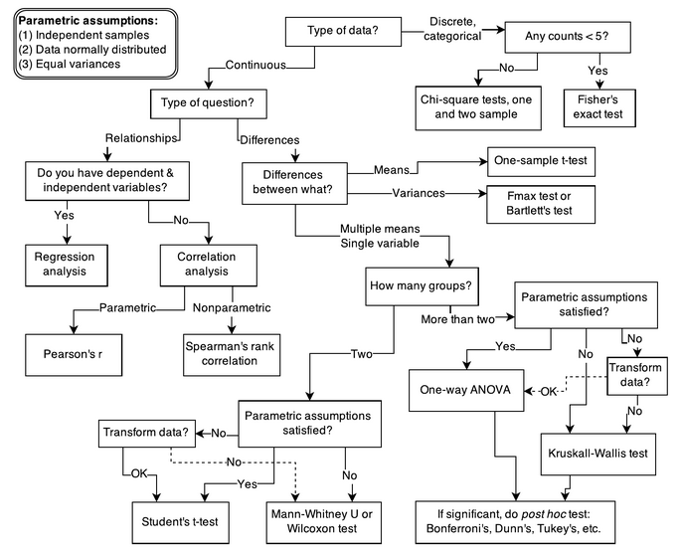
Data Analysis Practices
In many cases, data analysis boils down to the selection of the most appropriate significance test.
McElreath, Richard. Statistical rethinking: A Bayesian course with examples in R and Stan. Chapman and Hall/CRC, 2018.

Slide 6
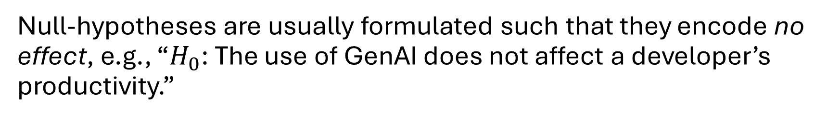

Null-Hypothesis Significance Tests
Null-hypothesis significance tests (NHSTs) work roughly as follows:
Null-hypothesis
NHST
Data
p-value $p∈[0, 1]$
Appropriate test
Null-hypotheses are usually formulated such that they encode no effect, e.g., “$H_{0}$: The use of GenAI does not affect a developer’s productivity.”
Notes:
NH + data + appropriate test = p-value

Slide 7
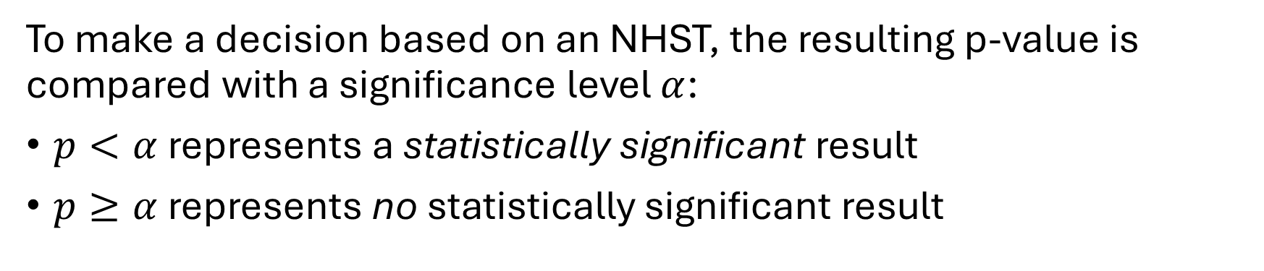
Null-Hypothesis Significance Tests
To make a decision based on an NHST, the resulting p-value is compared with a significance level $α$:
$p<α$ represents a statistically significant result
$p≥α$ represents no statistically significant result
Statistical significant results imply that two distributions are statistically are unlikely to have come from the same population.

Slide 8
Null-Hypothesis Significance Tests
A p-value is a statement about the observed data.
A p-value is the probability of observing data at least as extreme as what you actually got, assuming the null hypothesis is true.
A null-hypothesis (encoding “no effect”) receiving a p-value of 4% on observed data implies that – if that null-hypothesis were true (and there is indeed no effect) – there is a 4% chance we would observe the collected data.

Slide 9
Null-Hypothesis Significance Tests
A p-value is a not statement about the formulated hypothesis.
A p-value is not the probability that the null hypothesis is correct, given what they observed.
However, this is usually the question of interest: how likely is there no/an effect of one variable on another? NHSTs do not answer this question.

Slide 10
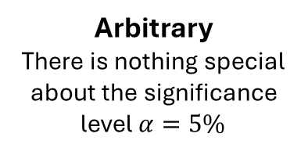
Null-Hypothesis Significance Tests
Analysing data using only NHSTs has several issues:
Binary
NHSTs reduce complex data to binary, seemingly certain results
Normal
NHSTs distinguish only normal from non-normal data
Interpretability
The p-value is often misinterpreted
Arbitrary
There is nothing special about the significance level $α=5\%$

Slide 11
Think Bayesian
An Alternative Perspective on Probability

Slide 12
Probability
Next to the frequentist paradigm, the Bayesian paradigm of statistics assigns a different meaning to probability:
In the frequentist paradigm, probability is a property of a repeatable random process. The probability of an event is the proportion of times it would occur if you repeated the experiment an infinite number of times under identical conditions. Probability only assigns to random events, not hypotheses.
In the Bayesian paradigm, probability is a statement about the state of knowledge of an observer, not about physical processes in the world. A probability quantifies how confident a rational agent is that something is true, given their current information. Probability assigns to belief, not to events (as these are factual).
Notes:
Frequentist probability: flipping a coin infinitely often will yield heads 50% of all times
Bayesian probability is epistemic: it only exists in our head, it describes a degree of belief

Slide 13
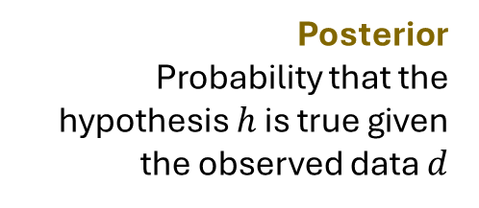
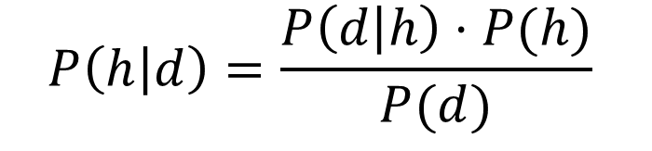
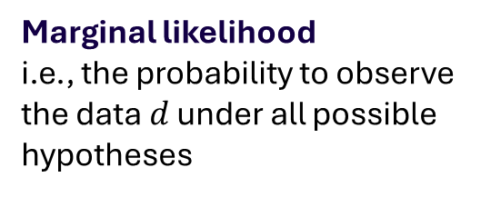
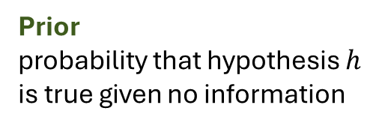
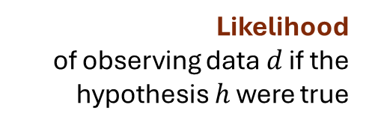
Bayes’ Theorem
The Bayesian thinking is based on Bayes’ Theorem:
Likelihood
of observing data $d$ if the hypothesis $h$ were true
Prior
probability that hypothesis $h$ is true given no information
Posterior
Probability that the hypothesis $h$ is true given the observed data $d$
$$P\left(h | d\right)=\frac{P\left(d | h\right)⋅P(h)}{P(d)}$$
Marginal likelihood
i.e., the probability to observe the data $d$ under all possible hypotheses

Slide 14
Example
We are investigating a static code analysis tool. The tool has 90% sensitivity and 10% false positive rate. Only 5% of files actually have bugs. What's the probability that a flagged file is buggy?

Slide 15


Example
We are investigating a static code analysis tool. The tool has 90% sensitivity and 10% false positive rate. Only 5% of files actually have bugs. What's the probability that a flagged file is buggy?
$h$: the file has a bug
$d$: the tool flags the file as buggy

Slide 16
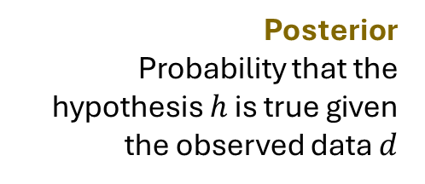
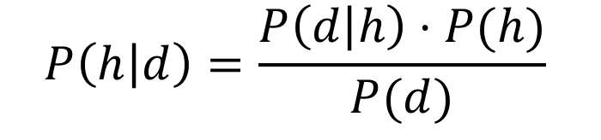
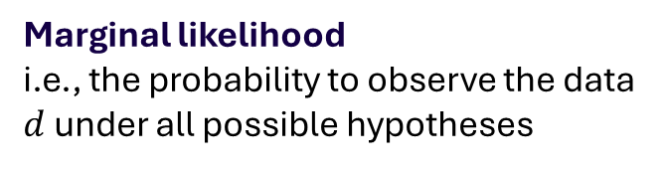

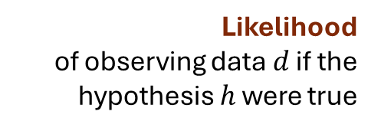
Example
We are investigating a static code analysis tool. The tool has 90% sensitivity and 10% false positive rate. Only 5% of files actually have bugs. What's the probability that a flagged file is buggy?
Likelihood
of observing data $d$ if the hypothesis $h$ were true
Prior
probability that hypothesis $h$ is true given no information
Posterior
Probability that the hypothesis $h$ is true given the observed data $d$
$$P\left(h | d\right)=\frac{P\left(d | h\right)⋅P(h)}{P(d)}$$
Marginal likelihood
i.e., the probability to observe the data $d$ under all possible hypotheses

Slide 17
Example
We are investigating a static code analysis tool. The tool has 90% sensitivity and 10% false positive rate. Only 5% of files actually have bugs. What's the probability that a flagged file is buggy?
Likelihood
of observing data $d$ if the hypothesis $h$ were true
Prior
probability that hypothesis $h$ is true given no information
Posterior
Probability that the hypothesis $h$ is true given the observed data $d$
$$P\left(h | d\right)=\frac{P\left(d | h\right)⋅P(h)}{P(d)}$$
Marginal likelihood
i.e., the probability to observe the data $d$ under all possible hypotheses

Slide 18
Example
We are investigating a static code analysis tool. The tool has 90% sensitivity and 10% false positive rate. Only 5% of files actually have bugs. What's the probability that a flagged file is buggy?
Likelihood
of observing data $d$ if the hypothesis $h$ were true
Prior
probability that hypothesis $h$ is true given no information
Posterior
Probability that the hypothesis $h$ is true given the observed data $d$
$$P\left(h | d\right)=\frac{P\left(d | h\right)⋅P(h)}{P(d)}$$
Marginal likelihood
i.e., the probability to observe the data $d$ under all possible hypotheses

Slide 19

Example
We are investigating a static code analysis tool. The tool has 90% sensitivity and 10% false positive rate. Only 5% of files actually have bugs. What's the probability that a flagged file is buggy?
The marginal likelihood $P(d)$ can be calculated from the other data:
$$P\left(d\right)=P\left(d | h\right)⋅P\left(h\right)+P\left(d | ¬h\right)⋅P(¬h)$$
$$0.9⋅0.05+0.1⋅0.95=0.14$$
Marginal likelihood
i.e., the probability to observe the data $d$ under all possible hypotheses
Notes:
In case of a binary hypothesis

Slide 20
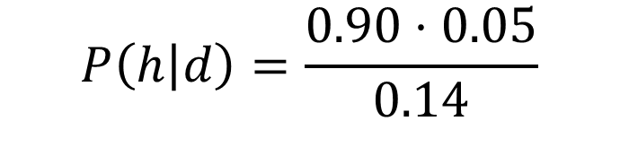

Example
We are investigating a static code analysis tool. The tool has 90% sensitivity and 10% false positive rate. Only 5% of files actually have bugs. What's the probability that a flagged file is buggy?
Likelihood
of observing data $d$ if the hypothesis $h$ were true
Prior
probability that hypothesis $h$ is true given no information
Posterior
Probability that the hypothesis $h$ is true given the observed data $d$
$$P\left(h | d\right)=\frac{0.90⋅0.05}{0.14}$$
Marginal likelihood
i.e., the probability to observe the data $d$ under all possible hypotheses
Notes:
This is exactly why experienced engineers treat static analysis warnings with scepticism, prioritise warnings by file history or change frequency, and don't treat every flag as a confirmed defect. They are, intuitively, doing Bayesian reasoning — updating a low prior with imperfect evidence and arriving at a moderate posterior rather than blind confidence. Bayes' theorem just makes that intuition precise and auditable.

Slide 21
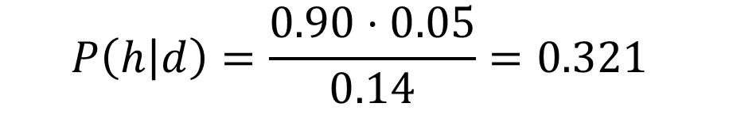
Example
We are investigating a static code analysis tool. The tool has 90% sensitivity and 10% false positive rate. Only 5% of files actually have bugs. What's the probability that a flagged file is buggy?
Likelihood
of observing data $d$ if the hypothesis $h$ were true
Prior
probability that hypothesis $h$ is true given no information
Posterior
Probability that the hypothesis $h$ is true given the observed data $d$
$$P\left(h | d\right)=\frac{0.90⋅0.05}{0.14}=0.321$$
Marginal likelihood
i.e., the probability to observe the data $d$ under all possible hypotheses
Notes:
This is exactly why experienced engineers treat static analysis warnings with scepticism, prioritise warnings by file history or change frequency, and don't treat every flag as a confirmed defect. They are, intuitively, doing Bayesian reasoning — updating a low prior with imperfect evidence and arriving at a moderate posterior rather than blind confidence. Bayes' theorem just makes that intuition precise and auditable.

Slide 22
Bayesian Data Analysis

Slide 23
Bayesian Regression Models
Utilizing Bayes’ theorem to answer research questions requires to formulate regression models of the following (simplified) form:
Outcome variable
Predictors
use of GenAI
productivity
x
y
$$productivity \sim α+β_{ai}⋅GenAI+β_{m}⋅motivation$$
Intercept
i.e., the baseline outcome value
a
motivation
Regression coefficients
i.e., the effect of each predictor on the outcome value
Notes:
Formulation of a Bayesian regression model
Components
Goal: posterior

Slide 24


Bayesian Regression Models
A regression model contains two types of terms:
Variables representing the values of events, and
Coefficients representing the impact of these variables on each other.
Variables filled in with collected data
use of GenAI
productivity
$$β_{ai}$$
x
y
$$productivity \sim α+β_{ai}⋅GenAI+β_{m}⋅motivation$$
$$β_{m}$$
a
motivation
Coefficients filled in with probability distributions
Notes:
Formulation of a Bayesian regression model
Components
Goal: posterior

Slide 25
Bayesian Regression Models
The process of training a Bayesian regression model is based on applying Bayes theorem: in order for the regression coefficients to represent the impact of variables, prior probability distributions are updated in light of the data to yield posterior probability distributions.
$$productivity \sim α+β_{ai}⋅GenAI+β_{m}⋅motivation$$
Prior probability distribution
Posterior probability distribution
Observed data

Slide 26



Bayesian Regression Models
Selecting priors for a regression coefficient means assigning a probability distribution to it.
$$productivity \sim α+β_{ai}⋅GenAI+β_{m}⋅motivation$$
$$α \sim N(μ= 5, σ=2)$$
$$β_{ai} \sim N(μ=0, σ=1)$$
weakly informative prior
$$β_{m} \sim N(μ=3, σ=0.5)$$
informative prior
Priors regularize: surprising results require strong evidence. Additionally, priors can be refined iteratively from study to study.
Notes:
Selecting priors
Uninformative, weakly informative, informative priors
Surprising claims require strong data
Iterative refinement of priors

Slide 27
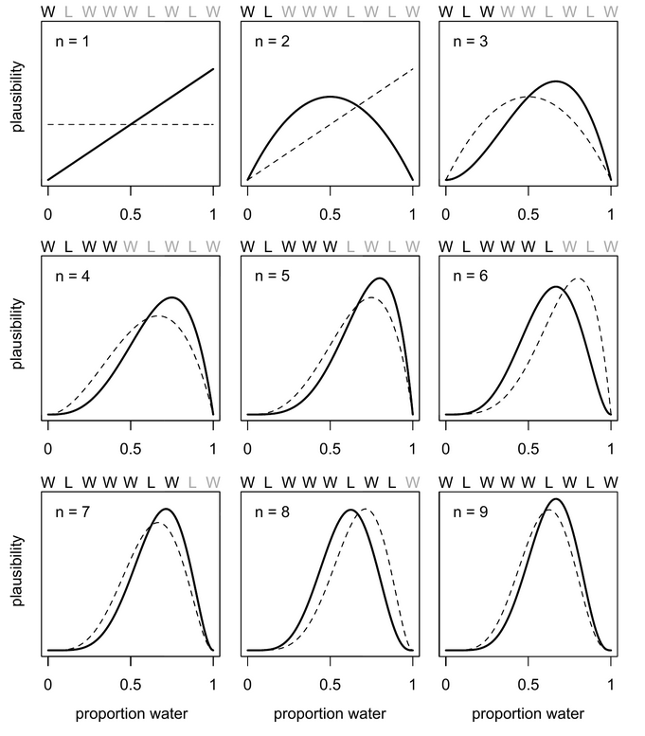
Updating Priors
Consider data about a globe toss resulting either in water (W) or land (L) to estimate the probability of landing in water when selecting a random place on the globe.

Slide 28
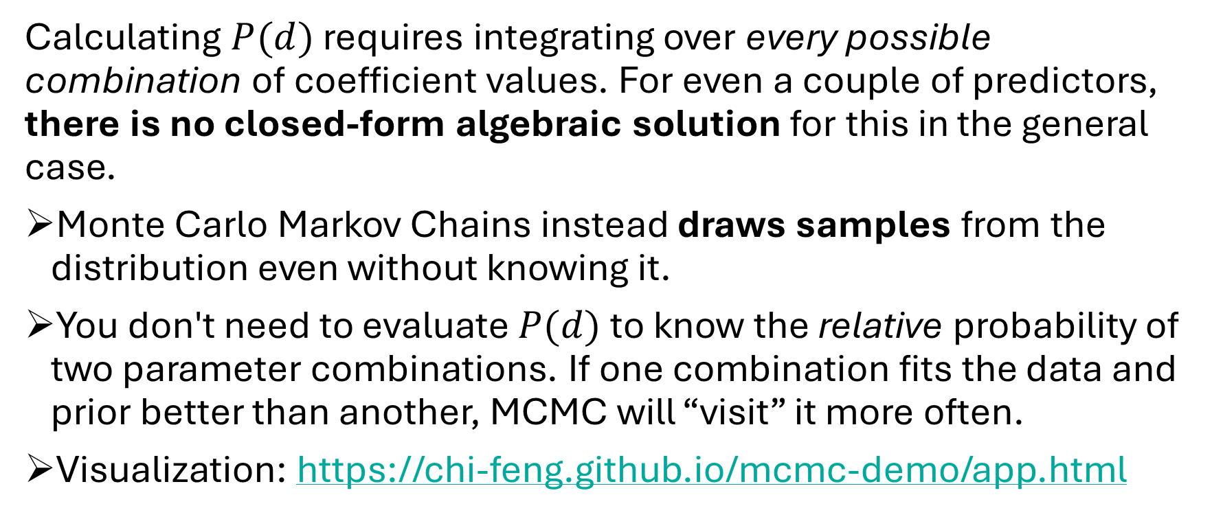
Updating Priors
Calculating $P(d)$ requires integrating over every possible combination of coefficient values. For even a couple of predictors, there is no closed-form algebraic solution for this in the general case.
Monte Carlo Markov Chains instead draws samples from the distribution even without knowing it.
You don't need to evaluate $P(d)$ to know the relative probability of two parameter combinations. If one combination fits the data and prior better than another, MCMC will “visit” it more often.
Visualization: https://chi-feng.github.io/mcmc-demo/app.html

Slide 29
Bayesian Workflow

Slide 30
The Bayesian Workflow
The complete Bayesian workflow for evaluating a hypothesis comprises the following steps:
Selecting a distribution family
that describes how the data was created
Notes:
Select distribution family
Select priors
Prior predictive check
Fit model
Posterior predictive check
Iterate

Slide 31
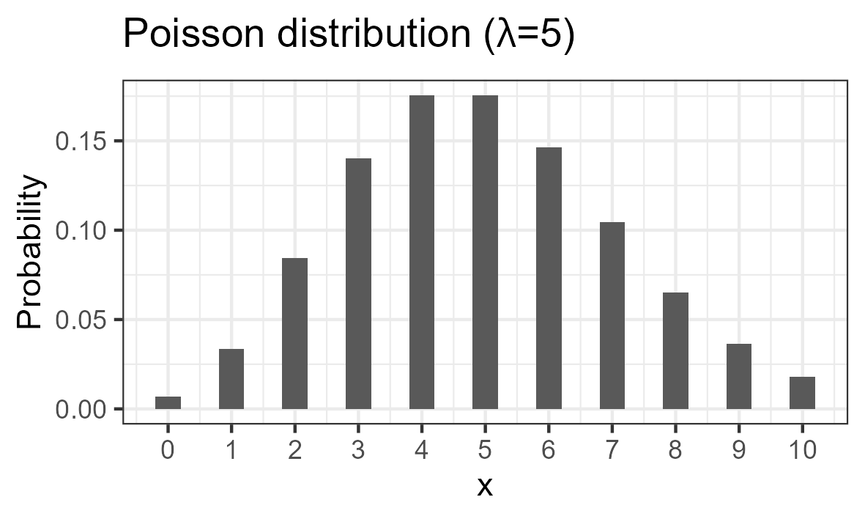
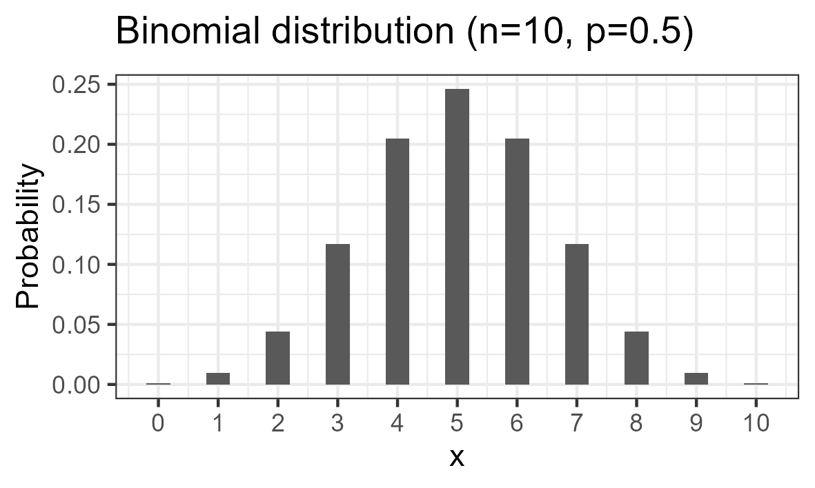
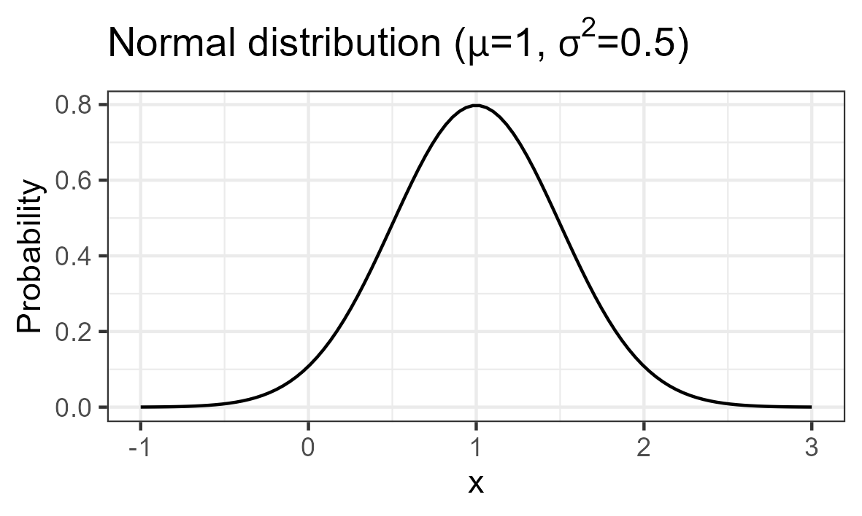
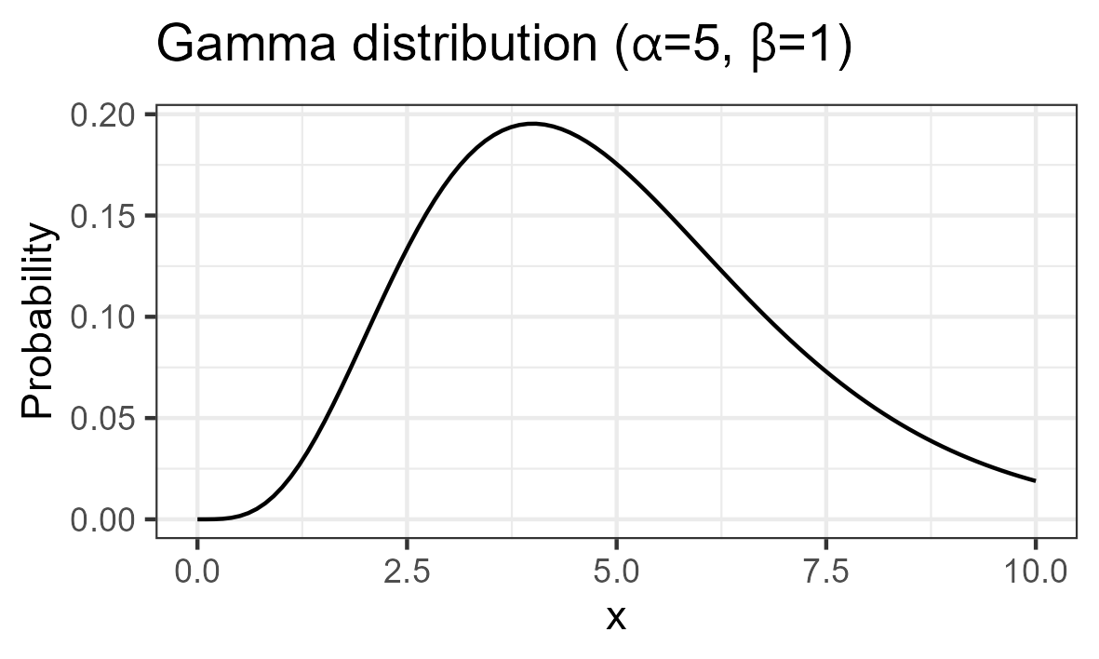
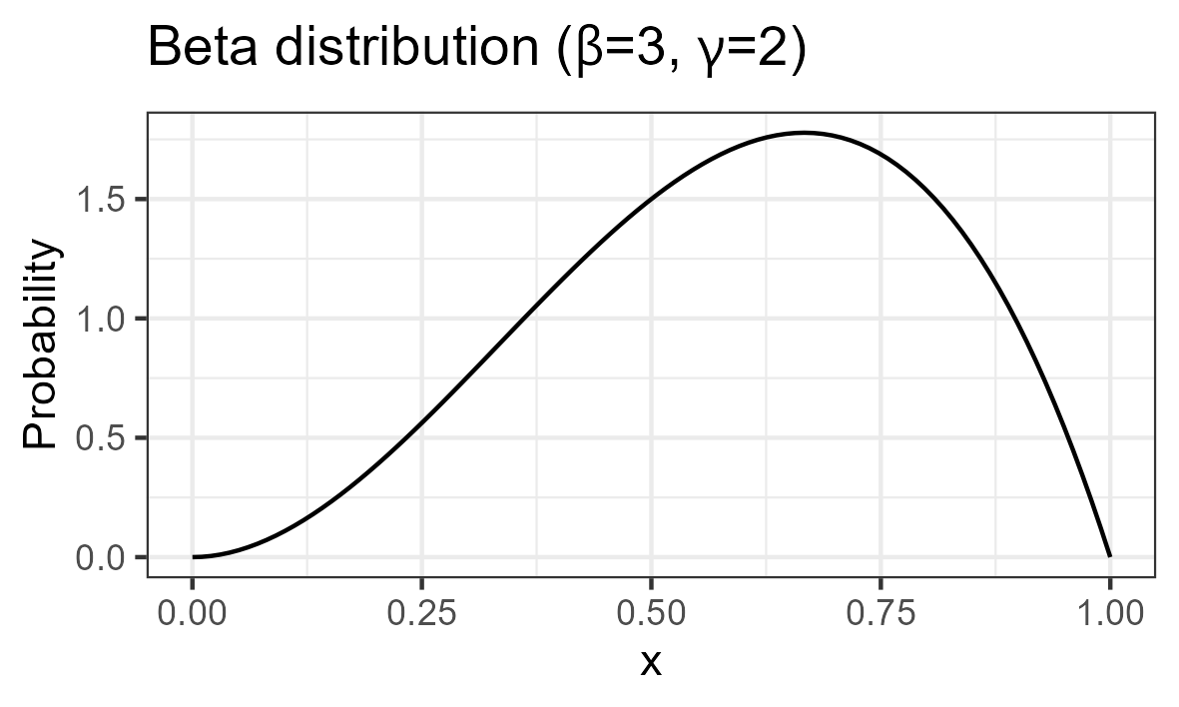











Determining a Distribution Family
$$μ=np$$
$$n→∞$$
$$σ^{2}=μ$$
$$μ=np$$
$$μ→∞$$
$$σ^{2}=np(1−p)$$
$$n→∞$$
$$μ=αβ$$
$$σ^{2}=α^{2}β$$
$$β→∞$$
$$\frac{X_{1}}{X_{1}+X_{2}}$$

Slide 32




Determining a Distribution Family
Fully specified, a Bayesian regression model will always start with a likelihood function (i.e., a distribution family) describing the outcome variable.
$$productivity \sim Poisson(λ)$$
$$\log\left(λ\right)←α+β_{ai}⋅GenAI+β_{m}⋅motivation$$
$$α \sim N(μ= 5, σ=2)$$
$$β_{ai} \sim N(μ=0, σ=1)$$
$$β_{m} \sim N(μ=3, σ=0.5)$$
This particular model would assume that productivity is Poisson-distributed (e.g., when operationalizing it as the number of commits.

Slide 33
The Bayesian Workflow
The complete Bayesian workflow for evaluating a hypothesis comprises the following steps:
Selecting a distribution family
that describes how the data was created
Selecting priors
encoding initial belief
Prior predictive check
confirming their eligibility
Model fitting
via MCMC sampling
Posterior predictive check
to confirm model training
Notes:
Select distribution family
Select priors
Prior predictive check
Fit model
Posterior predictive check
Iterate

Slide 34
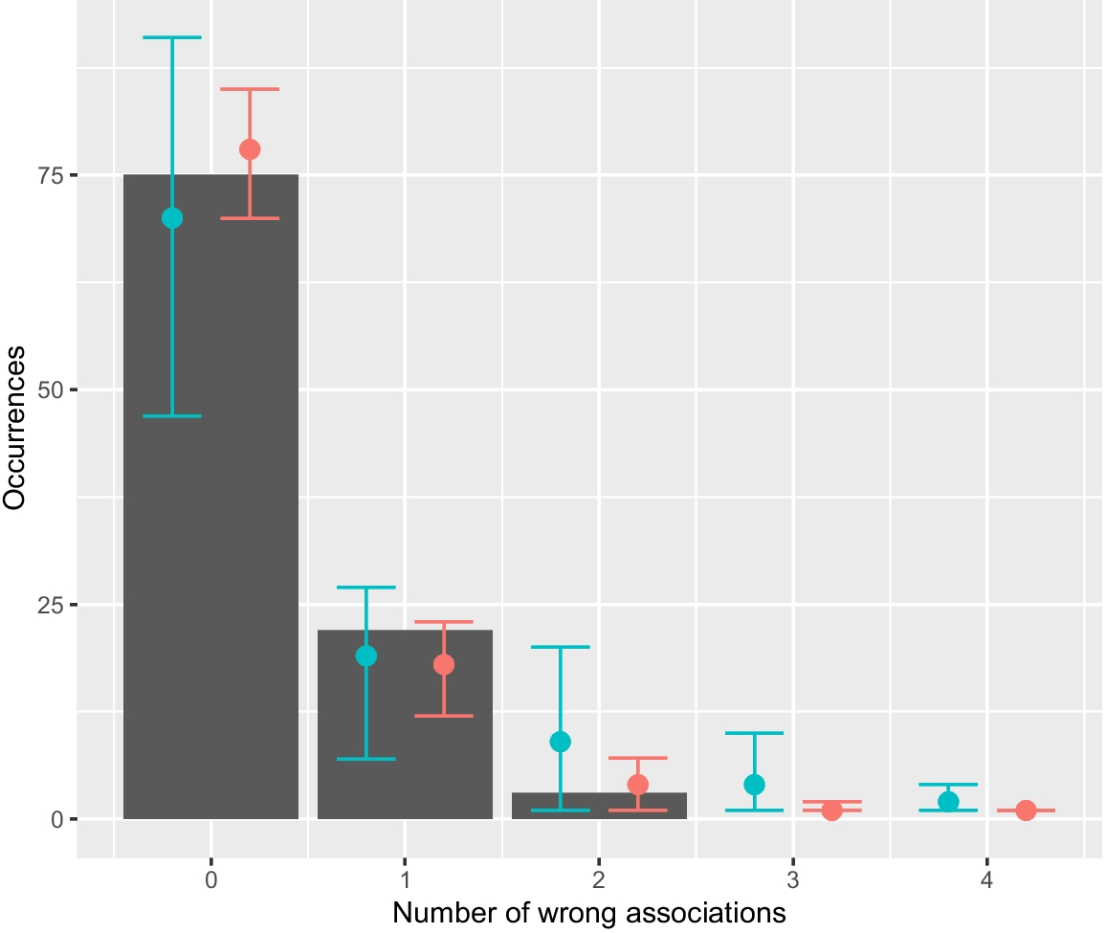
Prior and Posterior Predictive Checks
We can perform a predictive check (i.e., sample from the model) by putting the collected data of the exposure and other covariates in our regression model and checking – given all the uncertainty of the regression coefficients – what the outcome would be.

Slide 35
The Bayesian Workflow
The complete Bayesian workflow for evaluating a hypothesis comprises the following steps:
Selecting a distribution family
that describes how the data was created
Selecting priors
encoding initial belief
Prior predictive check
confirming their eligibility
Model fitting
via MCMC sampling
Posterior predictive check
to confirm model training
Evaluating
the results of the model
Notes:
Select distribution family
Select priors
Prior predictive check
Fit model
Posterior predictive check
Iterate

Slide 36
Evaluating Bayesian Output
The result of a Bayesian regression model are credible intervals for each regression coefficient representing their effect on the outcome. They are set at a certain level (e.g., 95% or 89%) but should not be confused with confidence intervals:
(Bayesian) credible intervals mean given the observed data, there is a X% probability that the true parameter value lies within this interval.
(frequentist) confidence intervals mean when repeating this experiment infinitely many times and computing a confidence interval each time, X% of those intervals would contain the true parameter value.

Slide 37
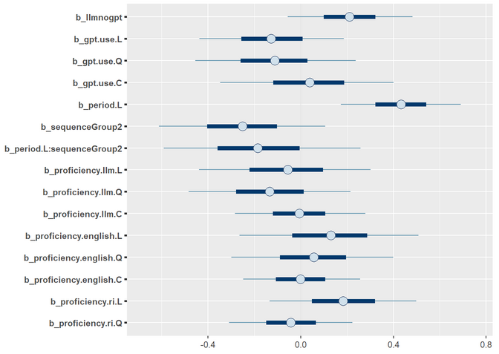
Evaluating Bayesian Output
Credible intervals of regression coefficients indicate, which variable affects the outcome significantly.
Here, significance is achieved if the interval is consistently above or below 0.

Slide 38




Evaluating Bayesian Output
If the distribution family of the regression model requires a link function, the credible intervals of regression coefficients cannot be interpreted directly anymore.
$$productivity \sim Poisson(λ)$$
$$\log\left(λ\right)←α+β_{ai}⋅GenAI+β_{m}⋅motivation$$
$$α \sim N(μ= 5, σ=2)$$
$$β_{ai} \sim N(μ=0, σ=1)$$
$$β_{m} \sim N(μ=3, σ=0.5)$$

Slide 39
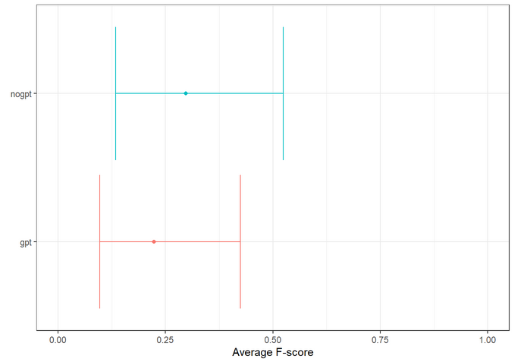
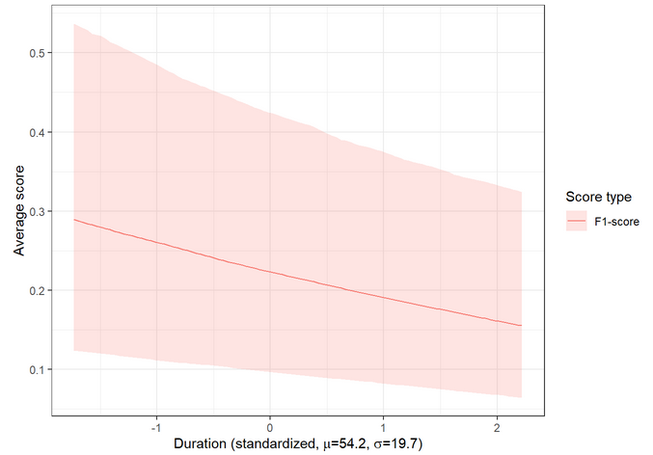
Evaluating Bayesian Output
The most natural result that a Bayesian regression model produces is a marginal effect, i.e., the isolated effect of one variable while keeping the others constant at a representative level. It encodes all uncertainty by all variables and serves to illustrate the true effect.

Slide 40
Limitations

Slide 41
Subjectivity of Priors
Prior probability distributions are – by nature – subjective and there is no standard procedure to ensure their “correctness”. However, they are
explicit, i.e., clearly communicated, and
changeable, i.e., possible to update given new information.
In general, a sufficient number of samples will “overwhelm” even strict priors. On the positive side, they serve as a bridge to consider qualitative domain knowledge.
Notes:
Priors are subjective and can bias the model
But: they are explicit, changeable, and updateable
Number of samples will overwhelm the priors
Domain knowledge serves as an input

Slide 42
Limitations
Despite all its advantages, Bayesian data analysis has several drawbacks, including:
Slow to compute
Converging a model requires significantly more time than a NHST
Hard to learn
Bayesian data analysis does not have out-of-the-box methods
Hard to explain
Bayesian data analysis is not yet well-established in software engineering
Requires more communication
There are more reportable details to Bayesian data analysis
Notes:
Slow to compute
Hard to explain
Requires more communication

Slide 43
Conclusion

Slide 44
How to Good Science
Internal validity requires visualizing and communicating your causal assumptions, and closing any backdoor paths by controlling confounders
External validity requires awareness of potential moderators that also affect trial eligibility
Construct validity requires operationalizing constructs with an encompassing and representative set of indicators
Conclusion validity requires analyzing the data true to its nature

