Slide 1

Bayesian Data Analysis for Statistical Causal Inference
A gentle challenge of Data Analysis Habits in
Software Engineering Research
JulianFrattini/bda4sci
Public
Copyright © 2024 Julian Frattini.
The source code is licensed under the Apache License 2.0.
This presentation is licensed under CC BY-NC-SA 4.0.
Notes:
Disclaimers:
I am not an expert on the topic yet, but been working with this material for about 2 years now and like to share the most valuable insights
I have no idea how long this material takes.
The more important part is at the beginning
We might cut off the rest at the end

Slide 2
Context & Goal
Context: Software engineering research aims to determine causal effects. Correlations serve for predictions, but do not inform interventions.
Problem: Many researchers are, however, ill-equipped to obtain valid answers to these causal questions.
Goal: This tutorial is aimed at academics that aim to tackle causal questions but lack the tools for it.
Notes:
Examples for causal effects: the benefit of using TDD vs. TL or agile vs. Plan-driven

Slide 3
Status Quo
Data Analysis in Software Engineering Research

Slide 4
Data Analysis in Software Engineering Research
Data analysis in empirical SE research with quantitative data typically follows a process like:
Formulate a hypothesis that attributes an impact of an independent on a dependent variable
Collect data from a specific context
Select an appropriate hypothesis test depending on the properties of the variables
Perform the test and calculate p-value and effect size
Report the results and limit the conclusions based on the context factors
Notes:
This process is based on an impression, not a systematic review.
Sometimes, step 1 and 2 are even switched.

Slide 5
Issues
This process is subject to several issues which are mostly rooted in two core problems.
Lack of a causal inference framework
Simple frequentist
analysis methods
Notes:
Lack of a causal inference framework
Simple frequentist methods

Slide 6
Statistical Causal Inference
A rigorous approach to obtaining valid conclusions from data
Notes:
What is the problem with the simple causal assumptions?

Slide 7
Overview
Most worthwhile research questions are of causal nature, but answers to such questions cannot be computed from data alone. Instead, addressing them necessitates knowledge about how the data was generated.
Statistical causal inference: inferring causal relationships from quantitative data
Pearl, J. (2009). Causal inference in statistics: An overview.

Slide 8
Terminology
Exchange about causal inference necessitates the following terms:
Factor: variable of a specific type (e.g., categorical, continuous) projecting a construct onto a value
  Treatment (or: main factor): independent variable of interest
  Outcome (or: response variable): dependent variable of interest
Relationships: association between two factors

Slide 9
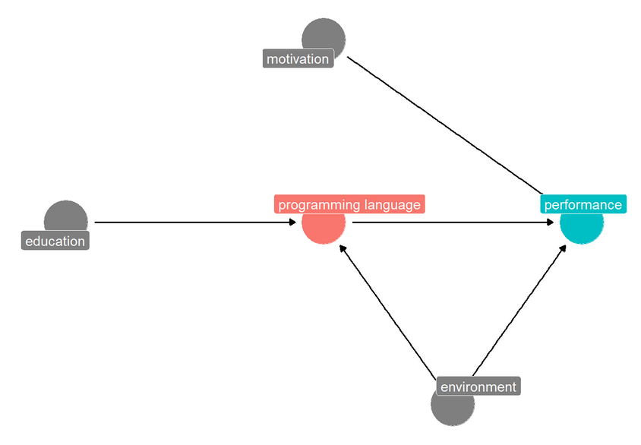
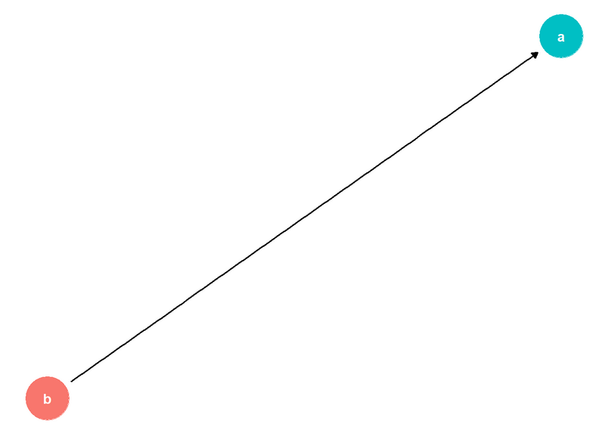
Visualizing causal Assumptions via Directed Acyclic Graphs (DAGs)
Notes:
Causal directed acyclic graphs: variables as nodes, effects as edges, independency as lack of edges, parents, children
Examples: simple 2-variable DAG, complex DAG with many variables
Estimating the strength of the relationships (especially between treatment and outcome) is our target.

Slide 10
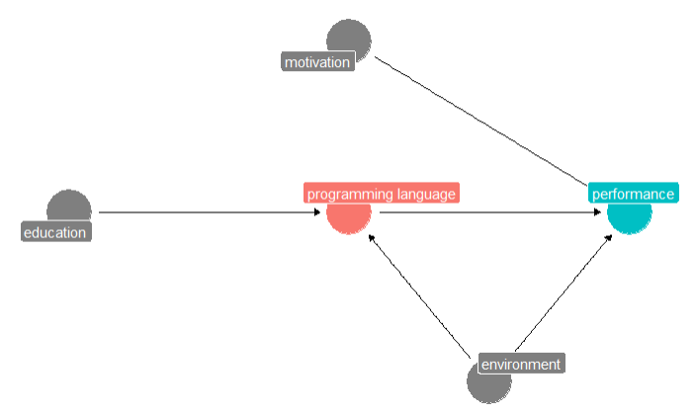
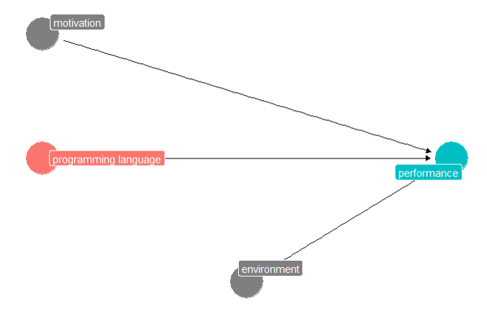
Experimental vs. Observational Studies
Notes:
In experimental studies, the variable of interest (the treatment) is controlled, i.e., set to specific levels
If the assignment of treatments to units is random, then we can assume that the effect is causal (see: SUTVA, ignorability, etc.)

Slide 11
Experimental vs. Observational Studies
Controlled experiments are expensive to conduct and controlling a treatment variable may be difficult without perturbing the context. Hence, we often need to resort to observational studies.
This, in turn, means that in the data generation process, the relationship between the treatment and outcome may be confounded through different types of association.

Slide 12
Sources of Association
Since (1) most relationships of interest are rarely limited to only two variables and (2) these additional variables may interact with the relationship of interest in unforeseen ways, we need to be aware of how they can interact.
Mediator
Fork
Collider
Notes:
Mediators/chains
Common causes/forks
Common effects/colliders

Slide 13
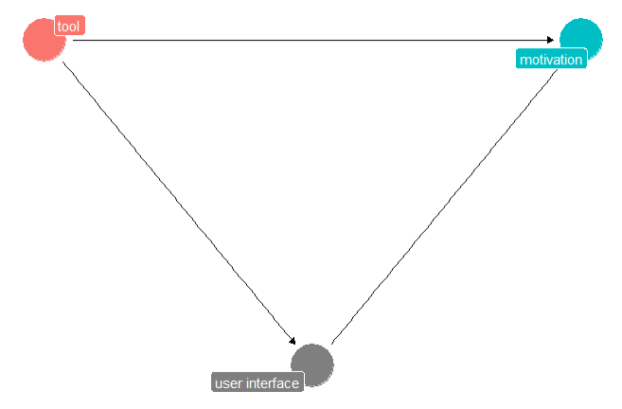
Mediators
Notes:
Direct vs indirect effect
Does not matter when interested in the total effect
May matter when interested in the direct effect
Counterfactual scenario: what if the the mediator is fixed at a certain level?

Slide 14
Mediators
Mediators do not introduce a confounding bias to the causal analysis. However, they influence the distinction between the direct and total effect.
Direct effect: immediate, isolated effect of the treatment on the outcome
Total effect: direct effect plus all mediated effects

Slide 15
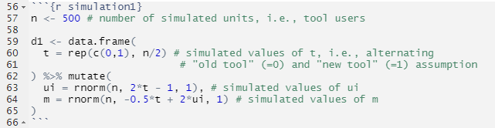



Mediators
To demonstrate this distinction, consider the following assumption.
$$β_{t}=−0.5$$
$$β_{t→ui}=2$$
$$β_{ui}=2$$

Slide 16
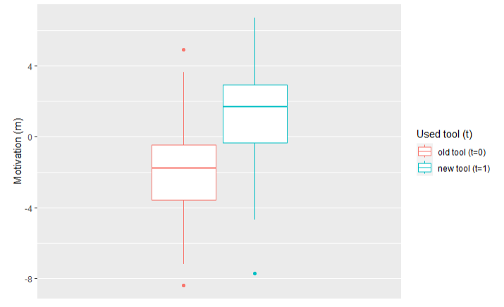
Mediators

Slide 17
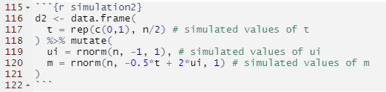

Mediators
Assume that the indirect effect changes.
$$β_{t}=−0.5$$
$$β_{t→ui}=0$$
$$β_{ui}=2$$

Slide 18
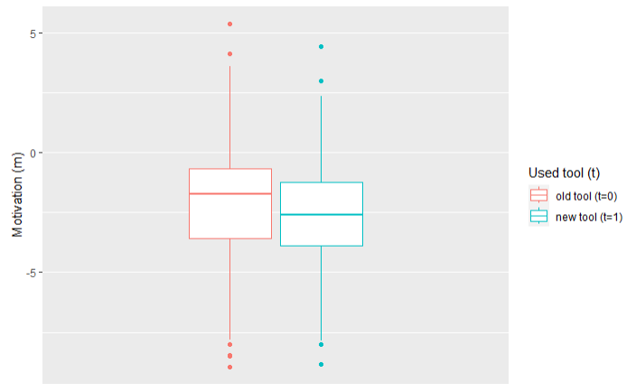
Mediators

Slide 19
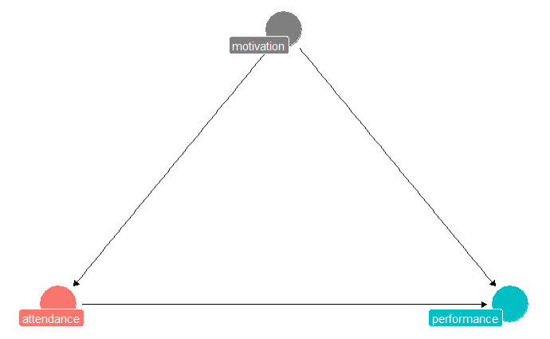
Forks
Notes:
Forks introduce spurious associations:
Example for a 3-variable DAG with a fork
Concrete example: LLMs -> productivity, LLMs <- motivation -> productivity
Association between LLMs and productivity
Can be spurious
But it does not have to
How would we know? Controlling for motivation
Check for the effect of LLMs -> productivity in all strata of motivation

Slide 20
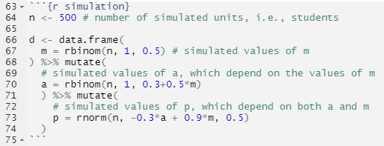



Forks
Assume the following ground truth.
$$β_{m→a}=0.5$$
$$β_{m→p}=0.9$$
$$β_{a→p}=−0.3$$

Slide 21
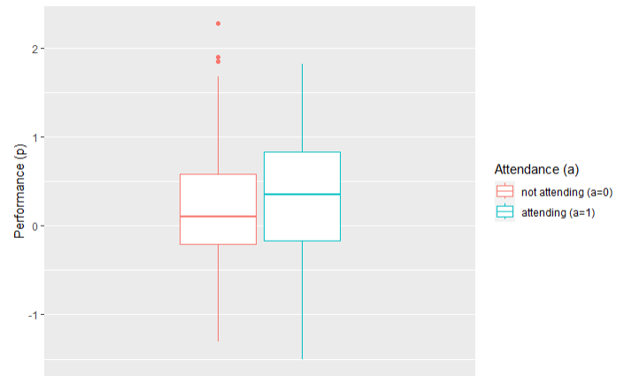
Forks

Slide 22
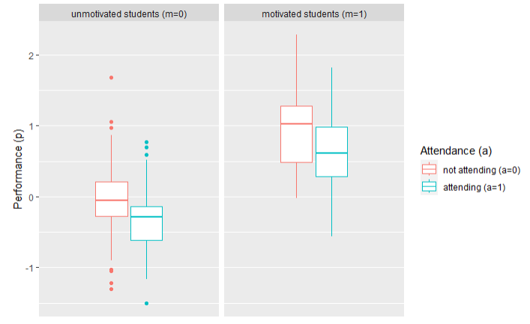
Forks

Slide 23
Forks
Notes:
We need to control/adjust for the potential confounder

Slide 24
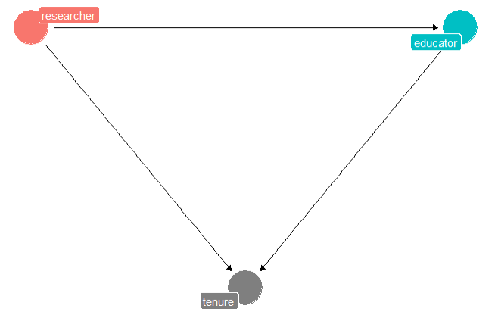
Colliders
Notes:
Usually, pre-treatment variables are considered safe to include in a regression model
We just saw that we should control for potential confounders
If useful information is available, include it in the prediction model
Collider example: researcher -> teacher, researcher -> tenure <- teacher

Slide 25
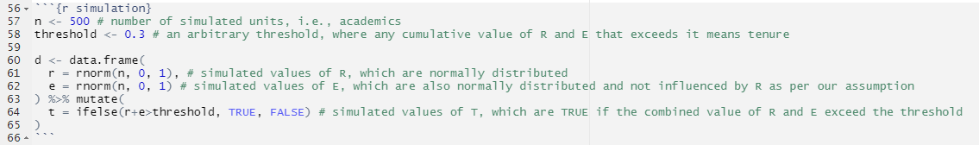
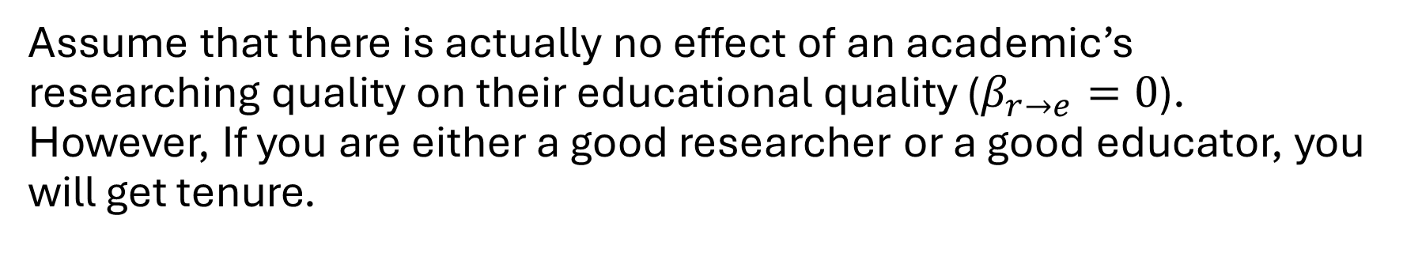
Colliders
Assume that there is actually no effect of an academic’s researching quality on their educational quality ($β_{r→e}=0$). However, If you are either a good researcher or a good educator, you will get tenure.

Slide 26
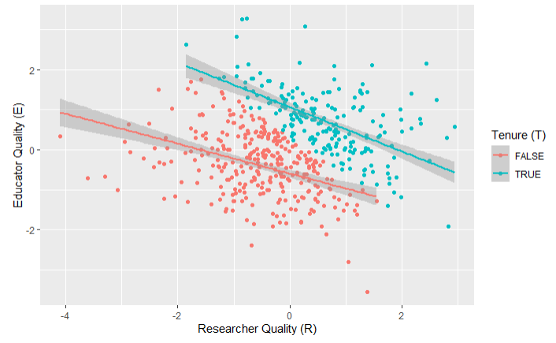
Colliders
For both academics that have tenure and those that do not, there is a negative association between researching and educational capability.

Slide 27
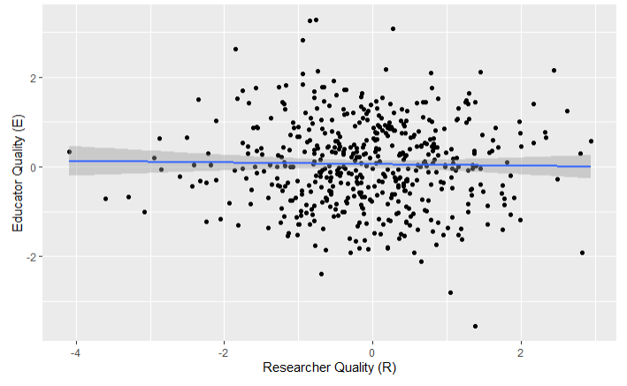
Colliders
This conclusion should not be possible, as we manually defined that there is no relationship between the two variables.

Slide 28
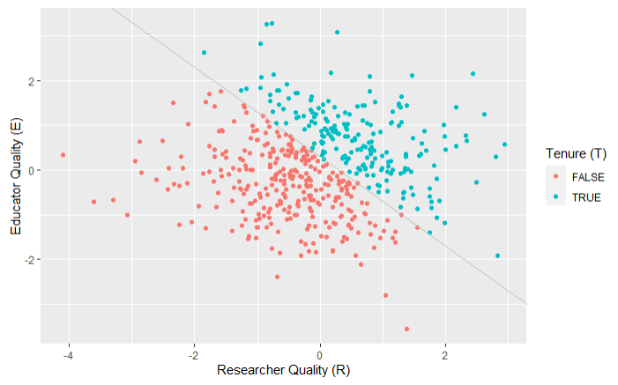
Colliders
By controlling for the collider t, we introduced a spurious association between r and e.

Slide 29
Controlling Variables
Controlling variables has a different effect on the ”flow of information” depending on their relationship.
Not controlling z
Controlling z
z
Mediator
x
y
z
Fork
x
y
z
x
y
Collider
Notes:
We cannot just mindlessly add variables to our analysis, we need a principled approach

Slide 30
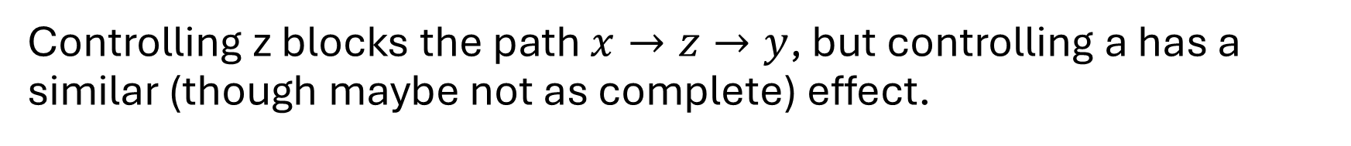
Controlling Descendants
Controlling the descendant (i.e., child) of a variable has a comparable effect as controlling for the actual variable.
a
z
z
x
y
x
y
Controlling z blocks the path $x→z→y$, but controlling a has a similar (though maybe not as complete) effect.

Slide 31
Paths
Two nodes are connected via a path, i.e., a series of adjacent arrows that pass through each node at most once.
Causal path: path where all arrows point from the treatment to the outcome
Non-causal path: path where at least one arrow points from the outcome to the treatment
Backdoor path: that enters the treatment

Slide 32
The Backdoor Adjustment
To infer a causal relationship from observational data, we need to deconfound the relation of interest by selecting a set of variables Z that conform the backdoor criterion:
Backdoor criterion: Given an ordered pair of variables (X,Y) in a model, a set of confounder variables Z satisfies the backdoor criterion if
no confounder variable Z is a descendent of X and
Z blocks every path between X and Y that contains an arrow into X.

Slide 33
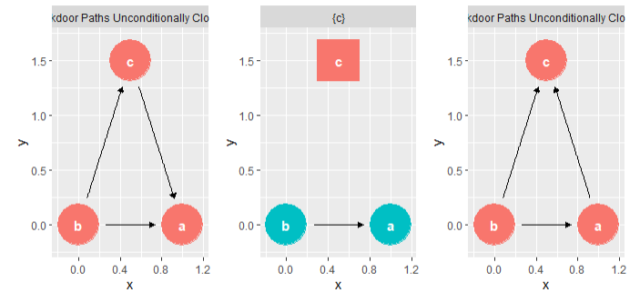
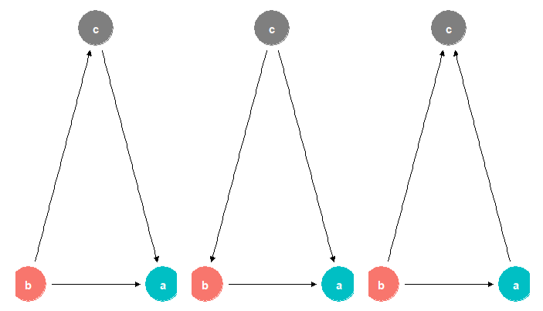
The Backdoor Adjustment

Slide 34
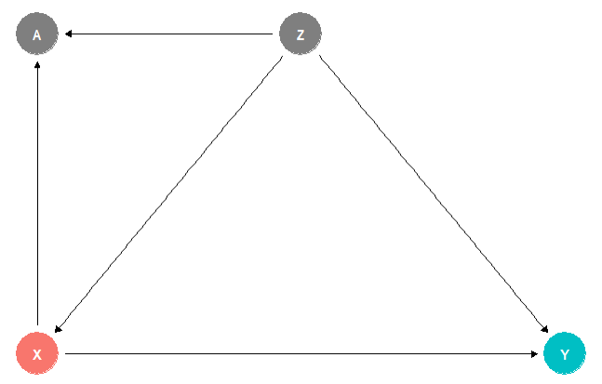
The Backdoor Adjustment

Slide 35
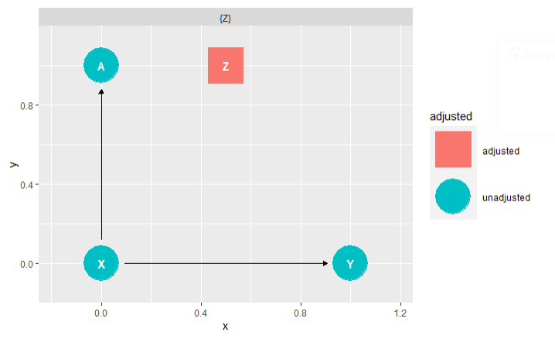
The Backdoor Adjustment

Slide 36
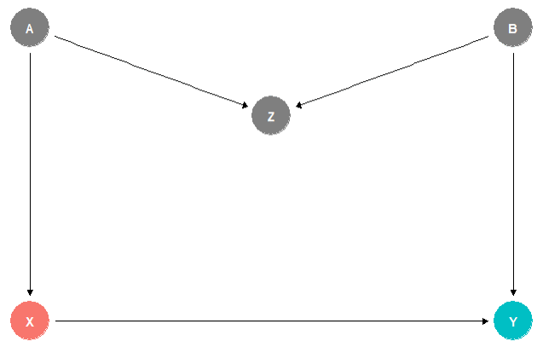
The Backdoor Adjustment

Slide 37

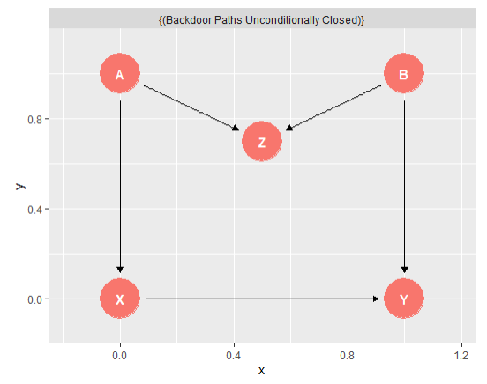
The Backdoor Adjustment

Slide 38
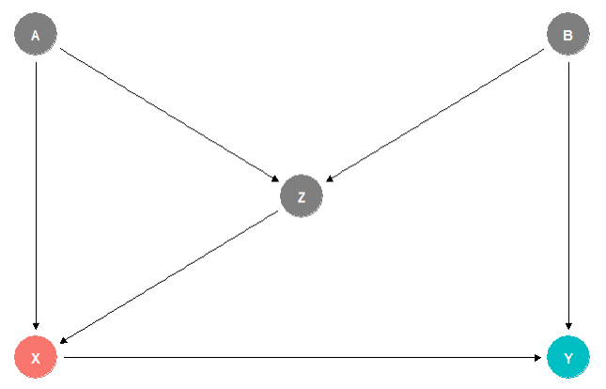
The Backdoor Adjustment

Slide 39
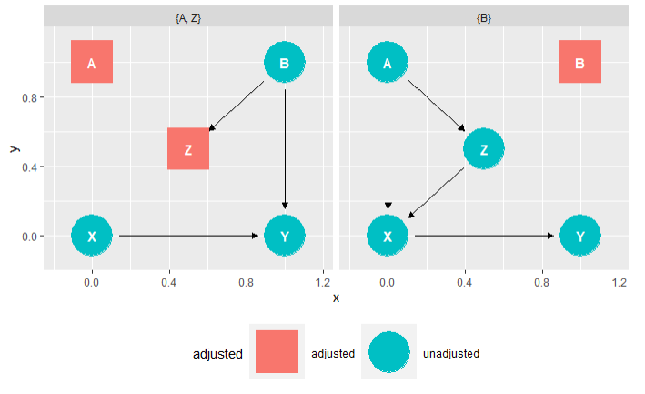
The Backdoor Adjustment

Slide 40
Summary of Part I
Answering causal research questions requires not only data about it, but also knowledge about the data generation process
Directed, acyclic graphs make causal assumptions explicit and allow us to systematically analyze a phenomenon from a causal perspective
The three basic types of associations in causal DAGs are mediators, forks, and colliders, and they behave differently when controlled for
Using the backdoor criterion, we can determine which variables to adjust for and which to ignore to deconfound the causal relationship of interest
Notes:
Answering causal questions in research requires knowledge about the data generation process
We can visualize causal hypotheses using DAGs
There are three basic types of association in DAGs: mediators, forks, and colliders
Using the backdoor criterion, we can decide which variables to adjust for and which to ignore

Slide 41
Frequentist Methods
State of the art for statistical inference in software engineering
Notes:
Frequentist methods are the state of the art in software engineering research (assumption)
Out-of-the-box methods (like NHSTs)
Popularity possibly stems from Claes Wohlins book

Slide 42
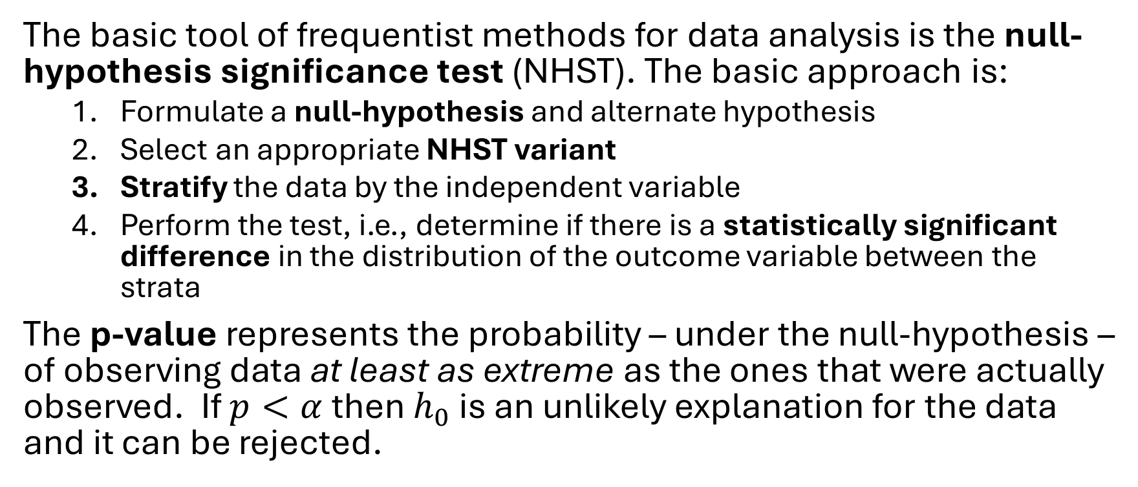
Basics
The basic tool of frequentist methods for data analysis is the null-hypothesis significance test (NHST). The basic approach is:
  Formulate a null-hypothesis and alternate hypothesis
  Select an appropriate NHST variant
  Stratify the data by the independent variable
  Perform the test, i.e., determine if there is a statistically significant difference in the distribution of the outcome variable between the strata
The p-value represents the probability – under the null-hypothesis – of observing data at least as extreme as the ones that were actually observed. If $p<α$ then $h_{0}$ is an unlikely explanation for the data and it can be rejected.

Slide 43
Issues
Frequentist methods are under critique for at least the following three reasons.
Arbitrary
significance level
Oversimplified summary
Unsound extension
of the modus tollens
Notes:
The selection of the significance level is arbitrary
The answer to a research question is a scalar summary, i.e., binary (significant difference or no significant difference)
Frequentist approaches use an unsound extension of the modus tollens

Slide 44


Modus tollens in frequentist Analyses
This extension is not sound!
Modus tollens
Probabilistic extension
Example 1:
X: a person lives in Switzerland
Y: a person is the King of Sweden
P[Y|X] is probably false, so if we observe Y then P[X] is probably false.
$$\frac{X→¬Y Y}{¬X}$$
$$\frac{P\left[Y | X\right]<ε Y}{P\left[X\right]< ε}$$
If X implies that Y is false, and we observe Y, then X is false.
If X implies that Y is probably false (equivalently: Y is improbably true), and we observe Y, then X is probably false.
Example 2:
X: a person lives in London
Y: a person is the Queen of England
P[Y|X] is probably false, but if we observe Y then P[X] is actually true.
Furia, C. A., Feldt, R., & Torkar, R. (2019). Bayesian data analysis in empirical software engineering research. IEEE Transactions on Software Engineering, 47(9), 1786-1810.

Slide 45
Bayesian Data Analysis
For statistical causal inference

Slide 46
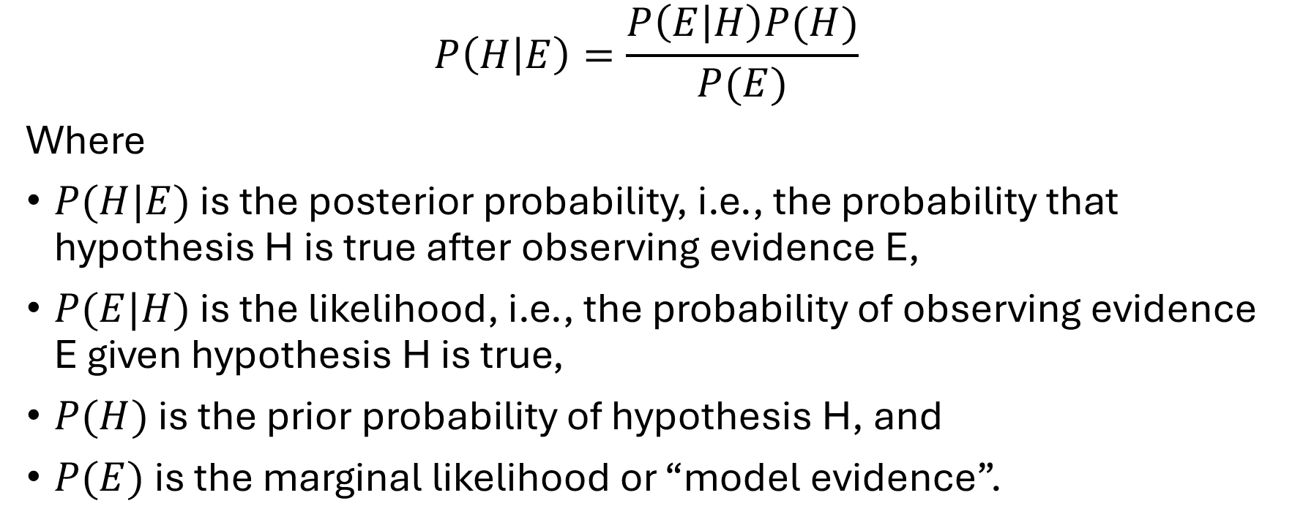
Bayes Theorem
$$P\left(H | E\right)=\frac{P\left(E | H\right)P(H)}{P(E)}$$
Where
$P(H|E)$ is the posterior probability, i.e., the probability that hypothesis H is true after observing evidence E,
$P(E|H)$ is the likelihood, i.e., the probability of observing evidence E given hypothesis H is true,
$P(H)$ is the prior probability of hypothesis H, and
$P(E)$ is the marginal likelihood or “model evidence”.

Slide 47
The Bayesian Data Analysis Approach
Define regression formula
Determine model distribution
Select priors for all included factors
Run prior predictive check
Fit the model to the collected data
Run posterior predictive check
Plot marginal distributions

Slide 48

Demonstration of the Bayesian Approach
Define regression formula

Slide 49
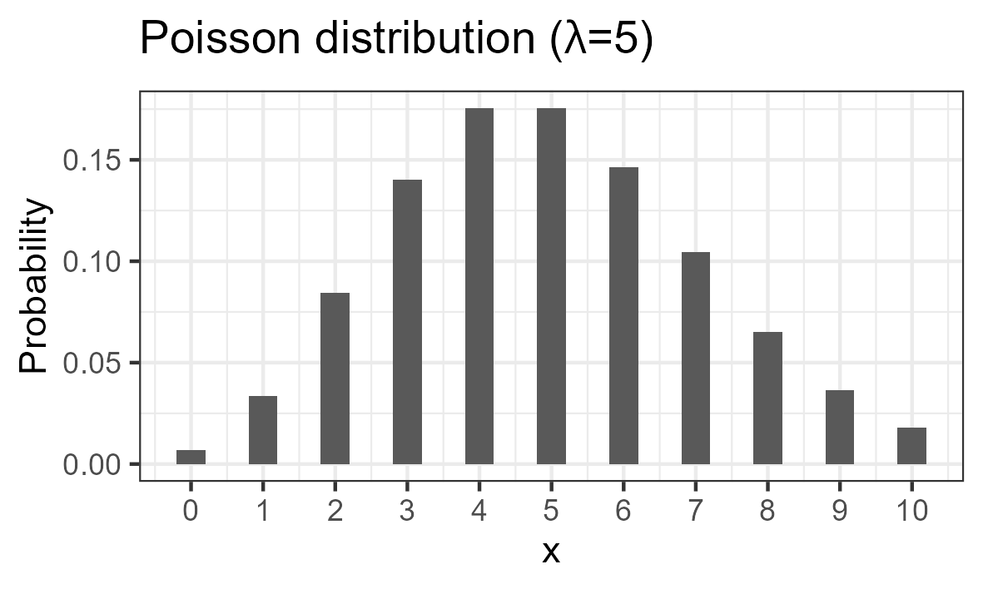
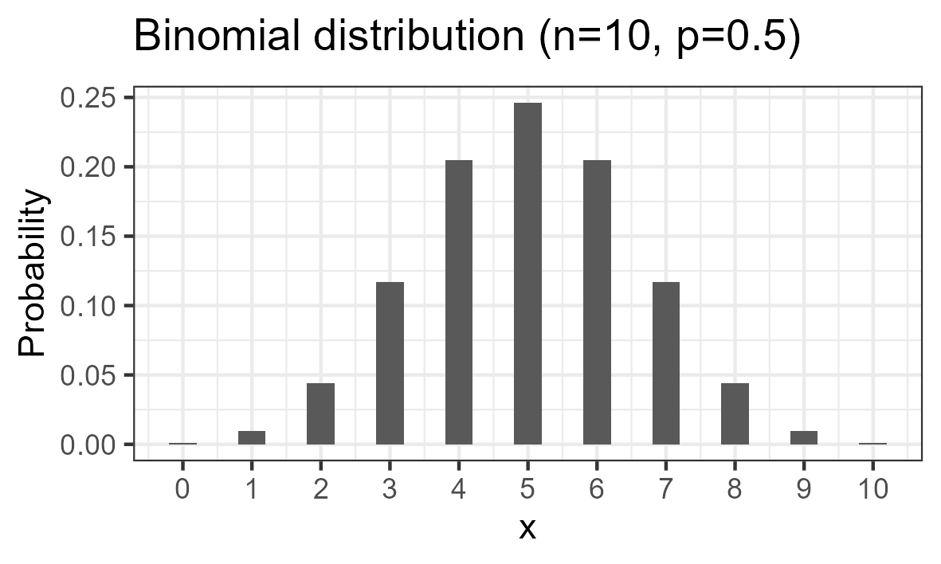
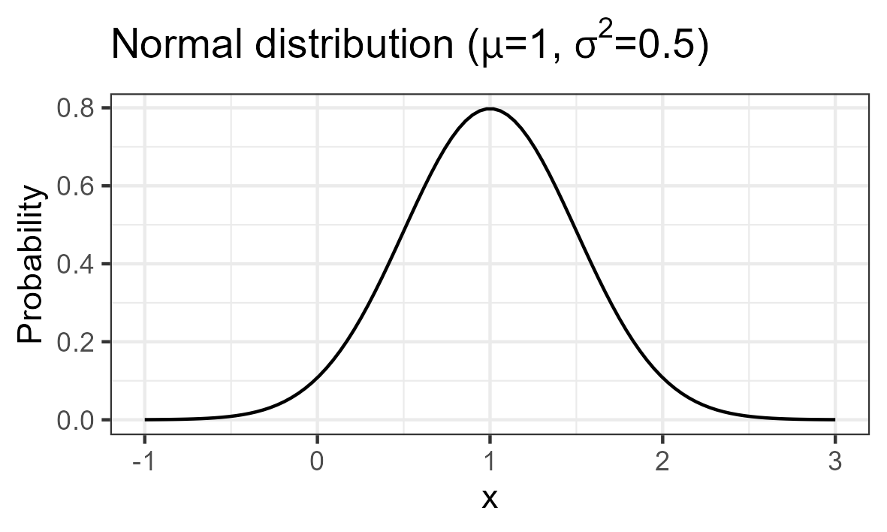
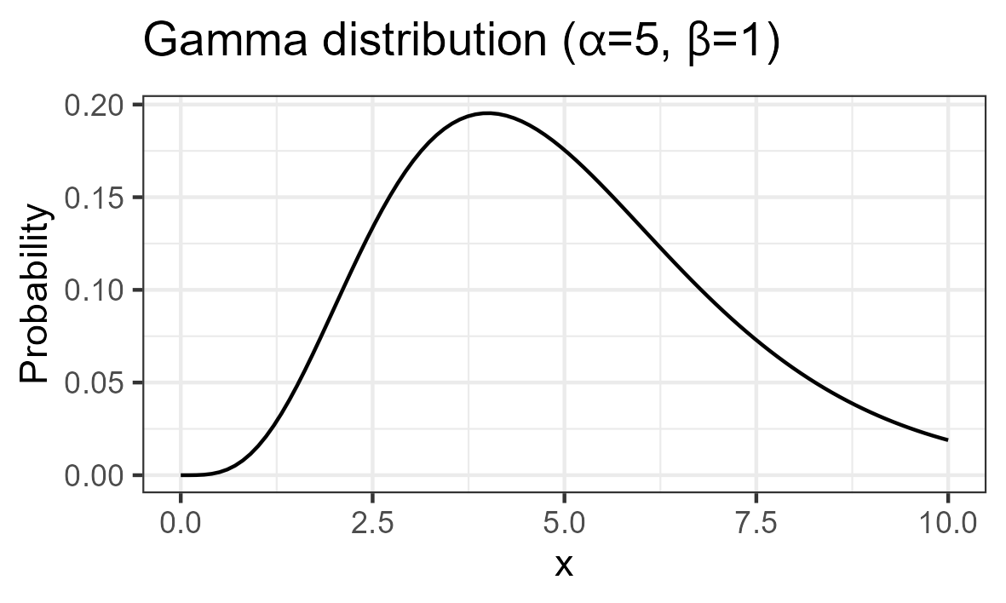
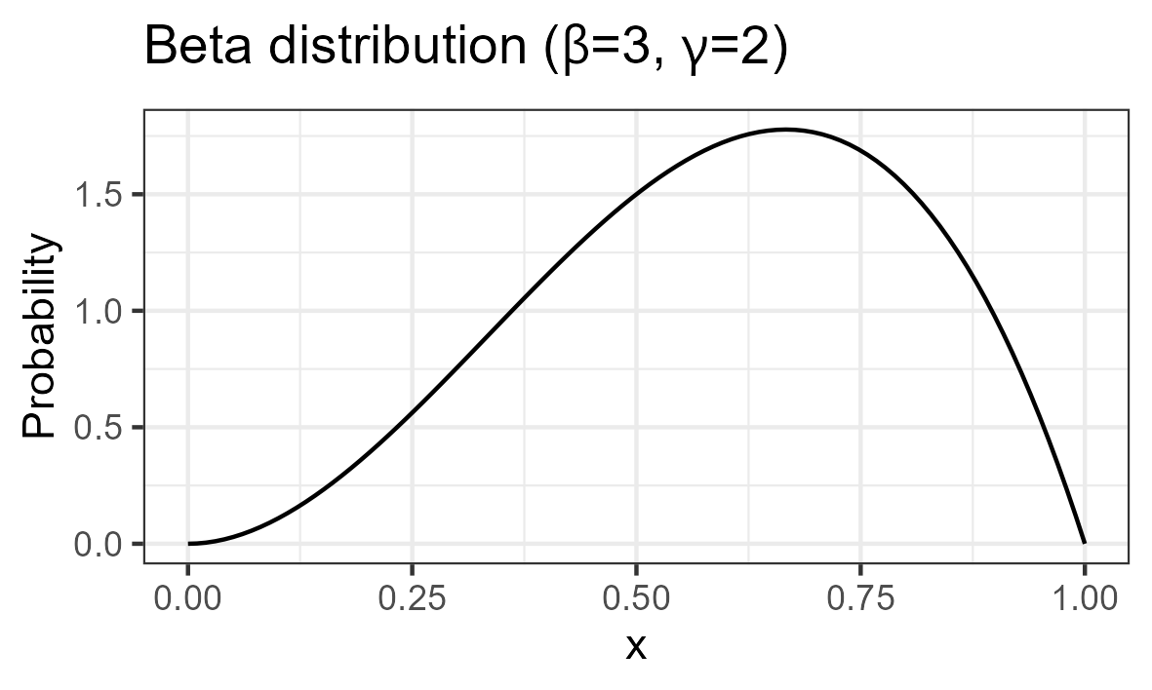











Determining the Model Distribution
$$μ=np$$
$$n→∞$$
$$σ^{2}=μ$$
$$μ=np$$
$$μ→∞$$
$$σ^{2}=np(1−p)$$
$$n→∞$$
$$μ=αβ$$
$$σ^{2}=α^{2}β$$
$$β→∞$$
$$\frac{X_{1}}{X_{1}+X_{2}}$$

Slide 50
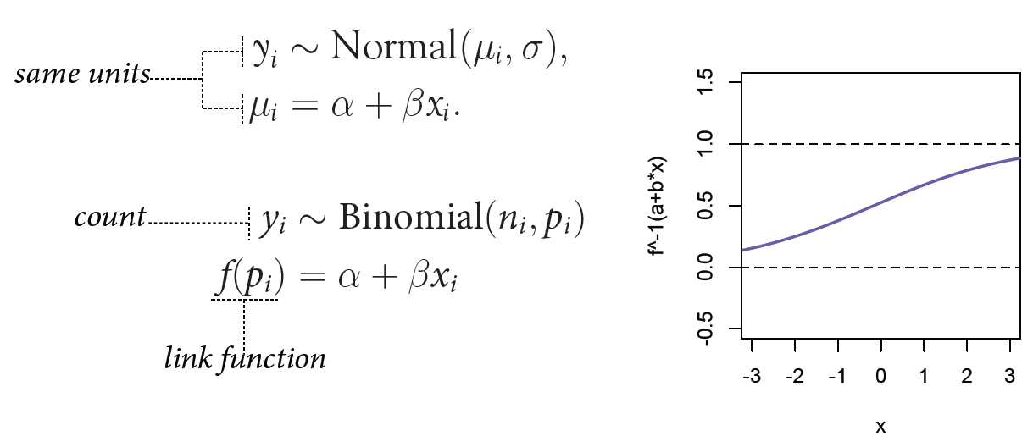
Constructing a Bayesian Model
Since some parameters of some distribution families underly certain constraints, a Bayesian model may involve link functions.

Slide 51
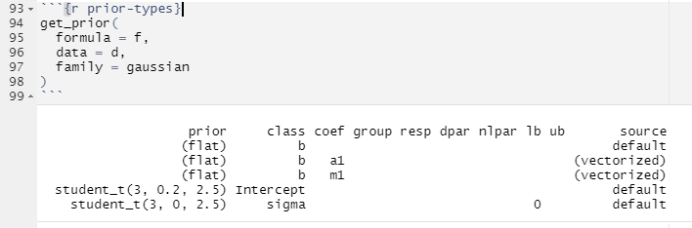

Demonstration of the Bayesian Approach
Determine model distribution
Select priors for all included factors

Slide 52
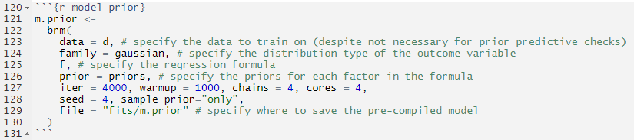
Demonstration of the Bayesian Approach
Run prior predictive check

Slide 53
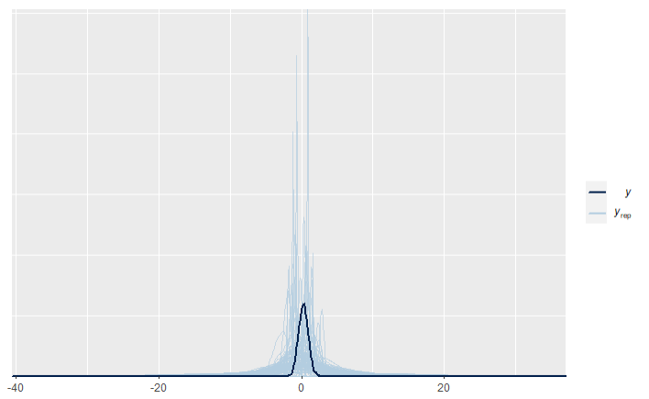

Demonstration of the Bayesian Approach
Run prior predictive check

Slide 54
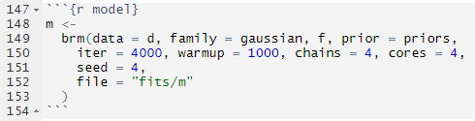
Demonstration of the Bayesian Approach
Fit the model to the collected data

Slide 55
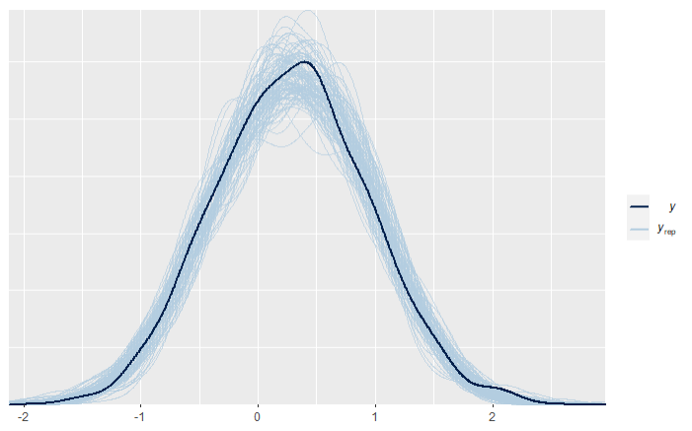
Demonstration of the Bayesian Approach
Run posterior predictive check

Slide 56
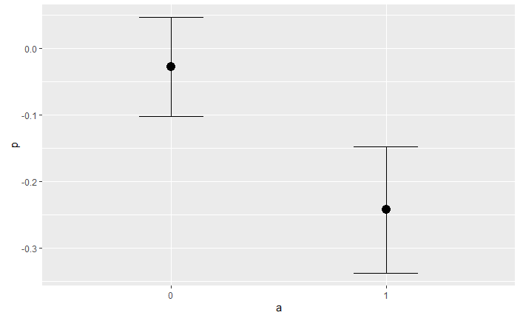
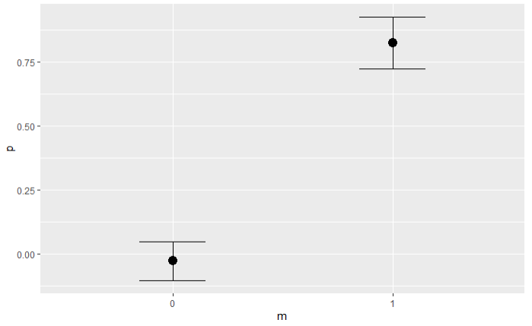
Demonstration of the Bayesian Approach
Plot marginal distributions

Slide 57
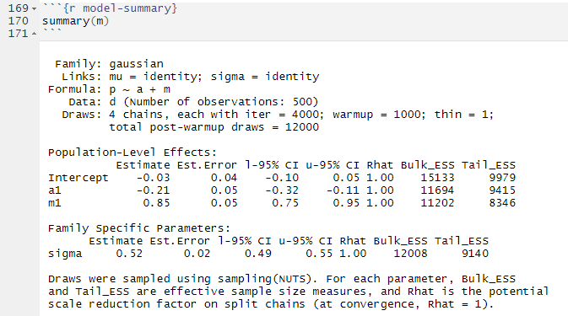
Demonstration of the Bayesian Approach
Inspect the model summary

Slide 58
Bayesian Data Analysis for Statistical Causal Inference

Slide 59
General Framework
Modelling: Draw a causal DAG around the phenomenon of interest to make your assumptions explicit and discussable.
Identification: Apply the backdoor criterion to select, which variables you need to control in order to deconfound the phenomenon of interest.
Estimation: If all deconfounders are observable, collect data about the relevant variables and perform a Bayesian data analysis to estimate the causal effect.
Pearl, J. (2009). Causality. Cambridge university press.
Siebert, J. (2023). Applications of statistical causal inference in software engineering. Information and Software Technology, 159, 107198.
Notes:
Modeling
Identification
Estimation:
Data collection
Bayesian data analysis

Slide 60
Reading List
Pearl, J., & Mackenzie, D. (2018). The book of why: the new science of cause and effect. Basic books.
McElreath, R. (2018). Statistical rethinking: A Bayesian course with examples in R and Stan. Chapman and Hall/CRC.
Siebert, J. (2023). Applications of statistical causal inference in software engineering. Information and Software Technology, 159, 107198.
Furia, C. A., Feldt, R., & Torkar, R. (2019). Bayesian data analysis in empirical software engineering research. IEEE Transactions on Software Engineering, 47(9), 1786-1810.
Furia, C. A., Torkar, R., & Feldt, R. (2022). Applying Bayesian analysis guidelines to empirical software engineering data: The case of programming languages and code quality. ACM Transactions on Software Engineering and Methodology (TOSEM), 31(3), 1-38.
Notes:
To deepen your understanding of statistical causal inference, consider the following reading list.

