Slide 1




Applied Statistical Causal Inference in Requirements Engineering
A Gentle Introduction to the Analysis of Quantitative Data from Observational Studies
Richard Torkar
Full Professor
https://torkar.github.io/
Robert Feldt
Full Professor
http://www.robertfeldt.net/
Hans-Martin Heyn
Senior Lecturer
https://martinheyn.github.io/
Julian Frattini
Postdoctoral Researcher
https://julianfrattini.github.io/

Slide 2

Applied Statistical Causal Inference in Requirements Engineering
A Gentle Introduction to the Analysis of Quantitative Data from Observational Studies
Monday, 1st of September, 14:00-17:30 in Room 2.3

Slide 3

Statistical Causal Inference
a gentle introduction to advanced analysis of quantitative data
Julian Frattini
Chalmers University of Technology, Sweden
https://julianfrattini.github.io/
JulianFrattini/bda4sci
Public
Copyright © 2024 Julian Frattini.
The source code is licensed under the Apache License 2.0.
This presentation is licensed under CC BY-NC-SA 4.0.

Slide 4
Meet your Instructors
Richard Torkar
Full Professor
https://torkar.github.io/
Robert Feldt
Full Professor
http://www.robertfeldt.net/
Hans-Martin Heyn
Senior Lecturer
https://martinheyn.github.io/
Julian Frattini
Postdoctoral Researcher
https://julianfrattini.github.io/

Slide 5
Overview
Session | Time | Content | Style
Introduction | 14:00-14:15 | State-of-the-art, motivation, and goals | Lecture
Fundamentals & Notation | 14:15-14:45 | Fundamental terminology in statistics, and notation used throughout this tutorial | Lecture
Causal Inference I | 14:45-15:30 | Mediation and confounders | Lecture
Break | 15:30-16:00
Causal Inference II | 16:00-16:45 | Colliders and model comparison | Lecture & Exercises
Application | 16:45-17:00 | Statistical causal inference for requirements engineering | Lecture
Conclusion | 17:00-17:15 | Scientific workflow for causal inference, structured reading list | Lecture
Feedback | 17:15-17:30 | Reflection, discussion, and closing | Open discussion

Slide 6
Introduction
Goals and Expectations

Slide 7
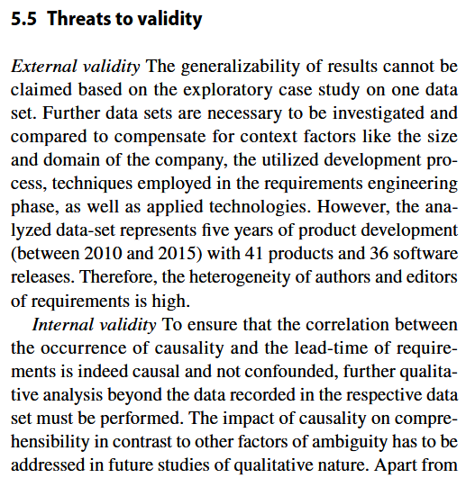
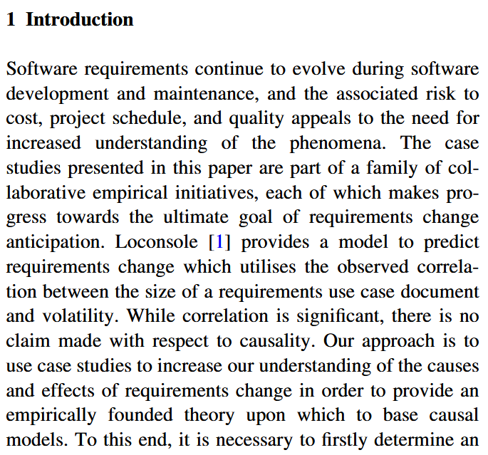
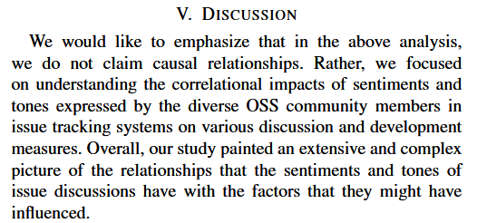
State-of-the-art
Sanei, A., Cheng, J., & Adams, B. (2021, May). The impacts of sentiments and tones in community-generated issue discussions. In 2021 IEEE/ACM 13th International Workshop on Cooperative and Human Aspects of Software Engineering (CHASE) (pp. 1-10). IEEE. DOI: 10.1109/CHASE52884.2021.00009
McGee, S., & Greer, D. (2012). Towards an understanding of the causes and effects of software requirements change: two case studies. Requirements Engineering, 17, 133-155. DOI: 10.1007/s00766-012-0149-0
Referring to Loconsole, A., & Borstler, J. (2005, December). An industrial case study on requirements volatility measures. In 12th Asia-Pacific Software Engineering Conference (APSEC'05) (pp. 8-pp). IEEE. DOI: 10.1109/APSEC.2005.38
Frattini, J., Fischbach, J., Mendez, D., Unterkalmsteiner, M., Vogelsang, A., & Wnuk, K. (2023). Causality in requirements artifacts: prevalence, detection, and impact. Requirements Engineering, 28(1), 49-74. DOI: 10.1007/s00766-022-00371-x
Notes:
There seems to be an implicit, collective agreement in our community that
Studying causal relationships is hard, and therefore
Detecting correlations is good-enough.
So: Why care about causality?

Slide 8
Correlation versus Causality
Correlation:
when we observe X,
we also observe Y
Causality:
when we do X,
we observe Y.
If we want to make a positive impact on the target audience of our research (i.e., RE/SE practitioners), we need to provide reliable recommendations on how to act – which we can only derive from causal relationships, not correlations.
We cannot infer causality from data alone – we must also know the process that created that data.¹
¹we’ll revisit this statement later
Notes:
We all know “Correlation does not imply causality” – but what exactly differentiates the two concepts?
Only causal relationships give us reliable recommendation on how to act, and therefore, how to make a positive impact on the target audience of our research (i.e., RE/SE practitioners).
Disclaimer:
I do not want to discredit correlational studies.
They are valuables to detect patterns and trends.
However, they do not get us any further and are unfit to recommend changes in an organization.
This is the fundamental difference between observing (correlations) and doing (interventions with causal effects).

Slide 9
Experimental vs. Observational Studies
One ”straightforward” way to distinguish correlation from causality: conduct a controlled experiment, where we exert control over a treatment and isolate its effect from all confounding.
Expensive
Recruiting eligible participants is difficult
Unrealistic
Experiments perturb the natural context
Impossible
Some factors are impossible to control
Assumed
The validity of experimental results depends on several conditions
Notes:
But: experiments are expensive and perturb the natural context of a phenomenon. Some phenomena cannot be studied in controlled experiments at all (e.g., impact of human factors) since the values of that variable cannot be assigned randomly.

Slide 10
Goals of this Tutorial
Convincing you of the value of statistical causal inference
Learning the fundamentals of drawing causal conclusions from quantitative data
collected in observational studies
Notes:
Convincing you of the value of causal inference (check)
Learning the fundamentals of drawing causal conclusions from quantitative data collected in observational studies

Slide 11
Learning Outcomes
Causal Modelling
Communicating transparent causal assumptions in graphical models
Statistical Causal Inference (SCI)
Drawing reliable conclusions from quantitative, observational data
Causal Workflow
Structured process for performing statistical causal inference in an empirical study
Notes:
Causal modelling: visualizing causal assumptions graphically
Statistical causal inference: drawing reliable conclusions from observational data
Causal workflow: a reliable workflow for SCI

Slide 12
Fundamentals & Notation
Syntax and Pedagogics of this Tutorial
Notes:
This may be a lengthy background section, but also
A good reminder for fundamentals of statistics,
The introduction of a valuable modeling concept, and
A recommendation for a statistical workflow.

Slide 13
Basic Terminology
“We study the effect of different document reading techniques on the number of identified defects in Bachelor- and Master-level students.”
Factors: variables that associate measurements with a construct (e.g., document reading technique, identified defects, student level)
Treatment/Exposure: main independent factor of interest
Outcome/Response: main dependent factor of interest
Phenomenon: main causal effect of interest (treatment → outcome)

Slide 14
Causal Modeling
Directed, acyclic graphs (DAGs) can represent causal assumptions, where nodes represent variables and edges represent assumed/potential causal relationships between those variables.
document reading technique
document reading technique
identified defects
identified defects
participation
motivation
DAGs are subjective and represent the view of a domain expert.
treatment
phenomenon
outcome
other factors
Notes:
More importantly, the absence of an edge encodes the certainty that two variables are not directly related.

Slide 15
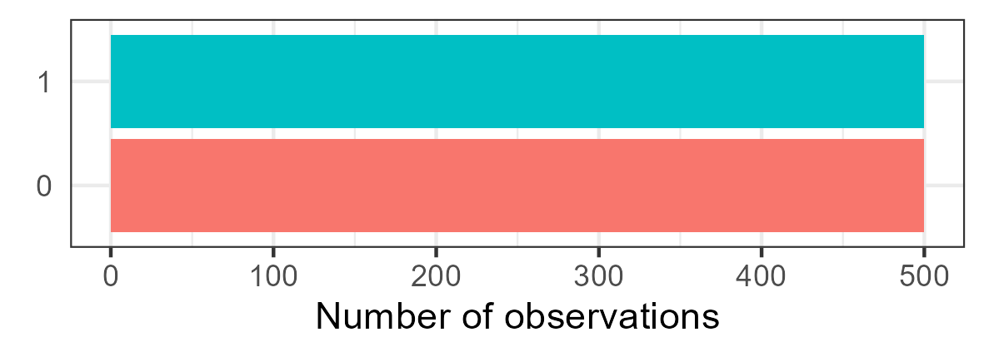
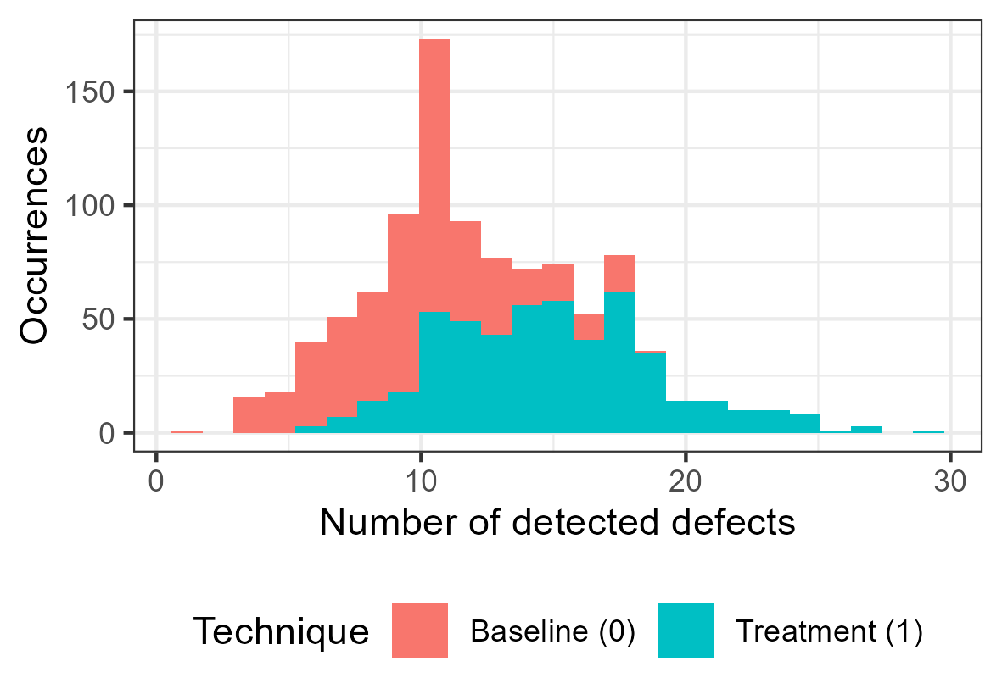
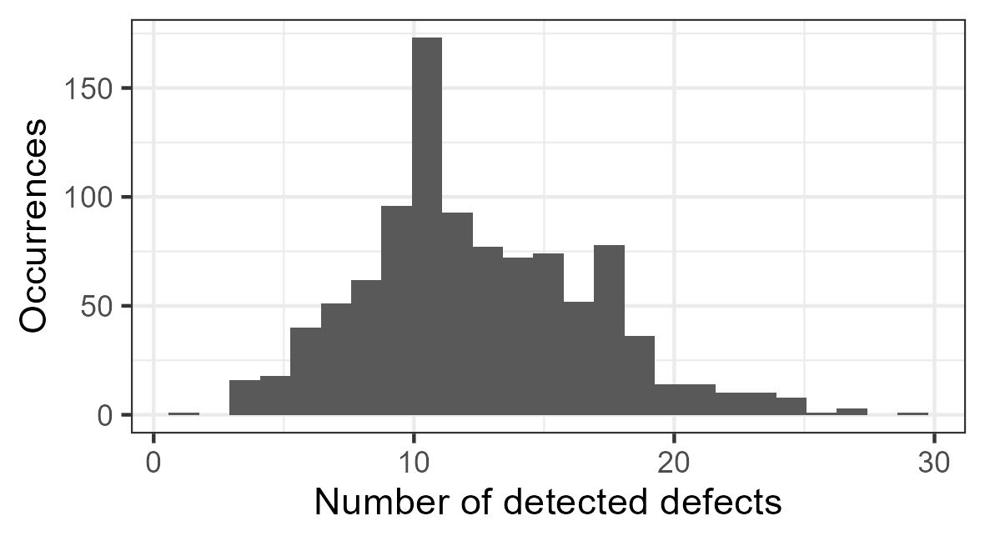
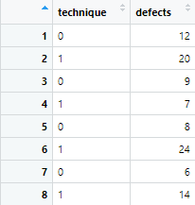



Simulations
To demonstrate the process of SCI, we simulate data sets. This gives us control over phenomena, i.e., a reliable ”ground truth.”
Discrete uniform distribution
Simulation of an independent variable
Simulation
$$technique=unif\{0, 1\}$$
$$10+$$
$$technique∗5$$
$$defects=Poisson(10+technique∗5)$$
Simulation of a dependent variable
Poisson distribution
Dependency of defects on technique
Notes:
(introduce random variables)
(show simulation formula and explain all terms)
(visualize simulated data)

Slide 16


Causal Modeling and Simulations
DAGs are typically used to formalize assumed causal relationships. They can also be used to represent simulated causal relationships.
Simulation
document reading technique
$$technique=unif\{0, 1\}$$
$$5$$
$$defects=Poisson(10+technique∗5)$$
identified defects
Path coefficient
Changing the cause by one unit causes the effect to change by <path coefficient> units. It is, therefore, our variable of interest representing effect strength.
Notes:
This represents our ground truth (both in terms of effects and their strength.
The path coefficient is the variable of interest, as it represents the effect strength (and direction) of one variable on another.

Slide 17
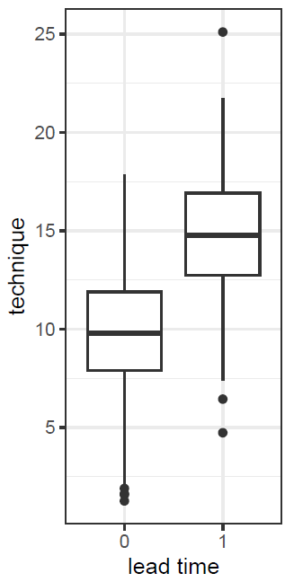
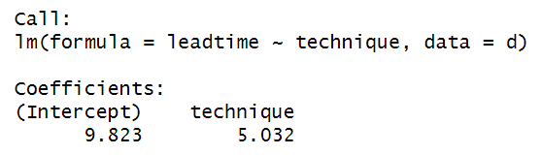



Data Analysis Tool: (Linear) Modeling
+ more accessible
more difficult to use and apply -
- less granular
more granular +
Null-Hypothesis
Significance Test
e.g., Student’s t-test,
Mann-Whitney U Test
(Generalized) Linear
(Mixed) Model
Bayesian Data
Analysis
outcome
predictor
$$leadtime \sim technique$$
$$leadtime \sim α+β_{t}∗ technique$$
intercept
path coefficient
Simulation
$$technique=unif\{0, 1\}$$
$$leadtime=N(10+technique∗5, 3)$$
Notes:
For our data analysis tool, we will use linear regressions (which are more powerful than NHSTs but more approachable than Bayesian data analysis).
Limitations: assumption of monotonicity, etc.
(example of a regression formula with explanations, regression+data, and results)

Slide 18

From causal to statistical Models
Model Derivation
Causal Models
encode causal assumptions
Statistical Models
implement inference
document reading technique
$$defects \sim technique+motivation$$
identified defects
How to derive statistical from causal models is core to statistical causal inference.
participation
motivation
Notes:
Connection between causal and statistical models:
Causal models encode causal assumptions
Statistical models implements inference
Statistical causal inference (SCI) = deriving statistical models from causal models
(how to do this is a major learning outcome of this tutorial)
“Science before statistics”

Slide 19
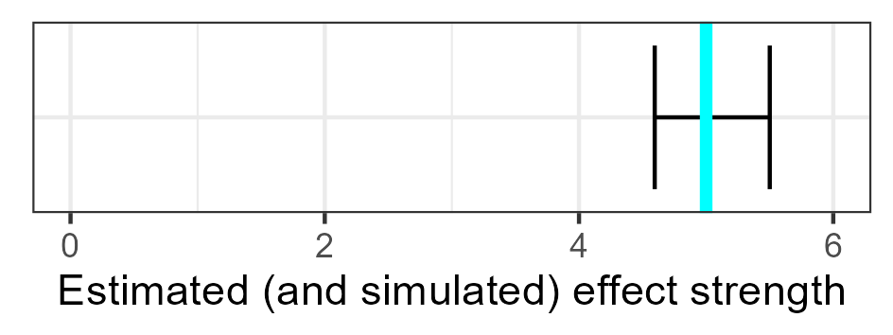


Pedagogy of this Tutorial
1. Ground Truth
Simulating data based on defined causal relationships
2. Regression
Deriving statistical models and running regression analyses
3. Comparison
Comparing the results of the analysis with the ground truth
4. Inference
Deducing obtainable knowledge from the analysis results
document reading technique
document reading technique
Model Derivation
$$5$$
identified defects
$$m:defects \sim 1+technique$$
identified defects
Notes:
With all of these fundamentals, this is how the following examples will look like:
example phenomenon x -> y with assumed DAG and data
derivation of a statistical model, running a regression analysis
comparing the results of the regression analysis with the values of the simulation: if they overlap, we inferred the correct causal conclusion
revealing the actual DAG with simulation weights

Slide 20
Causal Inference I
Confounders and Mediators
Notes:
Since
most relationships of interest are rarely limited to only two variables, and
these additional variables may interact with the relationship of interest in unforeseen ways,
we need to be aware of how they can interact.

Slide 21




Confounding: Common Causes
“The company pushed for a use case driven requirements specification approach. We investigate whether the specification format of a requirement decreased the normalized lead time.”
specification format
(0 = baseline, 1 = use case driven)
lead time
$$\sim bernoulli(0.8−0.5∗pressure)$$
$$\sim N(0−2∗pressure+0∗format, 1)$$
$0$: the specification format does not affect lead time
$−0.5$: high pressure lets requirements engineers resort to their baseline way-of-working.
$−2$: high pressure strongly reduces the lead time
pressure (0 = low, 1 = high)
$$\sim bernoulli(0.3)$$

Slide 22

Confounding: Common Causes
“The company pushed for a use case driven requirements specification approach. We investigate whether the specification format of a requirement decreased the normalized lead time.”
specification format
$$m_{1}: leadtime\sim 1+format$$
Model Derivation
lead time
$$m_{2}: leadtime\sim 1+format+pressure$$
pressure

Slide 23
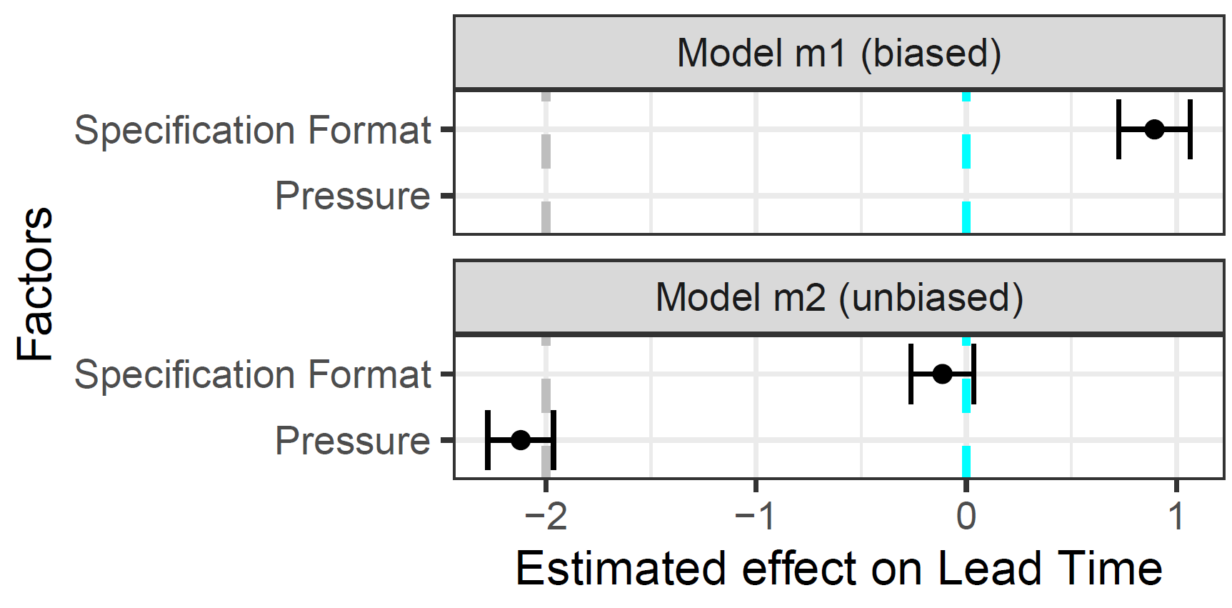

Confounding: Common Causes
“The company pushed for a use case driven requirements specification approach. We investigate whether the specification format of a requirement decreased the normalized lead time.”
$$m_{1}: leadtime\sim 1+format$$
$$m_{2}: leadtime\sim 1+format+pressure$$

Slide 24
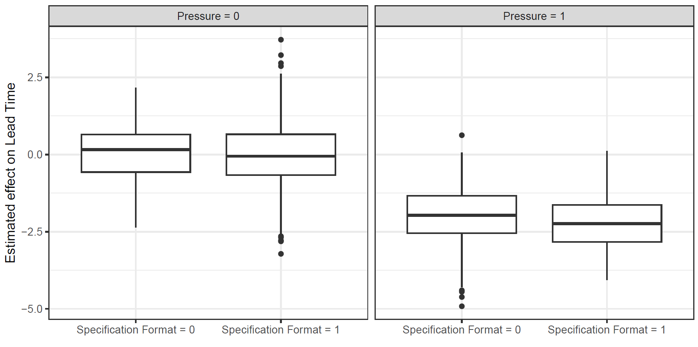
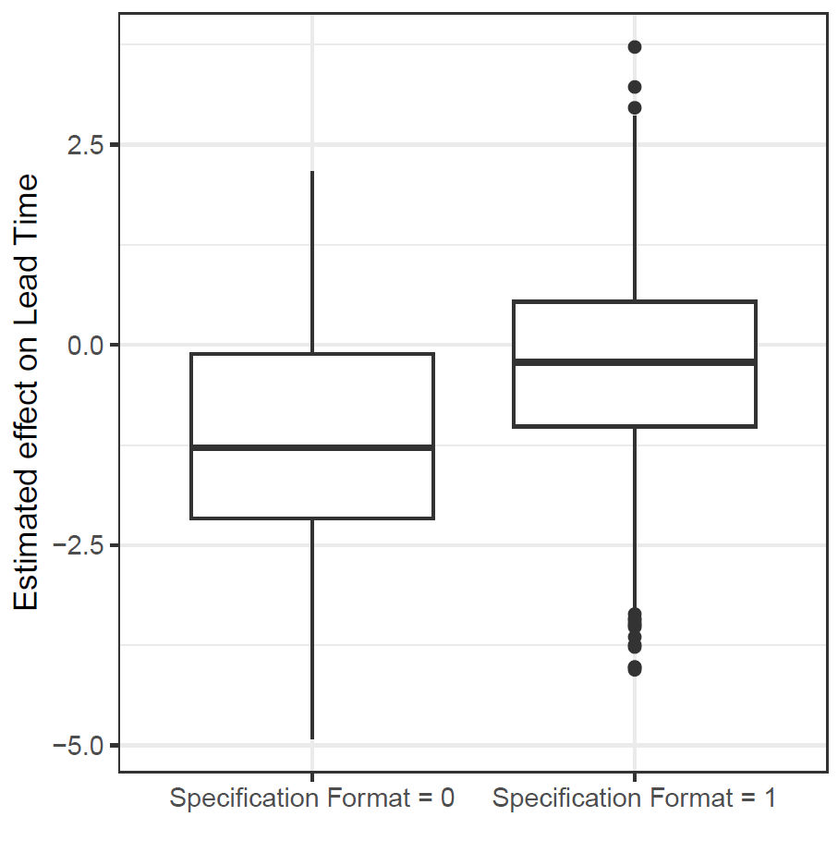
Confounding: Common Causes
“The company pushed for a use case driven requirements specification approach. We investigate whether the specification format of a requirement decreased the normalized lead time.”
Notes:
Only looking into the effect of format on lead time suggests that the specification format has a positive effect
However: stratifying by pressure levels shows that the specification format has no impact at all

Slide 25

Confounding: Common Causes
“The company pushed for a use case driven requirements specification approach. We investigate whether the specification format of a requirement decreased the normalized lead time.”
specification format
$$m_{1}: leadtime\sim 1+format$$
Model Derivation
lead time
$$m_{2}: leadtime\sim 1+format+pressure$$
pressure
If both treatment and outcome have a common cause, we need to statistically adjust for (i.e., control) the confounder to de-bias the effect of interest.
Notes:
But why is it so?

Slide 26
Confounding: Common Causes
Whenever specification format = 0, the likelihood that pressure = 1 is much higher which causes a lower lead time.
specification format
“Whenever specification format = 0, the likelihood that pressure = 1 is much higher” is an association, but not causal in this direction!
lead time
Remember:
observing ≠
doing
pressure
When not controlling the confounder, “information flows” from the cause through the confounder to the effect in a non-causal direction.

Slide 27

Practical Example of Confounding
“Coverage Is Not Strongly Correlated with Test Suite Effectiveness”
test suite coverage
mutation score
test suite coverage
mutation score
test suite size
http://dx.doi.org/10.1145/2568225.2568271
Inozemtseva, L., & Holmes, R. (2014, May). Coverage is not strongly correlated with test suite effectiveness. In Proceedings of the 36th international conference on software engineering (pp. 435-445).
Most Influential Paper at ICSE’24

Slide 28





Mediation: Pipes
“The company tested a new technique in their requirements engineering phase that is enabled by a prototype tool. We investigated whether this technique improved the engineers’ productivity.”
technique
(0 = baseline, 1 = treatment)
productivity
$$\sim bernoulli(0.5)$$
$$\sim N(0+0.5∗technique+2∗appeal, 1)$$
$0.5$: the treatment technique slightly improves productivity
$−1$: the prototype implementation of the new technique is not yet appealing
$2$: the more appealing the tool, the greater the productivity
tool appeal
$$\sim N(0−1∗technique)$$

Slide 29

Mediation: Pipes
“The company tested a new technique in their requirements engineering phase that is enabled by a prototype tool. We investigated whether this technique improved the engineers’ productivity.”
technique
$$m_{1}:productivity\sim 1+technique$$
Model Derivation
productivity
$$m_{2}:productivity\sim 1+technique+appeal$$
tool appeal

Slide 30
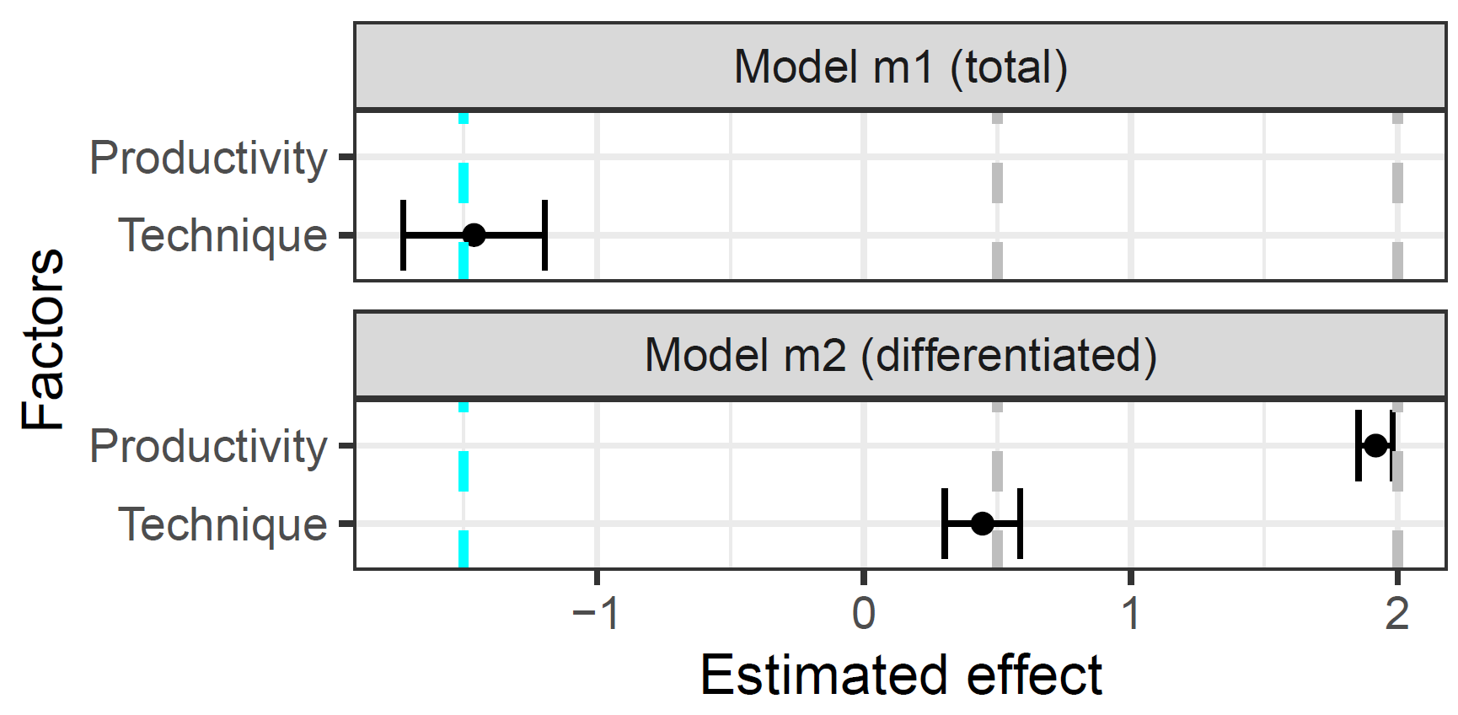
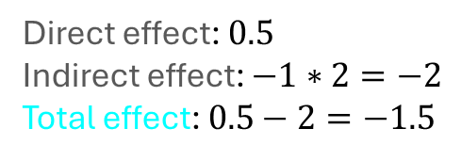



Mediation: Pipes
“The company tested a new technique in their requirements engineering phase that is enabled by a prototype tool. We investigated whether this technique improved the engineers’ productivity.”
technique
productivity
$$0.5$$
$$−1$$
$$2$$
tool appeal
Direct effect: $0.5$
Indirect effect: $−1∗2=−2$
Total effect: $0.5−2=−1.5$
$$\sim N(0−1∗technique)$$

Slide 31
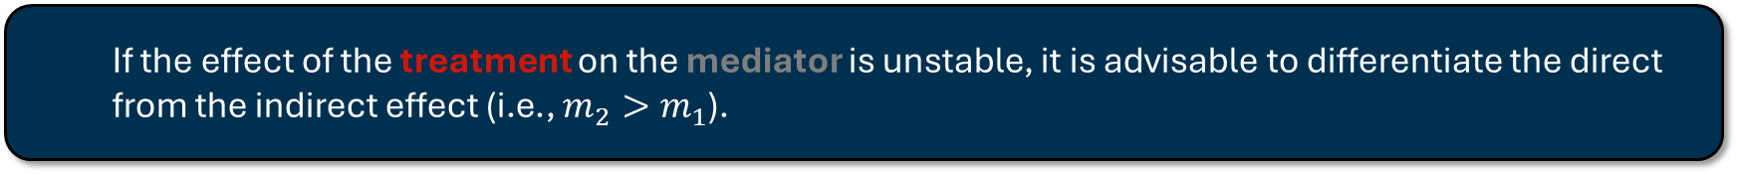

Mediation: Pipes
Both statistical models are causally unbiased. The choice, which of them to prefer depends on whether one is interested in the direct or total effect of the treatment.
technique
$$m_{1}:productivity\sim 1+technique$$
Model Derivation
productivity
$$m_{2}:productivity\sim 1+technique+appeal$$
tool appeal
If the effect of the treatment on the mediator is unstable, it is advisable to differentiate the direct from the indirect effect (i.e., $m_{2}>m_{1}$).

Slide 32
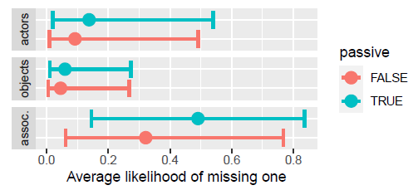
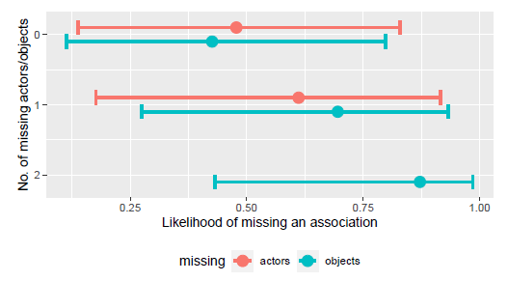
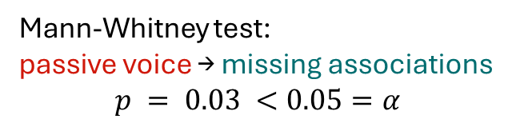
Practical Example of Mediation
missing actors
missing actors
passive voice
missing associations
passive voice
missing associations
missing objects
missing objects
Mann-Whitney test:
passive voice → missing associations
$$p = 0.03 <0.05=α$$
https://doi.org/10.1145/2652524.2652554
https://doi.org/10.1145/3643664.3648211
Femmer, H., Kučera, J., & Vetrò, A. (2014, September). On the impact of passive voice requirements on domain modelling. In Proceedings of the 8th ACM/IEEE international symposium on empirical software engineering and measurement (pp. 1-4).
Frattini, J., Fucci, D., Torkar, R., & Mendez, D. (2024, April). A second look at the impact of passive voice requirements on domain modeling: Bayesian reanalysis of an experiment. In Proceedings of the 1st IEEE/ACM International Workshop on Methodological Issues with Empirical Studies in Software Engineering (pp. 27-33).
Notes:
Studying the effect of passive voice on the completeness of resulting domain models, we found a mediation.

Slide 33
Causal Inference II
Colliders, D-separation, and Model Comparison
Notes:
So far, we learned that including additional variables is beneficial to (1) differentiate the total from the direct effect (in the case of a mediator) and (2) deconfound a causal effect (in the case of a confounder. So: just add all available variables?

Slide 34




Colliding: Common Effects
“Does the length of a requirements specification affect its quality? Both factors do affect whether the specified feature is implemented successfully.”
specification size
specification quality
$$\sim N(0, 1)$$
$$\sim N(0, 1)$$
$0$: the specification size does not affect its quality
A feature is successful if it is very elaborately described ...
... or its description is high-quality
feature success (0 = rejected, 1 = approved)
$$\sim \left(size+quality>0.7\right)$$

Slide 35
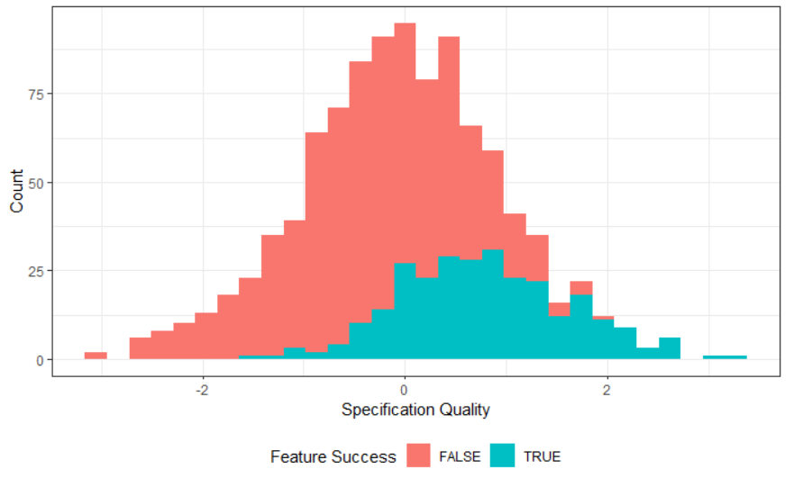


Colliding: Common Effects
“Does the length of a requirements specification affect its quality? Both factors do affect whether the specified feature is implemented successfully.”
specification size
specification quality
$$m_{1}:quality\sim 1+size+success$$
Model Derivation
$$m_{2}:quality\sim 1+size$$
feature success
Notes:
You can rightfully ask: why include “success” in the statistical model anyways?
We do see that “feature success” contains information about “specification quality”
Hence, it might be valuable for the estimation

Slide 36
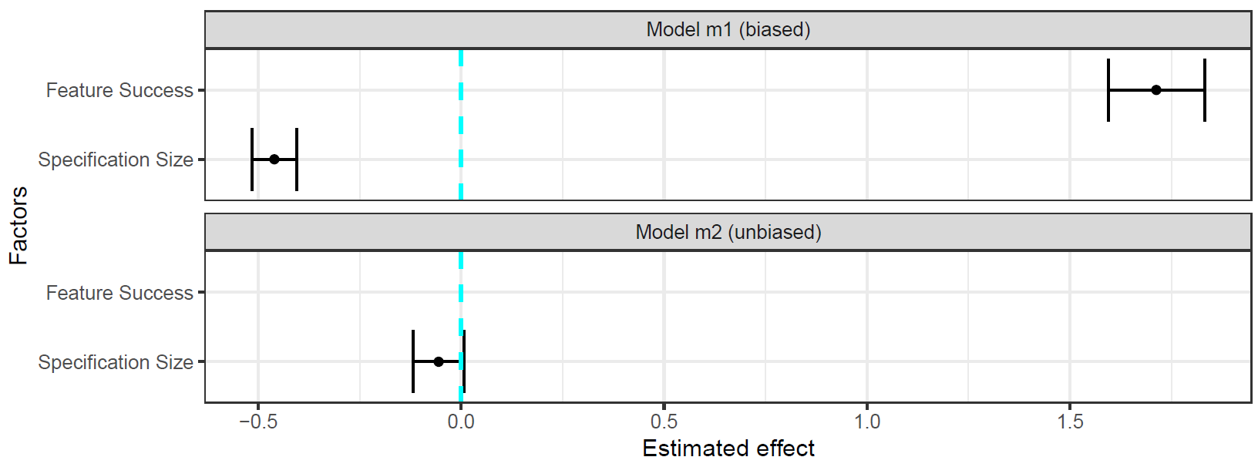

Colliding: Common Effects
“Does the length of a requirements specification affect its quality? Both factors do affect whether the specified feature is implemented successfully.”
$$m_{1}:quality\sim 1+size+success$$
Notes:
The estimation suggests that specification size has an effect far beyond what we simulated

Slide 37
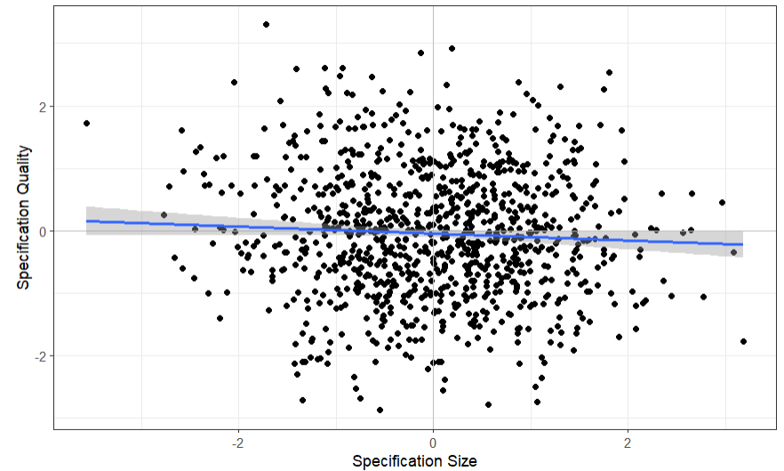
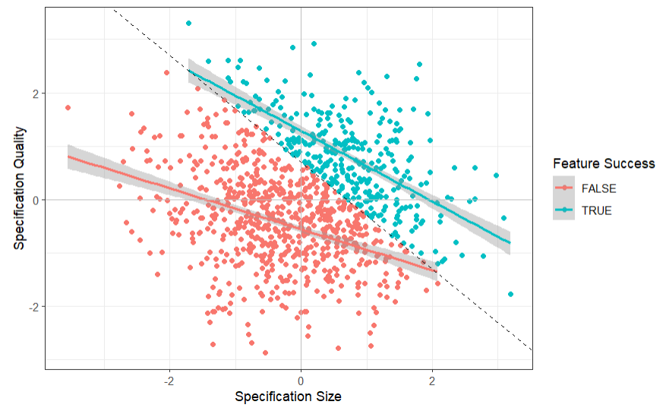
Colliding: Common Effects
“Does the length of a requirements specification affect its quality? Both factors do affect whether the specified feature is implemented successfully.”
Notes:
The visualization of the raw data shows that there is indeed no effect
The trendline is nearly horizontal
That means: there is no effect of one variable on the other
But stratifying by the third variable (feature success) paints a different picture:
Stratification by color (and the grey cut-off line intersects the y-axis at exactly 0.7)
Looking into each of the two strata individually, there is a negative association between the variables

Slide 38
Colliding: Common Effects
“Does the length of a requirements specification affect its quality? Both factors do affect whether the specified feature is implemented successfully.”
For any high quality value, if feature success is false, then it is more likely that the specification size was small.
For any low quality value, if feature success is true, then it is more likely that the specification size was large.

Slide 39
Colliding: Common Effects
“Does the length of a requirements specification affect its quality? Both factors do affect whether the specified feature is implemented successfully.”
specification size
specification quality
feature success
The non-causal association suggests a negative relationship between the cause and effect (Berkson’s paradox/fallacy).

Slide 40


Colliding: Common Effects
“Does the length of a requirements specification affect its quality? Both factors do affect whether the specified feature is implemented successfully.”
$$m_{1}:quality\sim 1+size+success$$
$$m_{2}:quality\sim 1+size$$

Slide 41


Colliding: Common Effects
“Does the length of a requirements specification affect its quality? Both factors do affect whether the specified feature is implemented successfully.”
specification size
specification quality
$$m_{1}:quality\sim 1+size+success$$
Model Derivation
$$m_{2}:quality\sim 1+size$$
feature success
If both treatment and outcome have a common effect, we must not condition on this common effect. Consequently, we cannot simply add all relevant variables as predictors.

Slide 42
Basic Types of Association
There are three basic types of association
Mediator
Fork
Collider

Slide 43
Basic Types of Association
The three basic types of association behave differently when statistically controlling for the third variable:
Not controlling z
Controlling z
z
Mediator
x
y
z
Fork
x
y
z
Information flows from x to y
Collider
Information does not flow
from x to y
x
y

Slide 44


Causal Modelling
Causal modelling is imperative for drawing the correct conclusions when conducting statistical causal inference.
We cannot infer causality from data alone – we must also know the process that created that data.
Causal Model
Model Derivation
Statistical Model
z
Fork
x | y | z
$$m:y\sim x+z$$
x
y
z
Collider
$$m:y\sim x$$
x
y
But how does this approach scale beyond three variables?
Notes:
Remember: “Data alone cannot give us causal inference – we must also know about how the data emerged” (show collider versus fork: same data, different statistical models from the causal models)

Slide 45
Deriving a statistical Model from a causal Model: d-separation
A general framework to derive statistical models from causal models uses d-separation. It produces an adjustment set, i.e., the set of variables to control statistically in order to de-confound the causal effect between the exposure and the outcome.
https://bayes.cs.ucla.edu/BOOK-2K/d-sep.html

Slide 46

Deriving a statistical Model from a causal Model: d-separation
A general framework to derive statistical models from causal models uses d-separation. It produces an adjustment set, i.e., the set of variables to control statistically in order to de-confound the causal effect between the exposure and the outcome.
c
d
Model Derivation
$$m:b\sim a$$
a
b
e
f
g
https://bayes.cs.ucla.edu/BOOK-2K/d-sep.html

Slide 47
Deriving a statistical Model from a causal Model: d-separation
A general framework to derive statistical models from causal models uses d-separation. It produces an adjustment set, i.e., the set of variables to control statistically in order to de-confound the causal effect between the exposure and the outcome.
c
d
Model Derivation
$$m:b\sim a$$
Identify every backdoor path.
a
b
e
f
g
https://bayes.cs.ucla.edu/BOOK-2K/d-sep.html

Slide 48
Deriving a statistical Model from a causal Model: d-separation
A general framework to derive statistical models from causal models uses d-separation. It produces an adjustment set, i.e., the set of variables to control statistically in order to de-confound the causal effect between the exposure and the outcome.
c
d
Model Derivation
$$m:b\sim a$$
Identify every backdoor path.
Check if there is a collider between the cause and effect of interest.
  If yes, do not condition on any of the variables on this path.
a
b
e
f
g
https://bayes.cs.ucla.edu/BOOK-2K/d-sep.html

Slide 49


Deriving a statistical Model from a causal Model: d-separation
A general framework to derive statistical models from causal models uses d-separation. It produces an adjustment set, i.e., the set of variables to control statistically in order to de-confound the causal effect between the exposure and the outcome.
$$m:b\sim a+f$$
c
d
Model Derivation
$$m:b\sim a+g$$
Identify every backdoor path.
Check if there is a collider between the cause and effect of interest.
  If yes, do not condition on any of the variables on this path.
  If not, condition on any of the variables on this path to “close” the backdoor path.
a
b
e
f
g
https://bayes.cs.ucla.edu/BOOK-2K/d-sep.html

Slide 50


Deriving a statistical Model from a causal Model: d-separation
A general framework to derive statistical models from causal models uses d-separation. It produces an adjustment set, i.e., the set of variables to control statistically in order to de-confound the causal effect between the exposure and the outcome.
$$m:b\sim a+f(+e)$$
c
d
Model Derivation
$$m:b\sim a+g(+e)$$
Identify every backdoor path.
Check if there is a collider between the cause and effect of interest.
  If yes, do not condition on any of the variables on this path.
  If not, condition on any of the variables on this path to “close” the backdoor path.
Optionally, condition on mediators to discern the direct effect.
a
b
e
f
g
https://bayes.cs.ucla.edu/BOOK-2K/d-sep.html

Slide 51
Deriving a statistical Model from a causal Model: d-separation
A general framework to derive statistical models from causal models uses d-separation. It produces an adjustment set, i.e., the set of variables to control statistically in order to de-confound the causal effect between the exposure and the outcome.
$$m:b\sim a+f(+e)$$
c
d
Model Derivation
$$m:b\sim a+g(+e)$$
Identify every backdoor path.
Check if there is a collider between the cause and effect of interest.
  If yes, do not condition on any of the variables on this path.
  If not, condition on any of the variables on this path to “close” the backdoor path.
Optionally, condition on mediators to discern the direct effect.
a
b
e
f
g
https://bayes.cs.ucla.edu/BOOK-2K/d-sep.html

Slide 52
Exercises
Determine the adjustment set of variables to de-confound the estimation of the effect of the phenomenon a → b via d-separation.
c
d
a
b

Slide 53
Exercises
Determine the adjustment set of variables to de-confound the estimation of the effect of the phenomenon a → b via d-separation.
c
d
c
d
a
b
a
b
Adjustment set = {d}
Adjustment set = {c}

Slide 54
Exercises
Determine the adjustment set of variables to de-confound the estimation of the effect of the phenomenon a → b via d-separation.
c
e
d
a
b

Slide 55
Exercises
Determine the adjustment set of variables to de-confound the estimation of the effect of the phenomenon a → b via d-separation.
c
e
d
a
b
Adjustment set = {}

Slide 56
Exercises
Determine the adjustment set of variables to de-confound the estimation of the effect of the phenomenon a → b via d-separation.
c
e
d
a
b

Slide 57
Exercises
Determine the adjustment set of variables to de-confound the estimation of the effect of the phenomenon a → b via d-separation.
c
e
d
a
b
The DAG contains two backdoor paths:
a ← c → d ← e → b
a ← d ← e → b

Slide 58
Exercises
Determine the adjustment set of variables to de-confound the estimation of the effect of the phenomenon a → b via d-separation.
c
e
c
c
e
d
d
a
b
a
b
Adjustment set = {e}
Adjustment set = {c, d}
Conditioning on d opens the backdoor-path a ← c → d ← e → b which then has to be closed by additionally conditioning on c.

Slide 59
Exercises
Determine the adjustment set of variables to de-confound the estimation of the effect of the phenomenon a → b via d-separation.
unobservable variable
c
e
d
a
b

Slide 60
Exercises
Determine the adjustment set of variables to de-confound the estimation of the effect of the phenomenon a → b via d-separation.
c
e
d
a
b
Adjustment set = {e}

Slide 61
Exercises
Determine the adjustment set of variables to de-confound the estimation of the effect of the phenomenon a → b via d-separation.
c
e
d
a
b

Slide 62
Exercises
Determine the adjustment set of variables to de-confound the estimation of the effect of the phenomenon a → b via d-separation.
c
e
d
a
b
For some DAGs, it is impossible to find an adjustment set that deconfounds the effect of interest.

Slide 63
Causal Modelling
d-separation is one reliable technique for but still depends on the construction of a “correct” causal model, i.e., a DAG representing causal assumptions where
the included variables are complete, and
the included (and excluded) relationships between them are correct.
Model Derivation
But in reality there is no grand reveal of the “actual” causal model (as in the simulations). So how do you determine which model is “correct”?

Slide 64
Causal Modelling
It is impossible to determine the correct causal model – we would need to look behind the curtain and see the ”fabric of the world.” But instead of aiming for a correct causal model, rather aim for a transparent and useful causal model.
Transparent
Visualize causal assumptions via DAGs to allow readers the underlying causal model
Useful
?
Notes:
“transparent” is easy: visualize your causal assumptions via DAGs
“useful” is more difficult: how do you assess the usability of a causal model?

Slide 65
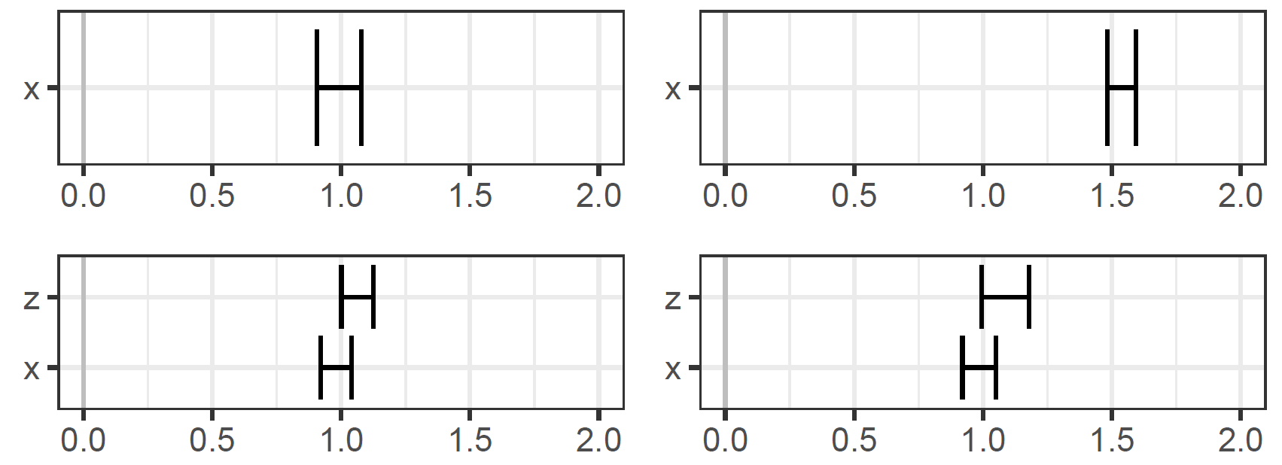


Model Comparison
Depending on the observed change in results, you can infer which assumed causal model describes the data creation process best
Simulated ground-truth
1
1
x
y
x
y
z
1
1
z
1
x
y
z
$$y\sim x$$
Assumed causal (and
consequent statistical) model
x
y
z
$$y\sim x+z$$
If the effect of x on y does not when including z, then z has no causal effect on x.
If the effect of x on y changes when including z, then z has a causal effect on x.
Notes:
We cannot assess the usefulness of a model in absolute terms, but in relative terms via model comparison!
In d1, z is just a moderator, but not a counfounder

Slide 66
Model Comparison
We cannot assess the usefulness of a model in absolute terms, but in relative terms via model comparison!
Useful
Reflecting the data generation process more accurately
A model that reflects the data generation process more accurately will provide more robust inferences under differing conditions. It is therefore – at least relatively speaking – more useful.

Slide 67
Statistical Causal Inference for Requirements Engineering
An Application Example of SCI in RE
Heyn, H. M., Mao, Y., Weiss, R., & Knauss, E. (2025, June). Causal Models in Requirement Specifications for Machine Learning: A vision. In Proceedings of the 33rd ACM International Conference on the Foundations of Software Engineering (pp. 1402-1405).
Notes:
Statistical causal inference is useful for analysis of quantitative data in any scientific discipline
But SCI principles can be used even more directly in RE
The following slides give an example of applying SCI in RE

Slide 68
Causal Models in Requirements Specifications for Machine Learning
RE struggles to translate high-level requirements into data needs. One reason for this under-specification is that operational context is often implicitly assumed in the data collection.
Operational Context
implicitly assumed in data collection
Brittle Models
that fail to generalize
Low Transferability
into unknown contexts
Ahmad, K., Abdelrazek, M., Arora, C., Bano, M., & Grundy, J. (2023). Requirements engineering for artificial intelligence systems: A systematic mapping study. Information and Software Technology, 158, 107176.
Mitchell, S., Potash, E., Barocas, S., D'Amour, A., & Lum, K. (2021). Algorithmic fairness: Choices, assumptions, and definitions. Annual review of statistics and its application, 8(1), 141-163.
D'Amour, A., Heller, K., Moldovan, D., Adlam, B., Alipanahi, B., Beutel, A., ... & Sculley, D. (2022). Underspecification presents challenges for credibility in modern machine learning. Journal of Machine Learning Research, 23(226), 1-61.
Notes:
RE struggles to translate high-level requirements into data needs (Ahmad et al., 2023; Alves et al., 2023; Pei et al., 2022).
One reason for this under specification is that operational context is often implicitly assumed in the data collection (Mitchell et al., 2021).
This leads to brittle models that lack robustness (D'Amour et al., 2022).
Assumptions affecting the data selection should be made explicit and testable!

Slide 69
Causal Modelling in RE
Using the principles of SCI in RE allows to ...
derive data and model requirements from prior knowledge about the operational context.
enable documentation of these prior assumptions.
allow for a systematic determination of testable conditions.
use of causal modelling as a Requirement Engineering activity.

Slide 70
Causal RE workflow
Step 1: Identify individual causal mechanisms
Step 2: Create / update a graphical causal model (DAG)
Step 3: Use d-separation to identify confounding and close non-causal paths.
Step 4: Check graph consistency and observability of necessary variables.

Slide 71
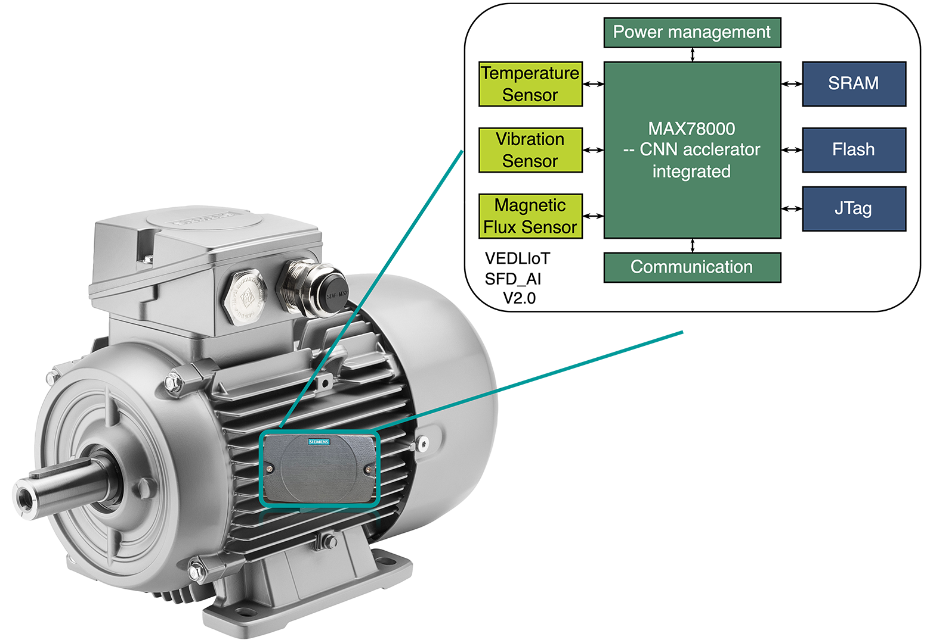
Use case example
Context: ML-based classification (outcome) of cooling faults in electric motors (exposure). The system uses sensors for temperature, vibration, and magnetic flux.
Functional Requirement:
GIVEN indoor operational environment WHEN the cooling system is abnormal THEN an alarm should be raised.

Slide 72
Methodology
Three exploratory workshops with two Siemens engineers and two academic researchers.
We introduced to the concept of causal modelling and d-separation.
Company expert outlined the use case and prior knowledge was formalized by identifying causal mechanisms and updating the causal model.
We used d-separation to close non-causal paths between exposure (i.e., the occurrence of a cooling fault), and the outcome (i.e., the classification result).
This resulted in data and model requirements, as well as testable conditions.
Interesting observation:
The structured approach to formalizing prior knowledge as causal graphs allowed them to ”discover” more prior knowledge.

Slide 73
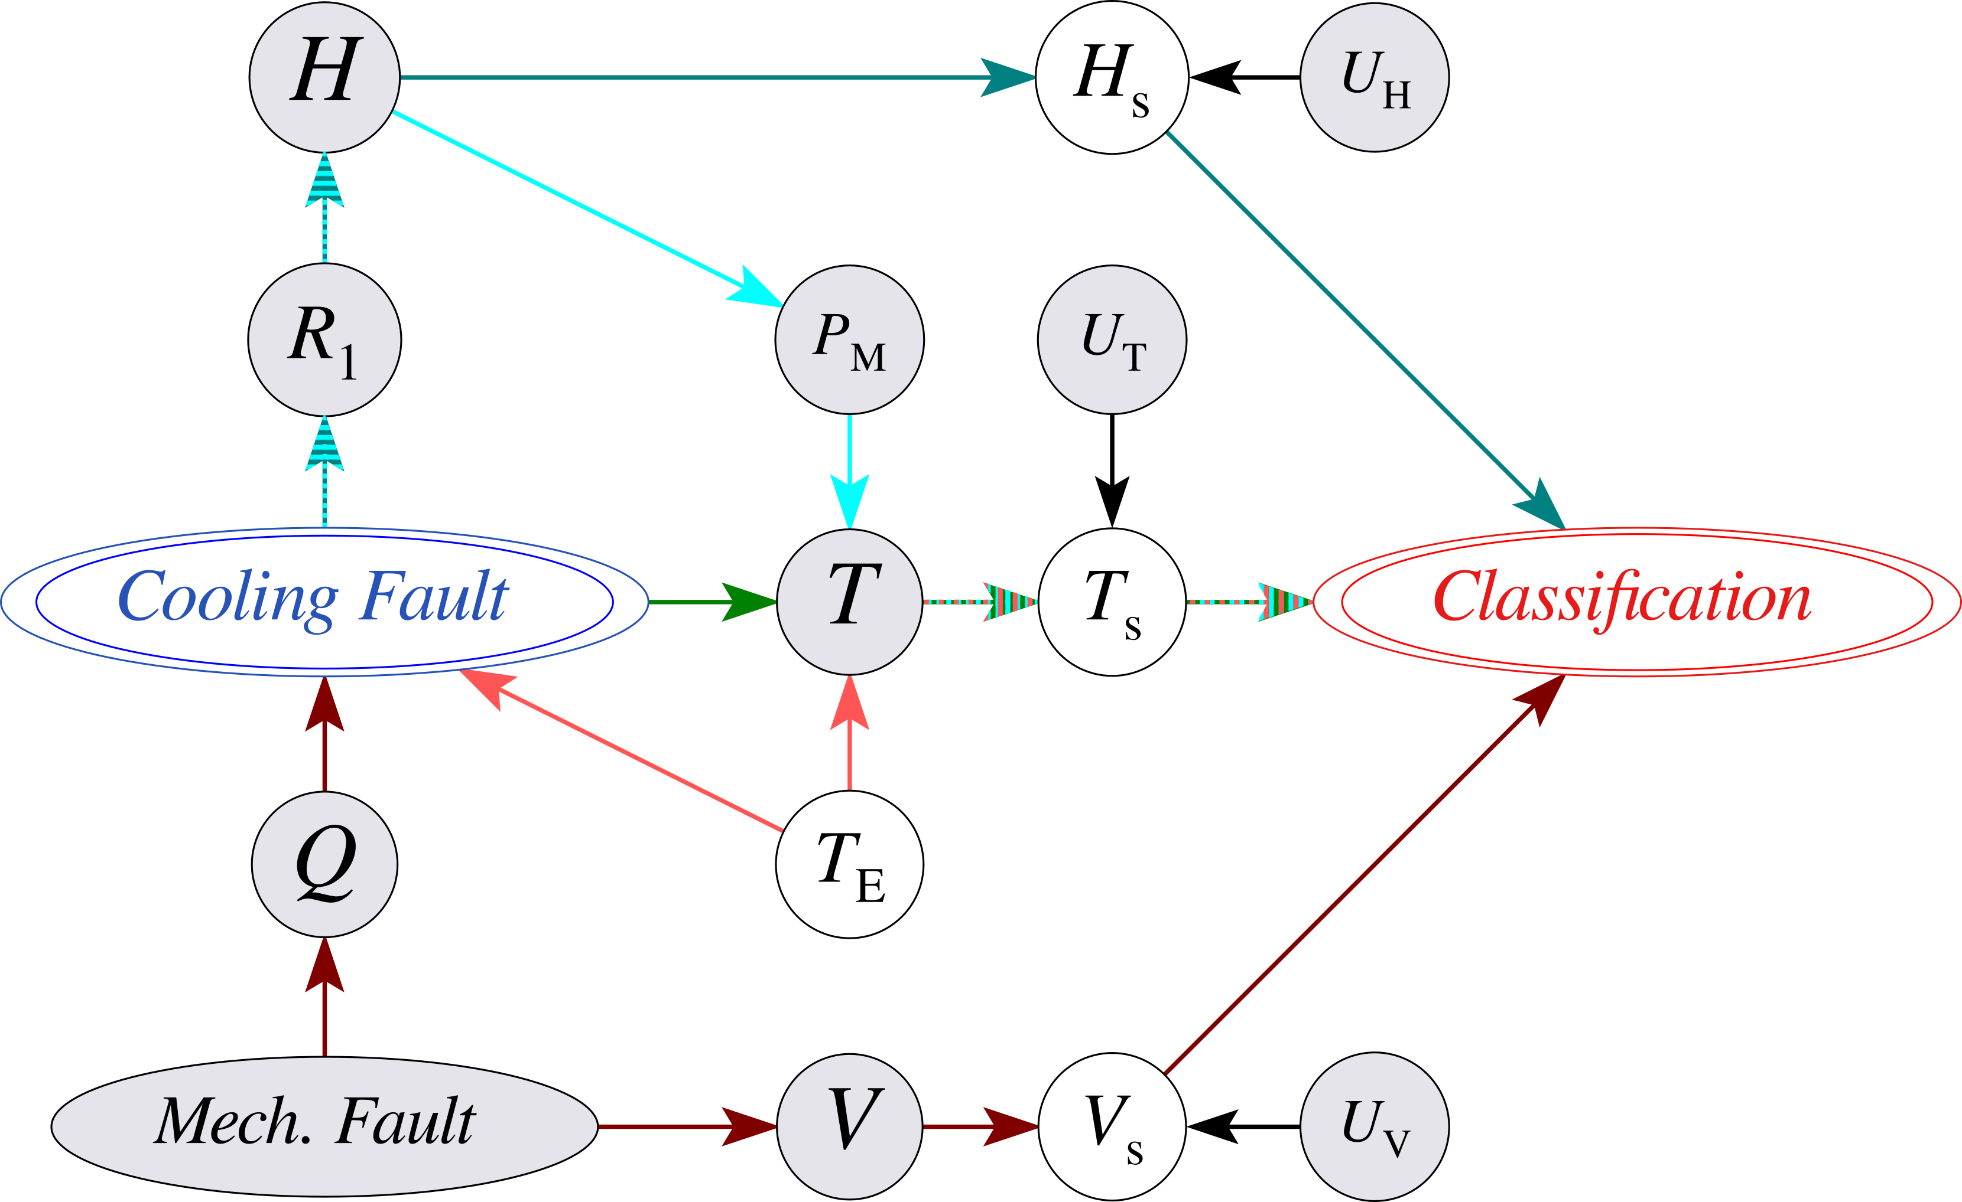
Resulting graphical causal model
Magnetic flux mechanism
Temperature mechanism
Mechanical power mechanism
Mechanical fault confounding
Environmental temperature confounding
magnetic flux
sensor noise
power
temp
Observations:
Vibration data alone is insufficient to detect cooling faults, because not all mechanical faults lead to a cooling fault.
Data on temperature and magnetic flux should be included.
Sensor data should contain sensor noise.
env. temp.
air flow
vibrations

Slide 74
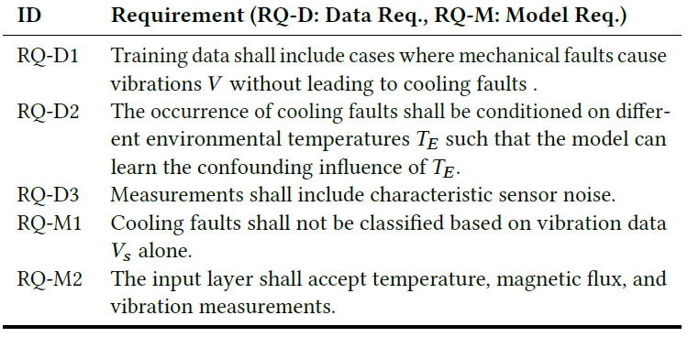
Resulting graphical causal model
Observations:
Vibration data alone is insufficient to detect cooling faults, because not all mechanical faults lead to a cooling fault.
Data on temperature and magnetic flux should be included.
Sensor data should contain sensor noise.
magnetic flux
sensor noise
power
temp
env. temp.
air flow
vibrations

Slide 75
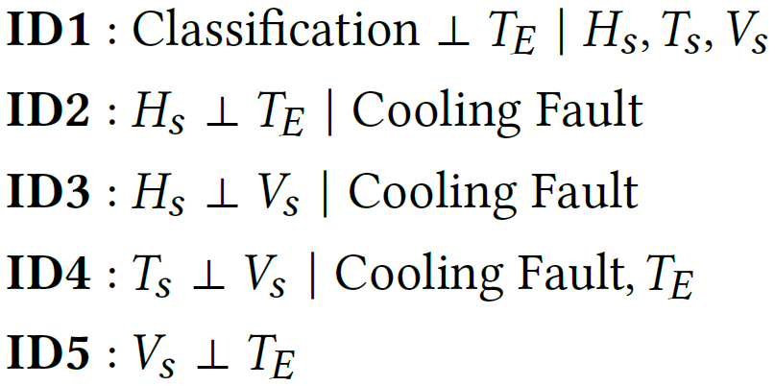
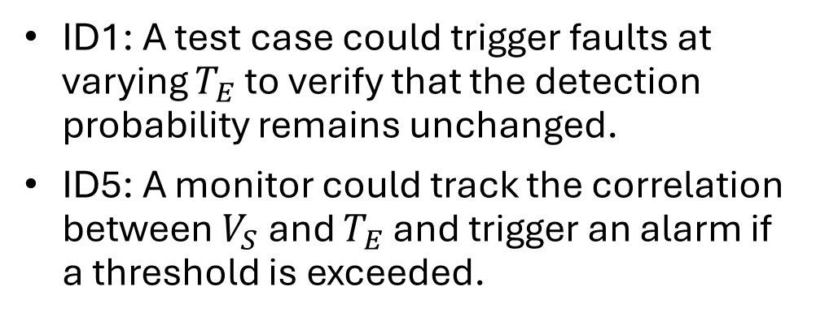
Resulting graphical causal model
magnetic flux
sensor noise
The causal graph provides testable conditions:
power
temp
env. temp.
ID1: A test case could trigger faults at varying $T_{E}$ to verify that the detection probability remains unchanged.
ID5: A monitor could track the correlation between $V_{S}$ and $T_{E}$ and trigger an alarm if a threshold is exceeded.
air flow
vibrations

Slide 76
Future work
Potential avenues for future research:
How can causal models complement natural language requirements? How must causal modelling be adopted to RE?
When does a causal graph include ”enough” prior knowledge? What is a sufficient set of variables in a causal graph for a given use case?
How can the modularization of cause-effect mechanisms help in modularization of ML software systems?
How can causal models serve as ”boundary object” between different stakeholders?
To what degree can data requirements from causal models enhance ML robustness and reduce data needs (more to come)
How can independence conditions be translated into testing strategies?
Notes:
We showed that causal modelling has potential as an RE activity.

Slide 77
Summary
We suggest to explore causal models and causal reasoning as an RE activity for ML systems.
In an industrial use case, we showed how causal modelling can be used to formalise prior knowledge.
We derived data and model requirements, as well as testable conditions from the emerging causal model.
We proposed a research agenda in which we formulated a set of questions that can lead to establishing causal modelling as an industry practice.

Slide 78
Conclusion
A Workflow for Causal Inference to take home

Slide 79
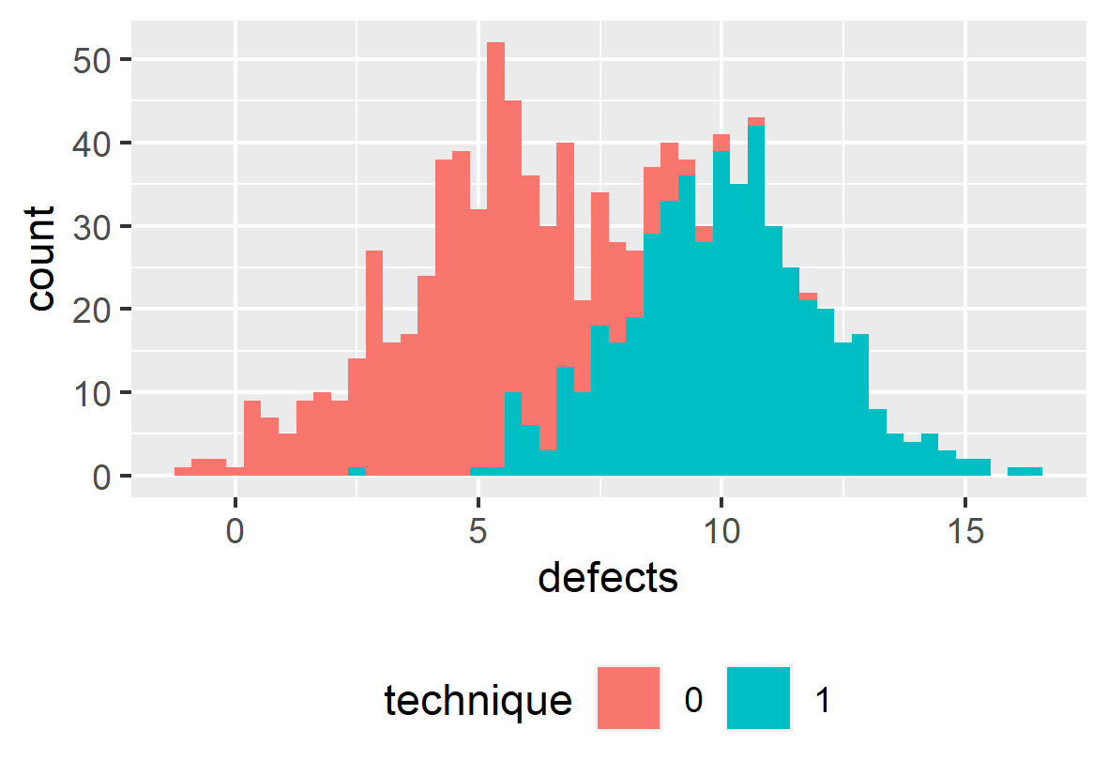

Workflow for Statistical Causal Inference
1) Modelling
Creating a DAG of assumed causal relationships
x
y
z
2) Identification
Deriving a statistical from the causal model
$$y\sim x+z$$
Model Derivation
3) Estimation
Training a statistical model with the observed data and evaluating the results
Siebert, J. (2023). Applications of statistical causal inference in software engineering. Information and Software Technology, 159, 107198.

Slide 80
Scientific Workflow: Traditional
Data Collection
Assumed DAG
Collected Data
Modelling
x | y
Identification
x
y
Estimation
Too often, we derive hypotheses from the data available to us.
Notes:
How do these conceptual steps intertwine with the operational steps necessary for quantitative studies?

Slide 81
Scientific Workflow: Better
Modelling
Assumed DAG
Collected Data
hard-to-measure
confounder
Identification
x | y | z
z
Data Collection
x
y
Estimation
Determine the variables about which you need to collect data in order to estimate an unbiased effect of interest before collecting that data.

Slide 82
Scientific Workflow: Best
Modelling
Assumed DAG
Collected Data
hard-to-measure
confounder
Identification
x | y | z | a
 |  |  | x
 |  |  | x
 |  |  | x
 |  |  | x
z
Data Collection
x
y
feasible?
a
Alternate
Strategy
Estimation
unobservable
confounder
Unobservable confounders require (a) acknowledgement in the threats to (internal) validity and (b) different research strategies.

Slide 83
A Vision of Coherent Science
Following this scientific workflow enables us as a community to effectively contribute to a coherent scientific endeavour.
Original Contribution
Close Replication
Causal Revision
Causal Revision
The Effect of X on Y
The Effect of X on Y:
A Replication Study
The Effect of X on Y is mediated by A
Z confounds the Effect of X on Y
z
x
y
x
y
x
a
y
x
a
y

Slide 84
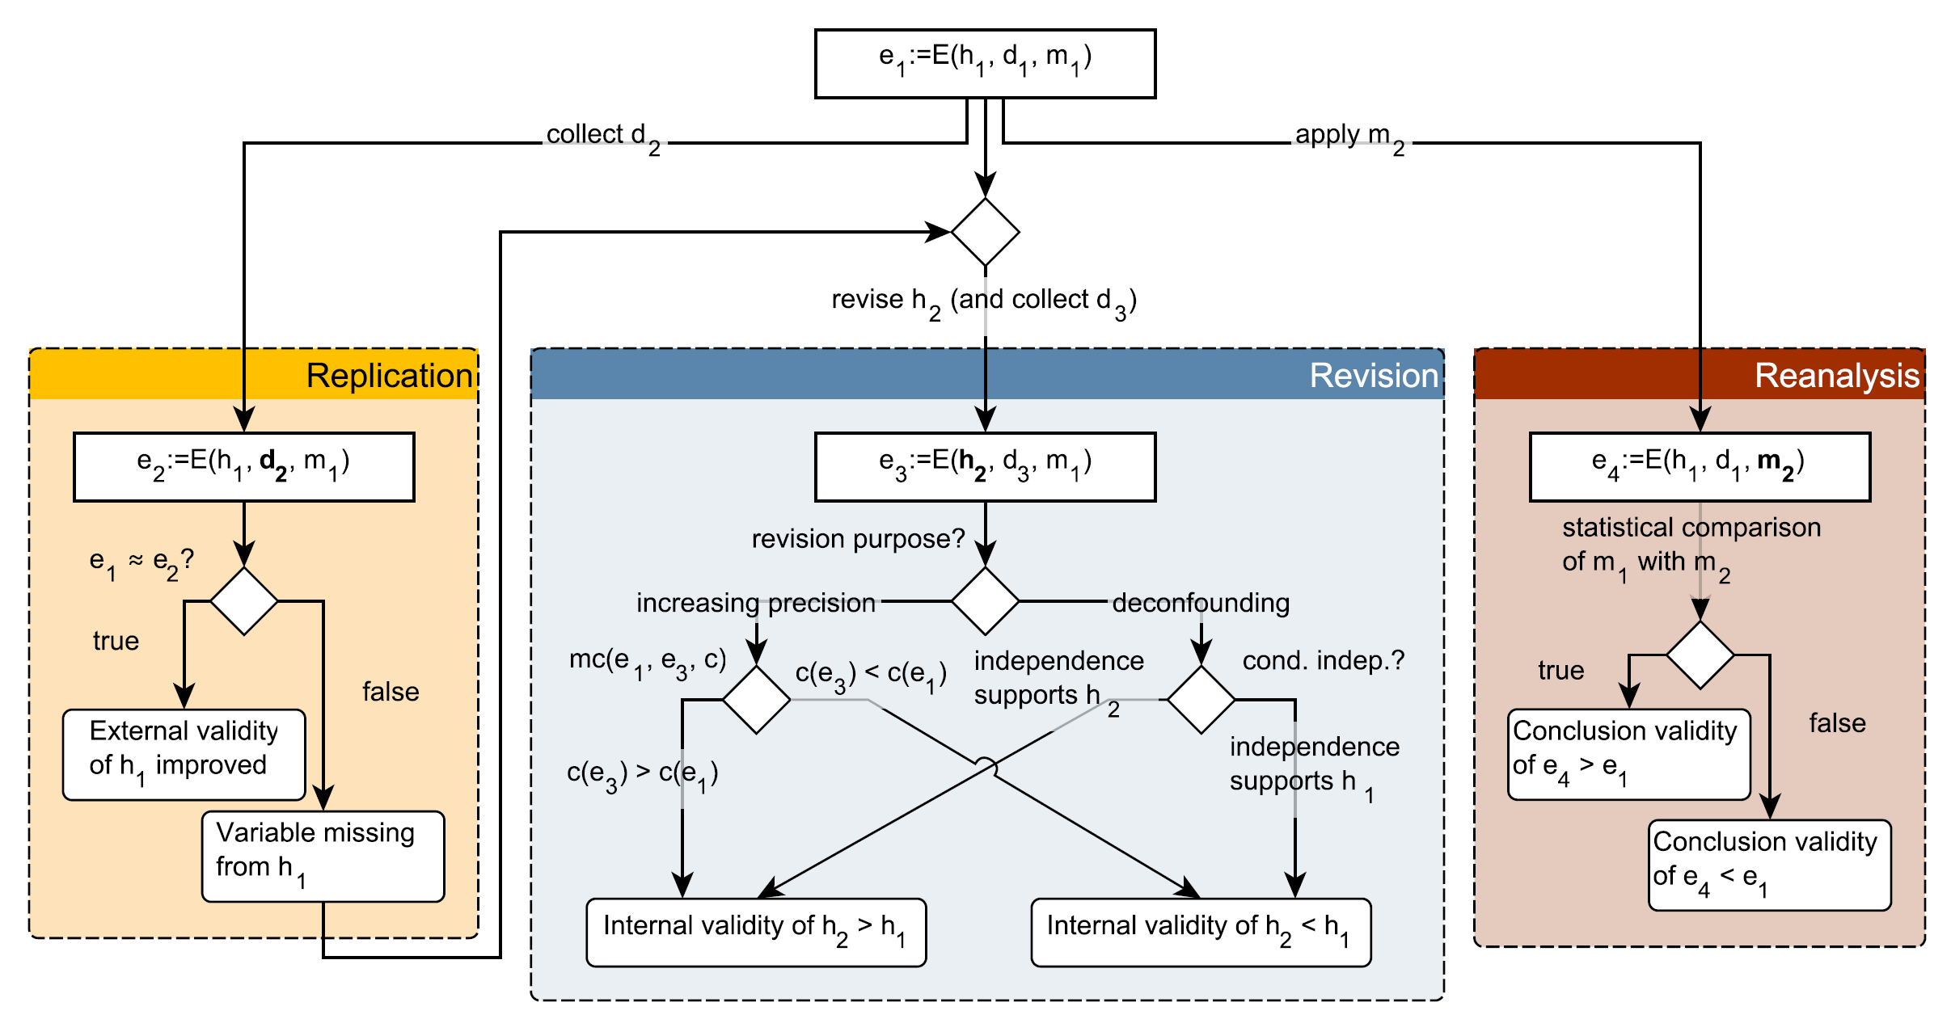
Supporting the Vision of Coherent Science
Frattini, J., Fischbach, J., Fucci, D., Unterkalmsteiner, M., & Mendez, D. (2024). Replications, Revisions, and Reanalyses: Managing Variance Theories in Software Engineering. arXiv preprint arXiv:2412.12634.

Slide 85
Closing
Final Remarks

Slide 86
Reading list
Pearl, J., & Mackenzie, D. (2018). The book of why: the new science of cause and effect. Basic books.
McElreath, R. (2018). Statistical rethinking: A Bayesian course with examples in R and Stan. Chapman and Hall/CRC.
Cinelli, C., Forney, A., & Pearl, J. (2024). A crash course in good and bad controls. Sociological Methods & Research, 53(3), 1071-1104.
Siebert, J. (2023). Applications of statistical causal inference in software engineering. Information and Software Technology, 159, 107198.
Furia, C. A., Feldt, R., & Torkar, R. (2019). Bayesian data analysis in empirical software engineering research. IEEE Transactions on Software Engineering, 47(9), 1786-1810.
Furia, C. A., Torkar, R., & Feldt, R. (2022). Applying Bayesian analysis guidelines to empirical software engineering data: The case of programming languages and code quality. ACM Transactions on Software Engineering and Methodology (TOSEM), 31(3), 1-38.

Slide 87
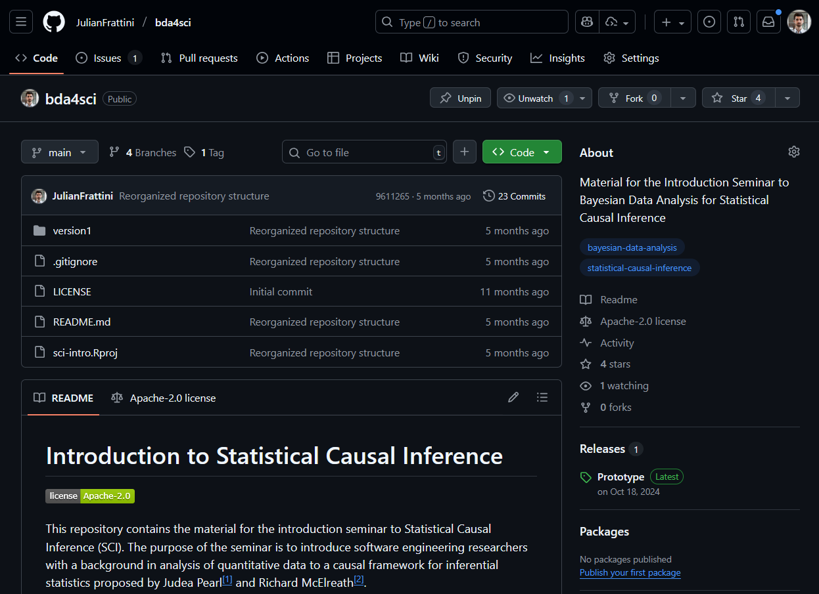
Material
JulianFrattini/bda4sci
Public
All material is public and open-source on GitHub. Feel free to clone, fork, and share the study material.
Comments, requests, and additions are welcome.

Slide 88
Limitations
This was but a gentle introduction. The topic of statistical causal inference contains many more elements, like
Ancestors: parent-child relationships in DAGs
Interaction: moderated inter-relationship between two or more variables and an outcome
Hierarchical model: partial pooling
Different types of regression: regression models for different outcome variable distributions
Bayesian data analysis: advanced estimation technique
And many more …

Slide 89
Ready for more?
Are you interested in a long-term, in-depth, academic-friendly course about statistical causal inference using Bayesian data analysis?
→ Contact Julian Frattini and express your interest
We plan to organize a chapter-wise joint reading and discussion of Richard McElreath’s “Statistical Rethinking” over the course of a year.
Julian Frattini, Ph.D.
Chalmers University of Technology, Sweden
https://julianfrattini.github.io/

